Slide 2
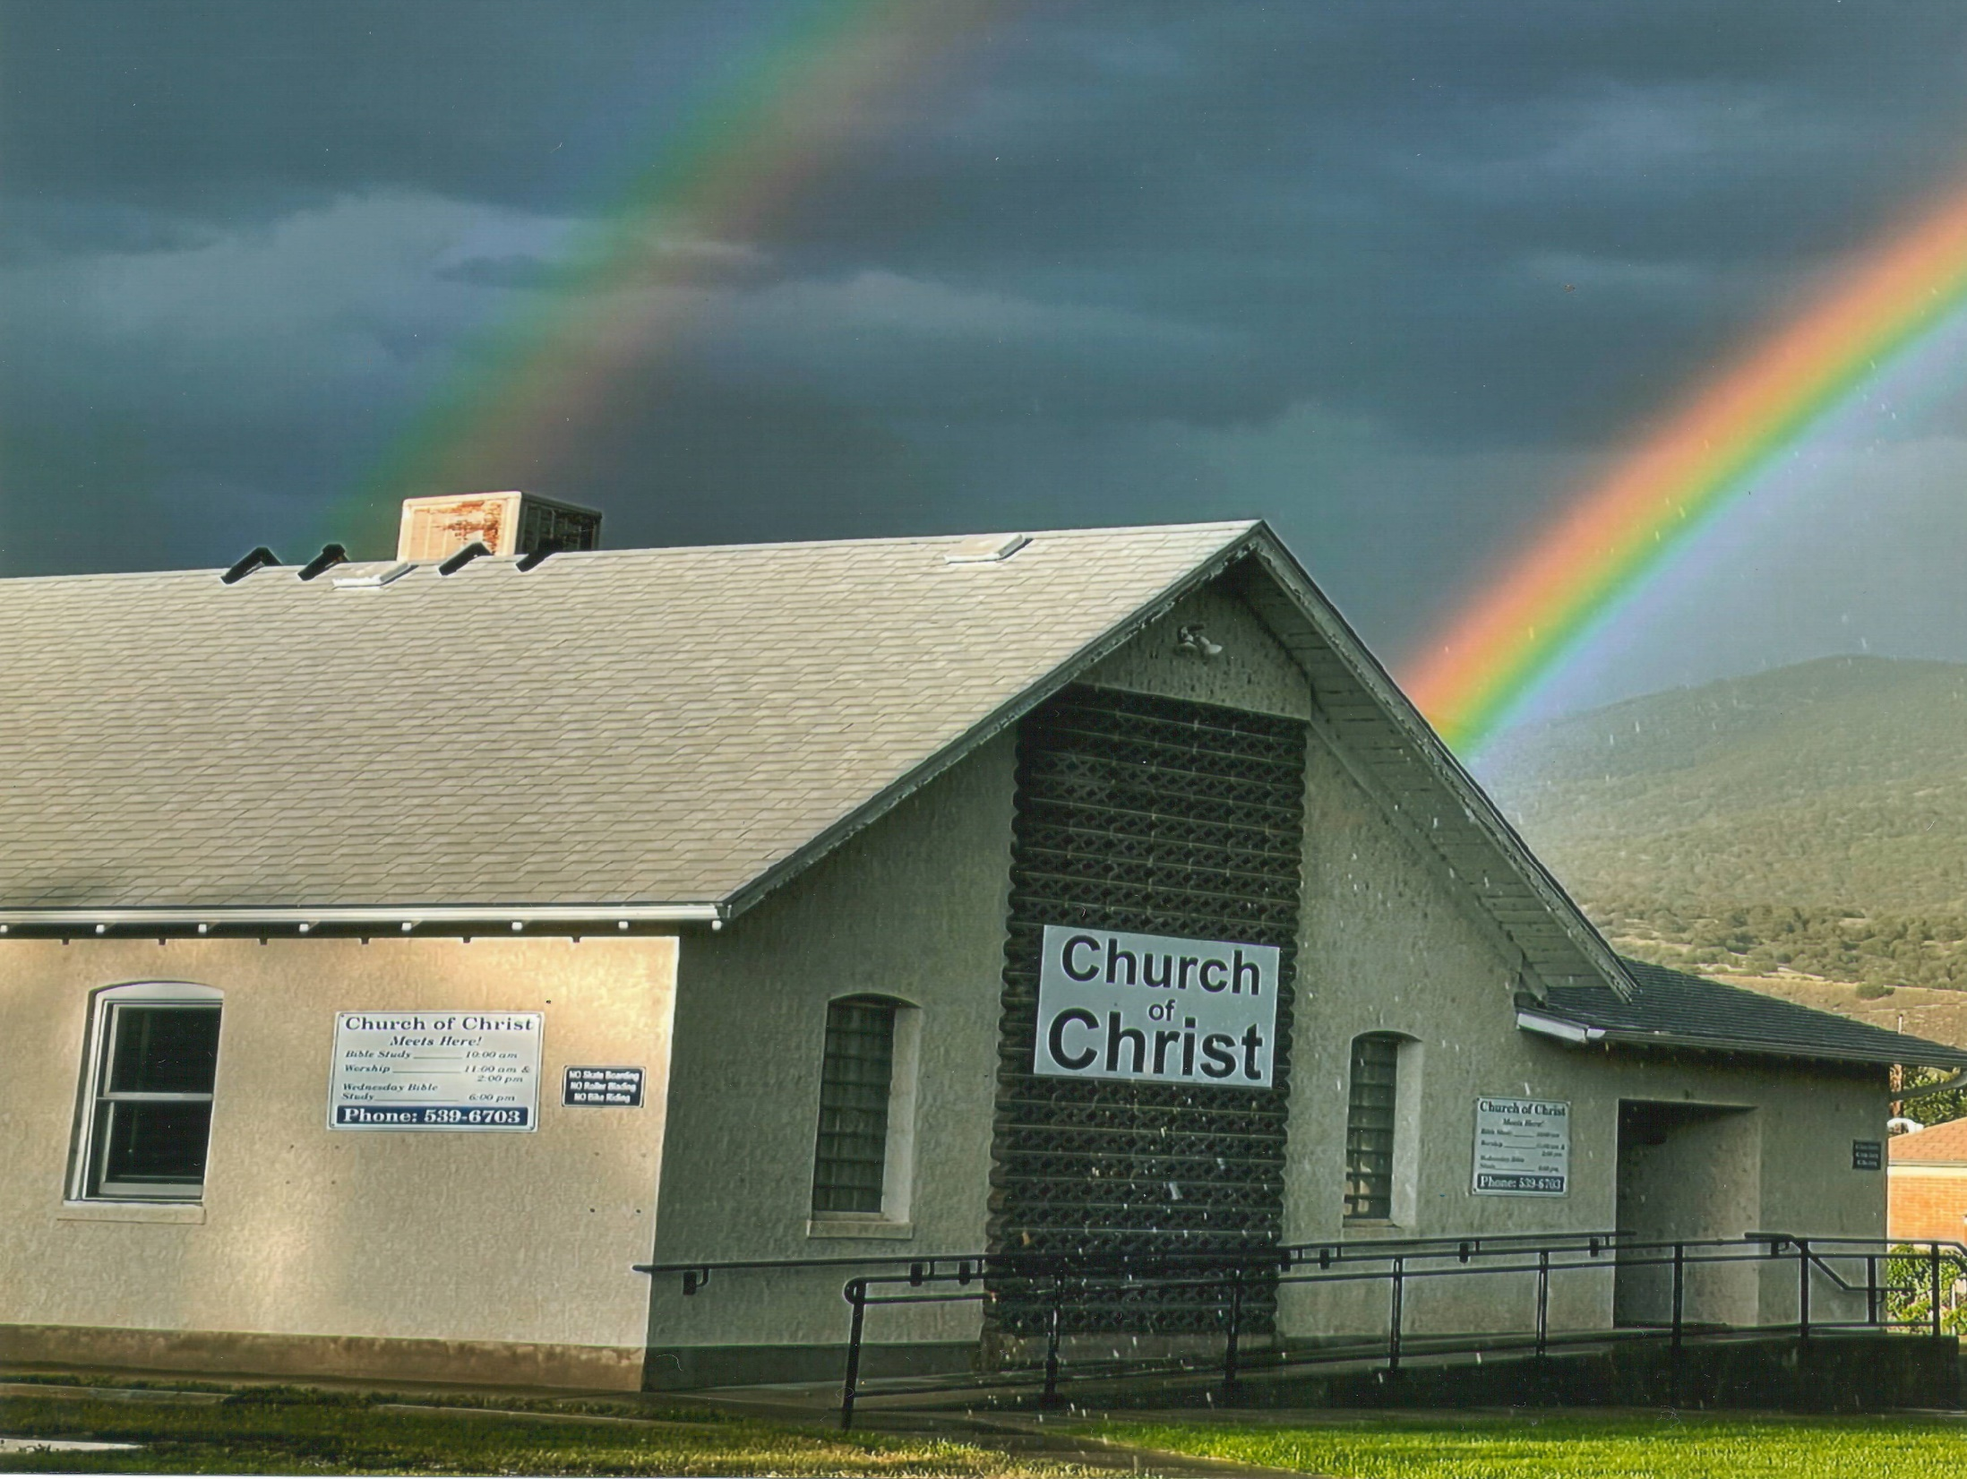
WORKS
June 25, 2023
Ron Bert

Slide 3
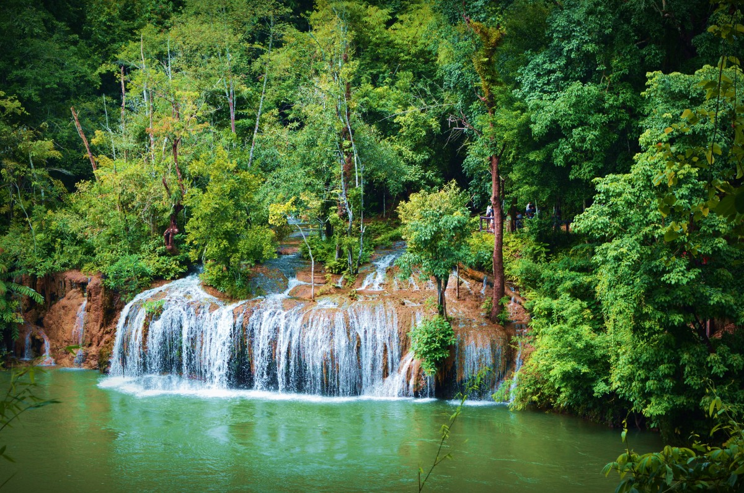
… while it is said: "Today, if you will hear His voice, Do not harden your hearts as in the rebellion." — Hebrews 3:15
Act on His Word
hear His voice
harden your heart
if
hear His voice
harden your heart
Do not act on His Word
Notes:
1,451 = if’s

Slide 4
Jesus answered and said to them, "This is the work of God, that you believe in Him whom He sent." — John 6:29
believe in Him
believe
believe
believe
believe
believe
believe
believe in Him
in
Him
Notes:
9,395 = in’s

Slide 5
Trust
Accept as true
Be certain of
Have faith in
in
Have confidence in
in
believe in Him
believe in Him
in Him
Consider

Slide 6
For we are His workmanship, created in Christ Jesus for good works, which God prepared beforehand that we should walk in them. — Ephesians 2:10
we are His workmanship
created in Christ Jesus
for good works
→
↓
we are His workmanship
created in Christ Jesus
for good
in
Christ Jesus
good
good
↓
works
God prepared
works
works
beforehand
we should
walk in them
in
God prepared beforehand
we should walk in them
→
prepared
←
prepared
prepared
prepared
prepared
prepared
prepared
prepared
prepared

Slide 7
Eternity
Love
Loyalty
Truth
Righteousness
Wisdom
Friendship
God prepared beforehand
we should walk in them
→
prepared
←
prepared

Slide 8
See then that you walk circumspectly, not as fools but as wise, redeeming the time, because the days are evil. Therefore do not be unwise, but understand what the will of the Lord is — Ephesians 5:15-17
walk
walk
circumspectly
watchfully
cautiously
vigilantly
carefully
circumspectly
understand what the will
of the Lord is

Slide 9
This is a faithful saying, and these things I want you to affirm constantly, that those who have believed in God should be careful to maintain good works. These things are good and profitable to men. — Titus 3:8
who have believed in God
in
God
. .
Notes:
553 = should’s

Slide 10
be careful to maintain
good works

Slide 11
"You will know them by their fruits. Do men gather grapes from thornbushes or figs from thistles? Even so, every good tree bears good fruit, but a bad tree bears bad fruit. A good tree cannot bear bad fruit, nor can a bad tree bear good fruit. Every tree that does not bear good fruit is cut down and thrown into the fire. Therefore by their fruits you will know them. Not everyone who says to Me, 'Lord, Lord,' shall enter the kingdom of heaven, but he who does the will of My Father in heaven." — Matthew 7:16-21
You will know them by their fruits
. .
by their fruits you will know them
. .

Slide 12
by their fruits you will know them good tree bears good fruit bad tree bears bad fruit Not everyone who says to Me, 'Lord, Lord,' shall enter the kingdom of heaven, but he who does the will of My Father in heaven
→ pruned
→ burned
who does the will of
. .

Slide 13
To enter the kingdom of heaven who does the will of God in heaven
↑
do
do
God
Notes:
2,240 = do’s

Slide 14
If we are faithless, He remains faithful; He cannot deny Himself. Remind them of these things, charging them before the Lord not to strive about words to no profit, to the ruin of the hearers. Be diligent to present yourself approved to God, a worker who does not need to be ashamed, rightly dividing the word of truth. But shun profane and idle babblings, for they will increase to more ungodliness. — 2nd Timothy 2:13-16

Slide 15
If we are faithless, He remains faithful
Remind them of these things
charging them not to strive about words to no profit, to the ruin of the hearers
● Be diligent to present yourself approved
to God, a worker who does not need to be ashamed, rightly dividing the word of truth
profane and idle babblings
they will increase to more ungodliness
If
→
Remind them
. .
not
words
not
words
to the ruin of the hearers
. .
name calling
gossip
ungodliness
ungodliness

Slide 16
In all labor there is profit, But idle chatter leads only to poverty. The crown of the wise is their riches, But the foolishness of fools is folly. A true witness delivers souls, But a deceitful witness speaks lies. — Proverbs 14:23-25
In
In all labor there is profit
But
. .
But
Honesty
But
Notes:
4,070 = But’s

Slide 17
crown of the wise is their riches the foolishness of fools is folly A true witness delivers souls a deceitful witness speaks lies
=
=
witness
witness

Slide 18
Therefore we also, since we are surrounded by so great a cloud of witnesses, let us lay aside every weight, and the sin which so easily ensnares us, and let us run with endurance the race that is set before us, … — Hebrews 12:1
endurance
endurance
Notes:
Romans 5:3 And not only that, but we also glory in tribulations, knowing that tribulation produces perseverance; 4 and perseverance, character; and character, hope. 5 Now hope does not disappoint, because the love of God has been poured out in our hearts by the Holy Spirit who was given to us.

Slide 19
Meditate on these things; give yourself entirely to them, that your progress may be evident to all. — 1st Timothy 4:15
→
progress
progress
evident to all
. .

Slide 20
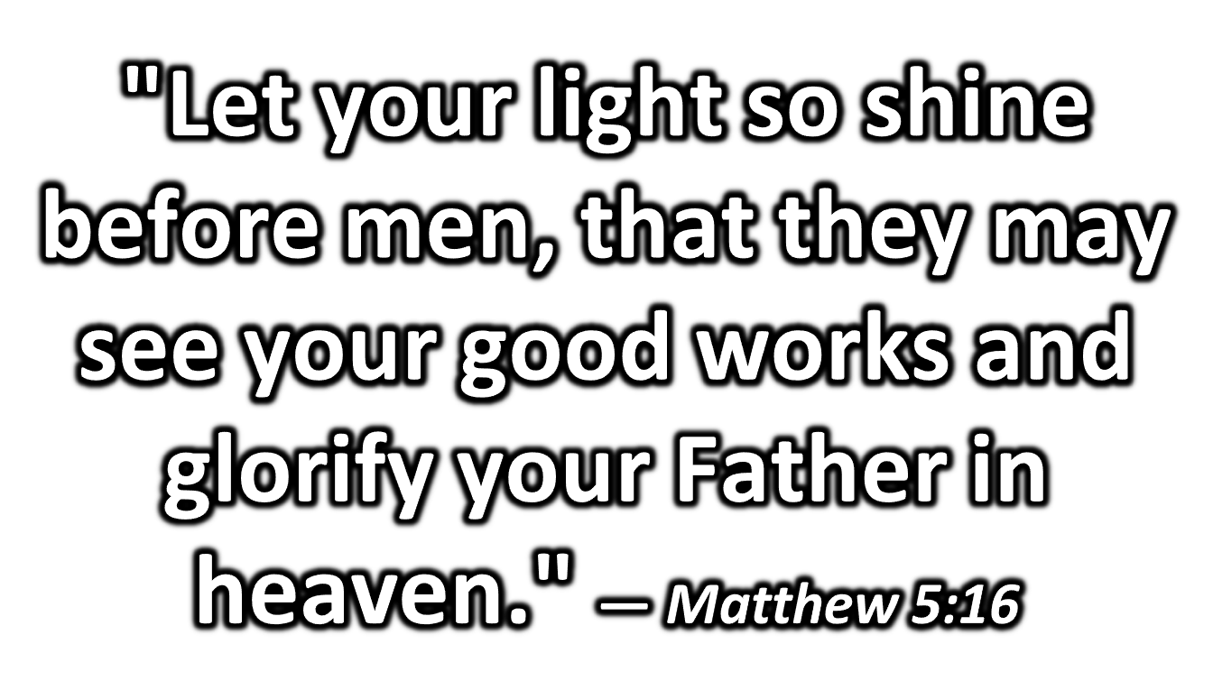
"Let your light so shine before men, that they may see your good works and glorify your Father in heaven." — Matthew 5:16

Slide 21
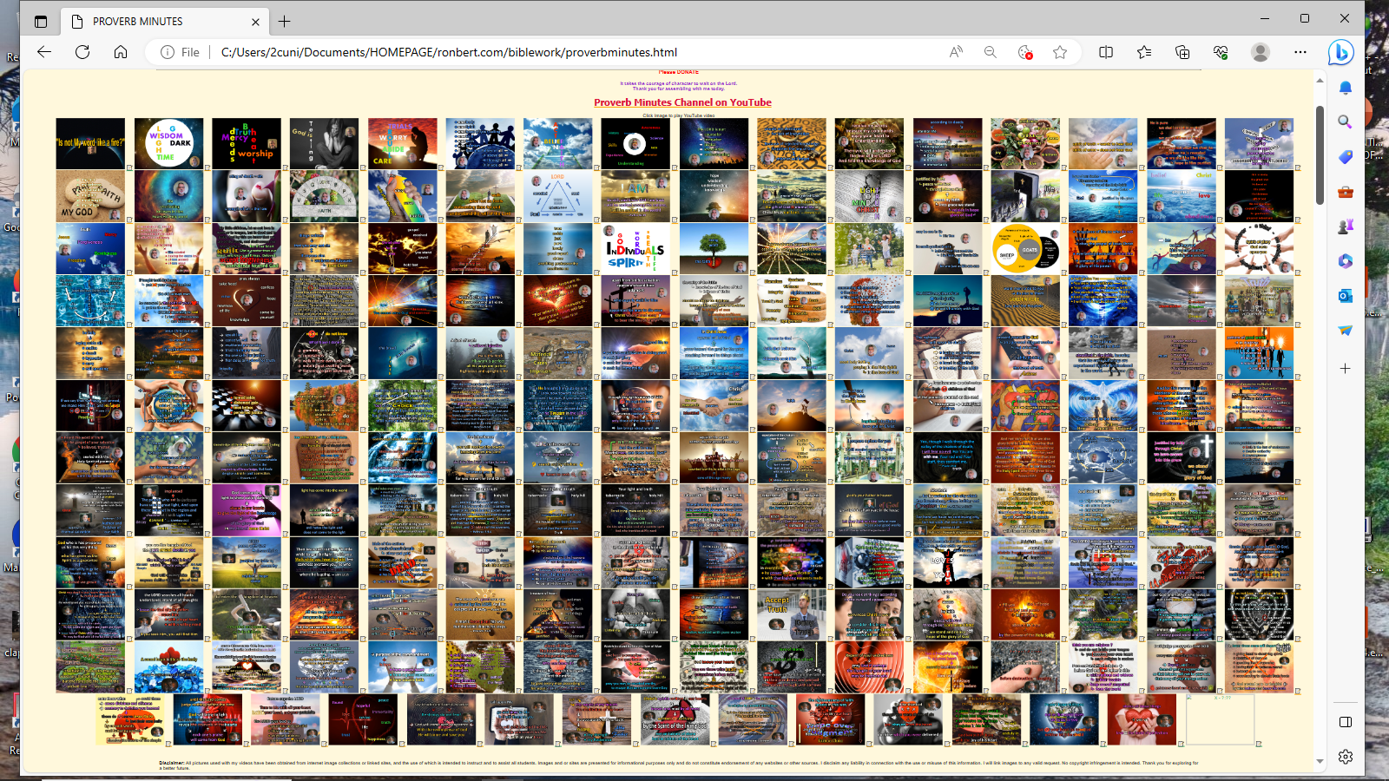

Slide 27
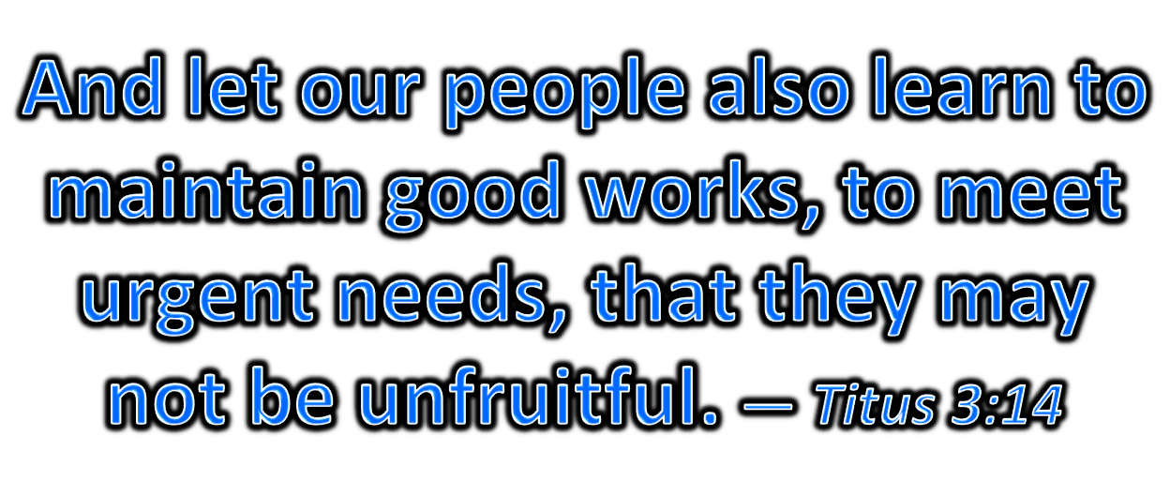
And let our people also learn to maintain good works, to meet urgent needs, that they may not be unfruitful. — Titus 3:14
learn to maintain good works to meet urgent needs not be unfruitful
learn to
learn
learn
maintain good works
to meet
urgent needs
may
not be unfruitful
Notes:
1,306 = may’s
35 = learn’s

Slide 28
Let him who stole steal no longer, but rather let him labor, working with his hands what is good, that he may have something to give him who has need. — Ephesians 4:28
taking
who stole steal no longer let him labor working what is good to give who has need
who stole steal no longer
let him labor
working
what is good
may
↓
to give
who has need
to give
. .

Slide 29
For this reason we also, since the day we heard it, do not cease to pray for you, and to ask that you may be filled with the knowledge of His will in all wisdom and spiritual understanding; that you may walk worthy of the Lord, fully pleasing Him, being fruitful in every good work and increasing in the knowledge of God; — Colossians 1:9-10
do not cease to pray ask that you may be filled with knowledge of His will in all wisdom / spiritual understanding may walk worthy of the Lord fully pleasing Him, being fruitful in every good work ● increasing in the knowledge of God
do
do
ask
do not cease to pray
↓
ask that you may be filled
may
His will
with
knowledge of His will
in all
in
in
wisdom
spiritual understanding
may walk worthy of the Lord
may
fully pleasing Him, being fruitful
in
in
→
in
←
every good work
increasing in the
in
knowledge of God
in
Notes:
2,240 = do’s

Slide 30
→ Hear God and do not harden your heart to Him
→ To believe in Jesus is a working call by God
→ God created His creation to uphold good character
→ God wills we be careful and understand His will
→ God wills we constantly maintain good works
→ A soul will be known by the fruits they produce
→ God wills we recall His warnings of ungodliness
→ God sees labors of the humbly wise & deceitful liars
→ God calls for us to meditate upon His words of truth
→ God wills we shine with our good works
→ Said to learn to maintain the needs of good works
→ God wills that we forgo thievery for giving hearts
→ To pray unceasingly seeking & applying His truths
God will judge
hearts as seeking Him
over self-seeking

Slide 32
Please visit http://www.RonBert.com to explore further
Ronald Bert Channel on
Notes:
Eternity never ends.

