Slide 1
Notes:
Darkness is lost for any clarity.

Slide 2
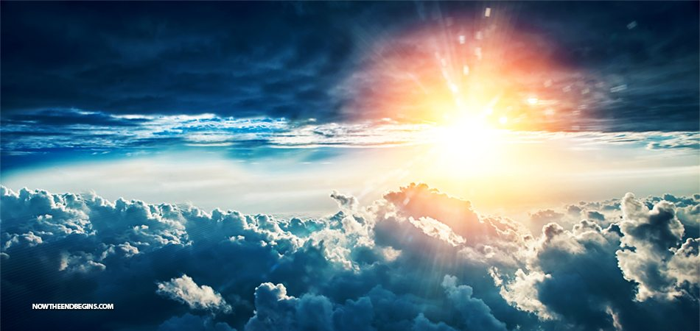
TRUTH
Ron Bert
August 13, 2017
Notes:
Truth is the highest of all ideals.

Slide 3
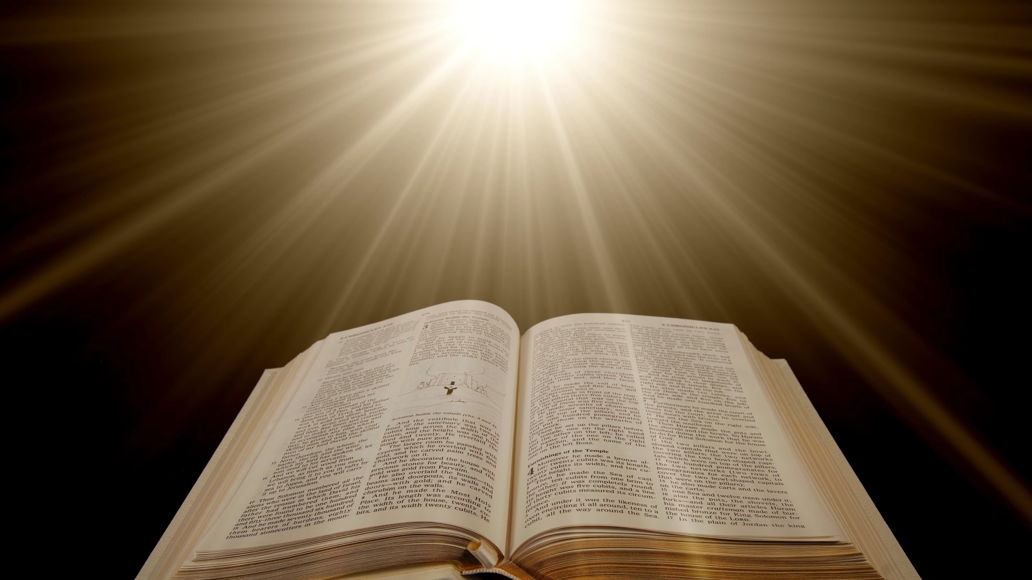
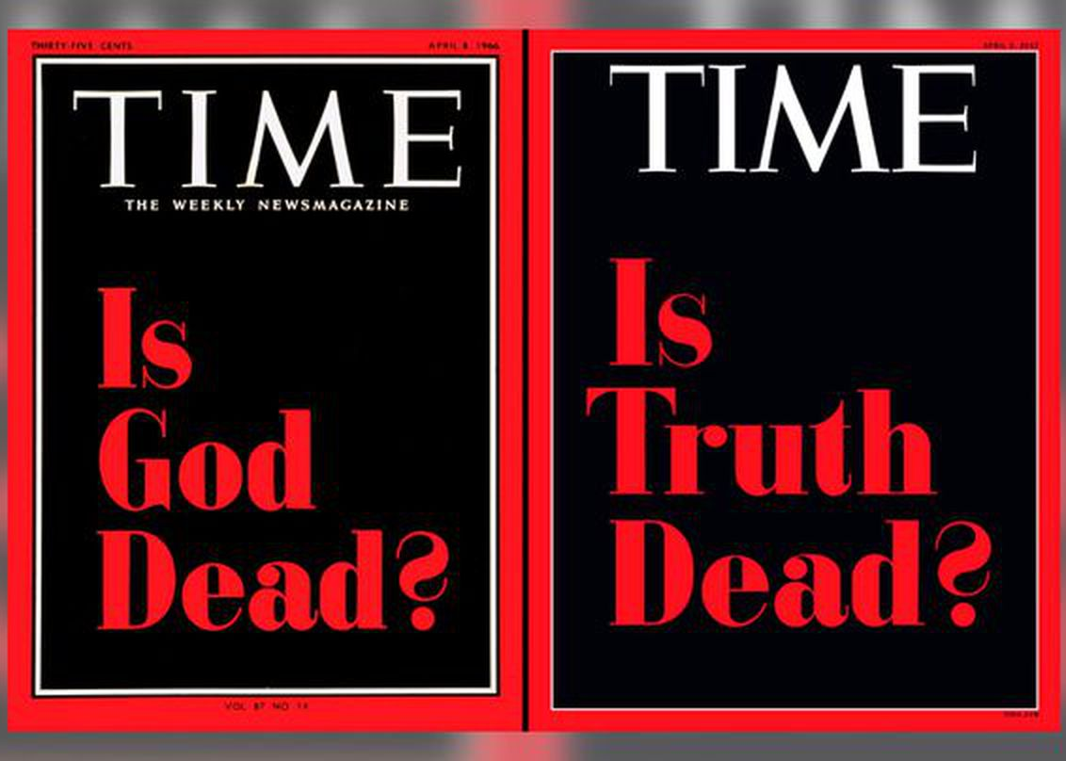
"Sanctify them by Your truth. Your word is truth." — John 17:17
The entirety of Your word is truth, And every one of Your righteous judgments endures forever. — Psalms 119:160
For the word of the LORD is right, And all His work is done in truth. — Psalms 33:4
truth
truth
truth
truth
Notes:
In this motions of time His Words enlighten the soul. We live in disturbing times where trust challenges any of all truths. Does contempt drive us, or seeking that which is truly higher?

Slide 4
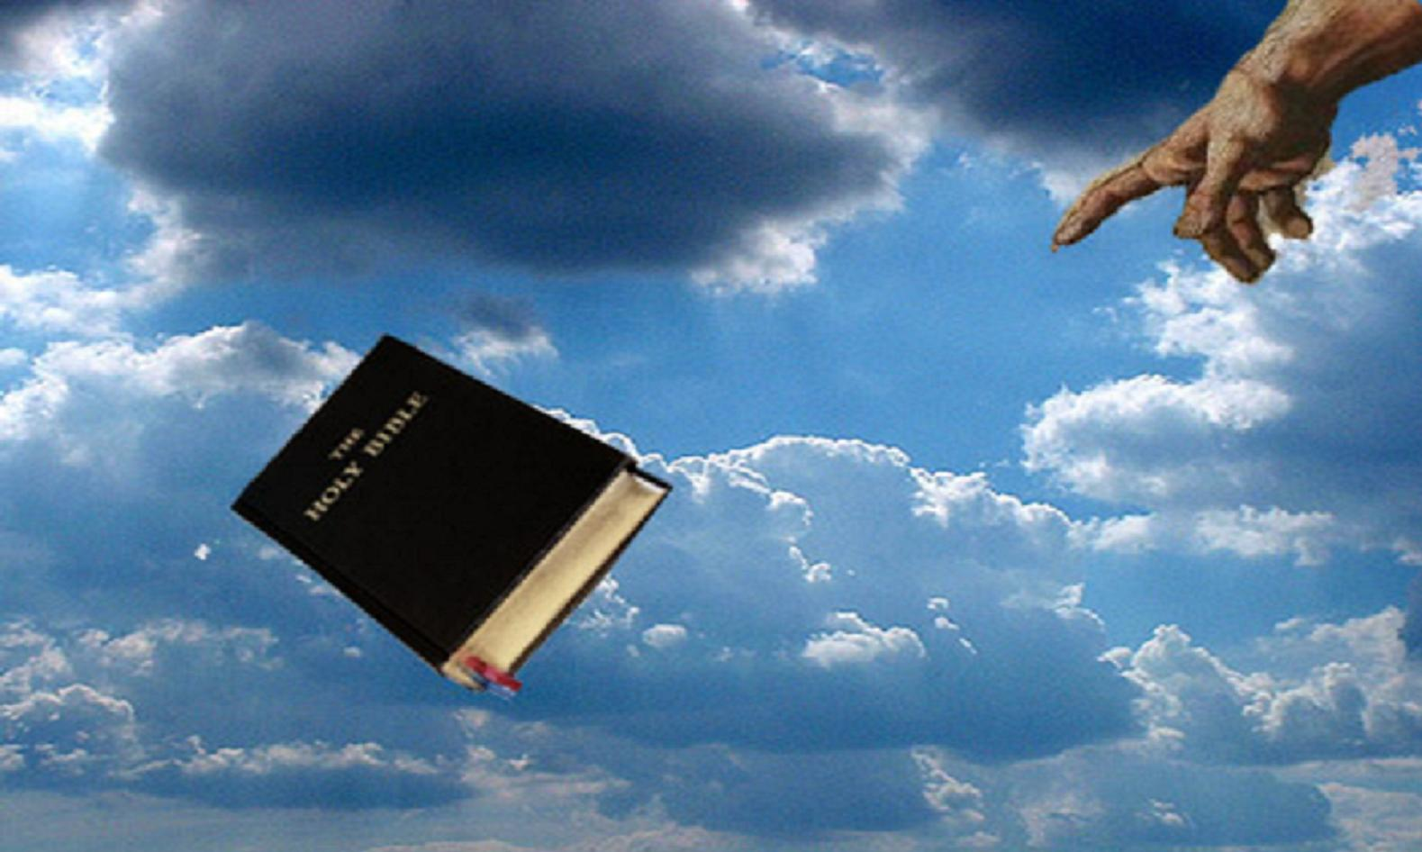
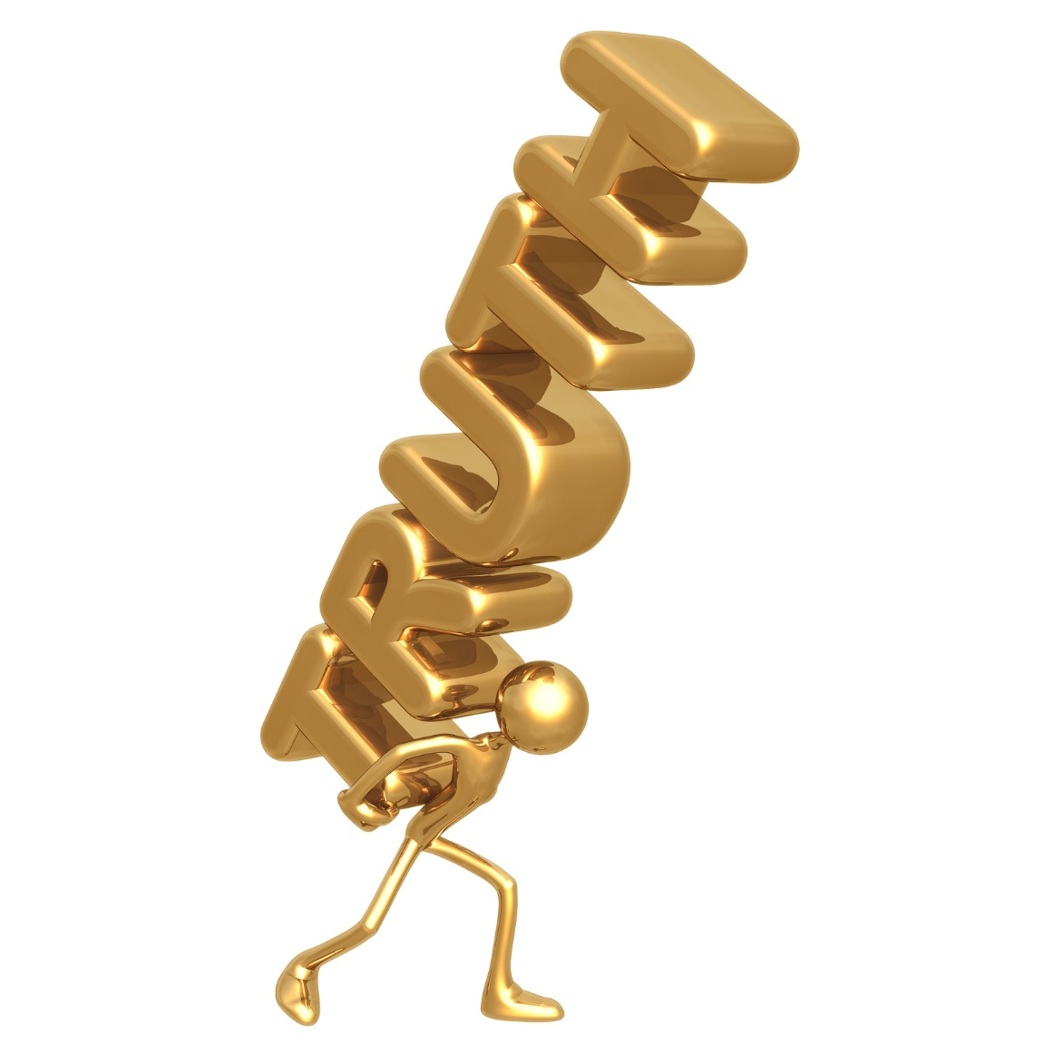
The LORD is near to all who call upon Him, To all who call upon Him in truth — Psalms 145:18
in
truth
truth
Notes:
Delivered by the hand of God Himself, truth holds the light of His just goodness.

Slide 5
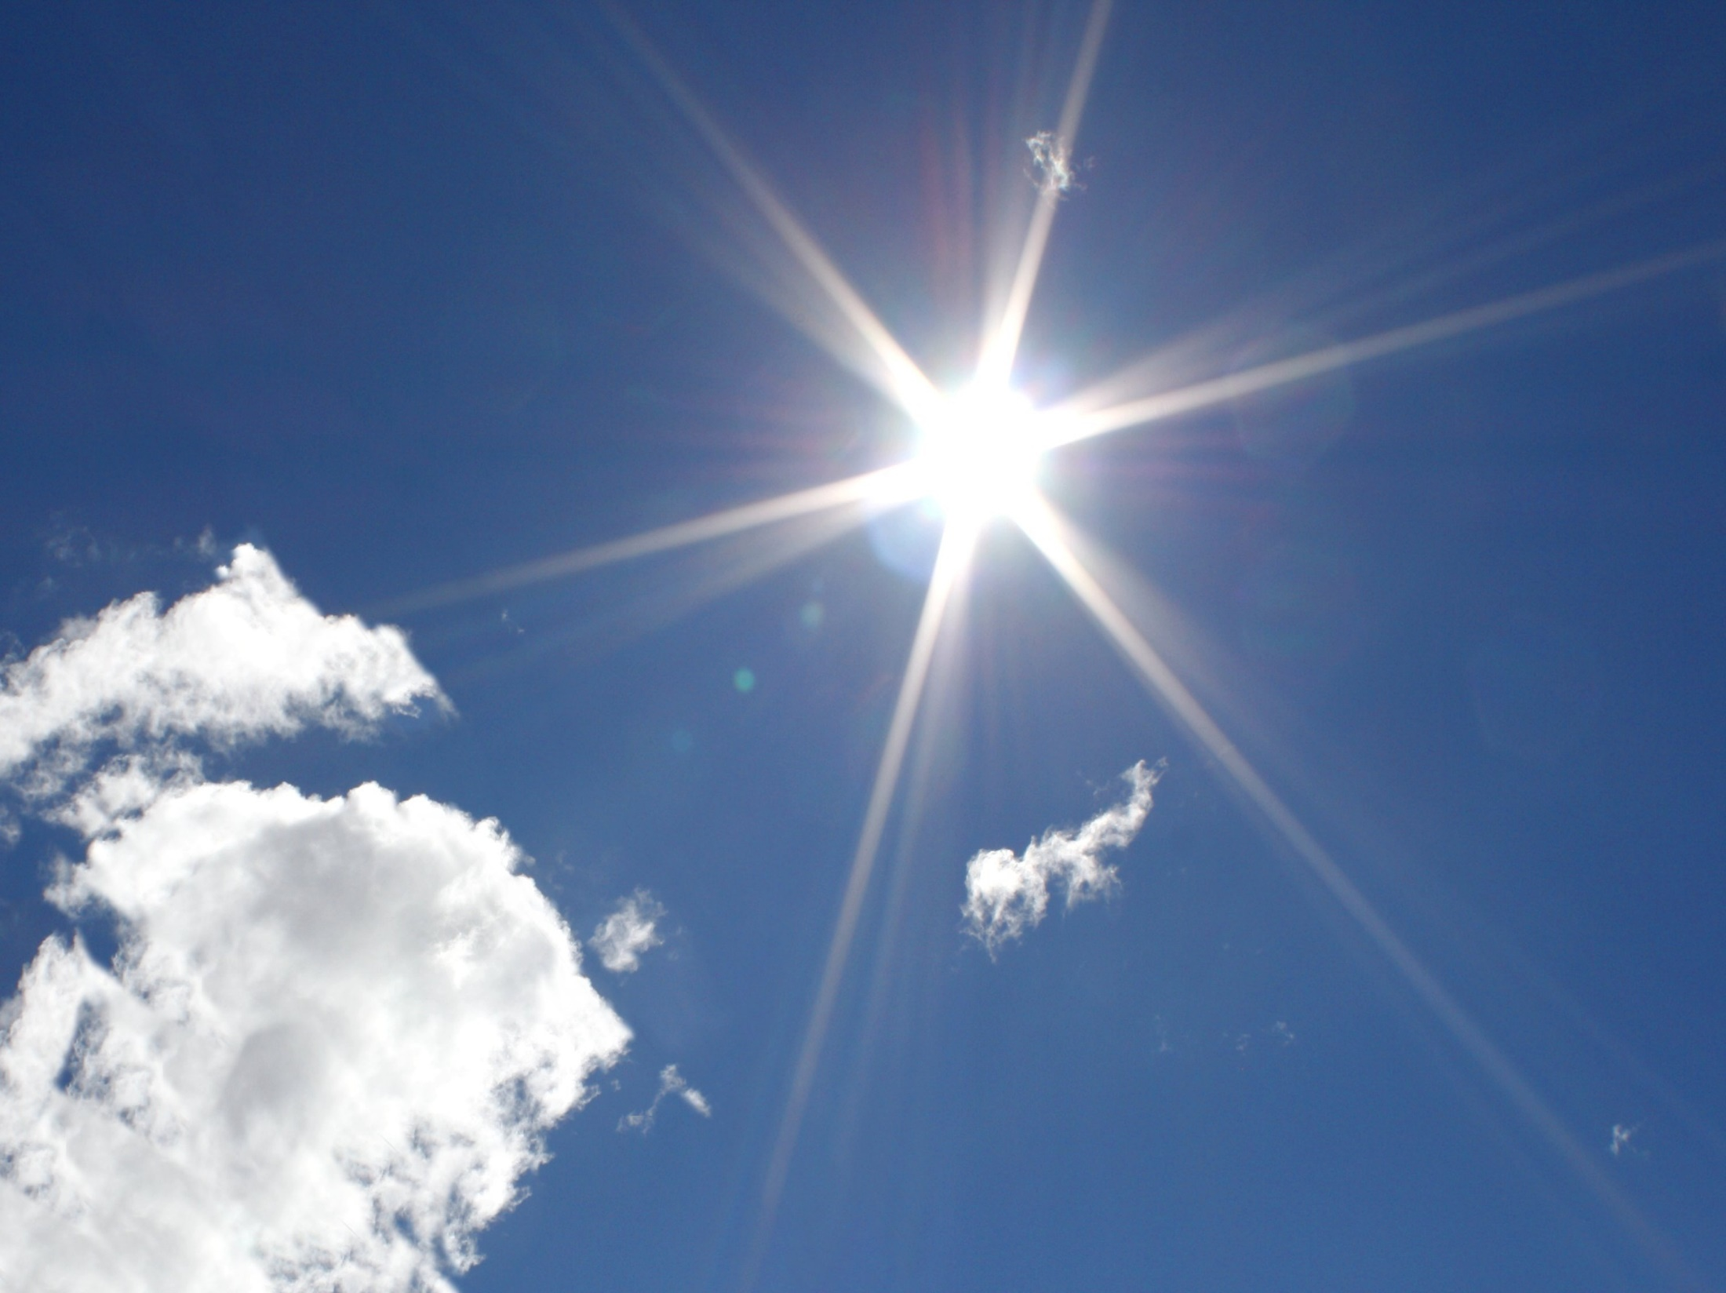
"God is Spirit, and those who worship Him must worship in spirit and truth." — John 4:24
truth
truth
Notes:
The pages of His light are found in His Word.

Slide 6
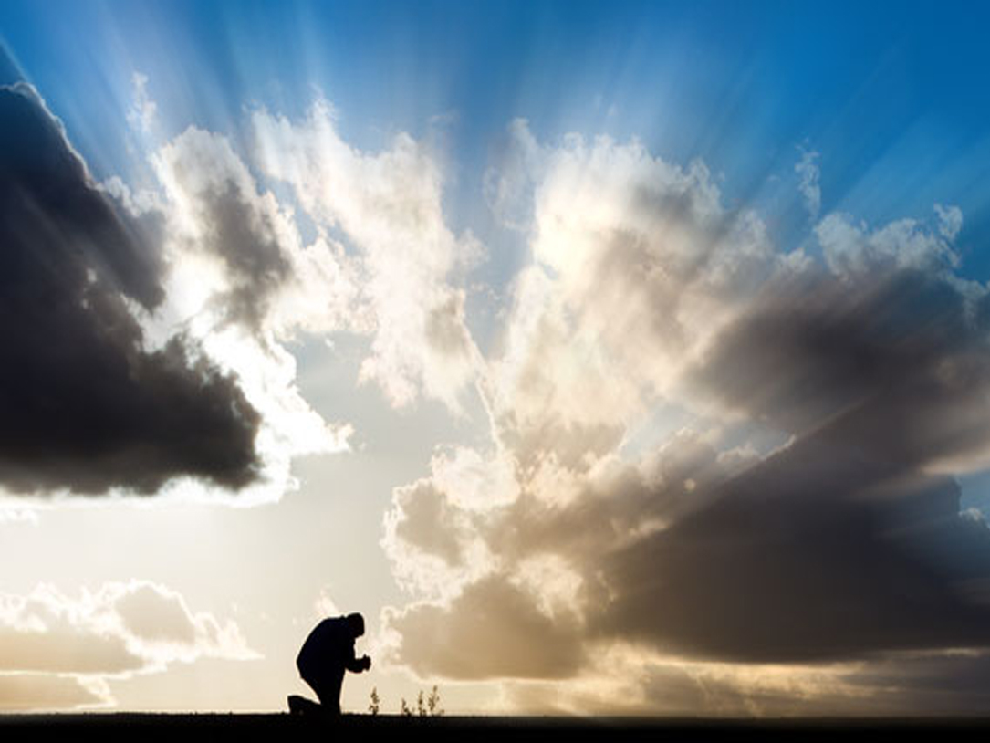
"Now therefore, fear the LORD, serve Him in sincerity and in truth, and put away the gods which your fathers served on the other side of the River and in Egypt. Serve the LORD!" — Joshua 24:14
follow
in
sincerity
truth
sincerity
Serve the
Serve the
truth
LORD
LORD
Notes:
From the depths of being comes forth true desire.

Slide 7
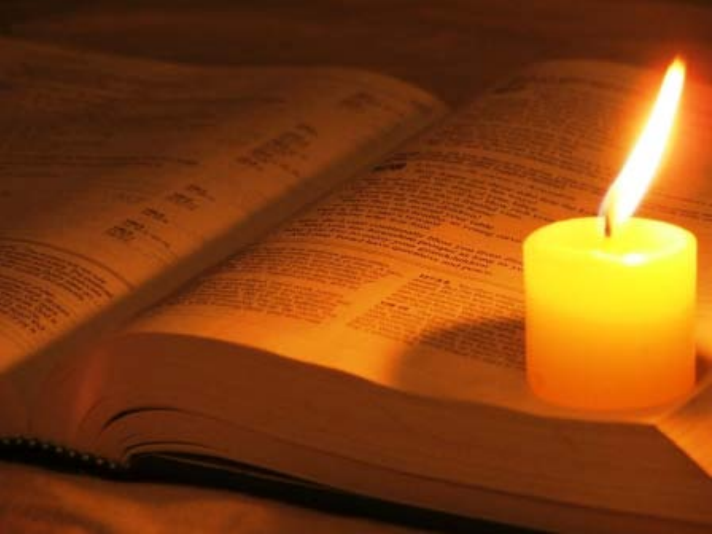
"And you shall know the truth, and the truth shall make you free." — John 8:32
truth
know
truth
know
truth
truth
Notes:
Truth has a ring springing up from the marrow of life. To know is the light of who we are.

Slide 8
Behold, You desire truth in the inward parts, And in the hidden part You will make me to know wisdom. — Psalms 51:6
truth
in
in
in
truth
me
know
me
Notes:
From the innermost parts of thought He commands we know. What we know defines what we are. Blessed are all those who are able to remain as spotless (sinless) as possible from falling from His presence in truth.

Slide 9
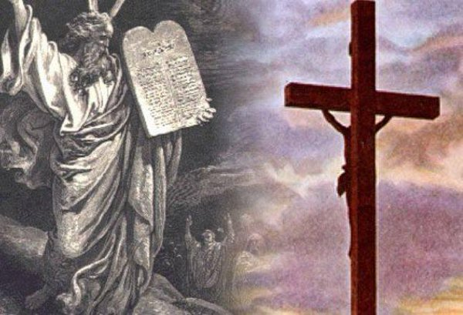
For the law was given through Moses, but grace and truth came through Jesus Christ. — John 1:17
truth came
truth came
truth
through
Jesus Christ
Jesus Christ
truth
Notes:
The law was given to endlessly show His mercy and grace above the fobbing's of man.

Slide 10
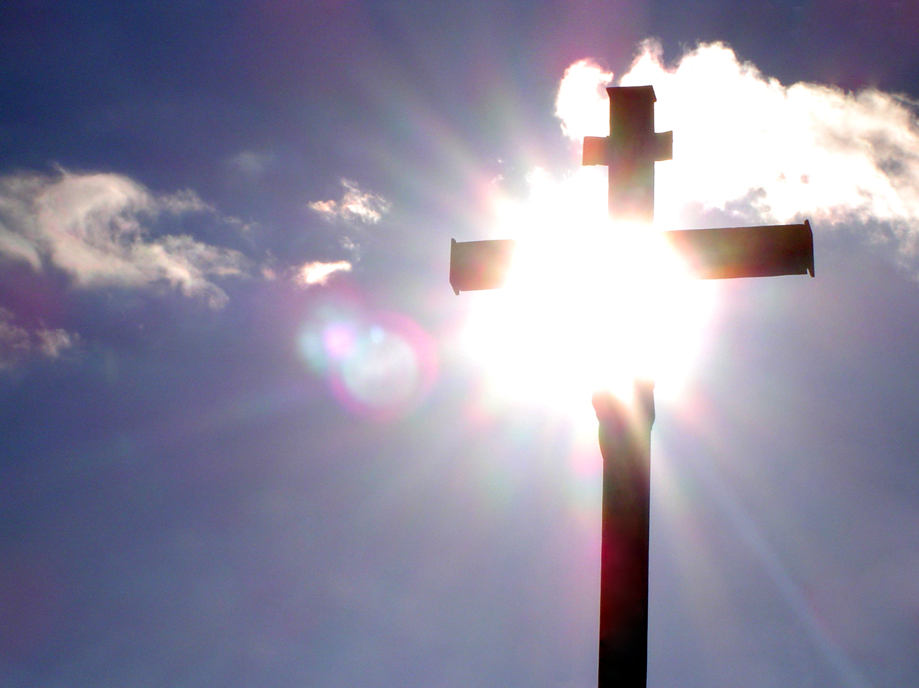
And the Word became flesh and dwelt among us, and we beheld His glory, the glory as of the only begotten of the Father, full of grace and truth. — John 1:14
truth
glory
glory
grace
truth
Notes:
His light brings truth into a liars world.

Slide 11
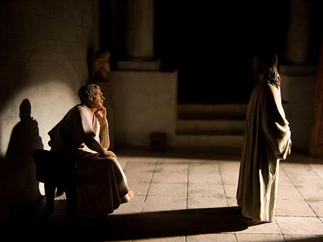
Pilate therefore said to Him, "Are You a king then?" Jesus answered, "You say rightly that I am a king. For this cause I was born, and for this cause I have come into the world, that I should bear witness to the truth. Everyone who is of the truth hears My voice." Pilate said to Him, "What is truth?" And when he had said this, he went out again to the Jews, and said to them, "I find no fault in Him at all. — John 18:37-38
Jesus
truth
truth
truth
truth
witness to the truth
truth
witness to the truth
truth
truth
What is truth
What is truth
no fault in Him
no fault in Him
Notes:
Christ came to explicitly reveal the truth of God. The Roman government declared the innocence of Christ.

Slide 12
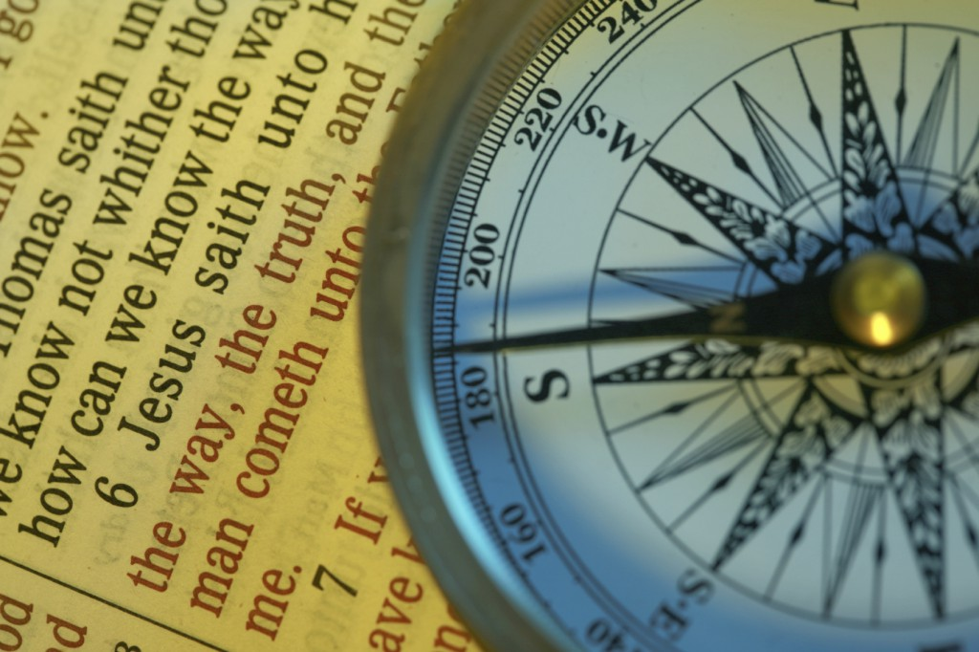
Jesus said to him, "I am the way, the truth, and the life. No one comes to the Father except through Me." — John 14:6
truth
I am the way
I am the way
truth
life
truth
truth
life
Notes:
Direction with, in the truth of, purpose drives one’s compass.

Slide 13
"… the Spirit of truth, whom the world cannot receive, because it neither sees Him nor knows Him; but you know Him, for He dwells with you and will be in you." — John 14:17
Spirit of truth
truth
Spirit of truth
know Him
in
truth
Notes:
In the field of life’s quest, His is an upwelling truth invigorating the spirit to continue on.

Slide 14
This is He who came by water and blood -- Jesus Christ; not only by water, but by water and blood. And it is the Spirit who bears witness, because the Spirit is truth. — 1st John 5:6
baptism
sacrifice
truth
=
truth
Spirit
truth
Notes:
His blood of life and presence of being blesses all who would know Him.

Slide 15
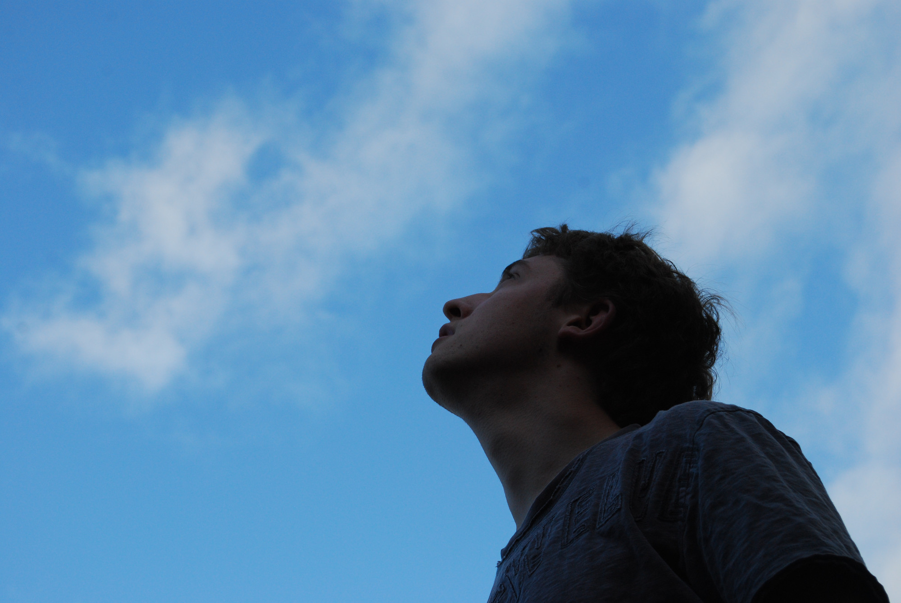
"But the hour is coming, and now is, when the true worshipers will worship the Father in spirit and truth; for the Father is seeking such to worship Him." — John 4:23
true worshipers
true worshipers
in
in spirit
truth
truth
Notes:
God’s greatest desire is that we return to Him in love.

Slide 16
"But when the Helper comes, whom I shall send to you from the Father, the Spirit of truth who proceeds from the Father, He will testify of Me." — John 15:26
truth
send to you
send to you
Spirit of truth
truth
①
③
②
Notes:
Without His light of truth the soul lacks His Spiritual inspirations.

Slide 17
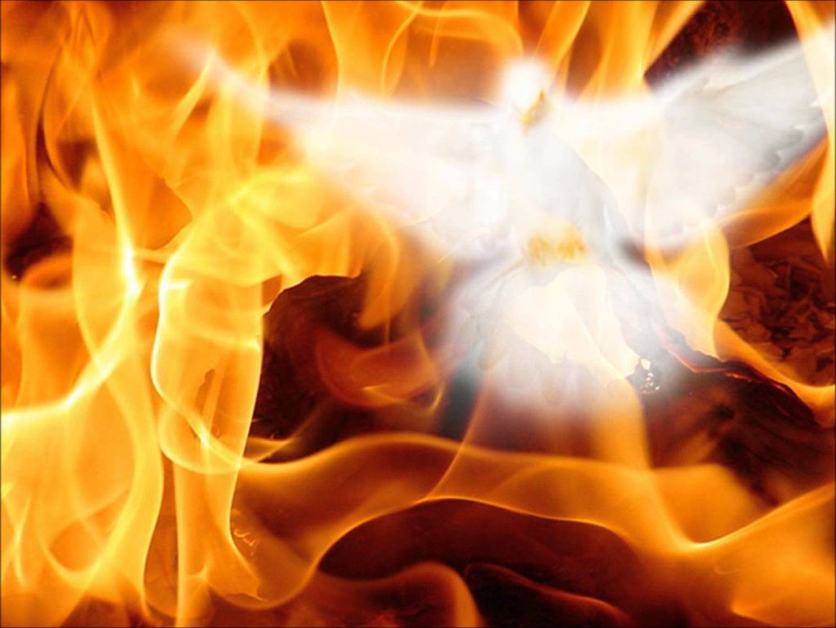
"However, when He, the Spirit of truth, has come, He will guide you into all truth; for He will not speak on His own authority, but whatever He hears He will speak; and He will tell you things to come. — John 16:13
truth
truth
truth
Spirit of truth
Spirit of truth
guide
truth
guide
truth
Notes:
By the Spirit truth lives, past the shallow fading's of flesh.

Slide 18
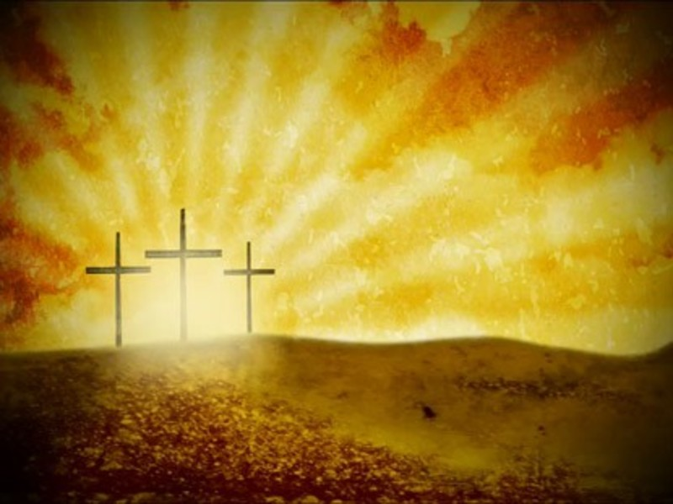
Of His own will He brought us forth by the word of truth, that we might be a kind of firstfruits of His creatures. — James 1:18
truth
truth
word of truth
word of truth
His creatures
His creatures
Notes:
His sacrifice allows us to see ourselves in creation’s becoming. We are His creatures especially when we embrace the truth He has delivered, as it is, truth.

Slide 19
Paul, a bondservant of God and an apostle of Jesus Christ, according to the faith of God's elect and the acknowledgment of the truth which accords with godliness, in hope of eternal life which God, who cannot lie, promised before time began, but has in due time manifested His word through preaching, which was committed to me according to the commandment of God our Savior; — Titus 1:1-3
acknowledgment of the truth
acknowledgment of the truth
truth
truth
godliness
in
Notes:
To acknowledge the truth is to embrace godliness in hope of all His promises.

Slide 20
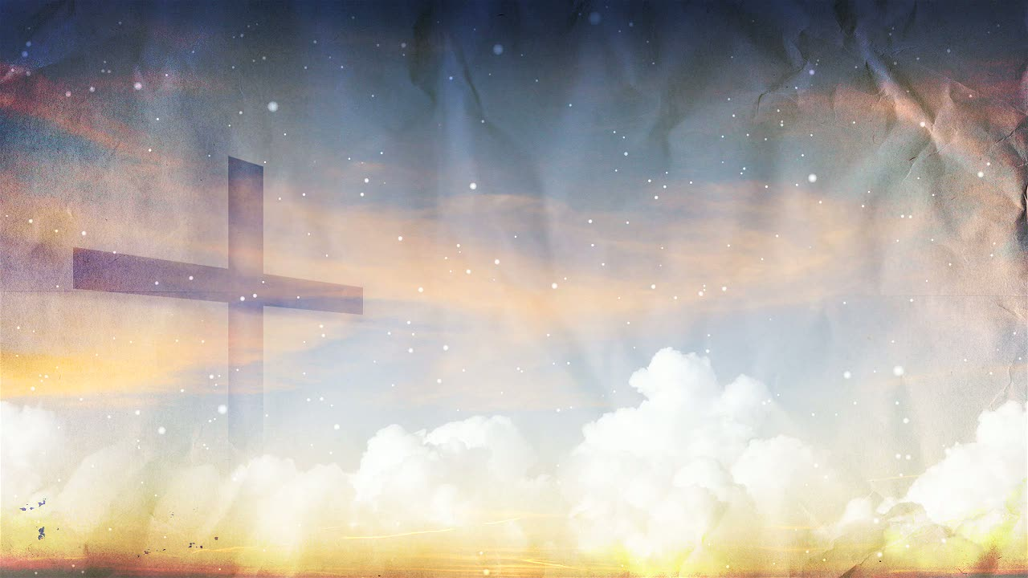
I tell the truth in Christ, I am not lying, my conscience also bearing me witness in the Holy Spirit, — Romans 9:1
truth
in
truth in Christ
Christ
truth in Christ
truth
Notes:
Truth comes clean and straight, and it is by nature innate to the creation of God.

Slide 21
And we know that the Son of God has come and has given us an understanding, that we may know Him who is true; and we are in Him who is true, in His Son Jesus Christ. This is the true God and eternal life. — 1st John 5:20
truth
in
tru
truth
th
Jesus
This is the true God
This is the true God
eternal life
Notes:
Everyone who comes to His light of truth finds a healing of spirit rising past all mortal afflictions.

Slide 22
In Him you also trusted, after you heard the word of truth, the gospel of your salvation; in whom also, having believed, you were sealed with the Holy Spirit of promise, who is the guarantee of our inheritance until the redemption of the purchased possession, to the praise of His glory. — Ephesians 1:13-14
In
In Him you also trusted, after you heard the word of truth, the gospel
of your salvation;
trust
. .
word of truth
truth
→
sealed
having believed
↓
Holy Spirit of promise
guarantee of our
FAITH
=
inheritance
until the redemption of
↓
the purchased possession
IN HIM

Slide 23
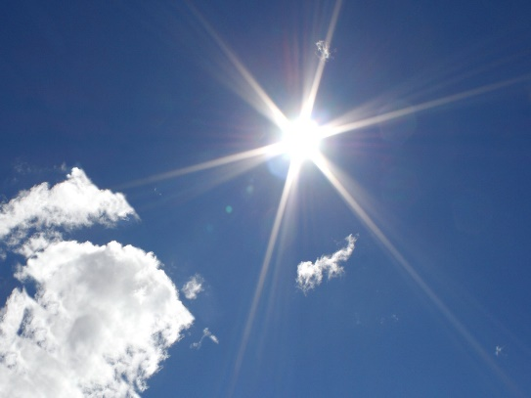
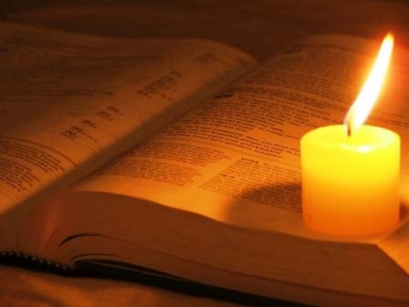
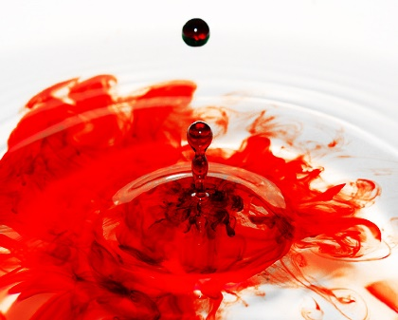
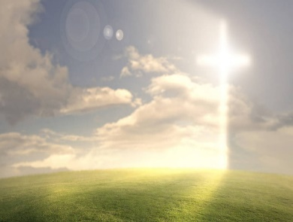

Slide 24
Truth
unlocks the
keys of Spirit
→ God’s word is truth
→ The entirety of Your word is truth
→ The LORD is near to all who call upon Him in truth
→ We are called to worship in spirit and truth
→ To serve Him in sincerity and in truth
→ The truth shall make you free
→ God desires truth in our inward parts
→ Grace and truth came through Jesus Christ
→ Jesus Christ of the Father is full of grace and truth
→ Jesus is the way, the truth, and the life
→ The Spirit is truth
→ The Spirit of truth has guided us into all truth
→ God cannot lie
Notes:
Truth unlocks the keys of Spirit

Slide 25
Notes:
Darkness has nothing new.

Slide 26
TRUTH
2
Ron Bert
August 13, 2017
Notes:
Time is His creation to test a souls desire, be it giving or taking.

Slide 27
Buy the truth, and do not sell it, Also wisdom and instruction and understanding. — Proverbs 23:23
truth
truth
Notes:
Eyes on the prize catches the glory.

Slide 28
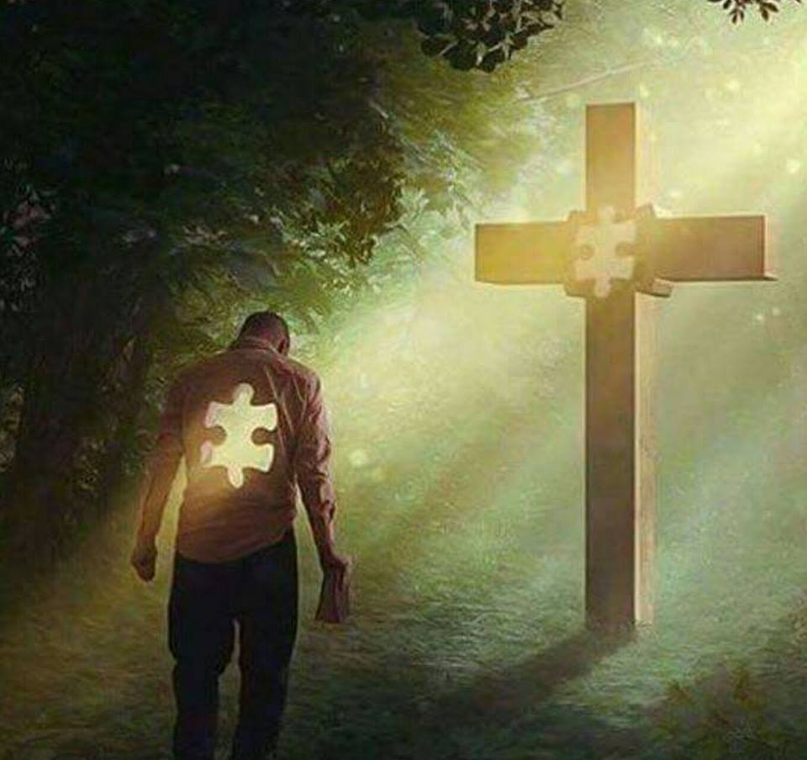
Be diligent to present yourself approved to God, a worker who does not need to be ashamed, rightly dividing the word of truth. — 2nd Timothy 2:15
truth
diligent
diligent
a worker
rightly dividing
truth
rightly dividing
Notes:
Each of us has a piece of realities puzzle. Finding who we are and why we are makes what living is.

Slide 29
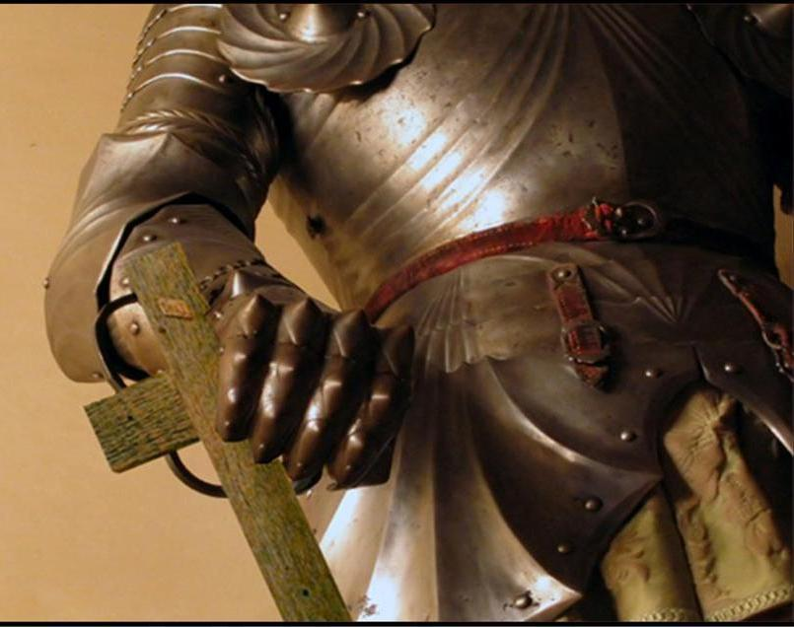
Stand therefore, having girded your waist with truth, having put on the breastplate of righteousness, and having shod your feet with the preparation of the gospel of peace; — Ephesians 6:14-15
truth
truth
righteousness
preparation
preparation
gospel of peace
truth
Notes:
God wants people to understand what He has delivered, and to be able to apply these principles, as a way of life. His sacrifice on the cross is our sword of truth.

Slide 30
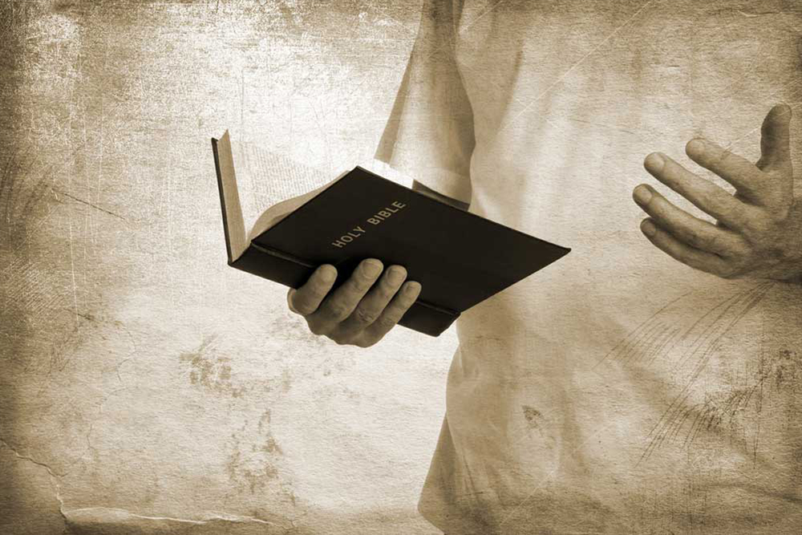
Preach the word! Be ready in season and out of season. Convince, rebuke, exhort, with all longsuffering and teaching. For the time will come when they will not endure sound doctrine, but according to their own desires, because they have itching ears, they will heap up for themselves teachers; and they will turn their ears away from the truth, and be turned aside to fables. — 2nd Timothy 4:2-4
Preach the word! Be ready in season and out of season. Convince, rebuke, exhort, with all longsuffering and
teaching.
truth
turn
turn
truth
aside
Notes:
The only way to surely know God is to read His word and understand His will for man and the proper behavior of a soul. Many are diametrically opposed to His word with false beliefs as a matter of convenience.

Slide 31
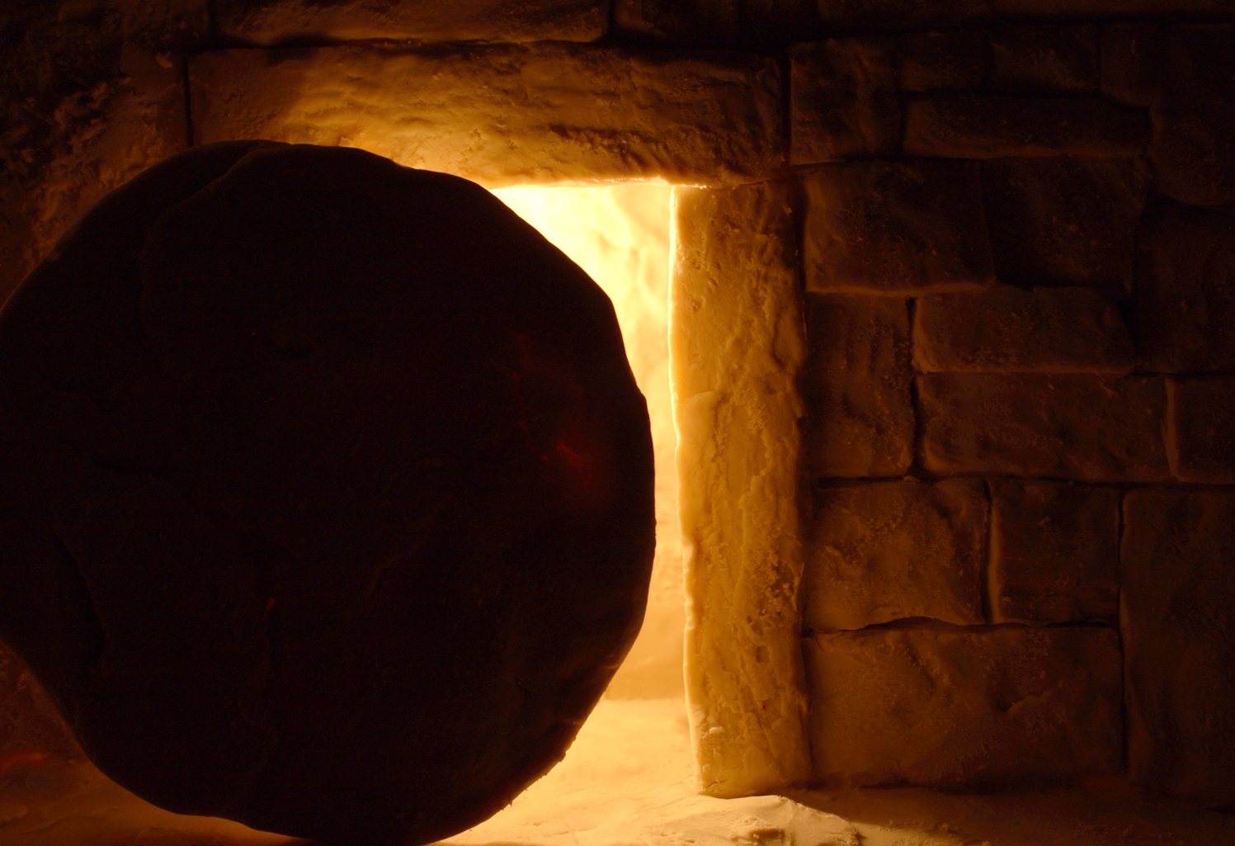
… who have strayed concerning the truth, saying that the resurrection is already past; and they overthrow the faith of some. — 2nd Timothy 2:18
truth
faith
truth
Notes:
Without the Bible we would not have the knowledge He promised would endure throughout all generations. It is the gift of His Spirit for us to autonomously know, and it is a choice to return or not. The truth of Jesus travels behind the veil. We see the light behind the door because we believe the truth He has given.

Slide 32
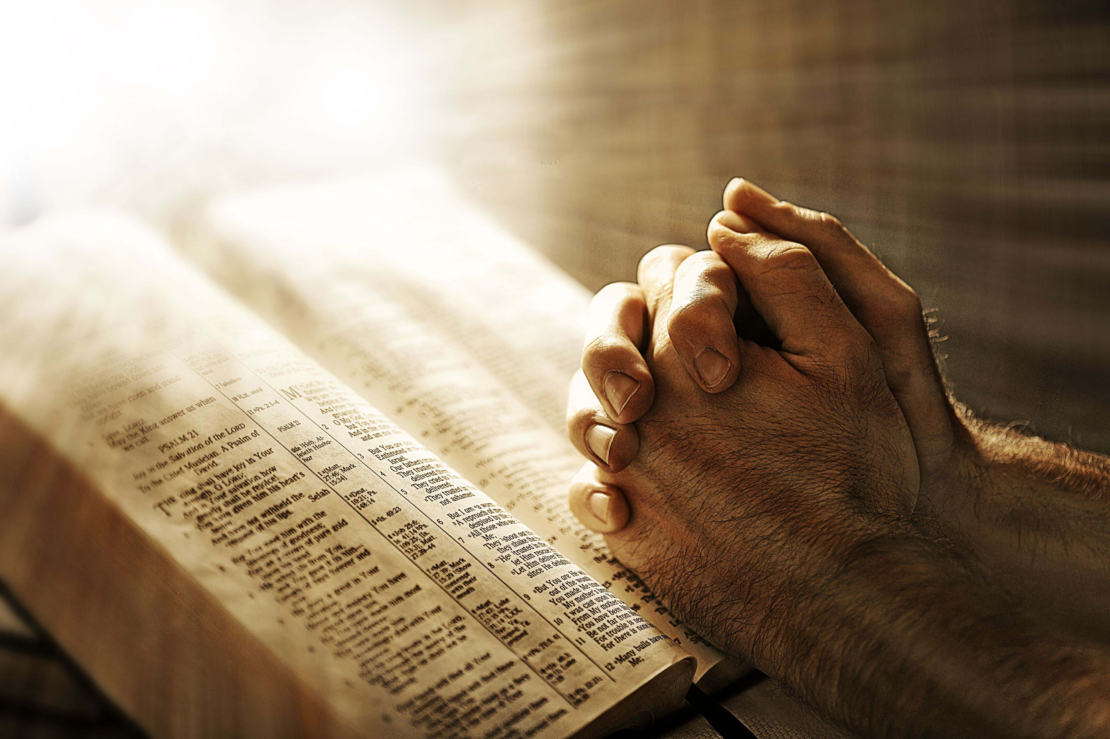
"As it is written in the Law of Moses, all this disaster has come upon us; yet we have not made our prayer before the LORD our God, that we might turn from our iniquities and understand Your truth." — Daniel 9:13
not
prayer
prayer
might turn
and understand
truth
truth
Notes:
People tend to talk with themselves not noticing earnest and genuine dialog directly with God Himself. Absorbed self-seekers are challenged in all higher order contemplations.

Slide 33
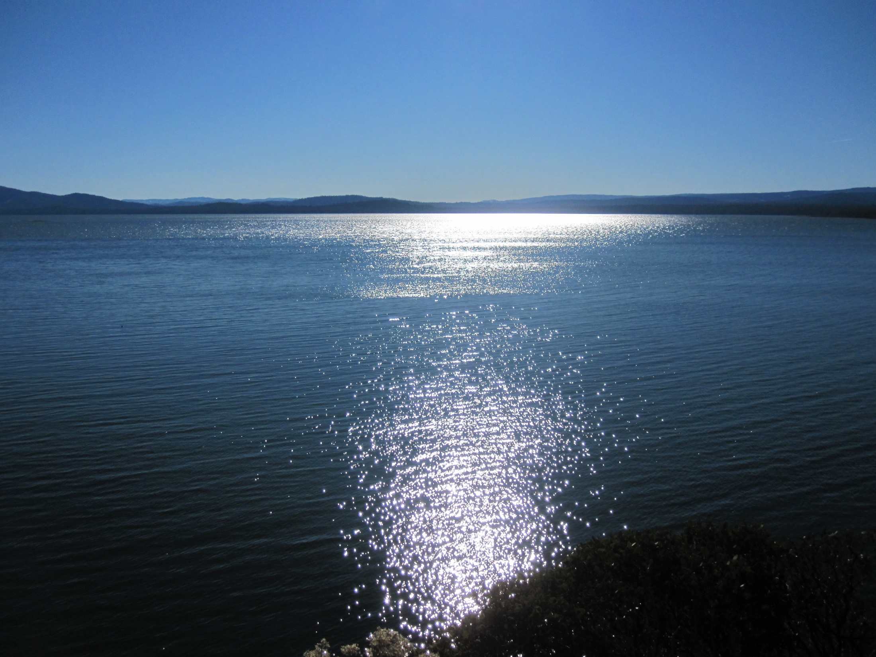
LORD, who may abide in Your tabernacle? Who may dwell in Your holy hill? He who walks uprightly, And works righteousness, And speaks the truth in his heart; — Psalms 15:1-2
LORD, who may abide in Your tabernacle? Who may dwell in Your holy hill? He who walks uprightly, And works righteousness, And speaks the truth in his heart; — Psalms 15:1-2
truth
righteousness
in
truth in his heart
truth in his heart
truth
truth
Notes:
Home is a state of mind either experienced by the freedom or relief it gives verses a prison of confinement in drudgery that steals peace in heart. It is the heart that defines home no matter location.

Slide 34
We are of God. He who knows God hears us; he who is not of God does not hear us. By this we know the spirit of truth and the spirit of error. — 1st John 4:6
hears
truth
does not hear
spirit of truth
spirit of truth
truth
spirit of error
spirit of error
Notes:
What makes a godlily spirit is one who is willing to listen; to not deny or dismiss, fairly discussing God’s Word. Many who claim religious superiority are unwilling to yield stubborn opinions of man or woman’s doctrines over simply submitting to the plain Word. Man manipulates through complexity where God’s message is that of the simplest of requests, obey. Hard to apply in a world of temptations and deception. It is the nature of many to judge and complain, and avoid, while not listening, and in this one can see the spirit of error or willingness to examine His truth. Alignment is right when with God and not dogmatically rigid to man’s devising. This is when people drink poison laced Kool-Aid, burn to death in buildings, and commit suicide in beds wearing white tennis-shoes, while waiting for a passing comet; God does not call for fanatics.

Slide 35
"But let your 'Yes' be 'Yes,' and your 'No,' 'No.' For whatever is more than these is from the evil one." — Matthew 5:37
t
truth
u
r
truth
th
Notes:
The truth has no confusion. Scripture teaches us about absolute right and wrong and what God expects from His creatures.

Slide 36
The truthful lip shall be established forever, But a lying tongue is but for a moment. — Proverbs 12:19
truth
truth
Notes:
What we speak is who we are. Too often spite can bite and without remorse, love may not have its’ healing influence. God will review the entirety of all of our puzzle pieces done in the flesh. The flesh is given to expose the heart.

Slide 37
If we say that we have no sin, we deceive ourselves, and the truth is not in us. — 1st John 1:8
truth
truth
in
Notes:
To leap away from the truth is to embrace deception where there is no transparency. Light is what is seen over anything hidden in the dark. It can sometimes be hard to see or admit the truth.

Slide 38
For we can do nothing against the truth, but for the truth. — 2nd Corinthians 13:8
truth
truth
truth
Notes:
Putting truth together has been the struggle of all generations.

Slide 39
Let not mercy and truth forsake you; Bind them around your neck, Write them on the tablet of your heart, … — Proverbs 3:3
truth
mercy and truth
mercy and truth
truth
Notes:
Mercy is our ability to have compassion on those less fortunate, be it both materially and or spiritually.

Slide 40
Love suffers long and is kind; love does not envy; love does not parade itself, is not puffed up; does not behave rudely, does not seek its own, is not provoked, thinks no evil; does not rejoice in iniquity, but rejoices in the truth; — 1st Corinthians 13:4-6
Love
truth
rejoices in the truth
truth
Notes:
Love’s greatest beacon is honesty.

Slide 41
My little children, let us not love in word or in tongue, but in deed and in truth. — 1st John 3:18
truth
love
in
in deed
in deed
in
in truth
truth
in truth
Notes:
The heart if in love is simple; a union deeper than flesh.

Slide 42
Since you have purified your souls in obeying the truth through the Spirit in sincere love of the brethren, love one another fervently with a pure heart, having been born again, not of corruptible seed but incorruptible, through the word of God which lives and abides forever, … — 1st Peter 1:22-23
obeying the truth
truth
obeying the truth
in
sincere love
in sincere love
truth
through
word of God
Notes:
To find His truth takes sincerity of heart.

Slide 43
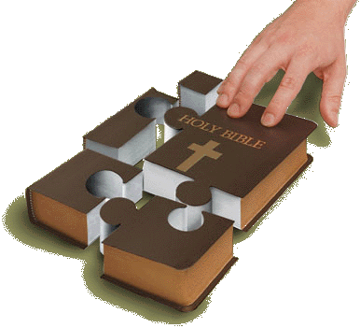
… because of the hope which is laid up for you in heaven, of which you heard before in the word of the truth of the gospel, which has come to you, as it has also in all the world, and is bringing forth fruit, as it is also among you since the day you heard and knew the grace of God in truth; — Colossians 1:5-6
in
in
truth of the gospel
truth
truth of the gospel
come to you
in
come to you
truth
truth
truth
in
truth
Notes:
Knowing the Word reveals the will of God and hope for our individual welfare under His grace.

Slide 44
(for the fruit of the Spirit is in all goodness, righteousness, and truth), finding out what is acceptable to the Lord. — Ephesians 5:9-10
all
truth
goodness
righteousness
finding out
truth
finding out
truth
Notes:
Righteous goodness is found in pursuit of pleasing His will and honoring His glory in that we are.

Slide 45
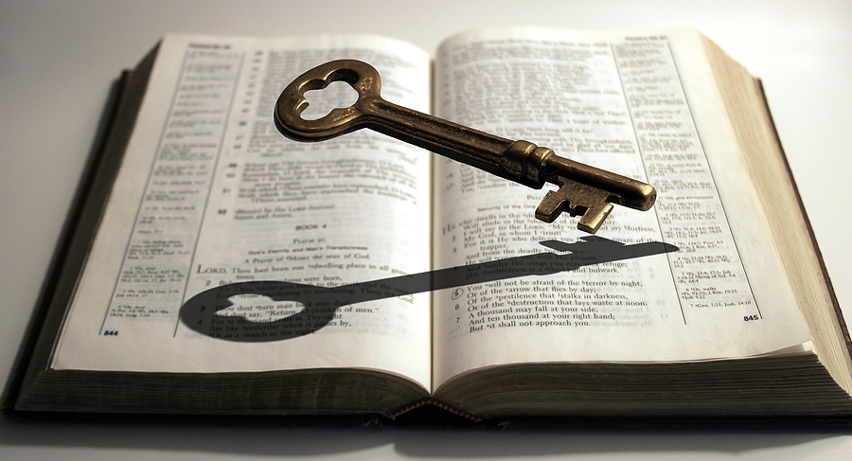
Lead me in Your truth and teach me, For You are the God of my salvation; On You I wait all the day. — Psalms 25:5
truth
God of my salvation
God of my
salvation
truth
Notes:
To unlock truth one must have faith in that which cannot be seen. Most of all that is real is not viewable for the shear reason of establishing eternal reality over temporary moments. The key of truth stares us all in the face.

Slide 46
Into Your hand I commit my spirit; You have redeemed me, O LORD God of truth. — Psalms 31:5
LOVE
L
O
R
D
L
O
R
D
O
R
D
R
R
D
W
O
R
D
T UTH
TRUTH
. .
truth
God of truth
DILIGENT

Slide 47
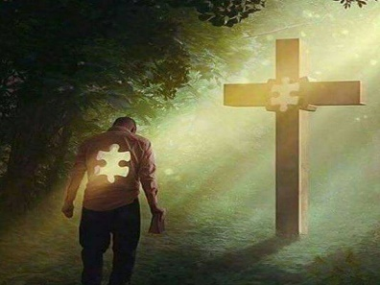

Slide 48
→ Buy the truth, and do not sell it
→ Be a worker rightly dividing the word of truth
→ People will turn away from the truth & to fables
→ Turn from iniquities and understand His truth
→ To abide in God one must speak the truth in heart
→ There is a spirit of truth and the spirit of error; hear
→ Let your 'Yes' be 'Yes,' and your 'No,' 'No'
→ If we say that we have no sin the truth is not in us
→ Let not mercy and truth forsake you
→ Love rejoices in the truth
→ Love in deed and in truth
→ Purify your soul in obeying the truth
→ Fruit / Spirit = all goodness, righteousness, & truth
His truth
delivers us
Notes:
His truth delivers us

Slide 49
Notes:
Darkness has a bottomless loss of direction.

Slide 50
Please visit http://www.LoveFromGod.com to explore further
Ronald Bert Channel on
Notes:
Eternity never ends.

Slide 51
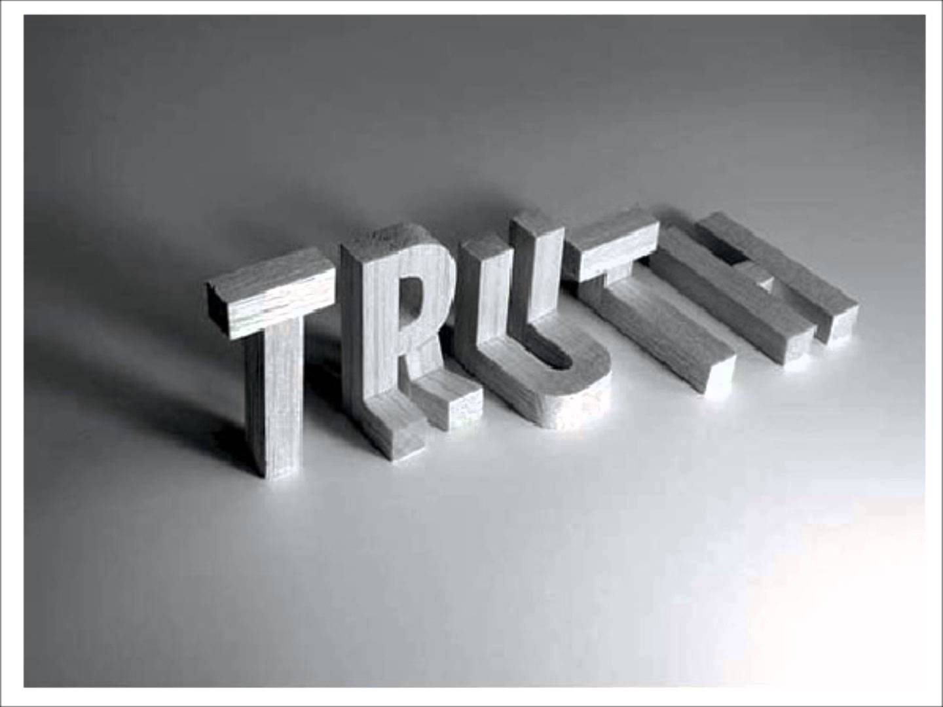
Notes:
It is God that magnifies truth. It is the imagination of man that twists truth away from what it is.

