Slide 2
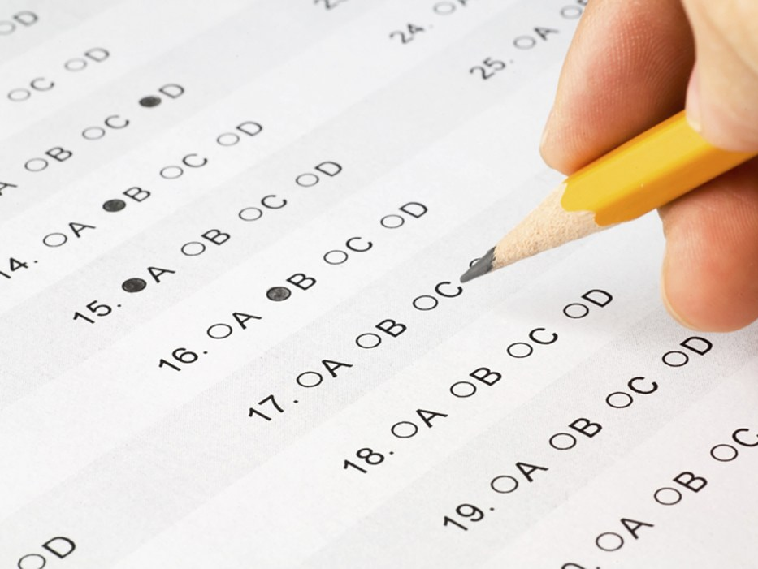
The Test
February 24, 2019

Slide 3
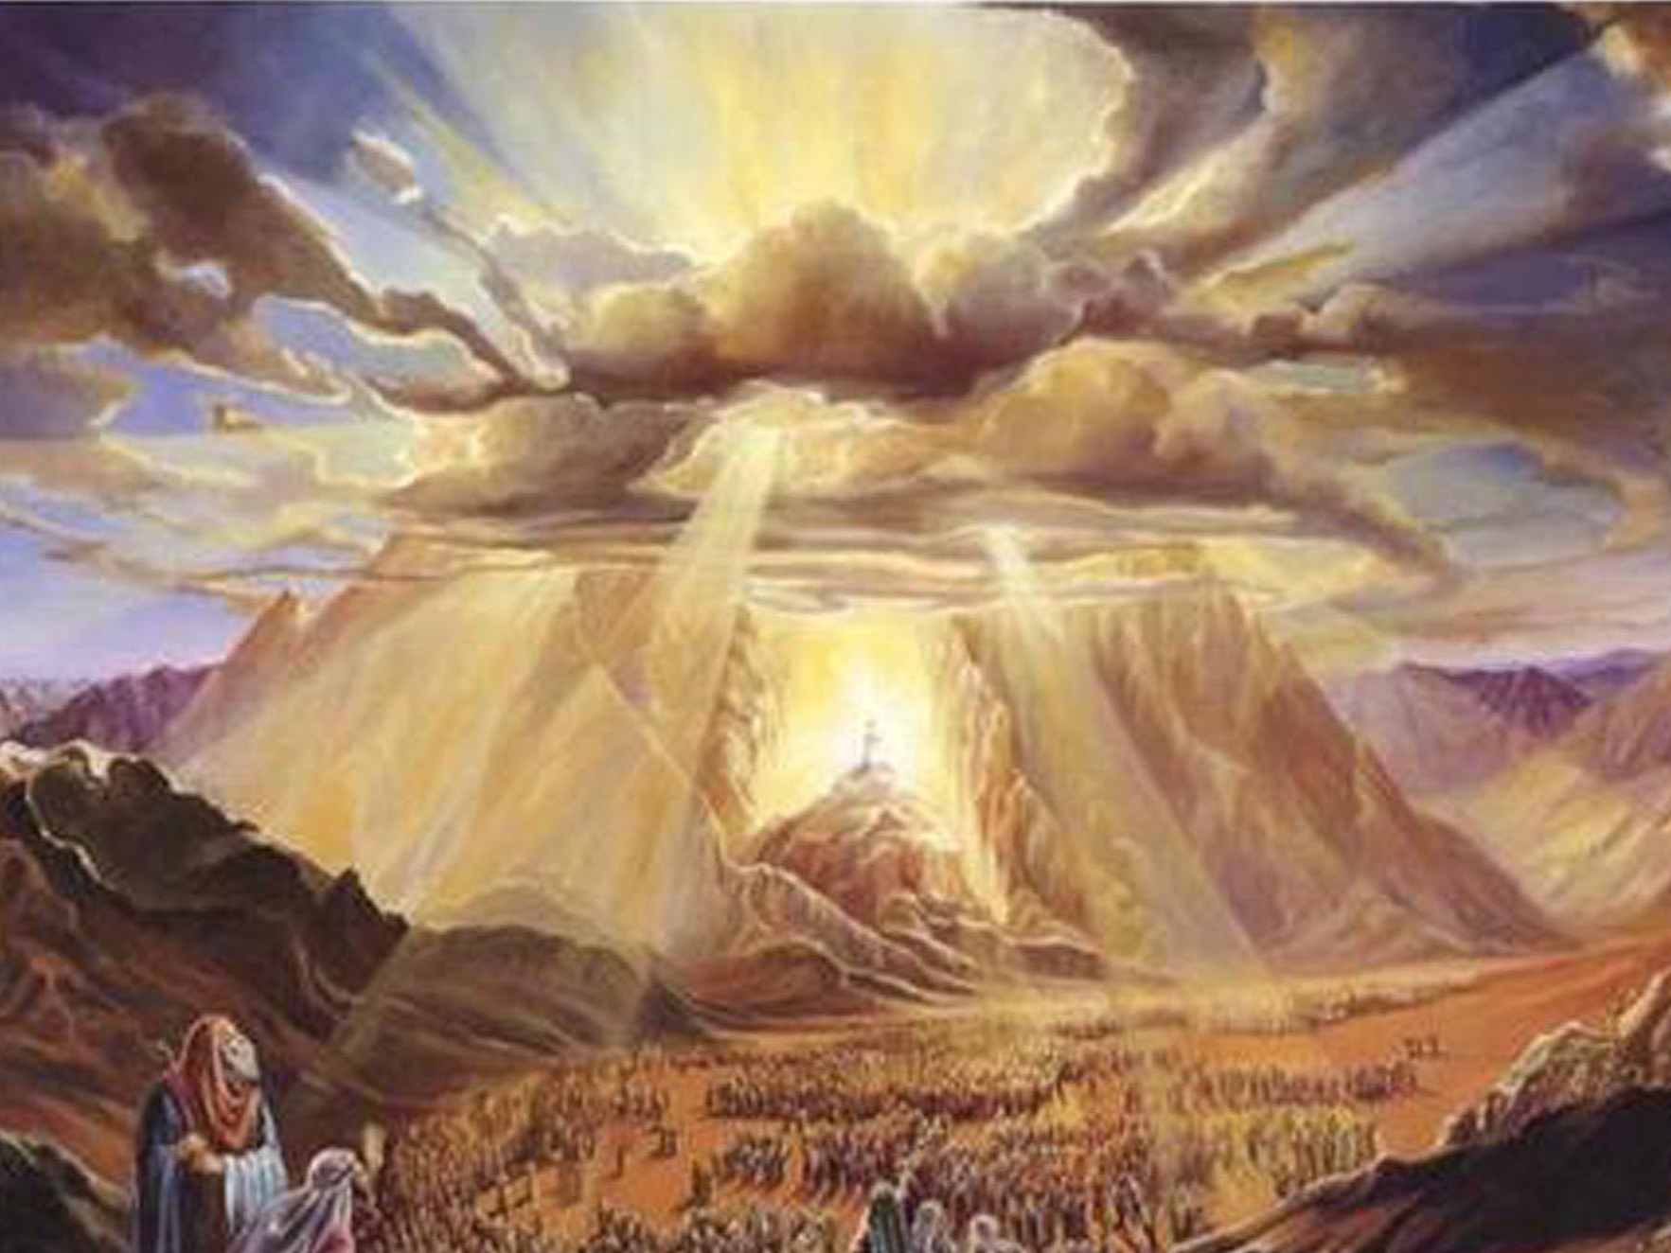
And Moses said to the people, "Do not fear; for God has come to test you, and that His fear may be before you, so that you may not sin." — Exodus 20:20
God
test
God
God
God
God
God
God
. .
God
test
. .

Slide 4
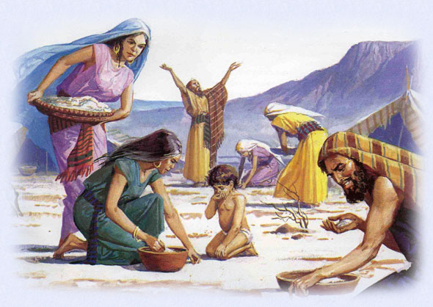
Then the LORD said to Moses, "Behold, I will rain bread from heaven for you. And the people shall go out and gather a certain quota every day, that I may test them, whether they will walk in My law or not. And it shall be on the sixth day that they shall prepare what they bring in, and it shall be twice as much as they gather daily." — Exodus 16:4-5
?
will they walk in My ways or not
y
test
s
that I may test them
will
wa
or
they
walk in My
not

Slide 5
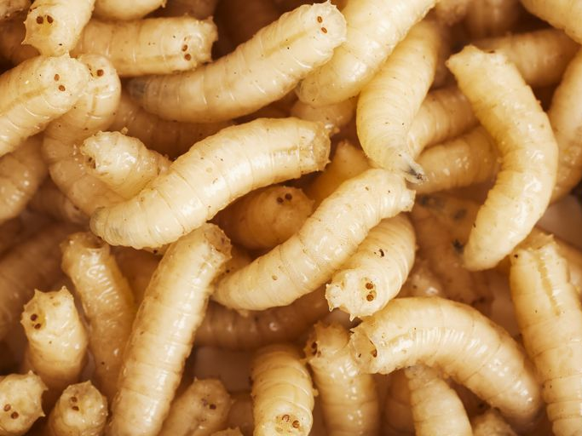
And Moses said, "Let no one leave any of it till morning." Notwithstanding they did not heed Moses. But some of them left part of it until morning, and it bred worms and stank. And Moses was angry with them. — Exodus 16:19-20
they did not heed
mindfulness
care
heed
notice
observe
follow
regard
worms
worms

Slide 6
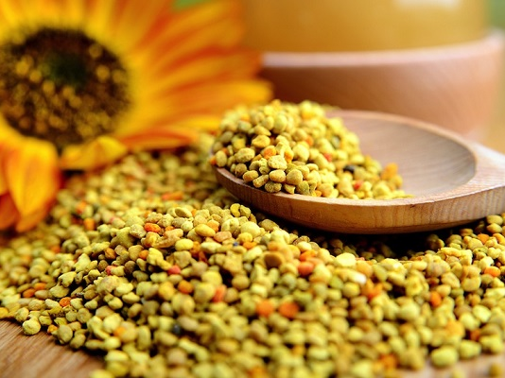
Then he said to them, "This is what the LORD has said: 'Tomorrow is a Sabbath rest, a holy Sabbath to the LORD. Bake what you will bake today, and boil what you will boil; and lay up for yourselves all that remains, to be kept until morning.'" So they laid it up till morning, as Moses commanded; and it did not stink, nor were there any worms in it. — Exodus 16:23-24
LORD
So
So
LORD
obedient
as
as
commanded
commanded
a
worms

Slide 7
"Six days you shall gather it, but on the seventh day, which is the Sabbath, there will be none." Now it happened that some of the people went out on the seventh day to gather, but they found none. And the LORD said to Moses, "How long do you refuse to keep My commandments and My laws?" — Exodus 16:26-28
LORD
LORD
keep
refuse to keep
?

Slide 8
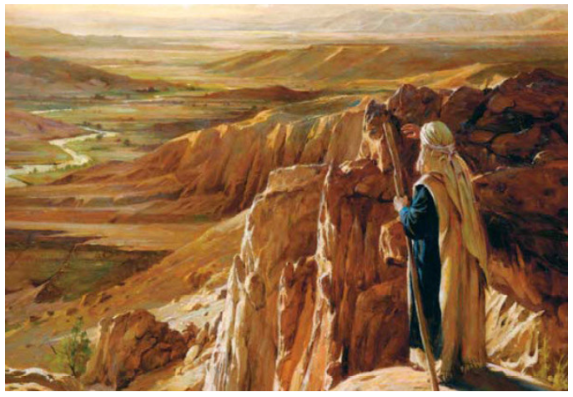
"Every commandment which I command you today you must be careful to observe, that you may live and multiply, and go in and possess the land of which the LORD swore to your fathers. And you shall remember that the LORD your God led you all the way these forty years in the wilderness, to humble you and test you, to know what was in your heart, whether you would keep His commandments or not. " — Deuteronomy 8:1-2
careful to observe
LORD
LORD
commandments
to humble you and test you
your heart
?
keep
commandments
keep

Slide 9
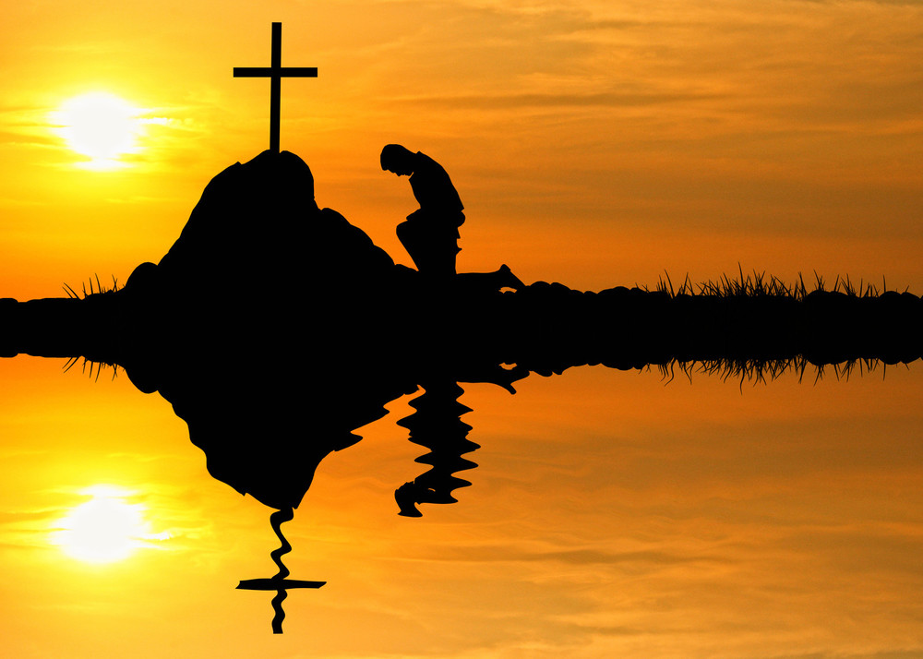
Here is the patience of the saints; here are those who keep the commandments of God and the faith of Jesus. — Revelation 14:12
keep
obey
obey
commandments
faith of Jesus
of
faith of
Jesus
Notes:
Not to fall away and worship the beast.

Slide 10
Do you not know that to whom you present yourselves slaves to obey, you are that one's slaves whom you obey, whether of sin leading to death, or of obedience leading to righteousness? — Romans 6:16
obedience leading to righteousness
obey
sin
able
leading to death
obedience
leading to righteousness
sin leading to death

Slide 11
No temptation has overtaken you except such as is common to man; but God is faithful, who will not allow you to be tempted beyond what you are able, but with the temptation will also make the way of escape, that you may be able to bear it. — 1st Corinthians 10:13
temptation
temptation
able
able
temptation

Slide 12
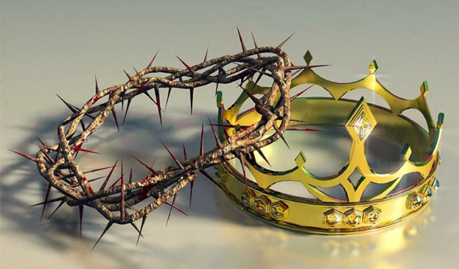
Blessed is the man who endures temptation; for when he has been approved, he will receive the crown of life which the Lord has promised to those who love Him. — James 1:12
endures
temptation
the just
crown of life
of
those who love Him
love
Notes:
Over 17,000 of’s in the Bible

Slide 13
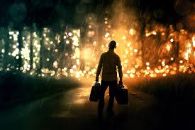
Oh, let the wickedness of the wicked come to an end, But establish the just; For the righteous God tests the hearts and minds. — Psalms 7:9
the just
righteous
God tests the hearts
righteous
Love
Hate

Slide 14
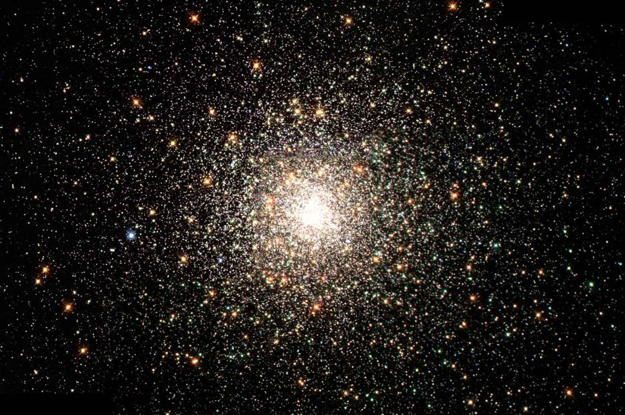
The LORD is in His holy temple, The LORD'S throne is in heaven; His eyes behold, His eyelids test the sons of men. The LORD tests the righteous, But the wicked and the one who loves violence His soul hates. — Psalms 11:4-5
LORD
LORD
LORD
LORD
The LORD tests
righteous
the righteous

Slide 15
Examine me, O LORD, and prove me; Try my mind and my heart. — Psalms 26:2
LORD
heart
heart

Slide 16
But as we have been approved by God to be entrusted with the gospel, even so we speak, not as pleasing men, but God who tests our hearts. — 1st Thessalonians 2:4
?
God
entrusted with the
to be
hearts
gospel
gospel
God
God
God who tests
hearts
heart

Slide 17
Do not harden your hearts as in the rebellion, In the day of trial in the wilderness, … — Hebrews 3:8
embittered
Do not harden
hearts
hearts
In
In
trial

Slide 18
… that you do not become sluggish, but imitate those who through faith and patience inherit the promises. — Hebrews 6:12
d
n
co
hearts
confidence
faith and patience
LOVE
Endurance
f
nce
i
e

Slide 19
Therefore do not cast away your confidence, which has great reward. — Hebrews 10:35
confidence
reward
God
Notes:
Swinging on a star.

Slide 20
And do not be conformed to this world, but be transformed by the renewing of your mind, that you may prove what is that good and acceptable and perfect will of God. — Romans 12:2
mind
heart
God

Slide 21
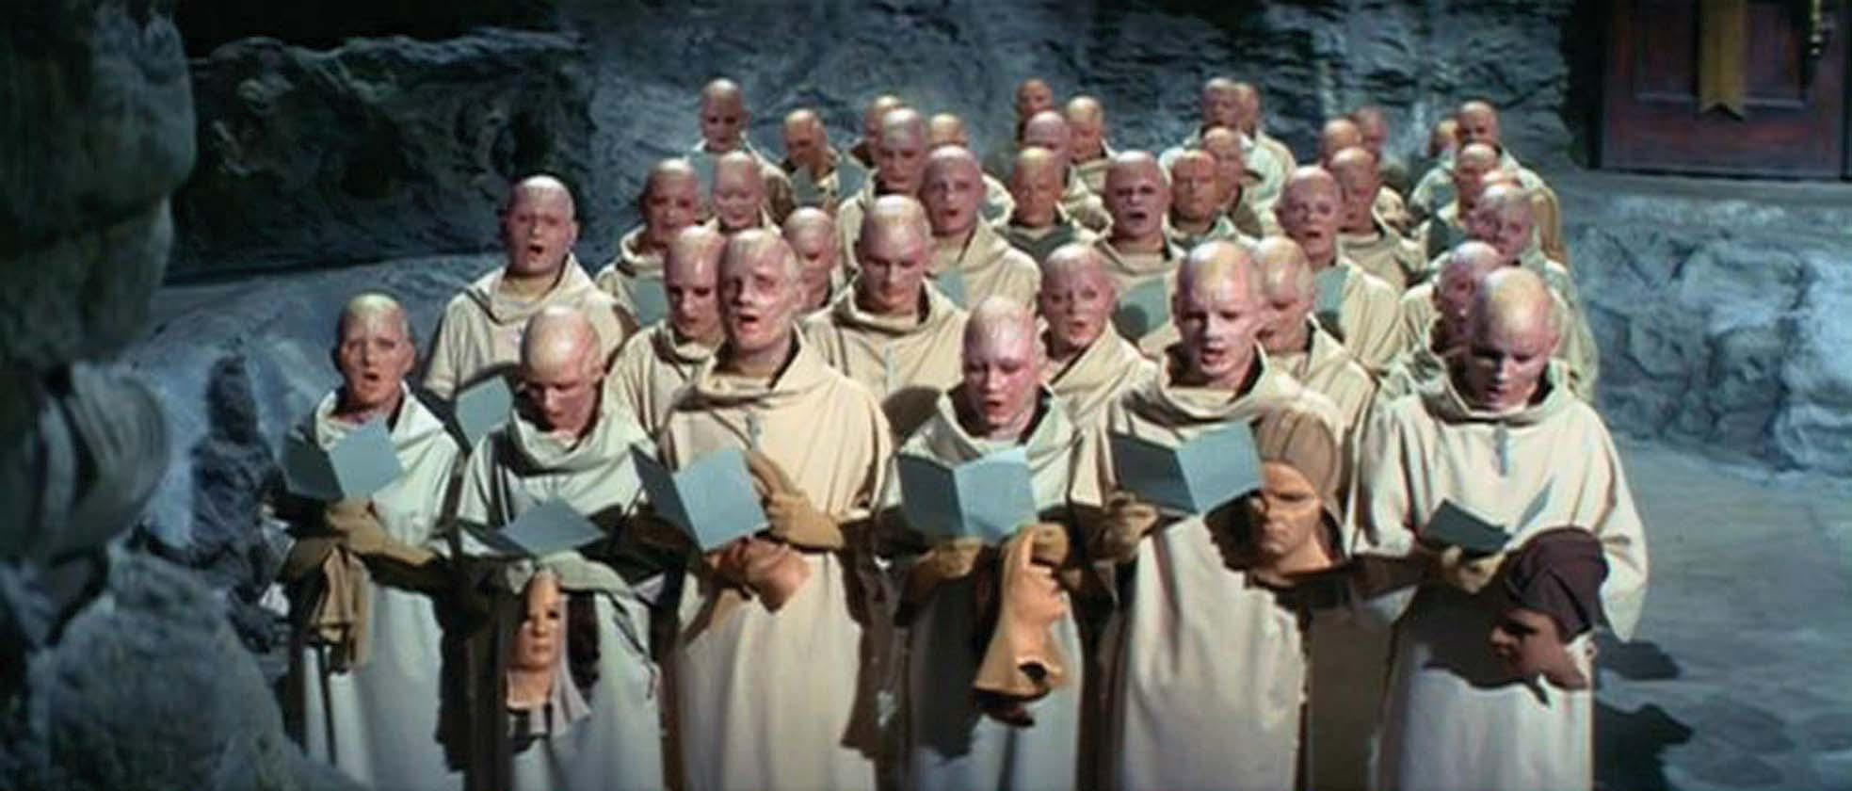
Do not be carried about with various and strange doctrines. For it is good that the heart be established by grace, not with foods which have not profited those who have been occupied with them. — Hebrews 13:9
strange doctrines
heart
established by grace
established
by grace

Slide 22
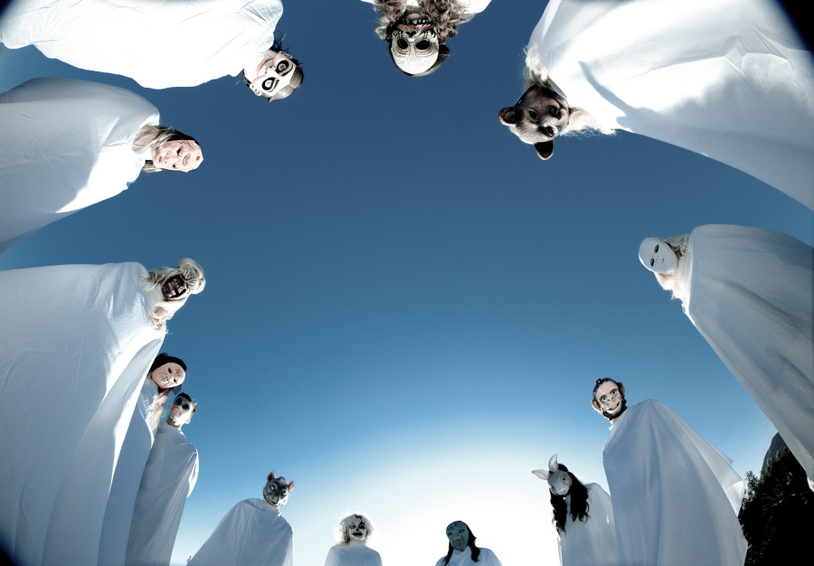
Beware lest anyone cheat you through philosophy and empty deceit, according to the tradition of men, according to the basic principles of the world, and not according to Christ. — Colossians 2:8
sham
cheat you
hoax
dishonesty
sham
deceit
deception
treachery
cheating
trickery
treachery
cheat you not according to Christ:
• philosophy
• empty deceit
• tradition of men
• basic principles of the world
philosophy
empty
cheating
deceit
tradition
hoax
Christ
by grace
of men
deceit
basic
trickery
principles of the world
not
deception
according to Christ
dishonesty

Slide 23
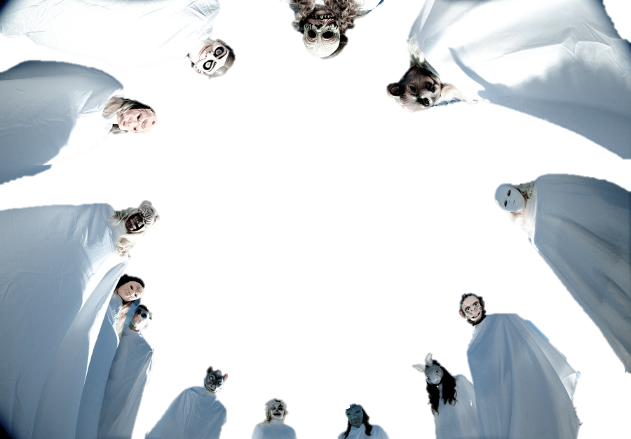
Let no one deceive you with empty words, for because of these things the wrath of God comes upon the sons of disobedience. — Ephesians 5:6
wrath of God
deceived with
empty words
sons of disobedience
deceive
with
deceit
empty words
wrath of God
deceived with
empty words
d
deceived with
empty words
LIE
sons of disobedience

Slide 24
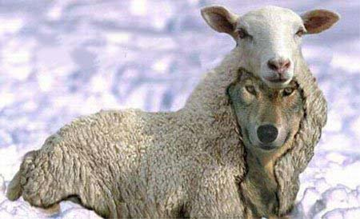
And Jesus answered and said to them: "Take heed that no one deceives you. For many will come in My name, saying, 'I am the Christ,' and will deceive many." — Matthew 24:4-5
Jesus
Take heed
heed
Christ
Jesus Christ

Slide 25
Beloved, do not believe every spirit, but test the spirits, whether they are of God; because many false prophets have gone out into the world. By this you know the Spirit of God: Every spirit that confesses that Jesus Christ has come in the flesh is of God, … — 1st John 4:1-2
Jesus Christ
God
God
God
Jesus Christ
Believes in Him
Believes in Him
in
of
God

Slide 26
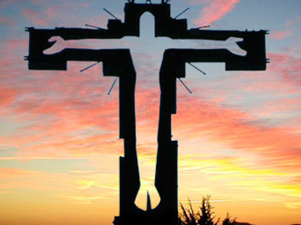
… and every spirit that does not confess that Jesus Christ has come in the flesh is not of God. And this is the spirit of the Antichrist, which you have heard was coming, and is now already in the world. You are of God, little children, and have overcome them, because He who is in you is greater than he who is in the world. — 1st John 4:3-4
confess Jesus Christ come in the flesh
confess
Jesus Christ
come in
Jesus Christ
Jesus Christ
the flesh
of
God
is
of God
God
spirit
overcome for spirit is of God
f
overcome
overcome
in
who is in you
or

Slide 27
Test all things; hold fast what is good. — 1st Thessalonians 5:21
Test
Test

Slide 28
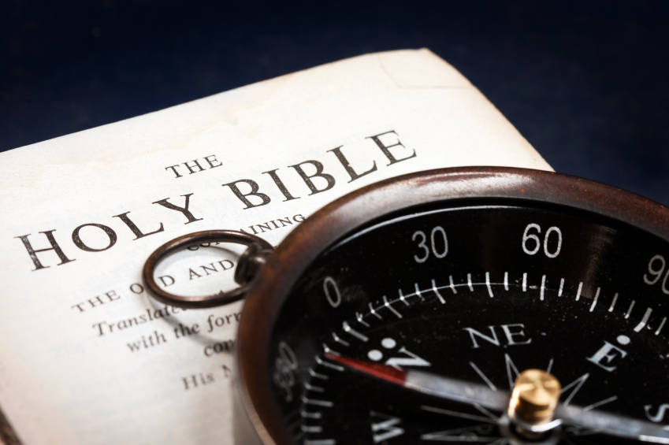
Examine yourselves as to whether you are in the faith. Test yourselves. Do you not know yourselves, that Jesus Christ is in you? -- unless indeed you are disqualified. — 2nd Corinthians 13:5
in
the faith
in the faith
Test
the faith
Jesus Christ
in
Jesus Christ
Jesus Christ is in
you
you
Jesus Christ

Slide 29
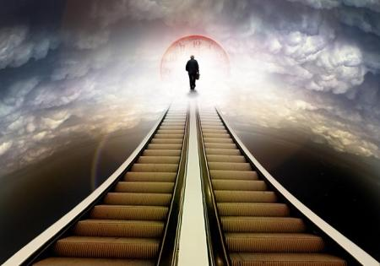
… strengthening the souls of the disciples, exhorting them to continue in the faith, and saying, "We must through many tribulations enter the kingdom of God." — Acts 14:22
students
believers
followers
devotees
in
continue in the faith
the faith
through many tribulations
kingdom of God
kingdom of God

Slide 30
→ Time is to humble and test our hearts
→ One is a slave to whom one obeys
→ Faith in God allows for an escape from sin
→ Endurance in loving Him receives the crown of life
→ The Lord tests the minds & hearts of the righteous
→ We are entrusted with the gospel from God
→ Imitate faithful & patient who inherit the promises
→ Not casting confidence away has great reward
→ Establish one’s heart in grace not strange doctrines
→ Beware of deceit & traditions of men without Christ
→ Test the spirits as whether they are of God
→ Spirits not confessing Christ are not of God
→ Examine yourself whether you are in the faith
No adventure is greater than our journey to heaven
Notes:
No adventure is greater than our journey to heaven

Slide 33
The Test
2
Ron Bert
March 3, 2019

Slide 34
I beseech you therefore, brethren, by the mercies of God, that you present your bodies a living sacrifice, holy, acceptable to God, which is your reasonable service. — Romans 12:1
present your bodies
God
God
reasonable service

Slide 35
Therefore do not let sin reign in your mortal body, that you should obey it in its lusts. And do not present your members as instruments of unrighteousness to sin, but present yourselves to God as being alive from the dead, and your members as instruments of righteousness to God. — Romans 6:12-13
do not:
• let sin reign in your mortal body
obey it in its lusts
• present unrighteousness to sin
to God:
• present yourselves
alive from the dead
• as instruments of righteousness
let sin reign in your
not
do not let sin reign
do not
do not
mortal body
obey it
in its lusts
EVIL
present
not
unrighteousness to sin
present
to God
God
to God
to God as being alive
yourselves
alive
from the dead
GOODNESS
as instruments of righteousness
Notes:
As we gaze into the hole of life there is evil with the goodness. God instructs us of what to do and what not to do.

Slide 36
For I fear lest, when I come, I shall not find you such as I wish, and that I shall be found by you such as you do not wish; lest there be contentions, jealousies, outbursts of wrath, selfish ambitions, backbitings, whisperings, conceits, tumults; — 2nd Corinthians 12:20
found
not
as you do not wish
selfish

Slide 37
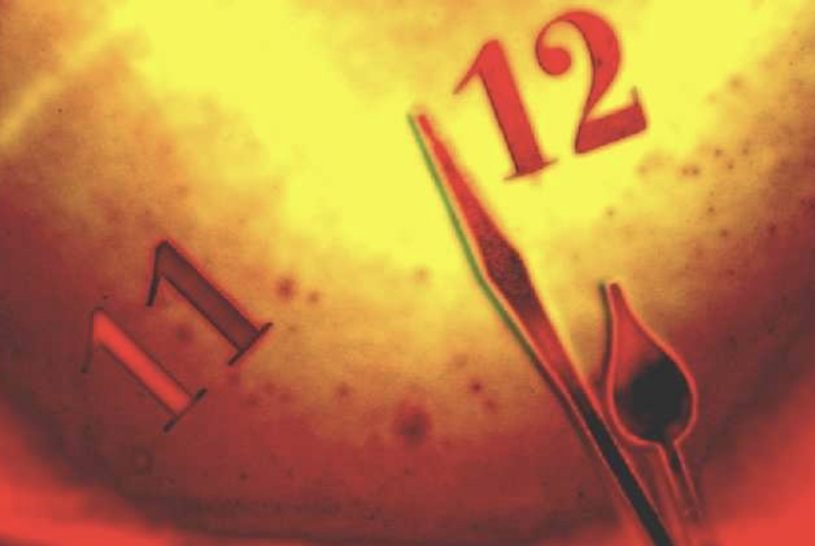
But know this, that in the last days perilous times will come: For men will be lovers of themselves, lovers of money, boasters, proud, blasphemers, disobedient to parents, unthankful, unholy, unloving, unforgiving, slanderers, without self-control, brutal, despisers of good, traitors, headstrong, haughty, lovers of pleasure rather than lovers of God, having a form of godliness but denying its power. And from such people turn away! — 2nd Timothy 3:1-5
• lovers of themselves
• lovers of money
• boasters
• proud
• blasphemers
• disobedient to parents
• unthankful
• unholy - unforgiving
• unloving
• slanderers
• without self-control
• brutal
• despisers of good
• traitors
• headstrong
• haughty
• lovers of pleasure rather than lovers of God
lovers of themselves
lovers of money
from such people turn away!
boasters
proud
blasphemers
disobedient
to parents
unthankful
unholy
unloving
unforgiving
slanderers
without self-
control
brutal
despisers of good
traitors
selfish
headstrong
haughty
lovers of pleasure
rather than lovers of God
from
from
such
people
turn
away!
such people turn away!

Slide 38
And as it is appointed for men to die once, but after this the judgment, — Hebrews 9:27
judgment
judgment

Slide 39
For if we would judge ourselves, we would not be judged. — 1st Corinthians 11:31
judge ourselves
judgment

Slide 40
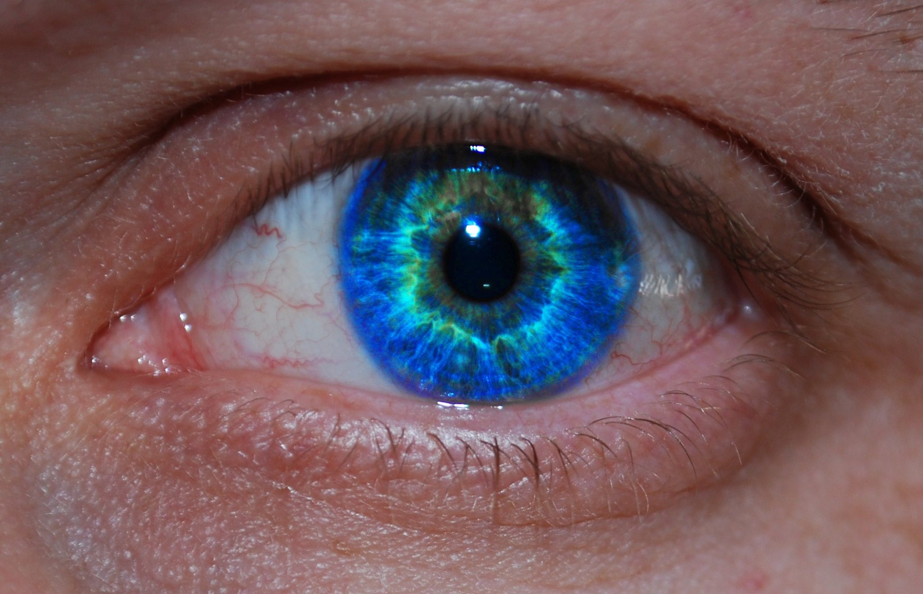
All the ways of a man are pure in his own eyes, But the LORD weighs the spirits. Commit your works to the LORD, And your thoughts will be established. — Proverbs 16:2-3
LORD
weighs the spirits
work
work
LORD

Slide 41
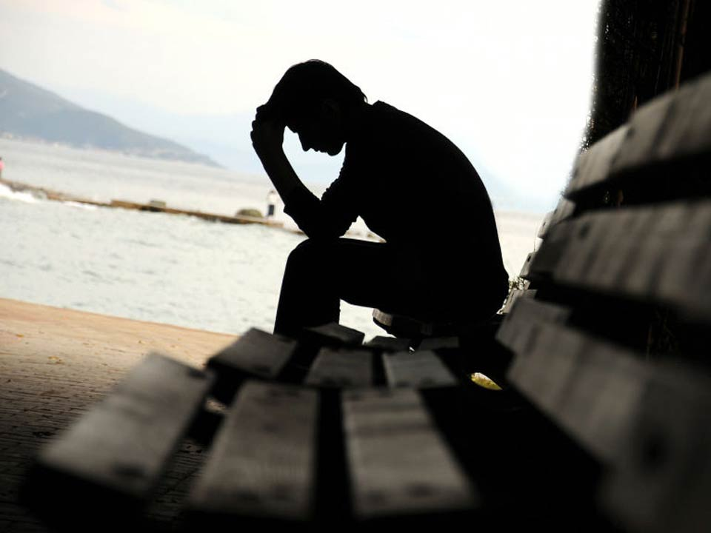
For God will bring every work into judgment, Including every secret thing, Whether good or evil. — Ecclesiastes 12:14
every work into judgment
work
into
work
Notes:
Each of us sits on a bench of eternity.

Slide 42
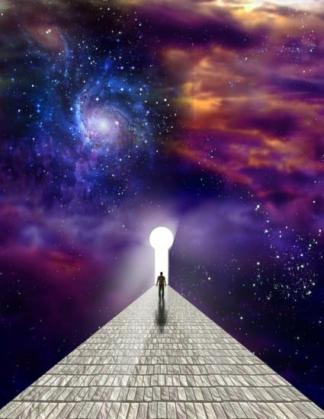
"And behold, l am coming quickly, and My reward is with Me, to give to every one according to his work." — Revelation 22:12
n
o
l
k
d
e
e
My reward
to give
knowledge
g
according to
w
work
grind
identity
desire
thought
purpose
effort
doings
drudgery

Slide 43
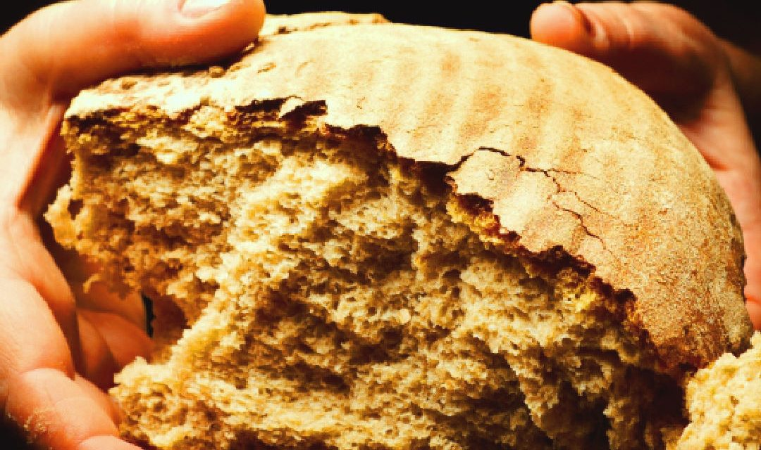
Then Jesus lifted up His eyes, and seeing a great multitude coming toward Him, He said to Philip, "Where shall we buy bread, that these may eat?" But this He said to test him, for He Himself knew what He would do. Philip answered Him, "Two hundred denarii worth of bread is not sufficient for them, that every one of them may have a little." — John 6:5-7
Then Jesus lifted up His eyes, and seeing a great multitude coming toward Him, He said to Philip, "Where shall we buy bread, that these may eat?" But this He said to test him, for He Himself knew what He would do. Philip answered Him, "Two hundred denarii worth of bread is not sufficient for them, that every one of them may have a little." — John 6:5-7
bread
5,000
faith
salvation
trust
But this He said to test him
LIFE
death
knowledge
h
d
earth
t
e
a

Slide 44
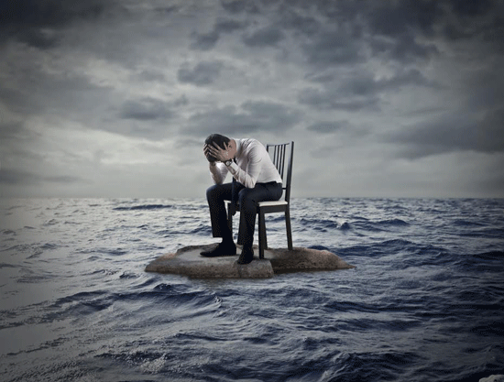
"Do not fear any of those things which you are about to suffer. Indeed, the devil is about to throw some of you into prison, that you may be tested, and you will have tribulation ten days. Be faithful until death, and I will give you the crown of life. He who has an ear, let him hear what the Spirit says to the churches. He who overcomes shall not be hurt by the second death." — Revelation 2:10-11
Do not fear
Do not fear that you may be tested
you will have tribulation
that you may be tested
you will have tribulation
He who overcomes shall not be hurt by the second death
death
I will give
Be faithful until death
death
you the crown of life
death
He who overcomes
Be faithful until death
I will give you the crown of life
shall not be hurt by
the second death

Slide 45
For the wages of sin is death, but the gift of God is eternal life in Christ Jesus our Lord. — Romans 6:23
For the wages of sin is death, but the gift of God is eternal life in Christ Jesus our Lord. — Romans 6:23
death
HOPE

Slide 46
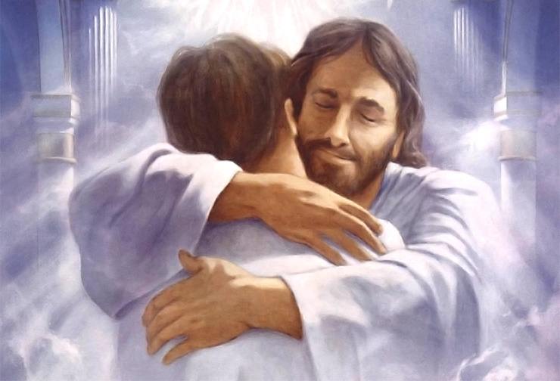
"If you love Me, keep My commandments." — John 14:15
love
love

Slide 47
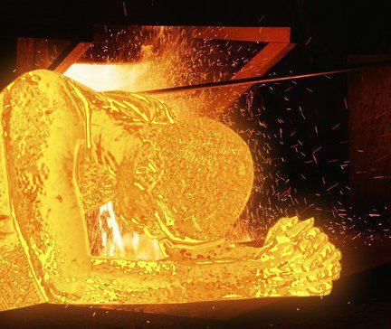
In this you greatly rejoice, though now for a little while, if need be, you have been grieved by various trials, that the genuineness of your faith, being much more precious than gold that perishes, though it is tested by fire, may be found to praise, honor, and glory at the revelation of Jesus Christ, … — 1st Peter 1:6-7
trial
trials precious
↘ ↙
genuineness of faith ← tested
↓
found to:
• praise
• honor
• glory at the revelation
of Jesus Christ
grieved by various
trials
genuineness of
trials
trial
faith
precious
love
tested
found to
praise
honor
glory at the
word
revelation
revelation
of Jesus Christ

Slide 48
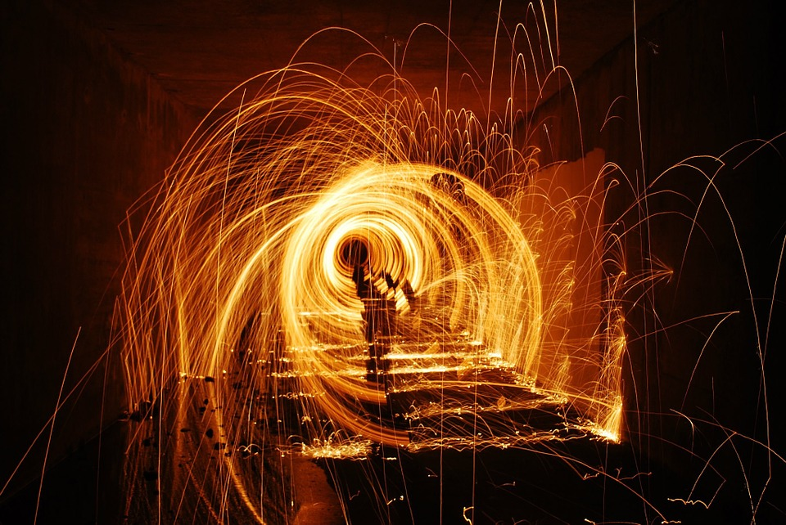
Beloved, do not think it strange concerning the fiery trial which is to try you, as though some strange thing happened to you; — 1st Peter 4:12
do not think it strange
trial
trial
fiery trial
strange thing happened to you
Notes:
Life can be a tunnel filled with suffering fires.

Slide 49
My brethren, count it all joy when you fall into various trials, knowing that the testing of your faith produces patience. — James 1:2-3
trial
test
tested
testing of your faith
d
e
produces patience

Slide 50
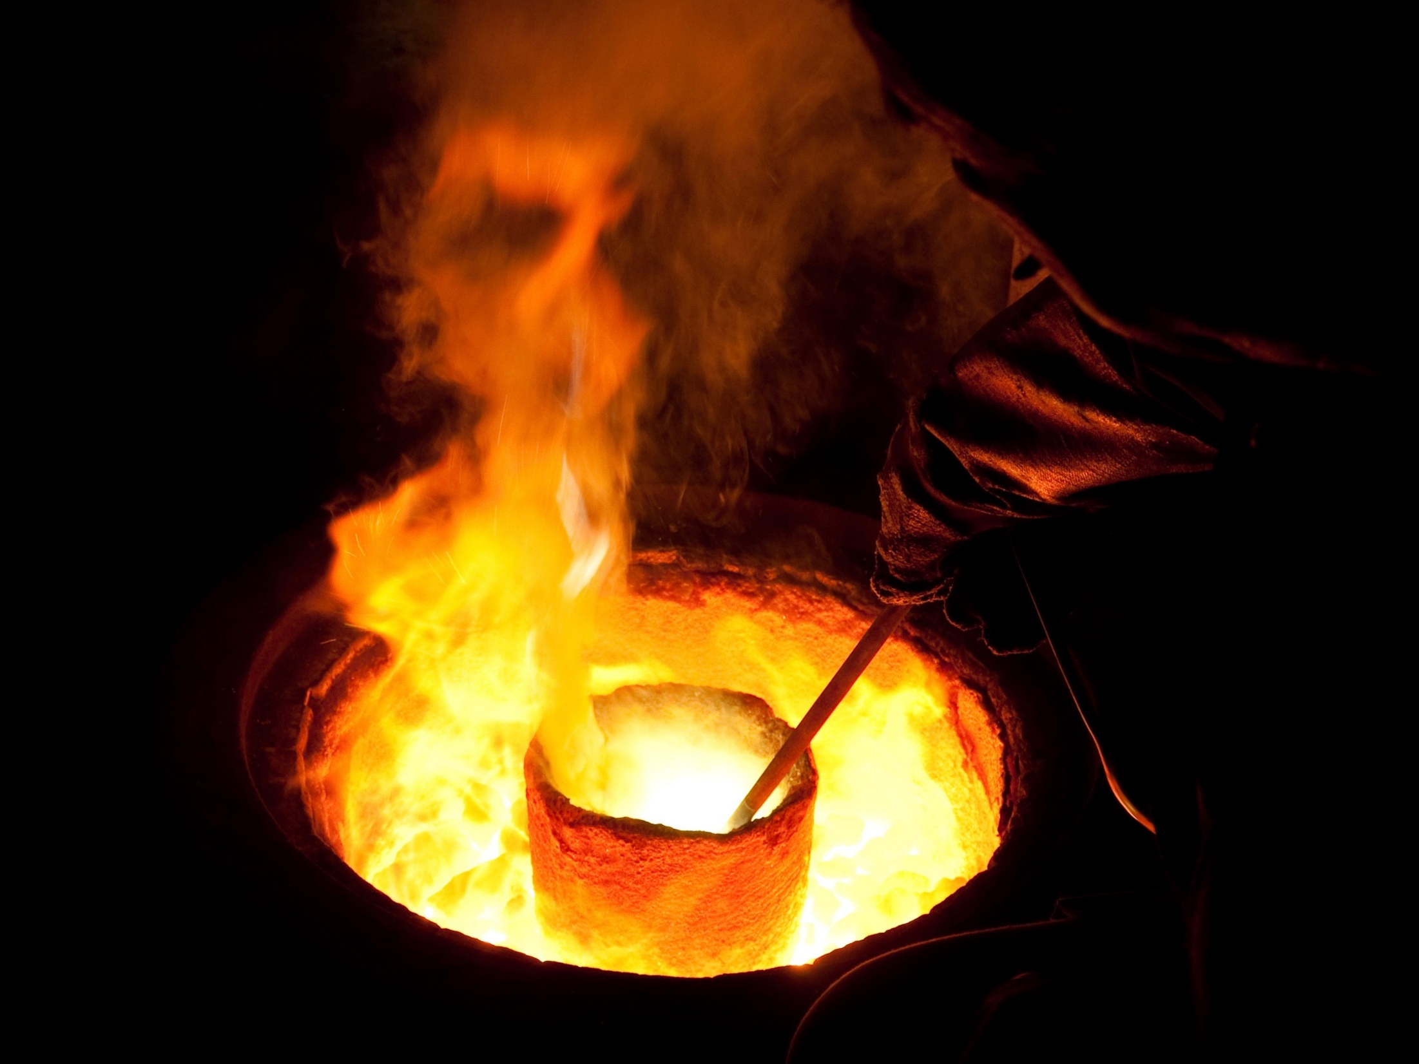
Behold, I have refined you, but not as silver; I have tested you in the furnace of affliction. — Isaiah 48:10
test
tested
furnace of affliction
test

Slide 51
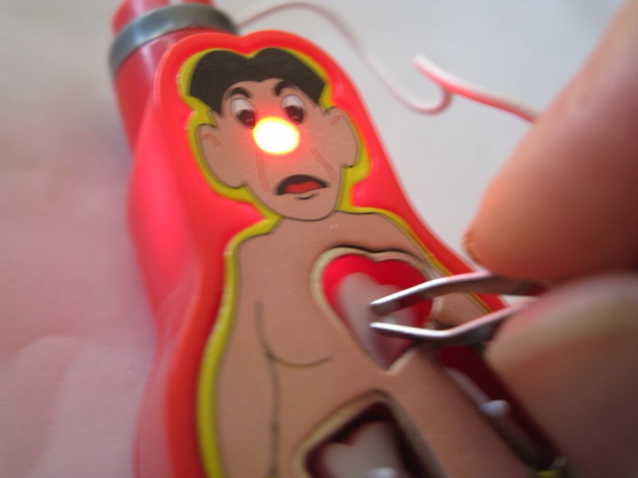
The refining pot is for silver and the furnace for gold, But the LORD tests the hearts. — Proverbs 17:3
test
test
the LORD tests the hearts

Slide 52
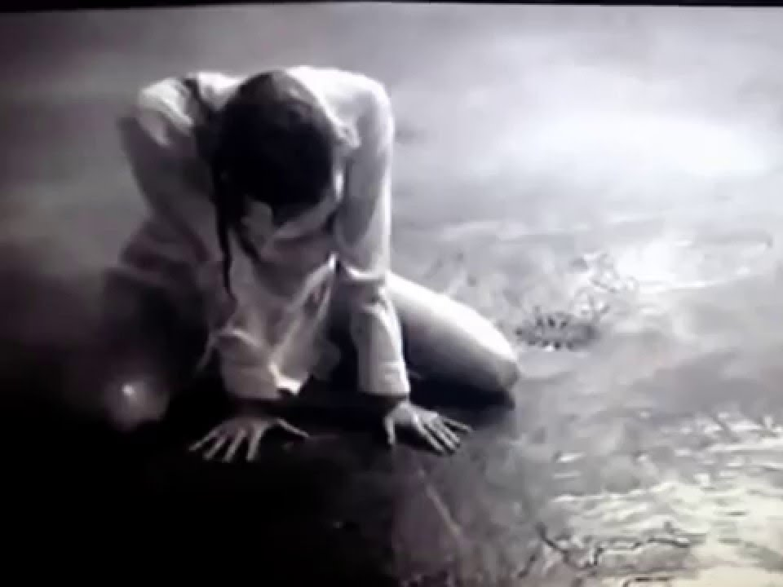
"The heart is deceitful above all things, And desperately wicked; Who can know it? I, the LORD, search the heart, I test the mind, Even to give every man according to his ways, According to the fruit of his doings." — Jeremiah 17:9-10
ar
s
k
darkness
es
test
I test
d
n

Slide 53
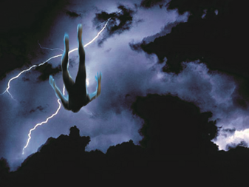
For if God did not spare the angels who sinned, but cast them down to hell and delivered them into chains of darkness, to be reserved for judgment; and did not spare the ancient world, but saved Noah, one of eight people, a preacher of righteousness, bringing in the flood on the world of the ungodly; — 2nd Peter 2:4-5
darkness
saved
righteous
righteous
righteous

Slide 54
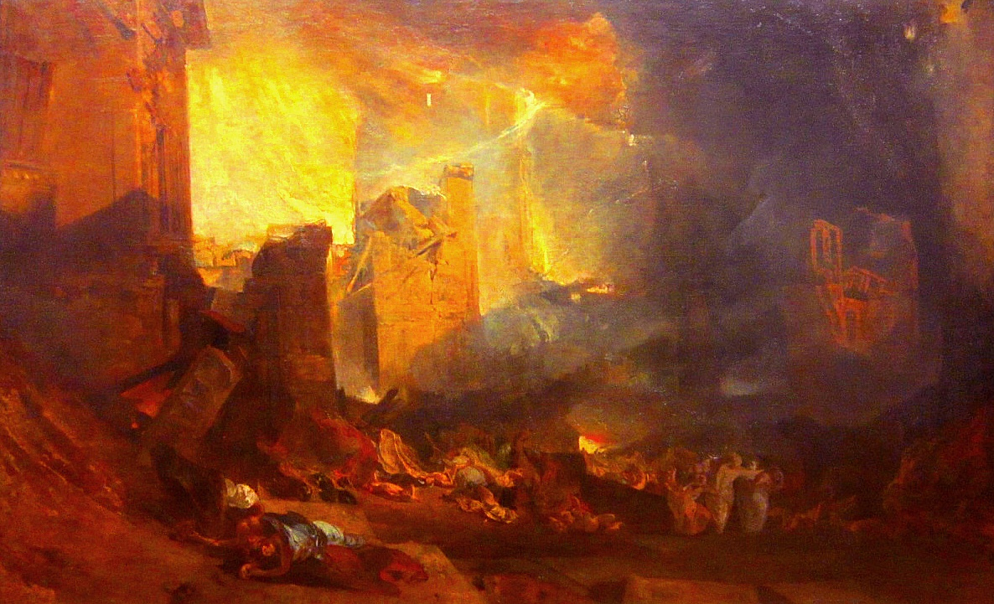
… and turning the cities of Sodom and Gomorrah into ashes, condemned them to destruction, making them an example to those who afterward would live ungodly; and delivered righteous Lot, who was oppressed by the filthy conduct of the wicked — 2nd Peter 2:6-7
righteous
an example
delivered righteous
righteous
Notes:
It takes will power to get through the canyons of evil.

Slide 55
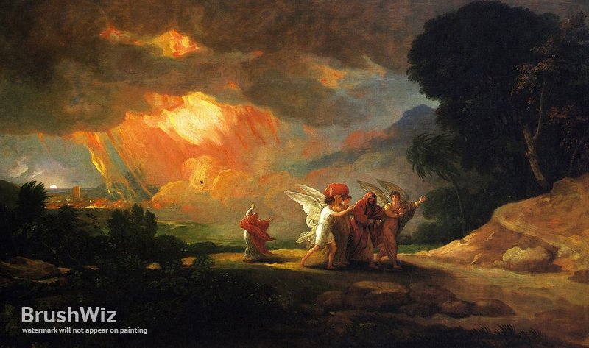
(for that righteous man, dwelling among them, tormented his righteous soul from day to day by seeing and hearing their lawless deeds) – … then the Lord knows how to deliver the godly out of temptations and to reserve the unjust under punishment for the day of judgment, … — 2nd Peter 2:8-9
reserve the unjust under punishment for the day of judgment
righteous
↙
the Lord knows
to deliver the godly
out of
how
↗
temptations
reserve the
the Lord knows how to deliver the godly out of temptations
unjust
under punishment for
the
day of judgment

Slide 56
… and especially those who walk according to the flesh in the lust of uncleanness and despise authority. They are presumptuous, self-willed. They are not afraid to speak evil of dignitaries, whereas angels, who are greater in power and might, do not bring a reviling accusation against them before the Lord. — 2nd Peter 2:10-11
walk
audacious
arrogant
rude
selfish
presuming
disrespectful
walk
Notes:
Privileged people are often the most unblessed having hardened rather than meek hearts. Plagued with depression or unfilled passions leave them on the edge of emptiness. If one walks with a selfish heart it may very well be darkness blinds one’s vision to see this coldness.

Slide 57
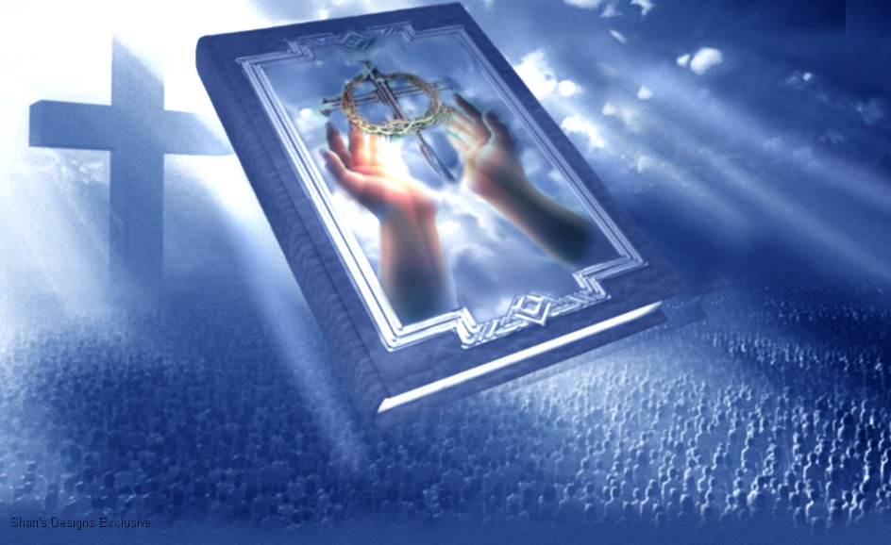
Look to yourselves, that we do not lose those things we worked for, but that we may receive a full reward. — 2nd John 1:8
do not
the way
lose
th
walk
w
e
ay
receive
reward

Slide 58
But He knows the way that I take; When He has tested me, I shall come forth as gold. — Job 23:10
knows the way
the way
has tested me
test
as gold
gold
test

Slide 59
"Because you have kept My command to persevere, I also will keep you from the hour of trial which shall come upon the whole world, to test those who dwell on the earth." — Revelation 3:10
persevere
keep you from the hour of trial
to test
test
on the earth

Slide 60
→ Offering holiness to God is your reasonable service
→ Do not obey lusts of the flesh
→ Habitual sinners will be found not as they wish
→ Turn away from self-centered mean spirits
→ Judge yourself if you don’t want to be judged
→ God will judge every work both good and evil
→ Be faithful until death and receive the crown of life
→ If you love God you will keep His commandments
→ Various trials test the genuineness of your faith
→ Testing of your faith produces patience
→ God searches the heart testing the mind’s ways
→ God can deliver the godly out of temptations
→ Keeping His commands saves in the hour of trial
Beauty is found in the simplicity of a loving soul
Notes:
Beauty is found in the simplicity of a loving soul

Slide 62
Please visit http://www.LoveFromGod.com to explore further
Ronald Bert Channel on
Notes:
Eternity never ends.

