Slide 1
Notes:
Darkness defeats one’s ability to see.

Slide 2
The Door
June 5, 2011
Ron Bert
Notes:
Each moment is a door to the future.

Slide 3
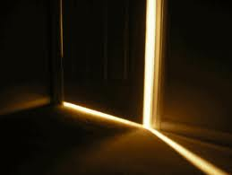
"Behold, I stand at the door and knock. If anyone hears My voice and opens the door, I will come in to him and dine with him, and he with Me." ~ Revelation 3:20
Notes:
A door defines exactly what it is, an opening or closing offered, to a passing in time. Excellence of worth does not have minimal in its’ vocabulary. The call is to come with your all.

Slide 4
Then Jesus spoke to them again, saying, "I am the light of the world. He who follows Me shall not walk in darkness, but have the light of life." ~ John 8:12
Truth
Jesus
Mercy
Forgiveness
Jesus
Gentleness
light of life
light of life
light of life
light of life
light of life
light of life
Freedom
light of life
Love
Notes:
Love is a word short of expressing its’ totality.

Slide 5
But God, who is rich in mercy, because of His great love with which He loved us, even when we were dead in trespasses, made us alive together with Christ (by grace you have been saved), and raised us up together, and made us sit together in the heavenly places in Christ Jesus, that in the ages to come He might show the exceeding riches of His grace in His kindness toward us in Christ Jesus. For by grace you have been saved through faith, and that not of yourselves; it is the gift of God, not of works, lest anyone should boast. For we are His workmanship, created in Christ Jesus for good works, which God prepared beforehand that we should walk in them. ~ Ephesians 2:4-10
rich in mercy
His
great love
He loved us
Jesus
His grace
His kindness
gift of God
For we are His workmanship, created in Christ Jesus for good works, which God prepared beforehand that we should walk in them. ~ Ephesians 2:4-10
in
in
created in
His workmanship
Christ Jesus
for good works
prepared beforehand
Notes:
What is tomorrow if one does not have today.

Slide 6
Moreover, brethren, I declare to you the gospel which I preached to you, which you received and in which you stand, by which also you are saved, if you hold fast that word which I preached to you - unless you believed in vain. For I delivered to you first of all that which I also received: that Christ died for our sins according to the Scriptures, ... ~ 1st ~ Corinthians 15:1-3
Moreover, brethren, I declare to you the gospel which I preached to you, which you received and in which you stand, by which also you are saved, if you hold fast that word which I preached to you - unless you believed in vain. For I delivered to you first of all that which I also received: that Christ died for our sins according to the Scriptures, ... ~ 1st ~ Corinthians 15:1-3
gospel
received
you stand
saved
hold fast
Christ died
Christ died
for our
sins

Slide 7
But God demonstrates His own love toward us, in that while we were still sinners, Christ died for us. ~ Romans 5:8
But God demonstrates His own love toward us, in that while we were still sinners, Christ died for us. ~ Romans 5:8
But God demonstrates His own love toward us, in that while we were still sinners, Christ died for us. ~ Romans 5:8
sinners
sinners

Slide 8
"Therefore whoever confesses Me before men, him I will also confess before My Father who is in heaven. But whoever denies Me before men, him I will also deny before My Father who is in heaven." ~ Matthew 10:32-33
confesses Me
confesses Me
confesses Me
or
sinners
denies Me

Slide 9
... that if you confess with your mouth the Lord Jesus and believe in your heart that God has raised Him from the dead, you will be saved. ~ Romans 10:9
... that if you confess with your mouth the Lord Jesus and believe in your heart that God has raised Him from the dead, you will be saved. ~ Romans 10:9
mouth
heart
raised
saved
from the
dead
saved

Slide 10
Therefore, having been justified by faith, we have peace with God through our Lord Jesus Christ, through whom also we have access by faith into this grace in which we stand, and rejoice in hope of the glory of God. ~ Romans 5:1-2
Therefore, having been justified by faith, we have peace with God through our Lord Jesus Christ, through whom also we have access by faith into this grace in which we stand, and rejoice in hope of the glory of God. ~ Romans 5:1-2
justified by faith
through Christ
we have access
Into this grace
justified by faith
through
Christ
we have access
into this grace
saved
we stand
in the
glory of God
we stand
the
glory of God
in
in

Slide 11
"He who rejects Me, and does not receive My words, has that which judges him - the word that I have spoken will judge him in the last day." ~ John 12:48
the
word
spoken
will
judge
in the last day
in
in

Slide 12
And Jesus came and spoke to them, saying, "All authority has been given to Me in heaven and on the earth. Go therefore and make disciples of all the nations, baptizing them in the name of the Father and of the Son and of the Holy Spirit, teaching them to observe all things that I have commanded you; and lo, I am with you always, even to the end of the age." Amen. ~ Matthew 28:18-20
And Jesus came and spoke to them, saying, "All authority has been given to Me in heaven and on the earth. Go therefore and make disciples of all the nations, baptizing them in the name of the Father and of the Son and of the Holy Spirit, teaching them to observe all things that I have commanded you; and lo, I am with you always, even to the end of the age." Amen. ~ Matthew 28:18-20
"Therefore I said to you that you will die in your sins; for if you do not believe that I am He, you will die in your sins." ~ John 8:24
"Therefore I said to you that you will die in your sins; for if you do not believe that I am He, you will die in your sins." ~ John 8:24
observe all
things
believe
commanded you

Slide 13
"And I also say to you that you are Peter, and on this rock I will build My church, and the gates of Hades shall not prevail against it. And I will give you the keys of the kingdom of heaven, and whatever you bind on earth will be bound in heaven, and whatever you loose on earth will be loosed in heaven." Then He commanded His disciples that they should tell no one that He was Jesus the Christ. ~ Matthew 16:18-20
I will build My church
confession

Slide 14
Then Peter said to them, "Repent, and let every one of you be baptized in the name of Jesus Christ for the remission of sins; and you shall receive the gift of the Holy Spirit." ~ Acts 2:38
Repent
be baptized
remission of sins
receive the gift

Slide 15
continued
And they continued steadfastly in the apostles' doctrine and fellowship, in the breaking of bread, and in prayers. ~ Acts 2:42
in
steadfastly
doctrine and fellowship
in
doctrine
in

Slide 16
But also for this very reason, giving all diligence, add to your faith virtue, to virtue knowledge, to knowledge self-control, to self-control perseverance, to perseverance godliness, to godliness brotherly kindness, and to brotherly kindness love. For if these things are yours and abound, you will be neither barren nor unfruitful in the knowledge of our Lord Jesus Christ. ~ 2nd Peter 1:5-8
But also for this very reason, giving all diligence, add to your faith virtue, to virtue knowledge, to knowledge self-control, to self-control perseverance, to perseverance godliness, to godliness brotherly kindness, and to brotherly kindness love. For if these things are yours and abound, you will be neither barren nor unfruitful in the knowledge of our Lord Jesus Christ. ~ 2nd Peter 1:5-8
virtue
knowledge
self-control
perseverance
love
godliness
brotherly kindness
love
Notes:
Life is a continuous act of improvement; otherwise oblivious to the reason why.

Slide 17
Greet one another with a holy kiss. The churches of Christ greet you. ~ Romans 16:16
Greet one another with a holy kiss. The churches of Christ greet you. ~ Romans 16:16
Greet one another with a holy kiss. The churches of Christ greet you. ~ Romans 16:16
love
greet
greet

Slide 18
Therefore "If your enemy is hungry, feed him; If he is thirsty, give him a drink; For in so doing you will heap coals of fire on his head." Do not be overcome by evil, but overcome evil with good. ~ Romans 12:20-21
evil
good
overcome evil with good
overcome evil with good
Notes:
Trust is synonymous with faith as is it with love; extended to those that violate.

Slide 19
... that by two immutable things, in which it is impossible for God to lie, we might have strong consolation, who have fled for refuge to lay hold of the hope set before us. This hope we have as an anchor of the soul, both sure and steadfast, and which enters the Presence behind the veil, where the forerunner has entered for us, even Jesus, having become High Priest forever according to the order of Melchizedek. ~ Hebrews 6:18-20
... that by two immutable things, in which it is impossible for God to lie, we might have strong consolation, who have fled for refuge to lay hold of the hope set before us. This hope we have as an anchor of the soul, both sure and steadfast, and which enters the Presence behind the veil, where the forerunner has entered for us, even Jesus, having become High Priest forever according to the order of Melchizedek. ~ Hebrews 6:18-20
... that by two immutable things, in which it is impossible for God to lie, we might have strong consolation, who have fled for refuge to lay hold of the hope set before us. This hope we have as an anchor of the soul, both sure and steadfast, and which enters the Presence behind the veil, where the forerunner has entered for us, even Jesus, having become High Priest forever according to the order of Melchizedek. ~ Hebrews 6:18-20
anchor of
the
soul
the Presence
behind the veil
enters

Slide 20
And Jesus cried out again with a loud voice, and yielded up His spirit. Then, behold, the veil of the temple was torn in two from top to bottom; and the earth quaked, and the rocks were split, and the graves were opened; and many bodies of the saints who had fallen asleep were raised; and coming out of the graves after His resurrection, they went into the holy city and appeared to many. ~ Matthew 27:50-53
Jesus
Jesus
veil
torn
veil
torn
to
to
opened
opened
all
all

Slide 21
And this is the promise that He has promised us - eternal life. ~ 1st John 2:25
eternal life

Slide 22
So Jesus answered and said, "Assuredly, I say to you, there is no one who has left house or brothers or sisters or fathers or mother or wife or children or lands for My sake and the gospel's, who shall not receive a hundredfold now in this time - houses and brothers and sisters and mothers and children and lands, with persecutions - and in the age to come, eternal life." ~ Mark 10:29-30
So Jesus answered and said, "Assuredly, I say to you, there is no one who has left house or brothers or sisters or fathers or mother or wife or children or lands for My sake and the gospel's, who shall not receive a hundredfold now in this time - houses and brothers and sisters and mothers and children and lands, with persecutions - and in the age to come, eternal life." ~ Mark 10:29-30
eternal life

Slide 23
"I am the door. If anyone enters by Me, he will be saved, and will go in and out and find pasture." ~ John 10:9

Slide 24
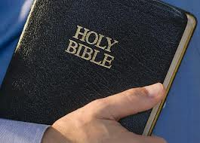
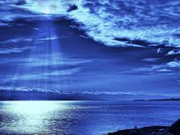
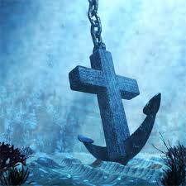
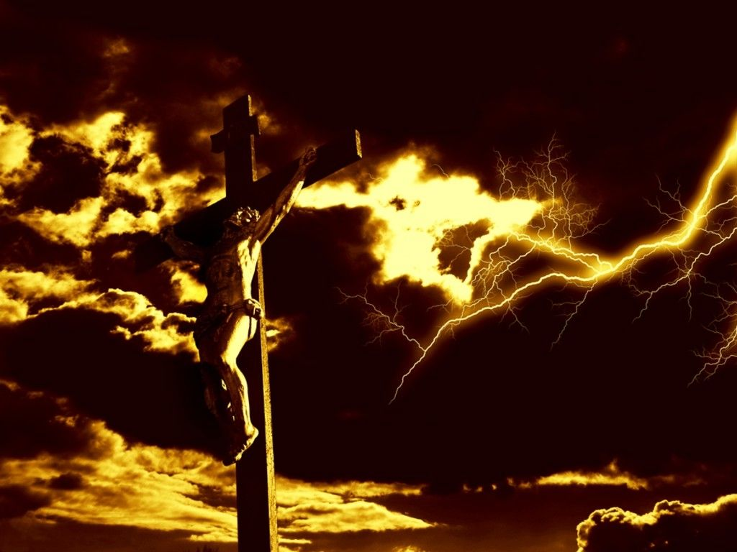
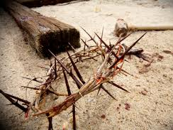
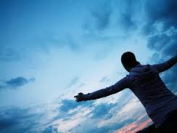
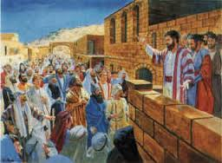
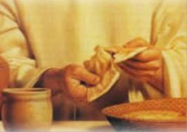
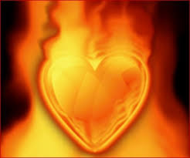
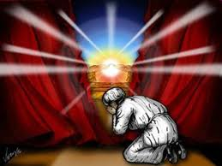
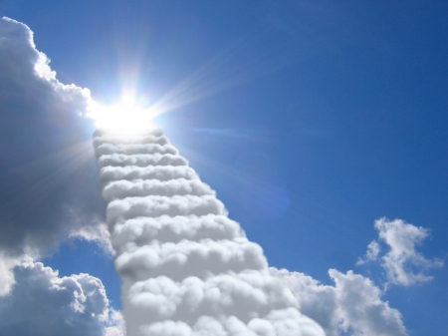
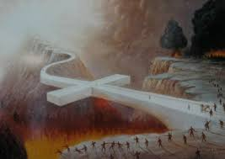
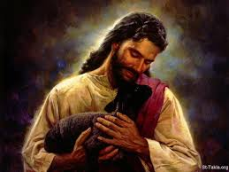
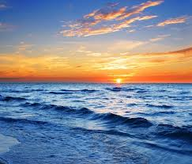
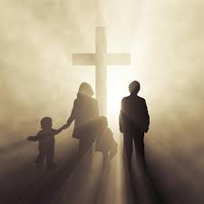
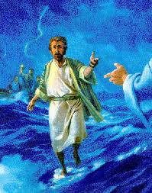
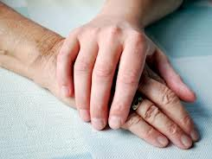
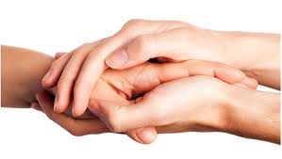
"And while they went to buy, the bridegroom came, and those who were ready went in with him to the wedding; and the door was shut." ~ Matthew 25:10
the door was shut

Slide 26
→ God waits to hear from each heart given
→ True believers follow God’s light of life
→ God made Himself clearly known through Christ
→ God stands by His love with His sacrificial call
→ Faith is a call to a heart of action
→ Snubbing words of truth renders a harsh judgment
→ True belief in God is the hinge of life or death
→ God has established His doctrine through His will
→ Overcome those doing you wrong with a good heart
→ Our anchor is God’s own truth in Christ
→ Eternal life is the standard set by God
→ The truth’s given by God are the pathway to peace
→ Neglecting God will close the door to eternal life
All journey upon the waves to meet God
Notes:
All journey upon the waves to meet God

Slide 28
2
The Door
June 5, 2011
Ron Bert

Slide 29
"Ask, and it will be given to you; seek, and you will find; knock, and it will be opened to you. For everyone who asks receives, and he who seeks finds, and to him who knocks it will be opened." — Matthew 7:7-8
Ask
Ask

Slide 30
Now a certain woman named Lydia heard us. She was a seller of purple from the city of Thyatira, who worshiped God. The Lord opened her heart to heed the things spoken by Paul. ~ Acts 16:14
Now a certain woman named Lydia heard us. She was a seller of purple from the city of Thyatira, who worshiped God. The Lord opened her heart to heed the things spoken by Paul. ~ Acts 16:14
Now a certain woman named Lydia heard us. She was a seller of purple from the city of Thyatira, who worshiped God. The Lord opened her heart to heed the things spoken by Paul. ~ Acts 16:14
heard
heed
heard
open
open
heart
heart
heed
things
heed
things
spoken
spoken

Slide 31
Take heed to yourself and to the doctrine. Continue in them, for in doing this you will save both yourself and those who hear you. — 1st Timothy 4:16
heed
the doctrine
the doctrine

Slide 32
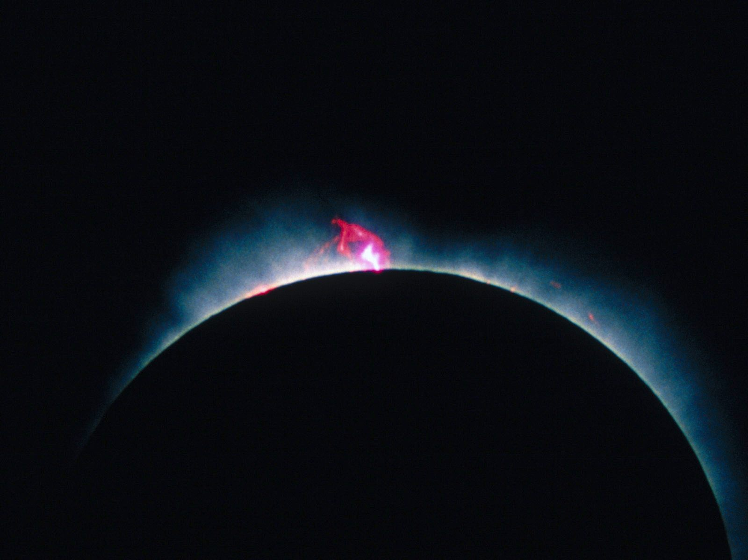
Depart from evil and do good; Seek peace and pursue it. — Psalm 34:14
2nd John
Judges
Joshua
1st John
Ruth
Deuteronomy
3rd John
2nd Peter
Numbers
1st & 2nd Samuel
Jude
1st Peter
Leviticus
Obadiah
Revelation
1st Corinthians
1st & 2nd Kings
Exodus
Amos
Jonah
James
2nd Corinthians
1st & 2nd Chronicles
Romans
Genesis
Joel
Galatians
Micah
Hebrews
Ezra
"Is not My word like a fire?"
"Is not My word like a fire?"
Hosea
Ephesians
Nehemiah
Daniel
Nahum
Philemon
Matthew
Malachi
Acts
Esther
Philippians
Habakkuk
Ezekiel
Titus
Zechariah
Mark
John
Job
Lamentations
Zephaniah
2nd Timothy
Colossians
Luke
Psalms
Haggai
Jeremiah
1st Timothy
Proverbs
1st Thessalonians
Isaiah
Ecclesiastes
2nd Thessalonians
Song of Solomon
Notes:
Only each humble heart can admit to how much one has examined His word concerning His presence among us. Sixty six books, 39 in the Old Testament and 27 in the New are open for review. To miss the Lord is to undermine the deepest reasons for living.
Jer 23:29 "Is not My word like a fire?" says the LORD, "And like a hammer that breaks the rock in pieces?

Slide 33
Set a guard, O LORD, over my mouth; Keep watch over the door of my lips. — Psalms 141:3
Keep watch
Keep watch

Slide 34
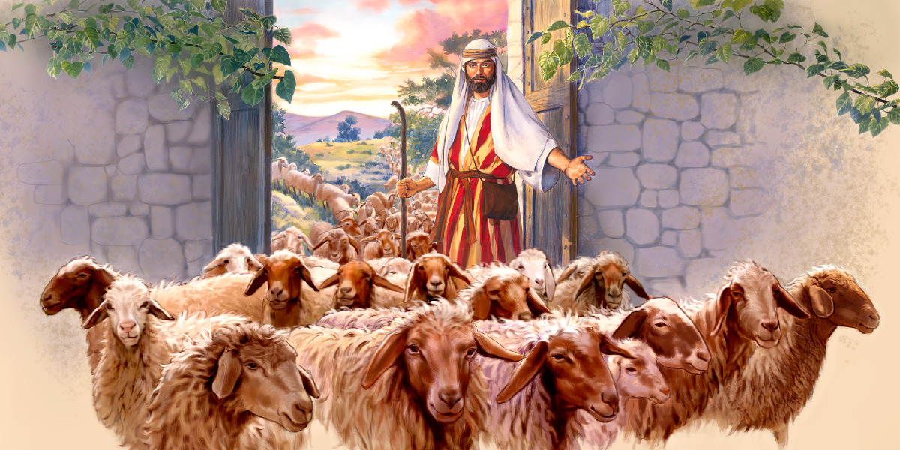
Then Jesus said to them again, "Most assuredly, I say to you, I am the door of the sheep." — John 10:7
I am the door
I am the door

Slide 35
And He said to them, "Go into all the world and preach the gospel to every creature. He who believes and is baptized will be saved; but he who does not believe will be condemned." — Mark 16:15-16
Go
Go
believes + baptized = saved
not believe = condemned
believes
baptized
saved
not
believe
condemned

Slide 36
Jesus answered, "Most assuredly, I say to you, unless one is born of water and the Spirit, he cannot enter the kingdom of God. — John 3:5
born of water
and the Spirit
enter
kingdom of God
enter

Slide 37
Jesus answered, "Most assuredly, I say to you, unless one is born of water and the Spirit, he cannot enter the kingdom of God. — John 3:5
enter
kingdom of God
enter

Slide 38
Then Jesus spoke to them again, saying, "I am the light of the world. He who follows Me shall not walk in darkness, but have the light of life." — John 8:12
Jesus
Jesus
I am He
I am
He
follows
follows
in
light
light of life
light of life

Slide 39
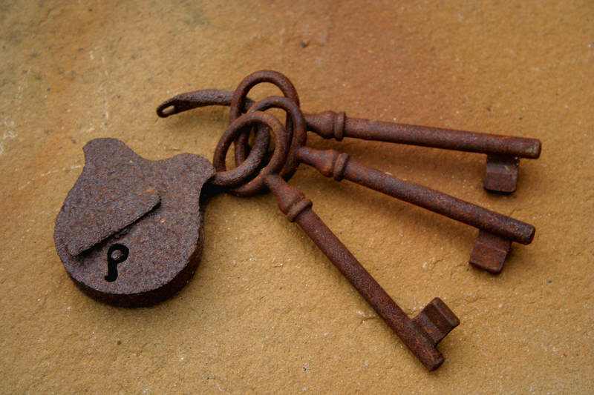
"I am He who lives, and was dead, and behold, I am alive forevermore. Amen. And I have the keys of Hades and of Death." — Revelation 1:18
I am He
So be it!
Amen
Amen
keys

Slide 40
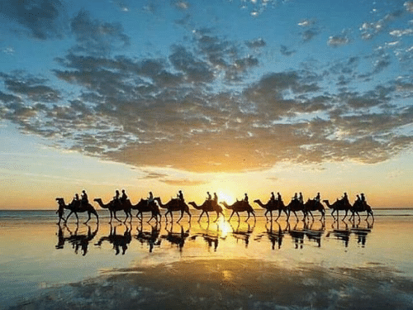
"Come to Me, all you who labor and are heavy laden, and I will give you rest." — Matthew 11:28
Come to Me
Come to Me
rest
I will give you rest
I will give you rest

Slide 41
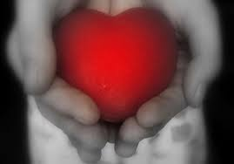
"And to the angel of the church in Philadelphia write, 'These things says He who is holy, He who is true, "He who has the key of David, He who opens and no one shuts, and shuts and no one opens: I know your works. See, I have set before you an open door, and no one can shut it; for you have a little strength, have kept My word, and have not denied My name." — Revelation 3:7-8

Slide 42
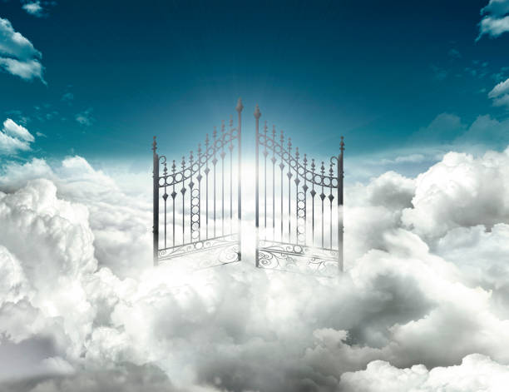
Its gates shall not be shut at all by day (there shall be no night there). — Revelation 21:25

Slide 43
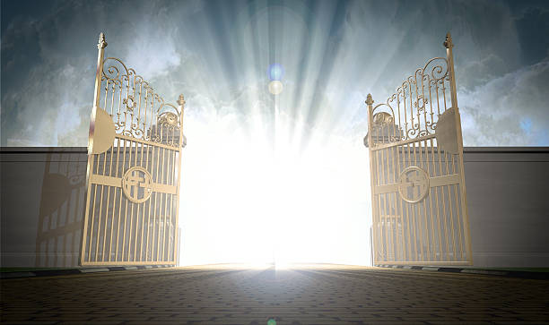
For a great and effective door has opened to me, and there are many adversaries. — 1st Corinthians 16:9
many adversaries
many adversaries

Slide 44
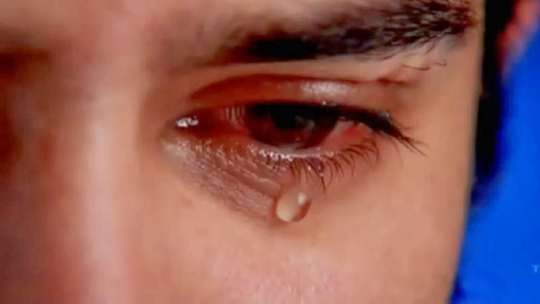
"Not everyone who says to Me, 'Lord, Lord,' shall enter the kingdom of heaven, but he who does the will of My Father in heaven." — Matthew 7:21
in
does the will
does the will
Father
Father in heaven
in
Father in heaven

Slide 45
grumbling
unbelief
Do not grumble against one another, brethren, lest you be condemned. Behold, the Judge is standing at the door! ~ James 5:9
Beware, brethren, lest there be in any of you an evil heart of unbelief in departing from the living God; ~ Hebrews 3:12
in
unbelief
Judge is
departing from the living
God
at the door

Slide 46
grumbling
grumbling
unbelief
unbelief
... and saying, "Where is the promise of His coming? For since the fathers fell asleep, all things continue as they were from the beginning of creation." ~ 2nd Peter 3:4
... and saying, "Where is the promise of His coming? For since the fathers fell asleep, all things continue as they were from the beginning of creation." ~ 2nd Peter 3:4
Where is
Where is

Slide 47
Today it’s religion, tomorrow it’s fable.
Jesus was married
Jesus was not murdered
Jesus was just a prophet
The BIBLE is incomplete

Slide 48
" 'These people draw near to Me with their mouth, And honor Me with their lips, But their heart is far from Me. And in vain they worship Me, Teaching as doctrines the commandments of men.' " ~ Matthew 15:8-9
" 'These people draw near to Me with their mouth, And honor Me with their lips, But their heart is far from Me. And in vain they worship Me, Teaching as doctrines the commandments of men.' " ~ Matthew 15:8-9
Teaching as doctrines
commandments of men
Notes:
God is not looking for organization of men, but individuals of heart.

Slide 49
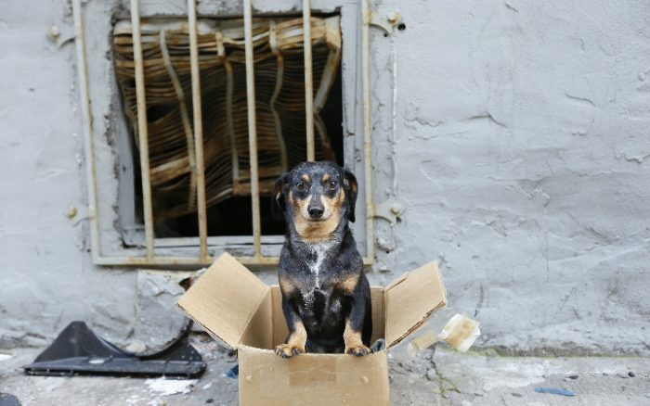
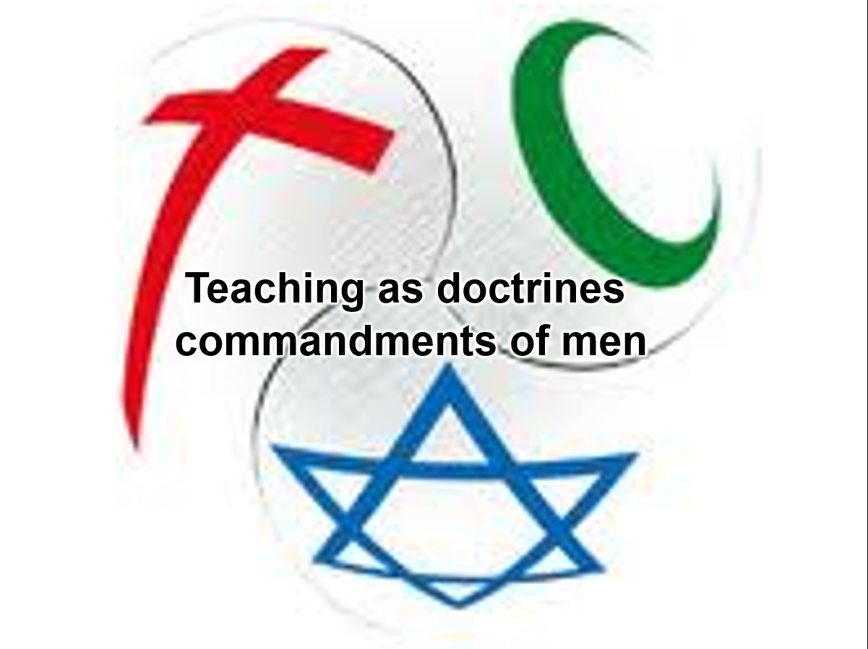
But outside are dogs and sorcerers and sexually immoral and murderers and idolaters, and whoever loves and practices a lie. — Revelation 22:15
outside:
● dogs
● sorcerers
● sexually immoral
● murderers
● idolaters
● loves and practices a lie
outside
dogs
Scavengers of garbage
sorcerers
sexually
Stealing from widows
immoral
murderers
Perverts
idolaters
loves
loves
Hate others
loves
and practices a lie
Worship stuff
a lie
a lie
Notes:
Too many see casual lying as a normal habit. Pray God we are not left to the outside where darkness consumes the sense of light in the truth.

Slide 50
"And these will go away into everlasting punishment, but the righteous into eternal life." ~ Matthew 25:46
"And these will go away into everlasting punishment, but the righteous into eternal life." ~ Matthew 25:46
everlasting
punishment
eternal
life

Slide 51
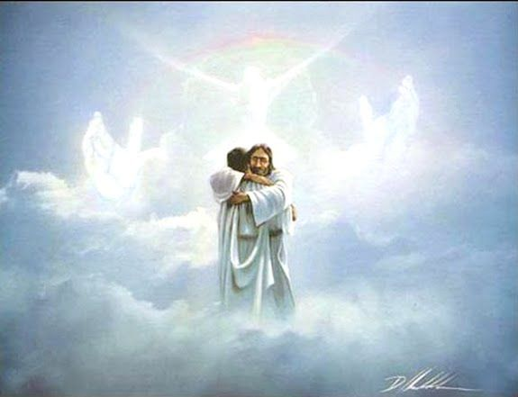
"If you do well, will you not be accepted? And if you do not do well, sin lies at the door. And its desire is for you, but you should rule over it." ~ Genesis 4:7
sin
the door
sin
desire
desire
rule over it
rule over it

Slide 52
"His lord said to him, 'Well done, good and faithful servant; you were faithful over a few things, I will make you ruler over many things. Enter into the joy of your lord.' " — Matthew 25:21
faithful
faithful
Enter into the joy
Enter into the joy

Slide 53
"Nor is there salvation in any other, for there is no other name under heaven given among men by which we must be saved." ~ Acts 4:12
no other
Jesus
under heaven
name
among men
must be saved

Slide 54
"… that they all may be one, as You, Father, are in Me, and I in You; that they also may be one in Us, that the world may believe that You sent Me. And the glory which You gave Me I have given them, that they may be one just as We are one: I in them, and You in Me; that they may be made perfect in one, and that the world may know that You have sent Me, and have loved them as You have loved Me." ~ John 17:21-23
"… that they all may be one, as You, Father, are in Me, and I in You; that they also may be one in Us, that the world may believe that You sent Me. And the glory which You gave Me I have given them, that they may be one just as We are one: I in them, and You in Me; that they may be made perfect in one, and that the world may know that You have sent Me, and have loved them as You have loved Me." ~ John 17:21-23
one
one
one
one
one

Slide 55
There is one body and one Spirit, just as you were called in one hope of your calling; one Lord, one faith, one baptism; one God and Father of all, who is above all, and through all, and in you all. ~ Ephesians 4:4-6
There is one body and one Spirit, just as you were called in one hope of your calling; one Lord, one faith, one baptism; one God and Father of all, who is above all, and through all, and in you all. ~ Ephesians 4:4-6
There is one body and one Spirit, just as you were called in one hope of your calling; one Lord, one faith, one baptism; one God and Father of all, who is above all, and through all, and in you all. ~ Ephesians 4:4-6
one
one
one
one body
Spirit
one hope
one
one Lord
one faith
one
one
one
one
baptism
one God
one

Slide 56
"Now therefore, listen to me, my children, For blessed are those who keep my ways. Hear instruction and be wise, And do not disdain it. Blessed is the man who listens to me, Watching daily at my gates, Waiting at the posts of my doors. For whoever finds me finds life, And obtains favor from the LORD; But he who sins against me wrongs his own soul; All those who hate me love death." — Proverbs 8:32-36
keep my ways
be wise
Watching daily at my gates
gates
gates
Watching daily at my gates
doors
doors
of my doors
of my doors

Slide 57
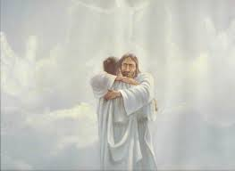
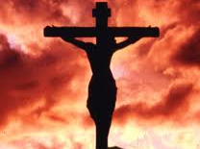
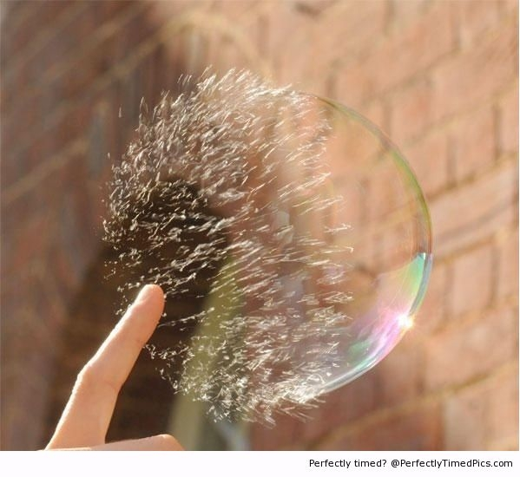
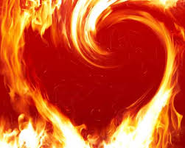
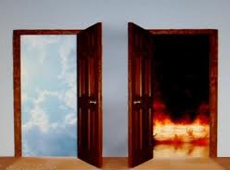
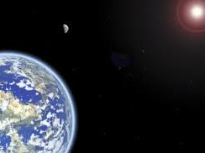
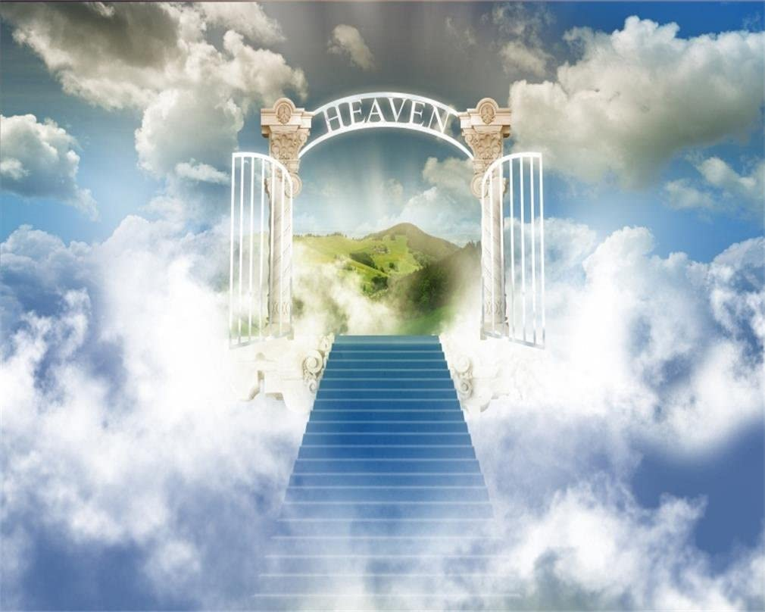
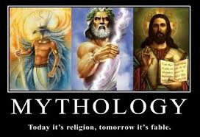
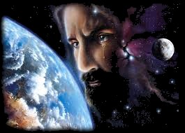
Lift up your heads, O you gates! Lift up, you everlasting doors! And the King of glory shall come in. Who is this King of glory? The LORD of hosts, He is the King of glory. Selah — Psalms 24:9-10
gates
doors

Slide 59
→ Without a desire for God no answer is given
→ Heed the Word as it saves both self and others
→ Jesus is the door for all who follow Him to eternity
→ Baptism is a key in unlocking heaven’s door
→ Following Jesus is God’s own revelation of light
→ Depart from evil; do good and pursue peace
→ An open door is now set with Jesus as gatekeeper
→ Eternity has the timeless reward of being
→ Not believing in God leads to the death of a soul
→ Mired in bitter self misses God’s door call to come
→ God knows true humble hearts over proud liars
→ God watches to see if we resist the knock of sin
→ An open door to life is offered to all wisely hoping
Love is God’s design to come home
Notes:
Love is God’s design to come home

Slide 61
Please visit http://www.RonBert.com to explore further
Ronald Bert Channel on
Notes:
Eternity never ends.

