Slide 2
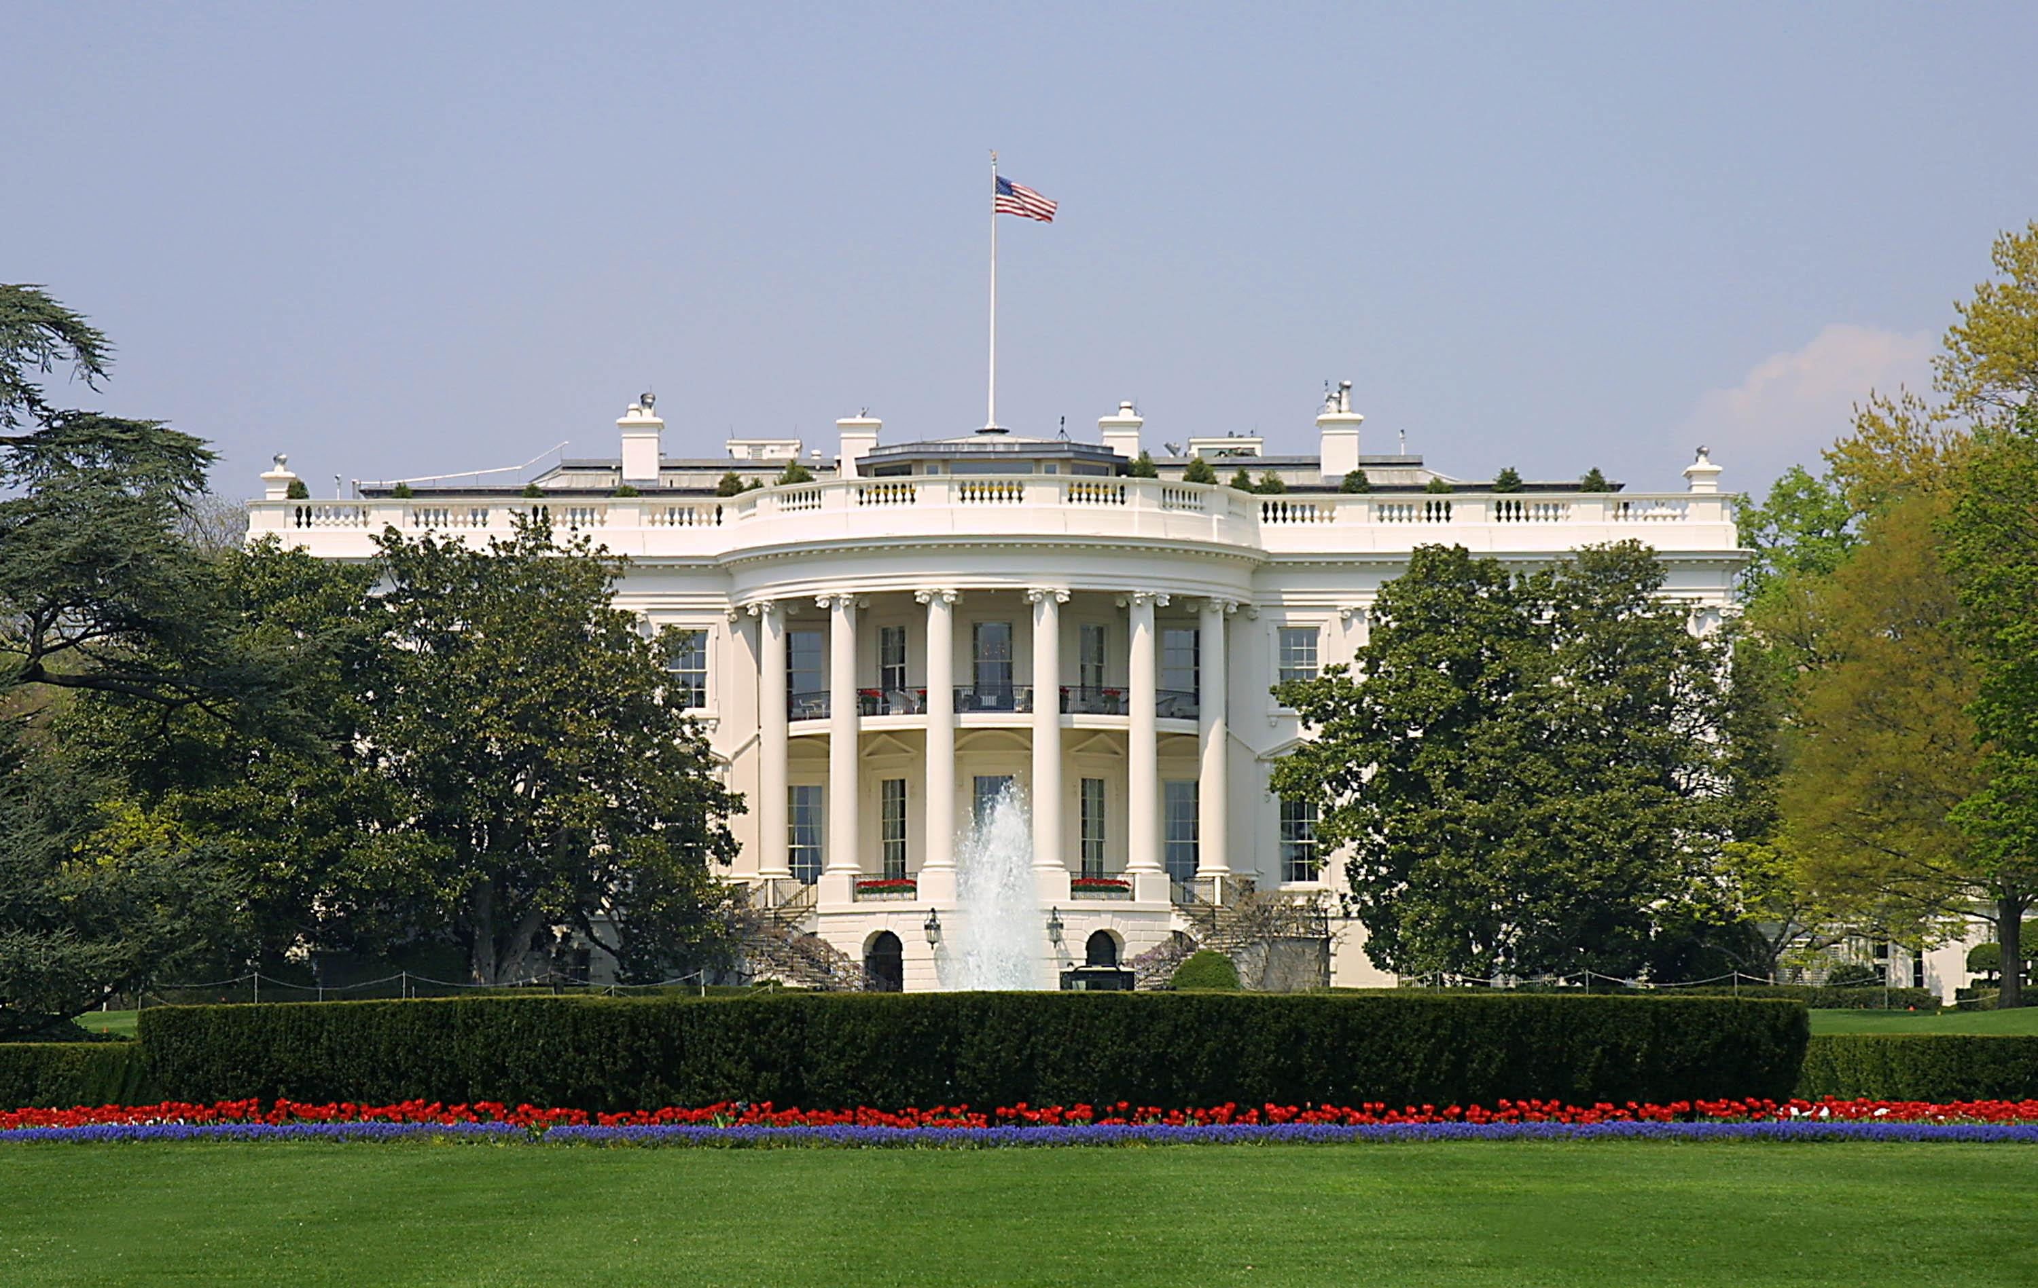
Presidential Quotes
Ron Bert
7
May 27, 2018

Slide 3
12. Zachary Taylor (1849-1850)

Slide 4
“The Bible is the best of books, and I wish it were in the hands of every one. It is indispensable to the safety and permanence of our institutions. A free government can not exist without religion and morals, and there cannot be morals without religion. Especially should the Bible be placed in the hands of the young. It is the best school book in the world. I would that all our people were brought up under the influence of that holy book.”
Bible is the best of books
Bible is the best of books
religion ↔ morals
↓
safety
↓
permanence of our institutions
↙ ↘
best school book free government
Bible
safety
permanence of our institutions
free
government
morals
religion
best school book

Slide 5
For the word of God is living and powerful, and sharper than any two-edged sword, piercing even to the division of soul and spirit, and of joints and marrow, and is a discerner of the thoughts and intents of the heart. — Hebrews 4:12

Slide 6
All Scripture is given by inspiration of God, and is profitable for doctrine, for reproof, for correction, for instruction in righteousness, ... — 2nd Timothy 3:16

Slide 7
He who disdains instruction despises his own soul, But he who heeds rebuke gets understanding. — Proverbs 15:32

Slide 8
“A strong reputation is like a good bonfire. When you have one kindled it's easy to keep the flame burning, even if someone comes along and tries to piss on it. But if you fall asleep and neglect it ... You'll wake up with ashes.”

Slide 9
"But he who endures to the end shall be saved.— Matthew 24:13

Slide 10
“The only ground of hope for the continuance of our free institutions is in the proper moral and religious training of the children, that they may be prepared to discharge aright the duties of men and citizens.”

Slide 11
“For more than half a century, during which kingdoms and empires have fallen, this Union has stood unshaken. The patriots who formed it have long since descended to the grave; yet still it remains, the proudest monument to their memory. . .”

Slide 12
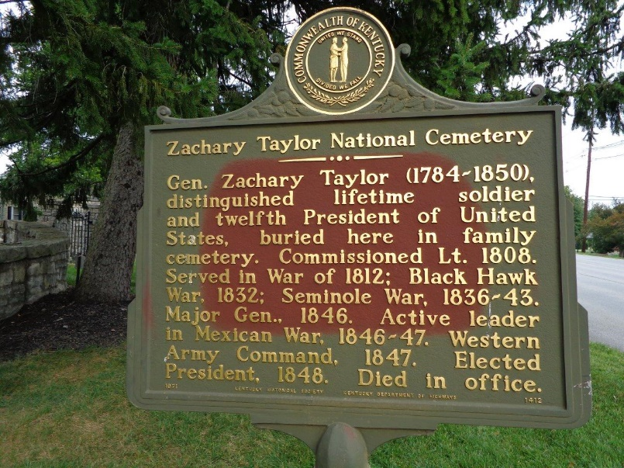

Slide 13
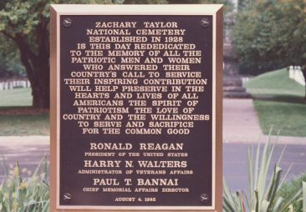

Slide 14
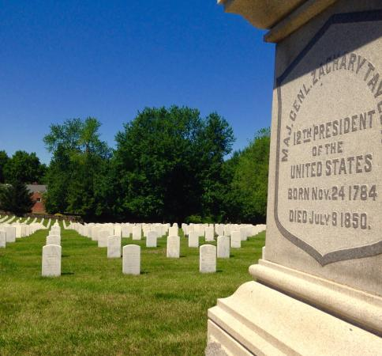

Slide 15
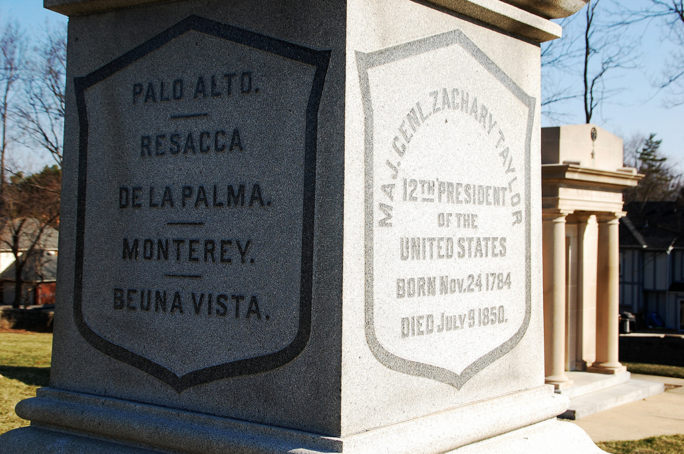

Slide 16
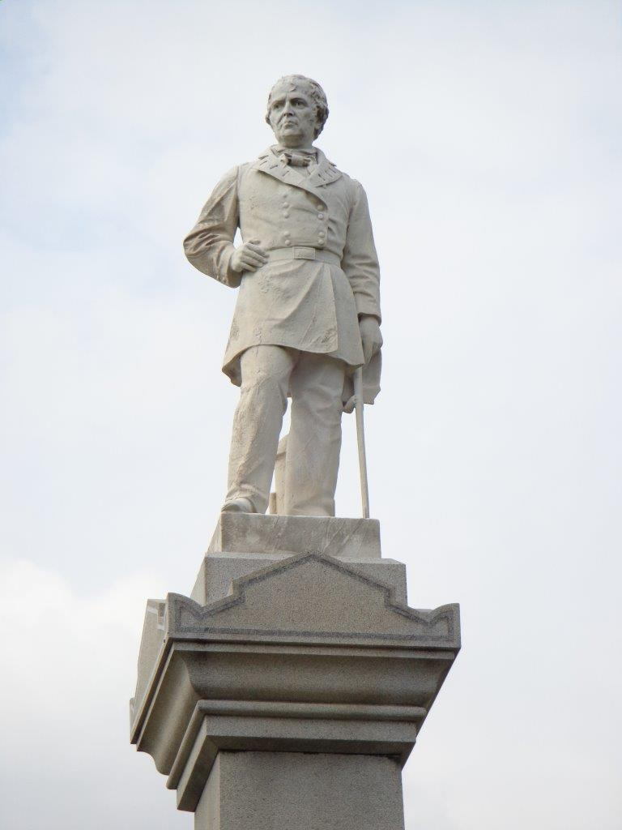
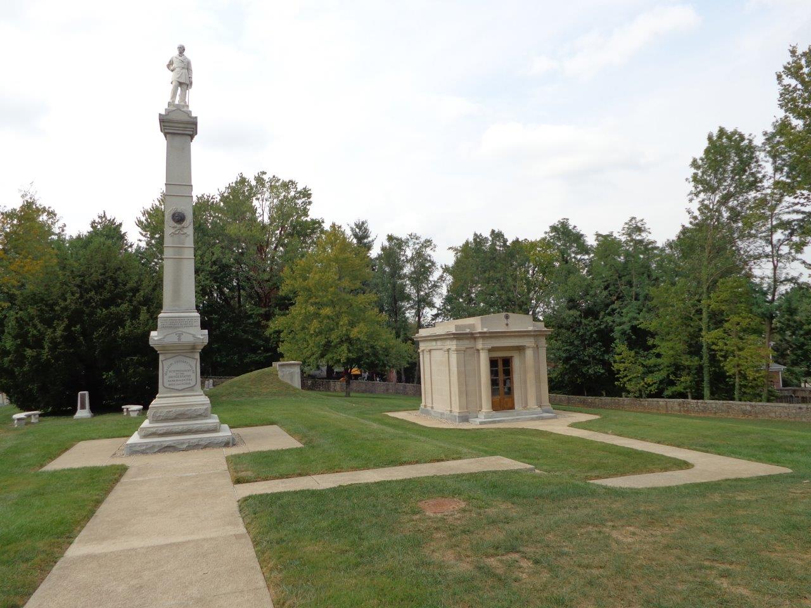
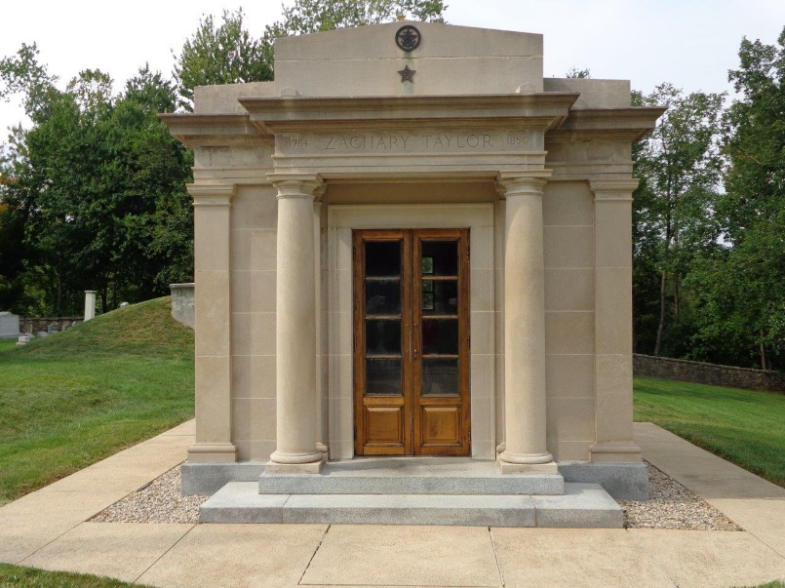

Slide 17
13. Millard Fillmore (1850-1853)

Slide 18
“May God save the country, for it is evident that the people will not.”

Slide 19
There is a way that seems right to a man, But its end is the way of death. — Proverbs 14:12

Slide 20
“Let us remember that revolutions do not always establish freedom. Our own free institutions were not the offspring of our revolution. They existed before.”

Slide 21
“God knows that I detest slavery, but it is an existing evil, for which we are not responsible, and we must endure it, till we can get rid of it without destroying the last hope of free government in the world.”

Slide 22
Stand fast therefore in the liberty by which Christ has made us free, and do not be entangled again with a yoke of bondage. — Galatians 5:1

Slide 23
“The Masonic fraternity tramples upon our rights, defeats the administration of justice, and bids defiance to every government which it cannot control.”

Slide 24
“I am tolerant of all creeds. Yet if any sect suffered itself to be used for political objects I would meet it by political opposition. In my view church and state should be separate, not only in form, but fact. Religion and politics should not be mingled.”

Slide 25
“The law is the only sure protection of the weak, and the only efficient restraint upon the strong.”

Slide 26
Let love be without hypocrisy. Abhor what is evil. Cling to what is good. — Romans 12:9

Slide 27
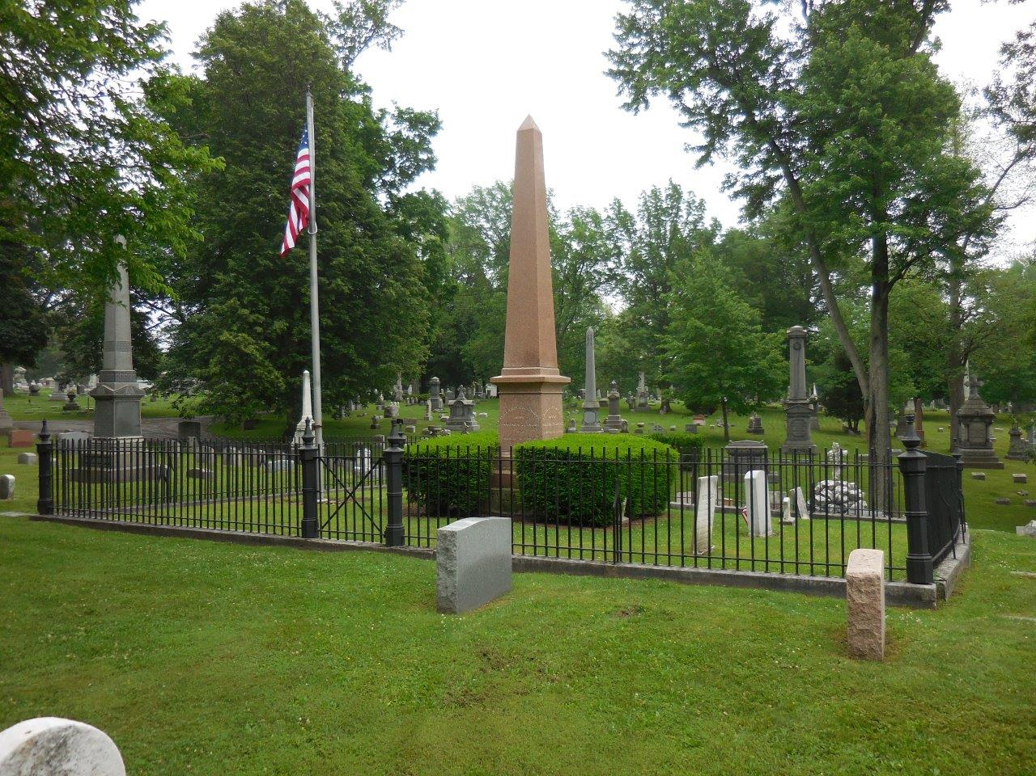

Slide 28
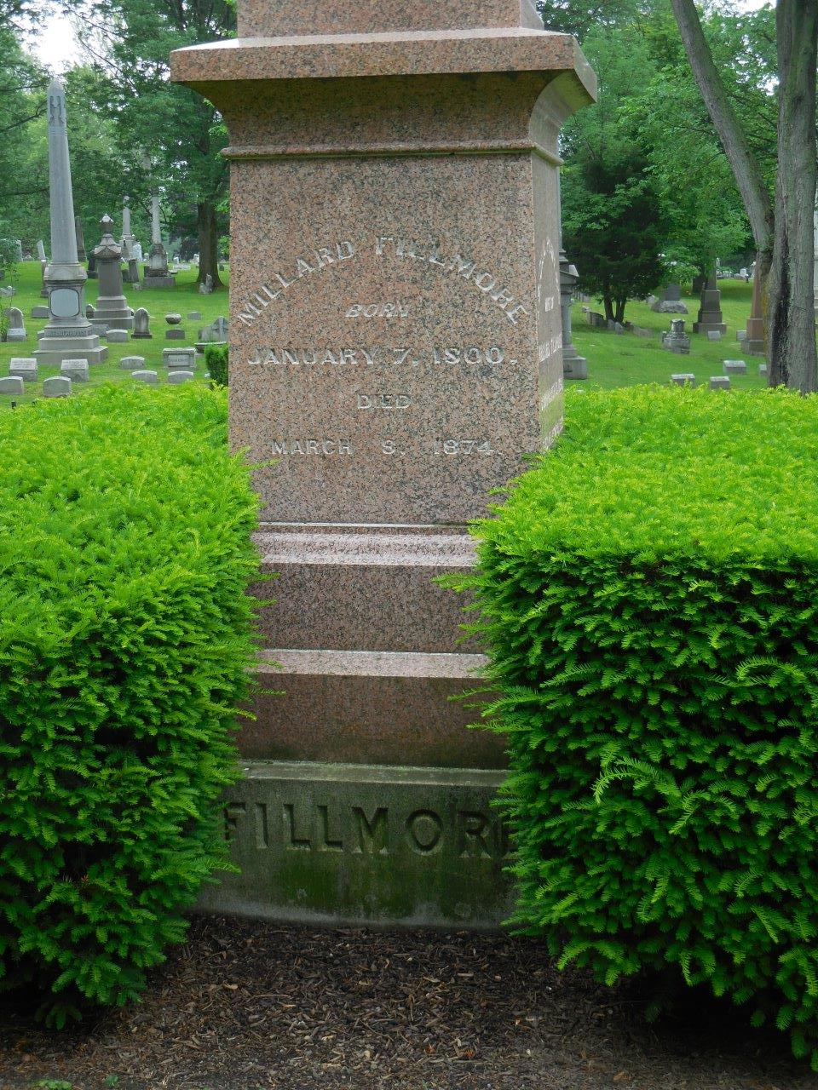
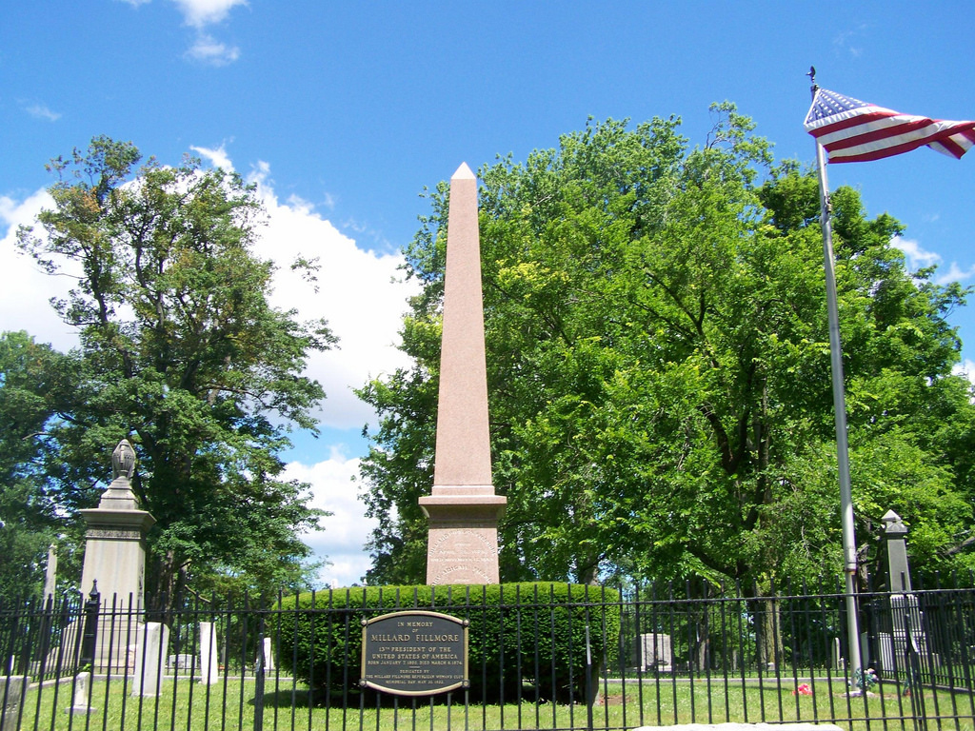

Slide 29
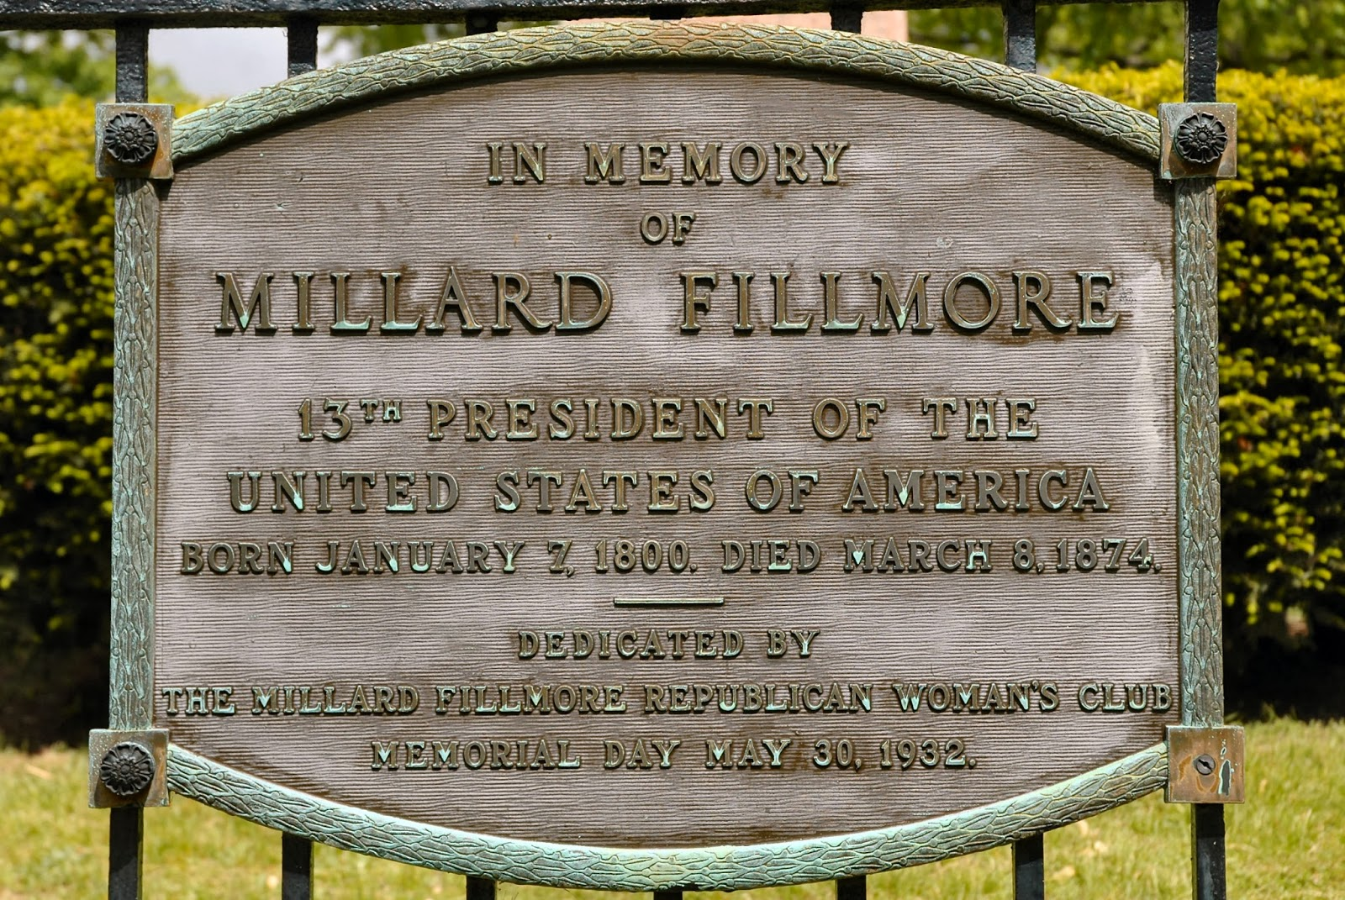

Slide 30
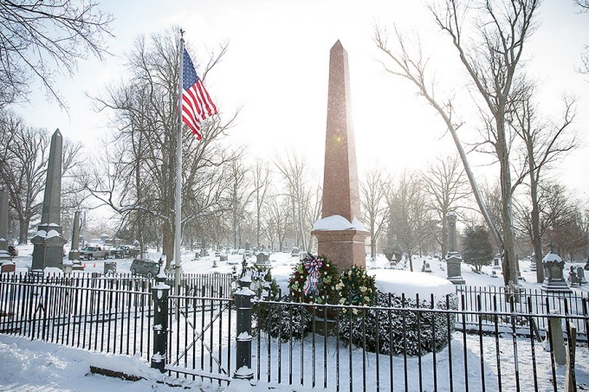

Slide 32
Presidential Quotes
Ron Bert
7½
June 10, 2018

Slide 33
12. Zachary Taylor (1849-1850)

Slide 34
“The Bible is the best of books, and I wish it were in the hands of every one. It is indispensable to the safety and permanence of our institutions. A free government can not exist without religion and morals, and there cannot be morals without religion. Especially should the Bible be placed in the hands of the young. It is the best school book in the world. I would that all our people were brought up under the influence of that holy book.”
Bible is the best of books
Bible is the best of books
religion ↔ morals
↓
safety
↓
permanence of our institutions
↙ ↘
best school book free government
Bible
safety
permanence of our institutions
free
government
morals
religion
best school book

Slide 35
13. Millard Fillmore (1850-1853)
“God knows that I detest slavery, but it is an existing evil, for which we are not responsible, and we must endure it, till we can get rid of it without destroying the last hope of free government in the world.”

Slide 36
14. Franklin Pierce (1853-1857)

Slide 37
“But let not the foundation of our hope rest upon man's wisdom. It will not be sufficient that sectional prejudices find no place in the public deliberations. It will not be sufficient that the rash counsels of human passion are rejected. It must be felt that there is no national security but in the nation's humble, acknowledged dependence upon God and His overruling providence.”
foundation of our hope
His overruling providence
↓
foundation of our hope
↕
national security
↑
humble dependence upon God
national
security
humble
dependence upon God
His overruling providence

Slide 38
“The dangers of a concentration of all power in the general government of a confederacy so vast as ours are too obvious to be disregarded.”

Slide 39
And with many other words he testified and exhorted them, saying, "Be saved from this perverse generation." — Acts 2:40

Slide 40
“In expressing briefly my views upon an important subject which has recently agitated the nation..., I fervently hope that the question is at rest and that no sectional or ambitious or fanatical excitement may again threaten the durability of our institutions.”

Slide 41
“I can express no better hope for my country than that the kind Providence which smiled upon our fathers may enable their children to preserve the blessings they have inherited.”

Slide 42
... who desires all men to be saved and to come to the knowledge of the truth. — 1st Timothy 2:4

Slide 43
“The constitutionality and propriety of the Federal Government assuming to enter into a novel and vast field of legislation, namely, that of providing for the care and support of all those ... who by any form of calamity become fit objects of public philanthropy. ... READILY and, I trust, feelingly acknowledge the duty incumbent on us all … to provide for those who, in the mysterious order of Providence, are subject to want and to disease of body or mind; …”
“… but I cannot find any authority in the Constitution for making the Federal Government the great almoner of public charity throughout the United States. To do so would, in my judgment, be contrary to the letter and spirit of the Constitution and subversive of the whole theory upon which the Union of these States is founded.”

Slide 44
Pure and undefiled religion before God and the Father is this: to visit orphans and widows in their trouble, and to keep oneself unspotted from the world. — James 1:27

Slide 45
“The founders of the Republic dealt with things as they were presented to them, in a spirit of self sacrificing Patriotism and as time has proved, with a comprehensive wisdom which it will always be safe for us to consult”

Slide 46
Of all knaves the religious knave is the worst.

Slide 47
Then Jesus answered and said: "A certain man went down from Jerusalem to Jericho, and fell among thieves, who stripped him of his clothing, wounded him, and departed, leaving him half dead. Now by chance a certain priest came down that road. And when he saw him, he passed by on the other side. " — Luke 10:30-31

Slide 48
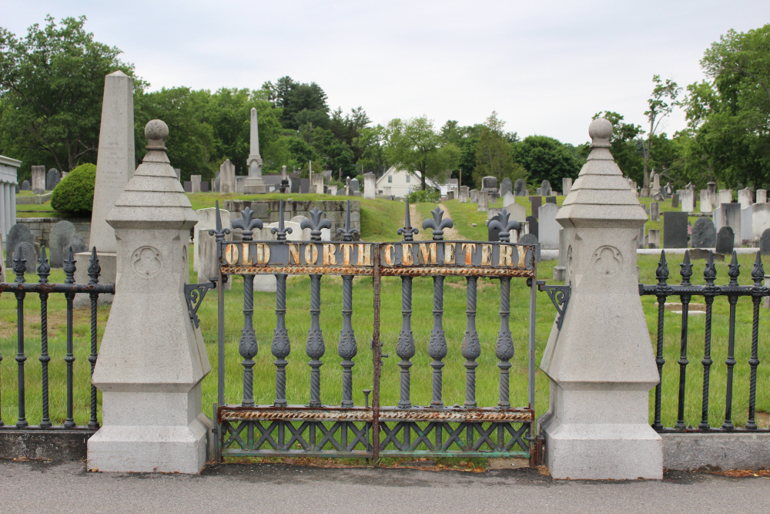

Slide 49
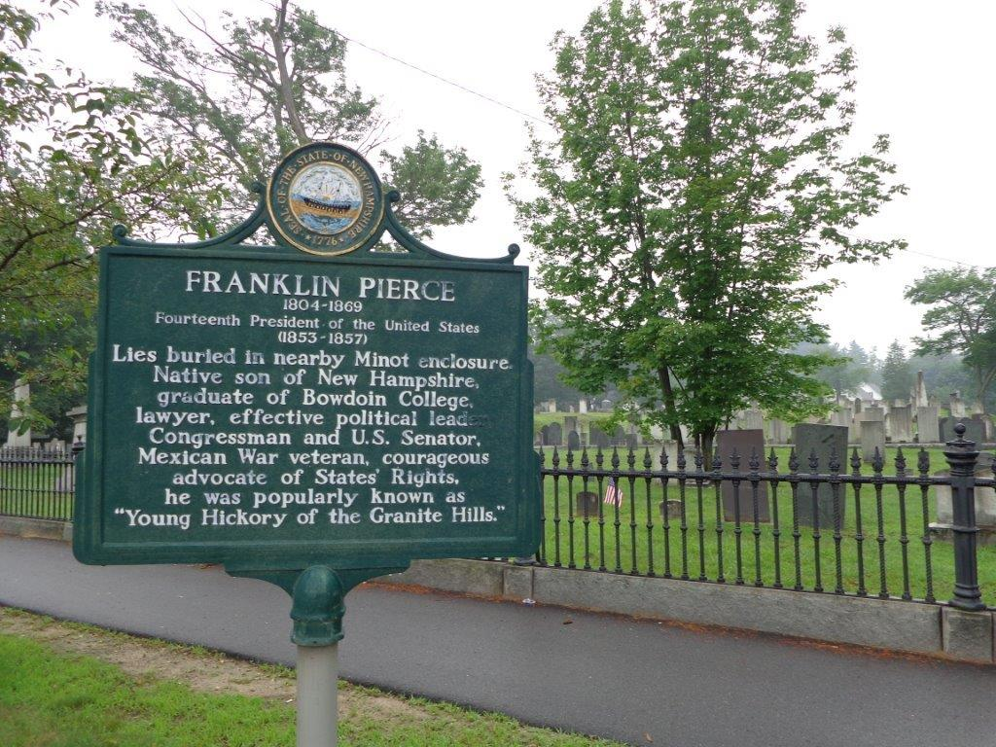

Slide 50
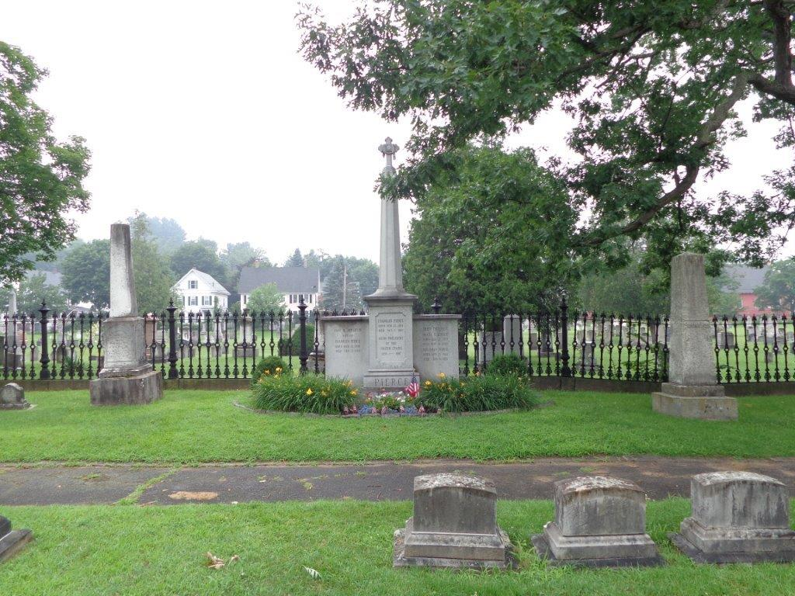

Slide 51
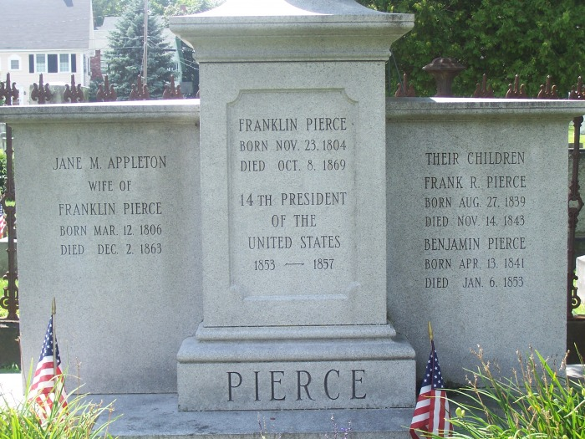

Slide 52
15. James Buchanan (1857-1861)

Slide 53
“The Government of the United States possesses no power whatever over the question of religion.”

Slide 54
So continuing daily with one accord in the temple, and breaking bread from house to house, they ate their food with gladness and simplicity of heart, praising God and having favor with all the people. And the Lord added to the church daily those who were being saved.. — Acts 2:46-47
the Lord added to
the church

Slide 55
“There is nothing stable but Heaven and the Constitution.”

Slide 56
“The course of events is so rapidly hastening forward that the emergency may soon arise when you may be called upon to decide the momentous question whether you possess the power by force of arms to compel a State to remain in the Union.”

Slide 57
“The storm of frenzy and faction must inevitably dash itself in vain against the unshaken rock of the Constitution.”

Slide 58
"Therefore whoever hears these sayings of Mine, and does them, I will liken him to a wise man who built his house on the rock: and the rain descended, the floods came, and the winds blew and beat on that house; and it did not fall, for it was founded on the rock. But everyone who hears these sayings of Mine, and does not do them, will be like a foolish man who built his house on the sand: and the rain descended, the floods came, and the winds blew and beat on that house; and it fell. And great was its fall." — Matthew 7:24-27

Slide 59
“Our union rests upon public opinion, and can never be cemented by the blood of its citizens shed in civil war.”

Slide 60
“Liberty must be allowed to work out its natural results; and these will, ere long, astonish the world.”

Slide 61
While they promise them liberty, they themselves are slaves of corruption; for by whom a person is overcome, by him also he is brought into bondage. — 2nd Peter 2:19

Slide 62
“I am the last President of the United States!”

Slide 63
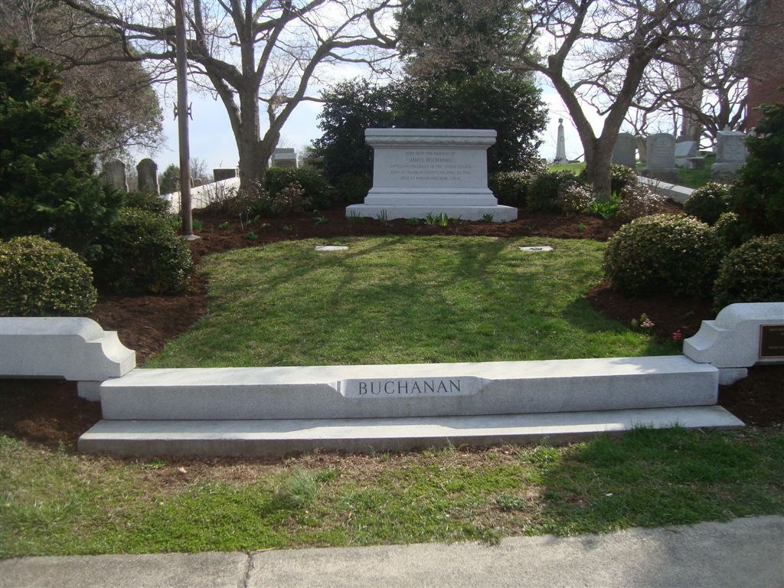

Slide 64
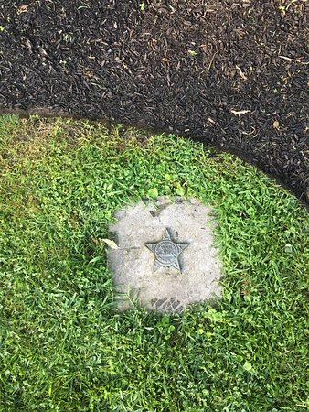
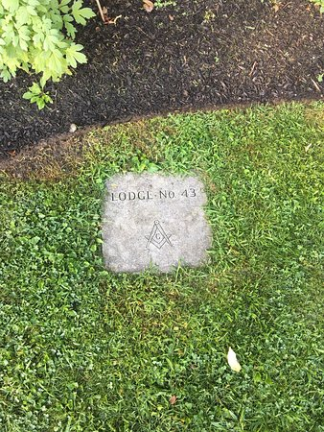
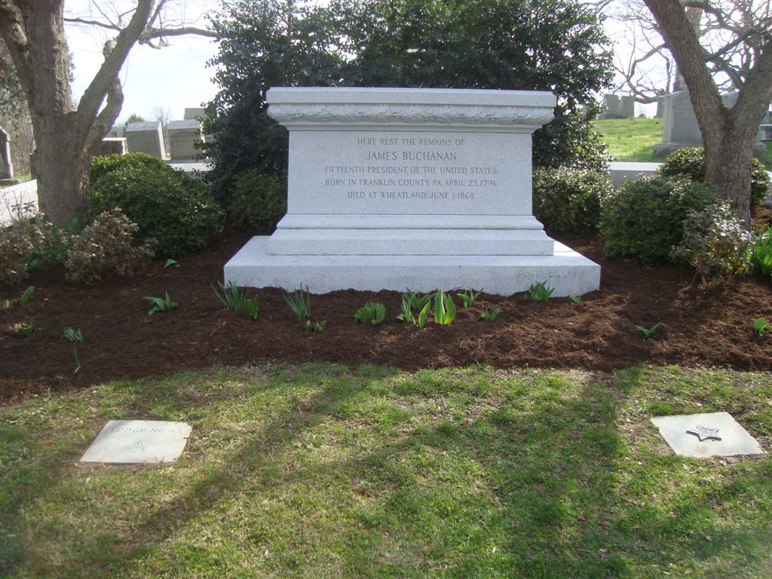

Slide 65
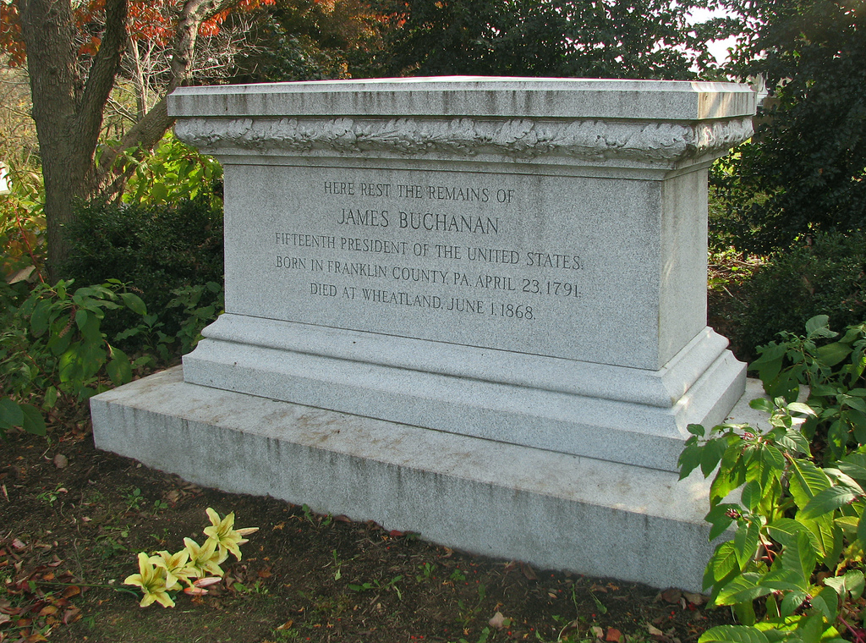

Slide 66
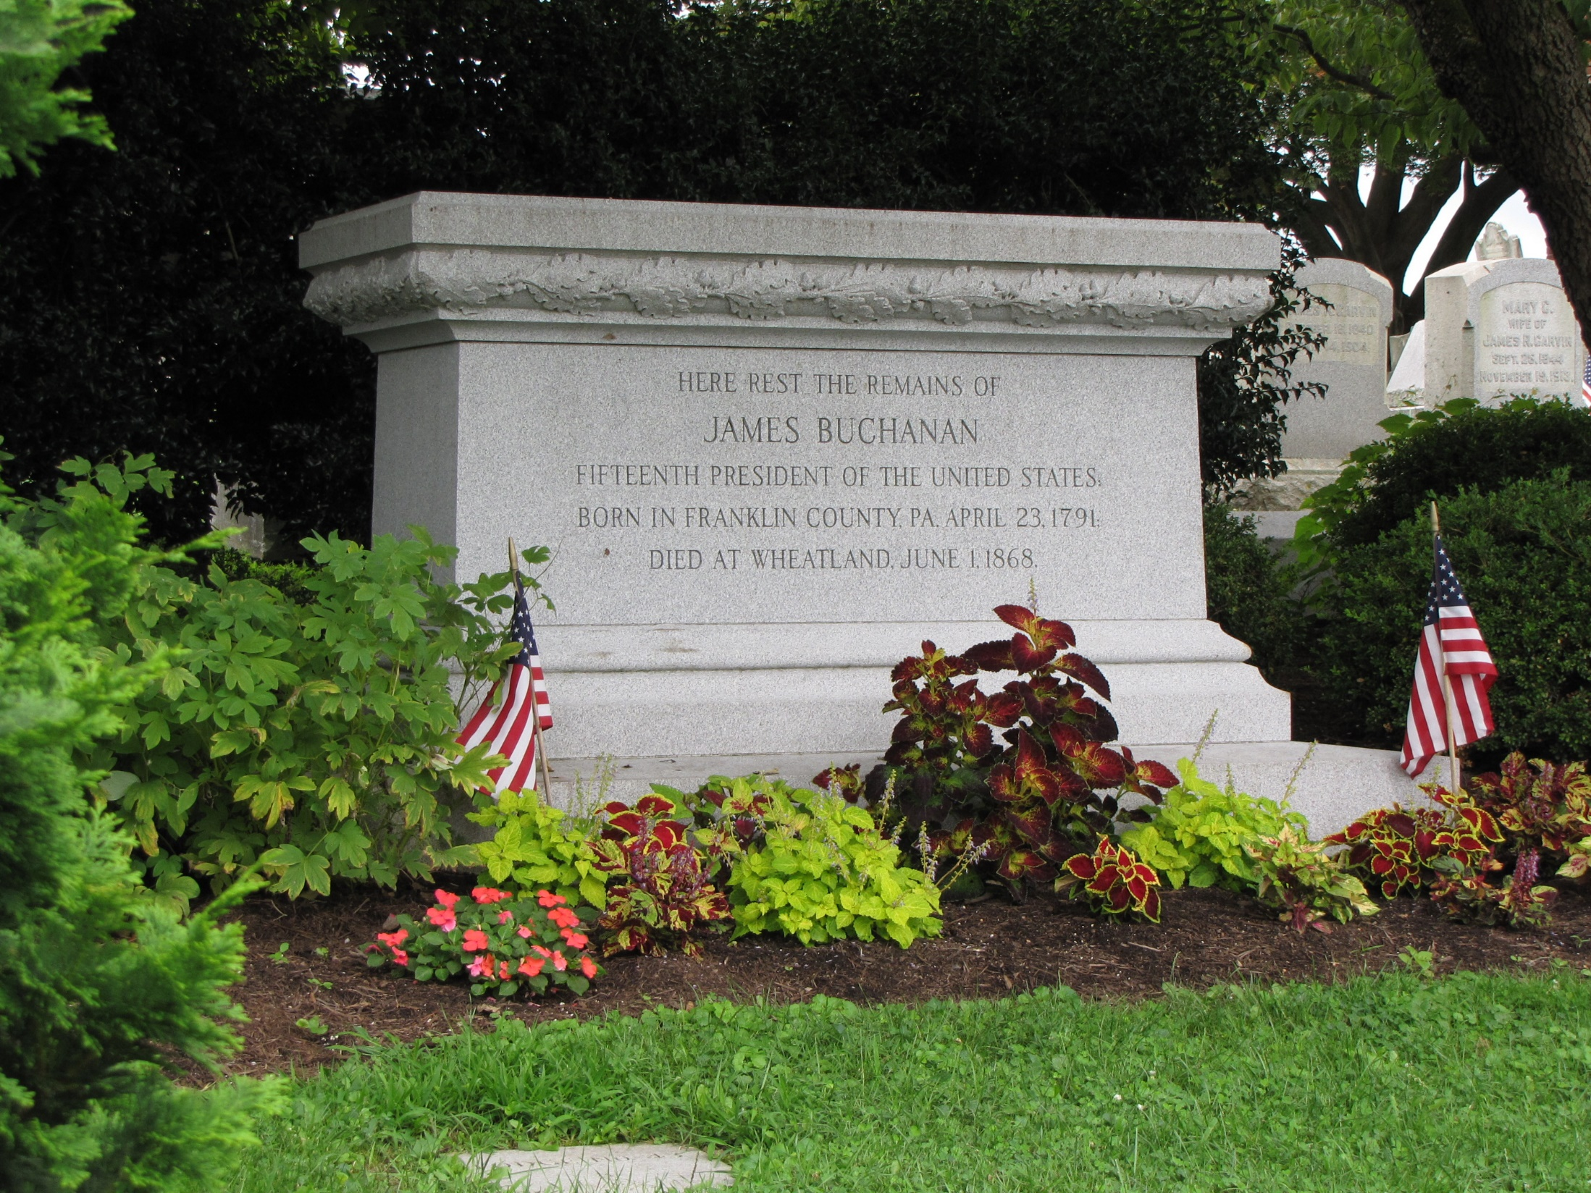

Slide 67
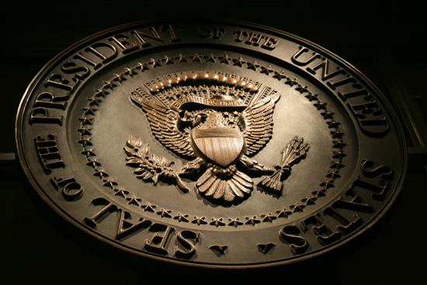
→ Bible is vital to the safety & stability of institutions
→ There cannot be morals without religion
→ The Bible is the best school book in the world
→ Integrity must vigilantly be maintained lest one fall
→ Moral/religious training of children protects freedom
→ In unity under one God comes common blessings
→ When religion tries to rule individual rights suffer
→ National security comes by reliance on God’s grace
→ The winds of war lie in diametrically opposed ideals
→ Slavery is the bind freedom intends to break
→ Government should not be a conduit for charity
→ Duty of individuals is to care for those deserving
→ In truth wisdom remains through the tests of time
Only God’s Word can save a people
from damning self-destruction

Slide 69
Please visit http://www.LoveFromGod.com to explore further
Ronald Bert Channel on
Notes:
Eternity never ends.

