Slide 2
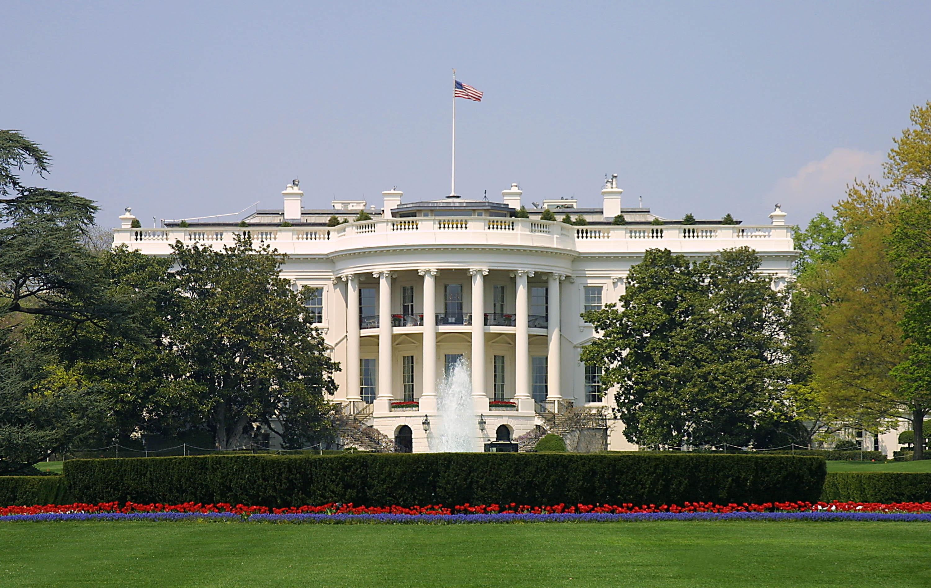
Presidential Quotes
Ron Bert
32
October 25, 2020

Slide 3
Part 1
40. Ronald Reagan (1981-1989)

Slide 4
“Since I came to the White House, I got two hearing aids, a colon operation, skin cancer, a prostate operation, and I was shot. The damn thing is, I've never felt better in my life.”

Slide 5
Wisdom is with aged men, And with length of days, understanding. — Job 12:12
The silver-haired head is a crown of glory, If it is found in the way of righteousness. — Proverbs 16:31
If
If

Slide 6
The days of our lives are seventy years; And if by reason of strength they are eighty years, Yet their boast is only labor and sorrow; For it is soon cut off, and we fly away. — Psalms 90:10
labor and
labor and
sorrow
sorrow

Slide 7
“You know, by the time you reach my age, you've made plenty of mistakes if you've lived your life properly. So you learn. You put things in perspective. You pull your energies together. You change. You go forward. My fellow Americans, I have a great deal that I want to accomplish with you and for you over the next two years. And, the Lord willing, that's exactly what I intend to do.”
learn
perspective
learn
perspective
Repentance
You change
You go forward
Faith
Lord willing
Lord willing

Slide 8
Brethren, I do not count myself to have apprehended; but one thing I do, forgetting those things which are behind and reaching forward to those things which are ahead, I press toward the goal for the prize of the upward call of God in Christ Jesus. — Philippians 3:13-14
in
God in Christ Jesus
↑
prize of the upward call
↗
toward the goal
↗
reaching forward ahead
↗
forgetting those things behind
Christ Jesus
forgetting those things
behind
reaching
forward
ahead
toward the
goal
prize of the upward
call
God in Christ Jesus

Slide 9
“I believe with all my heart that standing up for America means standing up for the God who has so blessed our land.”
standing up for
God
standing up for
God
God

Slide 10
“America needs God more than God needs America. If we ever forget that we are One Nation under God, then we will be a nation gone under.”
God
If
If
God
God
God

Slide 11
“Our National Motto - 'In God We Trust' - was not chosen lightly. It reflects a basic recognition that there is a divine authority in the universe to which this nation owes homage.”
God
In God We Trust
. .
divine authority
. .
worship
honor
tribute
respect

Slide 12
Trust

Slide 13
Trust in the LORD with all your heart, And lean not on your own understanding; In all your ways acknowledge Him, And He shall direct your paths. — Proverbs 3:5-6
Trust

Slide 14
“We believe faith and freedom must be our guiding stars, for they show us truth, they make us brave, give us hope, and leave us wiser than we were.”
faith and freedom:
→ show us truth
→ make us brave
→ give us hope
→ leave us wiser
faith and freedom
faith and freedom
faith and freedom
→
→
make us
show us truth
brave
→
give us hope
leave us
→
wiser

Slide 15
“The struggle now going on for the world will never be decided by bombs or rockets, by armies or military might. The real crisis we face today is a spiritual one; at the root, it is a test of moral will and faith.”
trust
love
belief
truth
devotion
respect
moral will
faith
moral will
faith

Slide 16
“Of the many influences that have shaped the United States into a distinctive nation and people, none may be said to be more fundamental and enduring than the Bible.”
shaped the United States
shaped the United States
the Bible
fundamental
fundamental
the Bible
the Bible
the Bible

Slide 17
“Within the covers of the Bible are the answers for all the problems men face.”
the Bible
the Bible

Slide 18
“Indeed, it is an indisputable fact that all the complex and horrendous questions confronting us at home and worldwide have their answer in that single book [the Bible].”
the Bible
Bible

Slide 19
“The Bible can touch our hearts, order our minds, refresh our souls.”
order our minds
The Bible
touch our
Bible
The Bible
refresh our souls
order our
hearts
minds
refresh
our souls
touch our
hearts

Slide 20
“Inside the Bible’s pages lie all the answers to all the problems man has ever known. It is my firm belief that the enduring values presented in its pages have a great meaning for each of us and for our nation. The Bible can touch our hearts, order our minds, and refresh our souls. I hope Americans will read and study the Bible.”
great meaning for each
great meaning for each
of us and for our nation
of us and for our nation

Slide 21
“Either [Jesus] was what he said he was or he was the world's greatest liar. It is impossible for me to believe a liar or charlatan could have had the effect on mankind that he has had for 2000 years. We could ask, would even the greatest of liars carry his lie through the crucifixion, when a simple confession would have saved him? ... Did he allow us the choice ... to believe in his teaching but reject his statements about his own identity?”
to believe in his teaching but reject his
statements about his own identity?”

Slide 22
And if Christ is not risen, your faith is futile; you are still in your sins! Then also those who have fallen asleep in Christ have perished. If in this life only we have hope in Christ, we are of all men the most pitiable. — 1st Corinthians 15:17-19

Slide 23
“Sometimes when I'm faced with an atheist, I am tempted to invite him to the greatest gourmet dinner that one could ever serve, and when we have finished eating that magnificent dinner, to ask him if he believes there's a cook.”

Slide 24
God's miracles are to be found in nature itself; the wind and waves, the wood that becomes a tree - all of these are explained biologically, but behind them is the hand of God.”
hand of God
hand of God
Intelligent Design

Slide 25
“Hope remains the highest reality, the age-old power.”
Hope

Slide 26
Blessed be the God and Father of our Lord Jesus Christ, who according to His abundant mercy has begotten us again to a living hope through the resurrection of Jesus Christ from the dead, to an inheritance incorruptible and undefiled and that does not fade away, reserved in heaven for you, who are kept by the power of God through faith for salvation ready to be revealed in the last time. — 1st Peter 1:3-5
to be revealed in the last time
through faith for salvation
● kept by the power of God
● reserved in heaven for you
through the resurrection of Jesus Christ
↑
an inheritance that does not fade
to a living hope
↑
begotten us again
according to His abundant mercy
according to His
abundant mercy
begotten us again
to a living hope
through the resurrection
living hope
. .
of Jesus Christ
an
inheritance
that does not fade
reserved in
heaven for you
kept by the
power of God
through faith for salvation
through faith for salvation
. .
to be revealed in the last time

Slide 27
“Our liberty springs from and depends upon an abiding faith in God.”
in
abiding faith in God
God
. .

Slide 28
Whoever transgresses and does not abide in the doctrine of Christ does not have God. He who abides in the doctrine of Christ has both the Father and the Son. — 2nd John 1:9

Slide 29
America was founded by people who believed that God was their rock of safety. I recognize we must be cautious in claiming that God is on our side, but I think it's all right to keep asking if we’re on His side.”
rock of safety
. .

Slide 30
“There is no foundation like the rock of honesty and fairness, and when you begin to build your life on that rock, with the cement of the faith in God that you have, then you have a real start.”
rock of honesty

Slide 31
He who walks with integrity walks securely, But he who perverts his ways will become known. — Proverbs 10:9

Slide 32
“The greatest leader is not necessarily the one who does the greatest things, He is the one that gets the people to do the greatest things.”

Slide 33
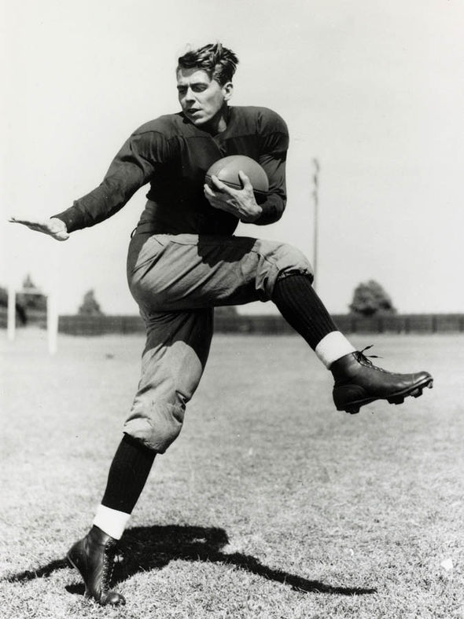
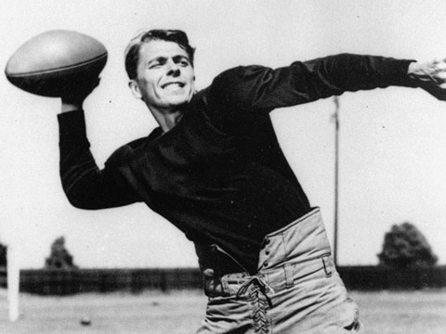

Slide 34
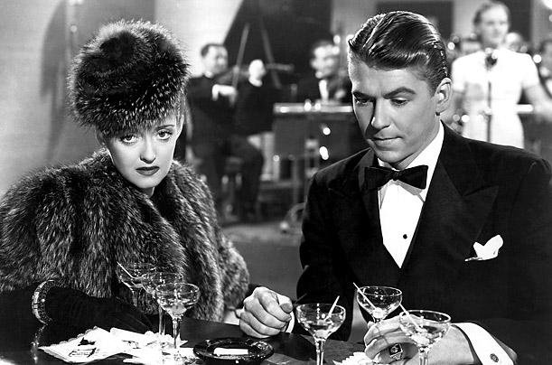
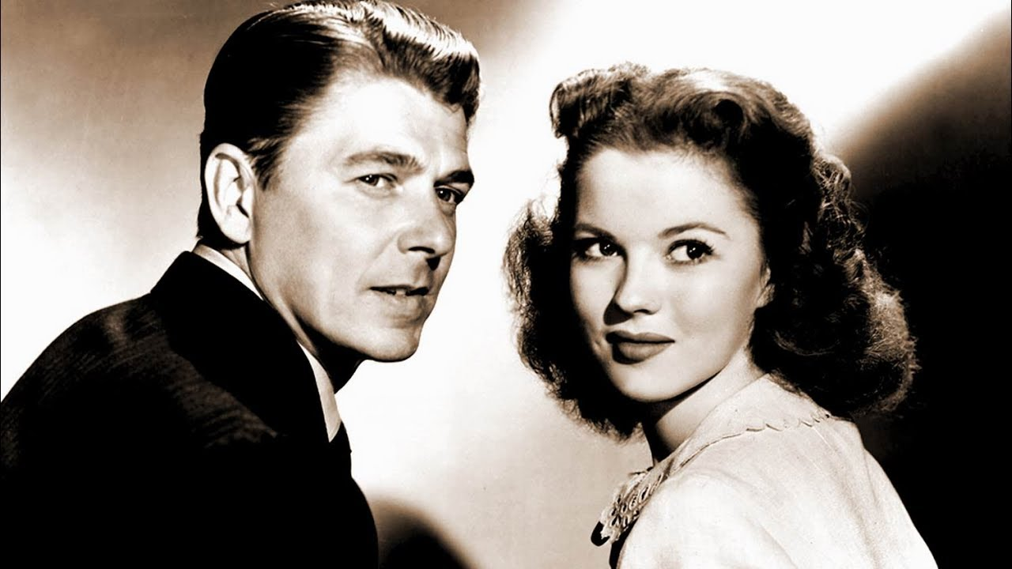
Betty Davis
Shirley Temple

Slide 35
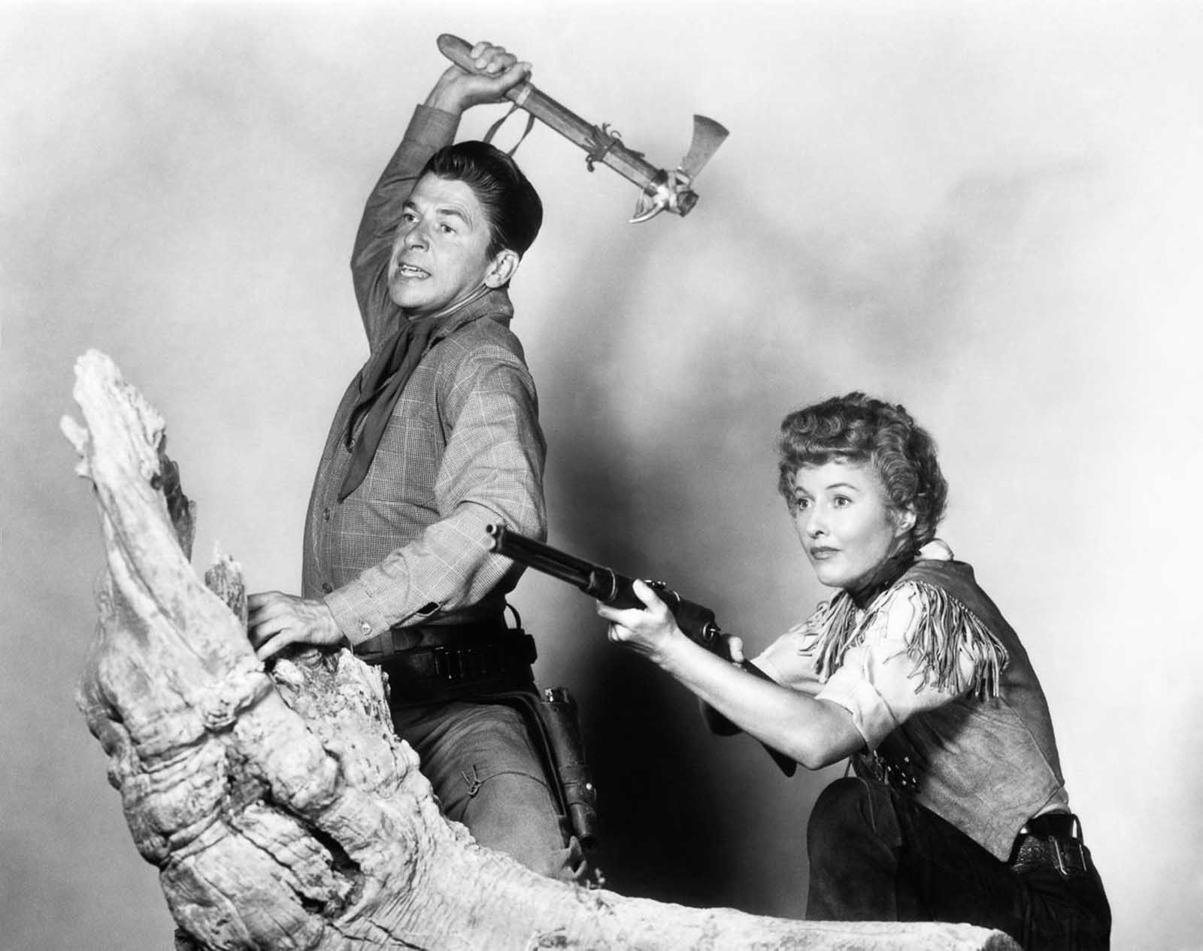
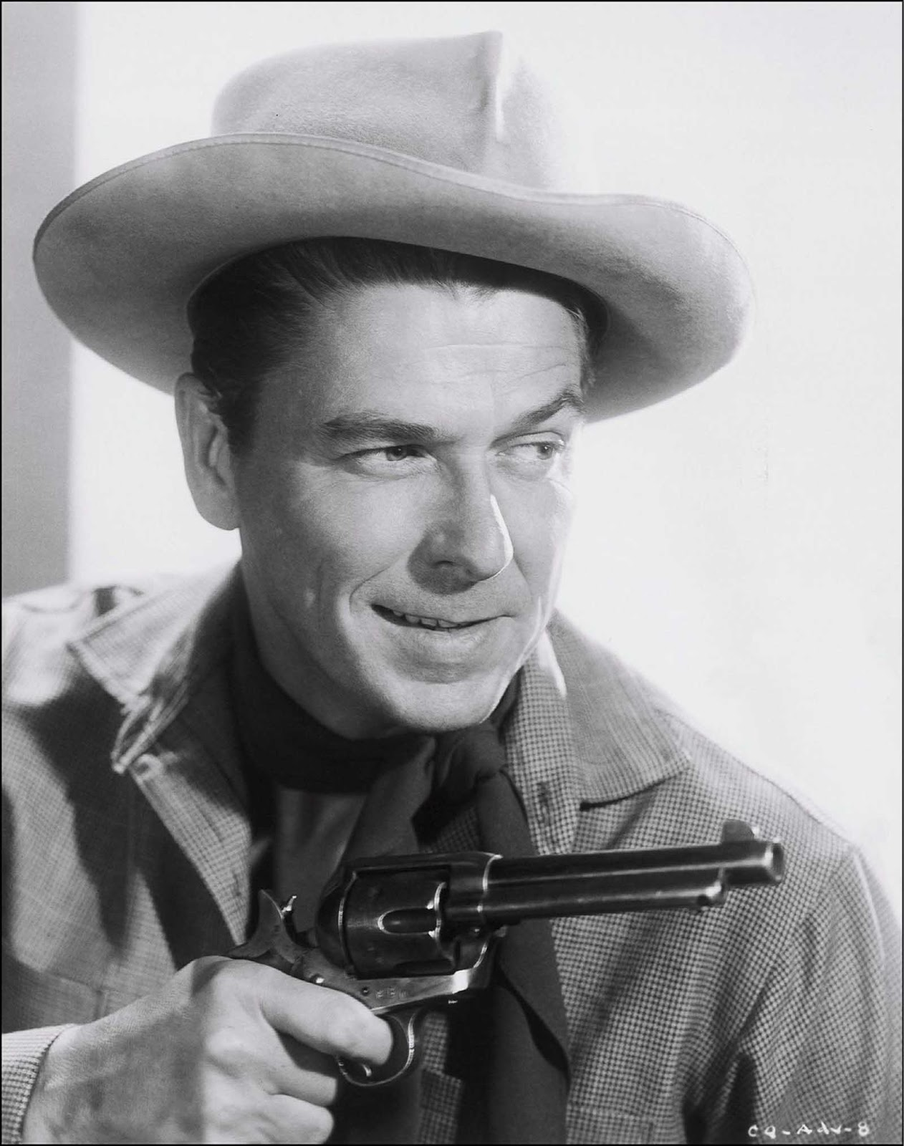
Barbara Stanwyck
Notes:
Barbara Stanwyck

Slide 36
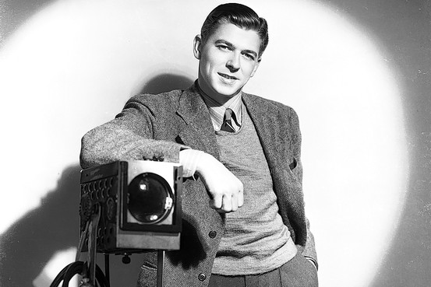
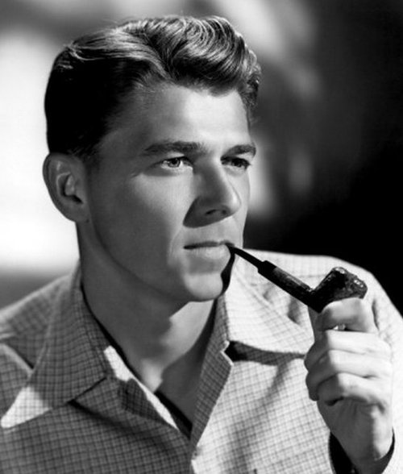
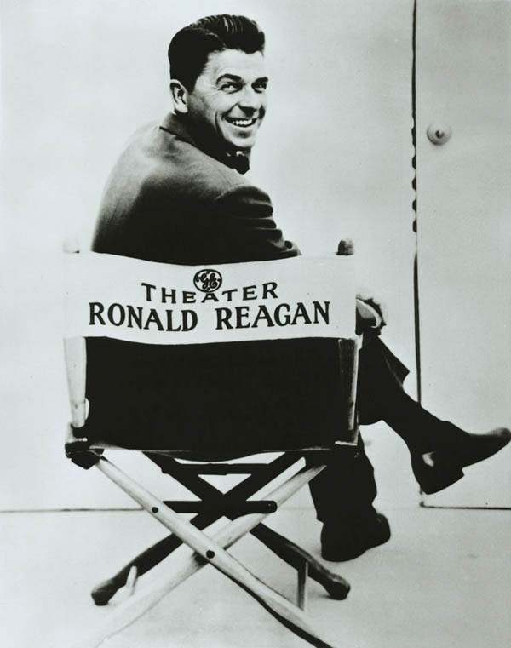

Slide 37
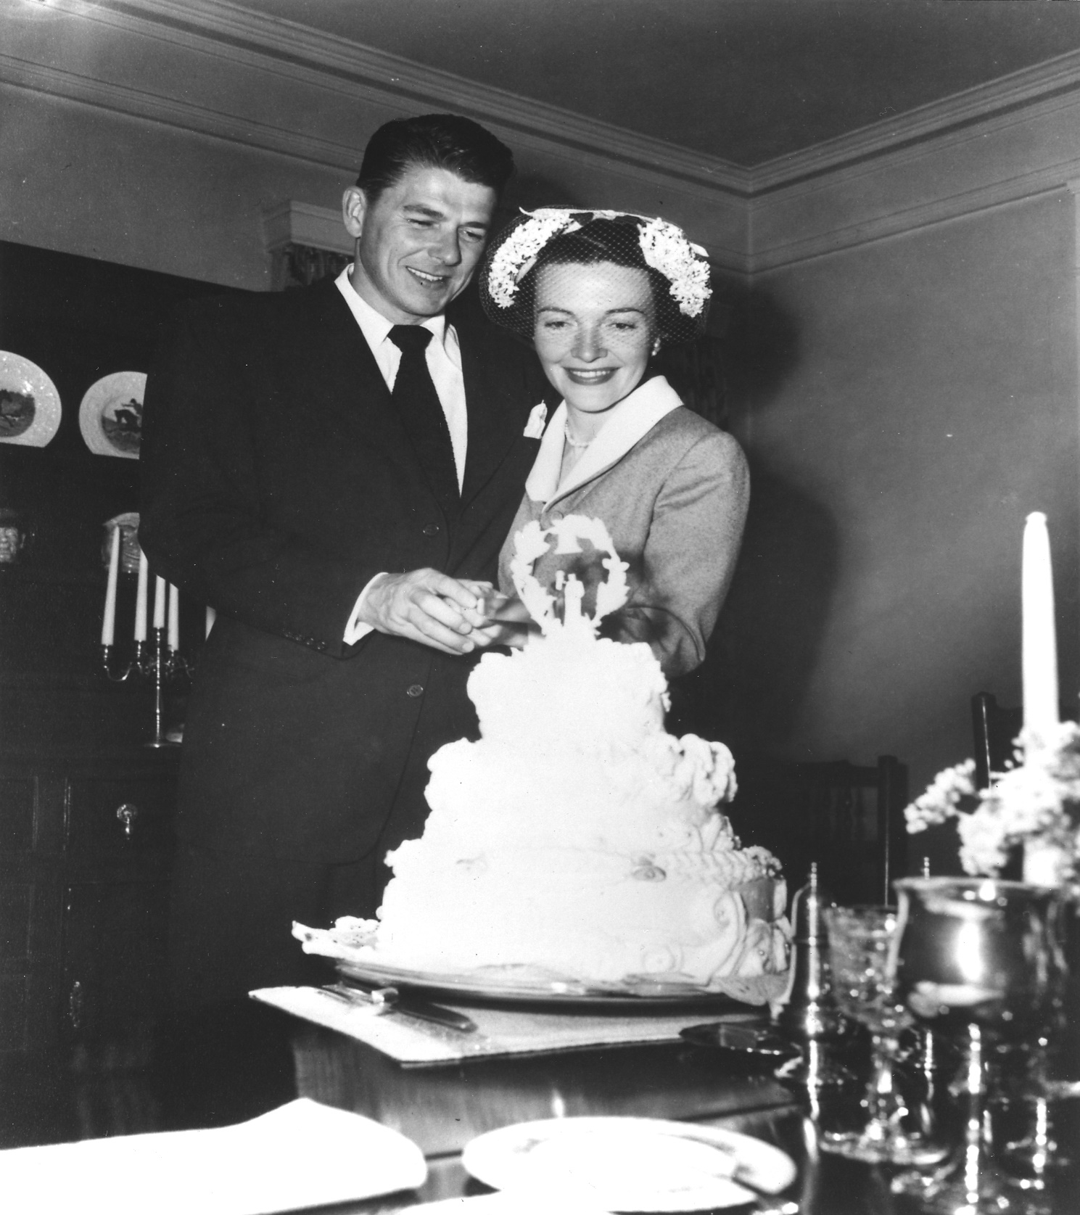
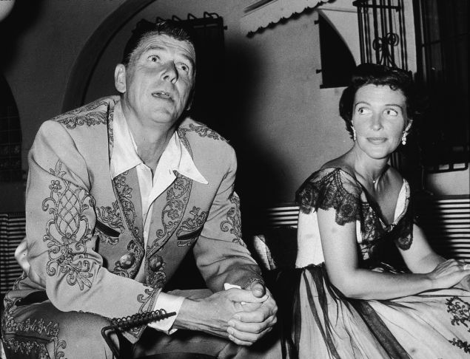

Slide 38
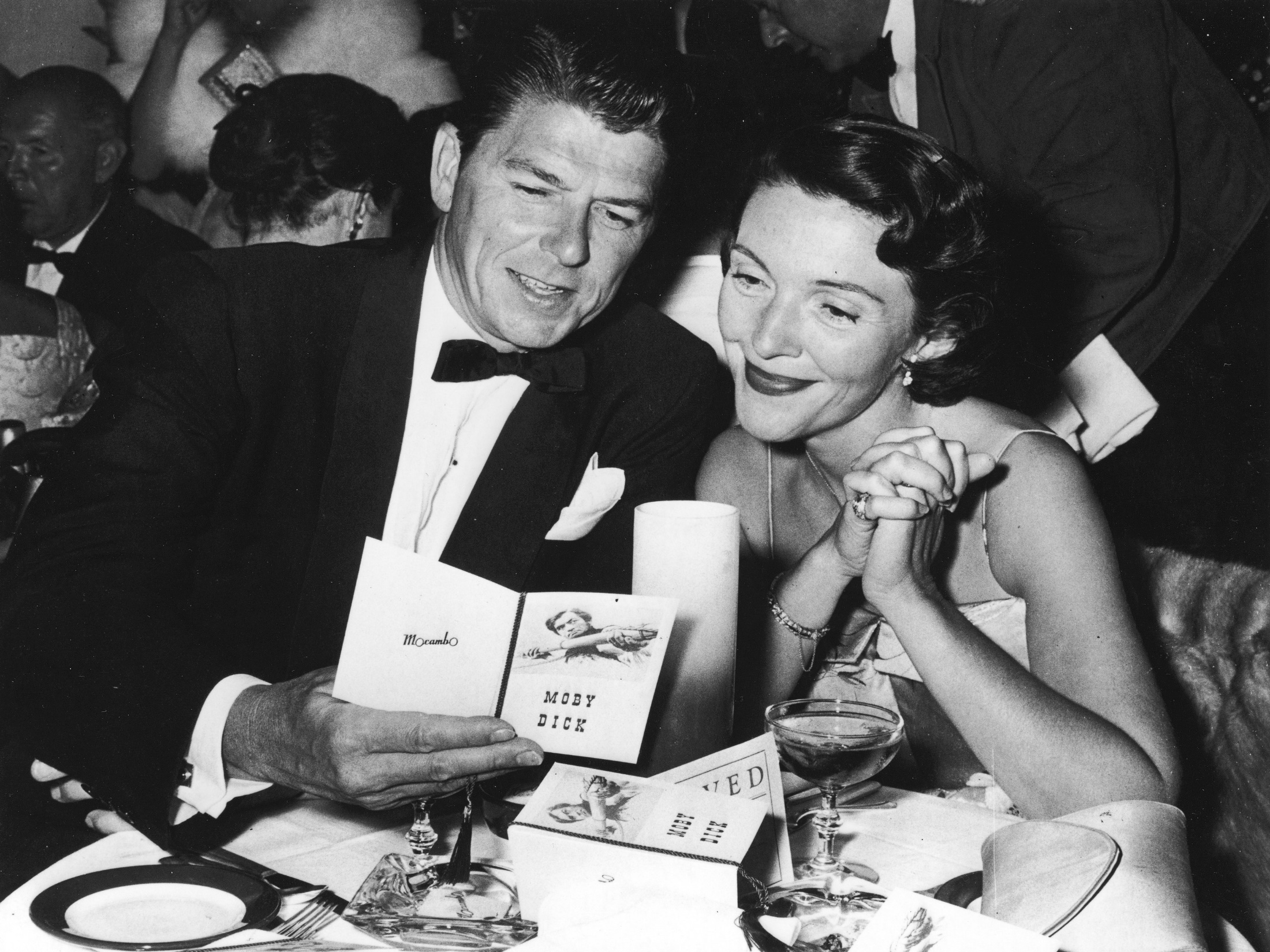
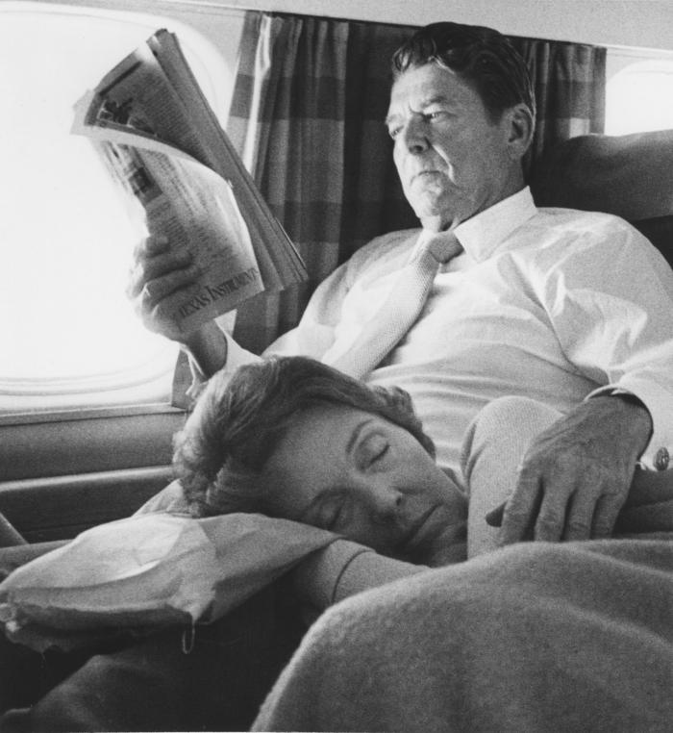
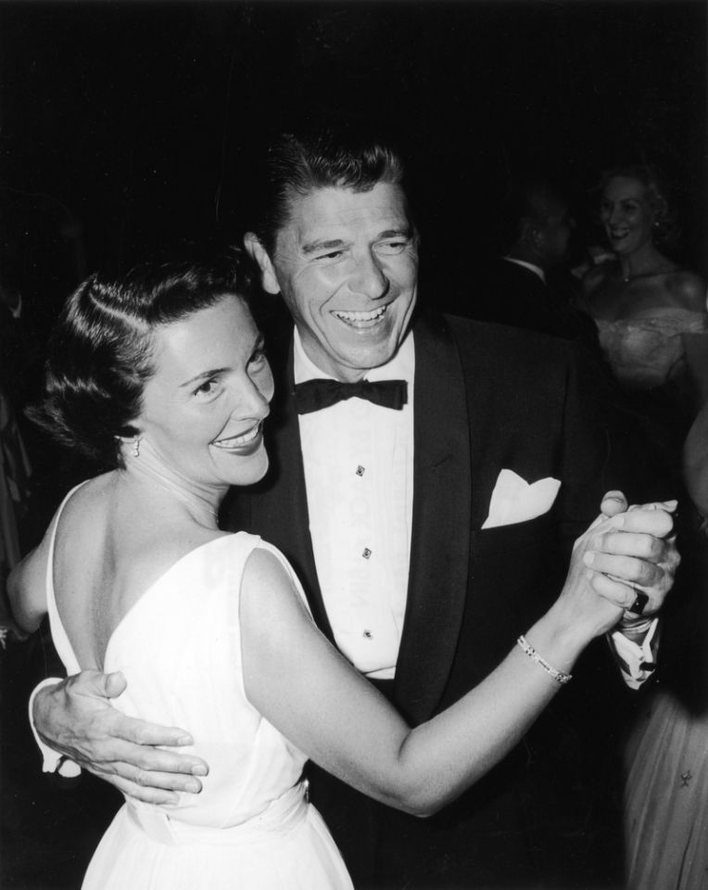

Slide 39
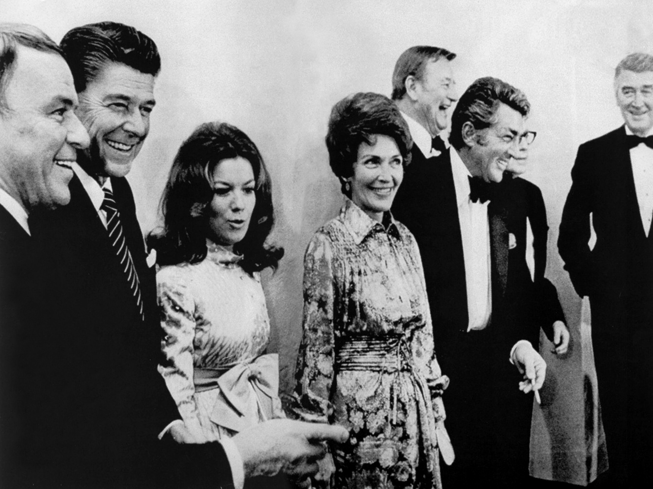
John Wayne
Jack Benny
Jimmy Stewart
Vicki Carr
Dean Martin
Frank Sinatra

Slide 40
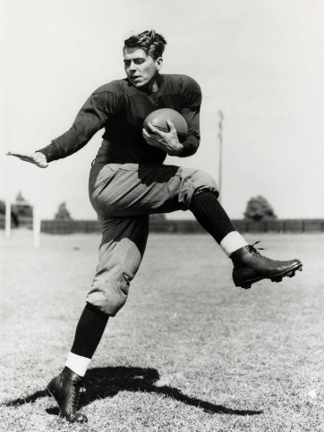
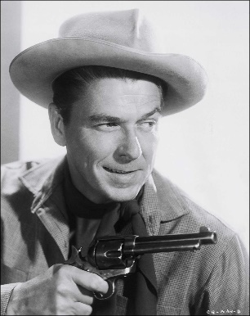
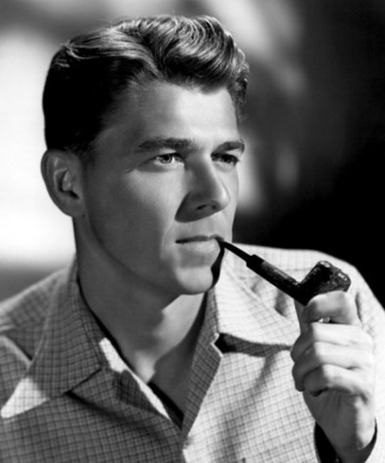

Slide 41
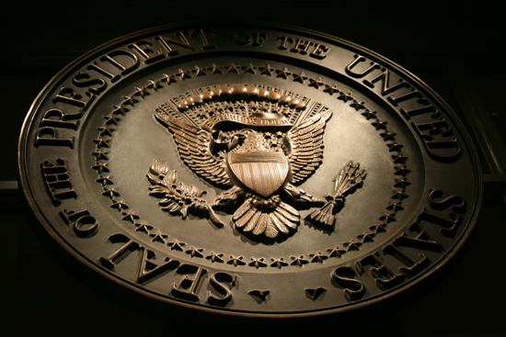
→ Each of us can accomplish more than we are able
→ Standing up for God magnifies the blessings
→ God is more important to us than can be calculated
→ One can not achieve a greater wisdom without Him
→ Wars and weapons will never resolve peace of heart
→ The Bible includes solutions to all man’s difficulties
→ Those missing the teachings of the Bible loose much
→ Jesus came to expose truth for all to know God
→ Atheists can never shine upon infinite truth
→ Voiced in nature is undeniable presence of God
→ Freedom is inspired from God’s desire for us
→ God’s rock only comes to those faithful in Him
→ Those who lead inspire others to be greater
Many scream of getting older yet birth is ahead
Notes:
Many scream of getting older yet birth is ahead

Slide 43
Presidential Quotes
Ron Bert
32½
November 1, 2020

Slide 44
Part 2
40. Ronald Reagan (1981-1989)

Slide 45
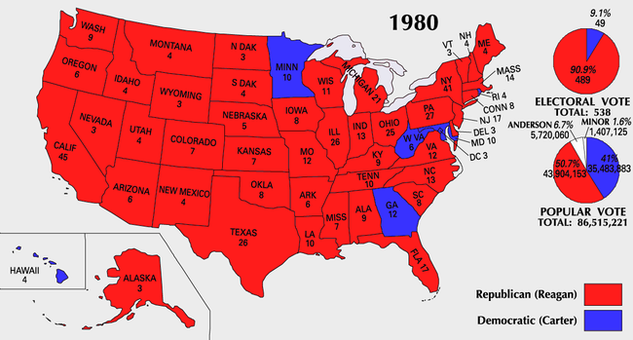

Slide 46
“Our nation will prosper or decline in direct proportion to our selection of leaders who are guided by the Holy Spirit. If we fail to select Godly leaders our destiny will surely be as that of the Roman Empire.”

Slide 47
When the righteous are in authority, the people rejoice; But when a wicked man rules, the people groan. — Proverbs 29:2

Slide 48
“We are never defeated unless we give up on God.”

Slide 49
“We in the United States, above all, must remember that lesson, for we were founded as a nation of openness to people of all beliefs. And so we must remain. Our very unity has been strengthened by our pluralism. We establish no religion in this country, we command no worship, we mandate no belief, nor will we ever. Church and state are, and must remain, separate. All are free to believe or not believe, all are free to practice a faith or not, and those who believe are free, and should be free, to speak of and act on their belief.”
free to believe
free to believe

Slide 50
“To those who cite the first amendment as reason for excluding God from more and more of our institutions and everyday life, may I just say: The first amendment of the Constitution was not written to protect the people of this country from religious values; it was written to protect religious values from government tyranny. . . . But now we're told our children have no right to pray in school. Nonsense. The pendulum has swung too far toward intolerance against genuine religious freedom. It is time to redress the balance.”
The first amendment of the Constitution
written to protect the people of this country
The first amendment of the Constitution
written to protect the people of this
country
to protect
religious from
values
government tyranny
to protect
religious
values
from
government
tyranny
intolerance against genuine religious freedom
intolerance against genuine religious freedom

Slide 51
But we have renounced the hidden things of shame, not walking in craftiness nor handling the word of God deceitfully, but by manifestation of the truth commending ourselves to every man's conscience in the sight of God. But even if our gospel is veiled, it is veiled to those who are perishing, whose minds the god of this age has blinded, who do not believe, lest the light of the gospel of the glory of Christ, who is the image of God, should shine on them. — 2nd Corinthians 4:2-4
glory of Christ
Christ
glory of Christ
image of God
shine on them
image of God
shine on them

Slide 52
“I know that it is often difficult to stand up for one's beliefs when they are being harshly challenged. But as one who has seen many challenges over a long lifetime, I can assure you that personal faith and conviction are strengthened, not weakened, in adversity.”

Slide 53
“The constitution was never meant to prevent people from praying; its declared purpose was to protect their freedom to pray.”
constitution
constitution
declared purpose
declared purpose
protect their freedom to pray
protect their freedom to pray

Slide 54
Continue earnestly in prayer, being vigilant in it with thanksgiving; — Colossians 4:2

Slide 55
“When our Founding Fathers passed the First Amendment, they sought to protect churches from government interference. They never intended to construct a wall of hostility between government and the concept of religious belief itself.”

Slide 56
“There is a fundamental difference between separation of church and state and denying the spiritual heritage of this country. Inscribed on the Jefferson Memorial in Washington, D.C. are Jefferson's words, 'The God Who gave us life gave us liberty -- can the liberties of a nation be secure when we have removed a conviction that these liberties are the gift of God?'”
denying the spiritual heritage
denying the spiritual heritage

Slide 57
“I believe that the most essential element of our defense of freedom is our insistence on speaking out for the cause of religious liberty.”
religious liberty
religious liberty

Slide 58
“The frustrating thing is that those who are attacking religion claim they are doing it in the name of tolerance, freedom and open-mindedness. Question: Isn't the real truth that they are intolerant of religion? They refuse to tolerate its importance in our lives.”

Slide 59
“Without God, there is no virtue because there is no prompting of the conscience... without God, there is a coarsening of the society; without God, democracy will not and cannot long endure.”
Without God
Without God
there is no
there is no
conscience
conscience
eroding
hardening
stiffening

Slide 60
“Politics and morality are inseparable. And as morality's foundation is religion, religion and politics are necessarily related. We need religion as a guide. We need it because we are imperfect, and our government needs the church, because only those humble enough to admit they're sinners can bring to democracy the tolerance it requires in order to survive.”
morality's foundation is religion
morality's foundation is religion

Slide 61
“God, the source of all knowledge, should never have been expelled from our children's classrooms.”
God, the source of all knowledge
God, the source of all knowledge

Slide 62
For the LORD gives wisdom; From His mouth come knowledge and understanding; He stores up sound wisdom for the upright; He is a shield to those who walk uprightly; — Proverbs 2:6-7

Slide 63
“If we get the federal government out of the classroom, maybe we'll get God back in.”

Slide 64
“The First Continental Congress made its first act a prayer, the beginning of a great tradition. We have then a lesson from the founders of our land. That lesson is clear: That in the winning of freedom and in the living of life, the first step is prayer.”
prayer
prayer

Slide 65
“We seek a constitutional amendment to permit voluntary school prayer. God should never have been expelled from America's classrooms in the first place.”

Slide 66
Rejoice always, pray without ceasing, in everything give thanks; for this is the will of God in Christ Jesus for you. Do not quench the Spirit. — 1st Thessalonians 5:16-19

Slide 67
“God...should never have been expelled from America's schools. As we struggle to teach our children ... we dare not forget that our civilization was built by men and women who placed their faith in a loving God. If Congress can begin each day with a moment of prayer ... so then can our sons and daughters.”

Slide 70
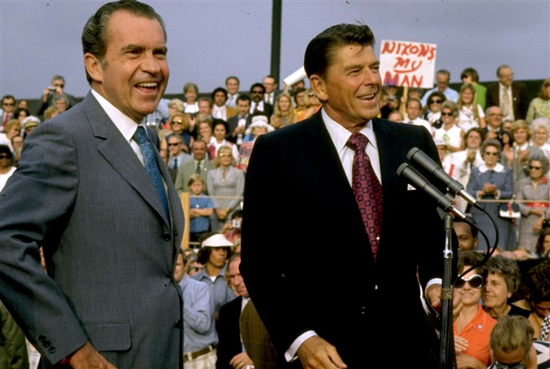

Slide 71
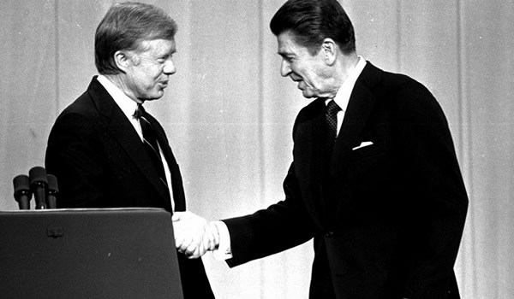

Slide 72
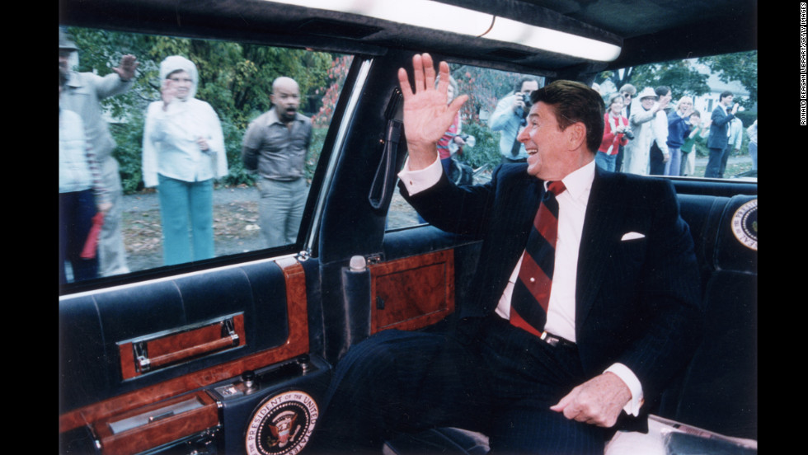

Slide 73
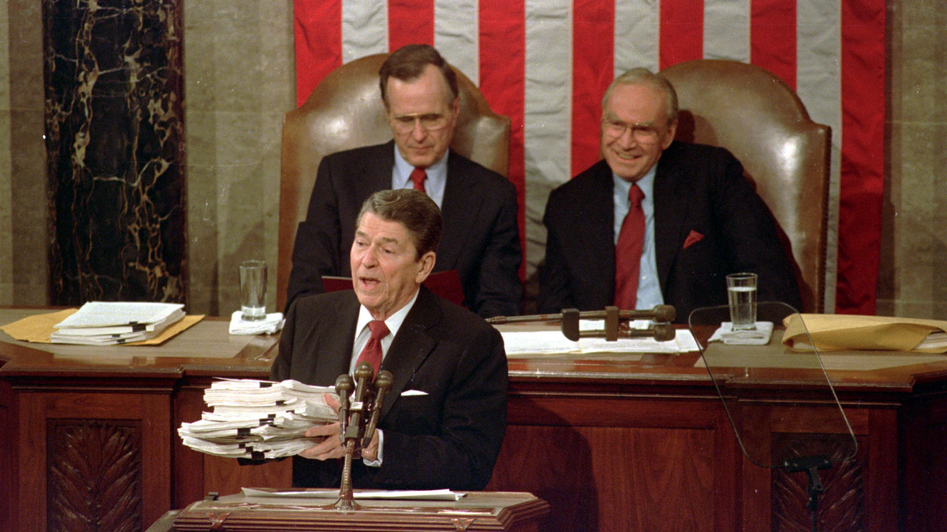

Slide 74
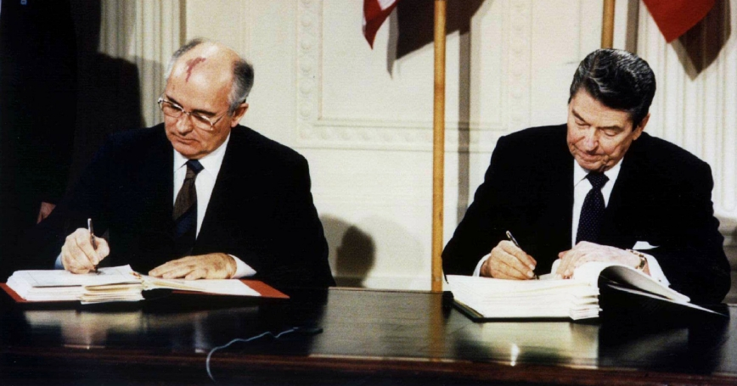

Slide 75
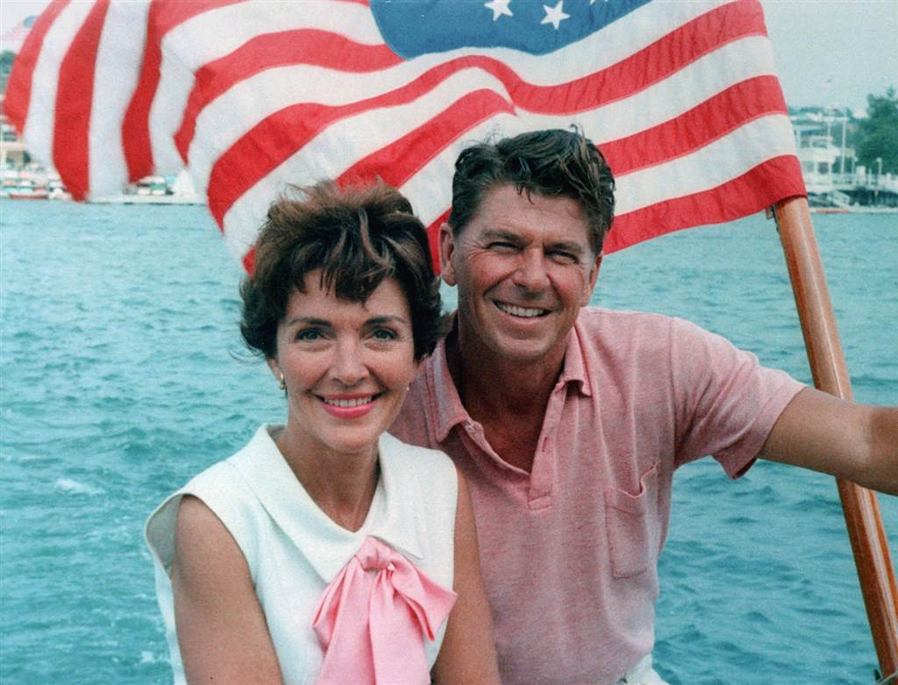

Slide 76
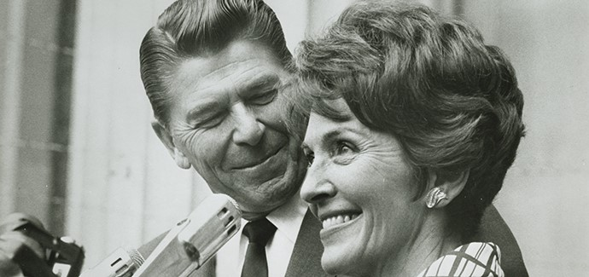

Slide 77
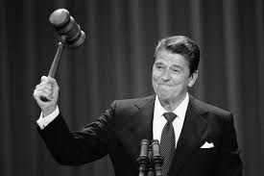
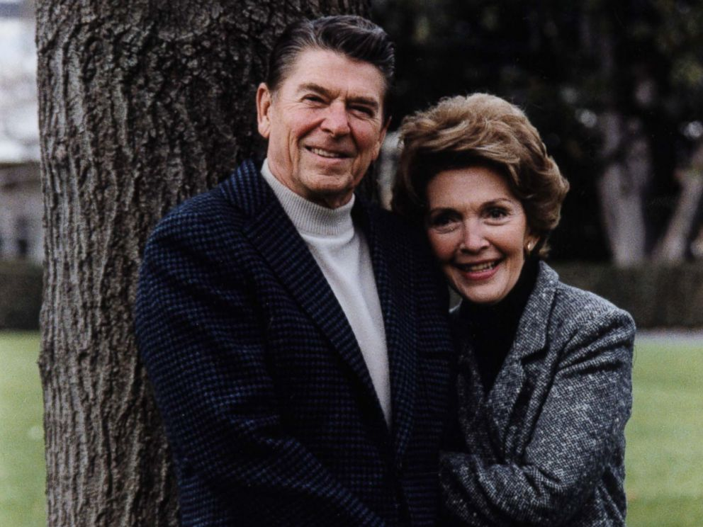
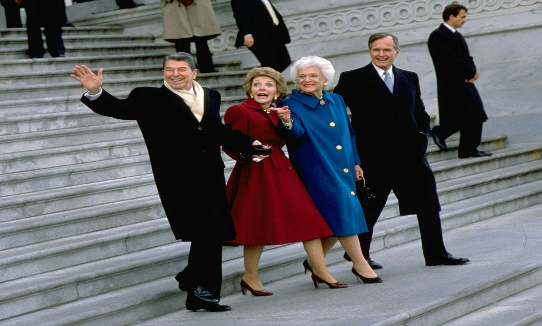
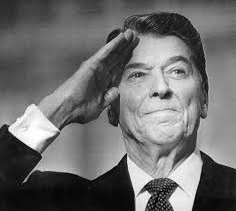
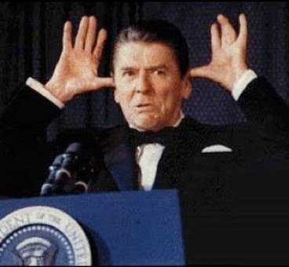

Slide 78
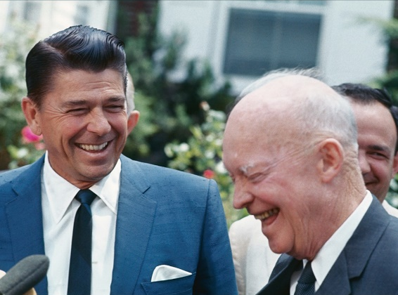

Slide 79
→ Without godly leaders quarrels will lead to defeat
→ Belief is a quest to know God in hope of life
→ Convoluted laws expose man’s evil against God
→ Conviction to God is strengthened in our weakness
→ Constitutional rights were written to protect faith
→ Our Government is to protect church not eliminate it
→ If we abandon God’s gift of life death is next
→ Continuing to speak of God ensures freedom
→ Without God our social system of life will collapse
→ It is an abomination to deny prayer to our children
→ Prayer is a unremovable tradition of national favor
→ Tragic is prayer being expelled from public schools
→ The best solution for youthful respect is God
In times of distress all hope for leadership
Notes:
In times of distress all hope for leadership.

Slide 81
Please visit http://www.LoveFromGod.com to explore further
Ronald Bert Channel on
Notes:
Eternity never ends.

