Slide 2
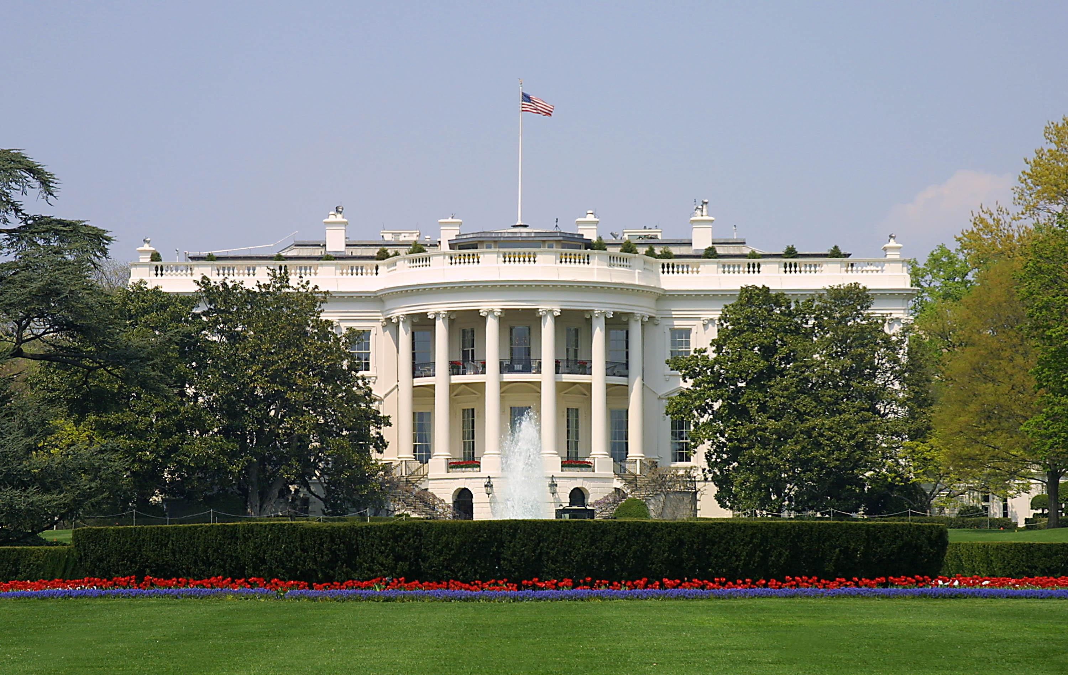
Presidential Quotes
Ron Bert
11
October 14, 2018

Slide 3
16. Abraham Lincoln (1861-1865)
Part 7

Slide 4
“We, on our side, are praying to Him to give us victory, because we believe we are right; but those on the other side pray to Him, look for victory, believing they are right. What must He think of us?”

Slide 5
God looks down from heaven upon the children of men, To see if there are any who understand, who seek God. Every one of them has turned aside; They have together become corrupt; There is none who does good, No, not one. — Psalms 53:2-3

Slide 6
“The will of God prevails. In great contests each party claims to act in accordance with the will of God. Both may be, and one must be, wrong. God cannot be for and against the same thing at the same time. In the present civil war it is quite possible that God's purpose is something different from the purpose of either party - and yet the human instrumentalities, working just as they do, are of the best adaptation to effect His purpose.”

Slide 7
"No servant can serve two masters; for either he will hate the one and love the other, or else he will be loyal to the one and despise the other. You cannot serve God and mammon." Now the Pharisees, who were lovers of money, also heard all these things, and they derided Him. And He said to them, "You are those who justify yourselves before men, but God knows your hearts. For what is highly esteemed among men is an abomination in the sight of God." — Luke 16:13-15

Slide 8
“Both read the same Bible, and pray to the same God; and each invokes His aid against the other. It may seem strange that any men should dare to ask a just God's assistance in wringing their bread from the sweat of other men's faces; but let us judge not that we be not judged. The prayers of both could not be answered; that of neither has been answered fully.”

Slide 9
For if we would judge ourselves, we would not be judged.. — 1st Corinthians 11:31

Slide 10
“The shepherd drives the wolf from the sheep for which the sheep thanks the shepherd as his liberator, while the wolf denounces him for the same act as the destroyer of liberty. Plainly, the sheep and the wolf are not agreed upon a definition of liberty.”

Slide 11
“The war, the American Civil War of 1861-1865, would never have been possible without the sinister influence of the Jesuits.”

Slide 12
The wicked prowl on every side, When vileness is exalted among the sons of men. — Psalms 12:8

Slide 13
“My earlier views of the unsoundness of the Christian scheme of salvation and the human origin of the scriptures have become clearer and stronger with advancing years, and I see no reason for thinking I shall ever change them.”

Slide 14
Pursue peace with all people, and holiness, without which no one will see the Lord: looking carefully lest anyone fall short of the grace of God; lest any root of bitterness springing up cause trouble, and by this many become defiled; ... — Hebrews 12:14-15
bitterness

Slide 15
“I have been driven many times upon my knees by the overwhelming conviction that I had nowhere else to go. My own wisdom and that of all about me seemed insufficient for that day.”

Slide 16
There is a way that seems right to a man, But its end is the way of death. — Proverbs 14:12

Slide 17
“If there is a worse place than Hell, I am in it.”

Slide 18
“I am now the most miserable man living. If what I feel were felt by the whole human race, there would not be one cheerful face left on earth.”

Slide 19
The heart knows its own bitterness, And a stranger does not share its joy. — Proverbs 14:10

Slide 20
“Weakness is what keeps driving us to God, by the overwhelming conviction that there just isn't anywhere else to go.”

Slide 21
And He said to me, "My grace is sufficient for you, for My strength is made perfect in weakness." Therefore most gladly I will rather boast in my infirmities, that the power of Christ may rest upon me. — 2nd Corinthians 12:9

Slide 22
“In this sad world of ours, sorrow comes to all; and, to the young, it comes with bitterest agony, because it takes them unaware.”

Slide 23
“Nevertheless, amid the greatest difficulties of my Administration, when I could not see any other resort, I would place my whole reliance on God, knowing that all would go well, and that He would decide for the right.”
reliance on God

Slide 24
“If it were not for my firm belief in an overruling Providence, it would be difficult for me, in the midst of such complications of affairs, to keep my reason on its seat. But I am confident that the Almighty has His plans, and will work them out; and, whether we see it or not, they will be the best for us.”
firm belief

Slide 25
“We hoped for a happy termination of this terrible war long before this; but God knows best, and has ruled otherwise. We shall yet acknowledge His wisdom and our own error therein.”
our own error

Slide 26
Where do wars and fights come from among you? Do they not come from your desires for pleasure that war in your members? You lust and do not have. You murder and covet and cannot obtain. You fight and war. Yet you do not have because you do not ask. You ask and do not receive, because you ask amiss, that you may spend it on your pleasures. Adulterers and adulteresses! Do you not know that friendship with the world is enmity with God? Whoever therefore wants to be a friend of the world makes himself an enemy of God. — James 4:1-4

Slide 27
“And while it has not pleased the Almighty to bless us with a return of peace, we can but press on, guided by the best light He gives, trusting that in His own good time, and wise way, all will yet be well.”
guided by
best light
trust

Slide 28
For it is better, if it is the will of God, to suffer for doing good than for doing evil. — 1st Peter 3:17
Brethren, I do not count myself to have apprehended; but one thing I do, forgetting those things which are behind and reaching forward to those things which are ahead, I press toward the goal for the prize of the upward call of God in Christ Jesus.. — Philippians 3:13-14

Slide 29
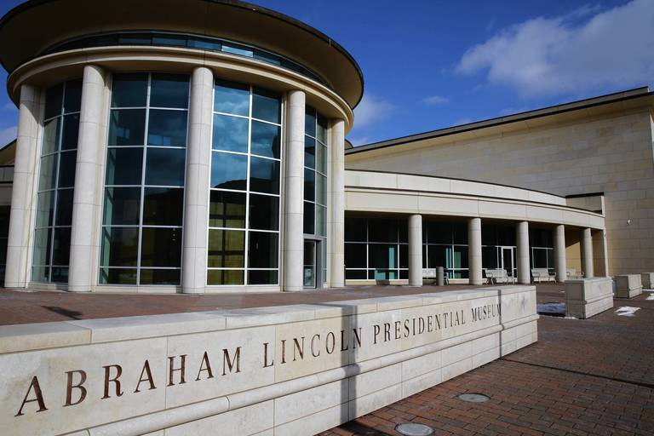
Notes:
Springfield, IL

Slide 30
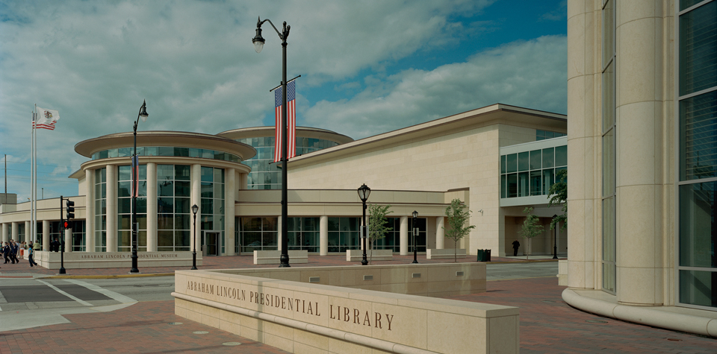

Slide 31
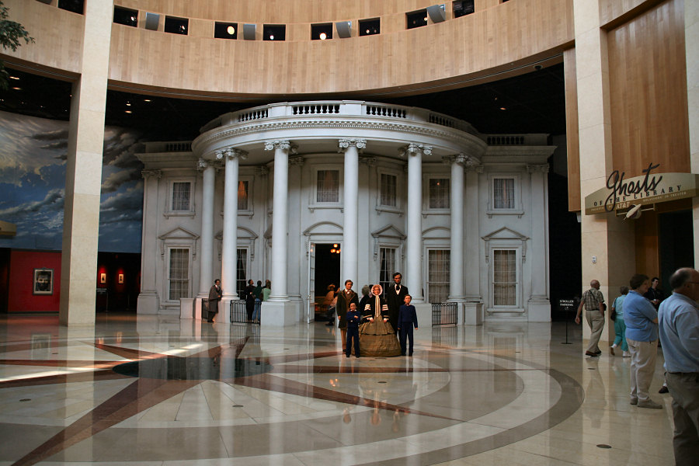

Slide 32
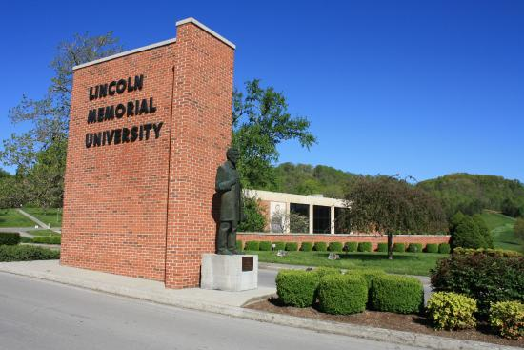
Notes:
Harrogate, Tennessee

Slide 33
Notes:
Harrogate, Tennessee

Slide 34
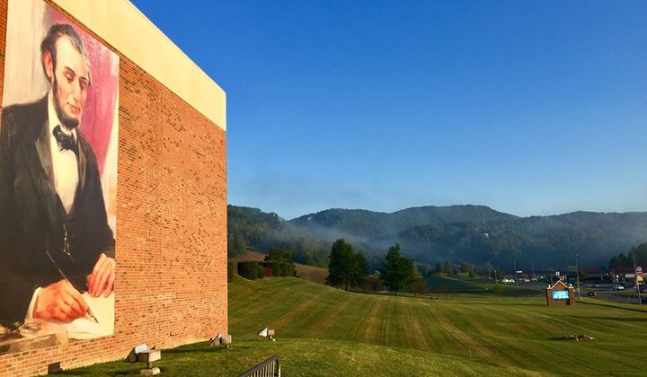
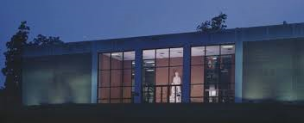

Slide 35
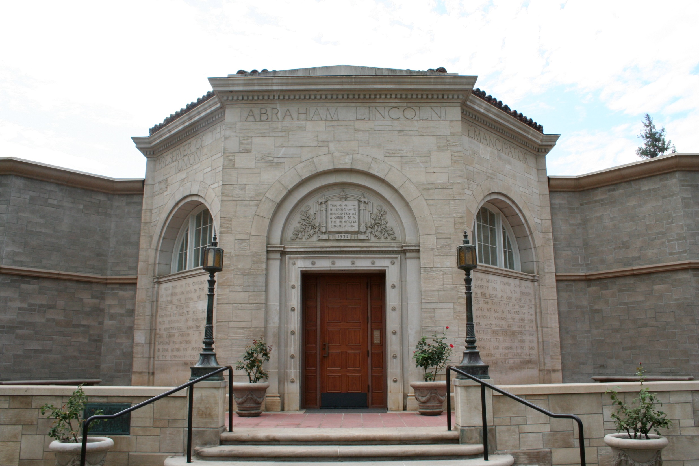
Notes:
Redlands CA

Slide 36
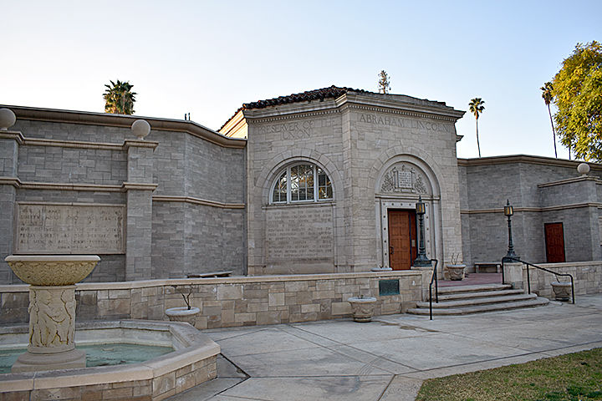

Slide 37
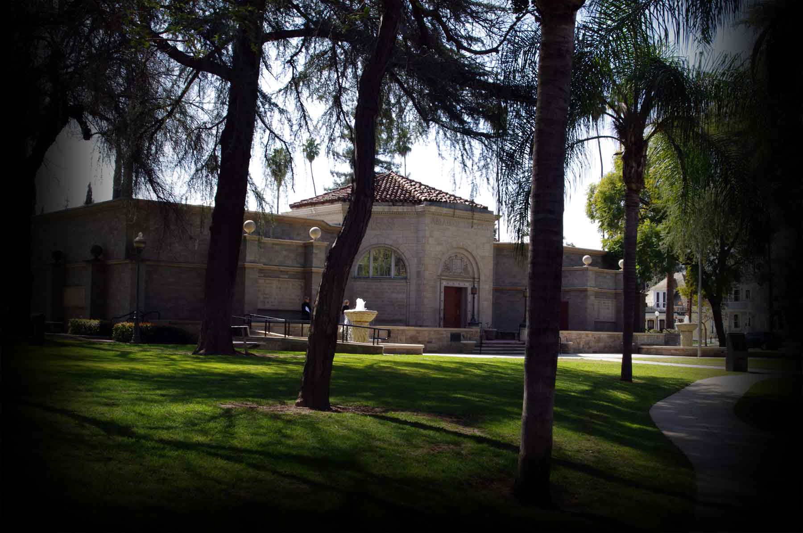

Slide 38
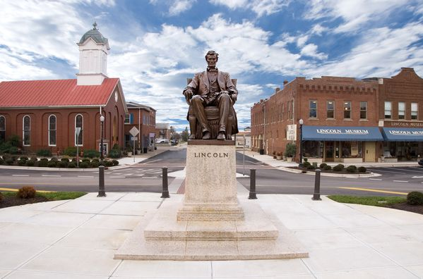
Notes:
HODGENVILLE, Ky

Slide 39
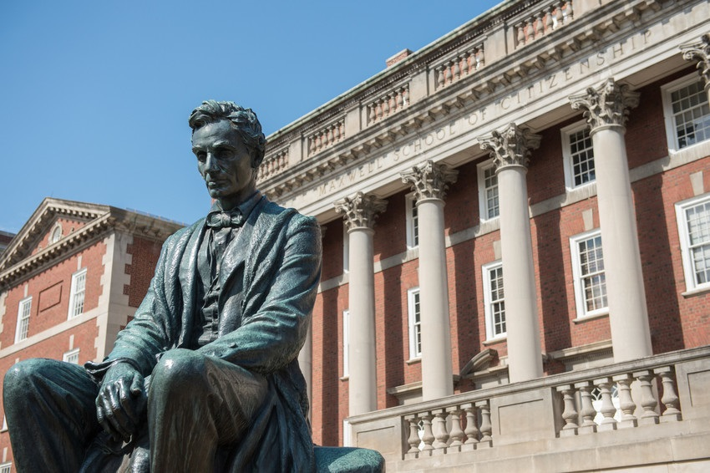
Notes:
Syracuse University

Slide 40
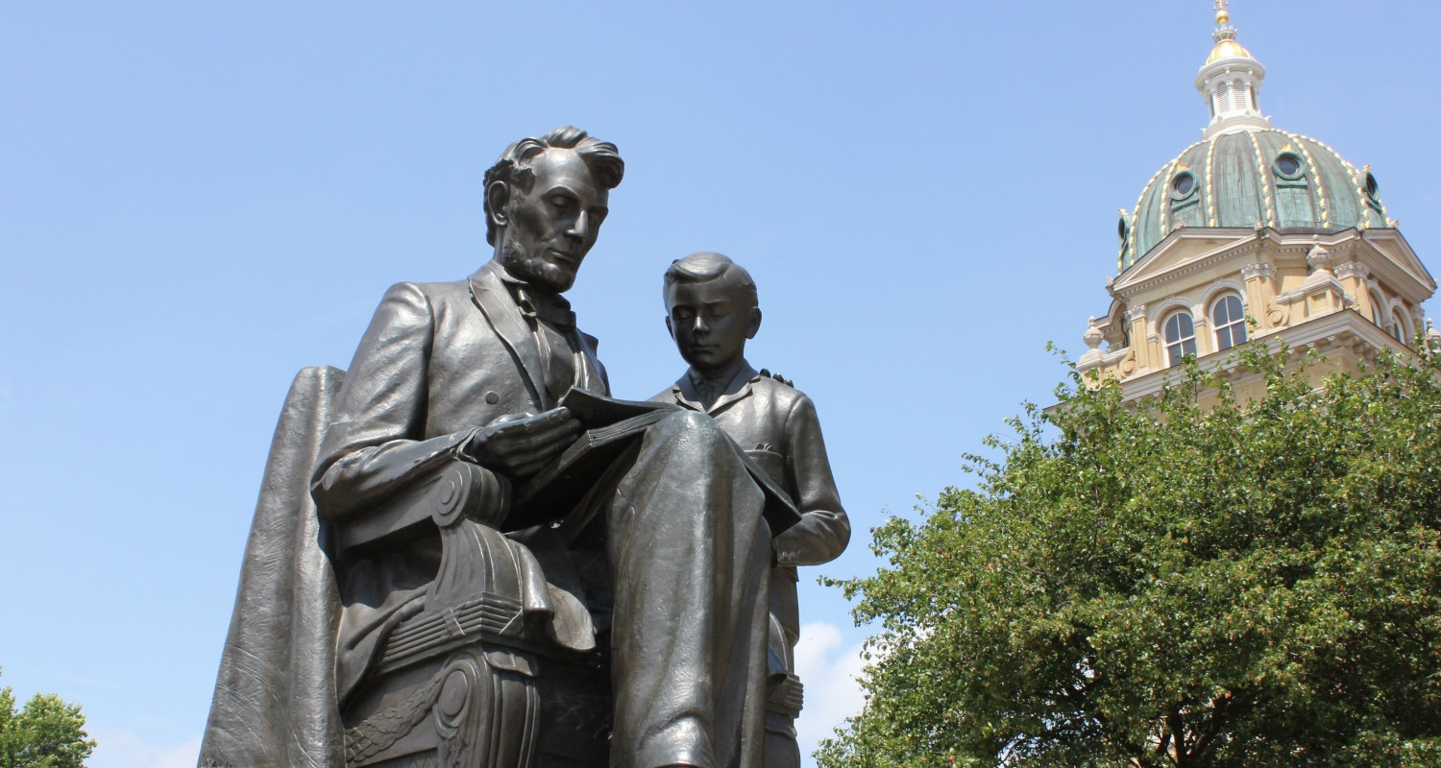
Notes:
Des Moines Iowa

Slide 41
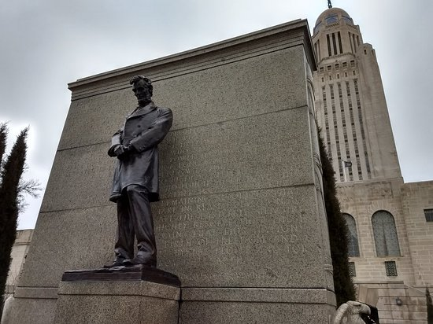
Notes:
Nebraska State Capitol

Slide 42
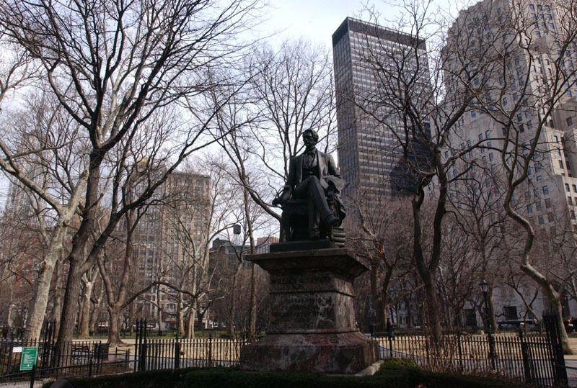
Notes:
Madison Square Park

Slide 43
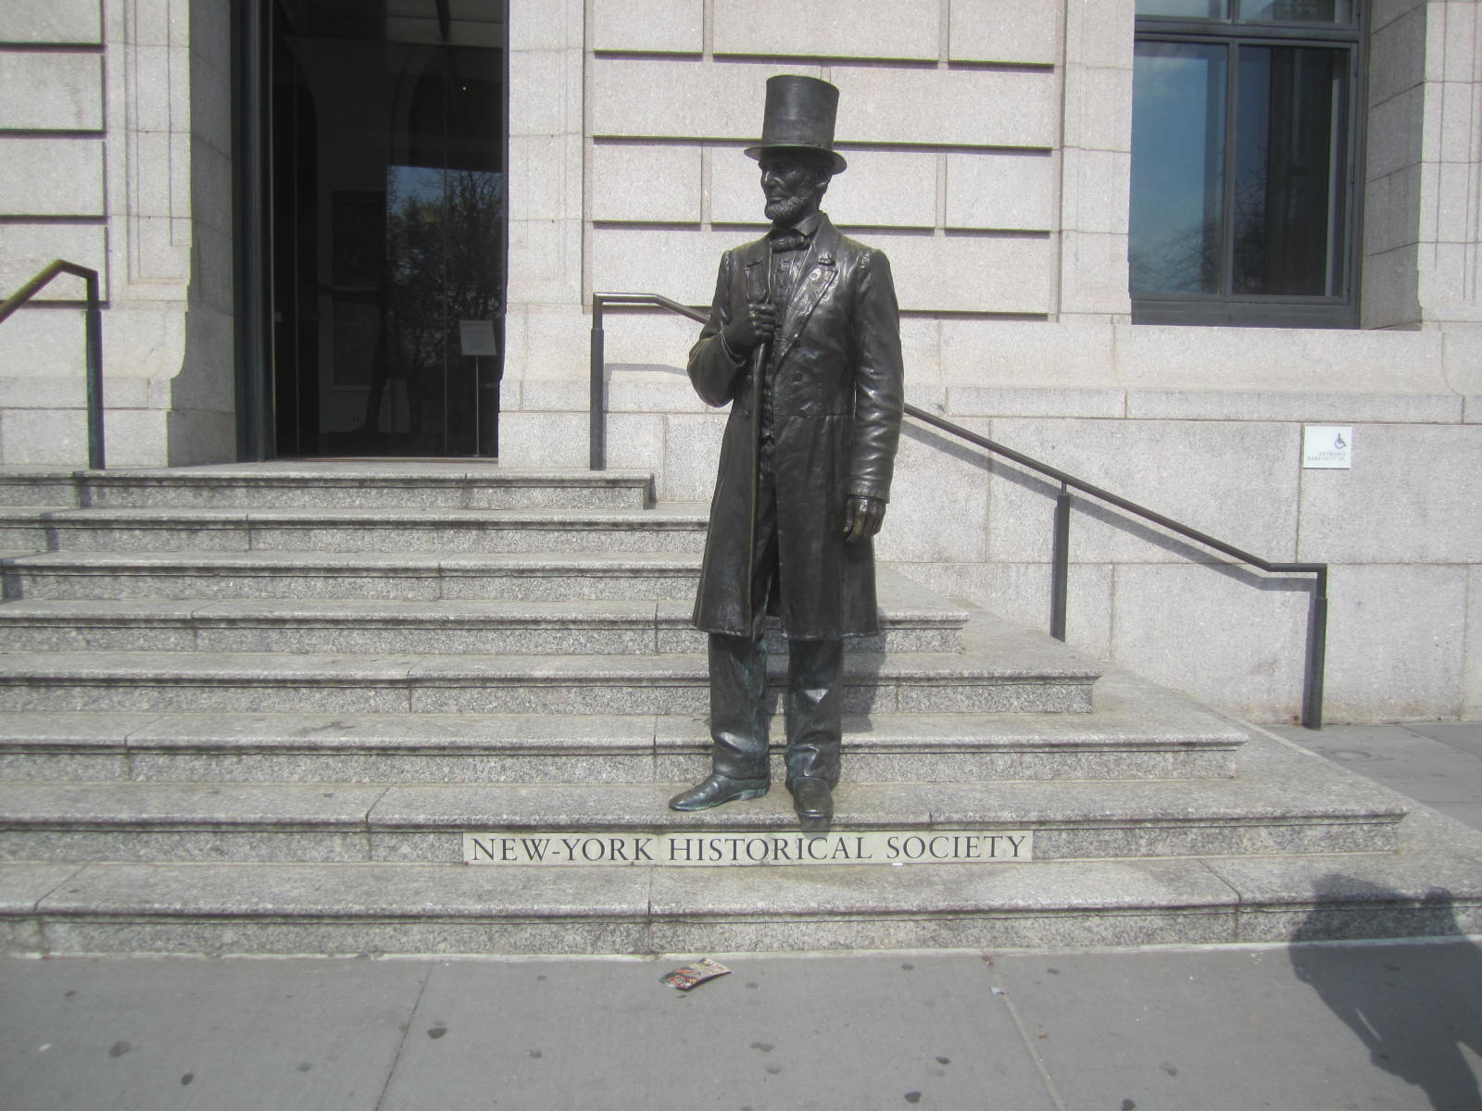

Slide 44
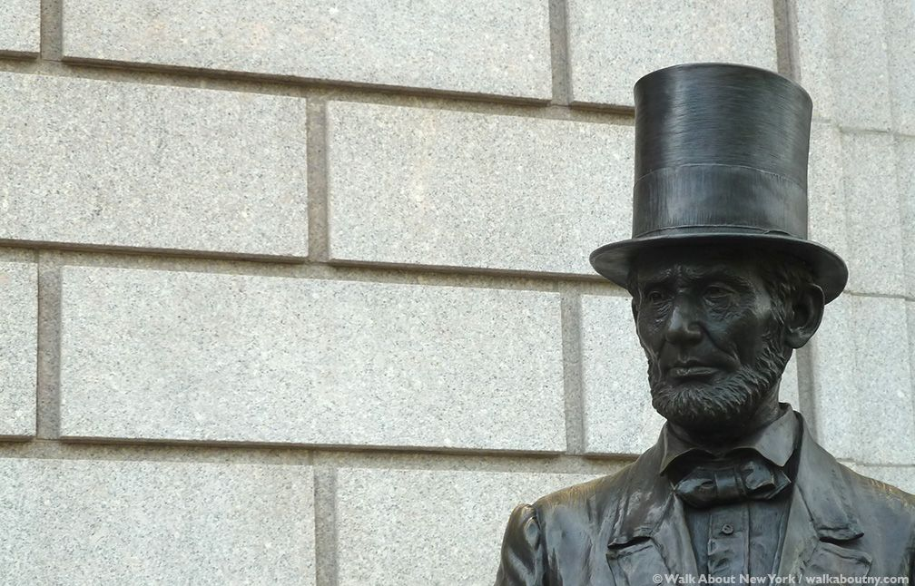

Slide 45
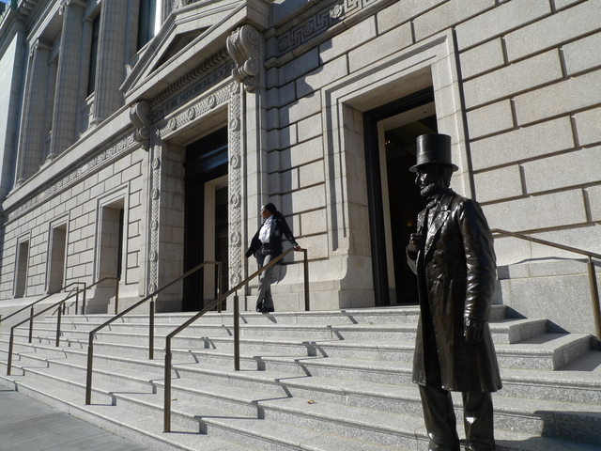

Slide 46
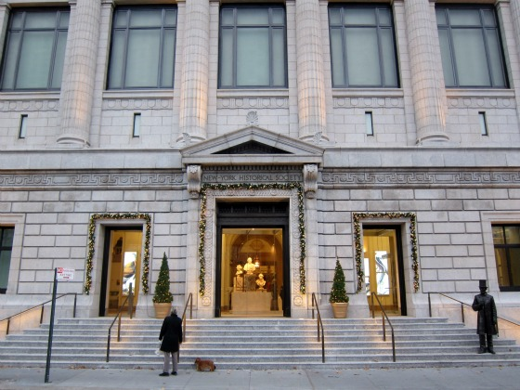

Slide 47
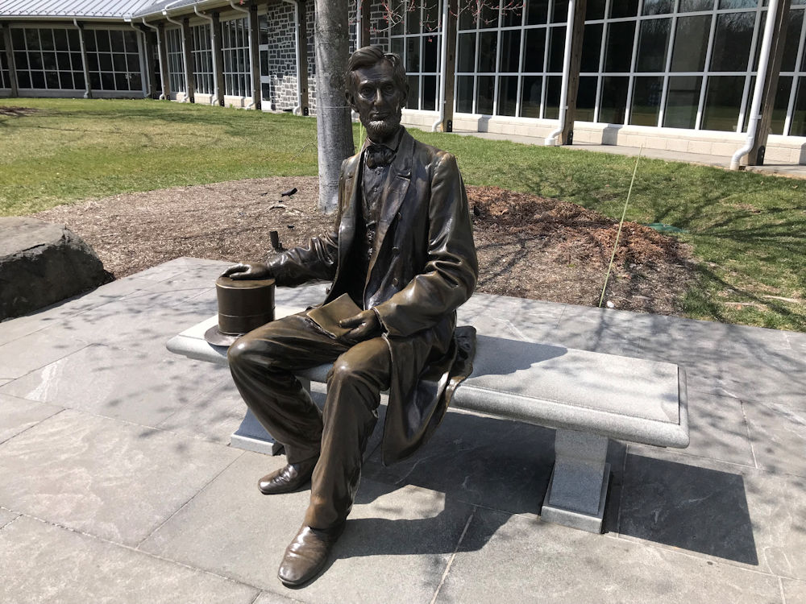
Notes:
Gettysburg

Slide 48
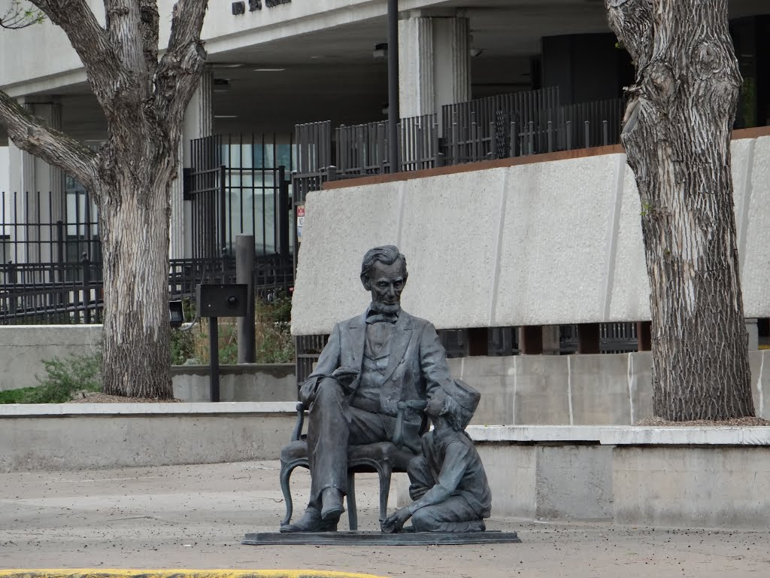
Notes:
Rapid City

Slide 49
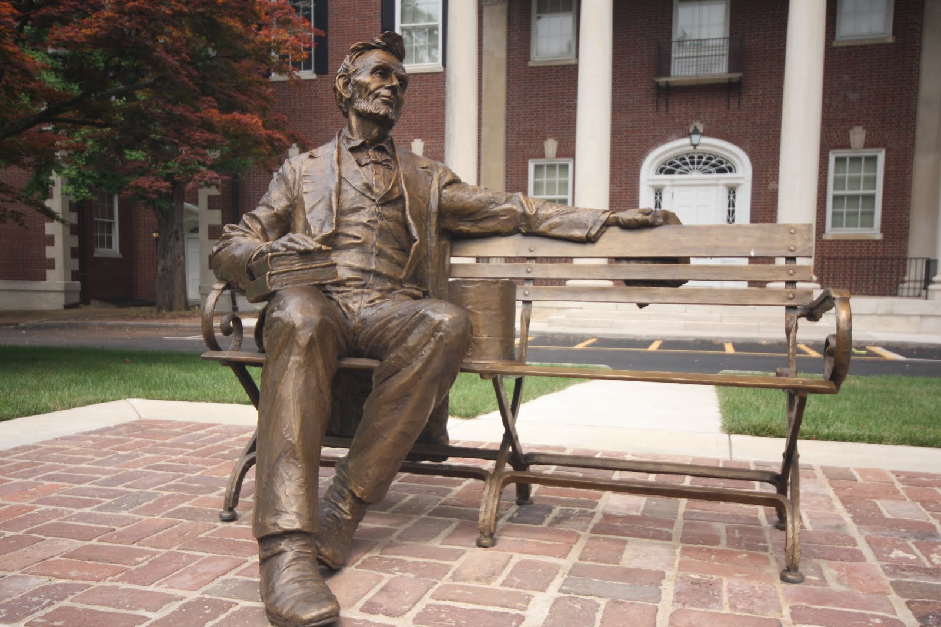
Notes:
Springfield

Slide 50
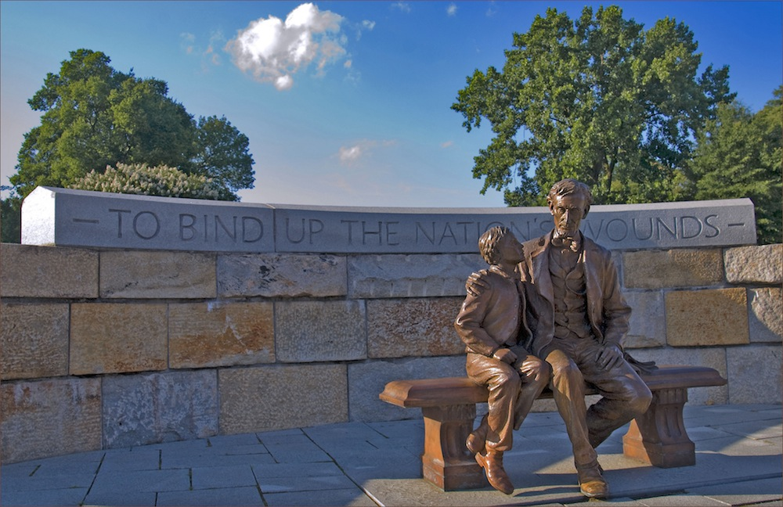
Notes:
Richmond

Slide 51
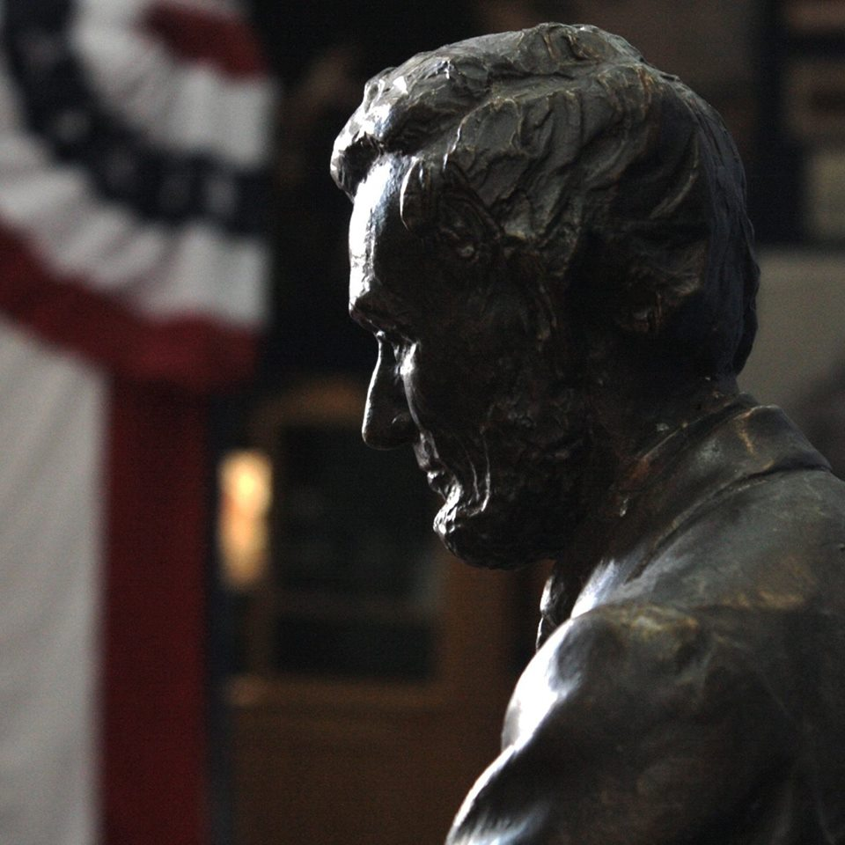

Slide 54
Presidential Quotes
Ron Bert
11½
October 21, 2018

Slide 55
16. Abraham Lincoln (1861-1865)
Part 8

Slide 56
“We must work earnestly in the best light He gives us.”
work earnestly
best light

Slide 57
“The purposes of the Almighty are perfect, and must prevail, though we erring mortals may fail to accurately perceive them in advance.”

Slide 58
For I proclaim the name of the LORD: Ascribe greatness to our God. He is the Rock, His work is perfect; For all His ways are justice, A God of truth and without injustice; Righteous and upright is He. — Deuteronomy 32:3-4

Slide 59
“I do not doubt that our country will finally come through safe and undivided. But do not misunderstand me... I do not rely on the patriotism of our people... the bravery and devotion of the boys in blue... (or) the loyalty and skill of our generals... But the God of our fathers, Who raised up this country to be the refuge and asylum of the oppressed and downtrodden of all nations, will not let it perish now. I may not live to see it... I do not expect to see it, but God will bring us through safe.”

Slide 60
And he said, "Listen, all you of Judah and you inhabitants of Jerusalem, and you, King Jehoshaphat! Thus says the LORD to you: 'Do not be afraid nor dismayed because of this great multitude, for the battle is not yours, but God's.'" — 2nd Chronicles 20:15

Slide 61
“I pray that our Heavenly Father may assuage the anguish of your bereavement, and leave you only the cherished memory of the loved and lost, and the solemn pride that must be yours, to have laid so costly a sacrifice upon the altar of Freedom.”

Slide 62
“We must remember that the people of all the States are entitled to all the privileges and immunities of the citizen of the several States. We should bear this in mind, and act in such a way as to say nothing insulting or irritating. I would inculcate this idea, so that we may not, like Pharisees, set ourselves up to be better than other people.”

Slide 63
"Talk no more so very proudly; Let no arrogance come from your mouth, For the LORD is the God of knowledge; And by Him actions are weighed." — 1st Samuel 2:3

Slide 64
Let no corrupt word proceed out of your mouth, but what is good for necessary edification, that it may impart grace to the hearers. — Ephesians 4:29

Slide 65
“I have always found that mercy bears richer fruits than strict justice.”

Slide 66
“Such will be a great lesson of peace: teaching men that what they cannot take by an election, neither can they take it by war.”

Slide 67
“Violence begins where knowledge ends.”

Slide 68
“Whereas the Senate of the United States, devoutly recognizing the supreme authority and just government of Almighty God in all the affairs of men and of nations, has by a resolution requested the President to designate and set apart a day for national prayer and humiliation; and Whereas it is the duty of nations as well as of men to own their dependence upon the overruling power of God, to confess their sins and transgressions in humble sorrow, yet with assured hope that genuine repentance will lead to mercy and pardon, and to recognize the sublime truth, announced in the Holy Scriptures and proven by all history, that those nations only are blessed whose God is the Lord;”

Slide 69
“Let the people know the truth and the country is safe.”

Slide 70
The LORD is near to all who call upon Him, To all who call upon Him in truth. He will fulfill the desire of those who fear Him; He also will hear their cry and save them. The LORD preserves all who love Him, But all the wicked He will destroy. — Psalms 145:18-20

Slide 71
“I never encourage deceit, and falsehood, especially if you have got a bad memory, is the worst enemy a fellow can have. The fact is truth is your truest friend, no matter what the circumstances are.”

Slide 72
“I am a firm believer in the people. If given the truth, they can be depended upon to meet any national crisis. The great point is to bring them the real facts.”

Slide 73
"And you shall know the truth, and the truth shall make you free." — John 8:32

Slide 74
“The legalized liquor business is the tragedy of our civilization. Alcohol is the greatest and most blighting curse of our modern civilization. The liquor seller is simply and only a privileged malefactor - a criminal.”

Slide 75
“You must remember that some things legally right are not morally right.”

Slide 76
“Whether or not the world would be vastly benefited by a total banishment from it of all intoxicating drinks seems not now an open question. Three-fourths of mankind confess the affirmative with their tongues, and I believe all the rest acknowledge it in their hearts.”

Slide 77
“The one victory we can ever call complete will be that one which proclaims that there is not one slave or one drunkard on the face of God's green earth.”

Slide 78
“But fight we must; and conquer we shall; in the end.”

Slide 79
"But he who endures to the end shall be saved." — Matthew 24:13

Slide 80
“Let’s have faith that right makes might; and in that faith let us, to the end, dare to do our duty as we understand it.”

Slide 81
For God has not given us a spirit of fear, but of power and of love and of a sound mind. — 2nd Timothy 1:7

Slide 82
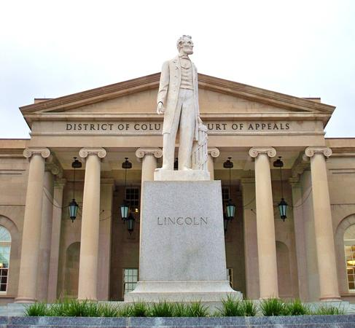

Slide 83
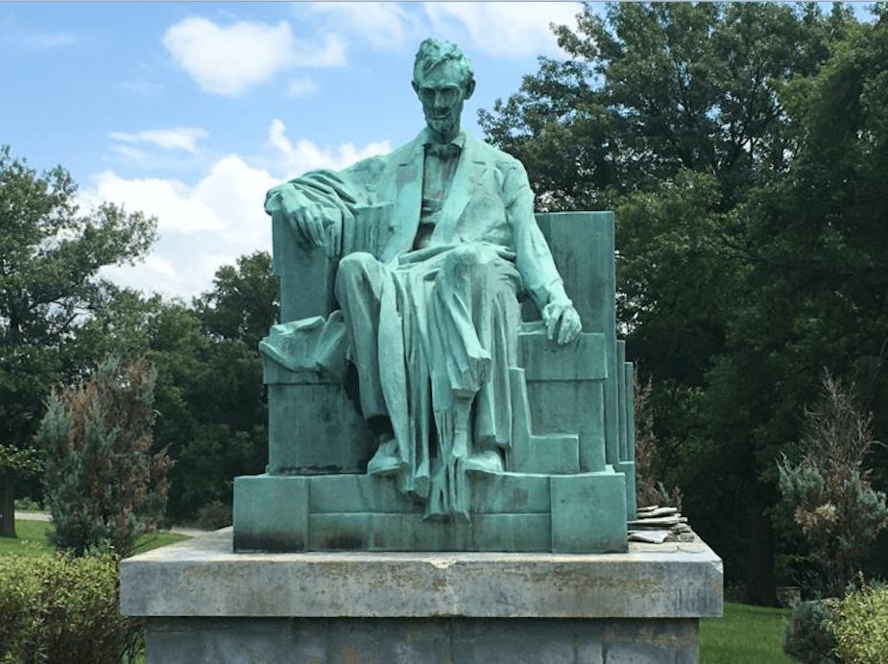
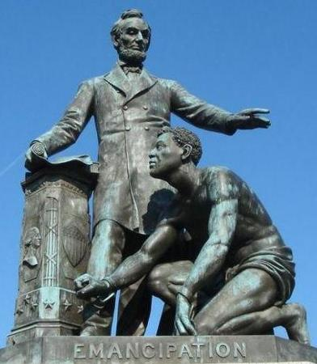

Slide 84
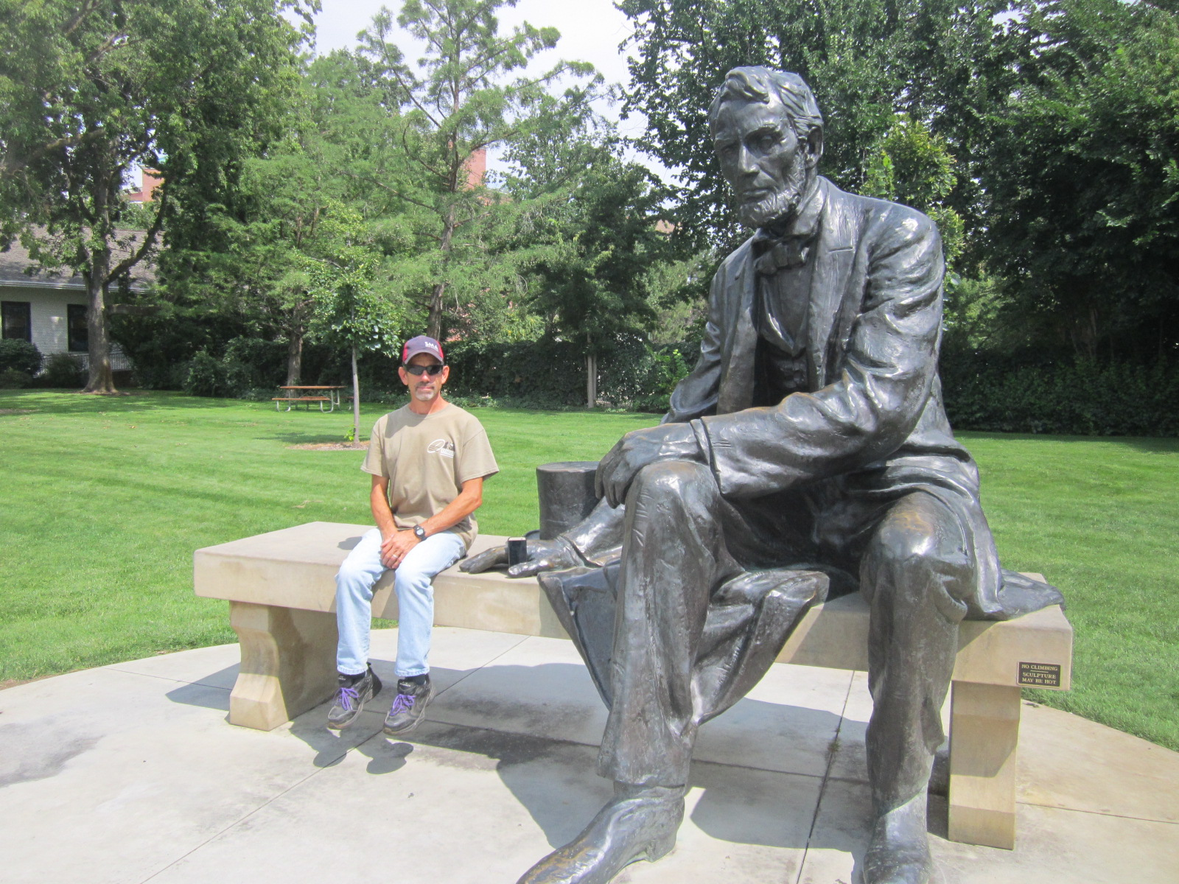

Slide 85
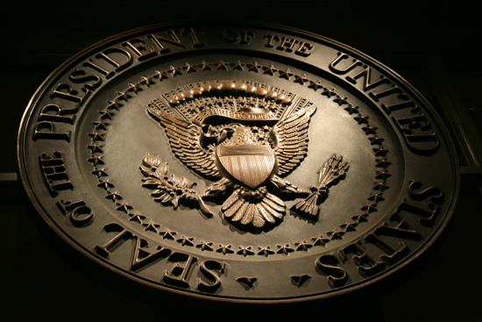
→ Man’s beliefs not always abide in the ways God
→ Liberty is a two-edged sword defined by desire
→ Sinister Jesuits enabled the American Civil war
→ Despair comes by a lack of faith and trust in Him
→ Weakness reveals one’s true strength
→ Faith is relying on God to bring about fair outcomes
→ Providence is God’s plan to gain the greatest good
→ Purpose is the light given by God that fills a soul
→ Only by God’s favor a people survive evil’s onslaught
→ Seasoned speech heals all who are humbled by it
→ Without guiding truths, society reduces to futility
→ Some things legally right are not morally right
→ Enduring dutiful faith glorifies God & uplifts people
Without God’s guidance mankind ceaselessly fails
Notes:
Without God’s guidance mankind ceaselessly fails

Slide 87
Please visit http://www.LoveFromGod.com to explore further
Ronald Bert Channel on
Notes:
Eternity never ends.

