Slide 2
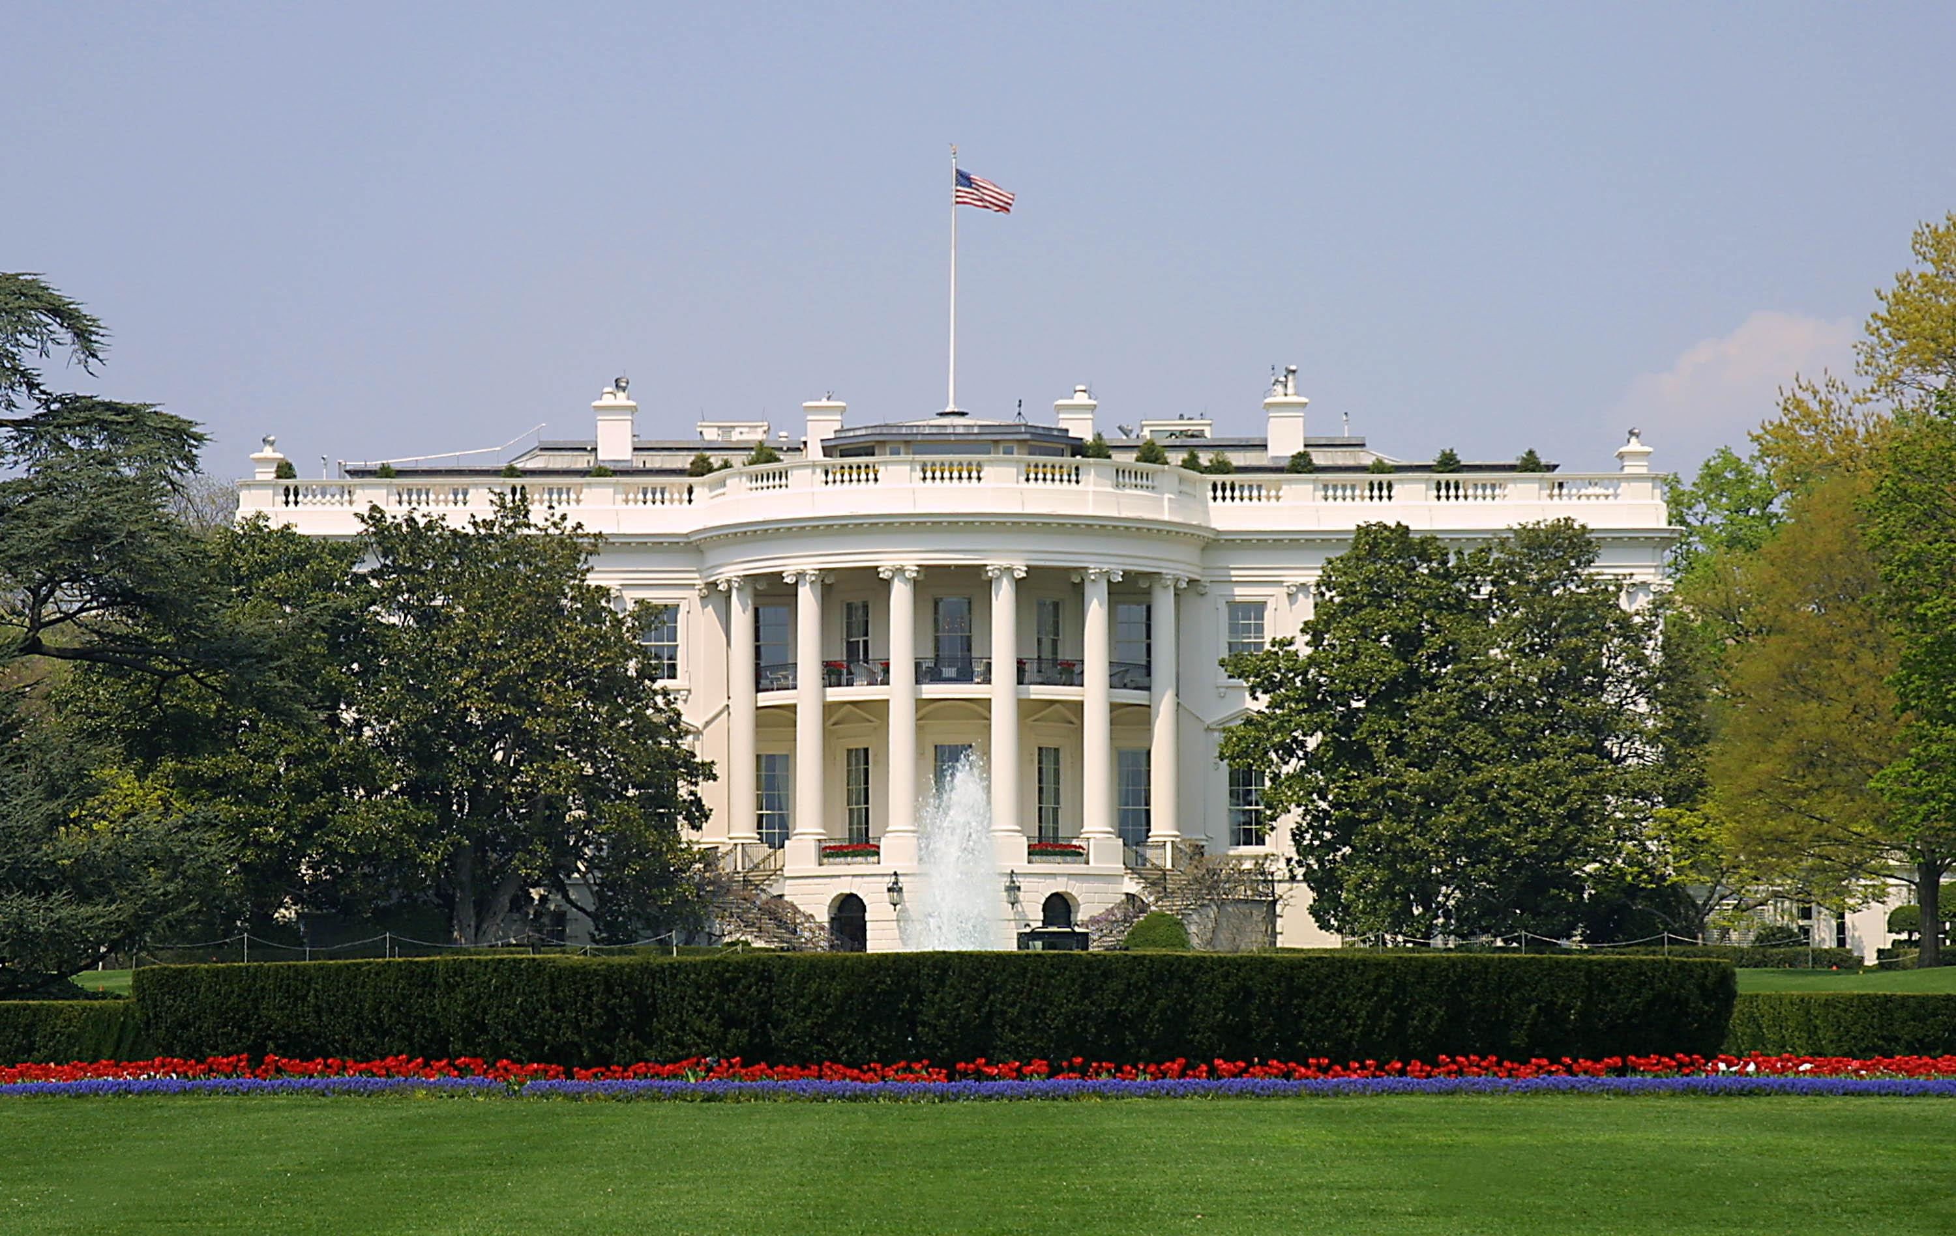
Presidential Quotes
Ron Bert
10
September 9, 2018

Slide 3
16. Abraham Lincoln (1861-1865)
Part 5

Slide 4
“Our popular government has often been called an experiment. Two points in it our people have already settled, the successful establishing and the successful administering of it. One still remains, its successful maintenance against a formidable internal attempt to overthrow it.”
establish
maintenance

Slide 5
"Now the parable is this: The seed is the word of God. Those by the wayside are the ones who hear; then the devil comes and takes away the word out of their hearts, lest they should believe and be saved. But the ones on the rock are those who, when they hear, receive the word with joy; and these have no root, who believe for a while and in time of temptation fall away." — Luke 8:11-13
"Now the ones that fell among thorns are those who, when they have heard, go out and are choked with cares, riches, and pleasures of life, and bring no fruit to maturity. But the ones that fell on the good ground are those who, having heard the word with a noble and good heart, keep it and bear fruit with patience." — Luke 8:14-15
constitution
Higher value on the material
establish
receive
established
maintenance

Slide 6
“I am struggling to maintain the government, not to overthrow it. I am struggling especially to prevent others from overthrowing it.”

Slide 7
“America will never be destroyed from the outside. If we falter and lose our freedoms, it will be because we destroyed ourselves.”

Slide 8
“Nations do not die from invasion; they die from internal rottenness.”

Slide 9
A sound heart is life to the body, But envy is rottenness to the bones. — Proverbs 14:30

Slide 10
For where envy and self-seeking exist, confusion and every evil thing are there. — James 3:16

Slide 11
“If this country is ever demoralized, it will come from trying to live without work.”

Slide 12
For even when we were with you, we commanded you this: If anyone will not work, neither shall he eat. For we hear that there are some who walk among you in a disorderly manner, not working at all, but are busybodies. — 2nd Thessalonians 3:10 -11

Slide 13
“Free labor has the inspiration of hope; pure slavery has no hope.”
Free labor
hope
pure slavery
no hope
Free labor = hope
pure slavery = no hope

Slide 14
“You cannot build character and courage by taking away people's initiative and independence. You cannot help people permanently by doing for them what they could and should do for themselves.”
i
character
a
d
courage
initiative
independence
[
character
courage
=
initiative +
independence
]
>
aid

Slide 15
“Any society that takes away from those most capable and gives to the least will perish.”

Slide 16
“You cannot help small men by tearing down big men.”

Slide 17
“You cannot escape the responsibility of tomorrow by evading it today.”

Slide 18
See then that you walk circumspectly, not as fools but as wise, redeeming the time, because the days are evil. — Ephesians 5:15-16

Slide 19
“You cannot bring about prosperity by discouraging thrift. You cannot establish sound security on borrowed money. You cannot keep out of trouble by spending more than you earn.”

Slide 20
"For which of you, intending to build a tower, does not sit down first and count the cost, whether he has enough to finish it -- lest, after he has laid the foundation, and is not able to finish, all who see it begin to mock him, saying, 'This man began to build and was not able to finish.'" — Luke 14:28 -30

Slide 21
“I am in favor of a national bank ... in favor of the internal improvements system and a high protective tariff.”

Slide 22
“In the early days of the world, the Almighty said to the first of our race "In the sweat of thy face shalt thou eat bread"; and since then, if we accept the light and the air of heaven, no good thing has been, or can be enjoyed by us, without having first cost labor.”

Slide 23
"In the sweat of your face you shall eat bread Till you return to the ground, For out of it you were taken; For dust you are, And to dust you shall return." — Genesis 3:19

Slide 24
“I think that if anything can be proved by natural theology, it is that slavery is morally wrong. God gave man a mouth to receive bread, hands to feed it, and his hand has a right to carry bread to his mouth without controversy.”

Slide 25
“No country can sustain, in idleness, more than a small percentage of its numbers. The great majority must labor at something productive.”

Slide 26
“In giving freedom to the slave, we assure freedom to the free.”

Slide 27
“I intend no modification of my oft-expressed wish that all men everywhere could be free.”

Slide 28
… (for the fruit of the Spirit is in all goodness, righteousness, and truth), finding out what is acceptable to the Lord. And have no fellowship with the unfruitful works of darkness, but rather expose them. — Ephesians 5:9-11

Slide 29
“Our reliance is in the love of liberty which God has planted in our bosoms.”

Slide 30
Now the Lord is the Spirit; and where the Spirit of the Lord is, there is liberty. — 2nd Corinthians 3:17

Slide 31
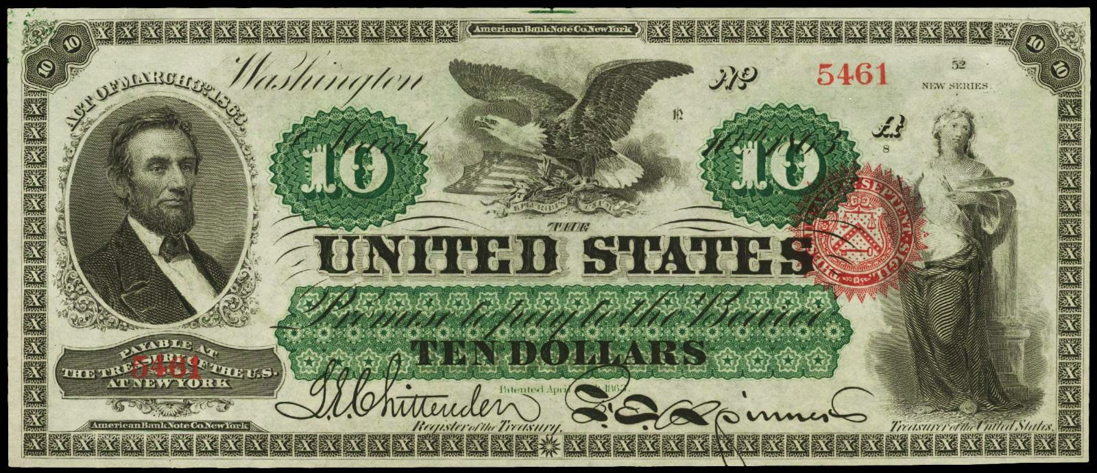
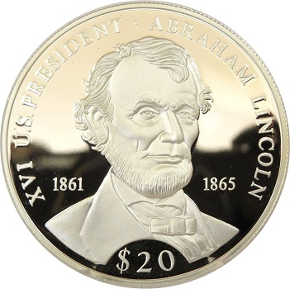
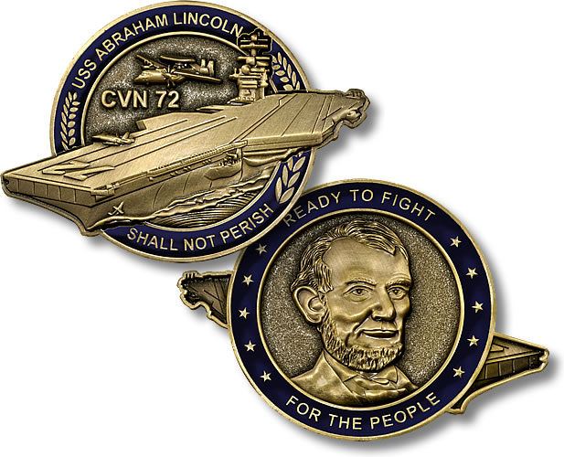
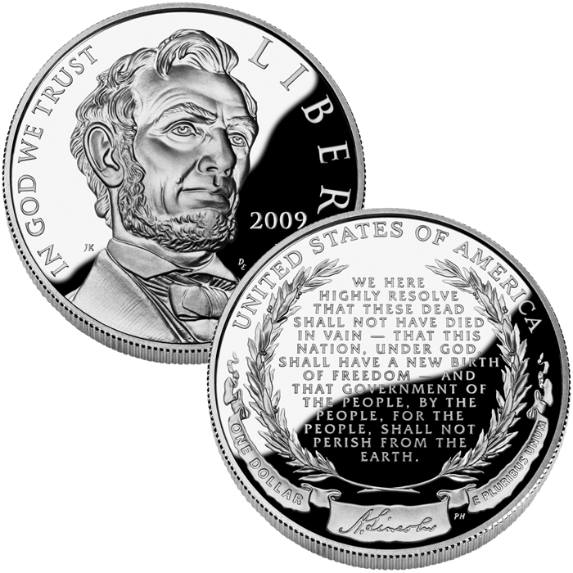
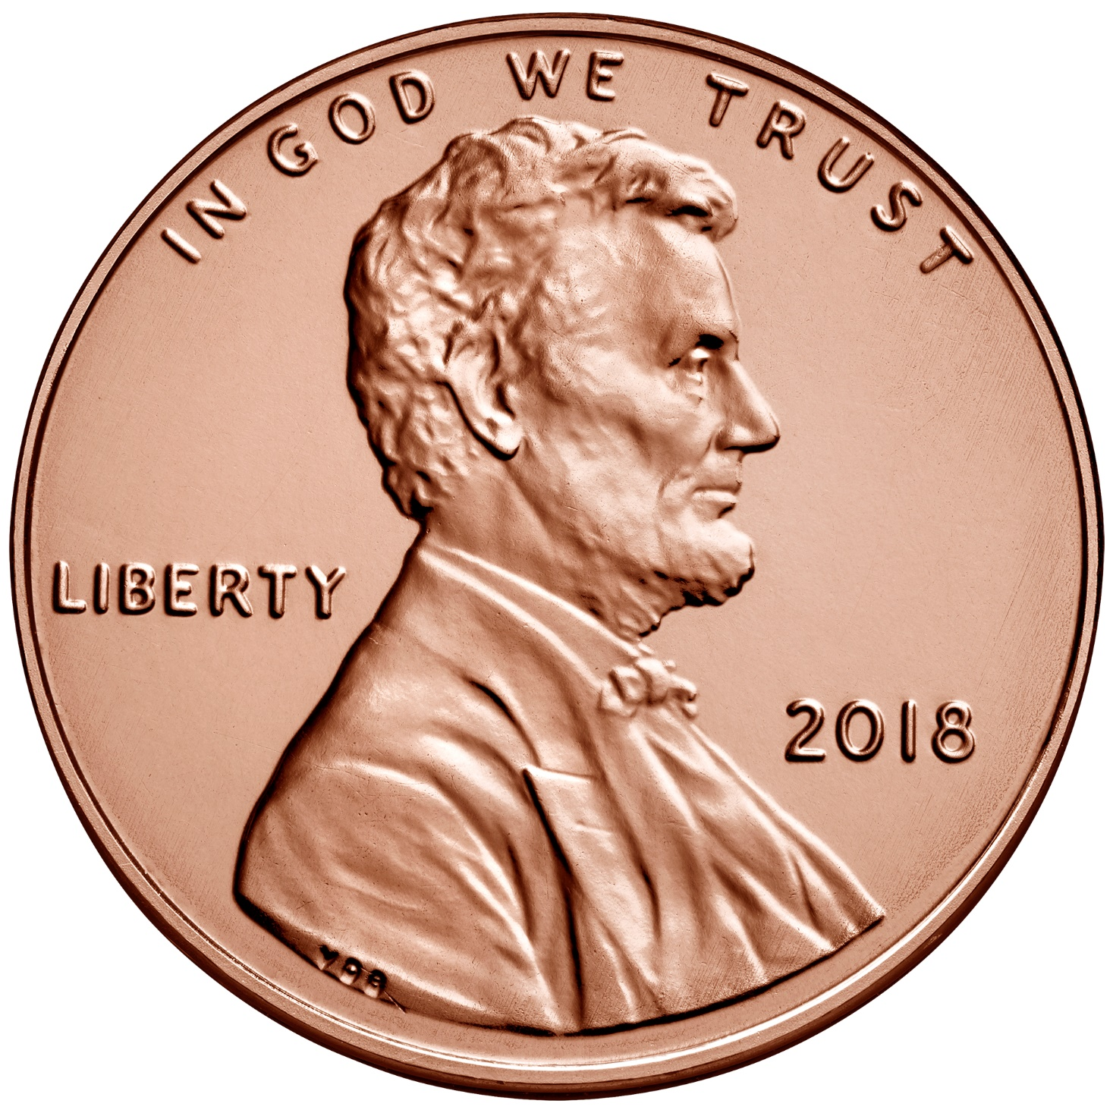
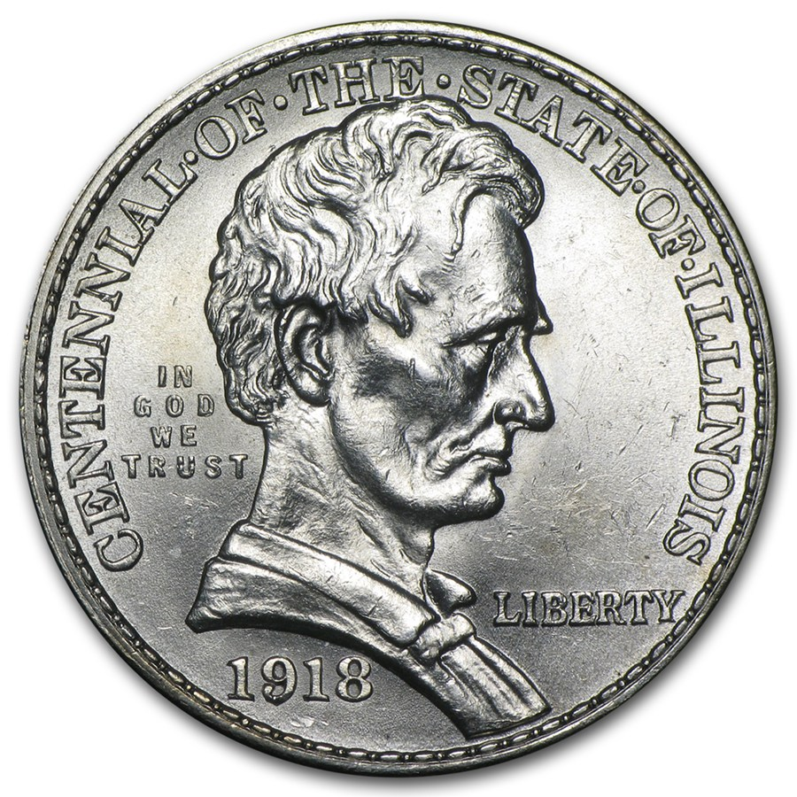
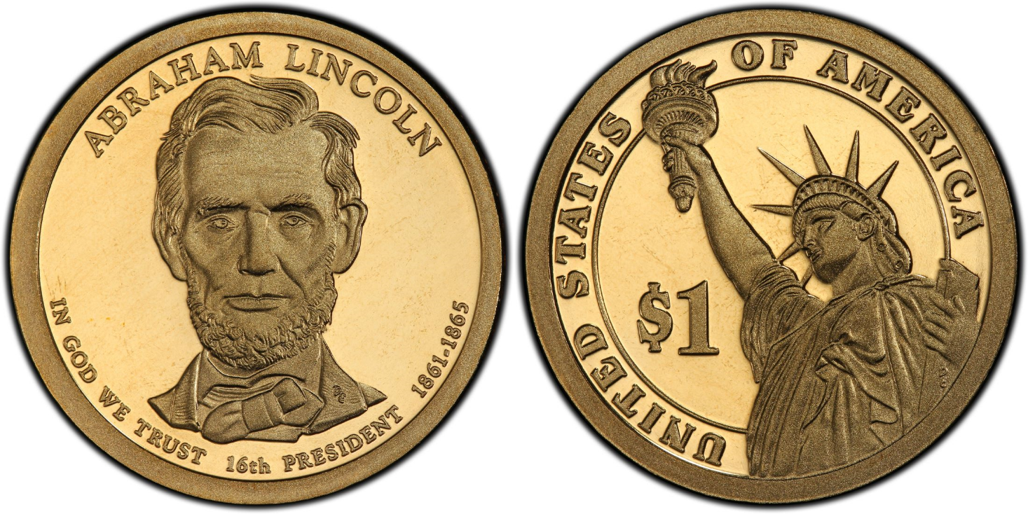
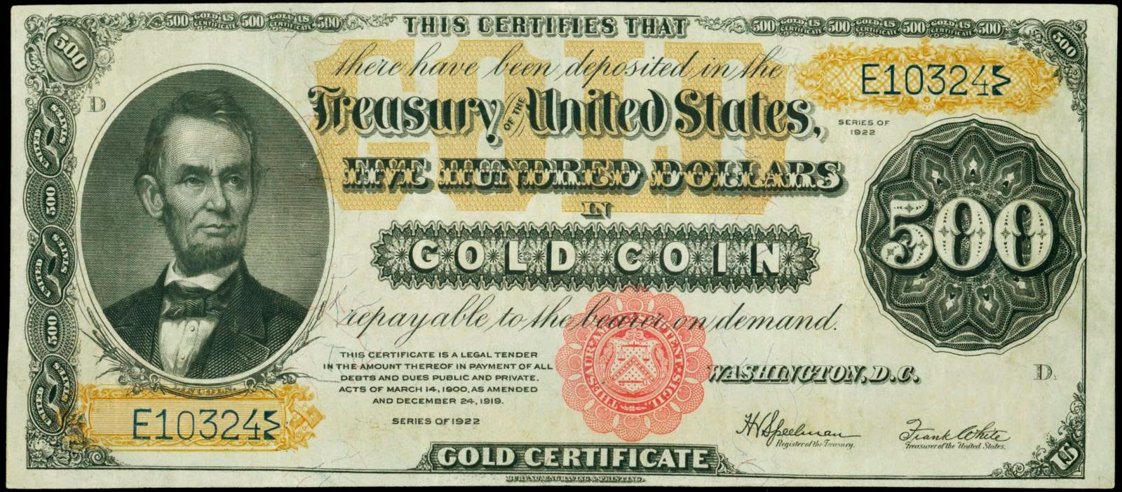
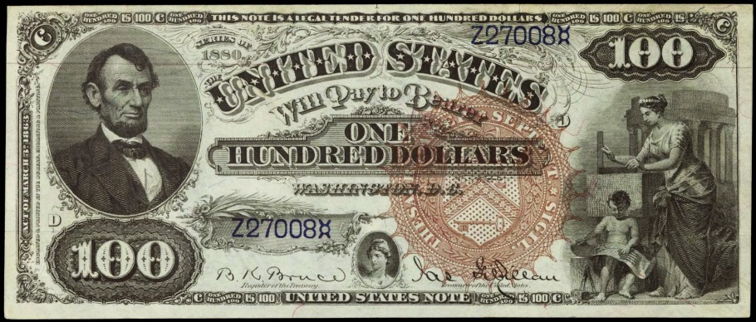

Slide 32
Now godliness with contentment is great gain. For we brought nothing into this world, and it is certain we can carry nothing out. And having food and clothing, with these we shall be content. But those who desire to be rich fall into temptation and a snare, and into many foolish and harmful lusts which drown men in destruction and perdition. – 1st Timothy 6:7-9
For the love of money is a root of all kinds of evil, for which some have strayed from the faith in their greediness, and pierced themselves through with many sorrows. But you, O man of God, flee these things and pursue righteousness, godliness, faith, love, patience, gentleness. – 1st Timothy 6:10-11
For the love of money is a root of all kinds of evil, for which some have strayed from the faith in their greediness, and pierced themselves through with many sorrows. But you, O man of God, flee these things and pursue righteousness, godliness, faith, love, patience, gentleness. – 1st Timothy 6:10-11
flee these
things

Slide 33
Pursue:
Love
Faith
Patience
Godliness
Gentleness
Righteousness

Slide 35
Presidential Quotes
Ron Bert
10½
September 23, 2018

Slide 36
16. Abraham Lincoln (1861-1865)
Part 6

Slide 37
“Cling to liberty and right; battle for them; lead for them; die for them, if need be; and have confidence in God.”
confidence in God

Slide 38
But Peter and the other apostles answered and said: "We ought to obey God rather than men. — Acts 5:29

Slide 39
“I will, to the best of my ability, preserve, protect and defend the Constitution of the United States. It is not the Constitution as I would like to have it, but as it is, that is to be defended. The Constitution will not be preserved & defended until it is enforced & obeyed in every part of every one of the United States. It must be so respected, obeyed, enforced and defended, and let the grass grow where it may.”
respected, obeyed
defended

Slide 40
Then Samuel said: "Has the LORD as great delight in burnt offerings and sacrifices, As in obeying the voice of the LORD? Behold, to obey is better than sacrifice, And to heed than the fat of rams. — 1st Samuel 15:22
to obey is better

Slide 41
“I trust that as He shall further open the way, I will be ready to walk therein, relying on His help and trusting in His goodness and wisdom.”

Slide 42
“I think that God means that we shall do more than we have yet done in furtherance of His plans and He will open the way for our doing it.”

Slide 43
He has delivered us from the power of darkness and conveyed us into the kingdom of the Son of His love, … — Colossians 1:13

Slide 44
“Of our political revolution of '76, we all are justly proud. It has given us a degree of political freedom, far exceeding that of any other nation of the earth. In it the world has found a solution of the long-mooted problem, as to the capability of man to govern himself. In it was the germ which has vegetated, and still is to grow and expand into the universal liberty of mankind.”

Slide 45
“I believe the declaration that ‘all men are created equal’ is the great fundamental principle upon which our free institutions rest.”

Slide 46
There is neither Jew nor Greek, there is neither slave nor free, there is neither male nor female; for you are all one in Christ Jesus. — Galatians 3:28

Slide 47
“I have never had a feeling, politically, that did not spring from the Declaration of Independence that all should have an equal chance. This is the sentiment embodied in the Declaration of Independence, I would rather be assassinated on this spot than surrender it.”

Slide 48
“Do not destroy that immortal emblem of humanity, the Declaration of Independence.”

Slide 49
“Don't interfere with anything in the Constitution. That must be maintained, for it is the only safeguard of our liberties.”

Slide 50
“Study the Constitution. Let it be preached from the pulpit, proclaimed in legislatures, and enforced in courts of justice.”

Slide 51
“Its authors meant it to be... a stumbling block to those who in after times might seek to turn a free people back into the hateful paths of despotism. They knew the proneness of prosperity to breed tyrants, and they meant when such should re-appear in this fair land and commence their vocation they should find left for them at least one hard nut to crack.”
back into the hateful paths

Slide 52
“Should my administration prove to be a very wicked one ... or a very foolish one, if you, the people, are true to yourselves and the Constitution, there is little harm I can do, thank God.”

Slide 53
“It is most cheering and encouraging for me to know that in the efforts which I have made and am making for the restoration of a righteous peace to our country, I am upheld and sustained by the good wishes and prayers of God's people. No one is more deeply than myself aware that without His favor our highest wisdom is but as foolishness and that our most strenuous efforts would avail nothing in the shadow of His displeasure.”
righteous peace
upheld
prayers
His favor
His displeasure

Slide 54
For the wisdom of this world is foolishness with God. For it is written, "He catches the wise in their own craftiness"; — 1st Corinthians 3:19

Slide 55
“If all men were just, there still would be some, though not so much, need of government.”

Slide 56
“If I had had my way, this war would never have been commenced; If I had been allowed my way this war would have ended before this, but we find it still continues; and we must believe that He permits it for some wise purpose of his own, mysterious and unknown to us; and though with our limited understandings we may not be able to comprehend it, yet we cannot but believe, that He who made the world still governs it.”
must believe
our limited understandings
not be able to comprehend it
He
governs it

Slide 57
He does great things past finding out, Yes, wonders without number. — Job 9:10

Slide 58
"For as the heavens are higher than the earth, So are My ways higher than your ways, And My thoughts than your thoughts." — Isaiah 55:9

Slide 59
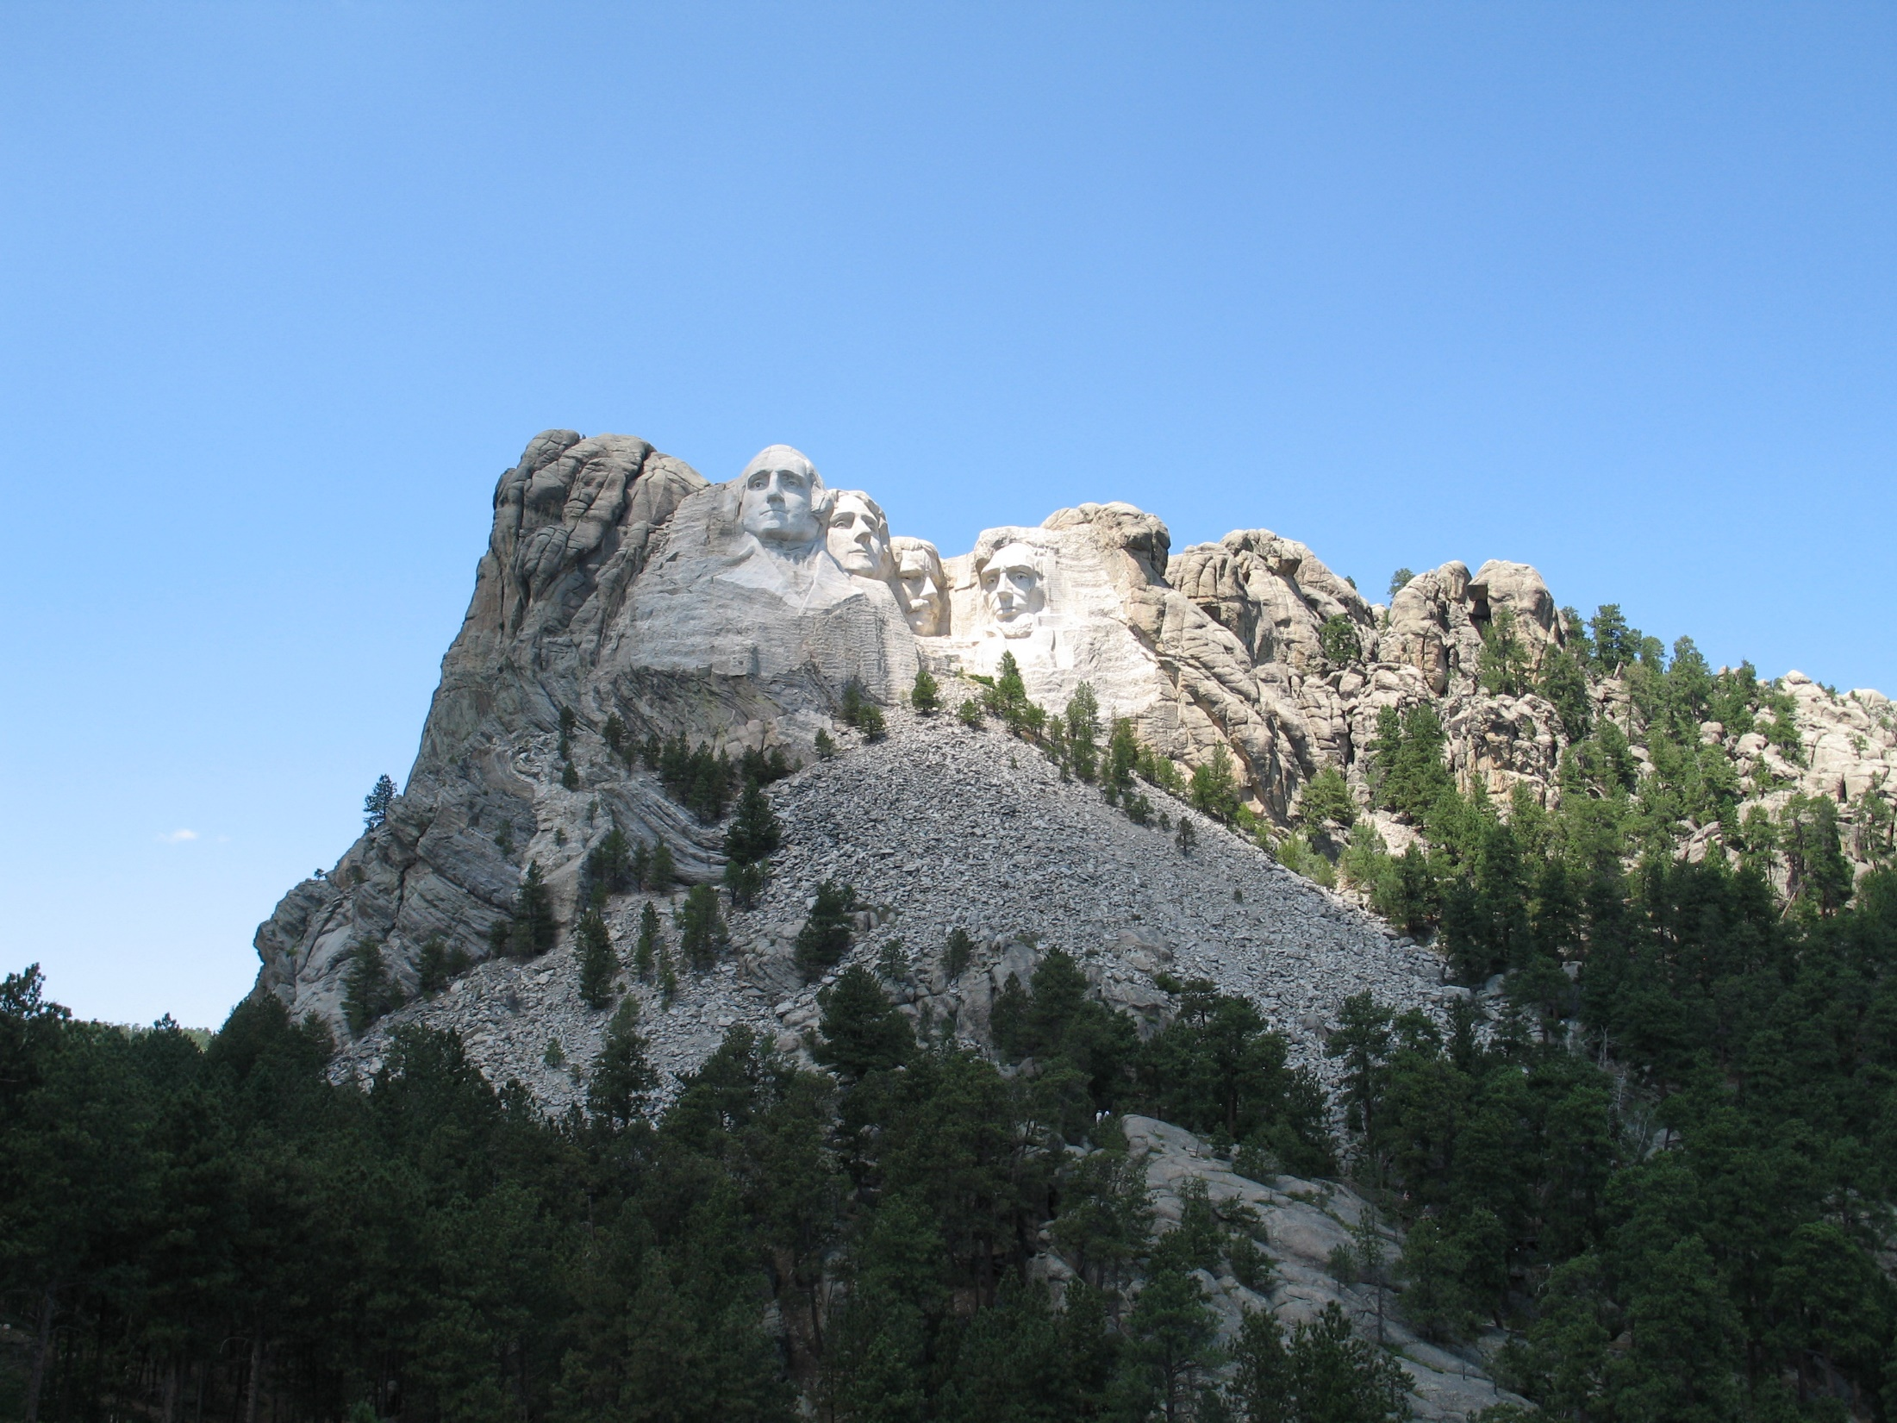

Slide 63
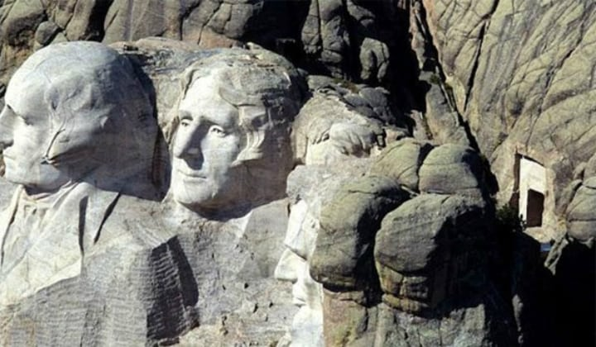

Slide 64
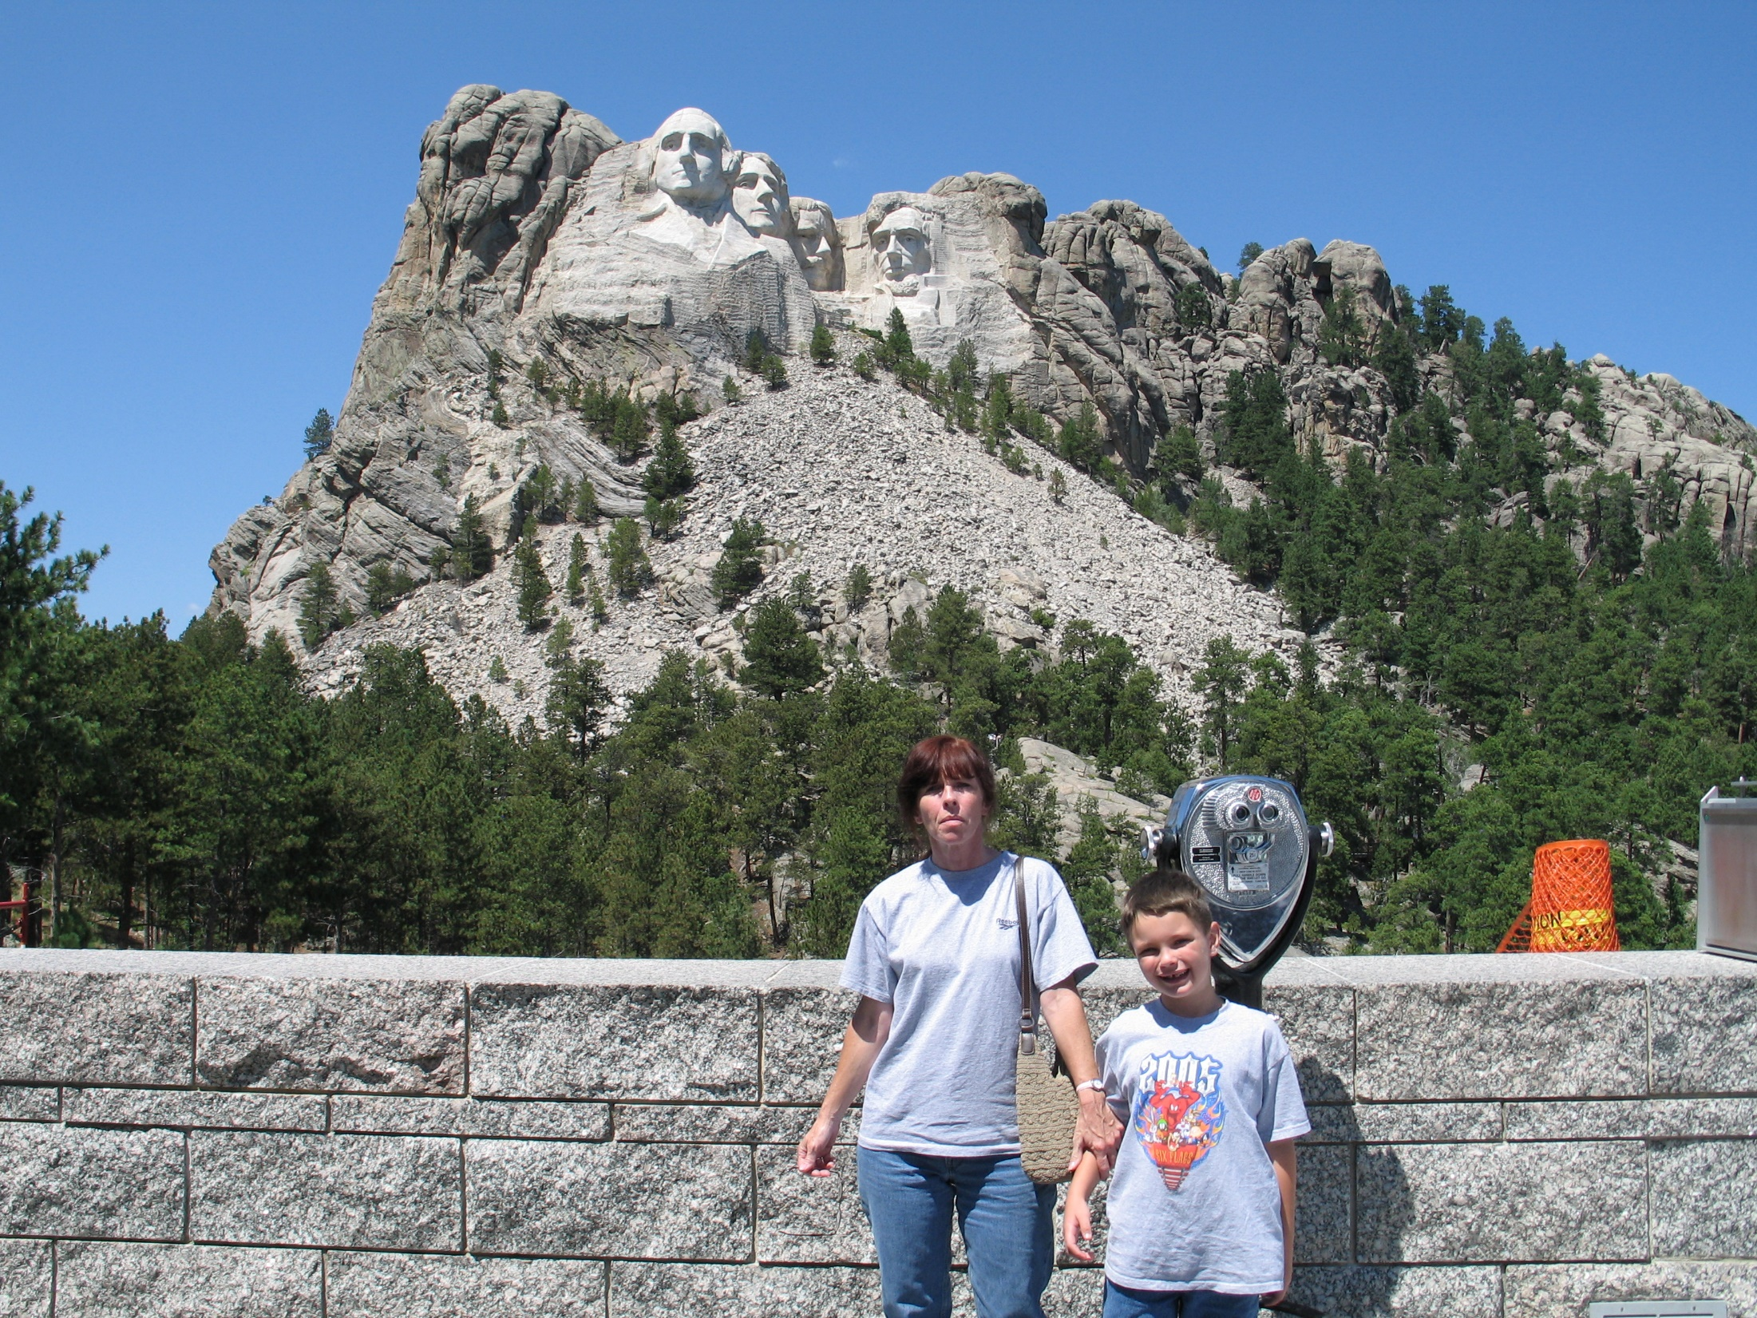

Slide 65
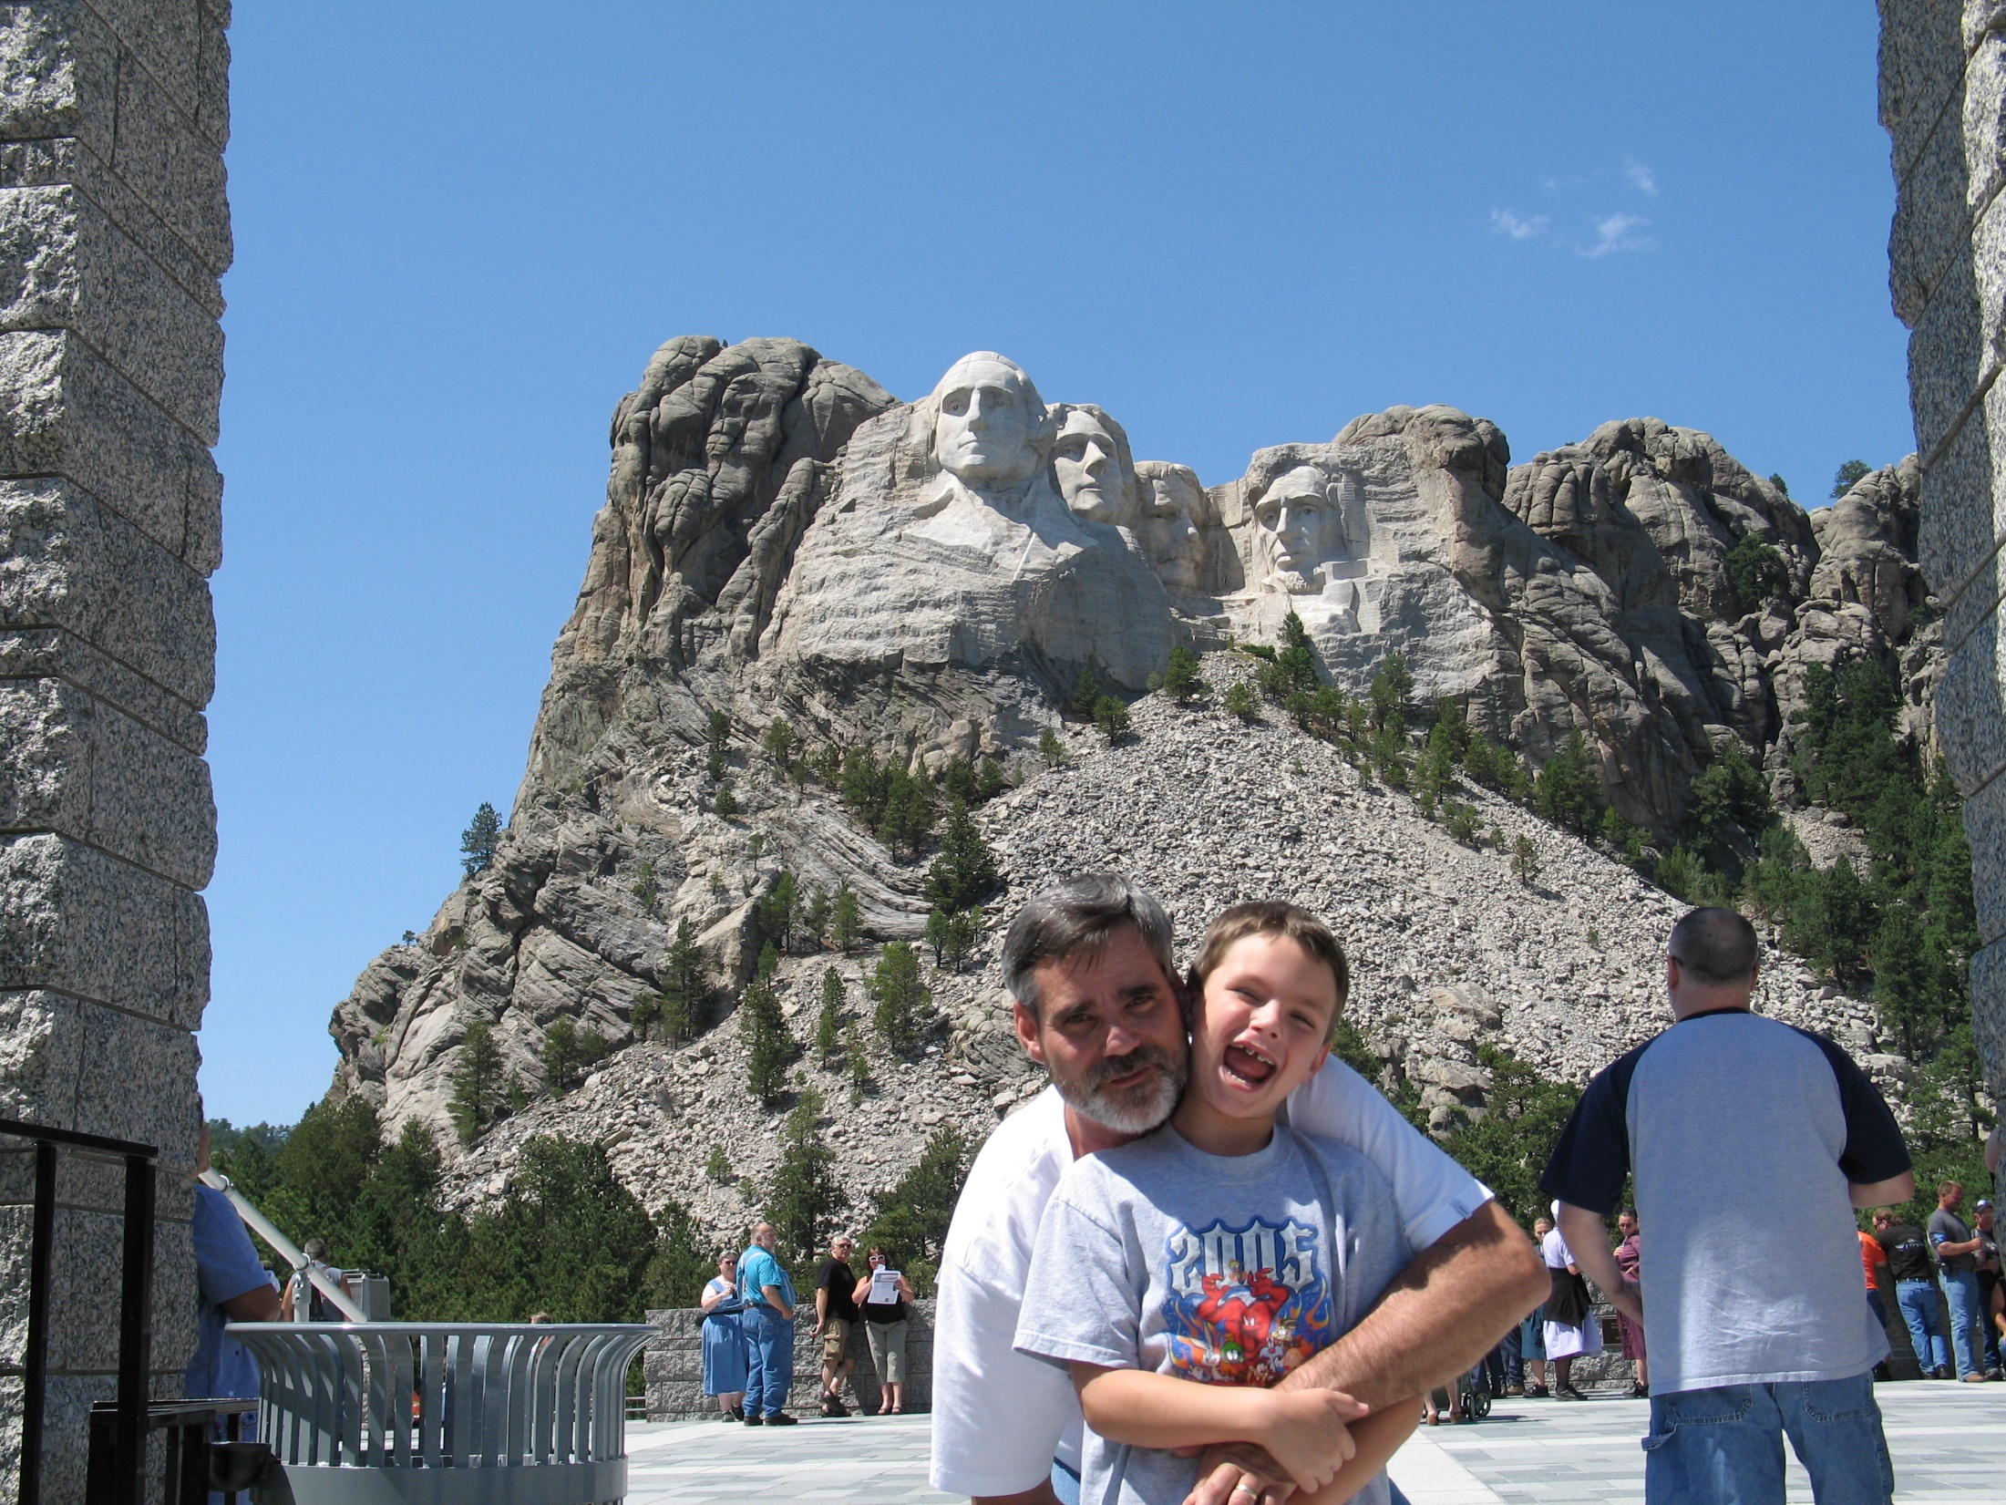

Slide 66
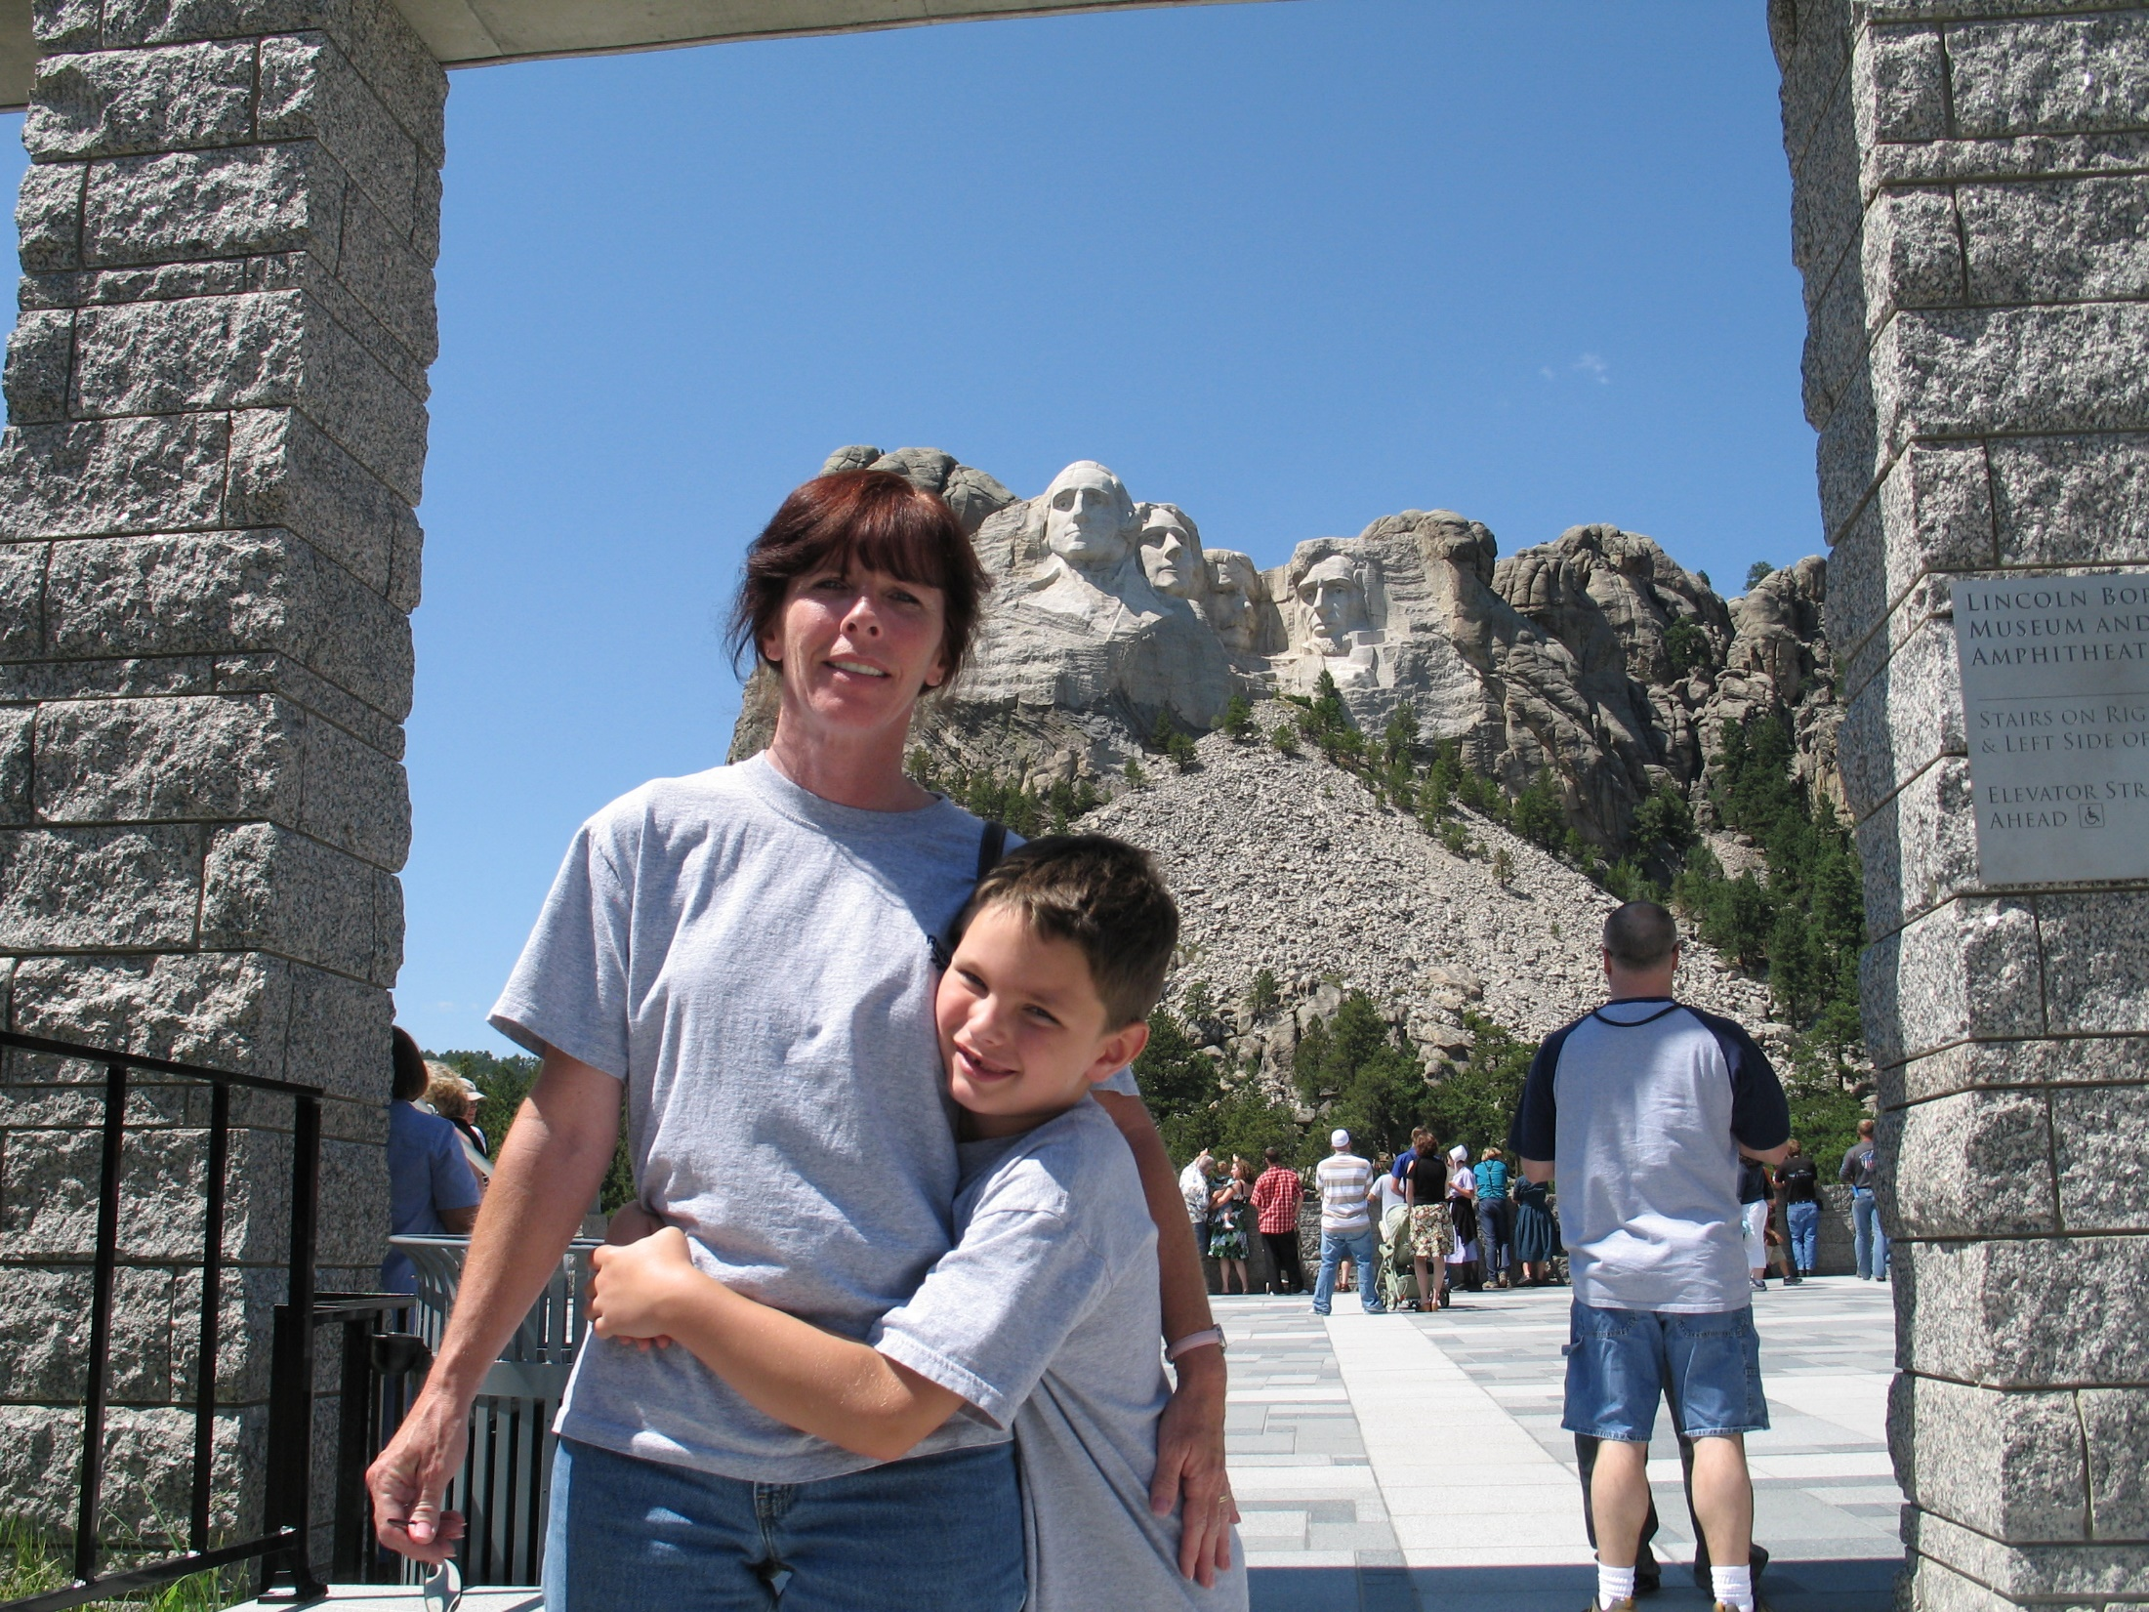

Slide 67
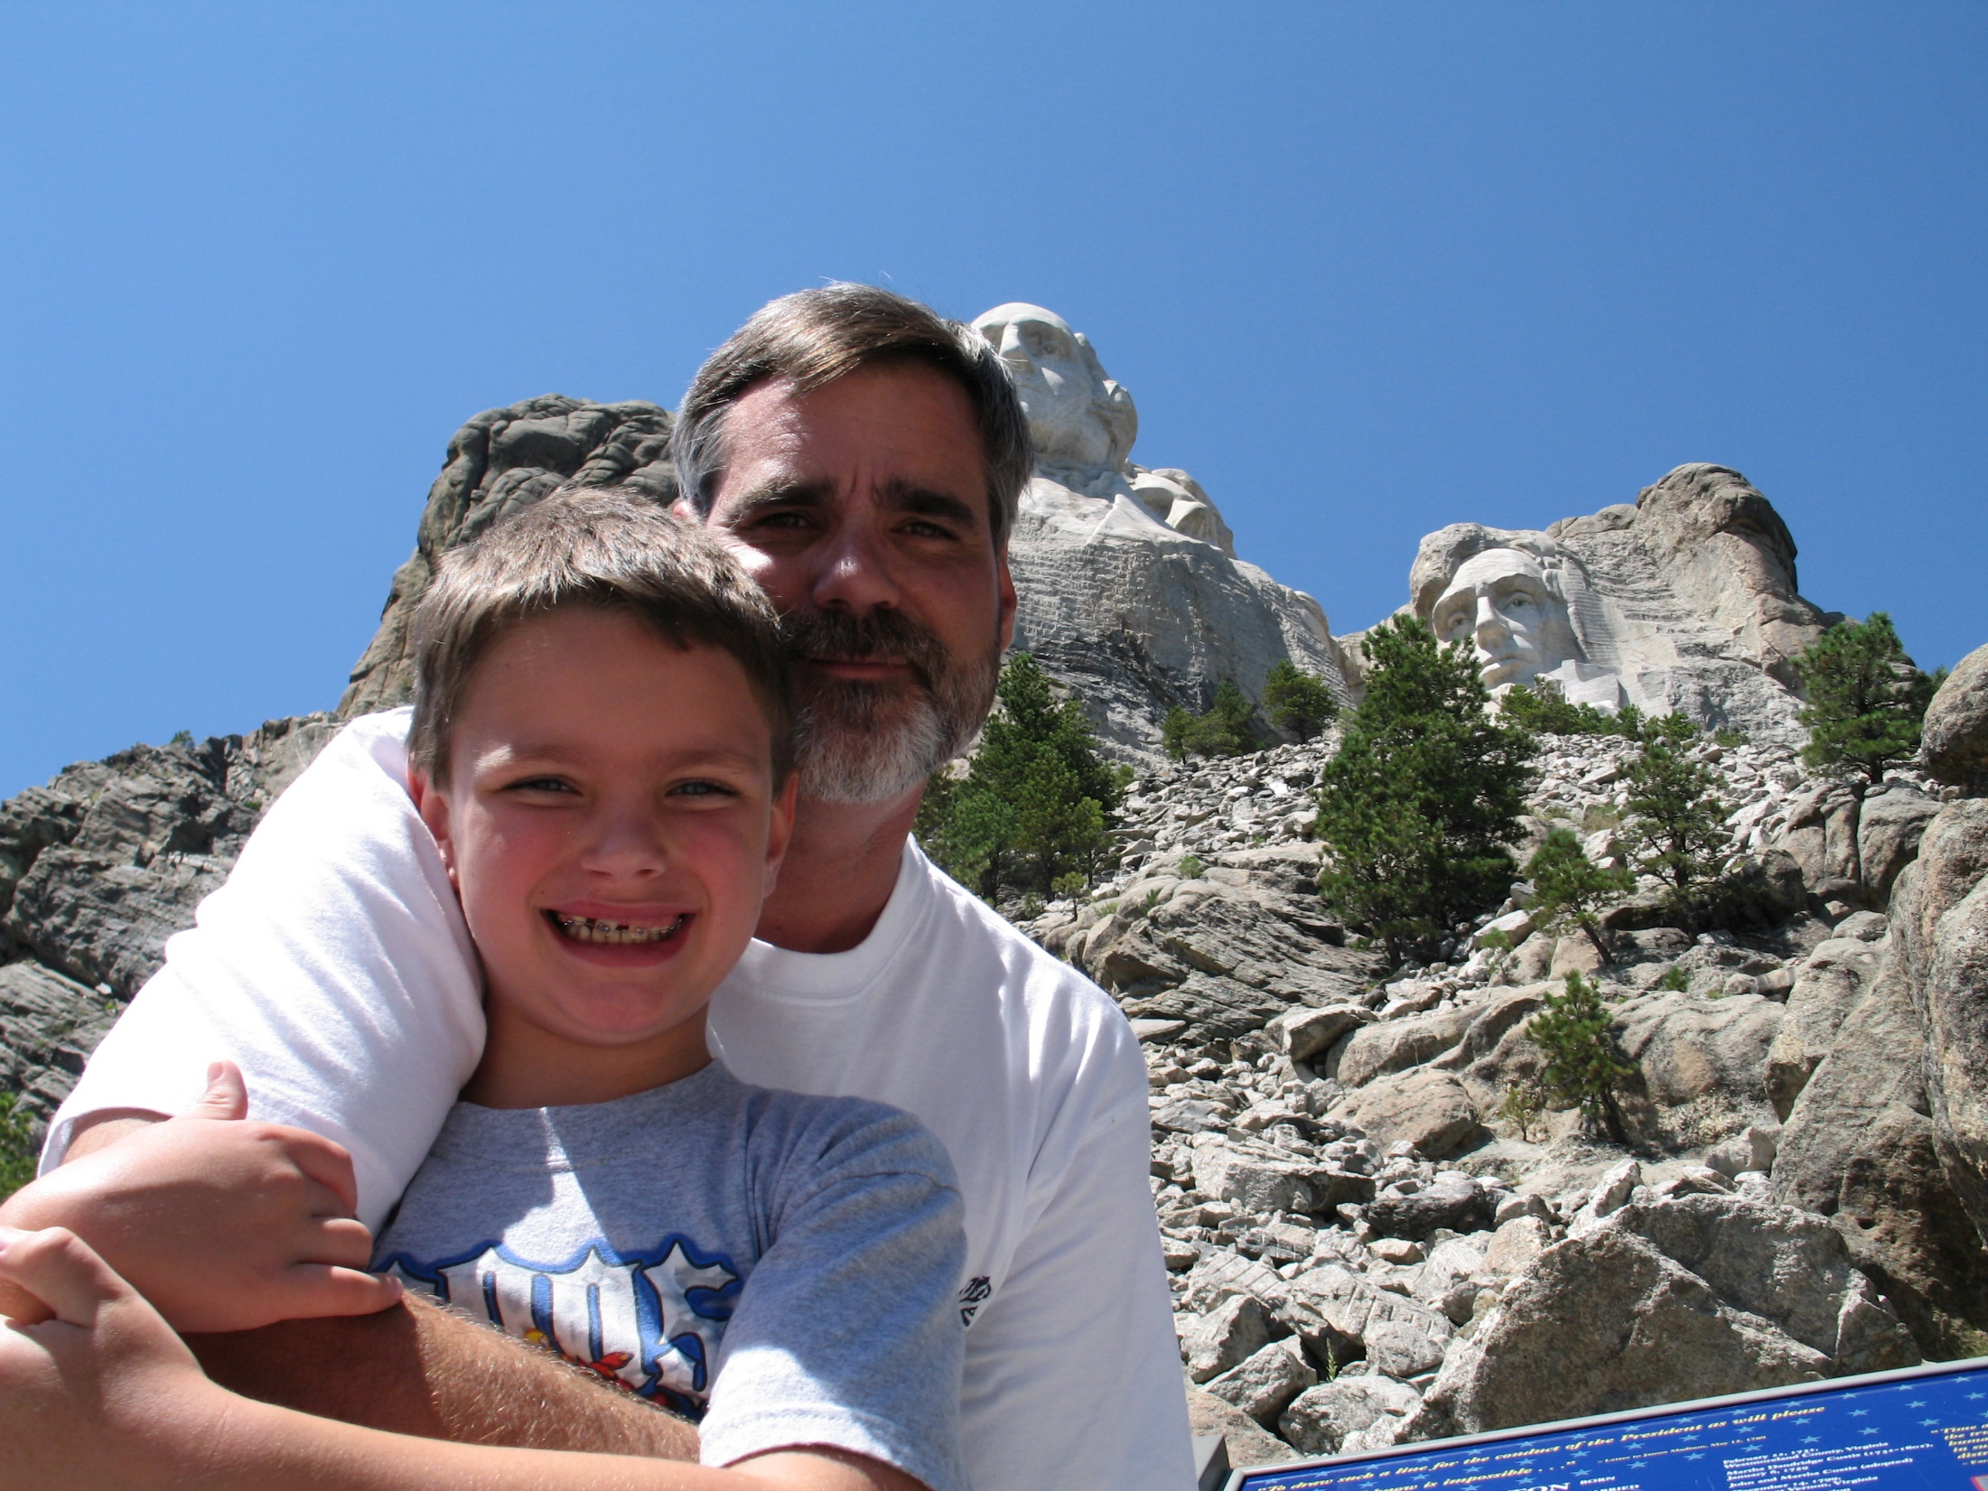

Slide 68
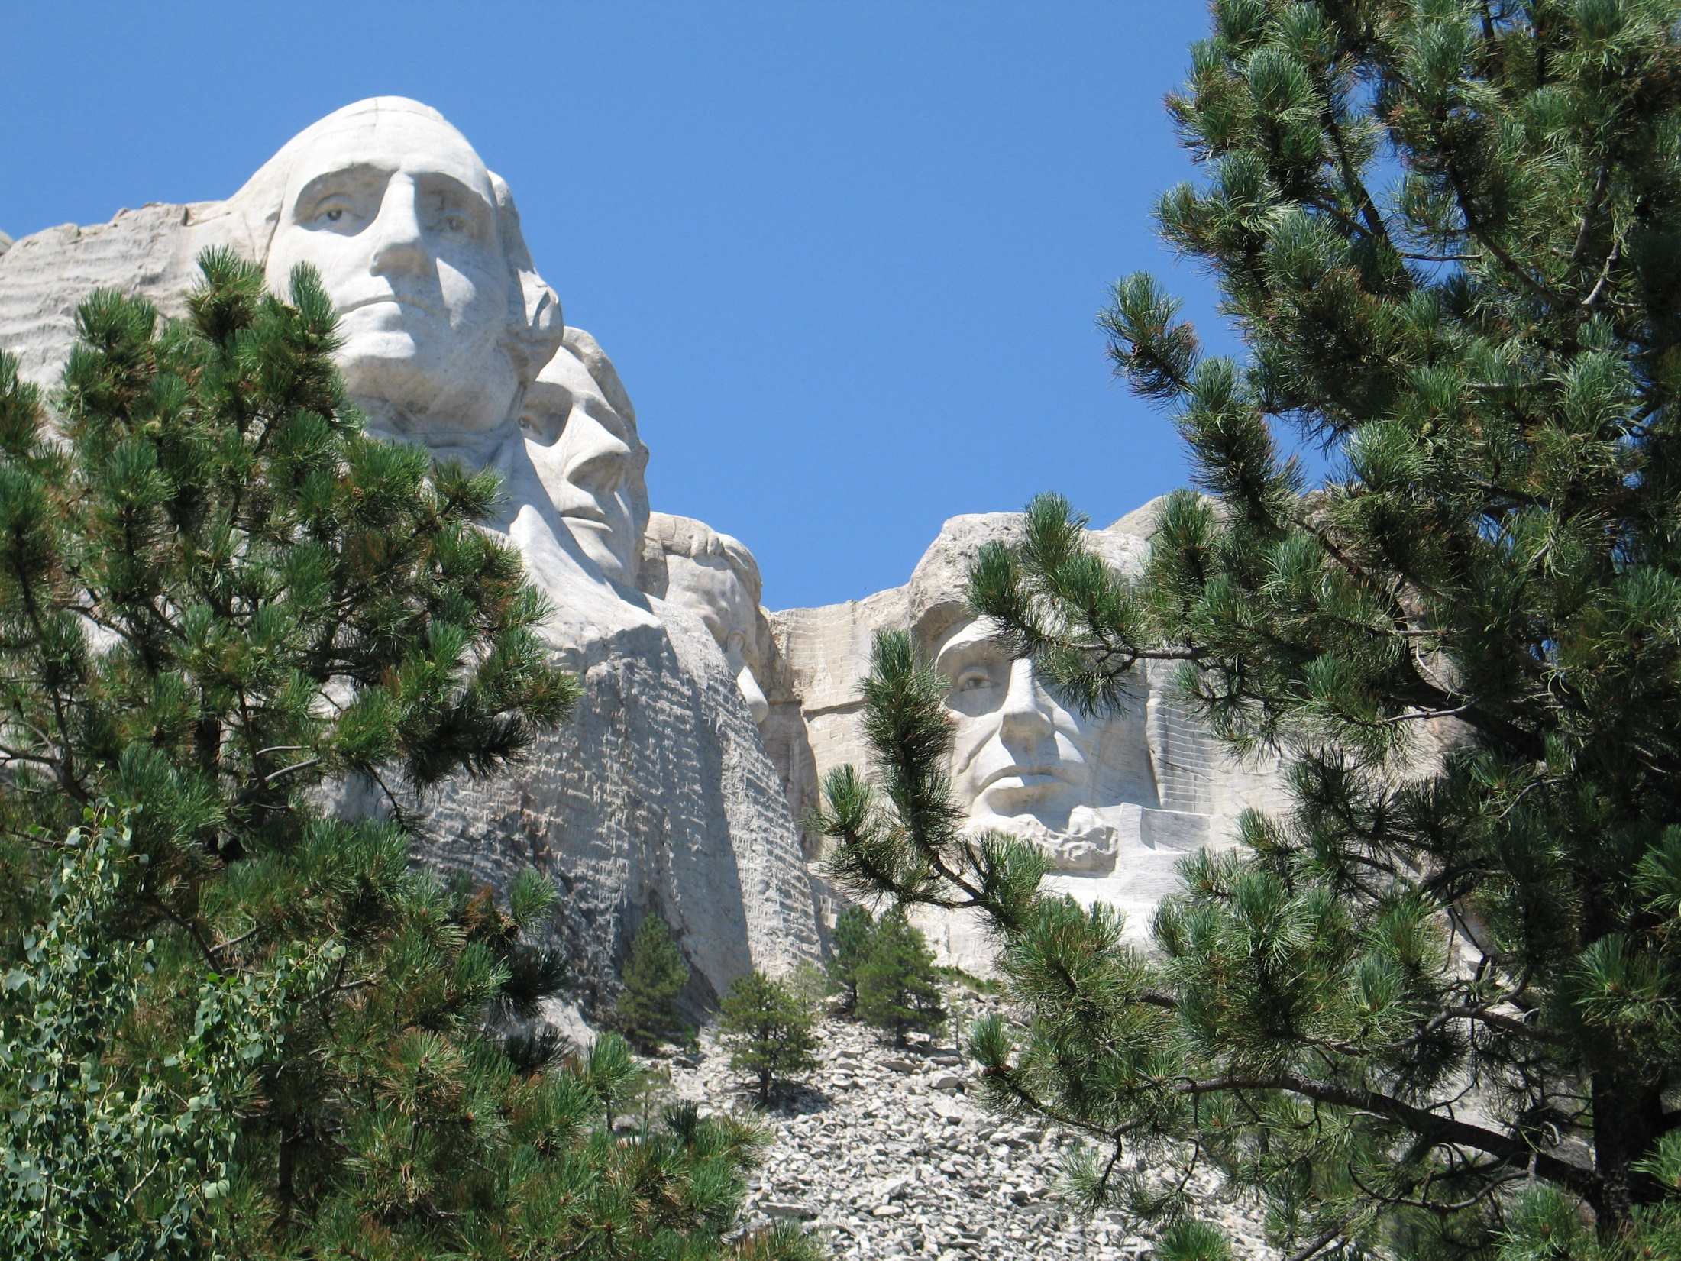
All successful enterprises involve dedication past cost.

Slide 69
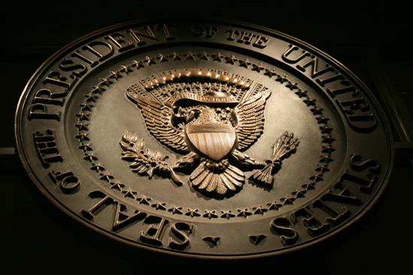
→ A government by free men is a timeless revolution
→ Free men are destroyed through excessive opulence
→ Labor is crucial if social slavery is to be averted
→ Greatness is built by the great helping the poor
→ Forcing the rich to pay for the poor magnifies apathy
→ People that spend more than earned defeat legacies
→ Eating of your own labors is God’s condition on man
→ Unrelenting domination of others is wrong
→ Freedom is worth all that it takes to live free
→ Declaration of Independence is a beacon to freedom
→ Wealth in the hands of a few breads tyrants
→ The constitution protects a return to tyranny
→ Beyond our ignorance, God’s wisdom will prevail
Disrespectfulness is the sign of social collapse
Notes:
Balance is a fine line holding the edge of reality.

Slide 71
Please visit http://www.LoveFromGod.com to explore further
Ronald Bert Channel on
Notes:
Eternity never ends.

