Slide 1
Notes:
Darkness renders a blank absence.

Slide 2
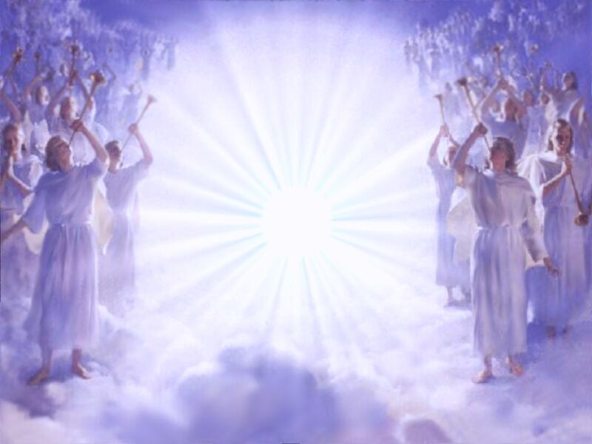
Prepare to Meet your Maker
Ron Bert
August 2, 2020

Slide 3
And he did evil, because he did not prepare his heart to seek the LORD. — 2nd Chronicles 12:14
seek
prepare
prepare
Notes:
Many plot to steal things they do not earn, be it physical or mental. To not prepare to meet God is actually an act of evil. Honest people do not hide, and this is the litmus test. We all have deficiencies, but to not seek the Lord is the greatest travesty.

Slide 4
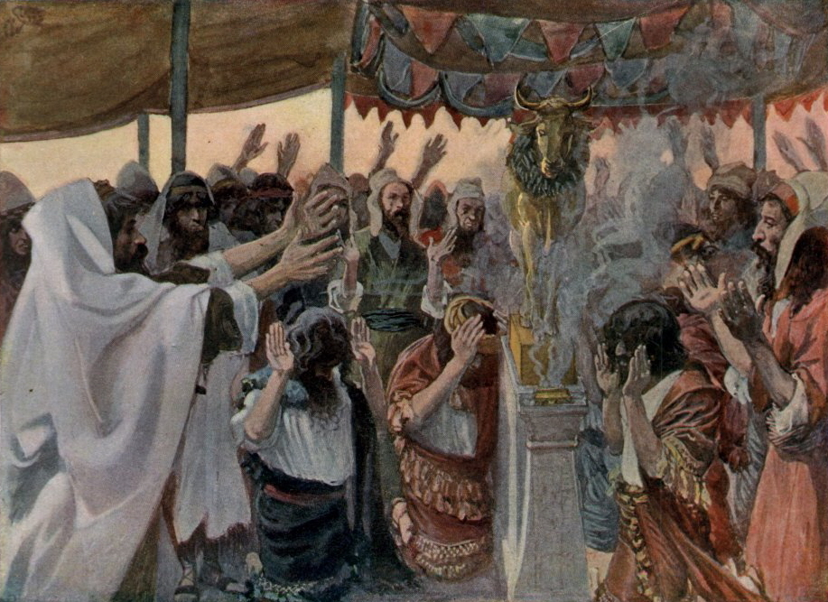
"Therefore thus will I do to you, O Israel; Because I will do this to you, Prepare to meet your God, O Israel!" — Amos 4:12
Turned away
Prepare
God
Prepare to meet your God
. .
Notes:
Turning away from the pure principles of living, from God Himself, has never led to positive results. Tragedy and widespread calamities more often plague faithless people lacking hope for salvation in the midst of turmoil. Preparing to meet God is something done inside the spirit of a soul, and not found by one from outward manifestations of man. When we lord over those things we materialistically idolize, the spirit dies.

Slide 5
LORD
LORD
LORD
LORD
LORD
LORD

Slide 6
Pleasure
LORD
Entertainment
Stuff
Money
Technology

Slide 7
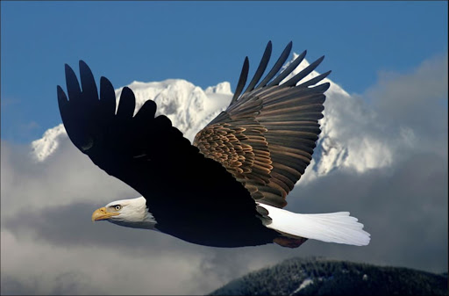
But those who wait on the LORD Shall renew their strength; They shall mount up with wings like eagles, They shall run and not be weary, They shall walk and not faint. — Isaiah 40:31
wait on the LORD
LORD
LORD
wait
wait on the LORD
Zeal
not be weary
not be weary
Faith
Notes:
Waiting on the Lord builds confidence in He is. There is no disenchantment when love is so humbling.

Slide 8
Rest in the LORD, and wait patiently for Him; Do not fret because of him who prospers in his way, Because of the man who brings wicked schemes to pass. — Psalms 37:7
Cease from anger, and forsake wrath; Do not fret-it only causes harm. — Psalms 37:8
in
LORD
Rest in the LORD
wait
Rest in the LORD
wrath
Rest in the LORD
wrath causes harm
patiently for Him
Do not fret
causes harm
● Rest in the LORD
● wait patiently for Him
● Do not fret
wicked schemes
Notes:
Aspirations may vanish as the wicked roll on, but God’s promise rises above all that is petty, and engages the spirit to see where the soul has come from. Peace arrives to those who settle on why He came to save each believer who responds to His truths. Like a fan beneath our feet, the wicked devise lies to submerge those who profess truth.

Slide 9
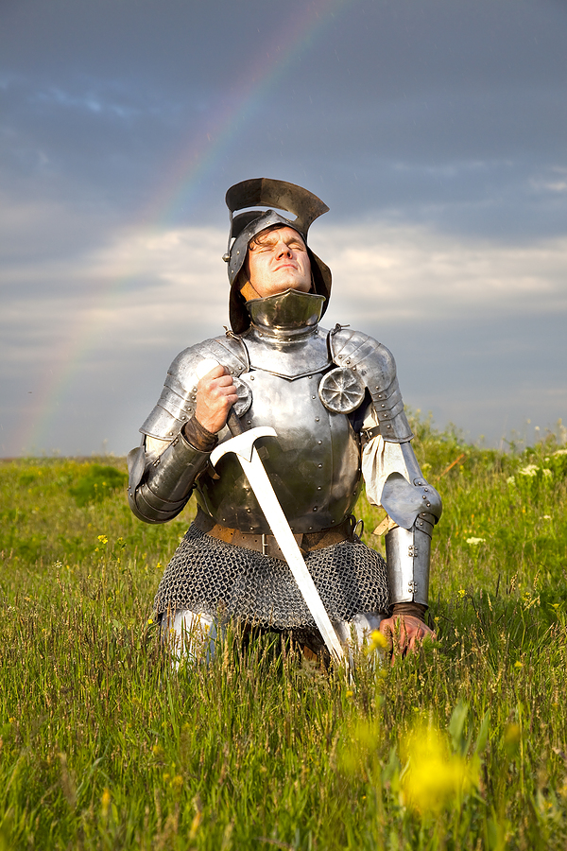
Therefore lay aside all filthiness and overflow of wickedness, and receive with meekness the implanted word, which is able to save your souls. But be doers of the word, and not hearers only, deceiving yourselves. — James 1:21-22
lay aside all filthiness
overflow of wickedness
be doers of the word
lay aside all filthiness
overflow of wickedness
not hearers only
deceiving yourselves
doer
receive with meekness
receive with meekness
be doers of
the word
not hearers only
deceiving yourselves
X
Notes:
Remaining ready is key to preserving purpose in His Kingdom of all that is forward.

Slide 10
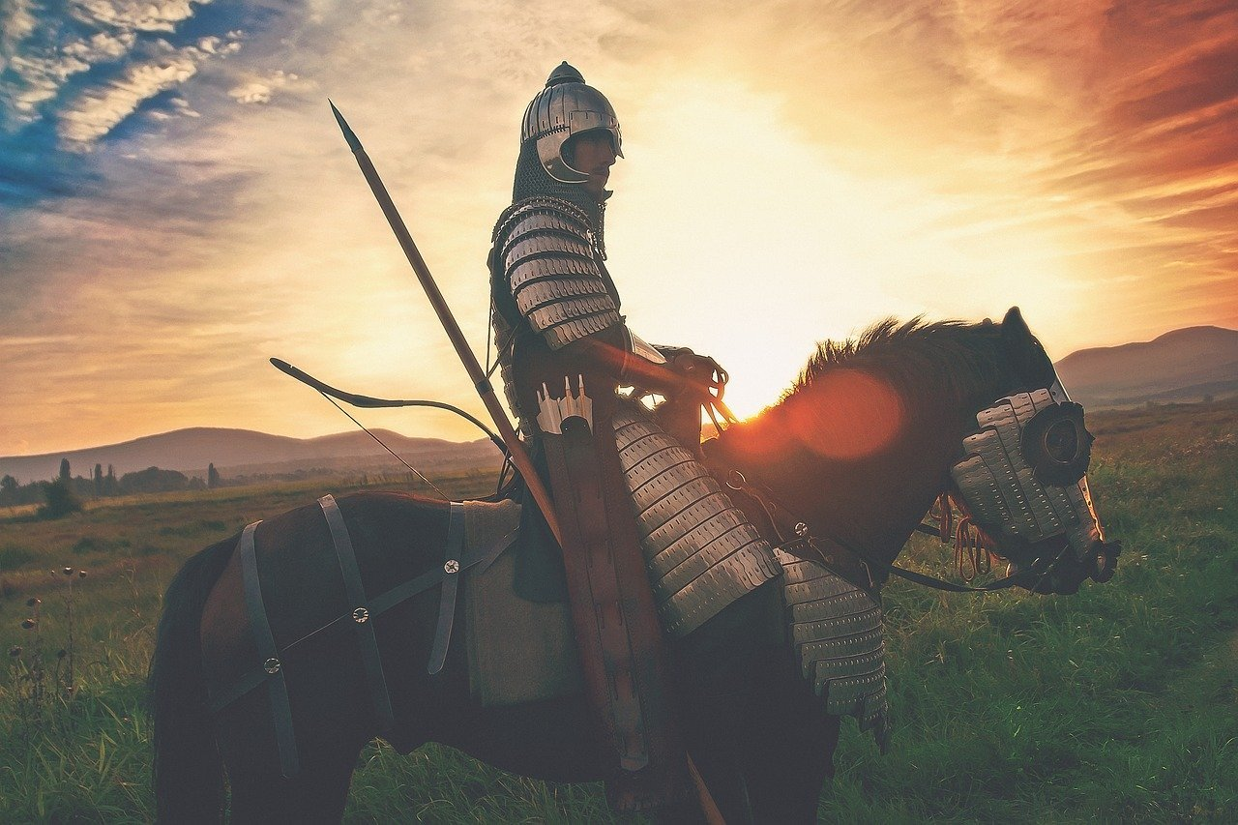
And Jesus answered and spoke to them again by parables and said: "The kingdom of heaven is like a certain king who arranged a marriage for his son, and sent out his servants to call those who were invited to the wedding; and they were not willing to come." — Matthew 22:1-3
The kingdom of heaven
The kingdom of heaven
for his son
for his son
invited to the wedding
invited to the wedding
not willing to come
Notes:
An invitation has gone out to all sentient creatures to return home for the feast God has prepared.

Slide 11
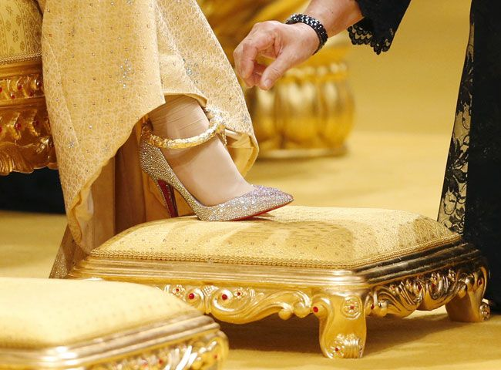
"Again, he sent out other servants, saying, 'Tell those who are invited, "See, I have prepared my dinner; my oxen and fatted cattle are killed, and all things are ready. Come to the wedding."'" — Matthew 22:4
Again
Again
I have prepared
I have prepared
Come
Come
Notes:
Many will and have rejected the word of God to come and pursue His ways of love and honesty.

Slide 12
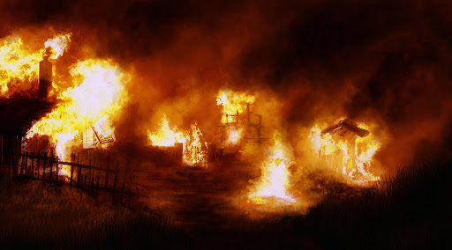
"But they made light of it and went their ways, one to his own farm, another to his business. And the rest seized his servants, treated them spitefully, and killed them. But when the king heard about it, he was furious. And he sent out his armies, destroyed those murderers, and burned up their city." — Matthew 22:5-7
seized his servants
seized his servants
meanly
disrespectfully
and killed them
unkindly
hurtfully
spitefully
hatefully
and killed them
destroyed those murderers
Notes:
Those who do not take God seriously now today will eventually see Him in the most serious way.

Slide 13
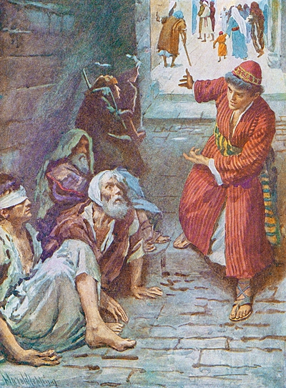
"Then he said to his servants, 'The wedding is ready, but those who were invited were not worthy. Therefore go into the highways, and as many as you find, invite to the wedding.' So those servants went out into the highways and gathered together all whom they found, both bad and good. And the wedding hall was filled with guests." — Matthew 22:8-10
wedding
find
invite
invite
wedding
bad and good
bad and good
Notes:
God is not partial to who would want to come, as the invitation extends to all, who are both good and bad.

Slide 14
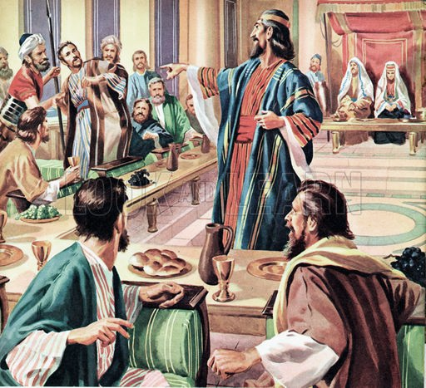
"But when the king came in to see the guests, he saw a man there who did not have on a wedding garment. So he said to him, 'Friend, how did you come in here without a wedding garment?' And he was speechless." — Matthew 22:11-12
in
king
came in to see
came in to see
king
did not have
wedding
did not have
in
come in
come in
garment?
garment?
character
Notes:
Many think they deserve without any consideration to observe His commands. The expectations of the entitled will be met with a deafening and resounding condemnation to their shock of inaction.

Slide 15
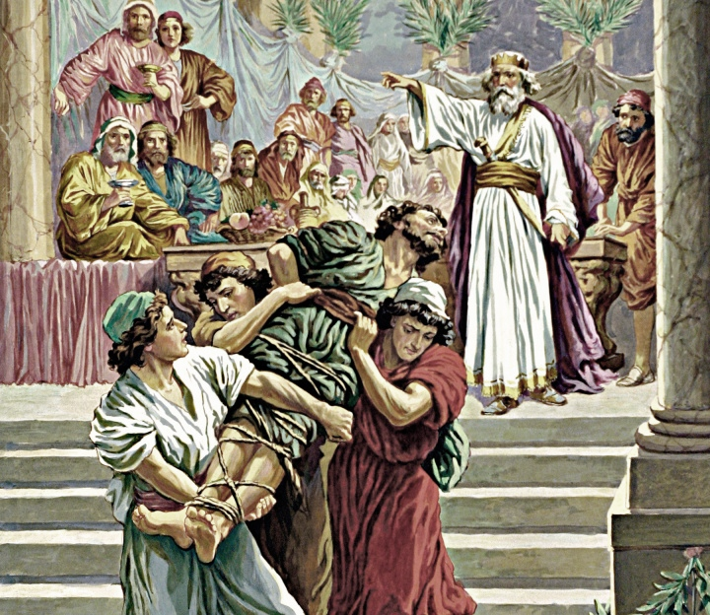
"Then the king said to the servants, 'Bind him hand and foot, take him away, and cast him into outer darkness; there will be weeping and gnashing of teeth.' For many are called, but few are chosen." — Matthew 22:13-14
king
many are called
few are chosen
many are called
few are
few
chosen
Notes:
There will be no mercy for those intruding on the holy, when they themselves have no holiness. If one believes they are the exalted example, on display for others to emulate, how little they know.

Slide 16
God
Sent prophets
Sent prophets
Jesus
Jesus
People (Jews) would not come
People (Jews) would not come
not
not
not
not
Wedding
prepared
Wedding
prepared
Put on Christ’s attributes
X
Killed prophets
Killed prophets
"Let us be glad and rejoice and give Him glory, for the marriage of the Lamb has come, and His wife has made herself ready." — Revelation 19:7
Re-invited everyone good and bad
This is a great mystery, but I speak concerning Christ and the church.
— Ephesians 5:32
Destroyed unworthy
Destroyed unworthy
The one unprepared
Thrown out - sent to the outer darkness
X
Notes:
Consider if one did nothing in response to the call of God.

Slide 17
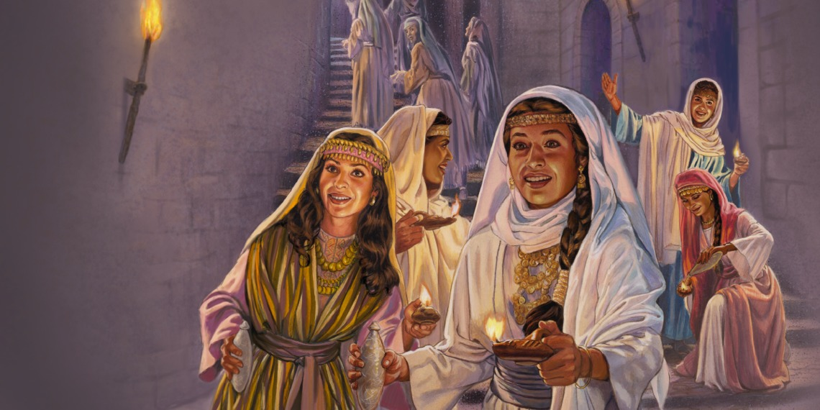
"Then the kingdom of heaven shall be likened to ten virgins who took their lamps and went out to meet the bridegroom." — Matthew 25:1
the kingdom of heaven
the kingdom of heaven
ten virgins
ten virgins
lamps
lamps
meet the bridegroom
Notes:
The kingdom of God is meant for those with light in their hearts for God.

Slide 18
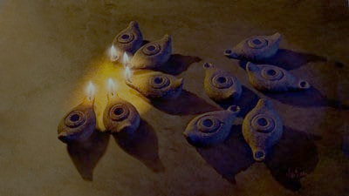
"Now five of them were wise, and five were foolish. Those who were foolish took their lamps and took no oil with them, but the wise took oil in their vessels with their lamps." — Matthew 25:2-4
wise
wise
foolish
foolish
lamps
lamps
lamps
Notes:
Wisdom is to know what is coming and to pay attention to this impending awaking at any moment.

Slide 19
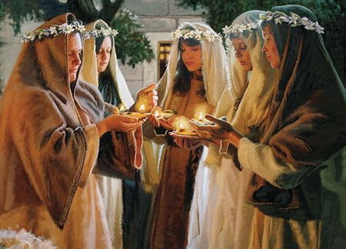
"But while the bridegroom was delayed, they all slumbered and slept. And at midnight a cry was heard: 'Behold, the bridegroom is coming; go out to meet him!' Then all those virgins arose and trimmed their lamps." — Matthew 25:5-7
lamps
all slumbered
all slumbered
Behold
is coming
meet him
is coming
meet him
lamps
Notes:
A point of no return is coming, and the trumpets will sound, as all arrive before Him. No one can deny life is wearisome, but our choice to believe in God defines our destiny. None of us can say we do not fall from time to time. This does not change the fact that we can be prepared in seeking Him, as “awake” should be a long term permanent goal.

Slide 20
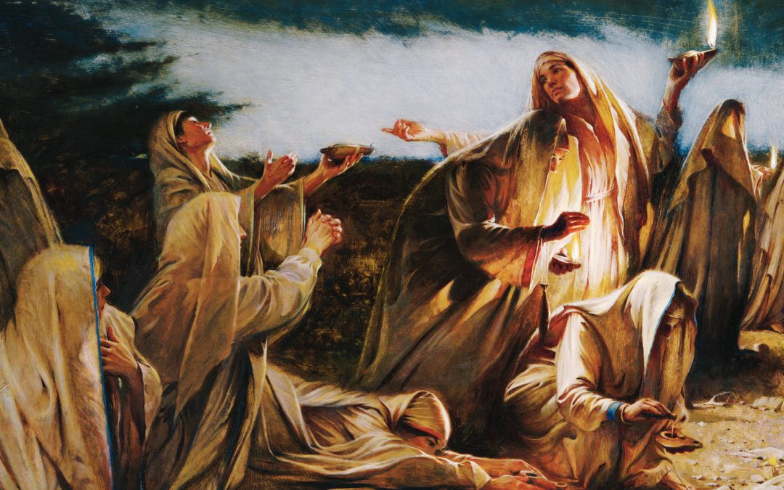
"And the foolish said to the wise, 'Give us some of your oil, for our lamps are going out.' But the wise answered, saying, 'No, lest there should not be enough for us and you; but go rather to those who sell, and buy for yourselves.' And while they went to buy, the bridegroom came, and those who were ready went in with him to the wedding; and the door was shut." — Matthew 25:8-10
lamps
door
in
who were ready went in
who were ready went in
door
Notes:
Last minute scrambling's will help little for those that have long neglected what is best in us as living souls. Ask, what qualities does He expect, in order to gain entrance? Honesty, endurance, and diligence toward His Holy word. For salvation to be had, one must save one self first.

Slide 21
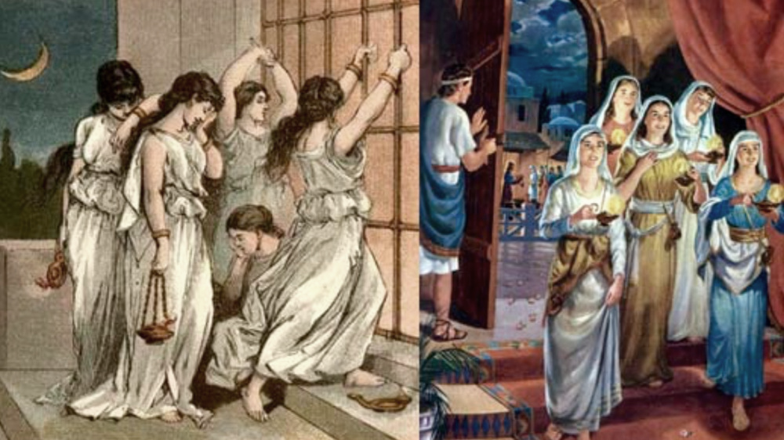
"Afterward the other virgins came also, saying, 'Lord, Lord, open to us!' But he answered and said, 'Assuredly, I say to you, I do not know you.' Watch therefore, for you know neither the day nor the hour in which the Son of Man is coming." — Matthew 25:11-13
Inattention
Consider
Guard
Neglect
Mind
oblivious
door
Beware
Watch
Watch
Ignore
Observe
Avoid
Examine
Carelessness
Notes:
Too late, many will cry without hope, and there will be gnashing of teeth for those missing the call to prepare.

Slide 22
5 Waiting
Prepared with oil
Faithful
5 Waiting
Prepared with oil
Faithful
Welcomed
Wedding Assembly
Ten Virgins
(The people)
Ten Virgins
(The people)
Midnight call to Come
X
Denied
5 Waiting
Unprepared without oil
Unfaithful
5 Waiting
Unprepared without oil
Unfaithful
Delayed Sidetracked
Notes:
All will know the truth of His coming before each, those faithful, as well as those unfaithful.

Slide 23
"Not everyone who says to Me, 'Lord, Lord,' shall enter the kingdom of heaven, but he who does the will of My Father in heaven. Many will say to Me in that day, 'Lord, Lord, have we not prophesied in Your name, cast out demons in Your name, and done many wonders in Your name?' And then I will declare to them, 'I never knew you; depart from Me, you who practice lawlessness!' " — Matthew 7:21-23
he who does the will of My Father
does
action
he who does the will of My Father
have we not
have we not
done
done
Notes:
Many miss that pride is an excluding factor, when considering God’s call to come with a humble heart. Many who see themselves above others will find God’s abandonment, just as they abandoned others in exalting themselves.

Slide 24
"But why do you call Me 'Lord, Lord,' and do not do the things which I say?" — Luke 6:46
cheaters
do not do
. .
ingenuine
proudful
Notes:
People that are impressed with themselves generally do not see their own wickedness.

Slide 25
pathway
pathway
pathway
pathway

Slide 26
In the way of righteousness is life, And in its pathway there is no death — Proverbs 12:28
reliable
honesty
devoted
life
pathway
death
Notes:
What a glorious path eternity holds for all who are faithful. If we choose life, we live for Christ. If we choose death, we live for ourselves and no other. God is looking for community, not isolationists.

Slide 27
The highway of the upright is to depart from evil; He who keeps his way preserves his soul. — Proverbs 16:17
highway
the
to depart
evil
depart from evil
. .
keeps
preserves
soul
keeps his way preserves his soul
Notes:
Observing His word is what Christians do, while the unfaithful miss what heaven has yet to unfold as we become.

Slide 28
highway preserves the soul to depart keeps evil
highway
preserves
the
soul
to depart
keeps
evil
low-way
Notes:
Observing His word is what Christians do, while the unfaithful miss what heaven has yet to unfold as we become.

Slide 29
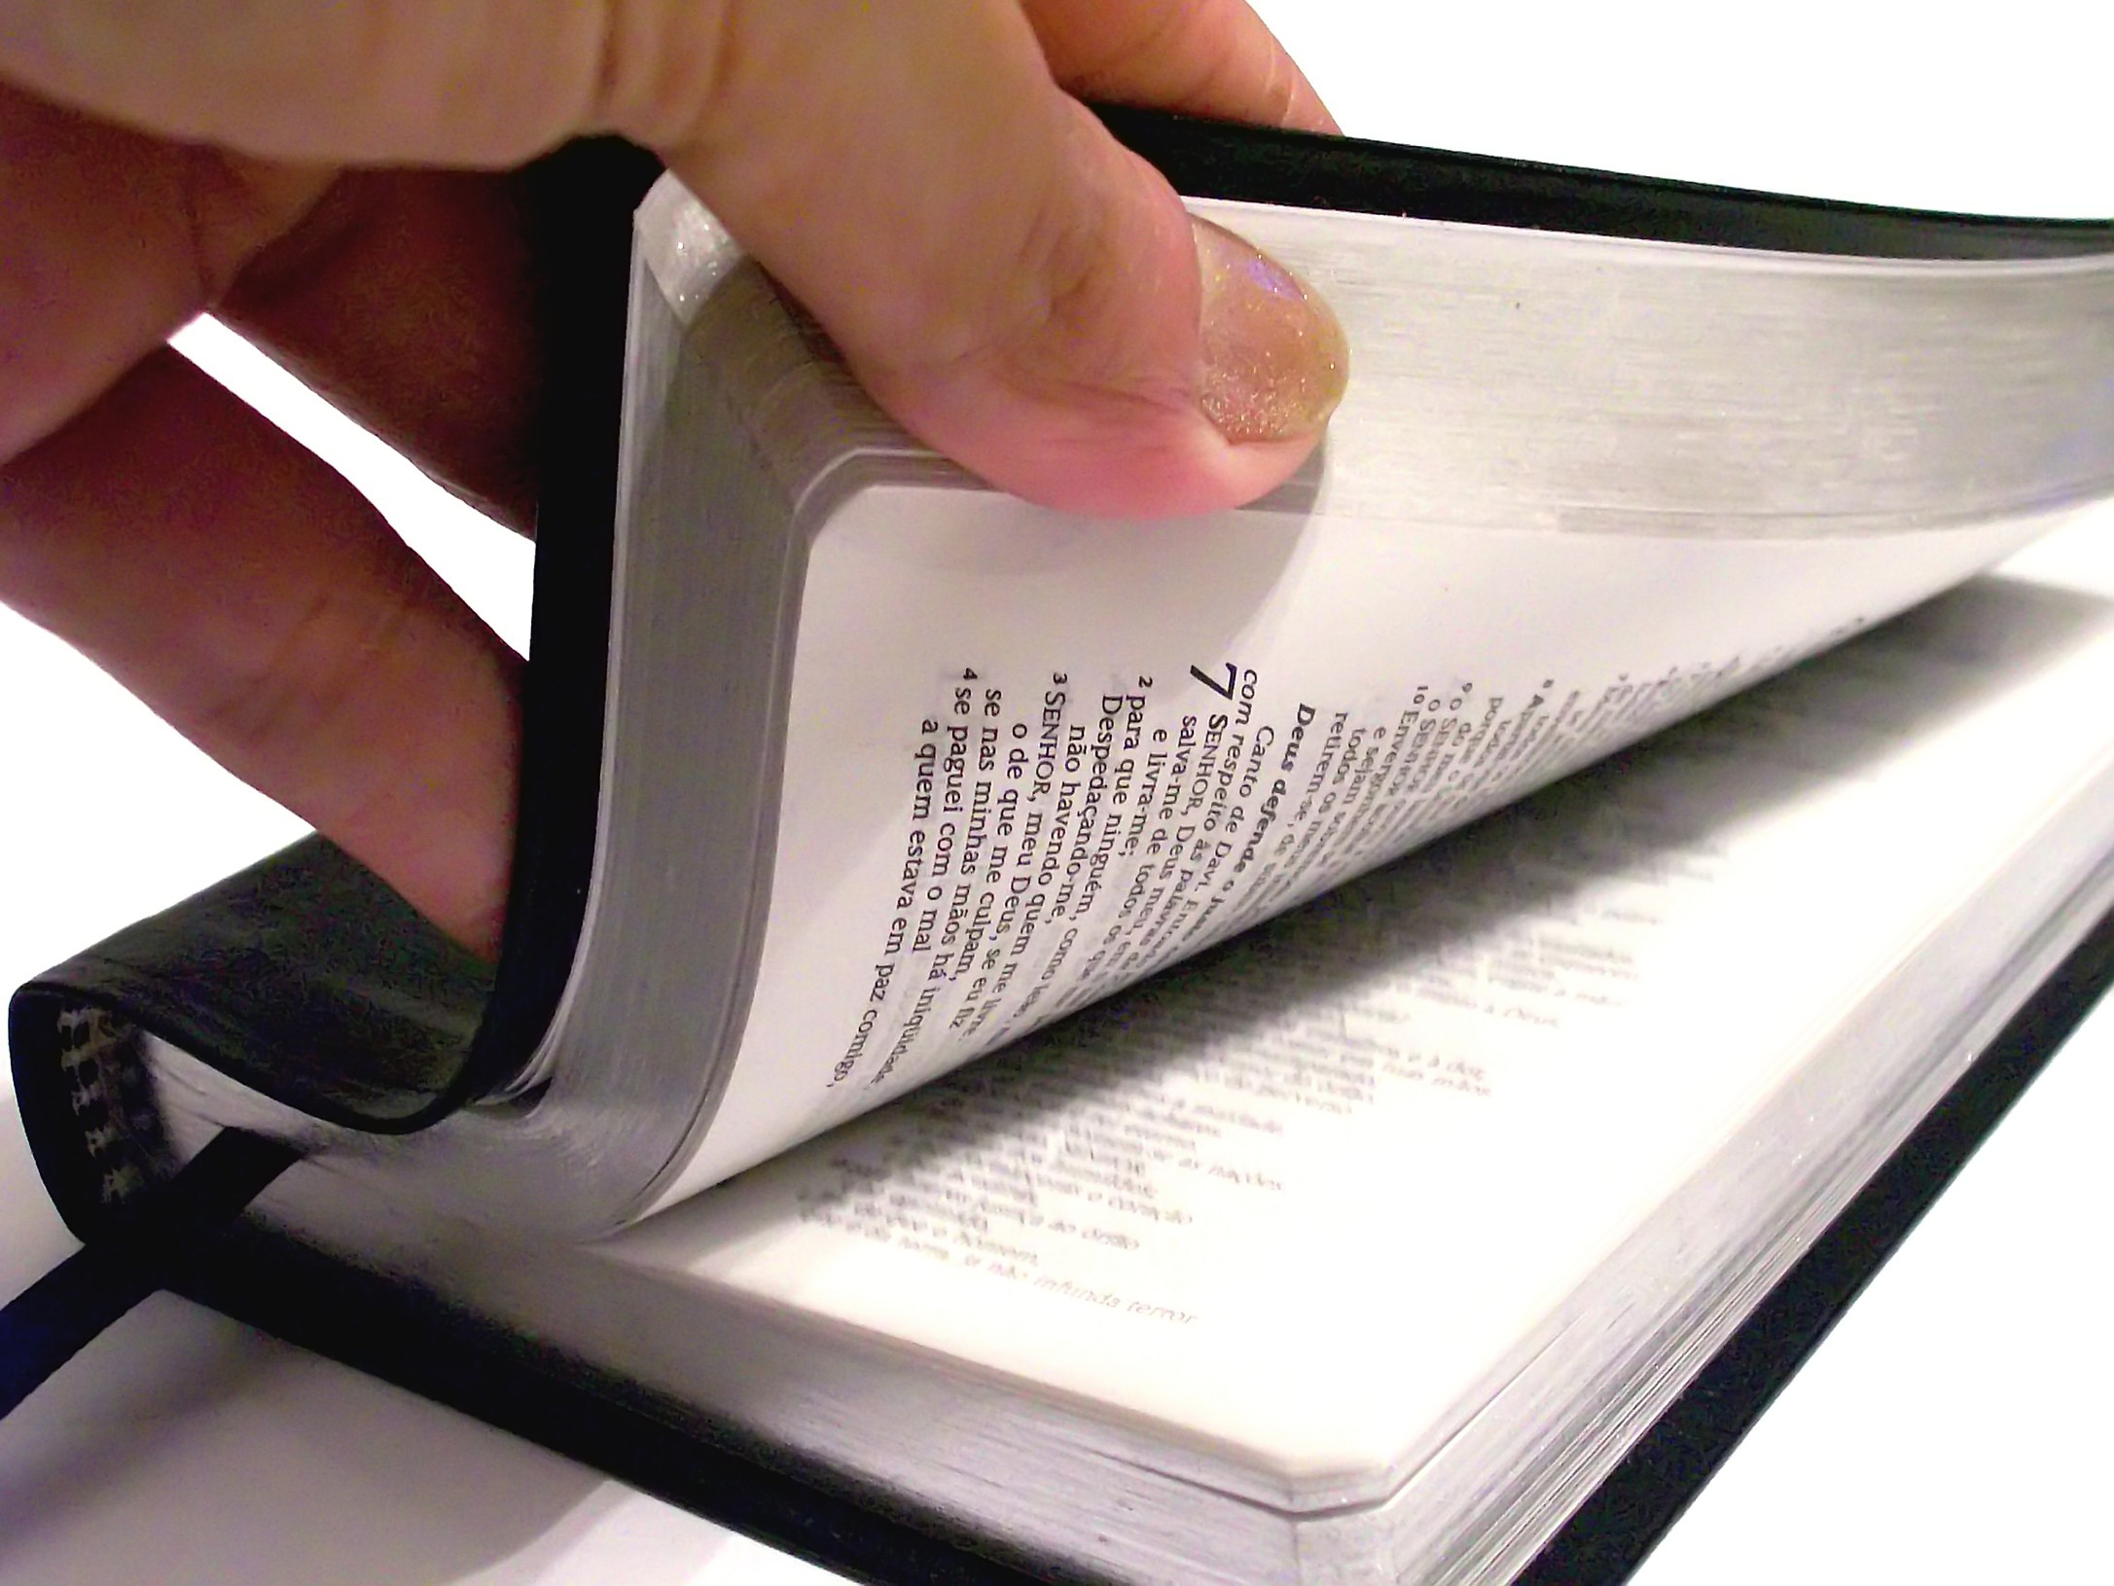
Therefore we must give the more earnest heed to the things we have heard, lest we drift away. — Hebrews 2:1
must give
earnest heed
to the things
we have heard
must give
earnest heed
to the things
we
have heard
lest we drift away
lest we drift away
Notes:
By either ignoring, forgetting, and or dismissing the word of God as casual, will have dire consequences. The Bible is a book of instructions to live a better life with oneself, others, and God. To not regard it and the principles it maintains, is to condemn oneself.

Slide 30
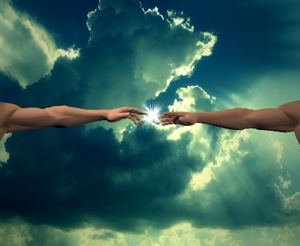
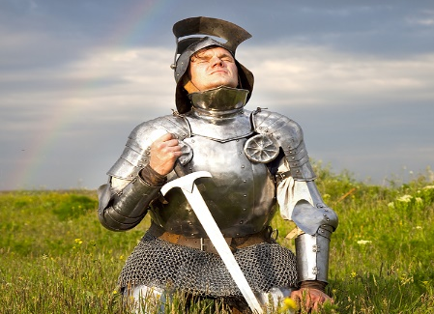
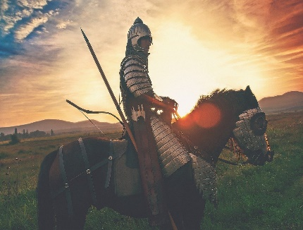
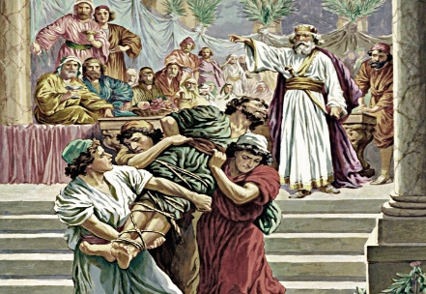
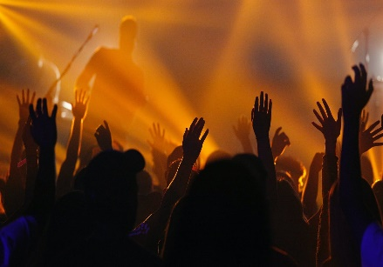
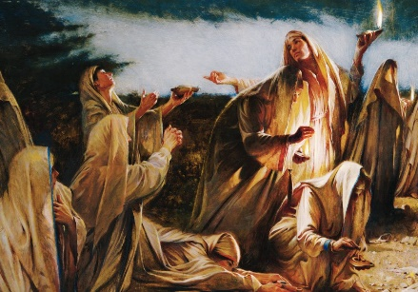

Slide 31
→ Evil occurs when God is not considered
→ God proclaims we prepare to meet Him
→ Waiting on the Lord increases personal strength
→ Do not fret as evil prospers in its’ wicked scheming
→ Trust in the Lord and do what He asks of us
→ God has invited all to come to His kingdom
→ Unprepared expecting souls will be thrown out
→ The warning to be prepared has gone forth
→ God’s call is to come before regret sees to late
→ Hypocrites say they believe but do not follow God
→ Living righteously leads to eternal life over death
→ Keeping away from evil preserves the soul in life
→ If one is not watchful one may drift away from truth
To truly come to oneself God is seen above all
Notes:
To truly come to oneself God is seen above all

Slide 33
Please visit http://www.RonBert.com to explore further
Ronald Bert Channel on
Notes:
Eternity never ends.

