Slide 1
Notes:
Without spirit, there is no light. Spirit expires without light.

Slide 2
Notes:
Prayer adds depth of spirit inviting the light.

Slide 3
Ron Bert
August 2, 2015
Notes:
Prayer is a humble heart opening event.

Slide 4
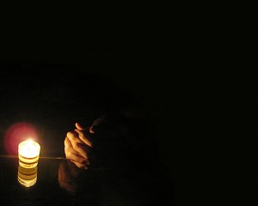
"And when you pray, you shall not be like the hypocrites. For they love to pray standing in the synagogues and on the corners of the streets, that they may be seen by men. Assuredly, I say to you, they have their reward. But you, when you pray, go into your room, and when you have shut your door, pray to your Father who is in the secret place; and your Father who sees in secret will reward you openly." — Matthew 6:5-6
honest
genuine
Bottom of One’s Heart
open submission
intimate
door
exposed
secret place
Notes:
Encounters with God come from the bottom of one’s heart in private. They are most intimately genuine, in honest and open-submission, exposing the whole of your soul. Fools expect to be seen by others rather than heard by God. Pride is a hypocrites Achilles heel and it is one’s nemesis to righteousness.

Slide 5
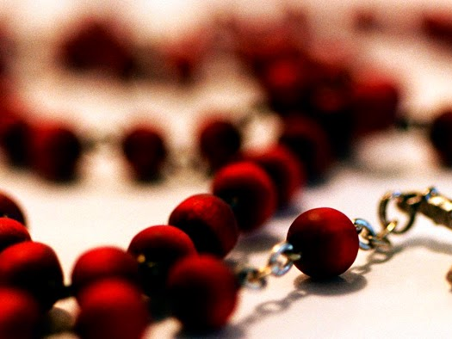
"And when you pray, do not use vain repetitions as the heathen do. For they think that they will be heard for their many words. Therefore do not be like them. For your Father knows the things you have need of before you ask Him." — Matthew 6:7-8
vain repetitions
X
Notes:
Vain self-seeking shallow prayers are not what God seeks; He seeks genuine humble trusting souls. Is asking for stuff more important than asking for life? He knows our deepest needs.

Slide 6
"And whatever things you ask in prayer, believing, you will receive." — Matthew 21:22
believing
Notes:
As a matter of belief, it is trust that eternally releases the love He offers. He is the caretaker. He supplies what we need to rise in Him.

Slide 7
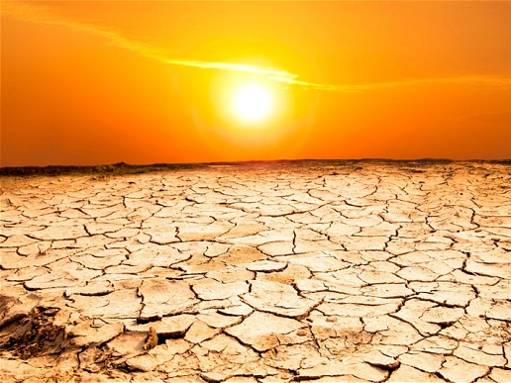
Elijah was a man with a nature like ours, and he prayed earnestly that it would not rain; and it did not rain on the land for three years and six months. And he prayed again, and the heaven gave rain, and the earth produced its fruit. — James 5:17-18
believing
Notes:
In the deserts of life's challenges, in which we all encounter, thereby comes the true tests and resolve that reveals a faithful heart, or not. Belief sharpens the depth of peace.

Slide 8
Now this is the confidence that we have in Him, that if we ask anything according to His will, He hears us. And if we know that He hears us, whatever we ask, we know that we have the petitions that we have asked of Him. — 1st John 5:14-15
a
y
according to
pray
His will
r
p
we have the petitions
Notes:
God’s will is perfect, and what is required for honest prayer is submission, in a relationship, trusting He knows best. His sees all and wills accordingly.

Slide 9
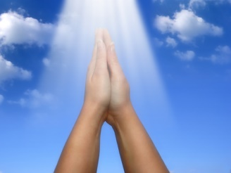
"Watch and pray, lest you enter into temptation. The spirit indeed is willing, but the flesh is weak." — Matthew 26:41
trust
t
pray
r
t
u
s
Notes:
Trust can be challenged in the weakness of our flesh, especially as sorrows splash across our bow.

Slide 10
Likewise the Spirit also helps in our weaknesses. For we do not know what we should pray for as we ought, but the Spirit Himself makes intercession for us with groanings which cannot be uttered. — Romans 8:26
trust
Notes:
Knowing He helps us more than we can help ourselves is what He looks for in our faith in Him. Again, trusting He knows exactly what we need, for our greatest benefit, though we can be oblivious and unaware of those needs, is God’s superseding knowledge from heaven. Delusions abound in many, if not all; a blinding darkness for the mire of humanities constant clear confusion. We all need His help in leading us to become, in a life living the best one can be. To be in God is to achieve nothing greater.

Slide 11
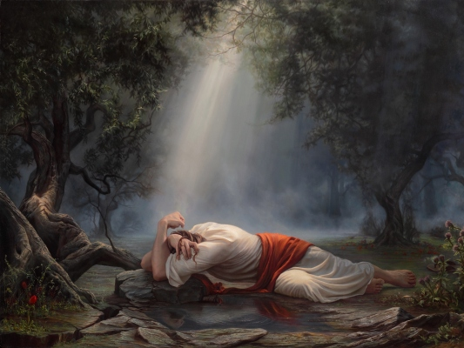
He went a little farther and fell on His face, and prayed, saying, "O My Father, if it is possible, let this cup pass from Me; nevertheless, not as I will, but as You will." Then He came to the disciples and found them asleep, and said to Peter, "What? Could you not watch with Me one hour? Watch and pray, lest you enter into temptation. The spirit indeed is willing, but the flesh is weak." — Matthew 26:39-41
Watch and pray
spirit
Notes:
Suffering tests one’s reliance upon Him.

Slide 12
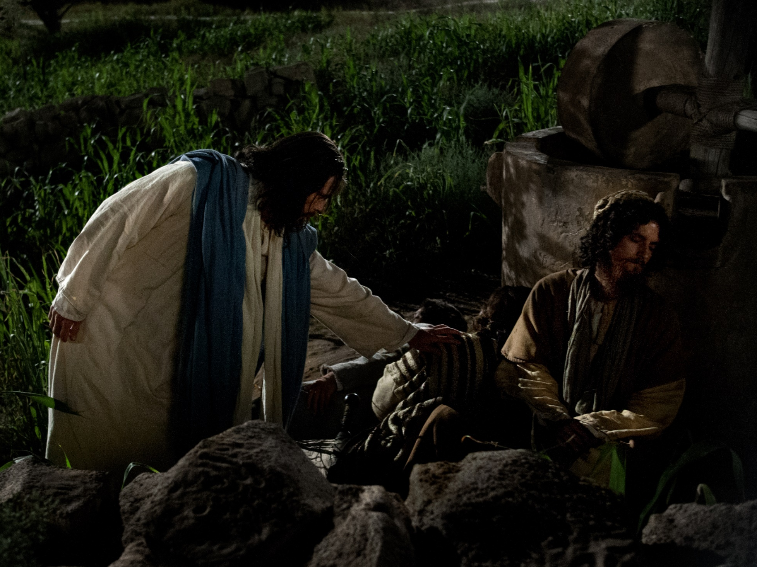
Again, a second time, He went away and prayed, saying, "O My Father, if this cup cannot pass away from Me unless I drink it, Your will be done." And He came and found them asleep again, for their eyes were heavy. — Matthew 26:42-43
second
Notes:
The flesh is a wearisome encounter for all.

Slide 13
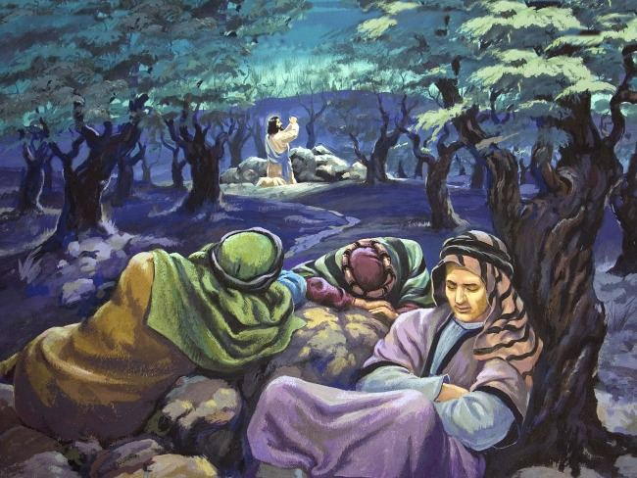
So He left them, went away again, and prayed the third time, saying the same words. Then He came to His disciples and said to them, "Are you still sleeping and resting? Behold, the hour is at hand, and the Son of Man is being betrayed into the hands of sinners. — Matthew 26:44-45
third
sleeping and resting
Notes:
In sorrow sleep is an escape from the brutal. God wants to hear our earnest beseechments and this is not the same as vain repetitive prayer. God wants serious seeking hearts, not just bobbling heads; automatons narrating useless programed ramblings; hail Mary bops. The deepest of prayers are not rehearsed, but surface as the times arise. In apparent unanswered prayers, He asks we not give up our cries but continue in our greatest concerns of heart.

Slide 14
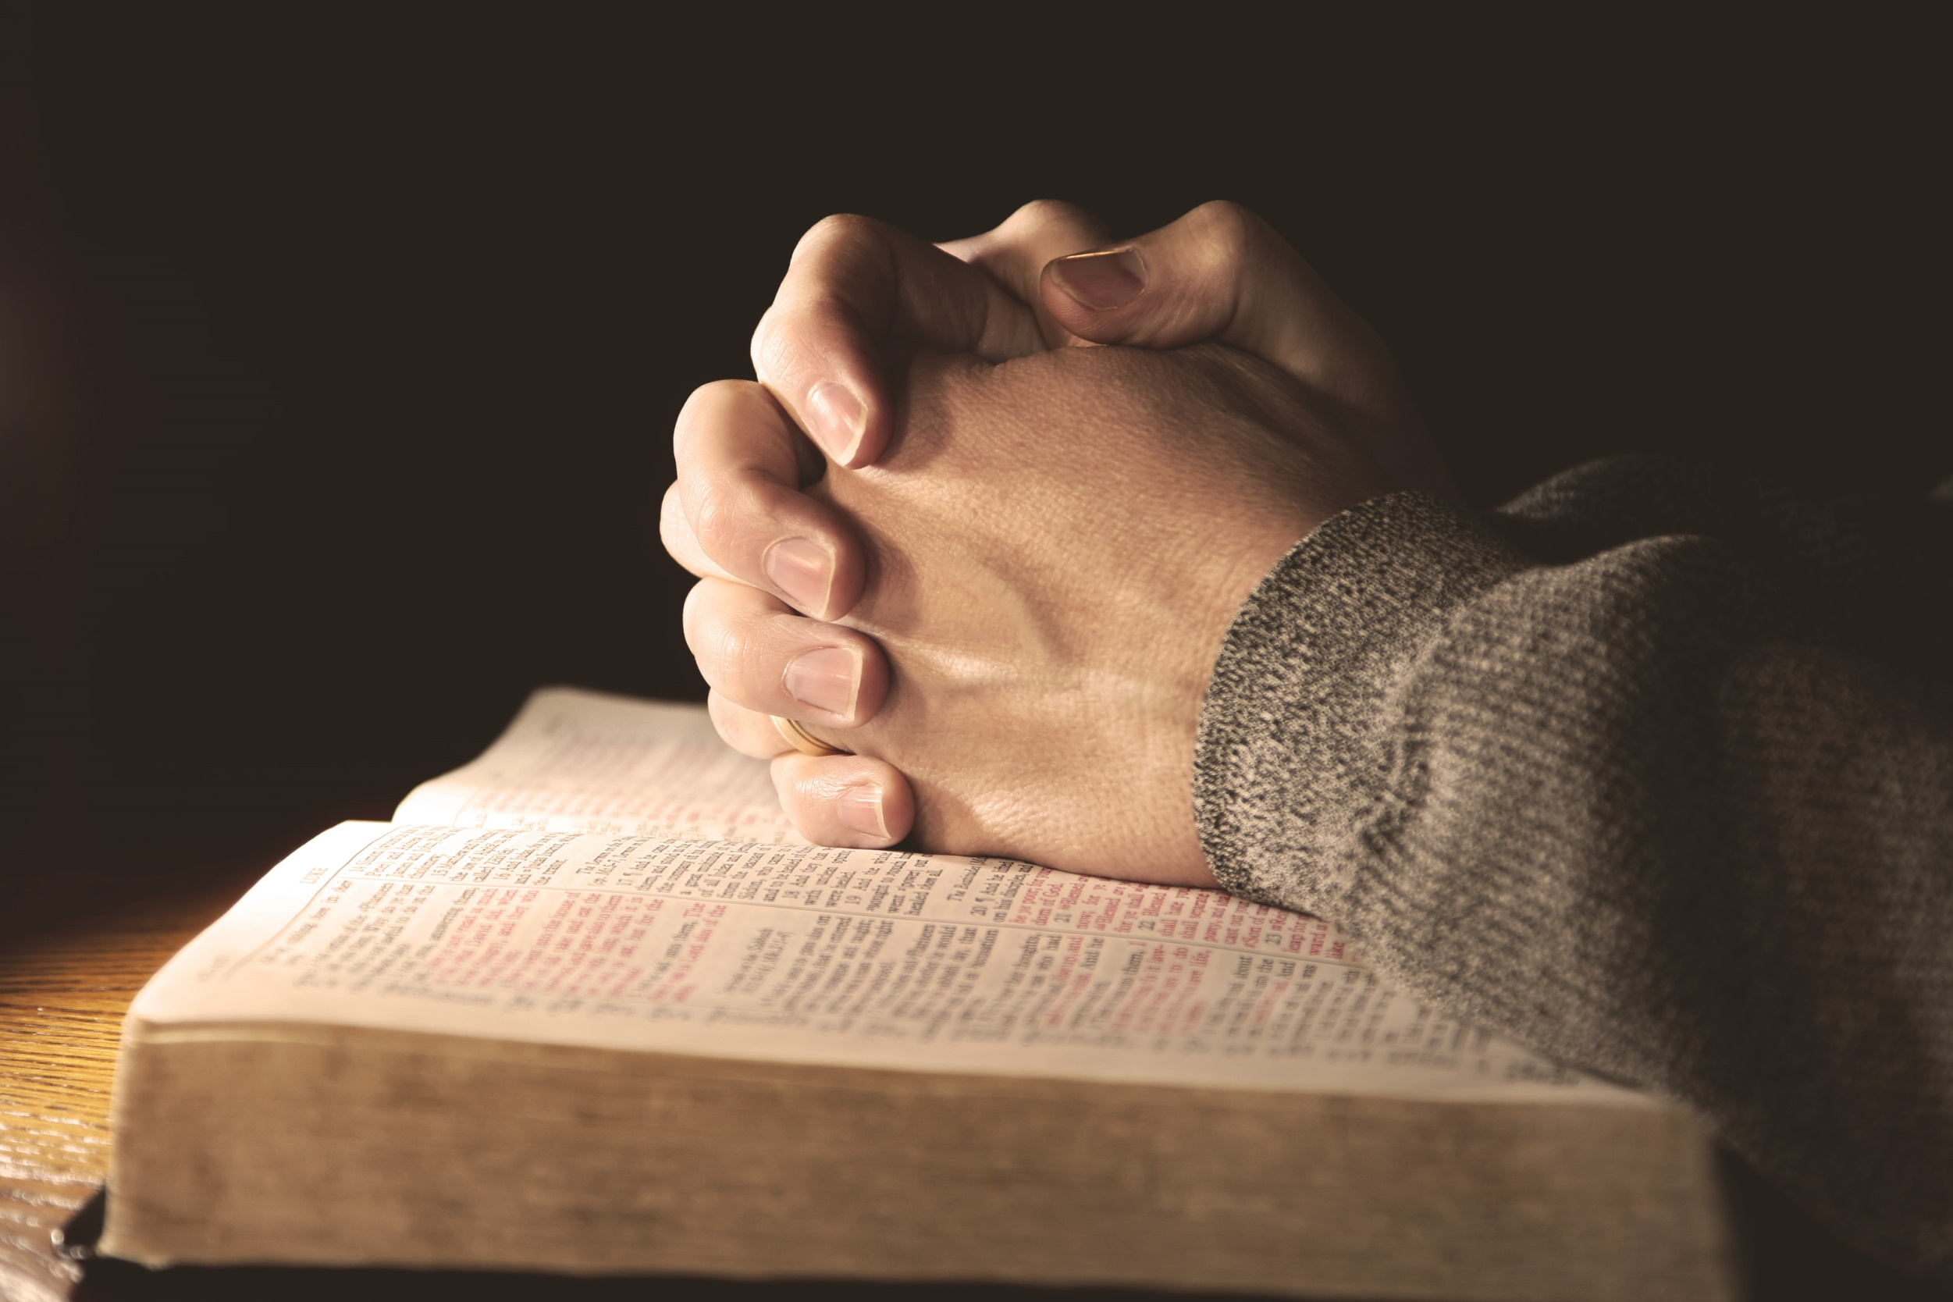
But the end of all things is at hand; therefore be serious and watchful in your prayers. — 1st Peter 4:7
serious
watchful
Notes:
The message Jesus brings to us is to be vigilant, not neglecting humble prayer, which comforts, in the face of hardship. It can not be overstated that being in God is not just a casual event. Many mask true serious worship with faux gospel messages, embracing social frolickings void of correct focus on God.

Slide 15
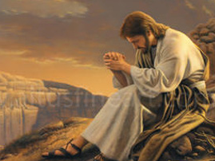
Now it came to pass in those days that He went out to the mountain to pray, and continued all night in prayer to God. And when it was day, He called His disciples to Himself; and from them He chose twelve whom He also named apostles: — Luke 6:12-13
continued all night
Notes:
Jesus prayed long and earnestly, especially in the face of important decisions ahead. How does our convictions bear up depending upon the guidance of God and His word? Habitual sin often neglects prayer, especially in acknowledging accountability. To believe in God is not a short term temporary exercise. Selective hearing is like selective prayers if we do not open our hearts up to His will. One must ask for His help if clarity of thought is truly to be had.

Slide 16
"... bless those who curse you, and pray for those who spitefully use you." — Luke 6:28
"But love
your enemies,
do good, and lend,
hoping for nothing in
return; and your reward
will be great, and you will
be sons of the Most High.
For He is kind to the
unthankful and evil."
— Luke 6:35
ne
s
l
ho
i
e
n
s
s
s
He is kind
is
kind
Notes:
Forgiving the anger of those that hate releases one’s heart to find peace. Kindness is holiness.

Slide 17
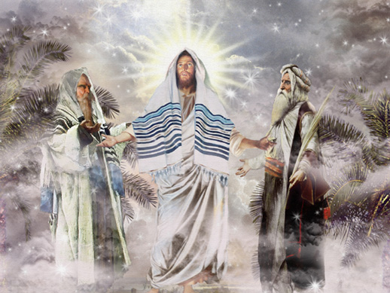
Now it came to pass, about eight days after these sayings, that He took Peter, John, and James and went up on the mountain to pray. — Luke 9:28
pray
pray
Notes:
Often, when important prayers were made, Jesus went off to areas of isolation. These times of deepest prayer come to one alone in the wilderness of humanity's chaos.

Slide 18
Then He said to them, "The harvest truly is great, but the laborers are few; therefore pray the Lord of the harvest to send out laborers into His harvest." — Luke 10:2
pray
pray
laborers
Notes:
Within this vast quagmire of humanity, the Lord looks for those that would help in drawing others to Him. We all need the help of one another, over the attacks that more often drive civilizations to their demise. Without caring hearts, oblivion approaches. It is a call to love the fields of His creation and awaken those to its’ being.

Slide 19
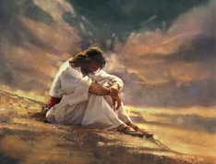
Now it came to pass, as He was praying in a certain place, when He ceased, that one of His disciples said to Him, "Lord, teach us to pray, as John also taught his disciples." So He said to them, "When you pray, say: Our Father in heaven, Hallowed be Your name. Your kingdom come. Your will be done On earth as it is in heaven. Give us day by day our daily bread. And forgive us our sins, For we also forgive everyone who is indebted to us. And do not lead us into temptation, But deliver us from the evil one." — Luke 11:1-4
Notes:
Jesus expressed that prayer should regard God in the highest, thanking Him for His mercy, though we do not deserve it, while maintaining a soft heart free of darkness. It is in His light that the heart is made lite.

Slide 20
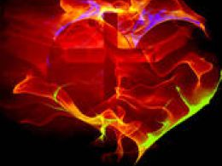
Then He spoke a parable to them, that men always ought to pray and not lose heart, saying: "There was in a certain city a judge who did not fear God nor regard man. Now there was a widow in that city; and she came to him, saying, 'Get justice for me from my adversary.' And he would not for a while; but afterward he said within himself, 'Though I do not fear God nor regard man, yet because this widow troubles me I will avenge her, lest by her continual coming she weary me.'" Then the Lord said, "Hear what the unjust judge said. And shall God not avenge His own elect who cry out day and night to Him, though He bears long with them? I tell you that He will avenge them speedily. Nevertheless, when the Son of Man comes, will He really find faith on the earth?" — Luke 18:1-8
always
pray and not lose heart
continual coming
Notes:
Conviction to one’s own genuine humble sincerity, in prayer, continually, reaps the reward of knowing He will deliver, while enduring oppressive life in the flesh. A true heart can only be defined as openly confessing all to God, in His light, free of the secret shadows of man or his perceived pompous superiority. None of us deserve His mercy and the endowment of His blessed grace. He wonders if true hearts, devoted to Him, can remain, over devotion to man and his organizations. Will man be able to bear up in His truth and flourish upon His obvious absence. Mortal life is in truth a test of soul conviction.

Slide 21
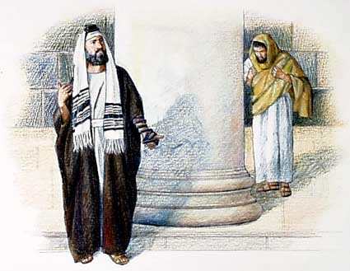
"Two men went up to the temple to pray, one a Pharisee and the other a tax collector. The Pharisee stood and prayed thus with himself, 'God, I thank You that I am not like other men — extortioners, unjust, adulterers, or even as this tax collector. I fast twice a week; I give tithes of all that I possess.' And the tax collector, standing afar off, would not so much as raise his eyes to heaven, but beat his breast, saying, 'God, be merciful to me a sinner!' I tell you, this man went down to his house justified rather than the other; for everyone who exalts himself will be humbled, and he who humbles himself will be exalted." — Luke 18:10-14
justified
he who humbles
justified
he who humbles
Notes:
Arrogance and judgment of others in prayer is not the kind of prayers God looks for. Prayer is not a place of cursing. Humble hearts speaking directly to Him is what touches His attention.

Slide 22
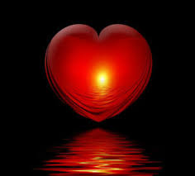
"But take heed to yourselves, lest your hearts be weighed down with carousing, drunkenness, and cares of this life, and that Day come on you unexpectedly. For it will come as a snare on all those who dwell on the face of the whole earth. Watch therefore, and pray always that you may be counted worthy to escape all these things that will come to pass, and to stand before the Son of Man." — Luke 21:34-36
justified
he who humbles
Watch therefore, and pray always
Notes:
The temporary cares of this world can only lead to limited if not empty returns; endlessly challenged, if void of His higher truths. Asking to be worthy in all obedient goodness, in His presence, how could a soul ask or seek for more?

Slide 23
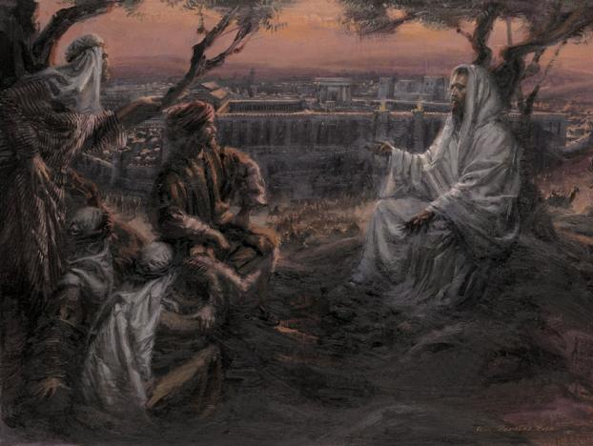
Coming out, He went to the Mount of Olives, as He was accustomed, and His disciples also followed Him. When He came to the place, He said to them, "Pray that you may not enter into temptation." And He was withdrawn from them about a stone's throw, and He knelt down and prayed, saying, "Father, if it is Your will, take this cup away from Me; nevertheless not My will, but Yours, be done." — Luke 22:39-42
accustomed
Notes:
Great release and comfort is found in submitting in prayer, to His will being done. Praying for sin to be kept away, from one’s life, helps in one’s ability to endure and withstand the temptations that all flesh encounter. It is an affirmation of not giving up, and asking for His help in strengthening the spirit to withstand wickedness. Evil that sickens all who would be decent engulfs the world.

Slide 24
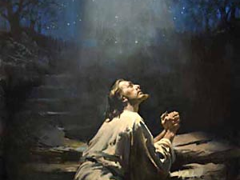
Then an angel appeared to Him from heaven, strengthening Him. And being in agony, He prayed more earnestly. Then His sweat became like great drops of blood falling down to the ground. When He rose up from prayer, and had come to His disciples, He found them sleeping from sorrow. Then He said to them, "Why do you sleep? Rise and pray, lest you enter into temptation." — Luke 22:43-46
agony
more
earnestly
Rise and pray
Notes:
Jesus calls all not to neglect earnest prayers, as they are the shield of the spirit. He implores us not to ignore His call to rise in holiness. Tribulation tests our resolve and should increase our prayer life, rather than succumbing to escaping pleasures of the flesh only diving deeper into the pits of despair.

Slide 25
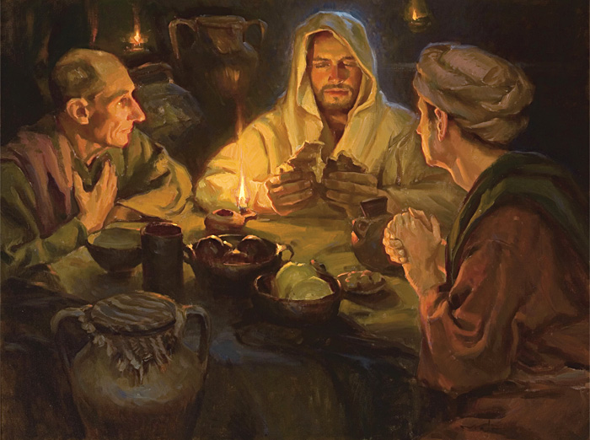
And they continued steadfastly in the apostles' doctrine and fellowship, in the breaking of bread, and in prayers. — Acts 2:42
continued
steadfastly
Notes:
Continuing in prayers is what make one’s relationship with God genuine. Temporary cannot replace that which is permanent.

Slide 26
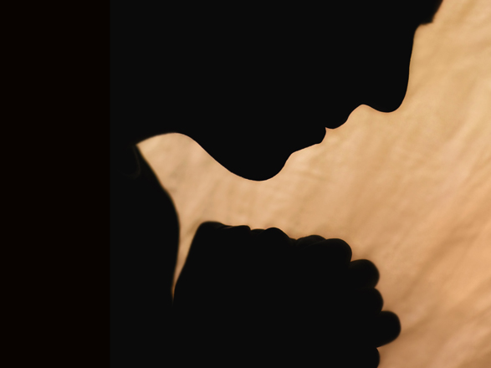
Husbands, likewise, dwell with them with understanding, giving honor to the wife, as to the weaker vessel, and as being heirs together of the grace of life, that your prayers may not be hindered. — 1st Peter 3:7
r
o
ea
ve
peace over anger
an
g
er
ce
prayers may not be hindered
p
Notes:
Peace with those close at home establishes a foundation for deeper prayers of heart. Pray for settling of turmoil.

Slide 27
For the eyes of the LORD are on the righteous, And His ears are open to their prayers; But the face of the LORD is against those who do evil." — 1st Peter 3:12
righteous
Blameless
Virtuous
Honorable
Moral
Obedient
Honest
Good
Upright
Just
Notes:
It is goodness that is a prerequisite for God to hear the brilliance of honest souls. Qualities of the virtuous embedded in righteousness include all that is just and good, morally obedient to God, blameless in Christ. Conniving and contemptuous hearts are left alone to fend for themselves, absent of His illuminating truths.

Slide 28
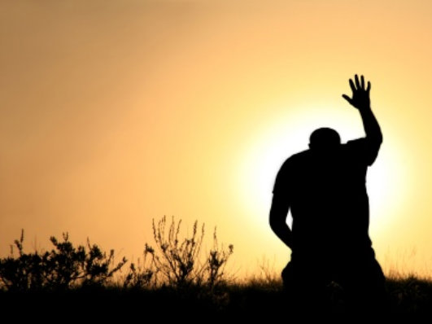
Confess your trespasses to one another, and pray for one another, that you may be healed. The effective, fervent prayer of a righteous man avails much. — James 5:16
healed
Notes:
Healing of the spirit is much more effective if done in union with others. One cannot heal in secret, and only open in His light has redeeming force. A transparent heart is a happy heart in the face of any affliction.

Slide 29
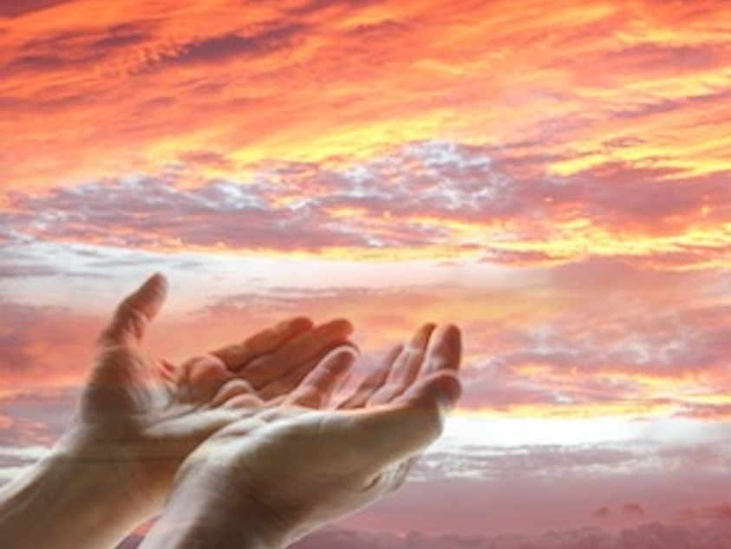
The LORD is far from the wicked, But He hears the prayer of the righteous. — Proverbs 15:29
He hears
the righteous
Notes:
Righteousness and obedience to the word is so crucial if one wants prayers to be acknowledged by God. He has established right over wrong and it should be no surprise to those that chose to rebel in constructions of their own. Fame has no value if not in the truth of His rising light.

Slide 30
"Now we know that God does not hear sinners; but if anyone is a worshiper of God and does His will, He hears him." — John 9:31
Therefore do not be unwise, but understand what the will of the Lord is. — Ephesians 5:17
does His will
will
Notes:
And it is by adhering to Gods will that the spirit is rewarded. The epiphany of highest prayer comes by thankful praise, in the midst of all circumstances.

Slide 31
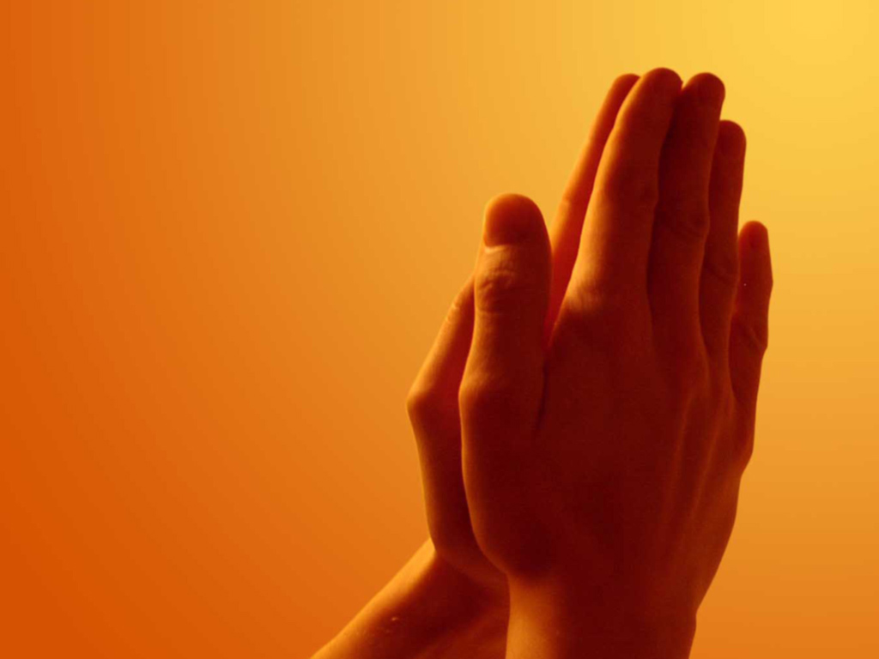
… pray without ceasing, … — 1st Thessalonians 5:17
Notes:
Our union in prayer is unceasing for the true saint. When are we told not to commune with God?

Slide 32
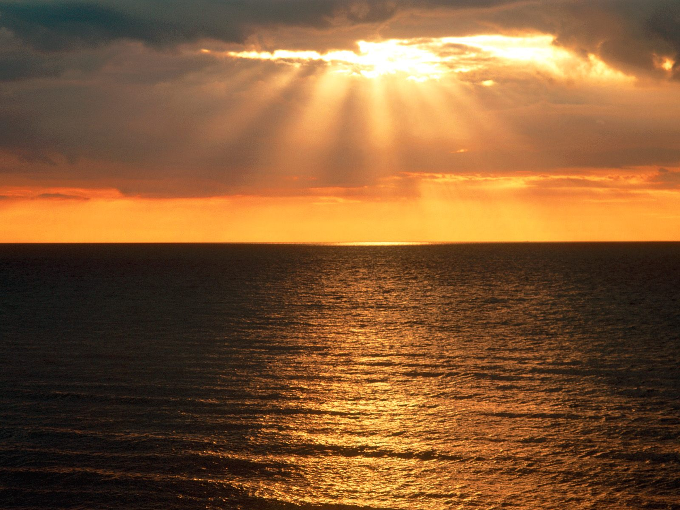
→ Pray in private to God not as a hypocrite
→ Do not pray in vain repetitions
→ Pray with a believing heart pleading for help
→ Be serious and watchful in your prayers
→ Pray to be in service to the Lord
→ Glorify God that His will be done
→ Pray with thanks asking for forgiveness
→ Pray for spiritual strength and salvation
→ Pray for those that spitefully use you
→ Pray continually and do not lose heart
→ Pray humbly and for one another
→ Pray you will be counted worthy
→ Rise and pray and without ceasing
Prayer is where
we meet God
Notes:
His light reaches down to touch us all with His truth. Prayer is where we meet God.

Slide 33
Notes:
To reject His ways in prayer is to find only darkness without Him. Darkness holds to nowhere.

Slide 34
Please visit http://www.LoveFromGod.com/prayers.htm to explore further
Notes:
Eternity never ends.

