Slide 2
One Minute Warning
Ron
Bert
January 5, 2020

Slide 3
Blessed is he who reads and those who hear the words of this prophecy, and keep those things which are written in it; for the time is near. — Revelation 1:3
hear the words
keep
time is near

Slide 4
"Behold, I am coming quickly! Hold fast what you have, that no one may take your crown." — Revelation 3:11
hold fast
I am coming quickly
Hold fast
Hold fast
Hold fast
Life
your crown
your crown
Notes:
Our crown of life is just that.

Slide 5
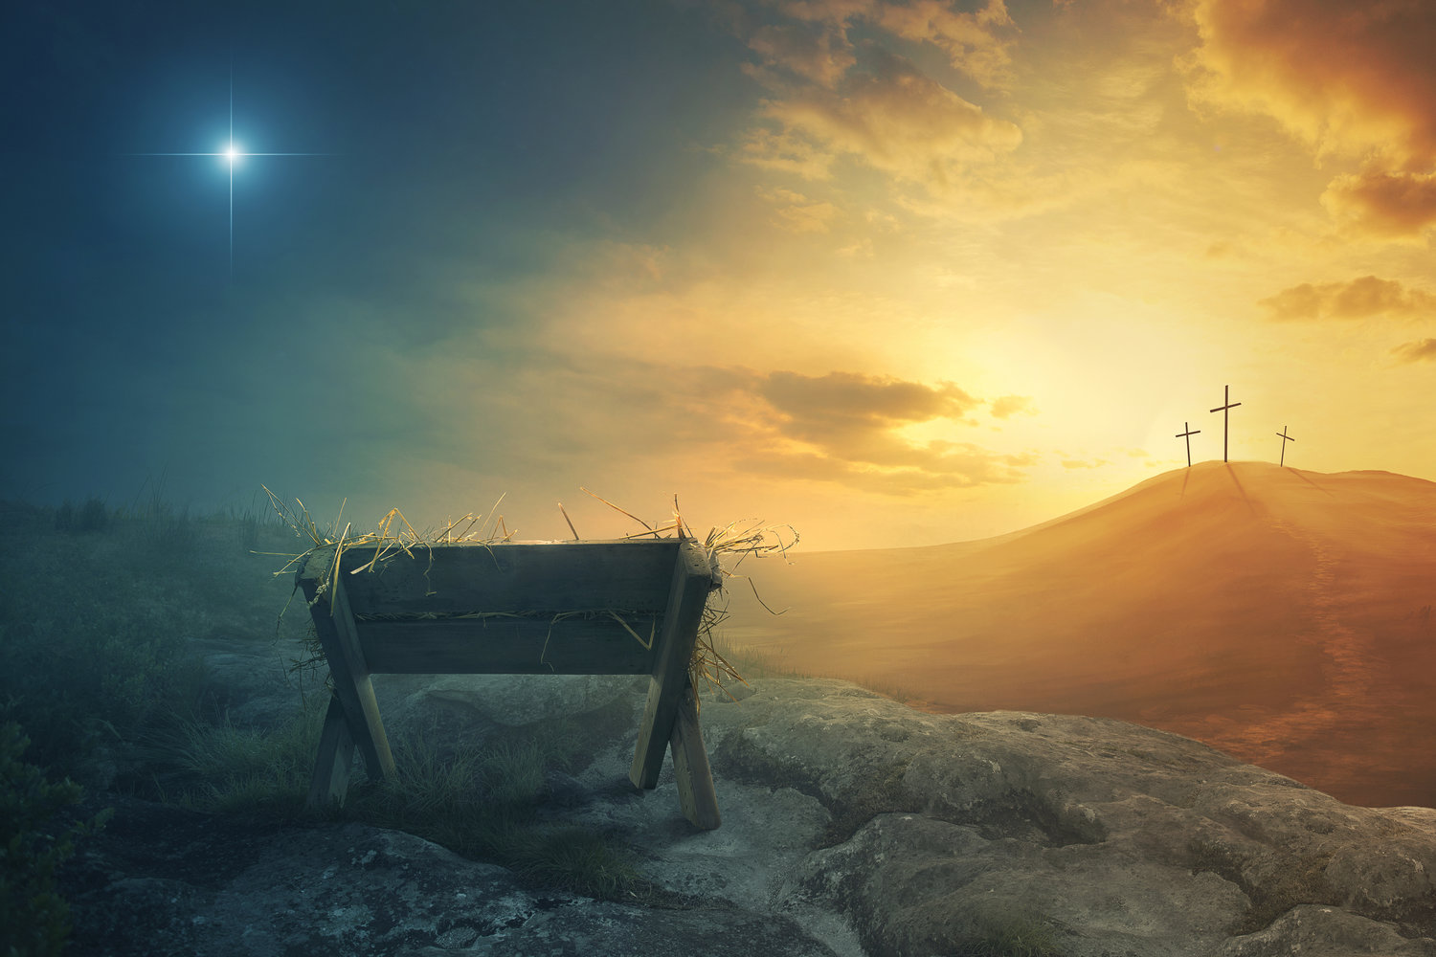
"Remember therefore how you have received and heard; hold fast and repent. Therefore if you will not watch, I will come upon you as a thief, and you will not know what hour I will come upon you." — Revelation 3:3
Remember
Remember
Hold fast
repent
Remember
watch
I will come
guarantee
I will come

Slide 6
"And behold, I am coming quickly, and My reward is with Me, to give to every one according to his work." — Revelation 22:12
I am coming quickly
I am coming quickly
My reward is with Me
Remember

Slide 7
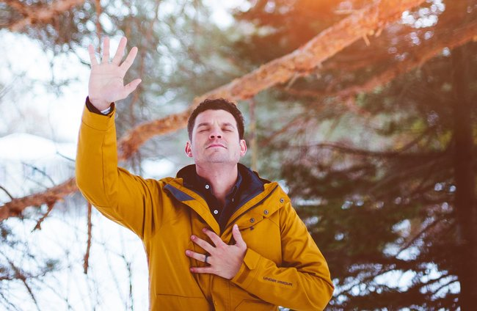
But the end of all things is at hand; therefore be serious and watchful in your prayers. And above all things have fervent love for one another, for "love will cover a multitude of sins." Be hospitable to one another without grumbling. — 1st Peter 4:7-9
end of all things
is at hand
be serious
watchful in
prayer
is at hand
love
one another
• be serious
• watchful in prayer
• love one another
• hospitable without grumbling
hospitable
without grumbling
Notes:
Ever raise your hand to be counted or called forth? It will be that way when the Lord calls out those who have remained faithful in Him until the end.

Slide 8
Let your gentleness be known to all men. The Lord is at hand. — Philippians 4:5
gentleness
is at hand
The Lord
is at hand

Slide 9
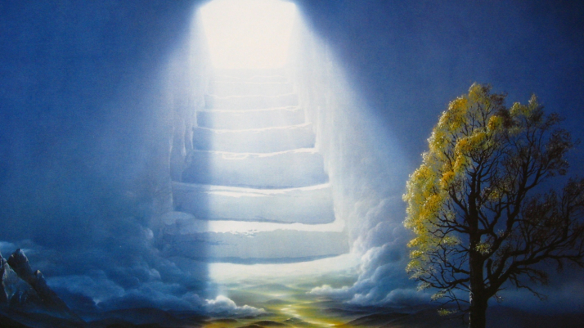
You also be patient. Establish your hearts, for the coming of the Lord is at hand. Do not grumble against one another, brethren, lest you be condemned. Behold, the Judge is standing at the door! — James 5:8-9
be patient
Establish your
coming of the Lord
hearts
coming of the Lord
is at hand
Do not grumble
Establish your hearts
be patient
Do not grumble
at the door

Slide 10
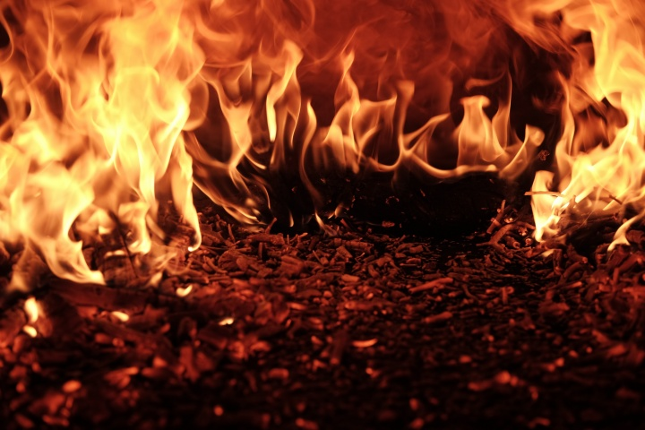
Now the works of the flesh are evident, which are: adultery, fornication, uncleanness, lewdness, idolatry, sorcery, hatred, contentions, jealousies, outbursts of wrath, selfish ambitions, dissensions, heresies, envy, murders, drunkenness, revelries, and the like; of which I tell you beforehand, just as I also told you in time past, that those who practice such things will not inherit the kingdom of God. — Galatians 5:19-21
Now the works of the flesh are evident, which are: adultery, fornication, uncleanness, lewdness, idolatry, sorcery, hatred, contentions, jealousies, outbursts of wrath, selfish ambitions, dissensions, heresies, envy, murders, drunkenness, revelries, and the like; of which I tell you beforehand, just as I also told you in time past, that those who practice such things will not inherit the kingdom of God. — Galatians 5:19-21
practice
Notes:
God has a stamp on unrepentant hearts and the word is NOT. We should not lie against what He has declared, and has been clearly stated repeatedly, as to what and who will have no access in to His kingdom of eternal life. Eternal life is declared by what individuals practice under His will and pronounced truths. The word will judge, not man.

Slide 11
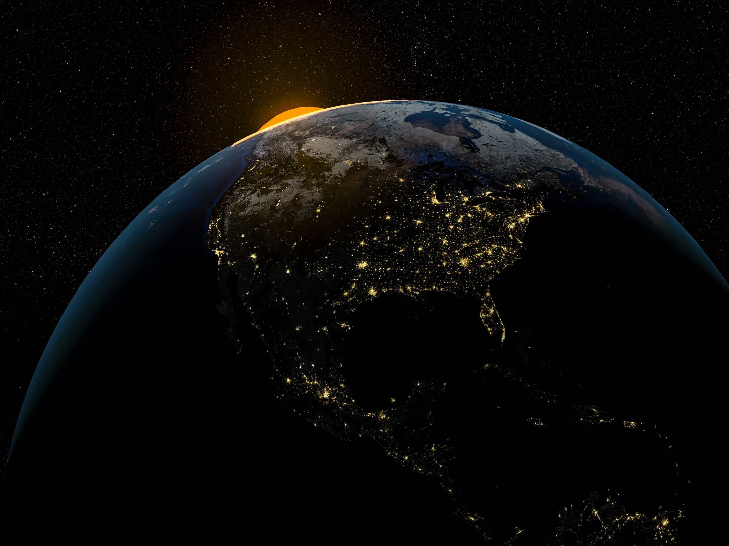
Do not love the world or the things in the world. If anyone loves the world, the love of the Father is not in him. For all that is in the world -- the lust of the flesh, the lust of the eyes, and the pride of life -- is not of the Father but is of the world. And the world is passing away, and the lust of it; but he who does the will of God abides forever. — 1st John 2:15-17
the lust of the flesh
the lust of the eyes
the pride of life
the lust
of the flesh
the lust of the eyes
the pride of life
And the world is passing away, and the lust of it; but he who does the will of God abides forever. — 1st John 2:15-17
passing away
who does
forever

Slide 12
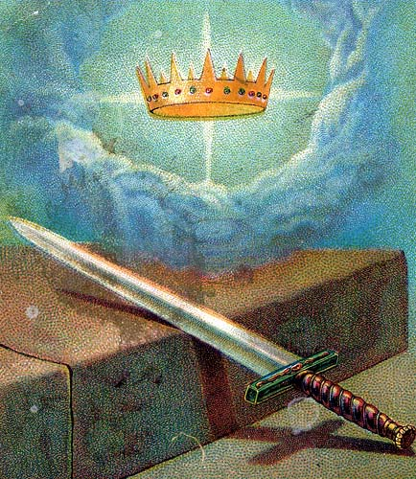
Look to yourselves, that we do not lose those things we worked for, but that we may receive a full reward. Whoever transgresses and does not abide in the doctrine of Christ does not have God. He who abides in the doctrine of Christ has both the Father and the Son. — 2nd John 1:8-9
examine
Look to
do not lose
is faithful
reward
in
in the doctrine of Christ
in the doctrine of Christ
Christ

Slide 13
Let us hold fast the confession of our hope without wavering, for He who promised is faithful. And let us consider one another in order to stir up love and good works, not forsaking the assembling of ourselves together, as is the manner of some, but exhorting one another, and so much the more as you see the Day approaching. — Hebrews 10:23-25
hold fast
is faithful
stir up love and good works
love
forsaking
forsaking
approaching
Day approaching
approaching
Notes:
Many say the last days are upon us, and yet these happenings have been occurring for millennia. The last days commenced when death came into existence as people rejected God’s will to be good obedient children, in His loving creation.

Slide 14
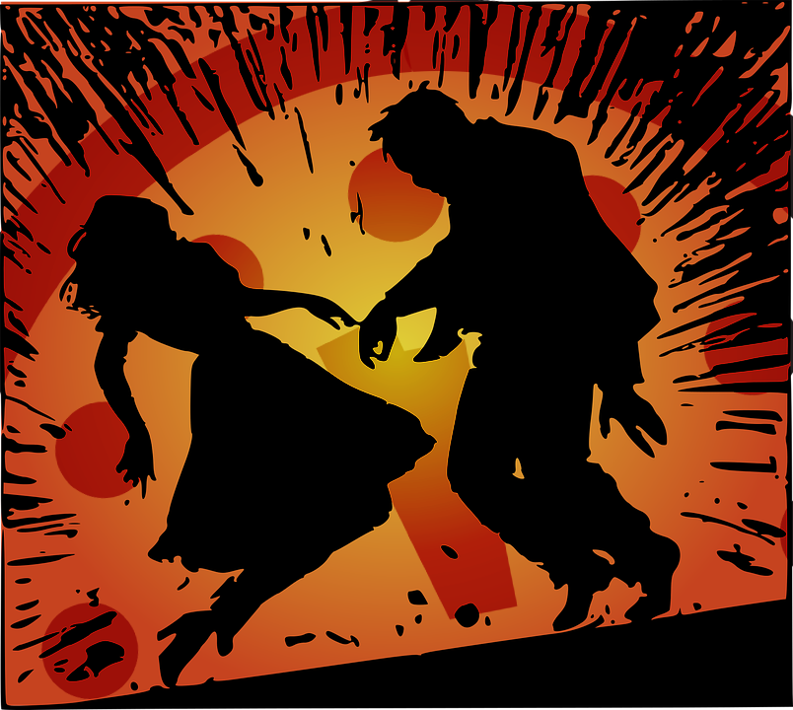
For if we sin willfully after we have received the knowledge of the truth, there no longer remains a sacrifice for sins, but a certain fearful expectation of judgment, and fiery indignation which will devour the adversaries. — Hebrews 10:26-27
sin willfully
sin
sin
fearful expectation of judgment

Slide 15
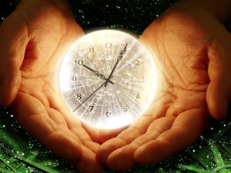
For the wages of sin is death, but the gift of God is eternal life in Christ Jesus our Lord. — Romans 6:23
God is eternal life
in Christ Jesus
sin
God is eternal life
in
God
Christ Jesus
Notes:
God is timelessness persistently. It is time that tests the souls as an entrance fee. The common currency is love where hate is deducted as debts. To enter His timeless realm one must adhere to His ways over the delusions of man.

Slide 16
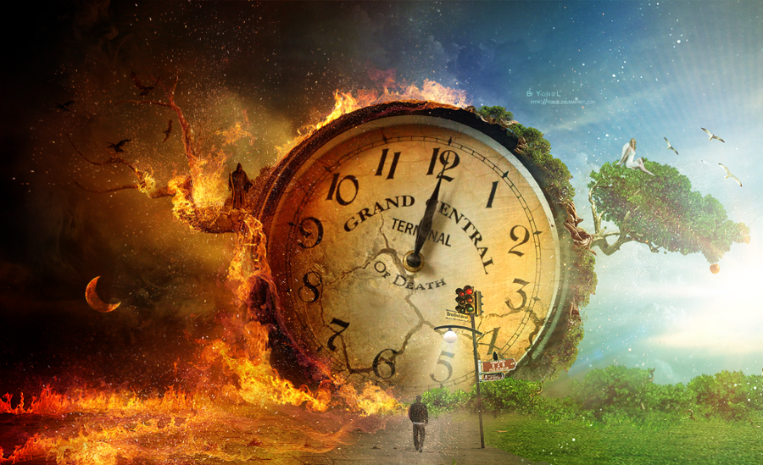
This is the message which we have heard from Him and declare to you, that God is light and in Him is no darkness at all. If we say that we have fellowship with Him, and walk in darkness, we lie and do not practice the truth. But if we walk in the light as He is in the light, we have fellowship with one another, and the blood of Jesus Christ His Son cleanses us from all sin. — 1st John 1:5-7
God is light
darkness
lie and
do not
practice
the truth
light
fellowship
blood of
Jesus Christ
cleanses us
from all sin
darkness
lie and
do not
practice
the
truth
light
fellowship
blood of
Jesus
Christ
cleanses us
from all sin
Notes:
Either time will consume us or set us free of it.

Slide 17
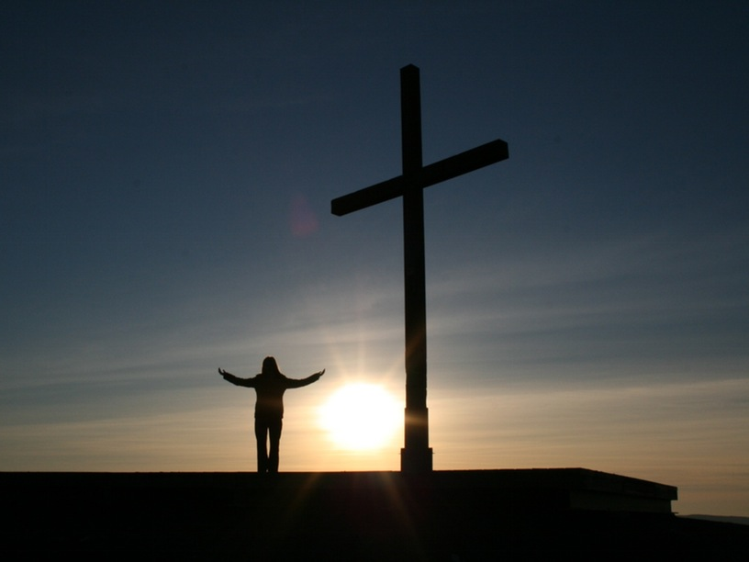
If we say that we have no sin, we deceive ourselves, and the truth is not in us. If we confess our sins, He is faithful and just to forgive us our sins and to cleanse us from all unrighteousness. If we say that we have not sinned, we make Him a liar, and His word is not in us. — 1st John 1:8-10
truth
confess our sins
confess our sins
He is faithful
to forgive us
He is faithful to forgive us
word
Notes:
The truth of His word declares that we must come to Him in prayer.

Slide 18
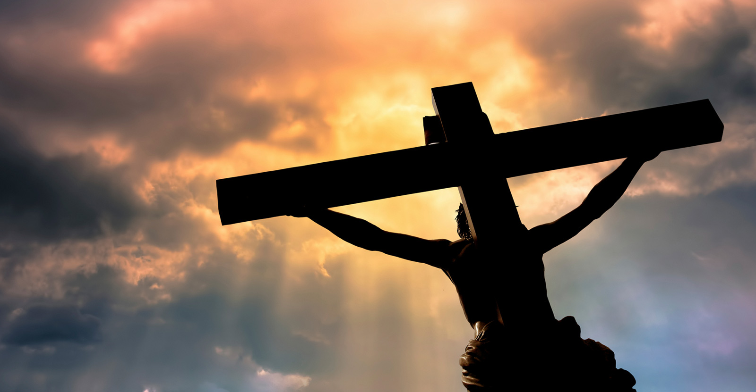
The Lord is not slack concerning His promise, as some count slackness, but is longsuffering toward us, not willing that any should perish but that all should come to repentance. — 2nd Peter 3:9
The Lord
The Lord is longsuffering
is longsuffering
word
truth

Slide 19
Therefore, beloved, looking forward to these things, be diligent to be found by Him in peace, without spot and blameless; and consider that the longsuffering of our Lord is salvation -- as also our beloved brother Paul, according to the wisdom given to him, has written to you, … — 2nd Peter 3:14-15
looking
forward
be diligent
be found
in peace
looking forward
be diligent
be found
• in peace
• without spot and blameless
to be found
without spot and blameless

Slide 20
Now we exhort you, brethren, warn those who are unruly, comfort the fainthearted, uphold the weak, be patient with all. See that no one renders evil for evil to anyone, but always pursue what is good both for yourselves and for all. Rejoice always, pray without ceasing, in everything give thanks; for this is the will of God in Christ Jesus for you. — 1st Thessalonians 5:14-18
warn
the will of God in Christ Jesus for you:
• comfort the fainthearted
• uphold the weak
• be patient with all
• no one renders evil for evil
• always pursue what is good for all
• Rejoice always
• pray without ceasing
• in everything give thanks
comfort the
fainthearted
uphold the weak
be
patient with all
no one renders
evil for evil
always
pursue what is good
for all
Rejoice always
pray without
ceasing
in everything give thanks
the will of God in Christ Jesus
for you

Slide 21
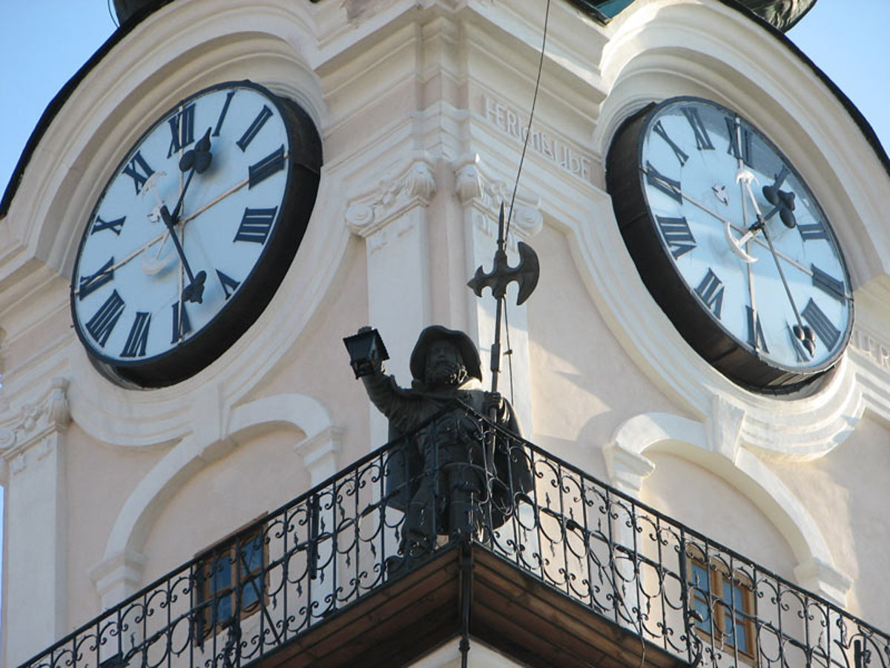
"Son of man, I have made you a watchman for the house of Israel; therefore hear a word from My mouth, and give them warning from Me: When I say to the wicked, 'You shall surely die,' and you give him no warning, nor speak to warn the wicked from his wicked way, to save his life, that same wicked man shall die in his iniquity; but his blood I will require at your hand. Yet, if you warn the wicked, and he does not turn from his wickedness, nor from his wicked way, he shall die in his iniquity; but you have delivered your soul." — Ezekiel 3:17-19
watchman
warn the wicked
wicked man shall die

Slide 22
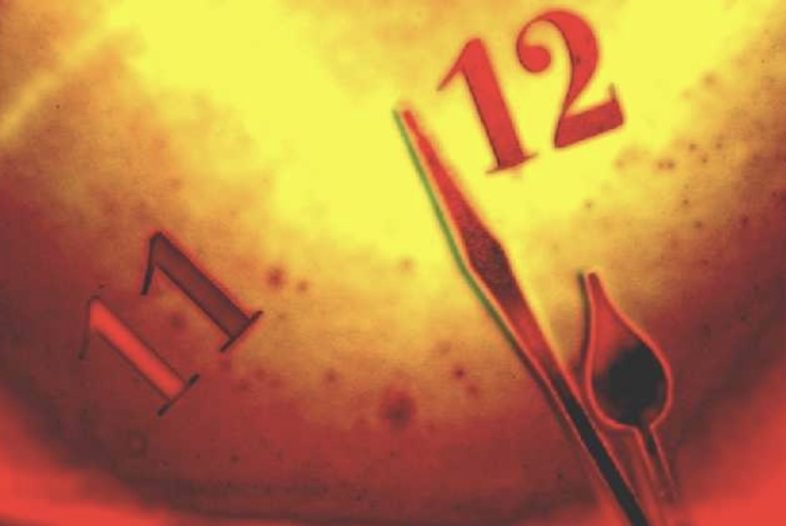
"Again, when a righteous man turns from his righteousness and commits iniquity, and I lay a stumbling block before him, he shall die; because you did not give him warning, he shall die in his sin, and his righteousness which he has done shall not be remembered; but his blood I will require at your hand. Nevertheless if you warn the righteous man that the righteous should not sin, and he does not sin, he shall surely live because he took warning; also you will have delivered your soul." — Ezekiel 3:20-21
because you did not give him warning
TRUTH
warn the righteous man
shall surely live because
Warning
he took warning

Slide 23
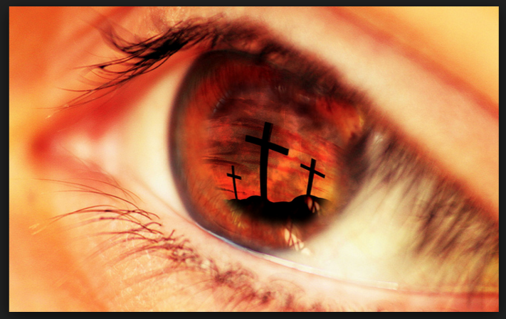
"Watch therefore, for you do not know what hour your Lord is coming." — Matthew 24:42
Watch therefore

Slide 24
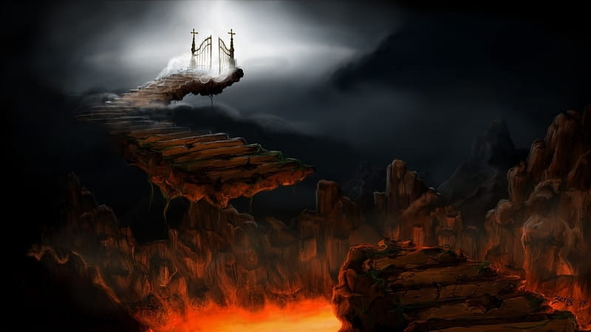
"Watch therefore, and pray always that you may be counted worthy to escape all these things that will come to pass, and to stand before the Son of Man." — Luke 21:36
Watch therefore
pray
always
worthy to escape
stand before the Son of Man
Notes:
Hope and clean hearts not willing harm to life, with regard for justice, especially for those in violation that they be held accountable for injustice, is the destination we all are flowing into.

Slide 25
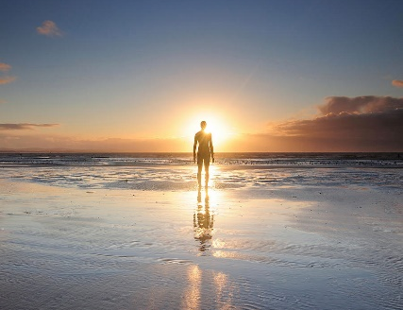
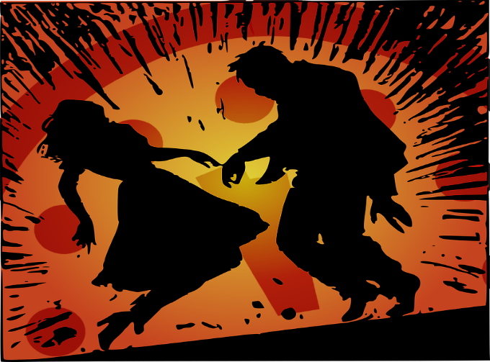
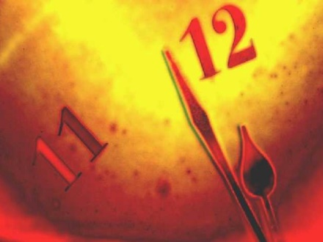

Slide 26
→ Pay attention to the words for the time is near
→ Hold fast to your faith that it may not be stolen
→ Repent or your life will be taken suddenly
→ God will reward each according to their works
→ Hospitably love one another without grumbling
→ Establish one’s heart for God’s judgment is coming
→ Only abiding in Christ’s doctrine delivers the soul
→ Do not forsake assembling as time will run out
→ One cannot find salvation practicing in the dark
→ Be diligent to be found at peace in Him
→ Warn sinners least they do not see to turn back
→ If the once righteous fall away they will die
→ Pray that you are counted worthy before God
Heaven leaves all heartaches behind in His love
Jesus
Notes:
Heaven leaves all heartaches behind in His love.

Slide 27
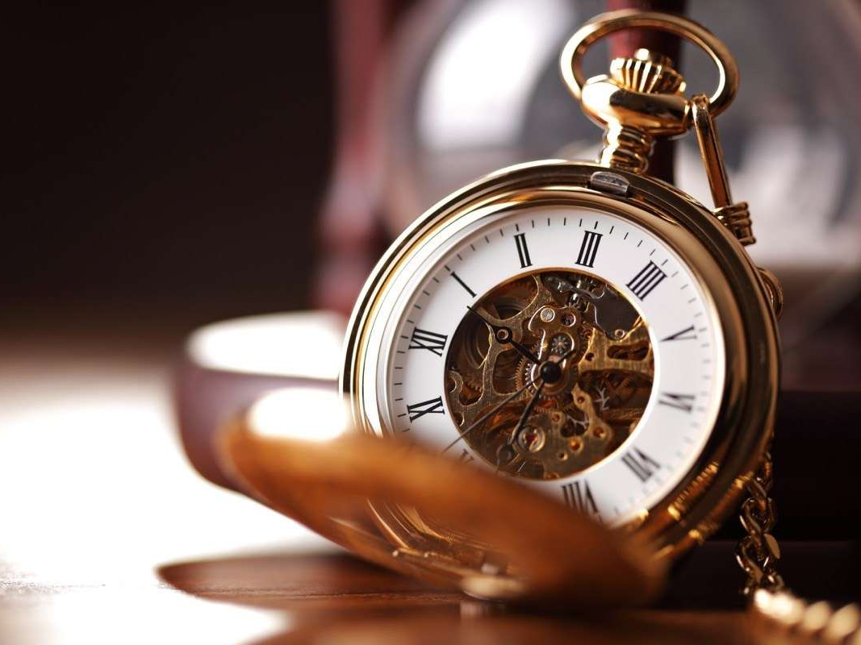

Slide 29
Please visit http://www.LoveFromGod.com to explore further
Ronald Bert Channel on
Notes:
Eternity never ends.

