Slide 2
Neglecting Diligent Effort Diminishes Glory to God
Ron Bert
June 28, 2020

Slide 3
I, therefore, the prisoner of the Lord, beseech you to walk worthy of the calling with which you were called, with all lowliness and gentleness, with longsuffering, bearing with one another in love, endeavoring to keep the unity of the Spirit in the bond of peace. — Ephesians 4:1-3
prisoner of the
Lord
lowliness
lowliness
longsuffering
longsuffering
in
in love
in love
unity
unity
peace
peace
prisoner of the Lord
Notes:
The Bible is not just words. It is a book of instructions and warnings to live a better life. Many do not have that passion for the Lord to do their best in His light. Life certainly can be challenging in favorable opportunities, and social issues with never-ending plagues of self-seeking, distances the soul from obtaining peace of heart. We all struggle to acquire those qualities the Bible calls us out to be. Mt. Zion is calling.

Slide 4
Paul and Timothy, bondservants of Jesus Christ, To all the saints in Christ Jesus who are in Philippi, with the bishops and deacons: Grace to you and peace from God our Father and the Lord Jesus Christ. — Philippians 1:1-2
bondservants
of Jesus Christ
Jesus Christ
. .
Christ
Christ
Christ
Christ
Notes:
Bondservants rise to the occasion and reach the mountain top for His cause. One must carry the cross each has been given to obtain the heights of clarity. Does one consider that we are able to hold the sacred chalice of truth?

Slide 5
And He Himself gave some to be apostles, some prophets, some evangelists, and some pastors and teachers, for the equipping of the saints for the work of ministry, for the edifying of the body of Christ, till we all come to the unity of the faith and of the knowledge of the Son of God, to a perfect man, to the measure of the stature of the fullness of Christ; — Ephesians 4:11-13
And He Himself gave some to be apostles, some prophets, some evangelists, and some pastors and teachers, for the equipping of the saints for the work of ministry, for the edifying of the body of Christ, till we all come to the unity of the faith and of the knowledge of the Son of God, to a perfect man, to the measure of the stature of the fullness of Christ; — Ephesians 4:11-13
He Himself gave
①
apostles
He Himself gave
apostles
②
prophets
③
evangelists
prophets
evangelists
④
pastors
⑤
teachers
pastors
teachers
for the edifying
for the edifying
Christ
Christ
to the unity
to the unity
faith
knowledge
faith
knowledge
Christ
of Christ
Christ
of Christ
Notes:
We all play a part in building a better life for ourselves and the family of man. To begin, one must come to the life of Christ, and understand His love, and sacrifice. As fingerprints are exclusive and unique, so too are the abilities given to each to find.

Slide 6
… not with eyeservice, as men-pleasers, but as bondservants of Christ, doing the will of God from the heart, … — Ephesians 6:6
Christ
Christ
Christ
of Christ
. .
from the heart
. .
Notes:
It is the bottom of a heart that either finds itself in God’s grace, or remains lost in the miseries of loss.

Slide 7
And whatever you do, do it heartily, as to the Lord and not to men, … — Colossians 3:23
to the Lord
to the Lord
to men?
Notes:
A higher sense of truth is had by all who dedicate their works to the glory of God. Inspiration rejoices when victory hears the music of His call. No mountain can hinder the advance of a passionate soul. Do we choose or reach out to do things for that higher glory of all that is greater, or are we more limited in seeking narrowly focused selfish pursuits?

Slide 8
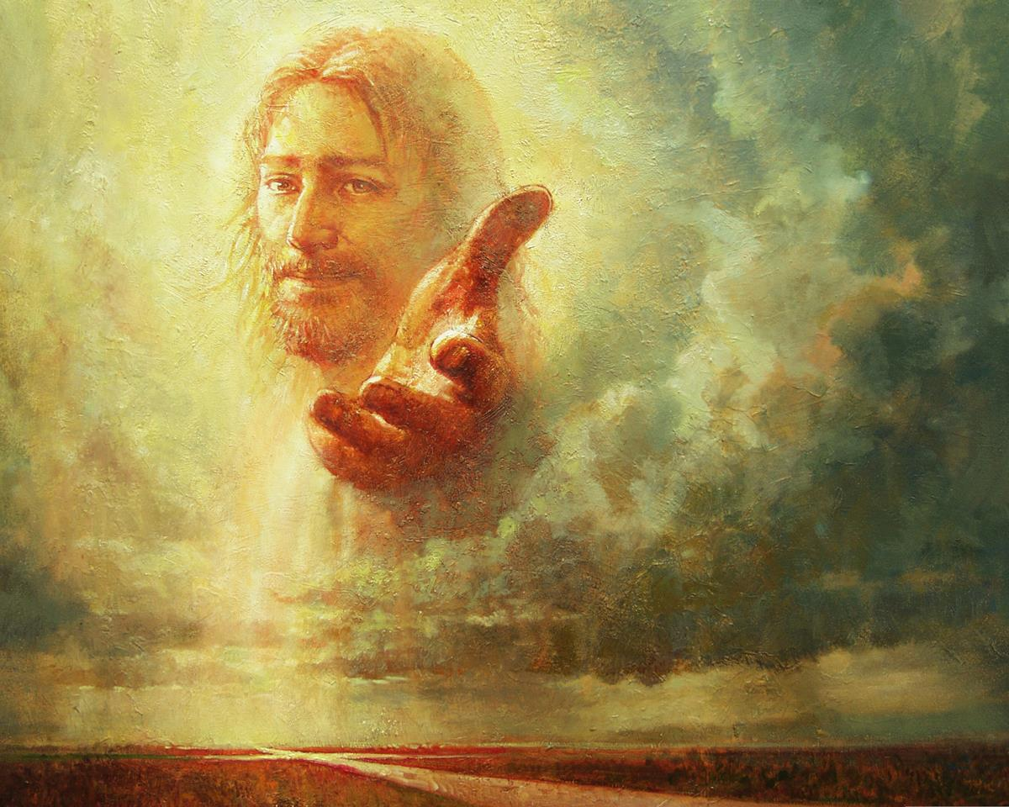
And having been perfected, He became the author of eternal salvation to all who obey Him, … — Hebrews 5:9
salvation to all who obey Him
. .
Notes:
It is Jesus Christ that leads us to the gates of heaven, and the door to eternity.

Slide 9
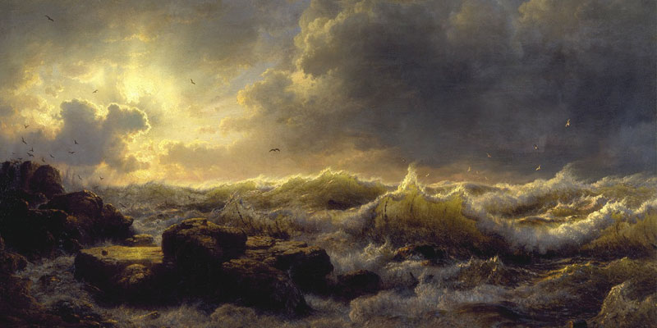
… that we should no longer be children, tossed to and fro and carried about with every wind of doctrine, by the trickery of men, in the cunning craftiness of deceitful plotting, … — Ephesians 4:14
children
tossed to and fro
with every wind of doctrine
→ by the trickery of men
in the cunning craftiness
of deceitful plotting
children
tossed to and fro
with every wind of
doctrine
by the trickery of men
in the cunning craftiness
of
deceitful plotting
Notes:
God commands that we rise above the mundane to find the truth no man can deliver; the heart emanations of each soul in His light.

Slide 10
This is a faithful saying: If a man desires the position of a bishop, he desires a good work. A bishop then must be blameless, the husband of one wife, temperate, sober-minded, of good behavior, hospitable, able to teach; not given to wine, not violent, not greedy for money, but gentle, not quarrelsome, not covetous; — 1st Timothy 3:1-3
self-control
● temperate, gentle
● sober-minded
● not given to wine
● of good behavior
● hospitable
● able to teach
● not violent
● not quarrelsome
● not greedy for money
● not covetous
addiction
desires a good work
desires a good work
temperate,
sober-minded
knowledgeable
of good behavior
hospitable
able to
teach
not given to wine
not violent
not greedy for money
gentle
not
quarrelsome
not covetous
self-seeking
Notes:
Desiring to do good work is a basic Christian principle, and what God looks for in each of us. God wants us to be planted firmly in His word, specifically, His actions for being. These qualities of nobleness are essential if we are to have good leadership in any and all pursuits.

Slide 11
… one who rules his own house well, having his children in submission with all reverence (for if a man does not know how to rule his own house, how will he take care of the church of God?); not a novice, lest being puffed up with pride he fall into the same condemnation as the devil. — 1st Timothy 3:4-6
church of God?
God
church of God?
Notes:
When one believes to be better than others, understanding of why we are has evaporated. The top of faith is found through a humble bottom. Pride is the great condemning force where peace is stolen and His nurturing sanctuary is absent. Obstinate pride disqualifies one from being in the church of God.

Slide 12
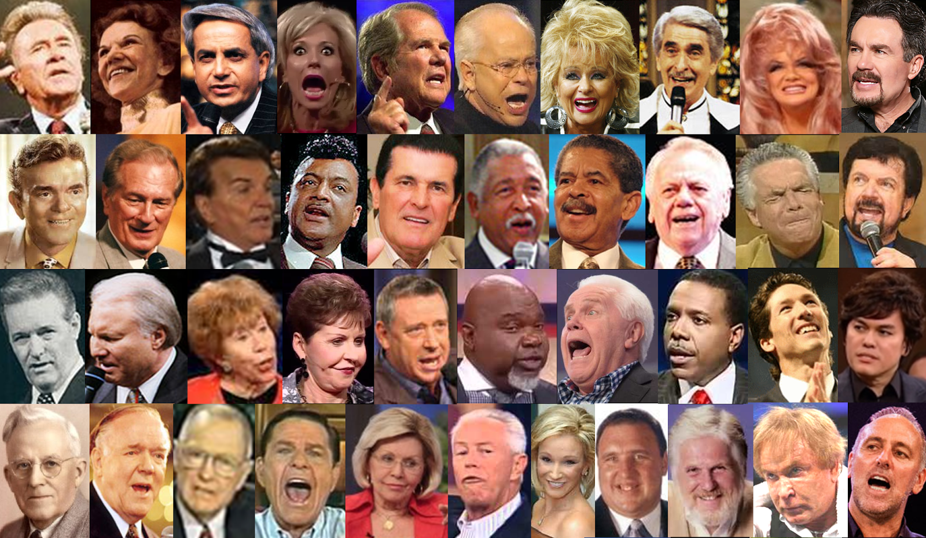
For the time will come when they will not endure sound doctrine, but according to their own desires, because they have itching ears, they will heap up for themselves teachers; — 2nd Timothy 4:3
apply
not endure sound doctrine
not endure sound doctrine
for themselves
for themselves
Notes:
To not apply the light of God’s own truth makes a church less than what God intended it to be, His house of sanctuary of true worshippers.

Slide 13
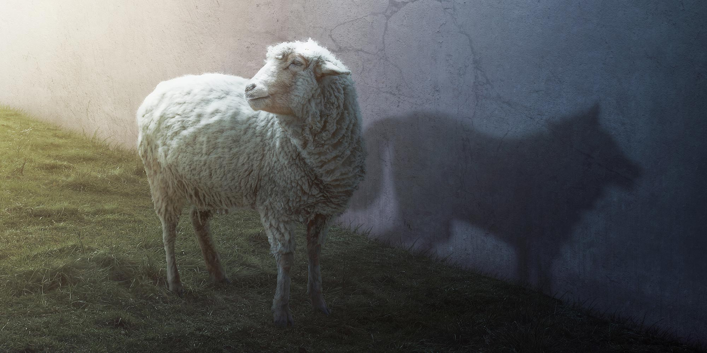
… he is proud, knowing nothing, but is obsessed with disputes and arguments over words, from which come envy, strife, reviling, evil suspicions, useless wranglings of men of corrupt minds and destitute of the truth, who suppose that godliness is a means of gain. From such withdraw yourself. Now godliness with contentment is great gain. — 1st Timothy 6:4-6
… he is proud, knowing nothing, but is obsessed with disputes and arguments over words, from which come envy, strife, reviling, evil suspicions, useless wranglings of men of corrupt minds and destitute of the truth, who suppose that godliness is a means of gain. From such withdraw yourself. Now godliness with contentment is great gain. — 1st Timothy 6:4-6
men of corrupt minds
obsessed with disputes
arguments
● envy
● strife
● reviling
● evil suspicions
● useless wranglings
● destitute of the truth
● suppose godliness is a means of gain
obsessed with disputes
arguments
envy
strife
reviling
evil suspicions
useless
defensive attitude
wranglings
men of corrupt minds
men of corrupt minds
men of corrupt minds
destitute of the truth
suppose
godliness is a means of
gain
Notes:
Those who craftily seek positions of authority, without doing the first for called out noble works, are the most despicable of despicable. What makes Christianity ineffective is men whose hypocritical qualities expose duplicity. Works exclusively for the self miss their service to humanity.

Slide 14
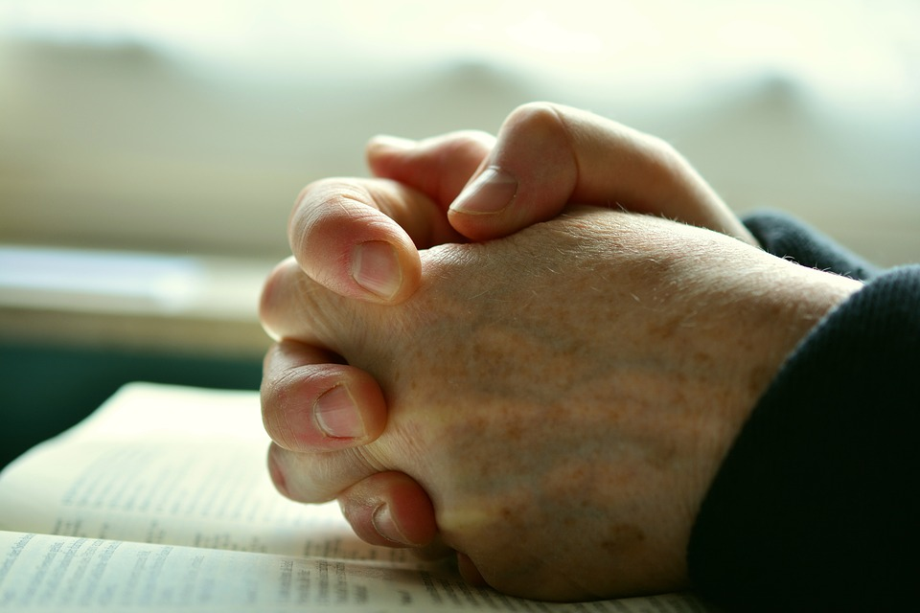
For a bishop must be blameless, as a steward of God, not self-willed, not quick-tempered, not given to wine, not violent, not greedy for money, but hospitable, a lover of what is good, sober-minded, just, holy, self-controlled, holding fast the faithful word as he has been taught, that he may be able, by sound doctrine, both to exhort and convict those who contradict. — Titus 1:7-9
steward of God:
● not self-willed
● not quick-tempered, not violent
● not greedy for money
● not given to wine
but …
● hospitable, just, holy
● a lover of what is good
● sober-minded, self-controlled
● holding fast the faithful word
steward of God
not self-willed
not
not
not quick-tempered,
not given to wine
not
not
not
not
not violent
not greedy for money
but
not
not
hospitable,
a lover of what is good
not
not
sober-minded,
just, holy
self-controlled
holding fast the faithful word
the faithful word
the faithful word
may be able
may be able
encourage
exhort and
exhort and
condemn
convict
convict
Notes:
Christian qualities are well defined. Applying them is the challenge for all.

Slide 15
For there are many insubordinate, both idle talkers and deceivers, especially those of the circumcision, whose mouths must be stopped, who subvert whole households, teaching things which they ought not, for the sake of dishonest gain. — Titus 1:10-11
disobedient
rebellious
unruly
defiant
overly pious
circumcision
dishonesty
circumcision
y
dishonest
dishonest gain
dishonest gain
Notes:
Many are just plainly dishonest, and purposely choose to be, to gain unjust advantage. Liars hide in the shadows of their scheming.

Slide 16
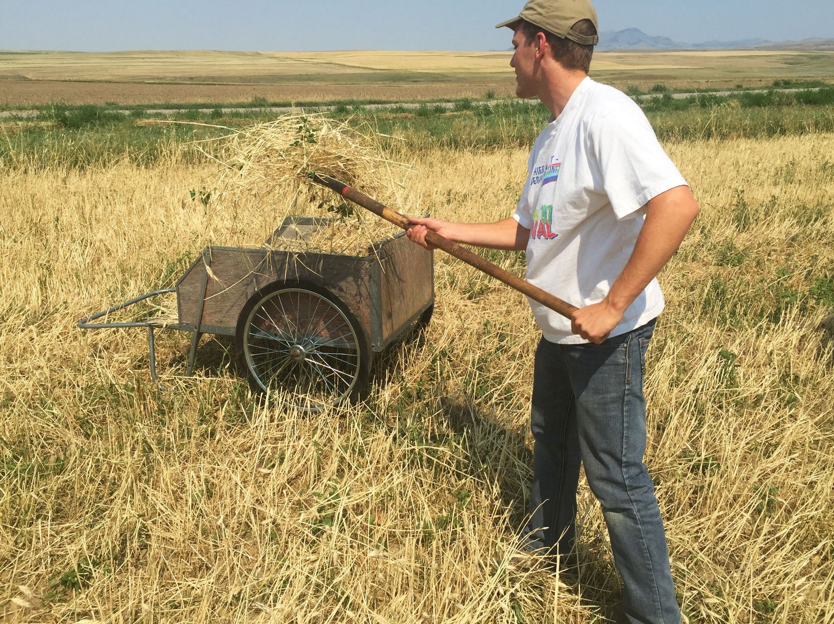
Wealth gained by dishonesty will be diminished, But he who gathers by labor will increase. — Proverbs 13:11
confusion
guilt
anguish
dishonesty
diminished
diminished
increase
gathers by labor will increase
gathers by labor will increase
satisfaction
peace
contentment
Notes:
Labor is well earned when reaping the seeds of peace. Honest labor increases satisfaction, contentment, and peace of work when well done. Dishonesty produces guilt, confusion, and anguish.

Slide 17
The soul of a lazy man desires, and has nothing; But the soul of the diligent shall be made rich. A righteous man hates lying, But a wicked man is loathsome and comes to shame. — Proverbs 13:4
the wicked man comes to shame
attentive
hardworking
painstaking
persistent
thorough
careful
the diligent shall be made rich
the
the diligent shall be made rich
wicked man
comes to shame
Notes:
For people that lack purpose, it can be a dreadful downward spiral.

Slide 18
These are grumblers, complainers, walking according to their own lusts; and they mouth great swelling words, flattering people to gain advantage. But you, beloved, remember the words which were spoken before by the apostles of our Lord Jesus Christ: how they told you that there would be mockers in the last time who would walk according to their own ungodly lusts. These are sensual persons, who cause divisions, not having the Spirit. — Jude 1:16-19
grumblers
complainers
walking
in
their own lusts
ungodly mockers in the last time:
● grumblers
● complainers
● walking in their own lusts
● flattering people to gain advantage
● who cause divisions
● not having the Spirit
flattering
people to gain advantage
remember the words
remember the words
mockers in the last time
ungodly
who cause divisions
not having the Spirit
Notes:
How does God see those who plot only for their own benefit? Many kiss rear ends holding a baseball bat behind their back. Without Godly fear and regard for accountability, merciless souls ravage the land.

Slide 19
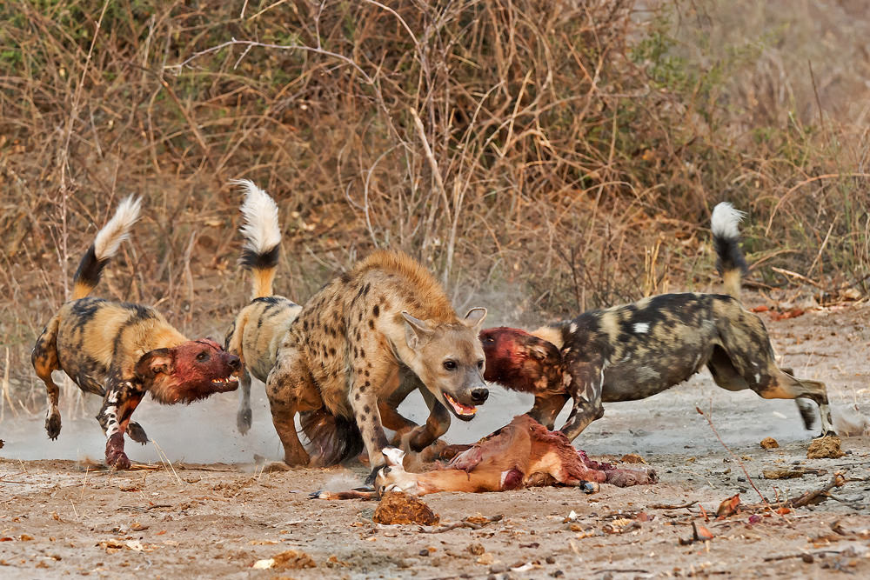
Yes, they are greedy dogs Which never have enough. And they are shepherds Who cannot understand; They all look to their own way, Every one for his own gain, From his own territory. — Isaiah 56:11
Yes, they are greedy dogs Which never have enough. And they are shepherds Who cannot understand; They all look to their own way, Every one for his own gain, From his own territory. — Isaiah 56:11
cannot understand
cannot understand
selfish narcissism
Notes:
There are those that live to steal. Looters are akin to mad dogs looking to gain at the expense of others; extreme selfish narcissism. There is no unity where only division guides the greedy. Those who lack understanding are rather driven by impulse.

Slide 20
"Woe to him who covets evil gain for his house, That he may set his nest on high, That he may be delivered from the power of disaster!" — Habakkuk 2:9
Woe
gain
Woe
covets evil gain
covets evil gain
gain
cannot understand
Notes:
Evil gain to obtain material riches has caused many wicked to prosper. These are the drug dealers to professional assassins that have plagued all ages. We should be familiar with scripture that asks, what would a man exchange for his eternal soul; to gain the world and lose life in God is the worst of all imaginable.

Slide 21
He who is greedy for gain troubles his own house, But he who hates bribes will live. — Proverbs 15:27
greed
greedy for gain troubles
gain
. .
greed
spirit
Notes:
Greed is the cancer of peace where turmoil in dissatisfaction devours the soul. Greed is often associated with dishonest gain, possibly cheating and stealing could be involved. What is stolen may be either tangible or non-tangible, or both. Wickedness has no definite path as it randomly seeks out injustice.

Slide 22
For where envy and self-seeking exist, confusion and every evil thing are there. — James 3:16
Notes:
Focusing exclusively on the self is a time bomb of inner turmoil. When one cannot see beyond oneself, the magic of true love and its’ accompanying pleasures go missed.

Slide 23
dishonest gain ≠ honest work

Slide 24
Shepherd the flock of God which is among you, serving as overseers, not by compulsion but willingly, not for dishonest gain but eagerly; nor as being lords over those entrusted to you, but being examples to the flock; — 1st Peter 5:2-3
God
pressure
obligation
duress
force
chore
not by compulsion
. .
dishonest gain
not for dishonest gain but eagerly
. .
God
Notes:
God wills that we achieve noble hearts in the light of His truth. He calls for us to help one another, rather than cutting organs from the backs of those we know. God wants us to be in His service, not seeing it as a burden, but a blessing for the opportunities presented. Just a job, is not a passion. God wants us to feed His flock, and not feast upon it.

Slide 25
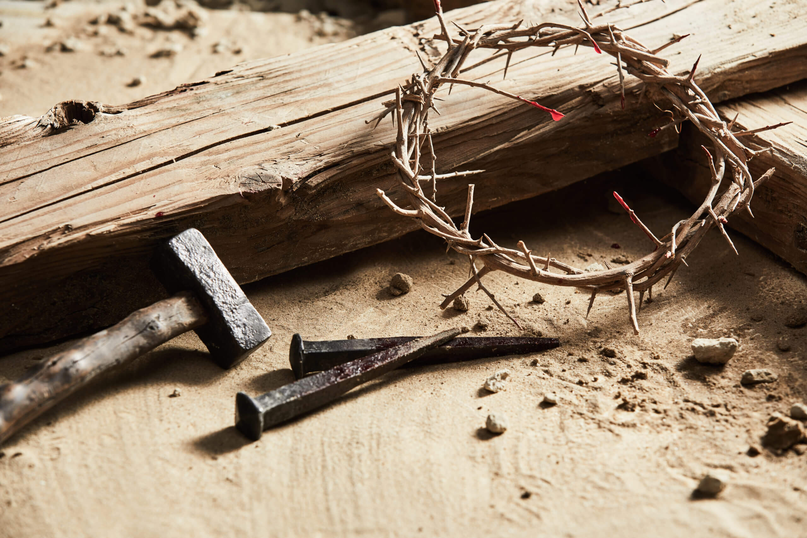
"Therefore take heed to yourselves and to all the flock, among which the Holy Spirit has made you overseers, to shepherd the church of God which He purchased with His own blood." — Acts 20:28
take heed
take heed
God
church of God
church of God
Notes:
One cannot serve God if not carefully watchful.

Slide 26
Preach the word! Be ready in season and out of season. Convince, rebuke, exhort, with all longsuffering and teaching. For the time will come when they will not endure sound doctrine, but according to their own desires, because they have itching ears, they will heap up for themselves teachers; — 2nd Timothy 4:2-3
Preach the word
. .
own desires
. .
false doctrines
Notes:
God instructs us to endure through the studies of His word, especially in the face of false doctrine promoted by charlatans. One must be careful not to believe the lies promoted by man.

Slide 27
the truth

Slide 28
… and they will turn their ears away from the truth, and be turned aside to fables. But you be watchful in all things, endure afflictions, do the work of an evangelist, fulfill your ministry. — 2nd Timothy 4:4-5
the truth
be watchful in all things
be watchful in all things
Notes:
Those who practice deception do not want to hear the truths God has put forth.

Slide 29
Obey those who rule over you, and be submissive, for they watch out for your souls, as those who must give account. Let them do so with joy and not with grief, for that would be unprofitable for you. — Hebrews 13:17
Obey those who rule over you, and be submissive, for they watch out for your souls, as those who must give account. Let them do so with joy and not with grief, for that would be unprofitable for you. — Hebrews 13:17
must give account
not with grief
not with grief
Notes:
What many neglect to observe is that each of us is made to give account for all that we are. When we go out of our way to cause grief in others, it is wholly unprofitable for all involved. Turmoil acquired through oppression is like a mountain that sinks into a whirlpool of troubles. Don’t’ give grief to those who would help you.

Slide 30
"… serving the Lord with all humility, with many tears and trials which happened to me by the plotting of the Jews; how I kept back nothing that was helpful, but proclaimed it to you, and taught you publicly and from house to house, …" — Acts 20:19-20
serving the Lord
serving the Lord
I kept back nothing
I kept back nothing
helpful, but proclaimed it
helpful, but proclaimed it
Notes:
Everything we need, to understand God’s will, is given in His word. All that is helpful has been disclosed.

Slide 31
Now I urge you, brethren, note those who cause divisions and offenses, contrary to the doctrine which you learned, and avoid them. For those who are such do not serve our Lord Jesus Christ, but their own belly, and by smooth words and flattering speech deceive the hearts of the simple. — Romans 16:17-18
note
note
do not serve
do not serve
Lord Jesus Christ
but their own
but their own
Notes:
Unfortunately, many deceive the simple minded to gain unjust advantage and steal what is meant to be holy.

Slide 32
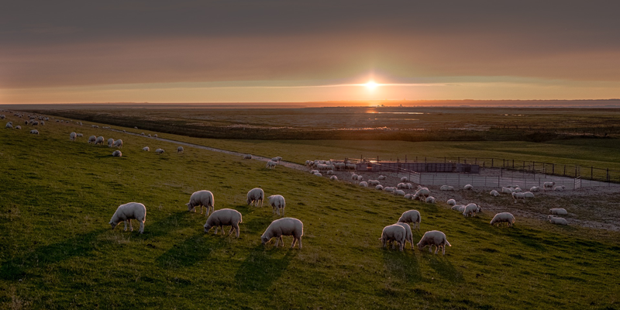
"Behold, I send you out as sheep in the midst of wolves. Therefore be wise as serpents and harmless as doves." — Matthew 10:16
wise
and harmless
wise
and harmless
Notes:
It is a dangerous world, and without keen understanding, the ocean of life may submerge one in a perpetual sinful nature.

Slide 33
Knowledgeable understanding
Non-
threatening
Effective
saint
+
=
Notes:
It is a dangerous world, and without keen understanding, the ocean of life may submerge one in a perpetual sinful nature.

Slide 34
But the end of all things is at hand; therefore be serious and watchful in your prayers. And above all things have fervent love for one another, for "love will cover a multitude of sins." Be hospitable to one another without grumbling. — 1st Peter 4:7-9
the end of all things is at
→ the end of all things is at hand
● be serious
● watchful in your prayers
● fervent love for one another
● Be hospitable to one another
without grumbling
hand
be serious
watchful in your prayers
fervent love
for one another
Be hospitable to one another
without grumbling
without grumbling
without grumbling
Notes:
All are called to pray with love in heart without grumbling.

Slide 35
As each one has received a gift, minister it to one another, as good stewards of the manifold grace of God. If anyone speaks, let him speak as the oracles of God. If anyone ministers, let him do it as with the ability which God supplies, that in all things God may be glorified through Jesus Christ, to whom belong the glory and the dominion forever and ever. Amen. — 1st Peter 4:10-11
As each one has received a gift, minister it to one another, as good stewards of the manifold grace of God. If anyone speaks, let him speak as the oracles of God. If anyone ministers, let him do it as with the ability which God supplies, that in all things God may be glorified through Jesus Christ, to whom belong the glory and the dominion forever and ever. Amen. — 1st Peter 4:10-11
each one has received a gift
each one has received a gift
of the manifold grace of God
as good stewards
do it as with the ability
which God supplies
that in all things God may be
glorified through Jesus Christ
whom belong the glory
as good stewards
of
the manifold grace of God
do it
as with the ability
which God supplies
that in all things God may be
glorified
through Jesus Christ
whom belong
the glory
Notes:
Blessed, if one is able to put all those spoken by the holy word conflicts away. What curses the good of the mind, and steals the peace of spirit, is when we abandon God’s given truths. By pursuing understanding and practicing His word, it is then that we can be; freedom of purpose to achieve the joy of living.

Slide 36
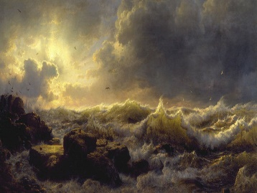
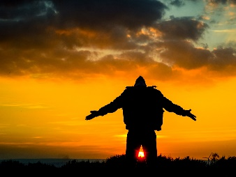
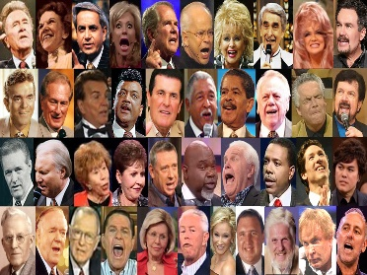
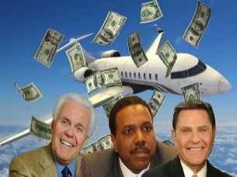
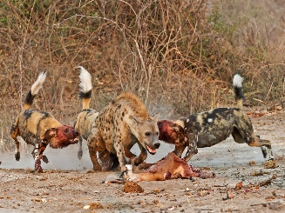
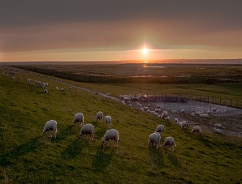

Slide 37
→ Prisoners of the Lord find peace through endurance
→ Perfection is a measure in the fullness of Christ
→ Do all to the Lord heartily, and not to men
→ Avoid trickery, cunning, & deceitful plotting of men
→ Many religious leaders will seek dishonest gain
→ The soul of the diligent shall be made rich
→ Remember last time warnings given by the word
→ Greed, envy, and self-seeking only brings troubles
→ Lead eagerly, willingly, not by need / dishonest gain
→ Preach the word to convince, rebuke, and exhort
→ Avoid who pursue false doctrine serving themselves
→ Love; be watchful in all things without grumbling
→ Each needs to use the gifts God gives to the fullest
Belief in God has no value without acting on His given truths
Notes:
Belief in God has no value without acting on His given truths

Slide 38
Notes:
Darkness stings by the shock of nothing
Darkness perhaps is the greatest loss

Slide 39
Please visit http://www.RonBert.com to explore further
Ronald Bert Channel on
Notes:
Eternity never ends.

