Slide 1
Notes:
The spiral of darkness takes one nowhere.

Slide 2
Ron Bert
INFINITE WEALTH
May 15, 2016
Notes:
We seek for something more than we are. A value unseen with worth untold. Why is it said that the best things in life are free? It is because there is a priceless treasure beyond compare in the bosom of an appreciating free spirit.

Slide 3
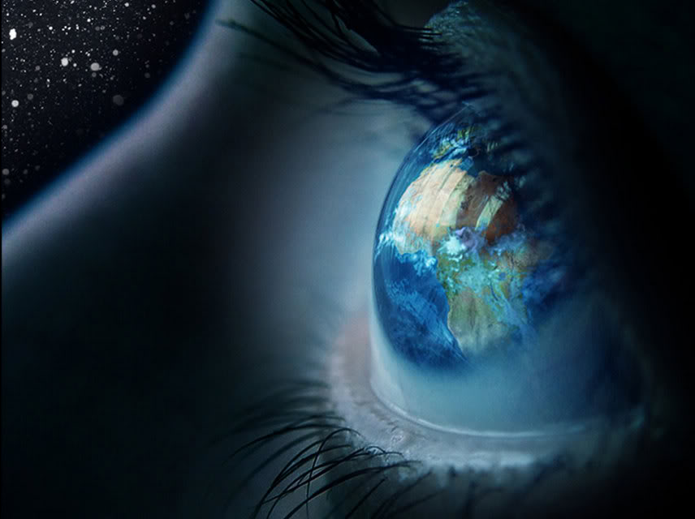
"And take heed, lest you lift your eyes to heaven, and when you see the sun, the moon, and the stars, all the host of heaven, you feel driven to worship them and serve them, which the LORD your God has given to all the peoples under the whole heaven as a heritage." — Deuteronomy 4:19
take heed
take heed
stars
feel
driven to worship them and serve
them
Notes:
As we search deep into the night filled sky, our wonder for creation can fall from appreciating that which created it, especially if we choose fantasies of our own devising, or personal sure understandings, over a humble spirit recognizing unknown realities across time are held by God alone. Common sense in truth has always been challenged by the delusional in moments of impulse.

Slide 4
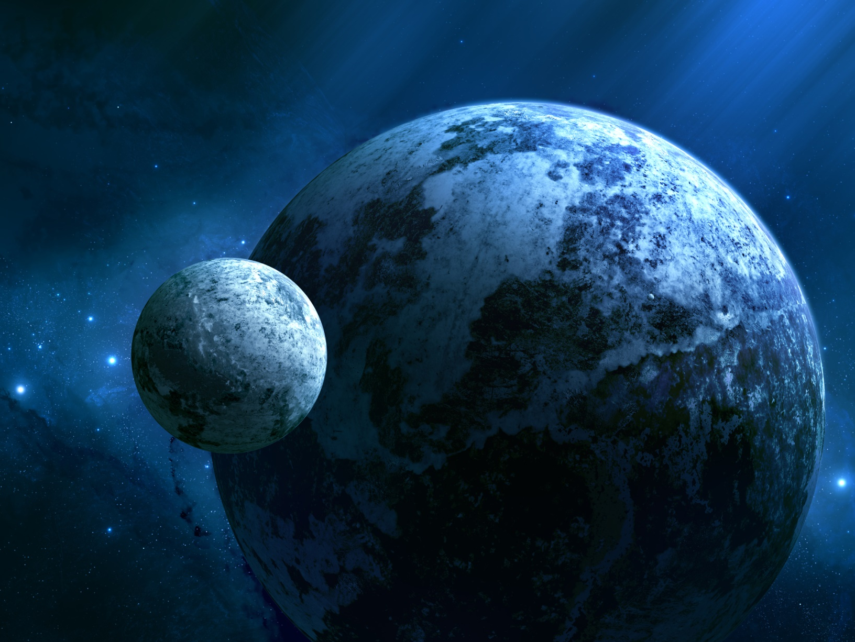
When I consider Your heavens, the work of Your fingers, The moon and the stars, which You have ordained, What is man that You are mindful of him, And the son of man that You visit him? — Psalms 8:3-4
stars
What
mindful
mindful
What
Notes:
In the sure vastness of all that is, and the despicableness of man, it is an honor and blessing that He considers us.

Slide 5
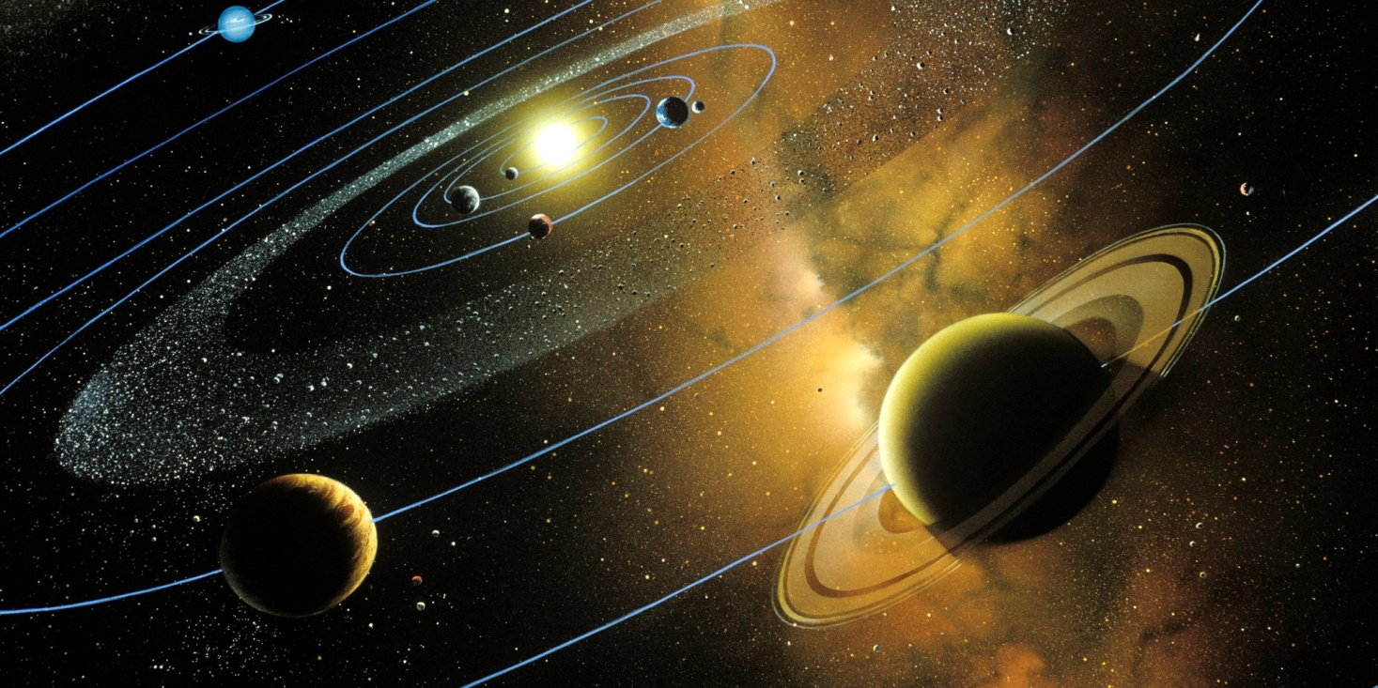
All the inhabitants of the earth are reputed as nothing; He does according to His will in the army of heaven And among the inhabitants of the earth. No one can restrain His hand Or say to Him, "What have You done?" — Daniel 4:35
All the inhabitants of the earth are reputed as nothing; He does according to His will in the army of heaven And among the inhabitants of the earth. No one can restrain His hand Or say to Him, "What have You done?" — Daniel 4:35
Him
What
Him
Notes:
We answer to the Lord, for certainly He does not answer to us. He needs no explanation as He orchestrates beyond the speck that we are.

Slide 6
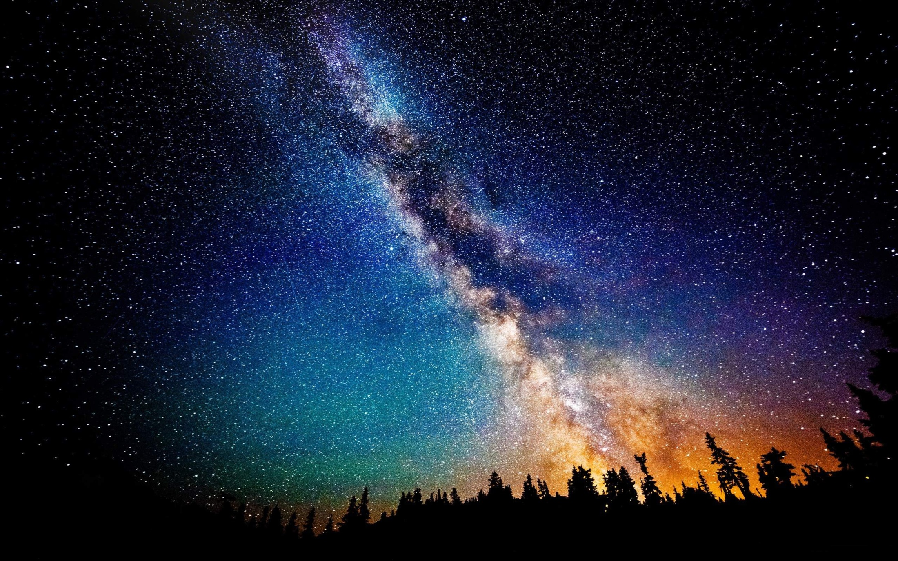
Who has directed the Spirit of the LORD, Or as His counselor has taught Him? With whom did He take counsel, and who instructed Him, And taught Him in the path of justice? Who taught Him knowledge, And showed Him the way of understanding? — Isaiah 40:13-14 `
the
r
LORD
the LORD is our:
counselor
instructor
justice
knowledge
understanding
r
is
counselor
Him
ou
instruct
justice
o
knowledge
understanding
Notes:
It is the Lord that has purposely devised all, so that only the best who are established in goodness and justice will survive forevermore, in His Kingdom of life. We are mostly ignorant to the greater good that He oversees in our favor. We need Him but He does not need us. Let us not misunderstand that He does want us, as a Father wants his children. He takes pleasure in the independence He has given for us to find on our own, as so He does. We are in fact part of His image of underlying infinite value, cherishing the most precious of all, life.

Slide 7
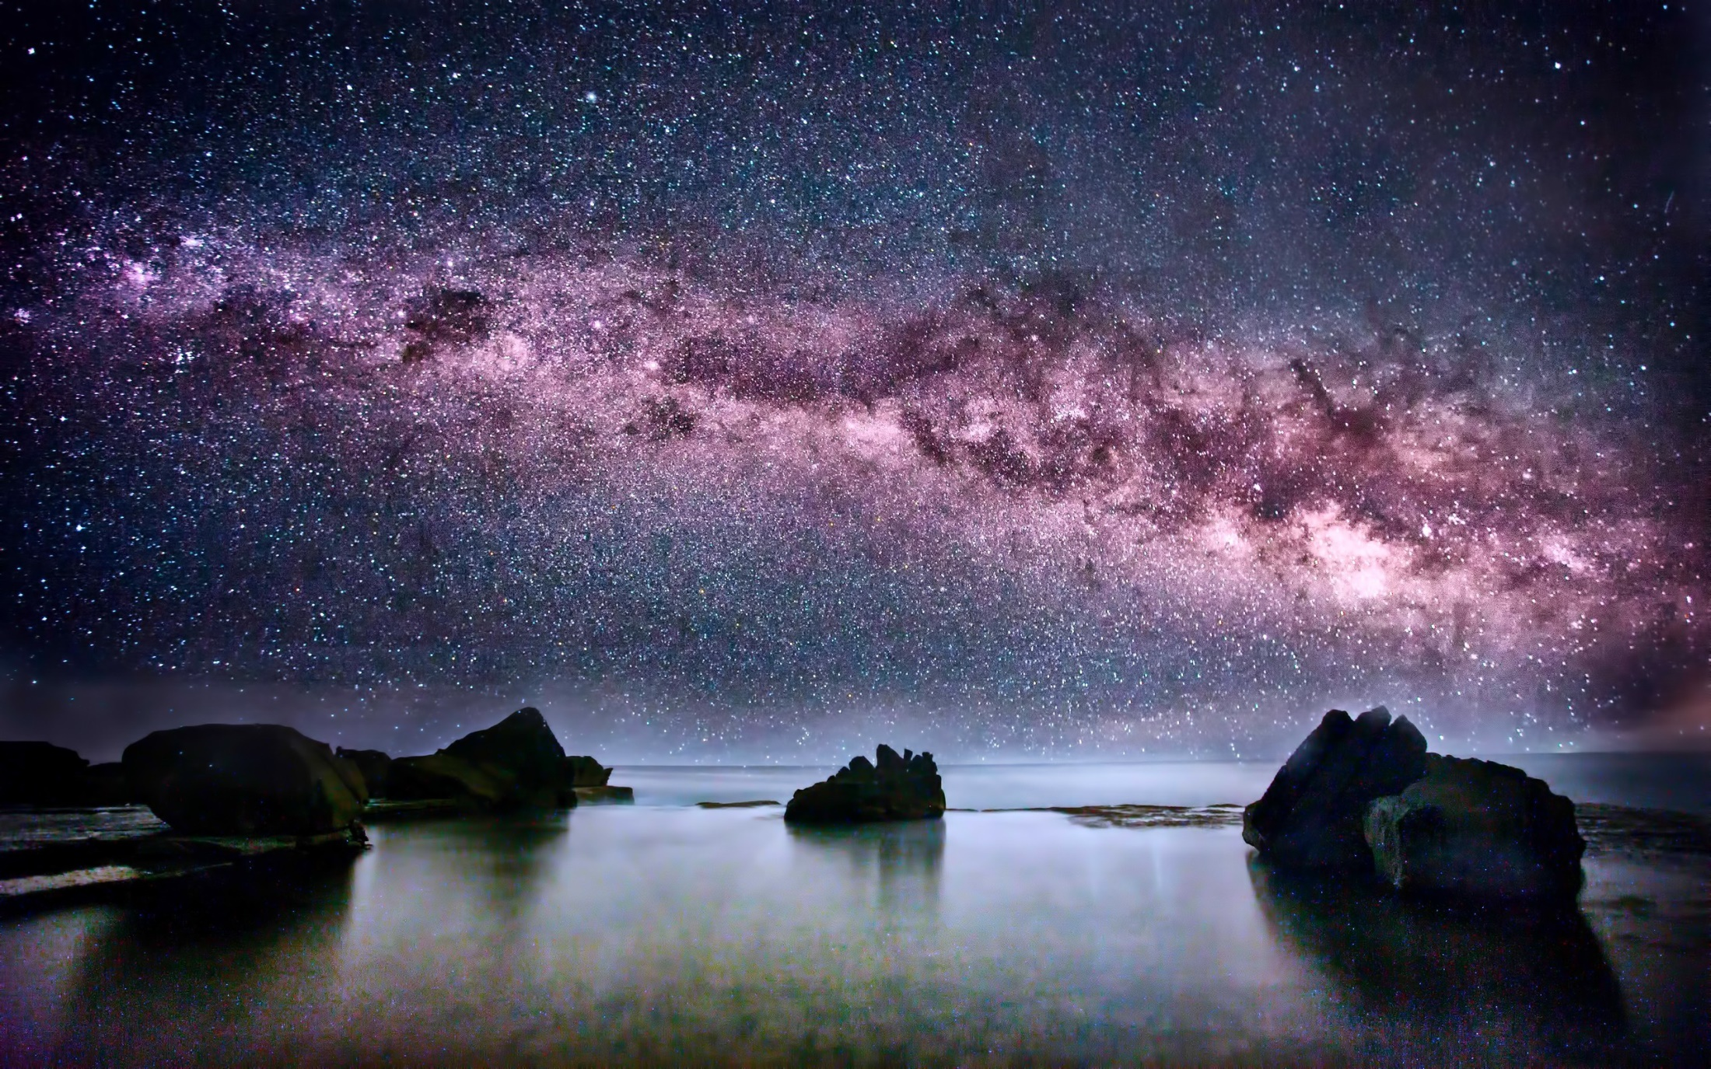
Behold, the nations are as a drop in a bucket, And are counted as the small dust on the scales; Look, He lifts up the isles as a very little thing. — Isaiah 40:15
nations
Upholds
He lifts
He lifts
Notes:
Our thinking limits us if we believe spatial moments, in time, have more value than the entire span of existence from beginning to end; what encapsulates the Alpha Omega is more than can be known. God has wealth beyond our reach. In loving Him our hearts reach out to mingle among the stars and more.

Slide 8
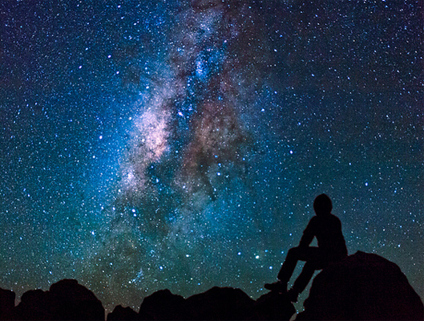
All nations before Him are as nothing, And they are counted by Him less than nothing and worthless. To whom then will you liken God? Or what likeness will you compare to Him? — Isaiah 40:17-18
nations
God
Notes:
If then we fit in as less than a blip on the scheme of all, how could we think to be able to fathom the shear magnitude of He who commenced it to be. We must accept God for who He is, and not create our own superseding deity, of man or beast, creating what we will never be able to achieve apart from His giving light, life. One cannot place creation over that of the rightful creator. No image can reveal God in His omnipotent glory. We are in truth, only a small part of Him, but how great is His love for us as His children of light.

Slide 9
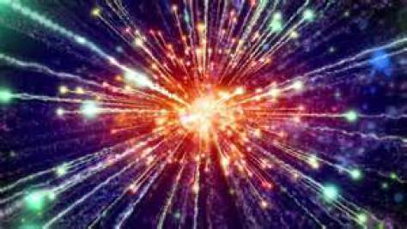
"Thus says the LORD, the King of Israel, And his Redeemer, the LORD of hosts: 'I am the First and I am the Last; Besides Me there is no God. And who can proclaim as I do? Then let him declare it and set it in order for Me, Since I appointed the ancient people. And the things that are coming and shall come, Let them show these to them. — Isaiah 44:6-7
"Thus says the LORD, the King of Israel, And his Redeemer, the LORD of hosts: 'I am the First and I am the Last; Besides Me there is no God. And who can proclaim as I do? Then let him declare it and set it in order for Me, Since I appointed the ancient people. And the things that are coming and shall come, Let them show these to them. — Isaiah 44:6-7
I
I
I am the First and I am the
I
God
Last; Besides Me there is no God
Besides Me there is no God
Besides Me there is no God
=
I
I
I
God
I
I
I
I
Notes:
No one but the Lord can hold from beginning to end, with insights of the order of what has been, producing what is to come. The Lord is able to circumvent beyond the domain that confines us. He is a God fulfilling prophesies of old. Without His intervening powers, all this universe would just decay away as life pettily squabbles, lost in the plunging darkness. What is more favorable, to rise in greater faith, or to drop to one’s own death alone? Hate certainly drags many into the abyss of suffering where love gives no joy. In God, love comes first, as He declares.

Slide 10
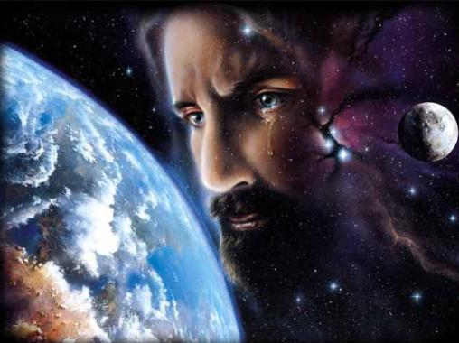
"I have made the earth, And created man on it. I-My hands-stretched out the heavens, And all their host I have commanded. I have raised him up in righteousness, And I will direct all his ways; He shall build My city And let My exiles go free, Not for price nor reward," Says the LORD of hosts. — Isaiah 45:12-13
I have raised Him up
I
I
I
I
I
I
I
I
I
I
I
I
I
I
I
I
I
I
I
go free
Not for price
Not for price
Notes:
Certainly the Lord has created all. And in such His plan incorporates priceless spiritual salvation, particularly for those that have obedient submissive loving hearts; to those ready to freely give thanks for His gift in the grace of living alive, that He offers to all through Christ. So often we live to die alone in the disgust that we are, and how dreadful mortal existence can be, it even wearies the angles. As prisoners in bondage upon the earth, He has come to release us from death into life. We can not earn salvation, but we can accept it. We need the service of His freely given infinite wisdom.

Slide 11
"Ho! Everyone who thirsts, Come to the waters; And you who have no money, Come, buy and eat. Yes, come, buy wine and milk Without money and without price. Why do you spend money for what is not bread, And your wages for what does not satisfy? Listen carefully to Me, and eat what is good, And let your soul delight itself in abundance. — Isaiah 55:1-2
buy
buy
without
without
money
money
. .
soul
your soul delight itself in abundance
itself
in
Notes:
Yes, freely offered by God are the fundamental ideals that build a soul toward finding eternal satisfaction. He offers eternal security over temporary fears. Heaven is a destination of abundance and not just an imagination pulled of thin air. When one comes to spiritually see, the world is a temporary restless realm of fading desires. He is the timeless rest our hearts thirst for as His real love pours out upon those that acceptingly know Him in glory. His wealth is instantly upon us, deeper than what can ordinarily be noticed. More than just a fuzzy feeling, He is an extent, and in the comforts He gives, many disregard those gifts given, which sustains life in His eternity. Let us rejoice in the abundance He gives, and not be left reduced to simpletons mired in unthankful selfish coveting desires of not having, especially when we have. Life is four letters in Love. Real worth cannot be paid for, as He so aptly informs us.

Slide 12
moments
of spirit
soul
=
. .

Slide 13
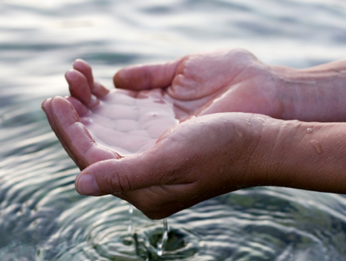
And the Spirit and the bride say, "Come!" And let him who hears say, "Come!" And let him who thirsts come. Whoever desires, let him take the water of life freely. — Revelation 22:17
Come
take
life freely
Notes:
Come is the call that echoes across all time, to return home with our Holy God most high, the source of our lives. Come is an individual call to His eternal existence, and it is not found exclusive to any one place on earth. He is humble light with no shadow, unhidden, while charlatans of affluence often attempt to hide His glory, and simple truth. Many have and do create spiritual lies, complex distorted boggling quandaries, plaguing all who succumb to their seed of false lustful desperate controlling desires. There is no confusion in what God has proclaimed. Sometimes, these self-seeking individuals are connivingly methodical, or it just reduces to fools comfortably following, surrounded in a crowd of deception, not adhering to God’s truth. Knowingly or unknowingly, souls holding to the lie stumble while digging deeper into the ditch of the downtrodden. It is said that it is hard to teach a man what he already knows. Arrogance over curiosity is what crushes all that is great in His wealth of Spirit. False worship focuses on claiming man’s power over His truth, clearly seen in facades exalting the material - for the great talented cleverness of man, short of the truth in spirit worship, God calls out for, from the heart. Are we to worship finite things, and turn our attention to dead rocks, or to live to the living God who calls us continually, no matter where we are. As it is written, earth is not a location of great significance, so why do we worship spots upon her fading surface? The instant moment in which we live declares the abundance of spirit we hold to. Let us rise to know the value of God over the nonsense of man.

Slide 14
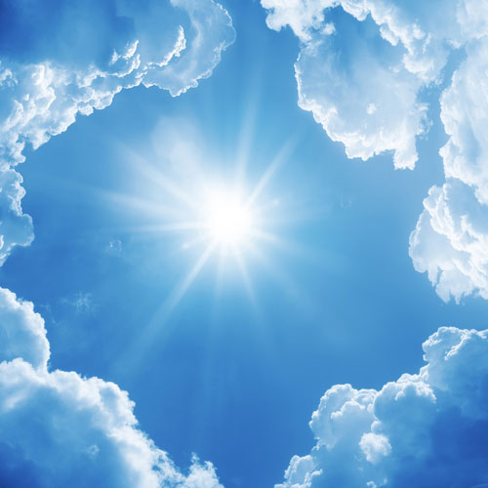
Seek the LORD while He may be found, Call upon Him while He is near. Let the wicked forsake his way, And the unrighteous man his thoughts; Let him return to the LORD, And He will have mercy on him; And to our God, For He will abundantly pardon. — Isaiah 55:6-7
Seek
Call upon Him
Call upon Him
● Seek
● return
● mercy
● pardon
return
mercy
pardon
Notes:
As stars flicker, God remains among us maintaining mercy, in hope that we may live in Him. What He has freely given is His light that we may live.

Slide 15
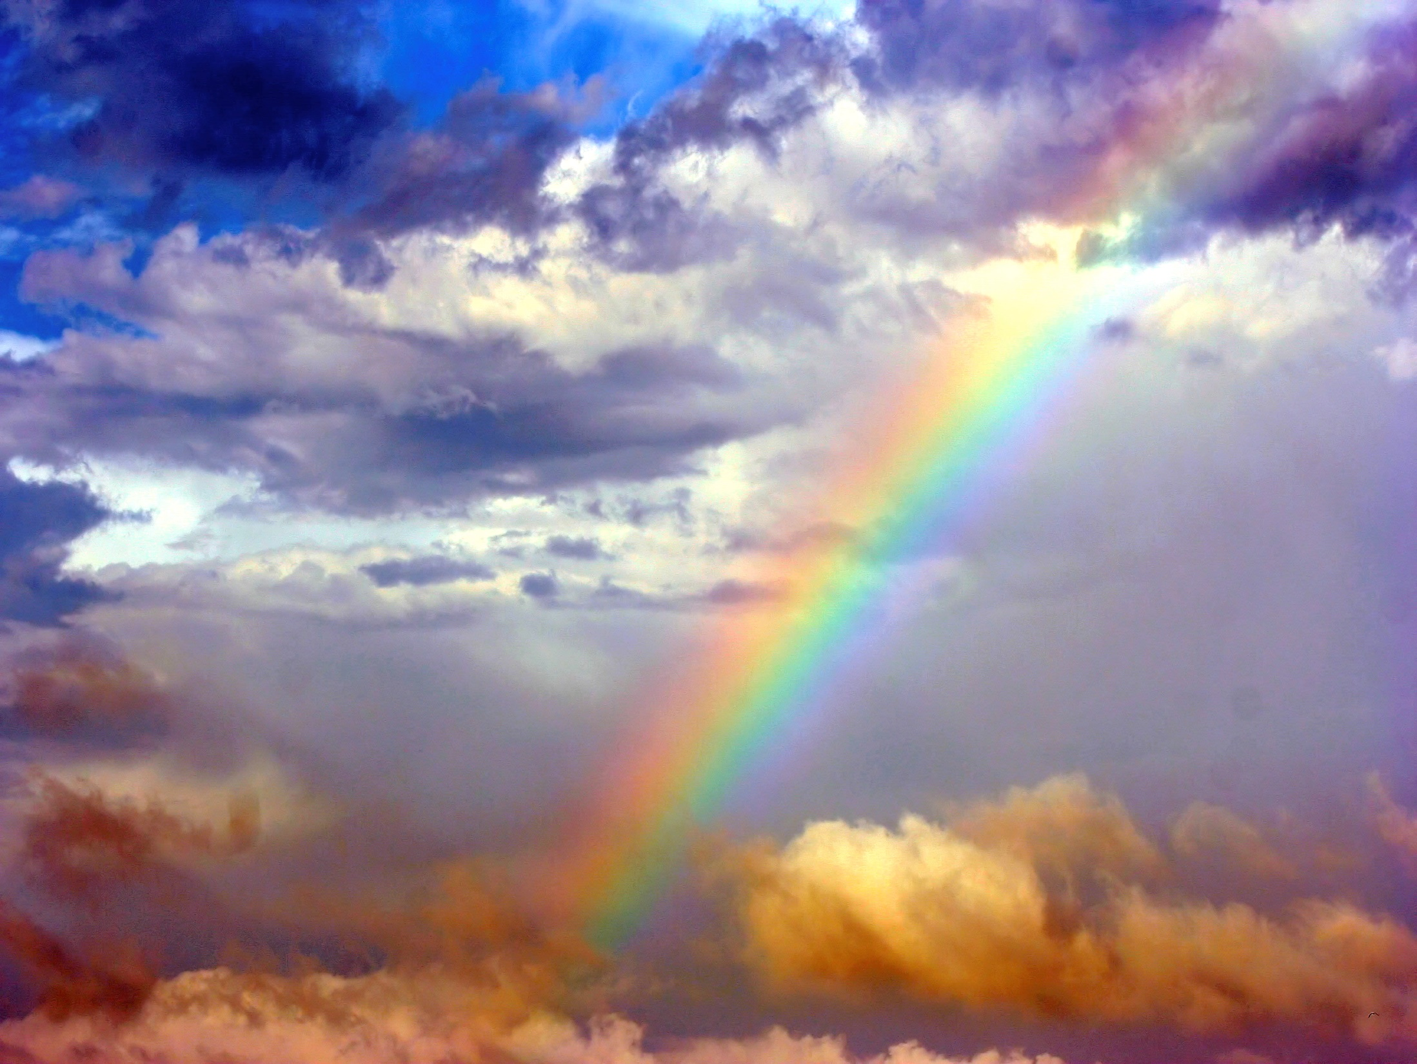
Who is a God like You, Pardoning iniquity And passing over the transgression of the remnant of His heritage? He does not retain His anger forever, Because He delights in mercy. — Micah 7:18
mercy
Notes:
God’s greatest pleasure is in those who love Him. To appreciate His ongoing call to the lost exposes His patient plan to gain loyal souls.

Slide 16
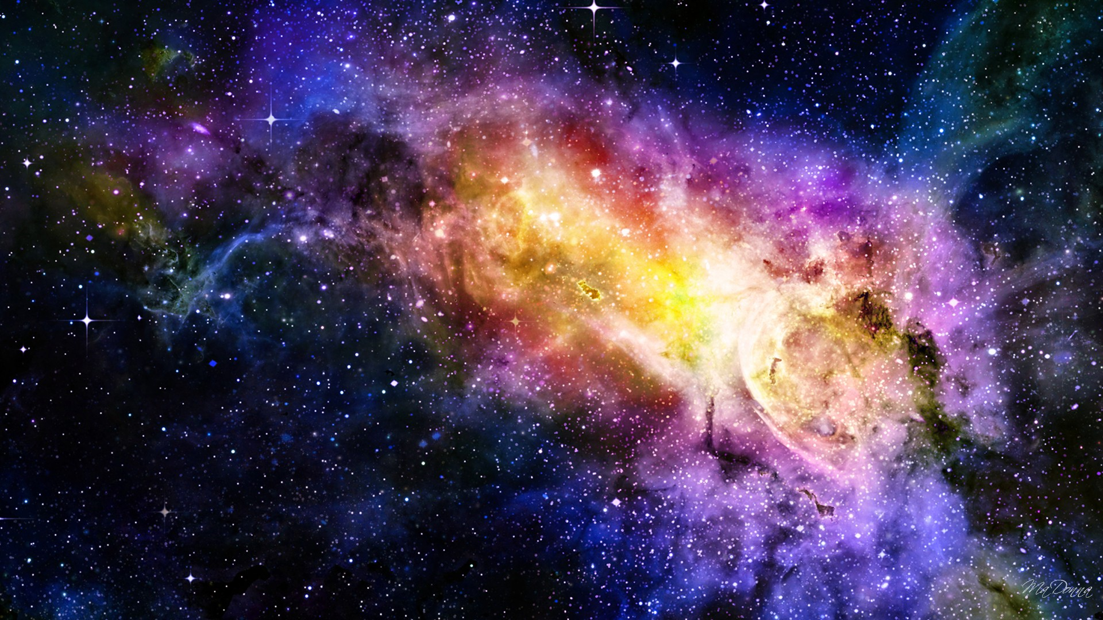
"For My thoughts are not your thoughts, Nor are your ways My ways," says the LORD. "For as the heavens are higher than the earth, So are My ways higher than your ways, And My thoughts than your thoughts. — Isaiah 55:8-9
higher than the earth
higher than the earth
ways
higher
thoughts
Notes:
No one can fully comprehend His greater glory for independent life to remain trustworthy in His ways of goodness. His value for us, as His living creation, exceeds all that we may value. He loves us more than we can love Him, even with utterly open hearts. To know this truth embraces his wisdom for us all to live. His ways and thoughts have devised His method to retrieve us from rebellion in the best way possible.

Slide 17
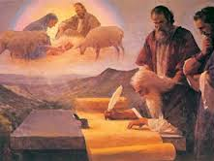
"The Redeemer will come to Zion, And to those who turn from transgression in Jacob," Says the LORD. "As for Me," says the LORD, "this is My covenant with them: My Spirit who is upon you, and My words which I have put in your mouth, shall not depart from your mouth, nor from the mouth of your descendants, nor from the mouth of your descendants' descendants," says the LORD, "from this time and forevermore." — Isaiah 59:20-21
My covenant
My covenant
My Spirit
My words
My Spirit
My words
from this time
forevermore
Notes:
His forethought has given the words of truth to man to simply find God, if courageously done, and free from embarrassment to do so. God calls, releasing freedom to be free, that true spirits may find His Spirit written upon their hearts. Truth is easily received by those that honestly seek it as it is innate to our natural nature, being that we are images of what is real. Our infinite wealth comes by His Spirit rendering His words of truth.

Slide 18
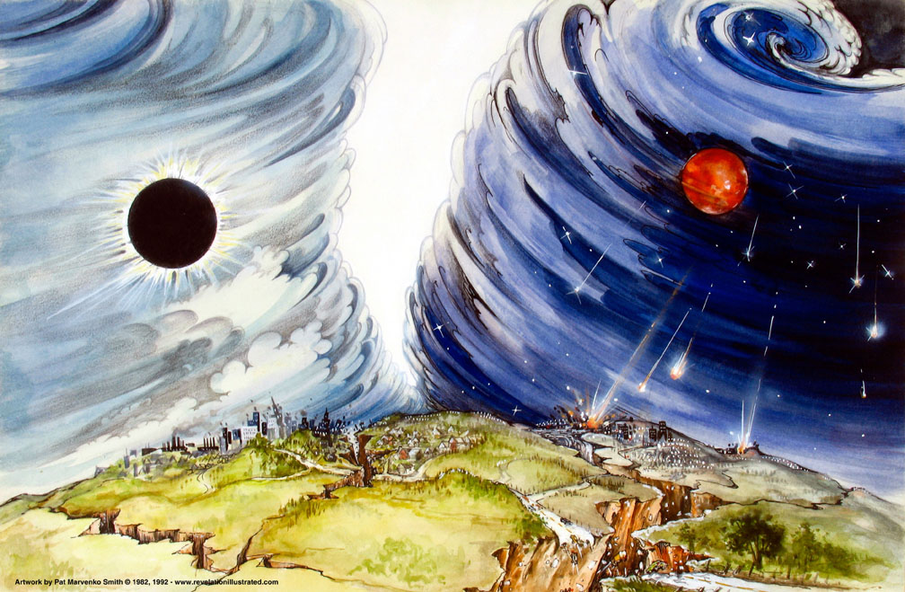
The Lord gave the word; Great was the company of those who proclaimed it: — Psalm 68:11
The Lord gave the word
The Lord gave the word
Lord
word
Notes:
The Lord selected those best able to carry the torch of His truth to light souls in darkness. In times past many were made privy to His presence through miraculous intervention. The Lord does not need to prove Himself as He has countlessly already done.

Slide 19
(For until the law sin was in the world, but sin is not imputed when there is no law. Nevertheless death reigned from Adam to Moses, even over those who had not sinned according to the likeness of the transgression of Adam, who is a type of Him who was to come. — Romans 5:13-14
Life
Lost
Love
Lies
Long
Lust
Notes:
The law is established to define God’s order and separate good from bad. Governments and religions of man often, if not always, skew away from the will of God by placing men and man’s desires over God. Exposing light in the darkness reveals true independent individual life reaching back to the source of all. Is one’s true desire to ignite in return to God? To have a sinless nature in God is where infinite wealth resides. We are all little children of God, and not masters over mere men or souls by any other name. It is dominion of God over man, not dominion of man over man. Jesus came for us to identify with, showing God’s own true absolute nature, in life. By His sacrifice and gift of eternal being, partaking through Him, we return in good grace to God and avoid death. Though many wish to die, its’ deeper mask is a desire to live. Without His supporting love, life becomes lost in the shadows of man. One must check one’s own heart to admit, or not to admit, that God is God, and if He is, then God cannot lie, and He is not the author of confusion, as man is, and His word holds true. It is then, through His word, that the individual finds God, over the manipulations of men. His promise of inspired truth lasting through the countless ages of man endures, though lies flourish among ungodly men who selfishly lash out in retaliation against the flesh. No heart that hates inherits value beyond worth.

Slide 20
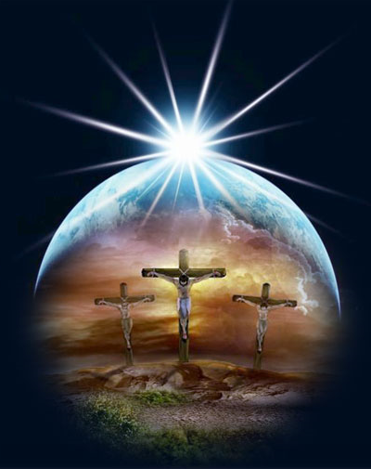
But the free gift is not like the offense. For if by the one man's offense many died, much more the grace of God and the gift by the grace of the one Man, Jesus Christ, abounded to many. — Romans 5:15
gift
free gift
free gift
Notes:
Abounding over the offence of a sinful nature, through the gift of God given to man, is in the whole of His truth.

Slide 21
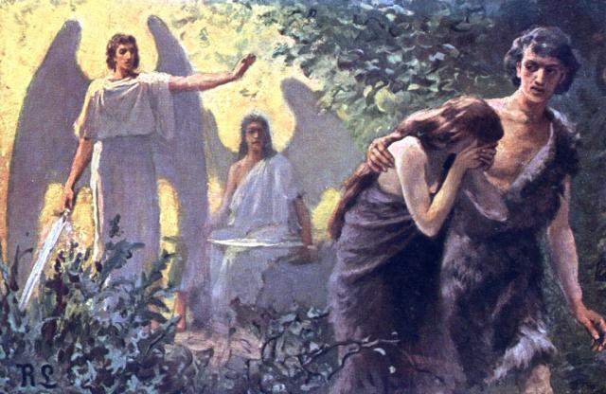
And the gift is not like that which came through the one who sinned. For the judgment which came from one offense resulted in condemnation, but the free gift which came from many offenses resulted in justification. — Romans 5:16
j
u
s
t
i
f
i
c
a
t
i
o
n
j
u
d
g
m
e
n
t
gift
the judgment
the judgment
offens
offense
free gift
justification
justification
Notes:
After the judgment of condemning rebellion against God’s good order to obedience, justification of souls came by God Himself, so that those who would genuinely love Him could return. Justification comes by a pure heart cleansed in the mercy of His love. His gift has made us free of death for those accepting His truth and acting upon it. For all that is good, it is easy to be repulsed by blatant callous evil.

Slide 22
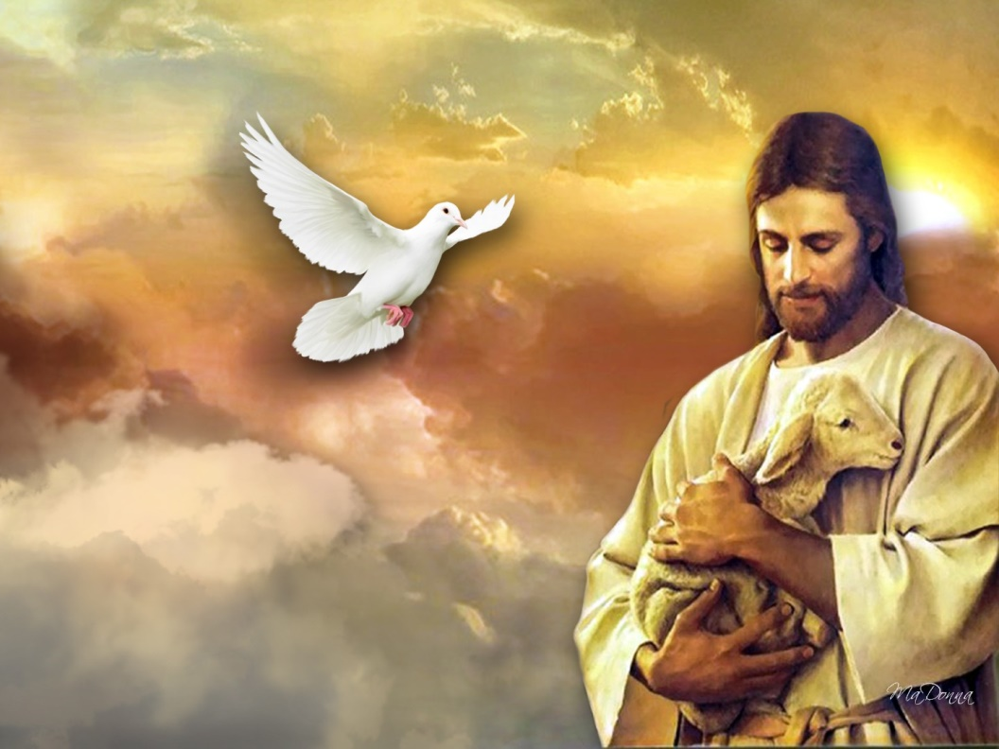
For if by the one man's offense death reigned through the one, much more those who receive abundance of grace and of the gift of righteousness will reign in life through the One, Jesus Christ.) — Romans 5:17
receive
receive
grace + the gift = life in Christ
grace
the gift
grace
gift
grace
gift
life
in
reign in life
in
Christ
Notes:
Through Christ we return to God, and by no other means. It is God who has declared it. God has one plan whereas man has the convolution of many.

Slide 23
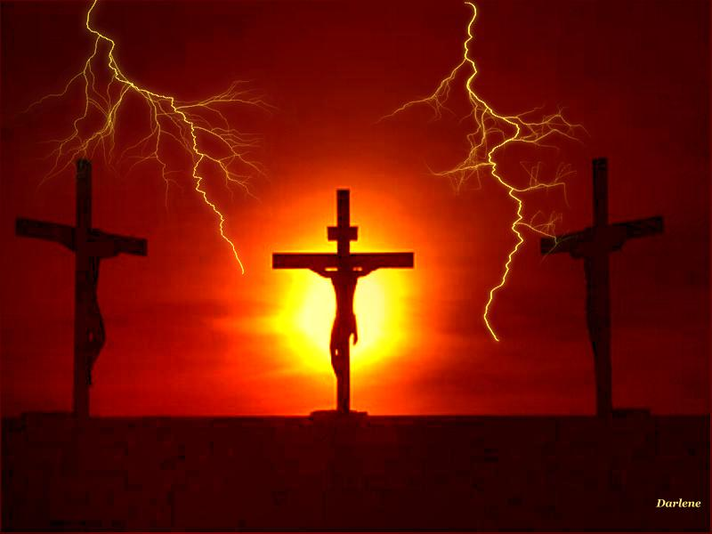
Therefore, as through one man's offense judgment came to all men, resulting in condemnation, even so through one Man's righteous act the free gift came to all men, resulting in justification of life. For as by one man's disobedience many were made sinners, so also by one Man's obedience many will be made righteous. — Romans 5:18-19
=
free gift justification of life
one Man's many
obedience made righteous
free gift
free gift
free gift
life
justification of life
life
=
obedience
one Man's
obedience
many
made righteous
made righteous
Notes:
By Christ’s righteous life, our lives are redeemed to rise in the unity of His Spirit. It is a call to return to righteousness in Him by God Himself. Obedience to the ways of God is forming righteousness.

Slide 24
Moreover the law entered that the offense might abound. But where sin abounded, grace abounded much more, so that as sin reigned in death, even so grace might reign through righteousness to eternal life through Jesus Christ our Lord. — Romans 5:20-21
r
i
g
h
t
e
o
u
s
n
s
r
i
g
h
t
e
o
u
s
n
e
s
s
r
i
g
h
t
e
o
u
s
n
s
s
grace
grac
grace
grace
through righteousness
through righteousness
eternal life through Jesus Christ
eternal life through Jesus Christ
eternal life
through Jesus Christ
Notes:
Uncovering evil is made clear by His word, that no man can deny, all are under His offer to return in Him.

Slide 25
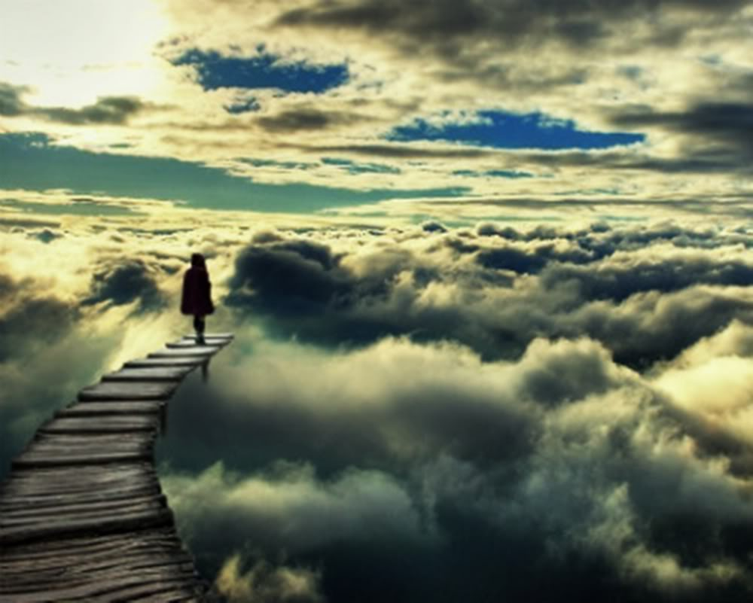
For the wages of sin is death, but the gift of God is eternal life in Christ Jesus our Lord. — Romans 6:23
grace
saved
For by grace you have been saved through faith, and that not of yourselves; it is the gift of God, … — Ephesians 2:8
through faith
the gift of God
grace = the gift of God
gift of God is eternal life
gift of God
eternal life
in
=
in
Notes:
Eternal life is a choice to be submissively in Christ, believing in His power, else a separate destructive delusion invades His kingdom assassinating His truth and simple calling. He offers a gift no man can give. Is not what Christians hope for is eternal life to freely roam in His abode?

Slide 26
"And this is eternal life, that they may know You, the only true God, and Jesus Christ whom You have sent." — John 17:3
eternal life = know God
eternal life
know
God
know You
know You
and Jesus Christ
Jesus Christ
and Jesus Christ
Notes:
No other plan offers true eternal life but that which has come of God Himself. Man does not return to man.

Slide 27
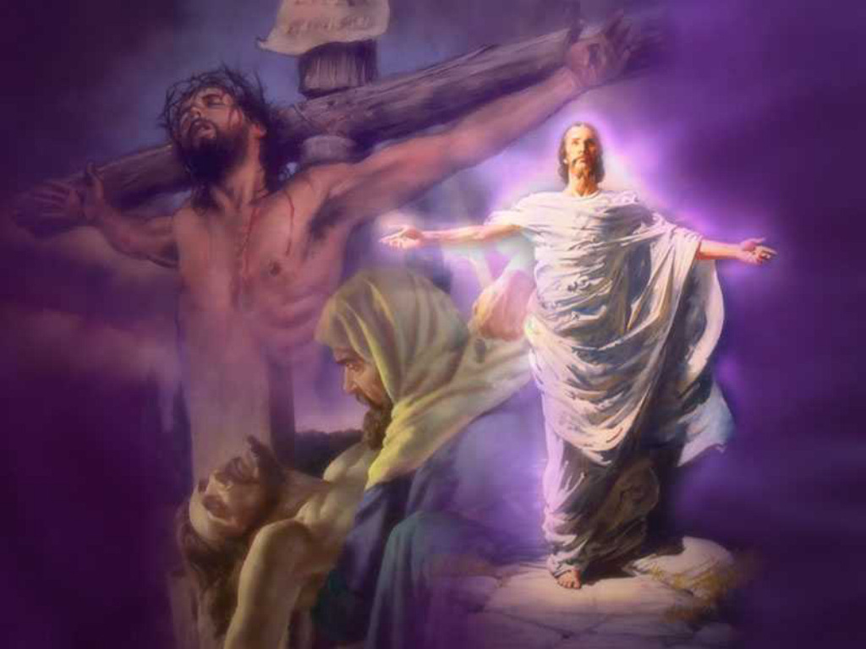
Blessed be the God and Father of our Lord Jesus Christ, who according to His abundant mercy has begotten us again to a living hope through the resurrection of Jesus Christ from the dead, to an inheritance incorruptible and undefiled and that does not fade away, reserved in heaven for you, who are kept by the power of God through faith for salvation ready to be revealed in the last time. — 1st Peter 1:3-5
eternal life = know God
inheritance incorruptible
inheritance incorruptible
heaven
heaven
revealed in the last time
in
Notes:
Time is not a constraint of eternal life. As the last time arrives, glory untold commences upon those accepting His pure inheritance from an irrevocable love.

Slide 28
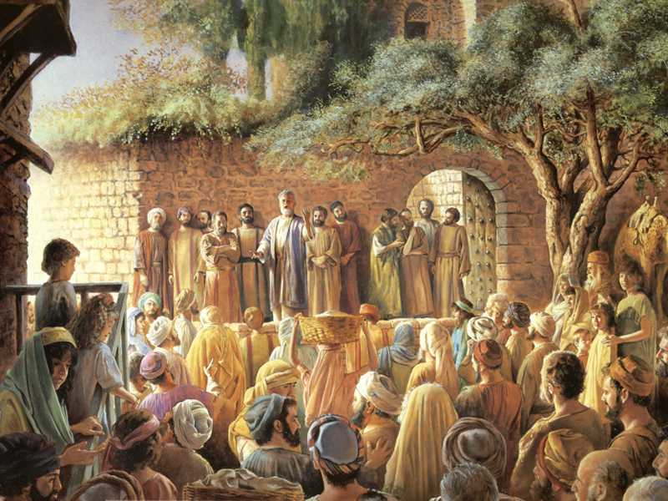
Then Peter said to them, "Repent, and let every one of you be baptized in the name of Jesus Christ for the remission of sins; and you shall receive the gift of the Holy Spirit. — Acts 2:38
be baptized
in
Jesus
for
Christ
remission of sins
receive the gift
receive the gift
Notes:
One must be immersed in His truth, and His call, for the remission of sins, which then in turn covers the soul with His Spirit. Christ supersedes all lawyers and reduces all magistrates to subjugation. We answer to Him, not men. Hear the call and act upon the heart of His truth before tomorrow is no more. Men may argue but the words of His truth is clear, without baptism in Christ, there is no remission of sins and the gift is not given.

Slide 29
And for this reason He is the Mediator of the new covenant, by means of death, for the redemption of the transgressions under the first covenant, that those who are called may receive the promise of the eternal inheritance. — Hebrews 9:15
. .
those who are called
. .
the promise
may receive
the promise
eternal inheritance
Notes:
It is Christ, and by His Spirit, that clears the way opening our return to God. Come to Him and wash away what no other means can wash, in a refreshing of conscience led by the Spirit. This call does not come by man or any of his faltering religions, and no promise by man can replace the true call of God to come to Him, by Him.

Slide 30
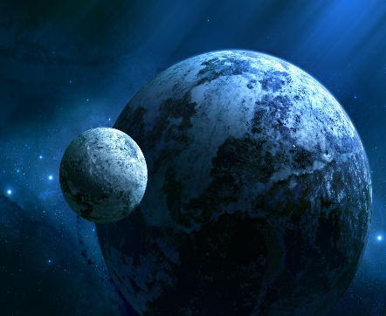
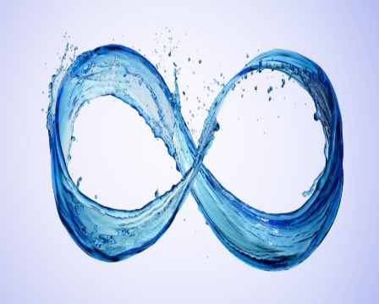
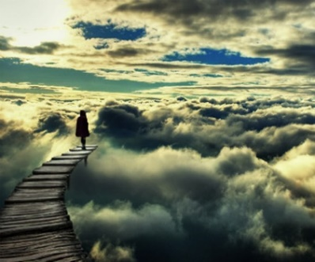

Slide 31
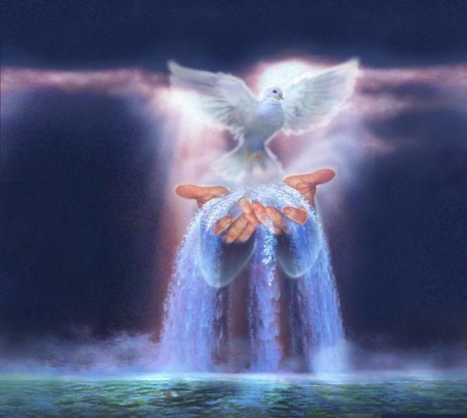
→ The whole universe is given as a heritage to all
→ All humanity is as insignificant in God’s extent
→ He encompasses all from beginning to end
→ The Lord sets His exiles to go free & not for price
→ Spiritual food alone is what satisfies a soul
→ The water of eternal life is freely offered
→ God’s mercy shall be upon those seeking Him
→ God’s Spirit comes to man through His word
→ The free gift of God offers grace for eternal life
→ Our faith enables grace as His gift is offered
→ To know God through Christ is to touch eternity
→ An inheritance of eternal life awaits the faithful
→ Through baptism His gift of saving Spirit is given
Infinite Wealth
is Life in God
Notes:
Infinite Wealth is Life in God.

Slide 32
Notes:
Darkness brings light to nothing.

Slide 33
Ron Bert
INFINITE WEALTH
May 15, 2016
PART 2
Notes:
In life we are to ourselves that we are as God is that He is. Perception defines a soul either for the greater good or left to the detriments of living. Questions of right and wrong are often answered by what is most sensible. Is it that the glass is half empty, or half full, and when asked as to what one holds in a simple open palm, the answer divulges the soul. Is it all or nothing we hold, and this exposes the appreciation of one’s thoughts. It is in truth a question, a test of giving or taking and the balance therein. Man against man is not the fundamental calling of God. To achieve wealth in His truth one has to see through the eyes of God Himself, and it is the Bible that delivers these nuggets enlightening true jewels of thought delivering treasures to the soul that have no compare. For the littleness that is man, God is not glorified, nor does He condone as great, lone fools waving weapons in hand, but condemns them as murderous fanatics, and certainly not true Jihadists to His cause. All suicides spawn from a selfish cowardly heart holding to an easy delusional excuse over real courage to plow through the pains of living reaching achievement. No suicide has ever finished anything great or honorable, but lowly joins to all that is detestable. Exception would be for the judgment of God though I doubt He favors self-termination in any instance. Value is in life, not death. God’s call is to be strong, even in our weakness, as we seek Him out, and not just a pitiful desire of man. What we seek is what we become. Though many disparagingly whine, one can not argue against the will of His truth. An orange will never be violet as a lie will never be true. Hate for self and or others is not the call of God but the power of Satan. It is truth that conveys infinite wealth. The question lays in how we live, not how we die. Most are good at dying, but the truly great live past all adversity carrying others. It is in His wealth of Spirit we endure, and in poverty of flesh, we die. To embrace only the ladder denies His saving grace. May His eternal Spirit of truth be upon us and our children. Without the pillar of His truths guiding us, a fearless and humble public power remains unobtainable.

Slide 34
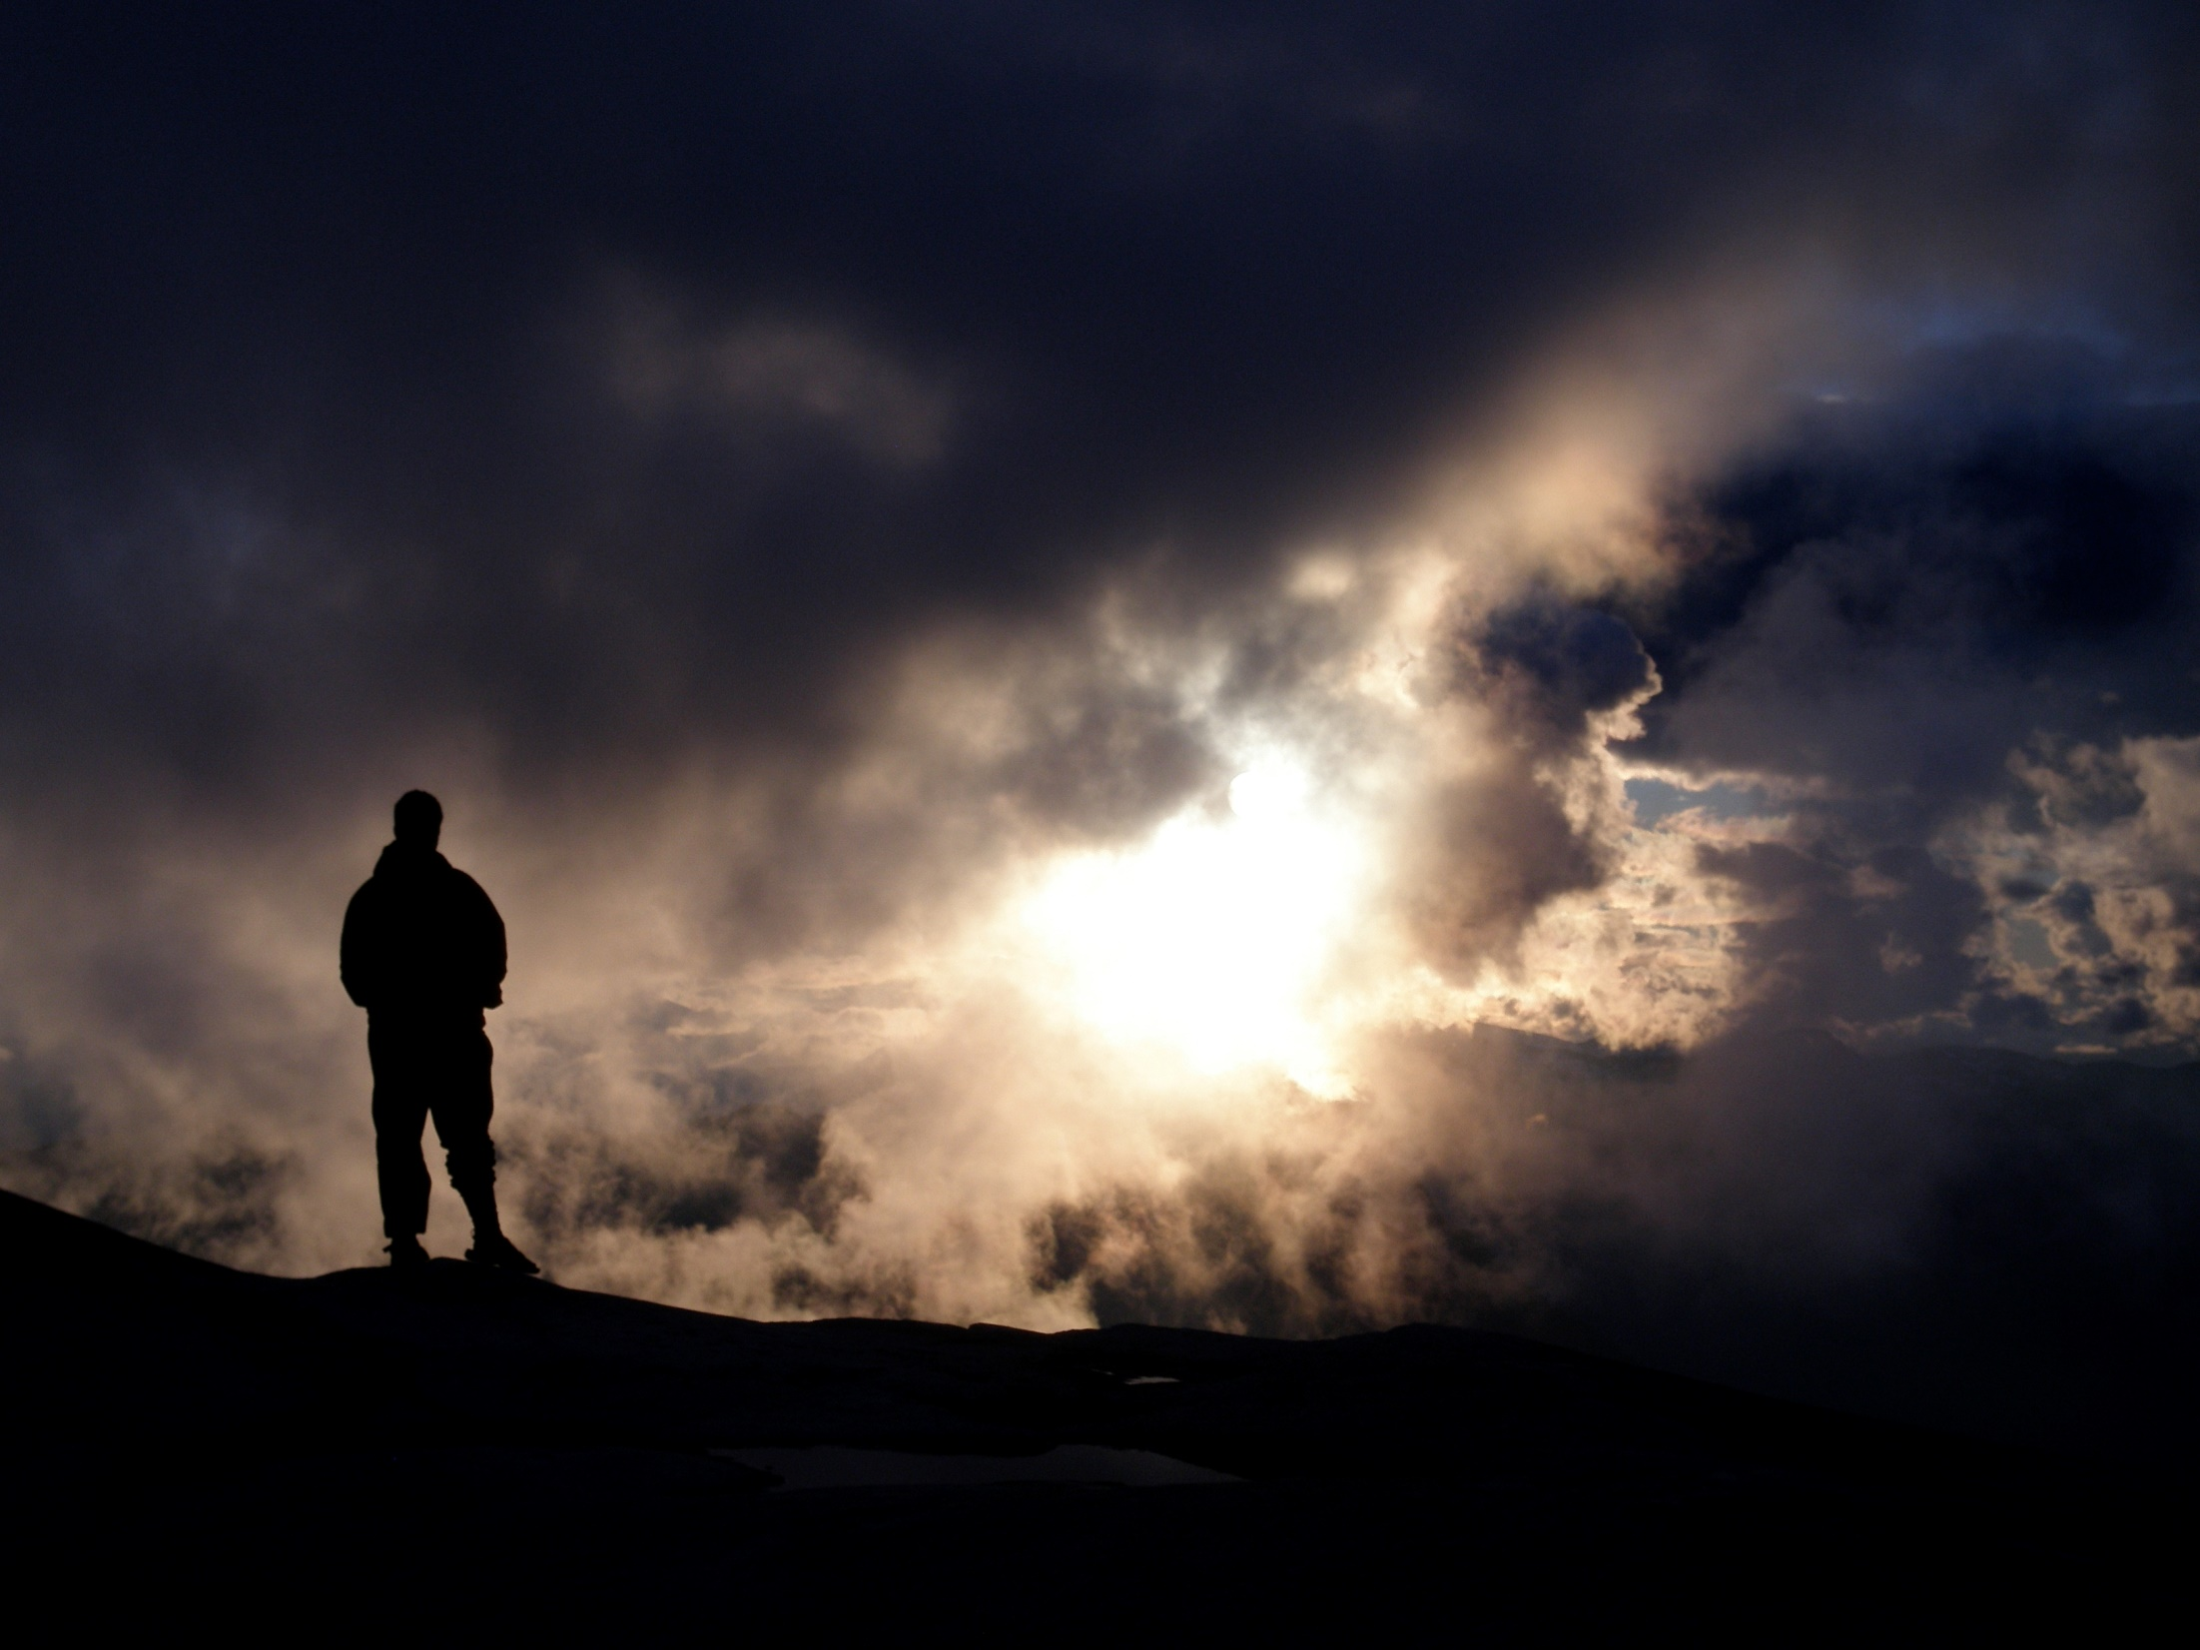
Now we have received, not the spirit of the world, but the Spirit who is from God, that we might know the things that have been freely given to us by God. — 1st Corinthians 2:12
we have received
we have received
might
might
know
know
freely given
Notes:
A greater light has touched our hearts lifting us beyond the confines of the mere mortal. If a quarter is left on the sidewalk, it is our choice to pick it up or not, not that it is earned, but would be received as a free gift, as is His truth, it has been left in the open for those that would find it valuable.

Slide 35
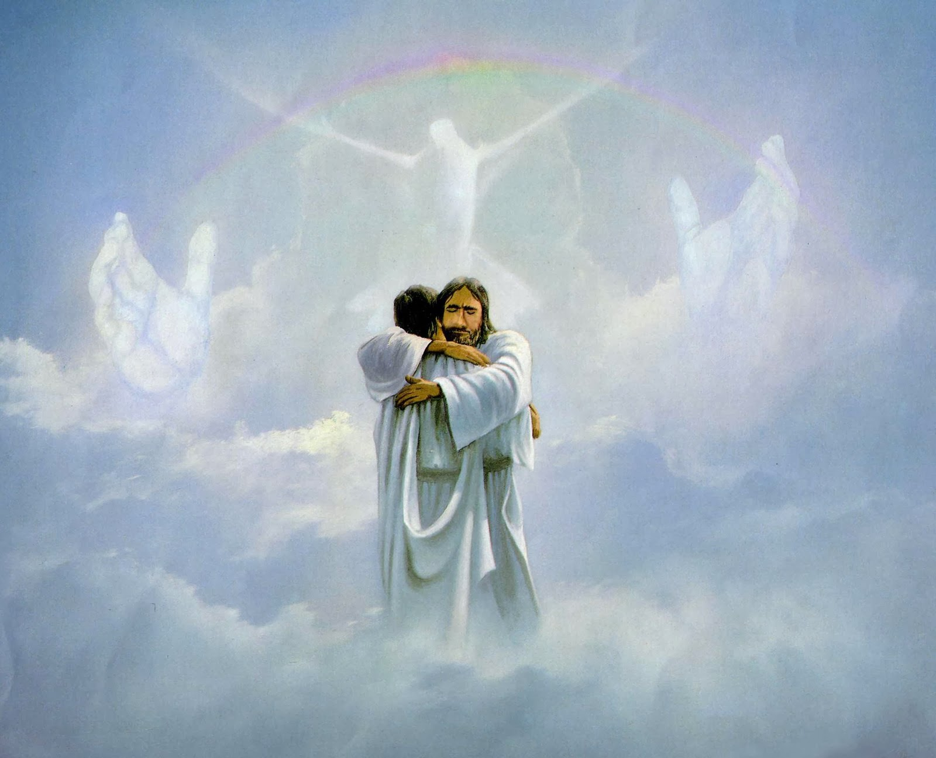
… to know the love of Christ which passes knowledge; that you may be filled with all the fullness of God. — Ephesians 3:19
passes knowledge
passes knowledge
filled
fullness
Notes:
To be filled beyond measure is not explainable, but felt in the bosom of His love.

Slide 36
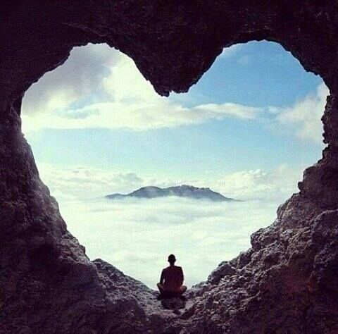
… and the peace of God, which surpasses all understanding, will guard your hearts and minds through Christ Jesus. — Philippians 4:7
surpasses all understanding
surpasses all understanding
heart
Christ Jesus
Notes:
Tranquility is found in the sanctuary of His essence, spiritual solitude alongside His Spirit.

Slide 37
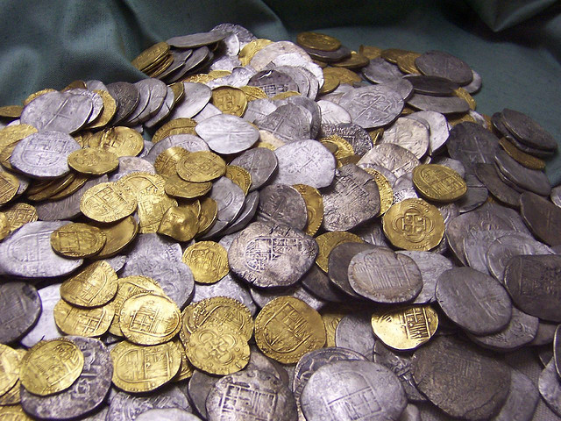
How much better to get wisdom than gold! And to get understanding is to be chosen rather than silver. — Proverbs 16:16
wisdom
gold
understanding
heart
silver
Notes:
To know understanding reveals immeasurable wealth.

Slide 38
wisdom ≠ gold
understanding ≠ silver
wisdom
≠
gold
understanding
≠
silver

Slide 39
wisdom
understanding

Slide 40
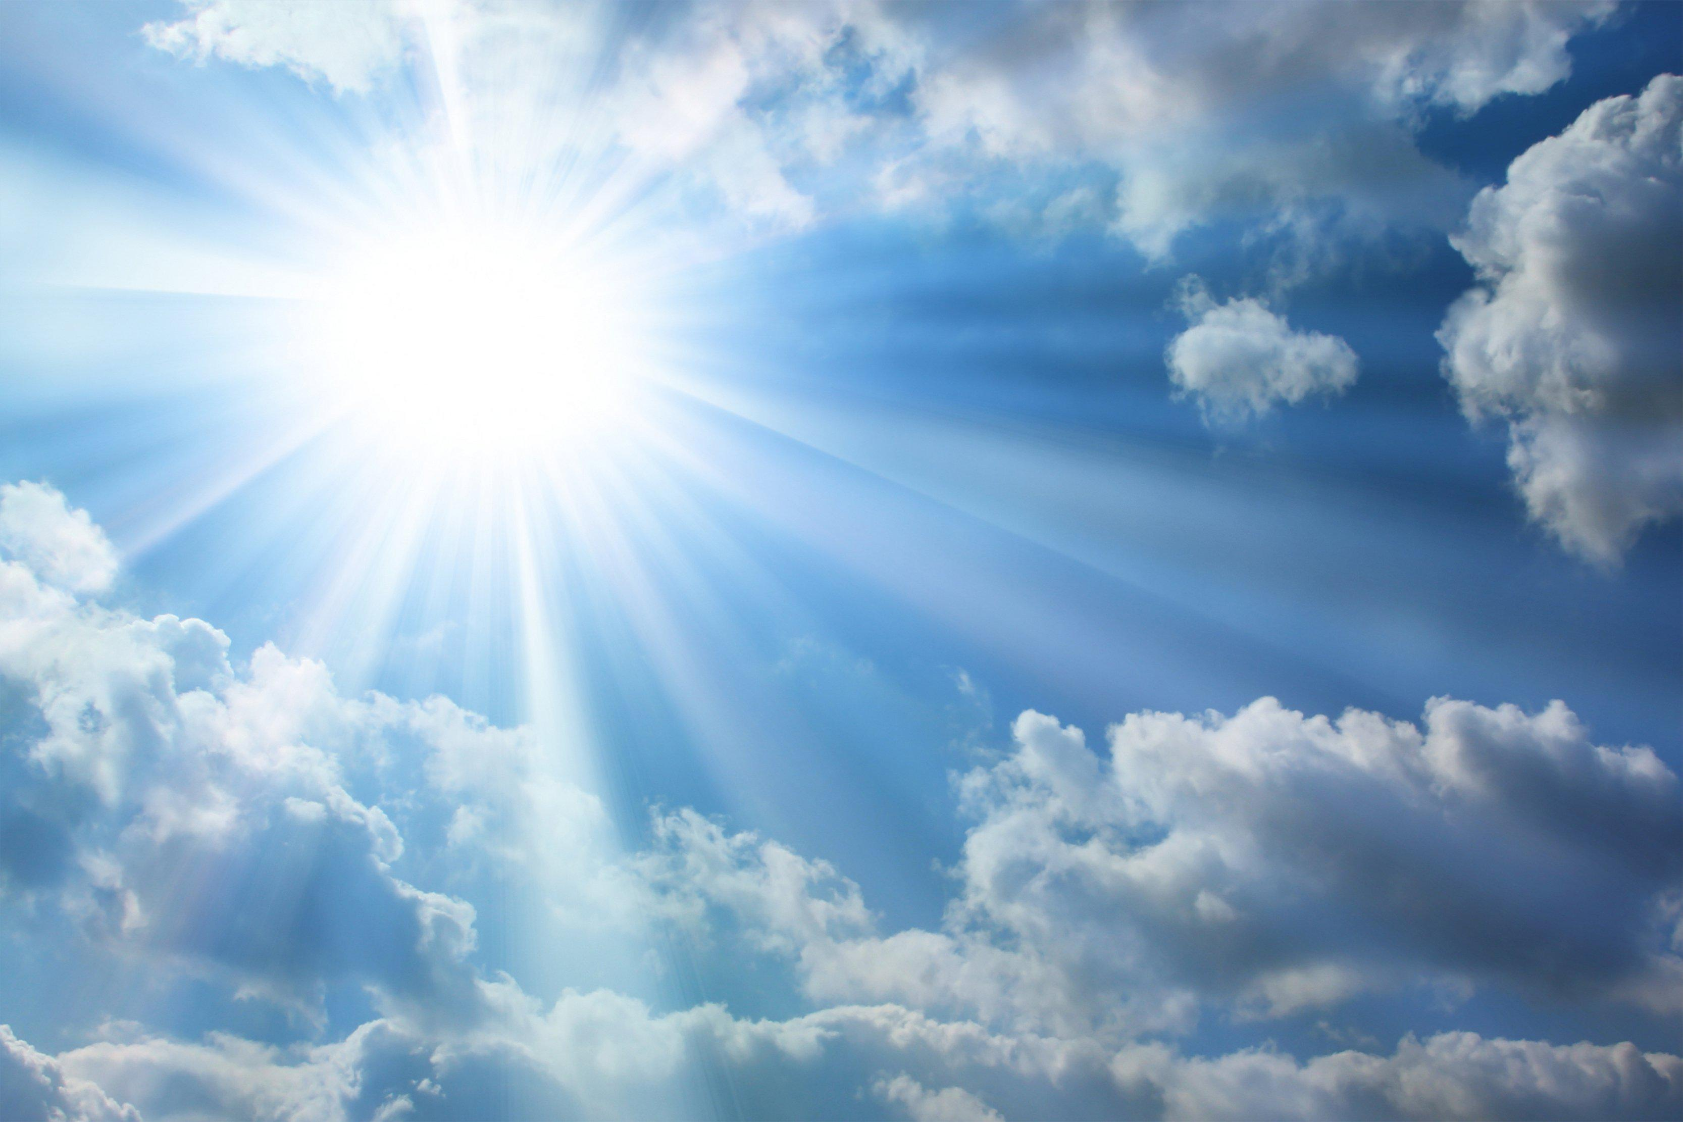
"But where can wisdom be found? And where is the place of understanding? Man does not know its value, Nor is it found in the land of the living. The deep says, 'It is not in me'; And the sea says, 'It is not with me.' It cannot be purchased for gold, Nor can silver be weighed for its price." — Job 28:12-15
wisdom
understanding
It cannot be purchased
It cannot be purchased
Notes:
The glory of truth reaches out before all, often higher than what is obtainable, yet rendered freely by God. To approach Him is to emulate His ways.

Slide 41
Counsel is mine, and sound wisdom; I am understanding, I have strength. By me kings reign, And rulers decree justice. By me princes rule, and nobles, All the judges of the earth. I love those who love me, And those who seek me diligently will find me. Riches and honor are with me, Enduring riches and righteousness. My fruit is better than gold, yes, than fine gold, And my revenue than choice silver. — Proverbs 8:14-19
love
love
better than gold
better than gold
Notes:
To possess wisdom has no price in its’ priceless worth. Infinite wealth dwells in the free spirit, and it cannot be paid for with all that the inert universe may contain. It is a bird suckling on a flower beneath a sparkling waterfall with the buzzing of a cricket. It is free. It reaches out from within touching all that is holy in His light.

Slide 42
I traverse the way of righteousness, In the midst of the paths of justice, That I may cause those who love me to inherit wealth, That I may fill their treasuries. — Proverbs 8:20-21
righteousness
justice
. .`
love
those who love me
Notes:
The treasury of knowledge is empty without incorporating wisdom to appreciate it. We all are challenged to see the forest beyond the tree that fixates us. Pray He opens the pearls we require to be in His truth. Infinite wealth lays in an upright just heart.

Slide 43
I traverse the way of righteousness, In the midst of the paths of justice, That I may cause those who love me to inherit wealth, That I may fill their treasuries. — Proverbs 8:20-21
in
her
it
inherit
wealth
treasuries
Notes:
The treasury of knowledge is empty without incorporating wisdom to appreciate it. We all are challenged to see the forest beyond the tree that fixates us. Pray He opens the pearls we require to be in His truth. Infinite wealth lays in an upright just heart.

Slide 44
"Sell what you have and give alms; provide yourselves money bags which do not grow old, a treasure in the heavens that does not fail, where no thief approaches nor moth destroys. For where your treasure is, there your heart will be also." — Luke 12:33-34
s
i
riches
c
e
treasure
treasure
does not fail
in the heavens
does not fail
in
in the heavens
h
r
Notes:
No rust or dust can consume that which is freely given by God. It is the treasure of an inner light glowing as it touches eternity itself.

Slide 45
Command those who are rich in this present age not to be haughty, nor to trust in uncertain riches but in the living God, who gives us richly all things to enjoy. Let them do good, that they be rich in good works, ready to give, willing to share, storing up for themselves a good foundation for the time to come, that they may lay hold on eternal life. — 1st Timothy 6:17-19
Command those who are rich in this present age not to be haughty, nor to trust in uncertain riches but in the living God, who gives us richly all things to enjoy. Let them do good, that they be rich in good works, ready to give, willing to share, storing up for themselves a good foundation for the time to come, that they may lay hold on eternal life. — 1st Timothy 6:17-19
riches
rich in good works
rich in good works
in
Notes:
Material wealth has no value if absent from compassion for that which is true in goodness. The greedy are left alone to the miseries that they unbearably endure. Better a little laughter in love than a feast full of contention.

Slide 46
… that you may walk worthy of the Lord, fully pleasing Him, being fruitful in every good work and increasing in the knowledge of God; strengthened with all might, according to His glorious power, for all patience and longsuffering with joy; giving thanks to the Father who has qualified us to be partakers of the inheritance of the saints in the light. — Colossians 1:10-12
light
partakers of the inheritance
in the light
in the light
Notes:
The call from the Lord is an upward one filled in His attributes to an unending life. Each one of us holds challenges as we embrace and embark on that life’s razor, of sheer pleasure upon the ice of pain. Making the leap to faith in God lifts one higher than what is obtainable otherwise.

Slide 47
For our light affliction, which is but for a moment, is working for us a far more exceeding and eternal weight of glory, while we do not look at the things which are seen, but at the things which are not seen. For the things which are seen are temporary, but the things which are not seen are eternal. — 2nd Corinthians 4:17-18
light
eternal weight
eternal weight
light
Notes:
In the mirror of life, one can see reflections of His truth in the shades of all colors. His approaching light is what we are to become eternally united in. Time itself is witness to that which conveys the temporary.

Slide 48
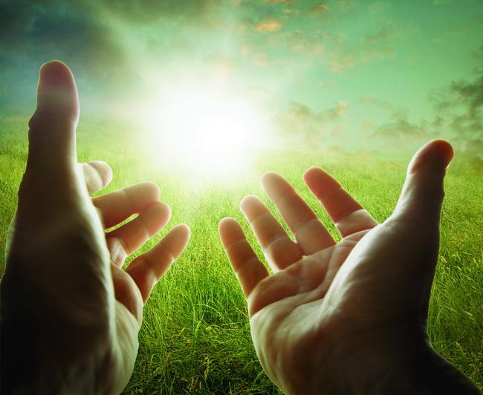
'to open their eyes, in order to turn them from darkness to light, and from the power of Satan to God, that they may receive forgiveness of sins and an inheritance among those who are sanctified by faith in Me.' — Acts 26:18
light
+ inheritance =
God
forgiveness
of sins
inheritance
sanctified
by faith
in
Notes:
It is a simple truth that God loves us. To truly love Him sets a soul free to soar in such unrestricted heights.

Slide 49
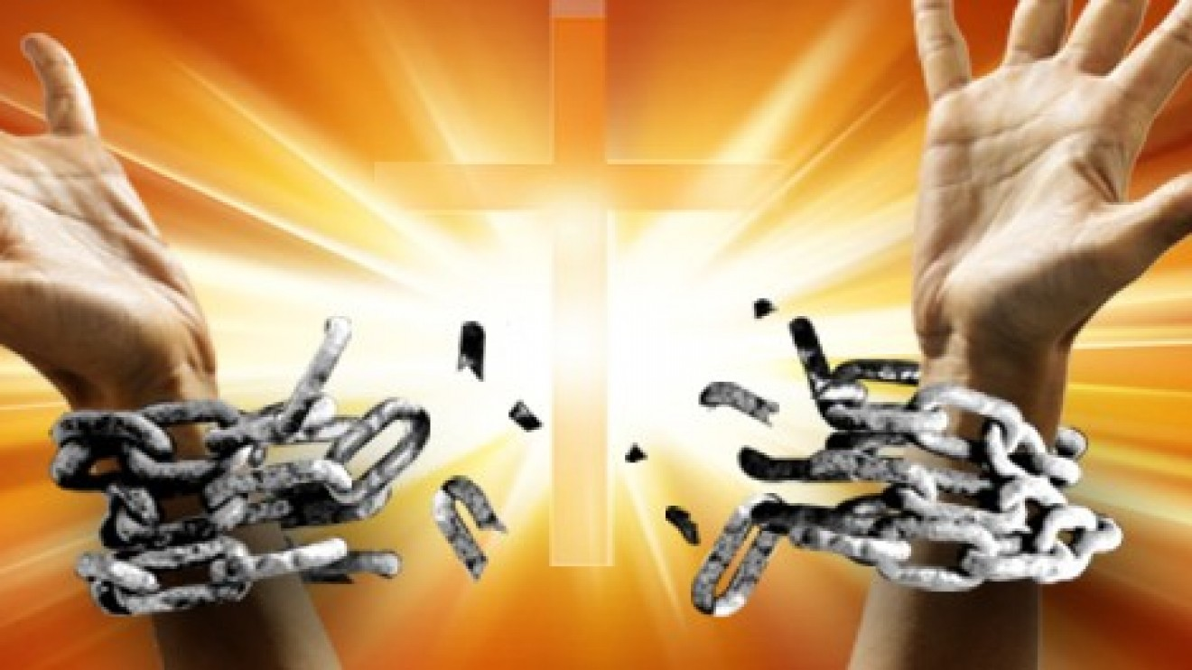
Do you not know that the unrighteous will not inherit the kingdom of God? Do not be deceived. Neither fornicators, nor idolaters, nor adulterers, nor homosexuals, nor sodomites, nor thieves, nor covetous, nor drunkards, nor revilers, nor extortioners will inherit the kingdom of God. And such were some of you. But you were washed, but you were sanctified, but you were justified in the name of the Lord Jesus and by the Spirit of our God. — 1st Corinthians 6:9-11
Do not be
Do not be
deceived
deceived
washed
washed
justified
sanctified
in
sanctified
justified
Lord Jesus
by
Spirit
Lord Jesus
by
Notes:
Evil be warned, no excuse will render what all desire without His pardon. One may choose ungodly pleasures over the self-control of heart that He demands of, from His creatures; and for those entitled to inherit the grace He offers, His will must take precedence. To gain Him avails eternal rewards. In our act of obedience He ordains the gift upon us.

Slide 50
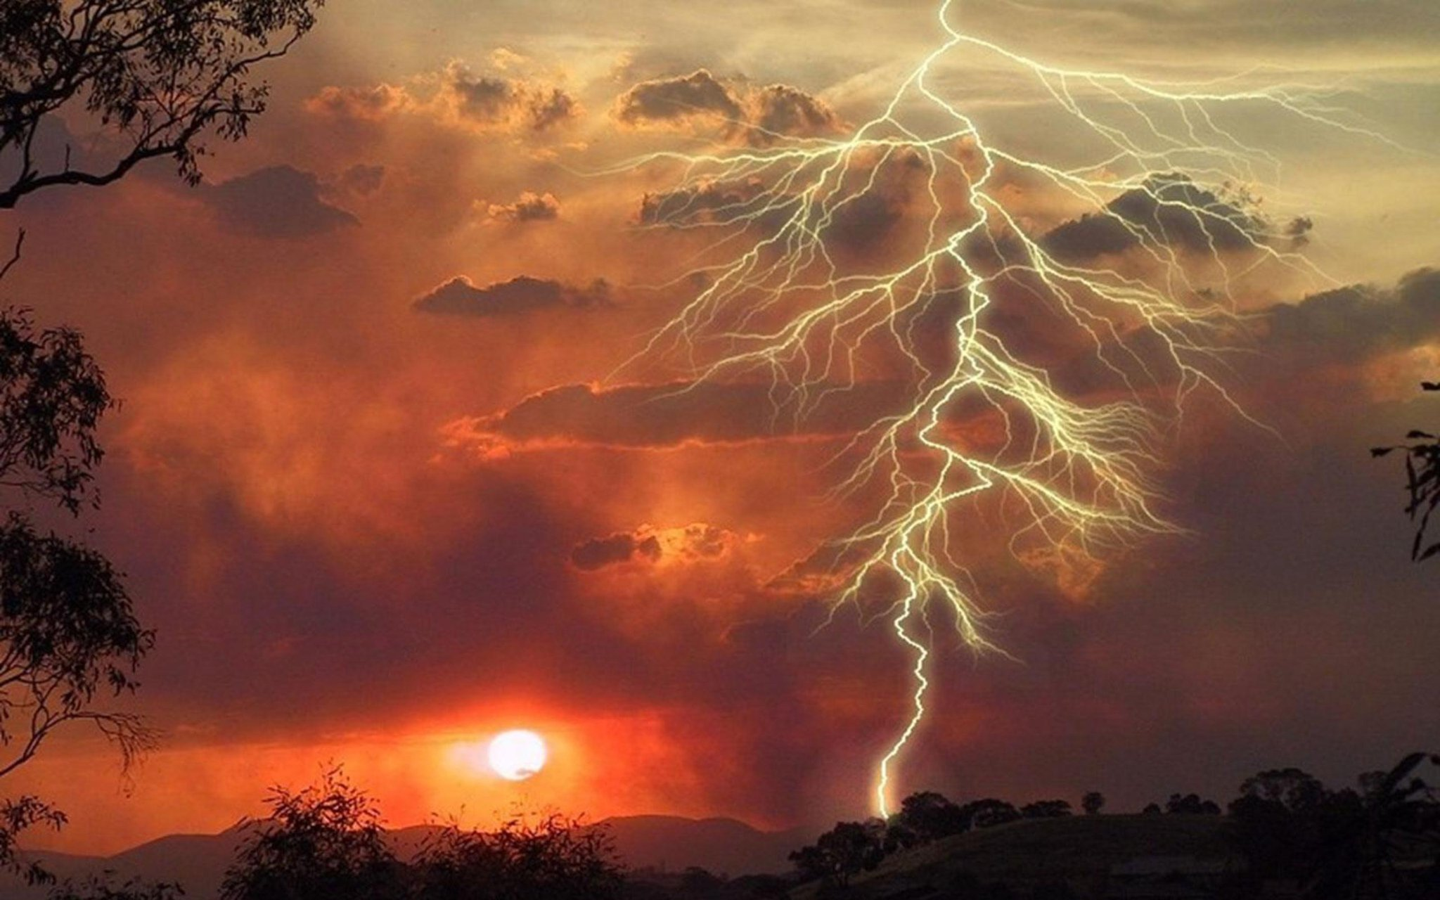
For what is the allotment of God from above, And the inheritance of the Almighty from on high? Is it not destruction for the wicked, And disaster for the workers of iniquity? — Job 31:2-3
allotment of God
God
allotment of God
inheritance
inheritance
Notes:
For all those refusing to regard His ways will find His final hand leaving them worthless. All knowledge is His and upon our actions we are judged.

Slide 51
The LORD knows the days of the upright, And their inheritance shall be forever. — Psalm 37:18
forever
forever
inheritance
inheritance
inheritance
heart
For the LORD will not cast off His people, Nor will He forsake His inheritance. — Psalm 94:14
not cast off
not cast off
Notes:
The Lord has made a promise of eternity to all those uprightly alive in Him. Each of us needs to cast off the works of darkness.

Slide 52
"A good man out of the good treasure of his heart brings forth good; and an evil man out of the evil treasure of his heart brings forth evil. For out of the abundance of the heart his mouth speaks." — Luke 6:45
heart
abundance
abundance
Notes:
The desire of the heart reveals the truth of a soul. Words of heart either defile or bless those surrounding. Ones compass uncovers true direction.

Slide 53
And the disciples were astonished at His words. But Jesus answered again and said to them, "Children, how hard it is for those who trust in riches to enter the kingdom of God! — Mark 10:24
trust
trust
God
God
Notes:
The obsession with material gain has not the protection that spiritual wealth delivers.

Slide 54
And He said to them, "Take heed and beware of covetousness, for one's life does not consist in the abundance of the things he possesses." — Luke 12:15
beware of covetousness
beware of covetousness
life
God
Notes:
Things are sent in tangible form as a test, from God, to show where primary importance or true value holds for a soul. Qualities of spirit define destiny, such as mercy over greed, love rather than hate, patience with the rash. God is telling us, “Look, I’m going to give you a world full of stuff. Do you want Me who gave you this stuff, or do you want the stuff more than Me?”

Slide 55
But Peter said to him, "Your money perish with you, because you thought that the gift of God could be purchased with money! — Act 8:20
gift of God
gift of God
God
Notes:
As it is written, no price can pay for what must be surrendered. Love of God is a mutual sharing and can not be possessed. Love is not taken, it is given. Salvation is as it is, a gift of God, and it can only be accepted upon His terms. It cannot be earned in a holy god forsaken war of man or seized by force. It only comes by a humble realization of what He asks of His creatures, which is put forth in His word.

Slide 56
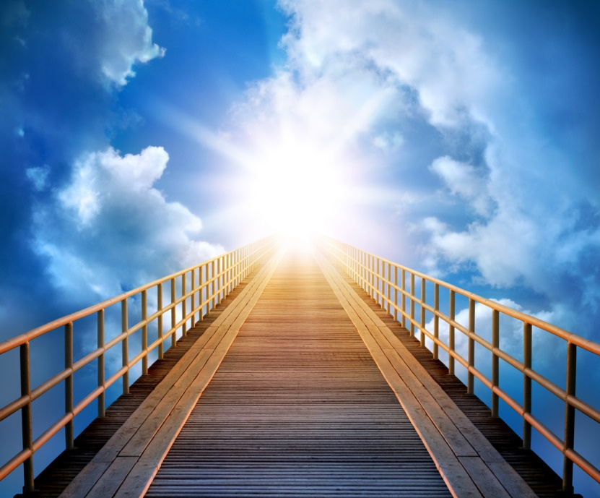
"Fools and blind! For which is greater, the gift or the altar that sanctifies the gift? — Matthew 23:19
promise
stuff
Notes:
What is more valuable, the gift of life or the action of substance?

Slide 57
"Fools and blind! For which is greater, the gift or the altar that sanctifies the gift? — Matthew 23:19
Spirit
gift
gift
gift
Material
Notes:
What is more valuable, the gift of life or the action of substance?

Slide 58
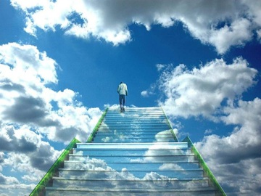
"Most assuredly, I say to you, he who hears My word and believes in Him who sent Me has everlasting life, and shall not come into judgment, but has passed from death into life." — John 5:24
ly
+
=
hears
word
gift
Hi
believes in Him
H
everlasting
life
o
s
death
life
from death into life
from death into life
believes
in Him
His
Notes:
Faith comes by hearing, and in hearing, if one acts upon His truth, true life is realized. It is critical that His word be examined by the individual soul for salvations sake. Belief is like a match. One hears that it is lit and, in sensibility, one does not expose flesh to its scorching. Believing reality, one would not knowingly harm oneself after the truth of its presence, or danger, was known. To hear baptism is required for salvation, from Jesus, and explained by Peter for the remission of sins, is it sensible to argue against His call to obey? Ignoring to hear God reaps due consequences in all stubborn hearts who would deny His plan in place of another. No human excuse or substitute doctrine will exonerate the guilty from the guillotine. If one believes an ax is swinging towards one’s neck, one moves. Belief is a call to action.

Slide 59
BELIEF
A
C
T
A
C
T
I
O
N
BELIE
BEL EF
BE
I
LIE
F
A
I
T
H
O
N
N
Notes:
Belief

Slide 60
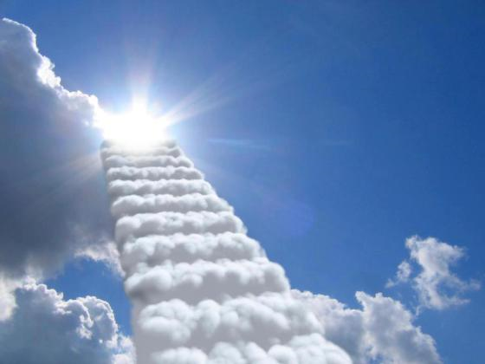
And having been perfected, He became the author of eternal salvation to all who obey Him, ... — Hebrews 5:9
eternal
all who obey Him
salvation
all who obey Him
Notes:
Jesus is the perfection and epitome of God. One’s soul is best served in service to God’s own call to obedience.

Slide 61
Therefore, leaving the discussion of the elementary principles of Christ, let us go on to perfection, not laying again the foundation of repentance from dead works and of faith toward God, of the doctrine of baptisms, of laying on of hands, of resurrection of the dead, and of eternal judgment. And this we will do if God permits. — Hebrews 6:1-3
on to perfection
on to perfection
sinfulness
old law
dead works
of faith
dead works
of faith
multiple plans of salvation
doctrine of baptisms
doctrine of baptisms
through man
resurrection
laying on of hands
resurrection
laying on of hands
judgment over faith
eternal judgment
eternal judgment
Notes:
He calls souls to incorporate His knowledge and propel toward greater attributes lifting those below to the unending heights He offers. Following His ways boosts a man closer to God leaving behind those mired in the petty arguments of men. It is also a call to leave the former wicked ways behind and not to compare oneself as to who is better in God’s eyes. Focusing on nonjudgmental quiet goodness is where the mature Christian resides.

Slide 62
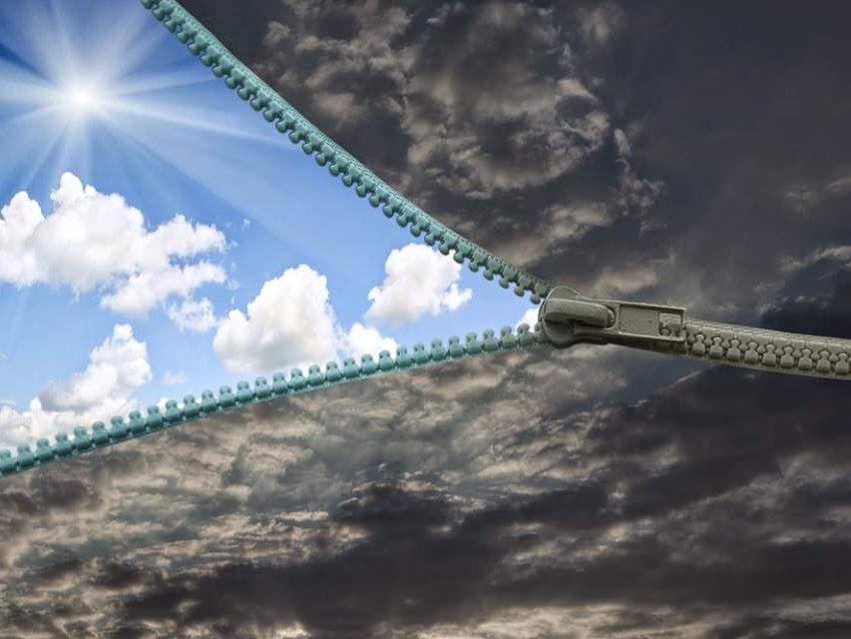
For it is impossible for those who were once enlightened, and have tasted the heavenly gift, and have become partakers of the Holy Spirit, and have tasted the good word of God and the powers of the age to come, if they fall away, to renew them again to repentance, since they crucify again for themselves the Son of God, and put Him to an open shame. — Hebrews 6:4-6
once enlightened
↘
of the Holy Spirit
↘
good word of God
fall away
renew repentance
once enlightened
of the Holy Spirit
word of God
word of God
God
good word of God
word of God
fall away
fall away
renew
repentance
Notes:
Truth is that it is truth. To reject His pronouncements leaves Him with little alternative than to oblige one’s wishes to live separate from the light He offers in truth. His revealing will expose those foreign to His ways. One cannot accept God and then reject His ways if salvation is to be had.

Slide 63
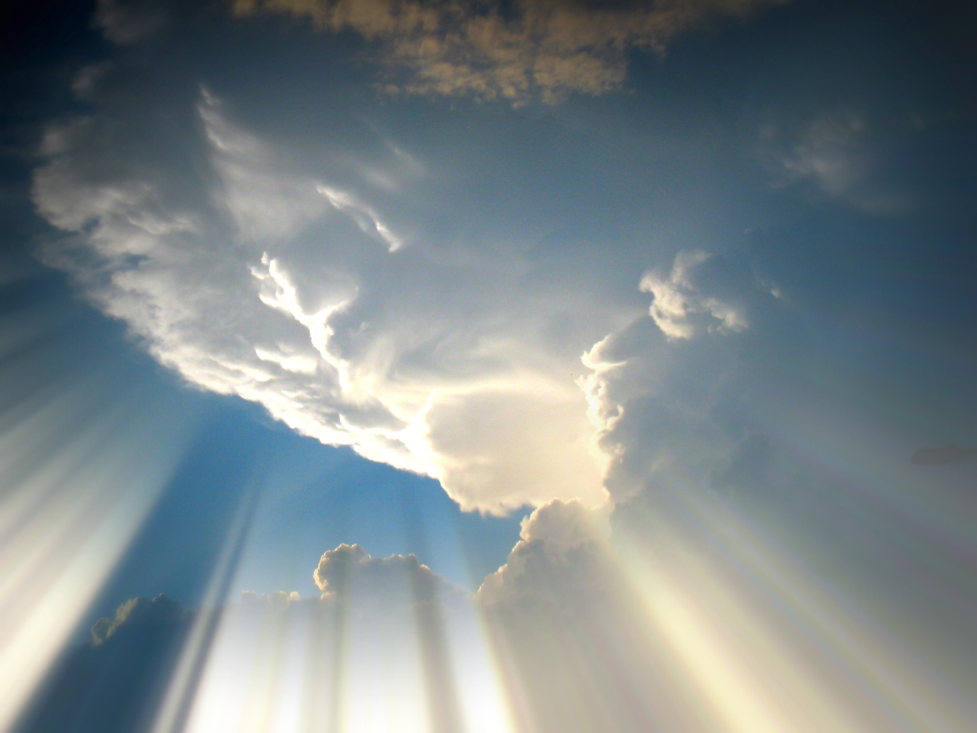
Now godliness with contentment is great gain. — 1st Timothy 6:6
God
contentment
contentment
Thanks be to God for His indescribable gift! — 2nd Corinthians 9:15
God
God
God
Thanks be
God
. .
Notes:
Each breath is a gift of life. Missing the eternal will be the biggest gasp ever felt.

Slide 64
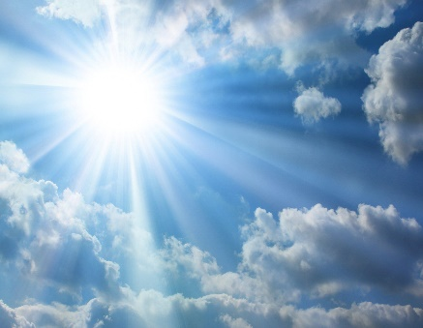
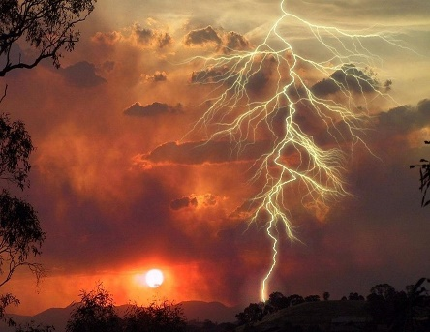
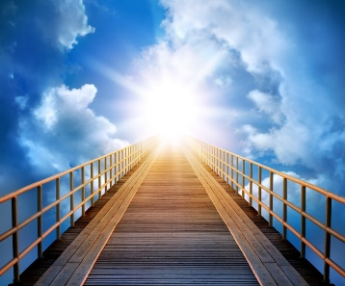
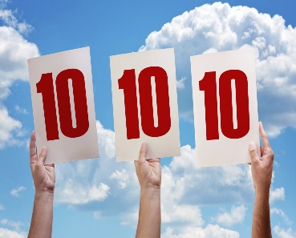

Slide 65
→ The Spirit of God gives to us all freely
→ The love of Christ passes knowledge
→ The peace of God surpasses all understanding
→ Wisdom or gifts of God cannot be purchased
→ The highest treasure is in the wealth of wisdom
→ Patient thankfulness is among the highest of value
→ What comes forth from the heart speaks true value
→ Possessions do not reveal worth or real value in life
→ Heavenly riches never fail; things unseen are eternal
→ Who believes the Word of God & Jesus lives forever
→ Forgiveness of sins precedes eternal life
→ Eternal salvation remains for those obedient
→ Godliness with contentment holds priceless value
Finding God
Unveils Eternity
Notes:
Infinite wealth is God’s love for us. To be washed in the heart of His truth has value beyond any measure. His promise is infinite wealth past all material for the faithful. Finding God unveils eternity.

Slide 66
Notes:
Darkness has no core. Deeper than deep, directionless, darkness holds no path.

Slide 67
Please visit http://www.RonBert.com to explore further
Ronald Bert Channel on
Notes:
Eternity never ends.

