Slide 2
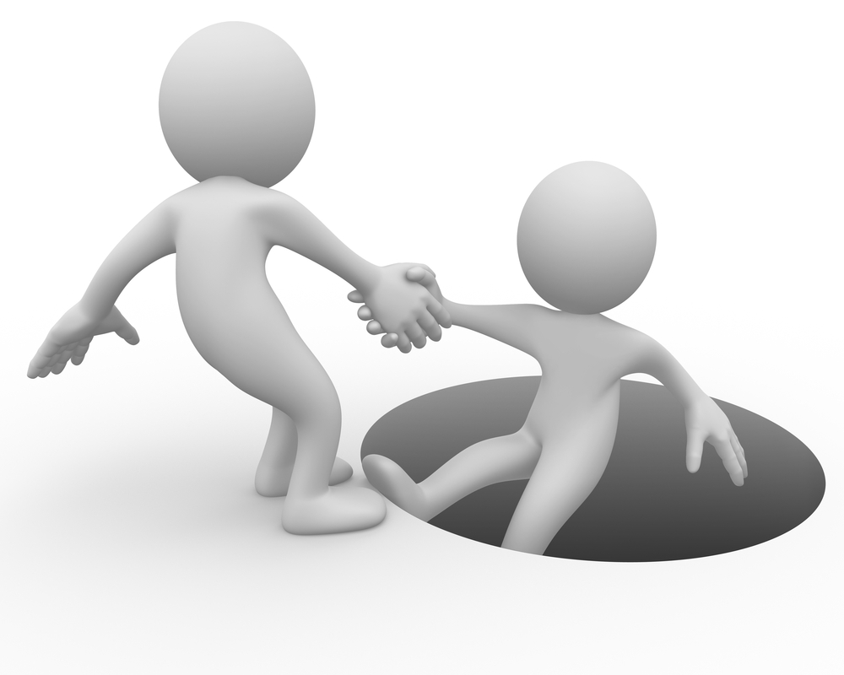
HELP!
Ron Bert
December 23, 2018

Slide 3
Depart from evil and do good; Seek peace and pursue it. The eyes of the LORD are on the righteous, And His ears are open to their cry. The face of the LORD is against those who do evil, To cut off the remembrance of them from the earth. — Psalms 34:14-16
Depart from evil
do good
Seek peace
pursue
LORD
eyes
LORD
ears
LORD
LORD

Slide 4
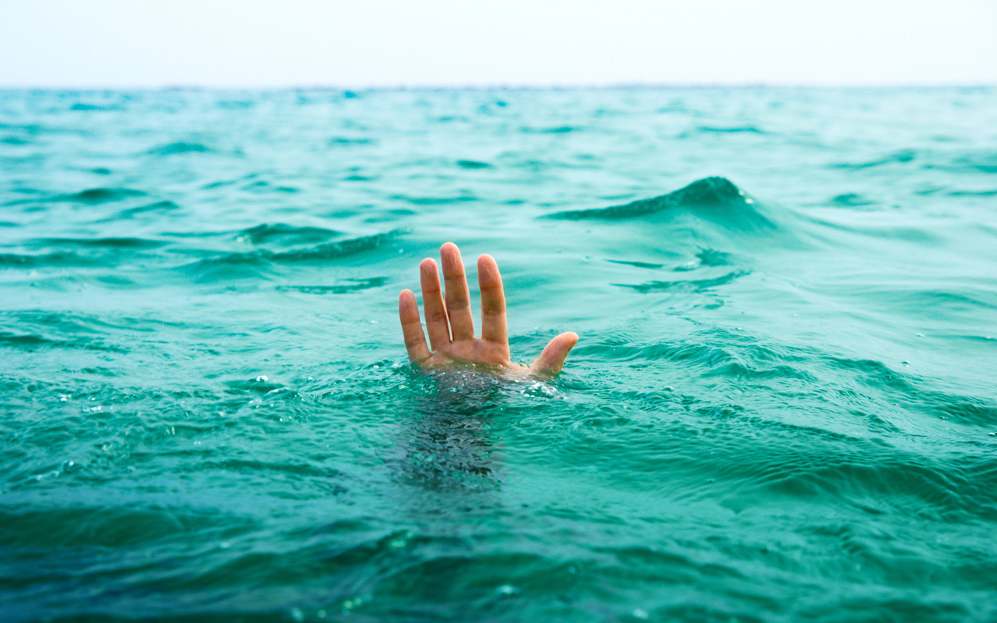
The righteous cry out, and the LORD hears, And delivers them out of all their troubles. The LORD is near to those who have a broken heart, And saves such as have a contrite spirit. Many are the afflictions of the righteous, But the LORD delivers him out of them all. — Psalms 34:17-19
The righteous cry out, and the LORD hears, And delivers them out of all their troubles. The LORD is near to those who have a broken heart, And saves such as have a contrite spirit. Many are the afflictions of the righteous, But the LORD delivers him out of them all. — Psalms 34:17-19
The righteous cry
Now this is the confidence that we have in Him, that if we ask anything according to His will, He hears us.— 1st John 5:14
d
O
hears
according to His will
near
O God
LORD
saves
LORD
LORD
Many
afflictions of the righteous
delivers
G
delivers
o
Notes:
Kind of grim news, but we all need help.

Slide 5
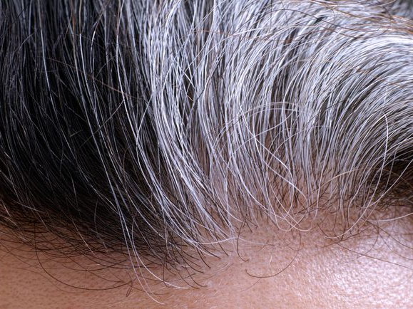
O God, You have taught me from my youth; And to this day I declare Your wondrous works. Now also when I am old and grayheaded, O God, do not forsake me, Until I declare Your strength to this generation, Your power to everyone who is to come. — Psalms 71:17-18
O God
taught me
O God
grayheaded
O God
WISDOM

Slide 6
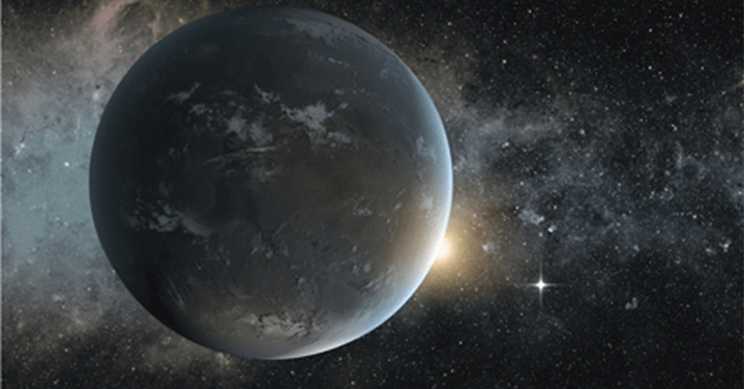
Also Your righteousness, O God, is very high, You who have done great things; O God, who is like You? You, who have shown me great and severe troubles, Shall revive me again, And bring me up again from the depths of the earth. — Psalms 71:19-20
O God
O God
O God
O God
O God
depths of
earth
severe troubles
revive me
depths of
earth

Slide 7
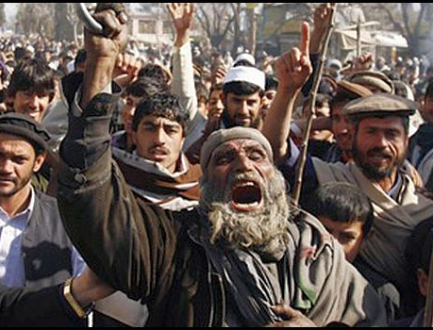
O God, the proud have risen against me, And a mob of violent men have sought my life, And have not set You before them. But You, O Lord, are a God full of compassion, and gracious, Longsuffering and abundant in mercy and truth. — Psalms 86:14-15
O God
God full of
● compassion
● gracious ● Longsuffering
● abundant in mercy and truth
mercy and truth
humanism
O Lord
God full
Do not say, "I will recompense evil"; Wait for the LORD, and He will save you. — Proverbs 20:22
Arrogant, inpatient, hostile, & vengeful?
of
compassion
gracious
Longsuffering
abundant in
mercy and truth
Notes:
Arrogant, inpatient, hostile, & vengeful?

Slide 8
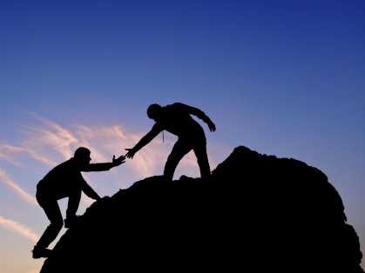
Oh, turn to me, and have mercy on me! Give Your strength to Your servant, And save the son of Your maidservant. Show me a sign for good, That those who hate me may see it and be ashamed, Because You, LORD, have helped me and comforted me. — Psalms 86:16-17
Wait on the LORD; Be of good courage, And He shall strengthen your heart; Wait, I say, on the LORD! — Psalms 27:14
LORD
Give Your strength
But those who wait on the LORD Shall renew their strength; They shall mount up with wings like eagles, They shall run and not be weary, They shall walk and not faint. — Isaiah 40:31
LORD
LORD
. .
LORD
Notes:
The spiritual mountain is a climb into the strength of spirit.

Slide 9
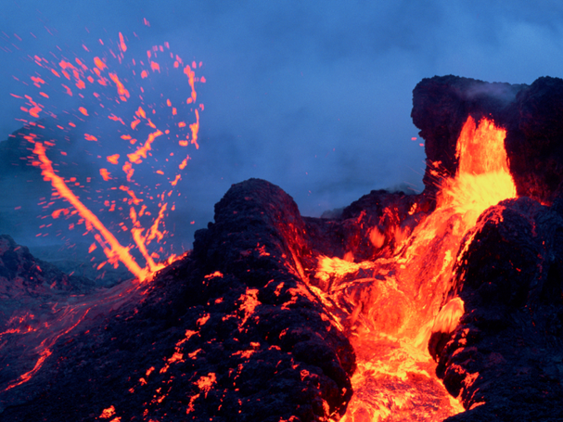
The pains of death surrounded me, And the pangs of Sheol laid hold of me; I found trouble and sorrow. Then I called upon the name of the LORD: "O LORD, I implore You, deliver my soul!" — Psalms 116:3-4
LORD
call
upon
LORD

Slide 10
Gracious is the LORD, and righteous; Yes, our God is merciful. The LORD preserves the simple; I was brought low, and He saved me. Return to your rest, O my soul, For the LORD has dealt bountifully with you. — Psalms 116:5-7
LORD
truth
submit
LORD
LORD
LORD
LORD
faith
Return to your rest
saved me
LORD

Slide 11
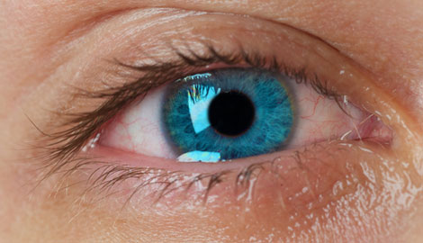
For You have delivered my soul from death, My eyes from tears, And my feet from falling. I will walk before the LORD In the land of the living. I believed, therefore I spoke, "I am greatly afflicted." — Psalms 116:8-10
delivered
from death
LORD
LORD
living
I believed
afflicted

Slide 12
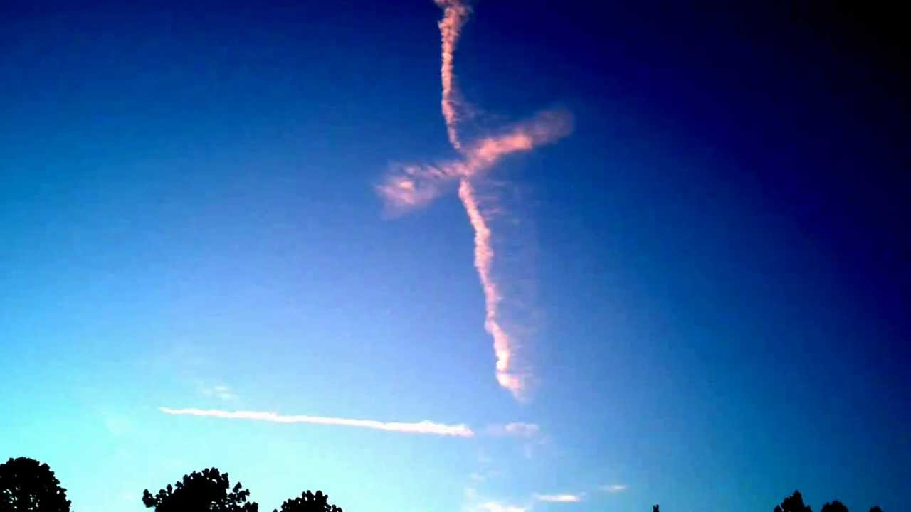
I said in my haste, "All men are liars." What shall I render to the LORD For all His benefits toward me? I will take up the cup of salvation, And call upon the name of the LORD. I will pay my vows to the LORD Now in the presence of all His people. — Psalms 116:11-14
I said in my haste, "All men are liars." What shall I render to the LORD For all His benefits toward me? I will take up the cup of salvation, And call upon the name of the LORD. I will pay my vows to the LORD Now in the presence of all His people. — Psalms 116:11-14
LORD
LORD
LORD
take up
faith
call
LORD
public confession

Slide 13
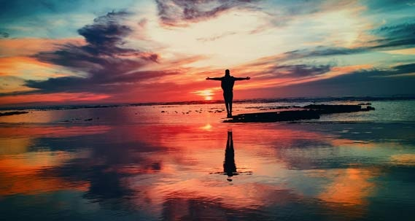
Precious in the sight of the LORD Is the death of His saints. O LORD, truly I am Your servant; I am Your servant, the son of Your maidservant; You have loosed my bonds. I will offer to You the sacrifice of thanksgiving, And will call upon the name of the LORD. — Psalms 116:15-17
LORD
LORD
LORD
offer
thanksgiving
call
LORD
LORD

Slide 14
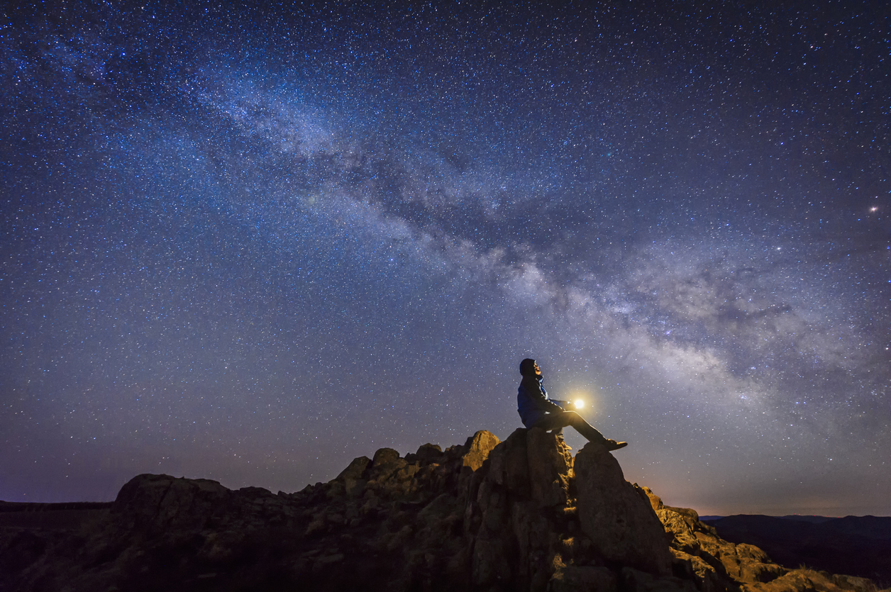
For in the time of trouble He shall hide me in His pavilion; In the secret place of His tabernacle He shall hide me; He shall set me high upon a rock. And now my head shall be lifted up above my enemies all around me; Therefore I will offer sacrifices of joy in His tabernacle; I will sing, yes, I will sing praises to the LORD. — Psalms 27:5-6
womb of His love
set me high
O LORD
thankful
offer
joy
joy
joy
O
LORD

Slide 15
Hear, O LORD, when I cry with my voice! Have mercy also upon me, and answer me. When You said, "Seek My face," My heart said to You, "Your face, LORD, I will seek." Do not hide Your face from me; Do not turn Your servant away in anger; You have been my help; Do not leave me nor forsake me, O God of my salvation. — Psalms 27:7-9
LORD
LORD
O LORD
LORD
Do not turn
Bitterness
O God
faith
Notes:
Bitterness disturbs a full relationship with God.

Slide 16
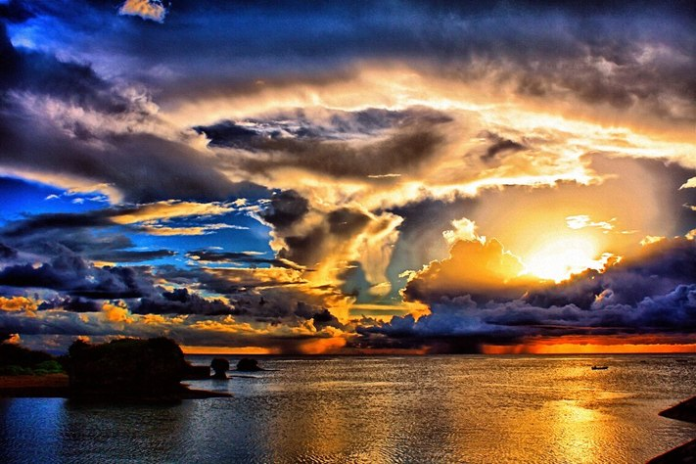
My help comes from the LORD, Who made heaven and earth. — Psalms 121:2
hope
h
p
LORD
o
e
heaven
earth

Slide 17
Happy is he who has the God of Jacob for his help, Whose hope is in the LORD his God, Who made heaven and earth, The sea, and all that is in them; Who keeps truth forever, Who executes justice for the oppressed, Who gives food to the hungry. The LORD gives freedom to the prisoners. The LORD opens the eyes of the blind; The LORD raises those who are bowed down; The LORD loves the righteous. — Psalms 146:5-8
God
God the LORD
● made heaven and earth
● keeps truth forever
● executes justice
● gives food to the hungry
● gives freedom to the prisoners
● opens the eyes of the blind
● raises those who are bowed down
● loves the righteous
hope
the LORD
made heaven and earth
keeps
truth forever
executes justice
gives food to the
hungry
gives freedom to the
prisoners
opens the eyes of the
blind
raises those who are
bowed down
loves the
righteous

Slide 18
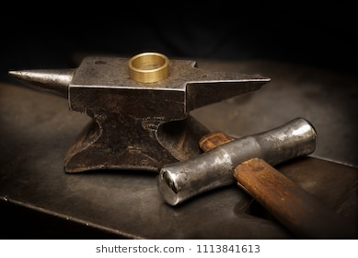
Everyone helped his neighbor, And said to his brother, "Be of good courage!" So the craftsman encouraged the goldsmith; He who smooths with the hammer inspired him who strikes the anvil, Saying, "It is ready for the soldering"; Then he fastened it with pegs, That it might not totter. — Isaiah 41:6-7
Everyone helped

Slide 19
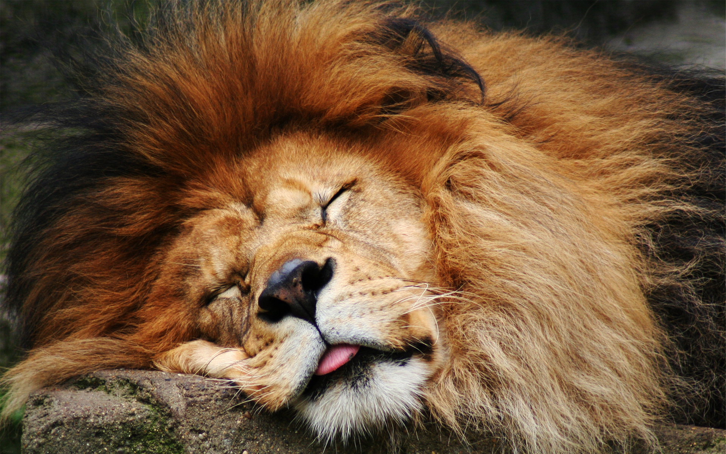
He delivers and rescues, And He works signs and wonders In heaven and on earth, Who has delivered Daniel from the power of the lions. — Daniel 6:27
He delivers and rescues

Slide 20
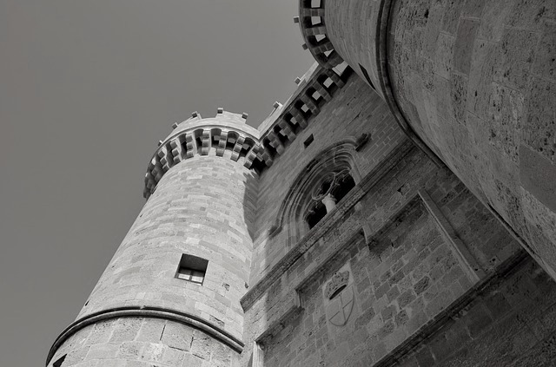
The LORD is good, A stronghold in the day of trouble; And He knows those who trust in Him. — Nahum 1:7
He knows
in
trust in Him

Slide 21
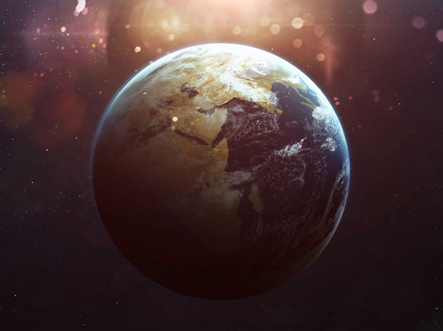
Jesus answered them, "Do you now believe? "Indeed the hour is coming, yes, has now come, that you will be scattered, each to his own, and will leave Me alone. And yet I am not alone, because the Father is with Me. "These things I have spoken to you, that in Me you may have peace. In the world you will have tribulation; but be of good cheer, I have overcome the world." — John 16:31-33
b
believe?
l
each to his own
I am not alone
faith
Father is with Me
able
Christians have a higher vision
a
e
Notes:
Christians have a higher vision

Slide 22
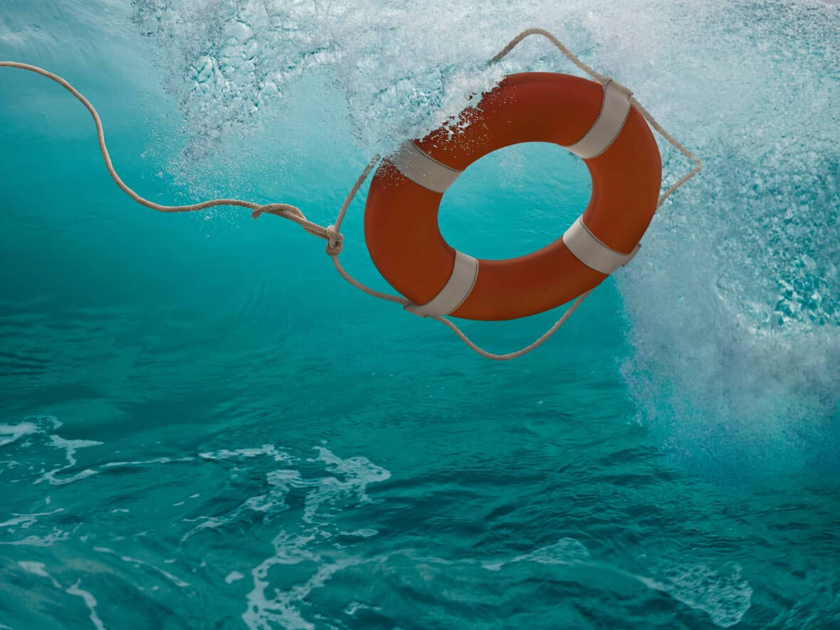
No temptation has overtaken you except such as is common to man; but God is faithful, who will not allow you to be tempted beyond what you are able, but with the temptation will also make the way of escape, that you may be able to bear it. — 1st Corinthians 10:13
God is faithful
able

Slide 23
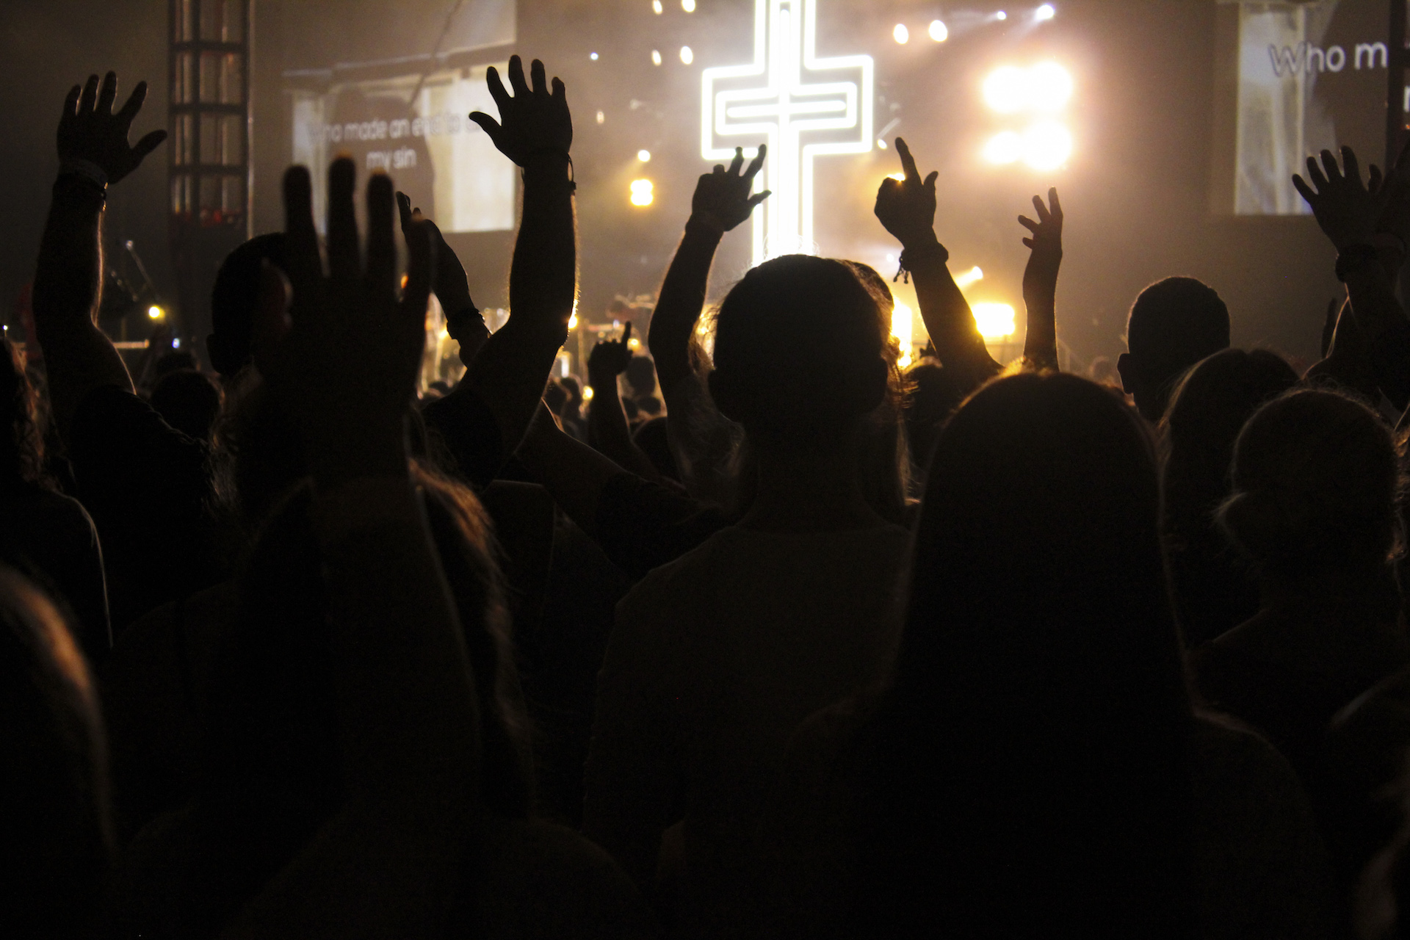
For the LORD takes pleasure in His people; He will beautify the humble with salvation. Let the saints be joyful in glory; Let them sing aloud on their beds. — Psalms 149:4-5
humble with salvation
faith
in
ai
joyful in glory
th
f

Slide 24
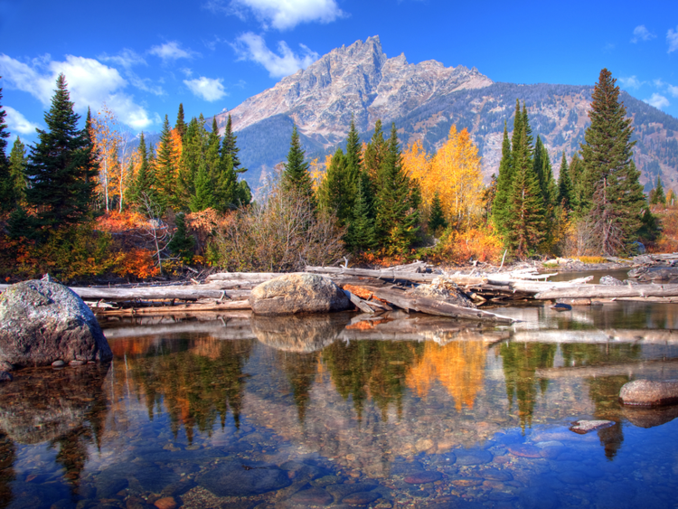
Not that we have dominion over your faith, but are fellow workers for your joy; for by faith you stand. — 2nd Corinthians 1:24
d
said
faith
faith
by faith you stand
ai
s
Notes:
It has been said to look into yourself to examine if we are in the faith He delivered or not. Believing in men can delude one into a false sense of security.

Slide 25
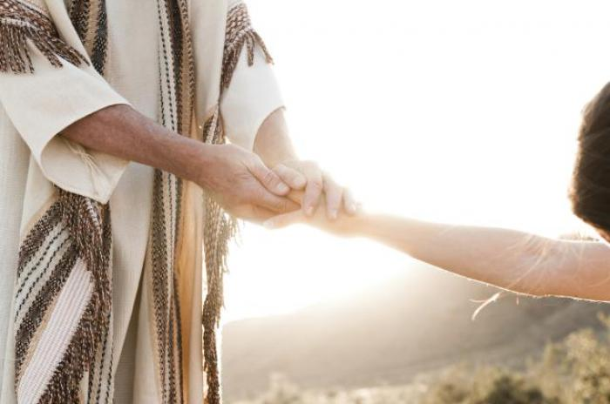
Let your conduct be without covetousness; be content with such things as you have. For He Himself has said, "I will never leave you nor forsake you." So we may boldly say: "The LORD is my helper; I will not fear. What can man do to me?" — Hebrews 13:5-6
Let your conduct be without covetousness; be content with such things as you have. For He Himself has said, "I will never leave you nor forsake you." So we may boldly say: "The LORD is my helper; I will not fear. What can man do to me?" — Hebrews 13:5-6
said
The LORD is my
helper; I will not fear

Slide 26
Likewise the Spirit also helps in our weaknesses. For we do not know what we should pray for as we ought, but the Spirit Himself makes intercession for us with groanings which cannot be uttered. Now He who searches the hearts knows what the mind of the Spirit is, because He makes intercession for the saints according to the will of God. And we know that all things work together for good to those who love God, to those who are the called according to His purpose. — Romans 8:26-28
Spirit
Spirit
helps
do not know
faith
For whatever is born of God overcomes the world. And this is the victory that has overcome the world -- our faith. — 1st John 5:4
Spirit
PEACE
His Will
Spirit
faith
intercession
God
trust
for good to those who love
God
called according
to His purpose

Slide 27
→ His eyes and ears realize cries of the righteous
→ The Lord delivers the righteous from their troubles
→ We need to ask for strength against souls who hate
→ It is through striving that we return to peace in Him
→ In contempt we become cynically untrusting
→ Sacrifices of thanksgiving & joy is healing He gives
→ Freedom in vision comes to who love the Lord
→ Success in life is only achieved through helping
→ God knows who puts their trust in Him
→ Each of us alone must overcome temptations
→ Temptations are overcome when trust is in Him
→ It is by faith that a person can stand for joy of God
→ With content confidence in God, what can man do?
The help of God delivers us back to Him
The help of God delivers us back to Him
Notes:
The help of God delivers us back to Him

Slide 29
Please visit http://www.LoveFromGod.com to explore further
Ronald Bert Channel on
Notes:
Eternity never ends.

