Slide 1
Notes:
Darkness is a well of nowhere.

Slide 2
Ron Bert
FORGIVENESS
June 18, 2017
Notes:
Forgiveness is key in understanding God and what He expects of us. Forgiveness is an integral part of our faith as Christians.

Slide 3
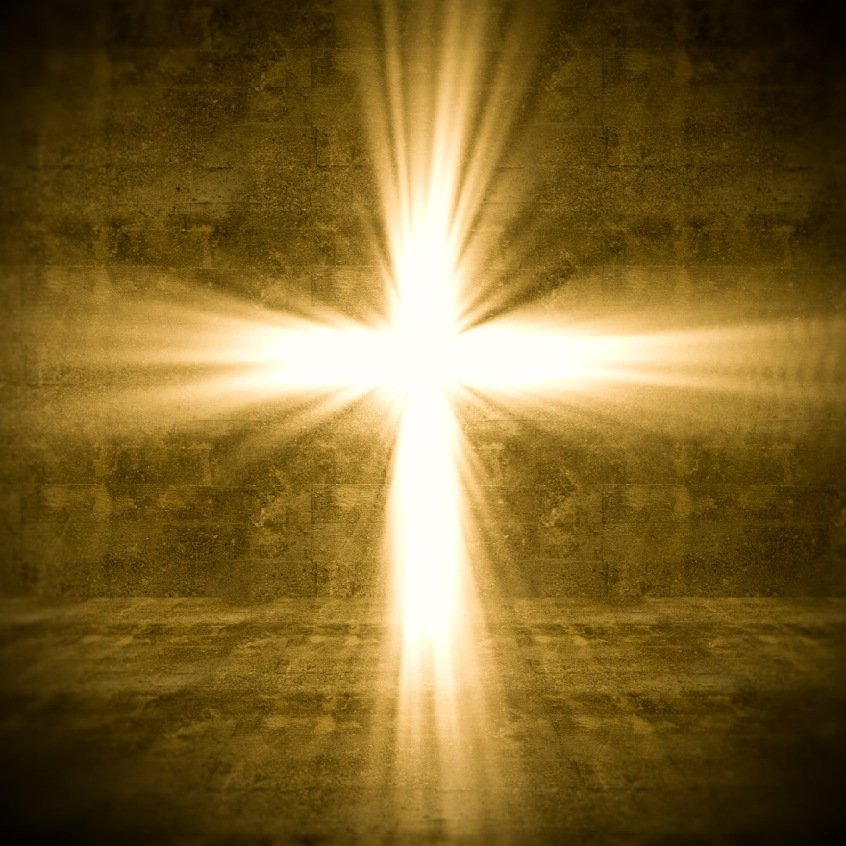
"To the Lord our God belong mercy and forgiveness, though we have rebelled against Him." — Daniel 9:9
mercy and forgiveness
mercy and forgiveness
rebelled against Him
Notes:
In rebellion against God, His mercy and forgiveness remain as offered to each of us. He is the source we need to consider.

Slide 4
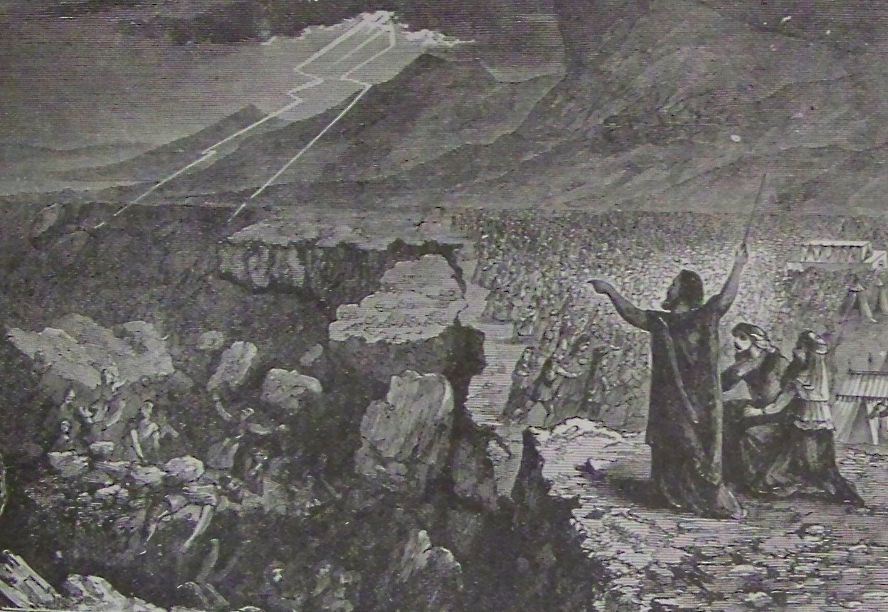
"But they and our fathers acted proudly, Hardened their necks, And did not heed Your commandments. They refused to obey, And they were not mindful of Your wonders That You did among them. But they hardened their necks, And in their rebellion They appointed a leader To return to their bondage. But You are God, Ready to pardon, Gracious and merciful, Slow to anger, Abundant in kindness, And did not forsake them." — Nehemiah 9:16-17
acted proudly
"But they and our fathers acted proudly, Hardened their necks, And did not heed Your commandments. They refused to obey, And they were not mindful of Your wonders That You did among them. But they hardened their necks, And in their rebellion They appointed a leader To return to their bondage. But You are God, Ready to pardon, Gracious and merciful, Slow to anger, Abundant in kindness, And did not forsake them." — Nehemiah 9:16-17
acted proudly
did not heed
did not heed
GOD IS FORGIVING PEOPLE WHO ARE NOT WORTHY
FORGIVENESS IS NOT NECESSARILY DESERVING, BECAUSE ONE SUDDENLY BECOMES WORTHY
Notes:
God is forgiving a people who are not worthy, the Israelites leaving Egypt. Forgiveness is not necessarily deserving because one suddenly becomes worthy.

Slide 5
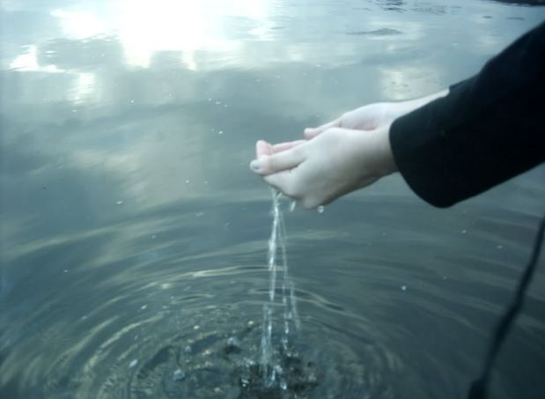
"But I had concern for My holy name, which the house of Israel had profaned among the nations wherever they went. Therefore say to the house of Israel, 'Thus says the Lord GOD: "I do not do this for your sake, O house of Israel, but for My holy name's sake, which you have profaned among the nations wherever you went. And I will sanctify My great name, which has been profaned among the nations, which you have profaned in their midst; and the nations shall know that I am the LORD," says the Lord GOD, "when I am hallowed in you before their eyes. For I will take you from among the nations, gather you out of all countries, and bring you into your own land. Then I will sprinkle clean water on you, and you shall be clean; I will cleanse you from all your filthiness and from all your idols." — Ezekiel 36:21-25
I do not do this for your sake
I do not do this for your sake
but for My holy name’s sake
but for My holy name’s sake
Notes:
God forgave those unworthy to show His nature and righteousness.

Slide 6
"Then you will remember your evil ways and your deeds that were not good; and you will loathe yourselves in your own sight, for your iniquities and your abominations. Not for your sake do I do this," says the Lord GOD, "let it be known to you. Be ashamed and confounded for your own ways, O house of Israel!" Thus says the Lord GOD: "On the day that I cleanse you from all your iniquities, I will also enable you to dwell in the cities, and the ruins shall be rebuilt." — Ezekiel 36:31-33
remember your evil ways
remember your evil ways
GOD FORGAVE TO SHOW HIS RIGHTEOUSNESS AND TO SHOW HIS NATURE
Not for
Not for
your sake do I do this
your sake do I do this
WE FORGIVE TO SHOW OUR NATURE REVEALING RIGHTEOUSNESS
Notes:
He did this not only to show Himself, but so we could see our own wicked ways in rebellion against Him, and to repent in thankfulness for Him. His nature shows us what He expects in our own nature.

Slide 7
For the flesh lusts against the Spirit, and the Spirit against the flesh; and these are contrary to one another, so that you do not do the things that you wish. — Galatians 5:17
flesh
against the
Spirit
you do not
so
hat
you do
flesh against the Spirit
so you do what you do not wish
w
wish
Notes:
It is hard to obey the spirit as the flesh wars against our better judgment. Carnal desires go against what is righteous. Many find an unforgiving heart easier, rather than forgiving one who has violated you. God made a decision to forgive the unworthy to expose who He was. Forgiveness is not a feeling, it is a decision. God did not feel good about those He forgave. One may never feel good against the perpetrator. Forgiveness releases anger and frees one to love. It is done to heal yourself, and it is for you, more than the offender. It is a temptation not to hold a forgiving heart, and it goes against nature not to have one. It is a way of living.

Slide 8
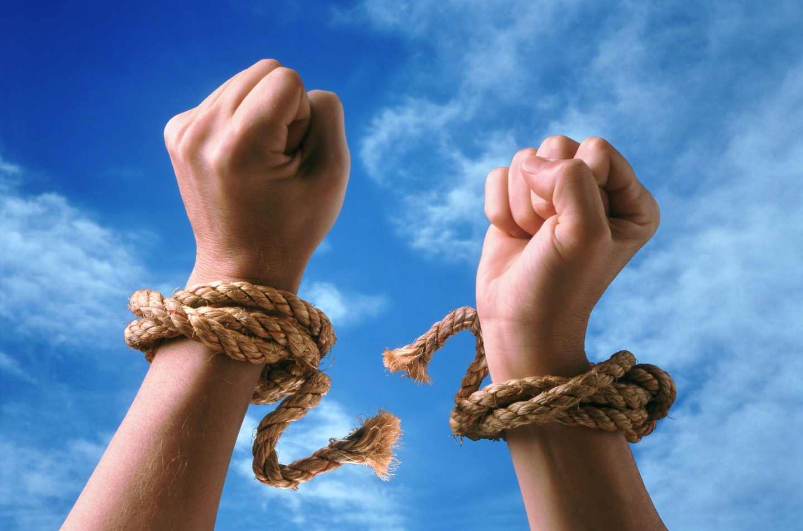
ONE MAY NEVER FEEL GOOD AGAINST THE PERPETRATOR
FORGIVENESS IS NOT A FEELING, IT IS A DECISION.
FORGIVENESS RELEASES ANGER AND FREES ONE TO LOVE
IT IS A WAY OF LIVING

Slide 9
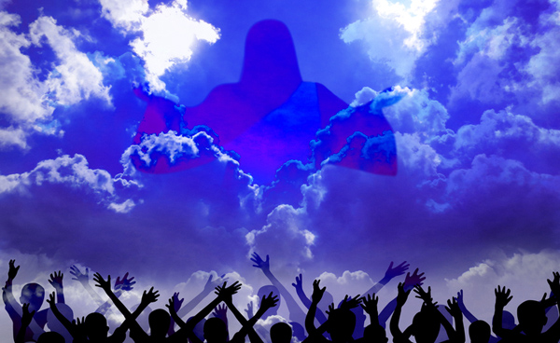
Then Peter came to Him and said, "Lord, how often shall my brother sin against me, and I forgive him? Up to seven times?" Jesus said to him, "I do not say to you, up to seven times, but up to seventy times seven. "Therefore the kingdom of heaven is like a certain king who wanted to settle accounts with his servants. And when he had begun to settle accounts, one was brought to him who owed him ten thousand talents. But as he was not able to pay, his master commanded that he be sold, with his wife and children and all that he had, and that payment be made. The servant therefore fell down before him, saying, 'Master, have patience with me, and I will pay you all.' Then the master of that servant was moved with compassion, released him, and forgave him the debt. — Matthew 18:21-27
490
forgave him the debt
forgave him the debt
Notes:
Again, to know God is to learn of His ways in what has been written. Seventy times seven is 490. It is a principle of heart, always ready to forgive.

Slide 10
"But that servant went out and found one of his fellow servants who owed him a hundred denarii; and he laid hands on him and took him by the throat, saying, 'Pay me what you owe!' So his fellow servant fell down at his feet and begged him, saying, 'Have patience with me, and I will pay you all.' And he would not, but went and threw him into prison till he should pay the debt. So when his fellow servants saw what had been done, they were very grieved, and came and told their master all that had been done. Then his master, after he had called him, said to him, 'You wicked servant! I forgave you all that debt because you begged me. Should you not also have had compassion on your fellow servant, just as I had pity on you?' And his master was angry, and delivered him to the torturers until he should pay all that was due to him. So My heavenly Father also will do to you if each of you, from his heart, does not forgive his brother his trespasses." — Matthew 18:28-35
torture
from his heart, does not forgive
from his heart, does not forgive
Notes:
The Word warns against a bitter heart. An unforgiving heart is a tortuous thing.

Slide 11
"And whenever you stand praying, if you have anything against anyone, forgive him, that your Father in heaven may also forgive you your trespasses. But if you do not forgive, neither will your Father in heaven forgive your trespasses." — Mark 11:25-26
against anyone
against anyone
X
peace
If you do not forgive
if you do not forgive
Notes:
As God forgave us, we are now in a state of temporary transience. He expects that we show the same character, and it is by His nature that we are shown what is best for us, in obtaining that coveted pureness of heart, in all good conscience. Without forgiveness, love is all but elusive.

Slide 12
"And forgive us our debts, As we forgive our debtors. And do not lead us into temptation, But deliver us from the evil one. For Yours is the kingdom and the power and the glory forever. Amen. For if you forgive men their trespasses, your heavenly Father will also forgive you. But if you do not forgive men their trespasses, neither will your Father forgive your trespasses." — Matthew 6:12-15
forgive
forgive
forgive
forgive
if you do not forgive
forgive
if you do not forgive
forgive
Notes:
Forgiveness of others is a big deal with God, and it hinges on how He will judge us.

Slide 13
"Take heed to yourselves. If your brother sins against you, rebuke him; and if he repents, forgive him. And if he sins against you seven times in a day, and seven times in a day returns to you, saying, 'I repent,' you shall forgive him." — Luke 17:3-4
Take heed
forgive
forgive
Notes:
How BIG is the warning not to fall into a bitter heart. Compassion for others who would attempt to be genuine should never be turned away. This is the command from God.

Slide 14
For judgment is without mercy to the one who has shown no mercy. Mercy triumphs over judgment. — James 2:13
IT IS ABOUT MERCY, NOT INSIGNIFICANCE WHERE JUSTICE DESERVES PUNISHMENT
'The LORD is longsuffering and abundant in mercy, forgiving iniquity and transgression; but He by no means clears the guilty, visiting the iniquity of the fathers on the children to the third and fourth generation.' — Numbers 14:18
Mercy triumphs over judgment
by no means clears the guilty
by no means clears the guilty
Mercy triumphs over judgment
THERE IS CONSEQUENCES
FOR OUR ACTIONS
Notes:
It is about mercy, not insignificance where justice deserves punishment. God declares that the guilty will account for their actions. There is consequences for our actions. Not being able to forgive tires a heart and divides our true relationship with God.

Slide 15
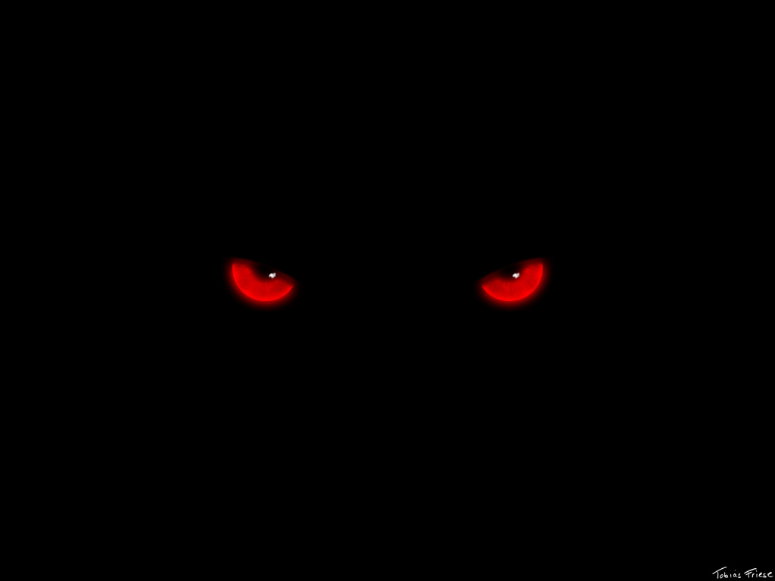
And even as they did not like to retain God in their knowledge, God gave them over to a debased mind, to do those things which are not fitting; being filled with all unrighteousness, sexual immorality, wickedness, covetousness, maliciousness; full of envy, murder, strife, deceit, evil-mindedness; they are whisperers, backbiters, haters of God, violent, proud, boasters, inventors of evil things, disobedient to parents, undiscerning, untrustworthy, unloving, unforgiving, unmerciful; who, knowing the righteous judgment of God, that those who practice such things are deserving of death, not only do the same but also approve of those who practice them. — Romans 1:28-32
unforgiving
those who practice such things are deserving of
those who practice such things are deserving of
death
death
Notes:
It is written, an unforgiving heart is worthy of death.

Slide 16
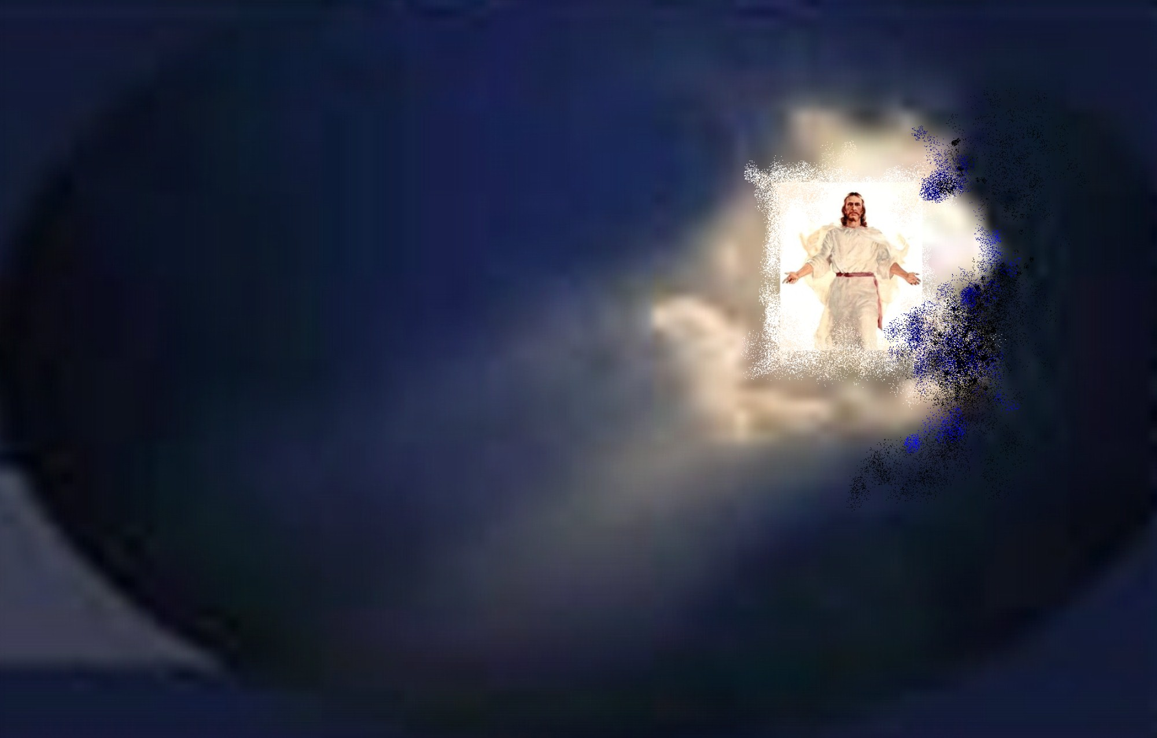
For the wages of sin is death, but the gift of God is eternal life in Christ Jesus our Lord. — Romans 6:23
Jesus
in
eternal life
Christ Jesus our Lord
Jesus
Notes:
To embrace sin knowing His will is to reject Him. It is a fact none sinful are worthy of forgiveness. God has given us a way to heal in His view. His word heals in bringing us back to our good senses. Without turning back to God and His call for goodness, we run the risk of rebellion in His sight. This is not how one wants to meet the maker of all creation.

Slide 17
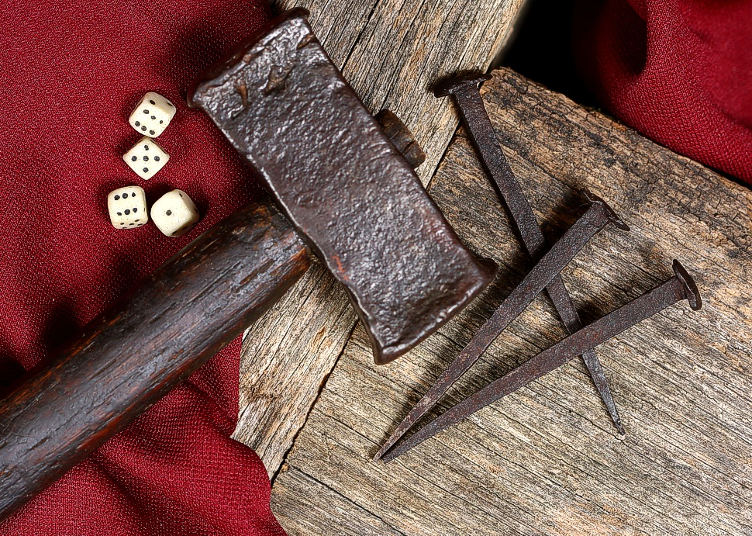
Then Jesus said, "Father, forgive them, for they do not know what they do." And they divided His garments and cast lots. — Luke 23:34
Jesus
unworthy
Notes:
Jesus did not feel good about those who murdered Him, and yet He forgave them as they did it. We too are under this temporary grace period, before His judgment will become final. Opportunity is like a string, which either can turn into a saving rope, or snapped away into the abyss. He watches as He calls for us to behave in all righteousness.

Slide 18
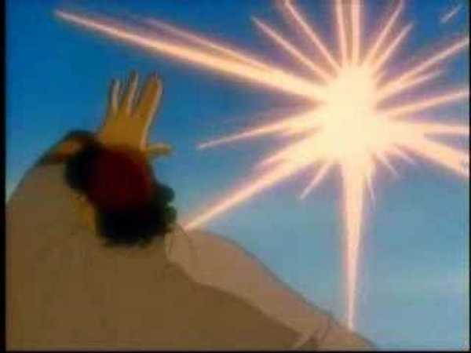
… although I was formerly a blasphemer, a persecutor, and an insolent man; but I obtained mercy because I did it ignorantly in unbelief. And the grace of our Lord was exceedingly abundant, with faith and love which are in Christ Jesus. — 1st Timothy 1:13-14
ignorant
ignorant
in
in unbelief
in unbelief
faith and love
in
Christ Jesus
Notes:
God takes into account individual hearts and it is fortunate He is the judge, and not us. May His mercy extend more than we are able. To be in Christ one must accept his love in faith.

Slide 19
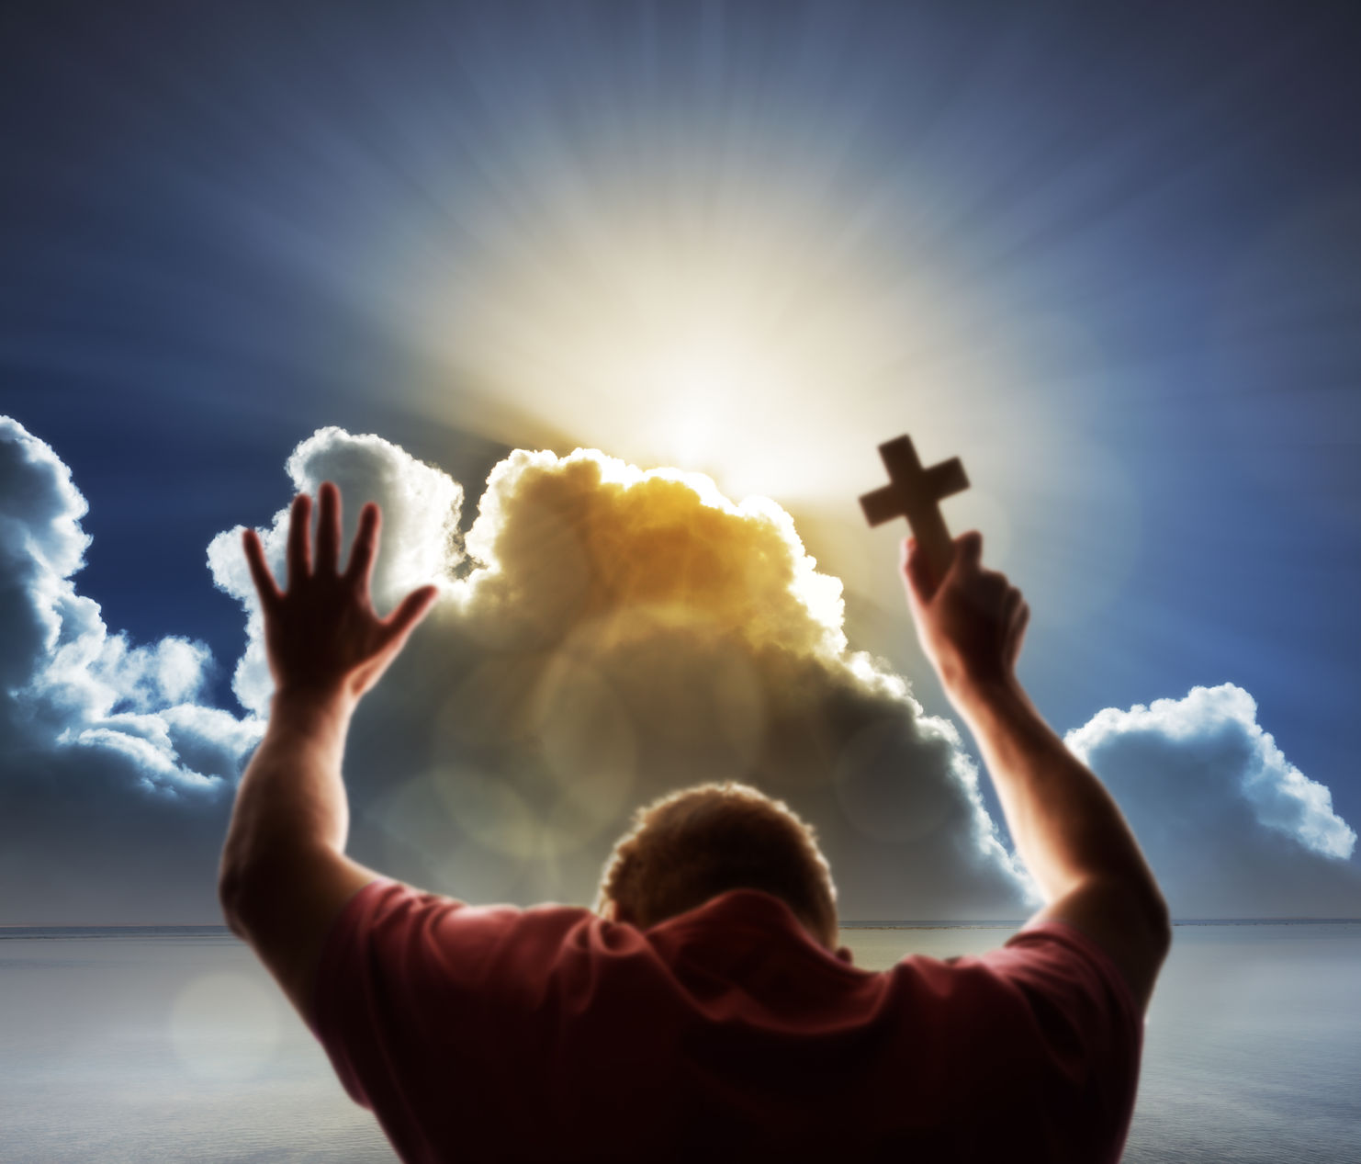
"When you spread out your hands, I will hide My eyes from you; Even though you make many prayers, I will not hear. Your hands are full of blood. Wash yourselves, make yourselves clean; Put away the evil of your doings from before My eyes. Cease to do evil, Learn to do good; Seek justice, Rebuke the oppressor; Defend the fatherless, Plead for the widow. Come now, and let us reason together," Says the LORD, "Though your sins are like scarlet, They shall be as white as snow; Though they are red like crimson, They shall be as wool." — Isaiah 1:15-18
sin
will not hear
will not hear
Wash yourselves
Wash yourselves
Cease to do evil
Learn to do good
Notes:
We know God does not hear sinners, so how can He hear us? It is when our will power becomes stronger than the flesh which deceives us. It is when we hear His call to wash ourselves and put away evil and learn to do good.

Slide 20
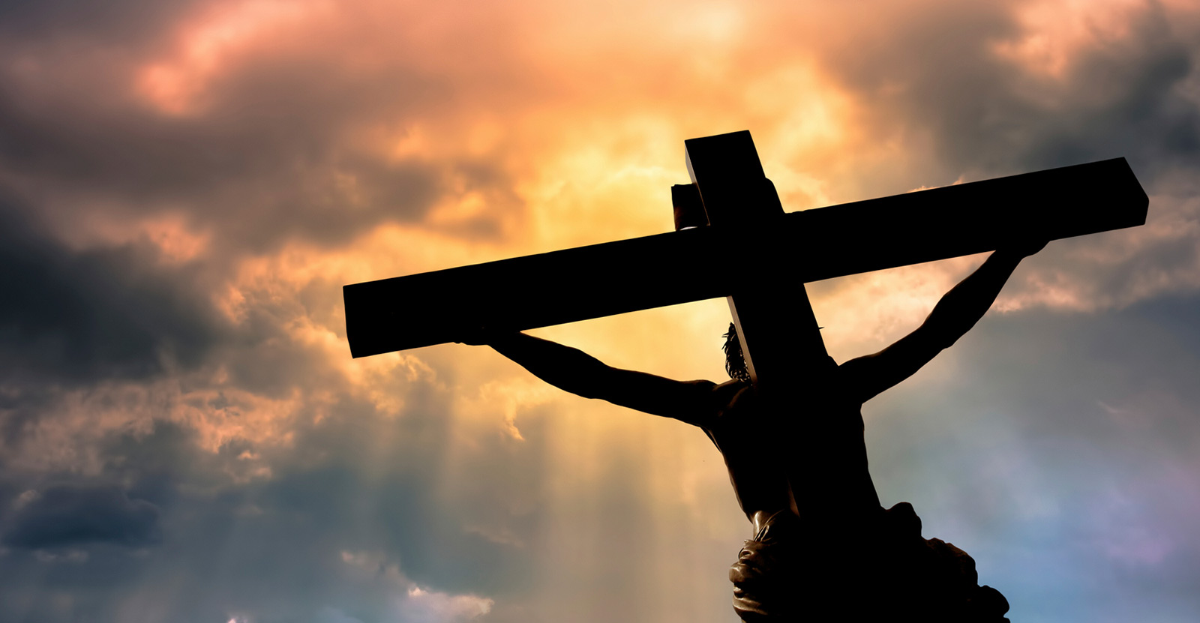
He has delivered us from the power of darkness and conveyed us into the kingdom of the Son of His love, in whom we have redemption through His blood, the forgiveness of sins. — Colossians 1:13-14
forgiveness
of sins
forgiveness
of sins
Notes:
It is in Christ that we have the forgiveness of sins.

Slide 21
"Therefore let it be known to you, brethren, that through this Man is preached to you the forgiveness of sins; and by Him everyone who believes is justified from all things from which you could not be justified by the law of Moses." — Acts 13:38-39
forgiveness
of sins
=
justified
believes
justified
justified
Notes:
To be justified in the sight of God one must believe in Jesus. This takes in to account all that He was and not to question that He was not. The trend of man is to replace God with religions and or beliefs of convenience, where accountability is nullified. In God, it is not so without Him. Do you hear that it is a fearful thing to fall into the hands of a living God?

Slide 22
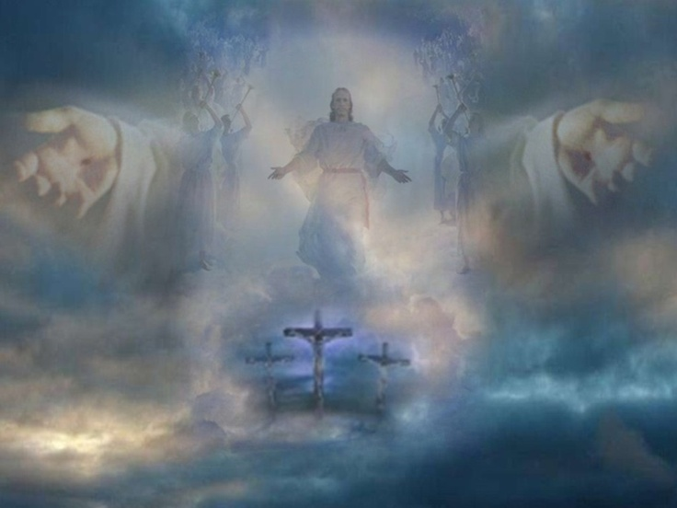
"Him God has exalted to His right hand to be Prince and Savior, to give repentance to Israel and forgiveness of sins." — Acts 5:31
repentance
+
repentance
→
forgiveness of sins
←
forgiveness of sins
Notes:
Would God not be God? It is God who is offering us forgiveness, and it has been plainly shown to those who believe as well as those who would not.

Slide 23
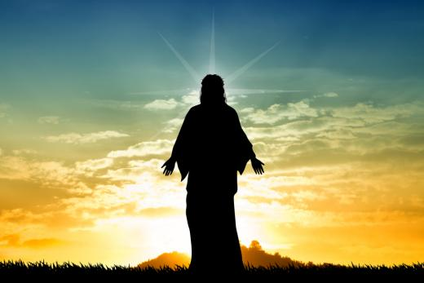
'to open their eyes, in order to turn them from darkness to light, and from the power of Satan to God, that they may receive forgiveness of sins and an inheritance among those who are sanctified by faith in Me.' — Acts 26:18
may receive
forgiveness
may receive
of sins
sanctified by faith
sanctified by faith
in
JESUS
Notes:
To be forgiven of sins, one must be sanctified by faith in Christ.

Slide 24
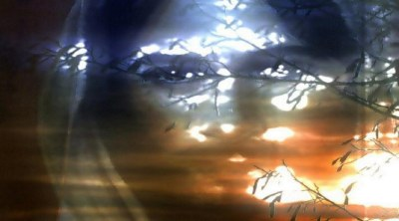
In Him we have redemption through His blood, the forgiveness of sins, according to the riches of His grace which He made to abound toward us in all wisdom and prudence, having made known to us the mystery of His will, according to His good pleasure which He purposed in Himself, — Ephesians 1:7-9
In
made known
made known
His will
His will
in
purposed in Himself
purposed in Himself
Notes:
We are not worthy of His grace, but by believing and following His ways, His will is fulfilled in our return.

Slide 25
Let all bitterness, wrath, anger, clamor, and evil speaking be put away from you, with all malice. And be kind to one another, tenderhearted, forgiving one another, just as God in Christ forgave you. — Ephesians 4:31-32
put away all:
● bitterness
● wrath
● anger
● clamor
● evil speaking
● malice
all
bitterness
wrath
anger
be to one another:
● kind
● tenderhearted
● forgiving
clamor
evil speaking
put
away
malice
be
kind
to one another
tenderhearted
forgiving
in
God in Christ
God in Christ
Christ
forgave you
forgave you
Notes:
For us to be free in spirit, we must become more like God. His word instructs us with the medical precision of a surgeon.

Slide 26
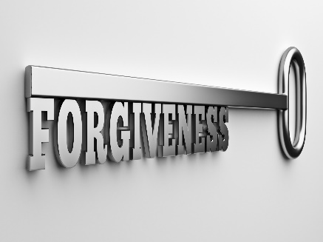
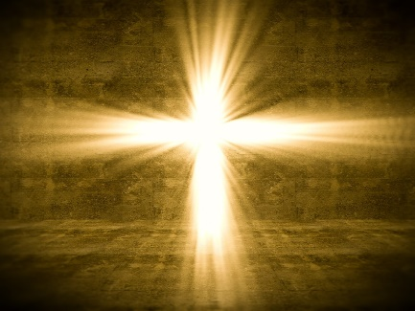
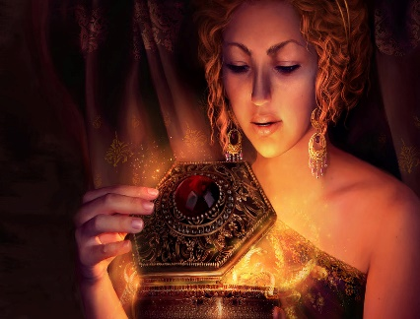
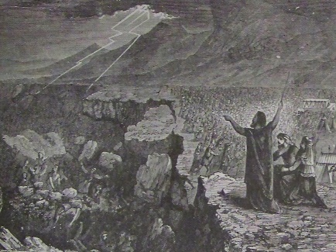
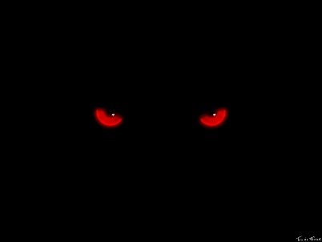
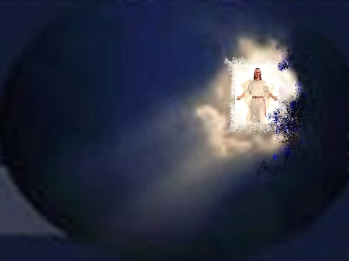
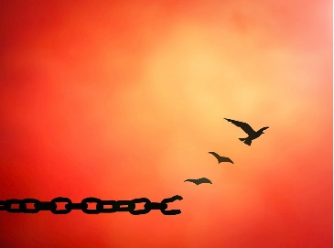

Slide 27
→ God is forgiving people who are not worthy
→ God forgives to show His righteousness & nature
→ We forgive to show our nature in righteousness
→ Forgiveness is not a feeling, it is a decision
→ Must have a forgiving heart to receive forgiveness
→ It is about mercy, not insignificance
→ Forgiveness is a way of life God demands
→ All have sinned and are worthy of death
→ We need Jesus’s sacrifice to have our sins forgiven
→ He forgives those that humbly turn to Him
→ He forgave to show us how to forgive
→ We can only be justified through belief Jesus
→ Redemption/forgiveness comes through His death
It is God who shows us how to forgive
Notes:
It is God who shows us how to forgive

Slide 28
Notes:
Darkness leaves nothing to turn on.

Slide 29
Please visit http://www.LoveFromGod.com to explore further
Ronald Bert Channel on
Notes:
Eternity never ends.

