Slide 1
Notes:
Darkness has no hint of color.

Slide 2
Authority
Authority
Authority
Ron Bert
November 4, 2018
Notes:
Authority is unimpeded actions under the constraints given by God. Authority is a condition of freedom; the ability to act exists within given liberties. God’s authority is supreme over all creation as He delegates various degrees of authority to man and or His creations in relation to their appointments in life exacted unto the physical and spiritual realms. Authority reaches out from God Himself to the smallest speck of dust. All reality has authority to be. By God’s power He sets all ordinances. As the ultimate authority and creator of all autonomous life in His image, our authoritative choices proclaim which eternal outcome will be received, in accordance with His said inspirations. It is God’s will that man exercise authority over the self, i.e. control of spirit ordered by His declarations and beneficially inspired commandments given to all mankind. Just words, and one may ask if authority is from above or below when evil seems to overwhelm good. It is by this authors vision that authority originates as a precious beacon from above guiding our paths back to the source of our creation. Our own spirit declares the authority we hold, be it gracious or despicable.

Slide 3
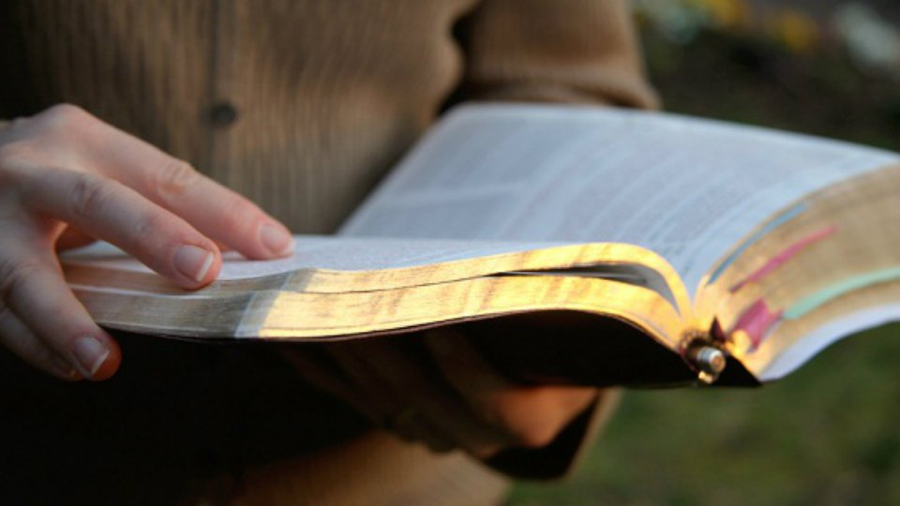
All Scripture is given by inspiration of God, and is profitable for doctrine, for reproof, for correction, for instruction in righteousness, that the man of God may be complete, thoroughly equipped for every good work. — 2nd Timothy 3:16-17
All Scripture
God
God
profitable
is
→ profitable for
● doctrine
● reproof
● correction
● instruction in righteousness
for
doctrine
reproof
instruction in
correction
God
for
righteousness
God
the man of God
in
Notes:
All Scripture is meant to bring us to God. The question is, is authority over stated, and is the Bible teachings that of generalizations, with letters specific to ancient congregations, and not intended for the greater whole? Many claim verses are to legalistic and that we are not subject to the hard line that it draws. As long as we have a spirit for God, this would and should be sufficient, and this is the faith of many current religions, or vicariously stated political movements. And so man would argue with God instructing Him as to what salvation is? It is God that has authority over man and not the reverse. One must decide and know the Bible is wholly the word of God and to dismiss parts of it is to invalidate God Himself. God is not a liar nor an author of confusion. Our God is straight forward. It is an all or nothing deal and we have been told what happens to the lukewarm as they will be spewn from His presence. Brutal but sobering. We are taught exactly what authority is through His word. Without trusting the authority of the word, it reduces to a work of fiction. To be a man of God one cannot ignore or avoid what God has delivered for us to know, unless one choses to be a man of man negating God.

Slide 4
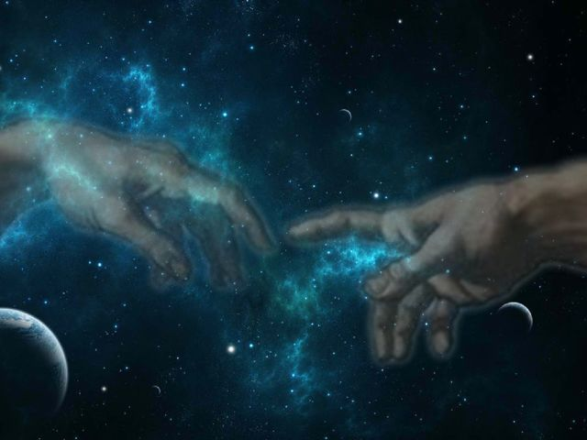
Let us hear the conclusion of the whole matter: Fear God and keep His commandments, For this is man's all. For God will bring every work into judgment, Including every secret thing, Whether good or evil. — Ecclesiastes 12:13-14
God
revealed from
For the wrath of God is revealed from heaven against all ungodliness and unrighteousness of men, who suppress the truth in unrighteousness, because what may be known of God is manifest in them, for God has shown it to them. For since the creation of the world His invisible attributes are clearly seen, being understood by the things that are made, even His eternal power and Godhead, so that they are without excuse, … — Romans 1:18-20
heaven
Let us hear the conclusion of the whole matter: Fear God and keep His commandments, For this is man's all. For God will bring every work into judgment, Including every secret thing, Whether good or evil. — Ecclesiastes 12:13-14
in
truth
God
God
of God
God
God will bring every
God has shown it to them
God
them
authority
work into judgment
clearly seen
His eternal
God
power and Godhead
Notes:
Man tends to reject the will of God if it is too inconvenient. The subtleties of living are all expressions of God’s eternal call; moment of love, truth, compassion, and knowledge of therein. The humble acknowledge and appreciate the gift of His graciousness. Straight to the conclusion of all matters is to fear God and keep His commandments. As all things will come into His judgment, and by His decree it will be; this is the ultimate unadulterated authority. As He created us in His image to witness His glory, He allows us to reach out and sense eternity both in time and spirit. To fall away from God is to fall from life itself to a self inflicted chasm of death. To see and consider death is His lesson to teach us of life in Him, or without Him. His word announces all required to know His will and hope for our return to living in Him by Him. All have been shown His untouchable expanse in order to humble true hearts to know the unknowable.

Slide 5
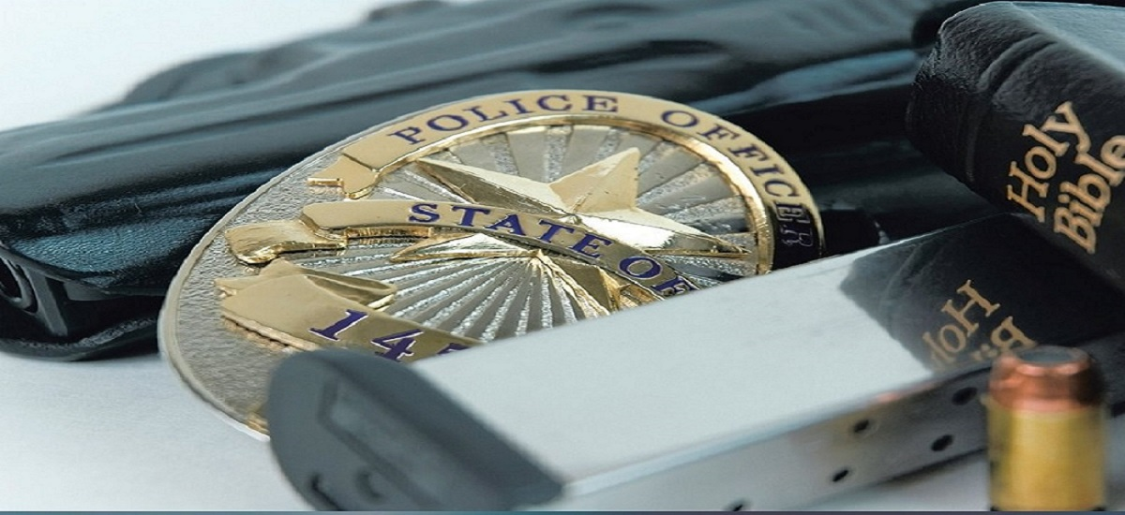
Let every soul be subject to the governing authorities. For there is no authority except from God, and the authorities that exist are appointed by God. Therefore whoever resists the authority resists the ordinance of God, and those who resist will bring judgment on themselves. — Romans 13:1-3
God
authority
God
no authority except from God
God
God
God
God
God
God
God
God
God
God
God
God
God
God
God
God
God
God
God
God
God
God
God
God
God
God
God
God
God
God
God
God
God
God
God
God
God
God
God
God
God
God
God
God
God
God
God
God
God
God
God
God
God
God
Notes:
The Bible is clear that at the top of the authority chain is God Himself, ruler and judge over all. Many of us have felt the intimidation of authority when those flashing lights of law enforcement have pulled us over. Magnify this feeling a gazillionfold as we come to bow at His feet exposed under His light. The Father, Son, and Holy Spirit, as one, need no patrol car to see our every action from the womb forward. You can run but you can’t hide. The ordinance of God is to respect authority within the bounds of obeying and respecting God. It is in fact obeying authority, when not seen, that has the greatest worth, both to God and self. Respect for authority strengthens the unity of a people. Hopes of the meek to find peace are often dashed or crushed under manipulative scheming uncaring liars who terrified by their own anger cannot see. Regretfully, man’s authority is more often enmeshed in corruption filtering immorality to all those under its’ oppressive dictates and false promises. Without respect for God, man does little for his fellow man.

Slide 6
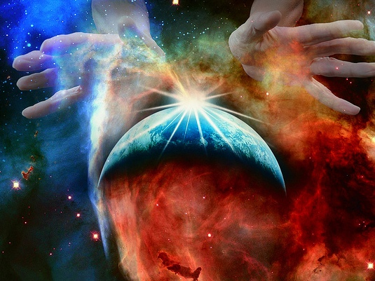
For God is the King of all the earth; Sing praises with understanding. God reigns over the nations; God sits on His holy throne. — Psalms 47:7-8
nations
God
God
God reigns
nations
authority
God
Notes:
God reigns over all nations and times from His exalted heavenly throne.

Slide 7
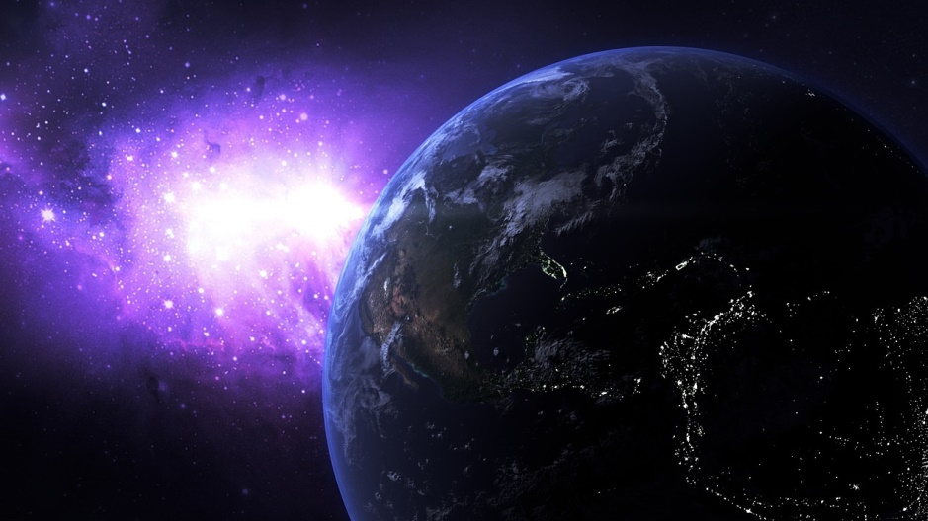
Behold, the nations are as a drop in a bucket, And are counted as the small dust on the scales; Look, He lifts up the isles as a very little thing. — Isaiah 40:15
nations
He lifts up
authority
nations
Notes:
To appreciate the grandness of God we need the perspective of something so much vaster than all of us.

Slide 8
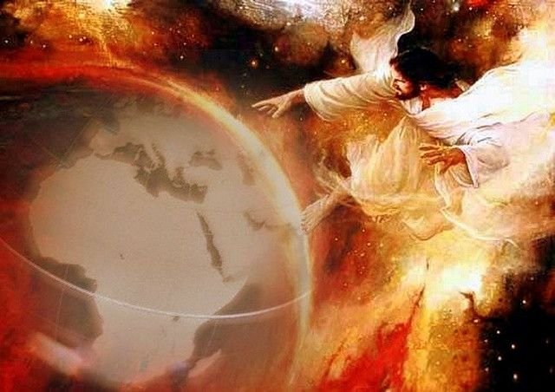
But the LORD is the true God; He is the living God and the everlasting King. At His wrath the earth will tremble, And the nations will not be able to endure His indignation. — Jeremiah 10:10
King
true
living
everlasting
King
nations
judgment
authority
Notes:
God is true, living, and everlasting, surpassing all the trivialities of the earth.

Slide 9
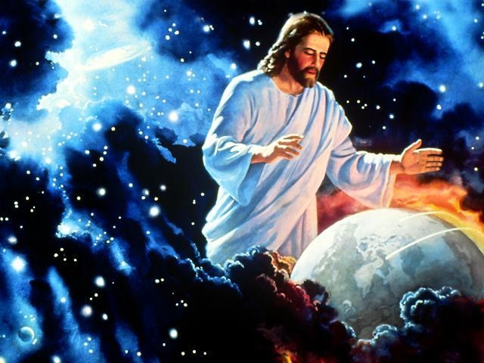
For the LORD is the great God, And the great King above all gods. In His hand are the deep places of the earth; The heights of the hills are His also. The sea is His, for He made it; And His hands formed the dry land. Oh come, let us worship and bow down; Let us kneel before the LORD our Maker. For He is our God, And we are the people of His pasture, And the sheep of His hand. Today, if you will hear His voice: — Psalms 95:3-7
LORD
God
the LORD
For the LORD is the great God, And the great King above all gods. In His hand are the deep places of the earth; The heights of the hills are His also. The sea is His, for He made it; And His hands formed the dry land. Oh come, let us worship and bow down; Let us kneel before the LORD our Maker. For He is our God, And we are the people of His pasture, And the sheep of His hand. Today, if you will hear His voice: — Psalms 95:3-7
great King above all
In
King
authority
LORD
God
LORD
our
our
Maker
God
Maker
Notes:
The Lord God is King over all. In Him we are greater than if not as He adds to those that love Him; a pulse of eternities touch. Woe to those who miss the love of God. As He sees all, we will come to Him baring all. He is the silver and gold of all creation. For all deepness knowable, how high is high, and those depths past knowing are all His.

Slide 10
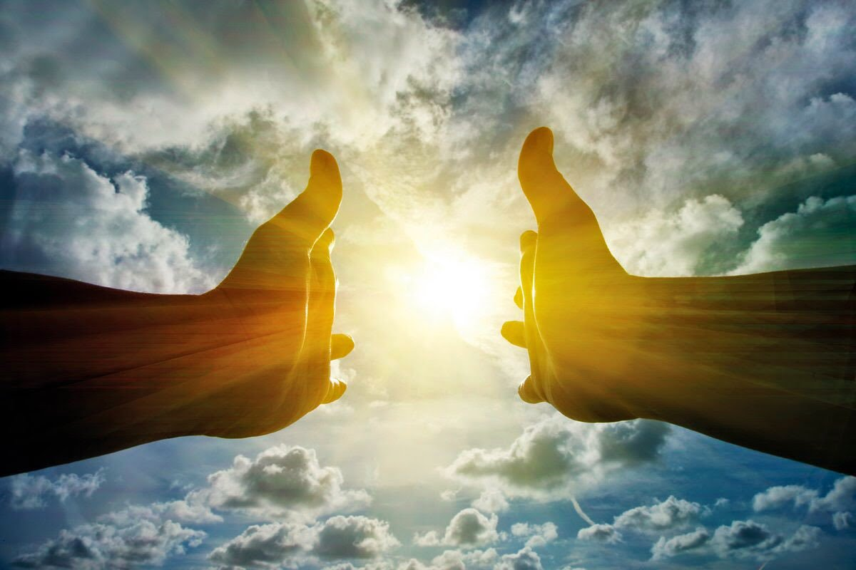
Oh, the depth of the riches both of the wisdom and knowledge of God! How unsearchable are His judgments and His ways past finding out! "For who has known the mind of the LORD? Or who has become His counselor? Or who has first given to Him And it shall be repaid to him?" For of Him and through Him and to Him are all things, to whom be glory forever. Amen. — Romans 11:33-36
the depth
past finding out
past finding out
the LORD
the LORD
LORD
.
God
For
of Him
through Him
For
authority
are all things
to Him
are all things
Amen
Notes:
Indubitably, God is past finding out as all is of Him, through Him, and to Him; glory untold! The Lord is simply unquantifiable by any of our meager means. Mankind does not have the ability to penetrate through those barrier secret’s of His light. Nothing tops God.

Slide 11
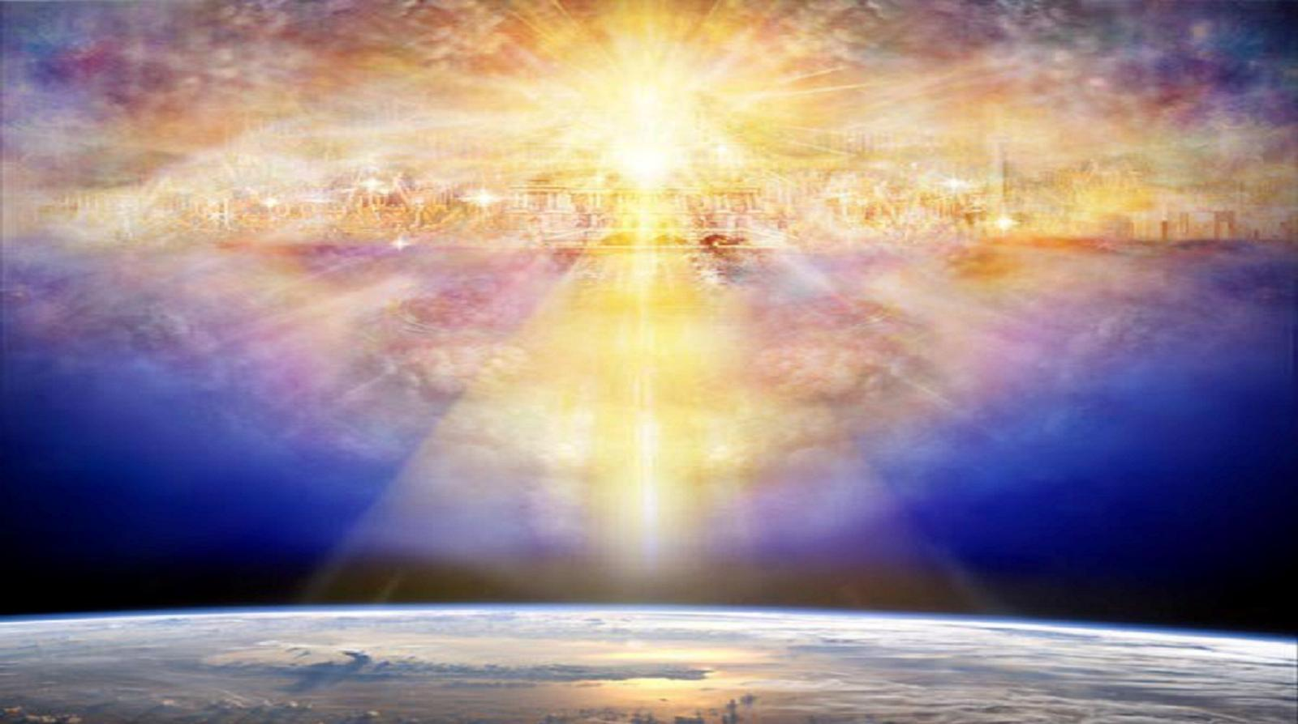
"For My thoughts are not your thoughts, Nor are your ways My ways," says the LORD. "For as the heavens are higher than the earth, So are My ways higher than your ways, And My thoughts than your thoughts." —Isaiah 55:8-9
the LORD
LORD
LORD
My ways
higher
authority
thoughts
Notes:
Untold glory cannot be expressed by the limited mind of man. The Lord has authority over so much more than we can ever know or comprehend.

Slide 12
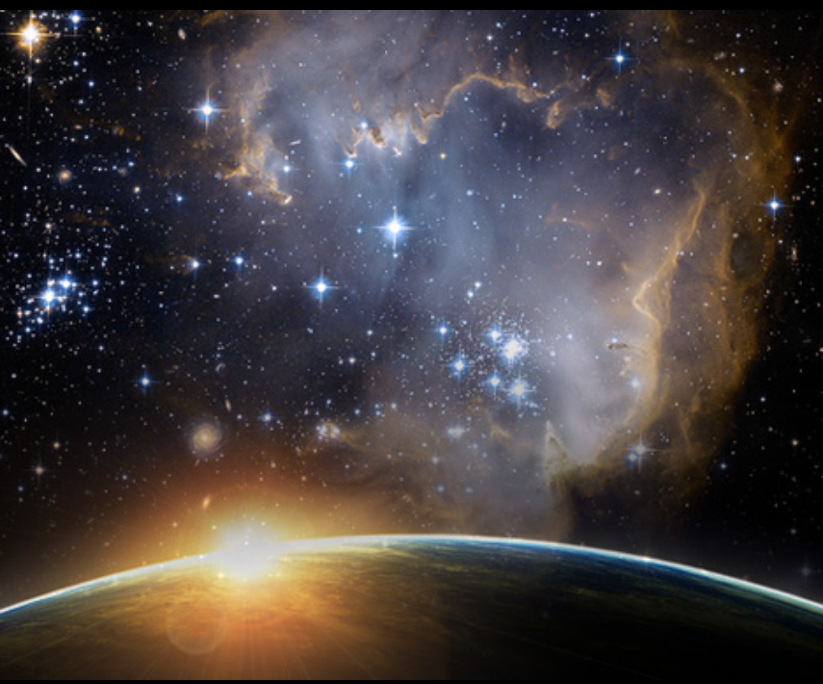
Great is our LORD, and mighty in power; His understanding is infinite. — Psalms 147:5
power
understanding
might
of the LORD the
By the word of the LORD the heavens were made, And all the host of them by the breath of His mouth. — Psalms 33:6
LORD
might
in
LORD
Inasmuch as there is none like You, O LORD (You are great, and Your name is great in might), … — Jeremiah 10:6
authority
heavens were made
in
breath
Notes:
As much as we are, it is simply unfathomable to consider all that He is. His is of authority beyond our grasp.

Slide 13
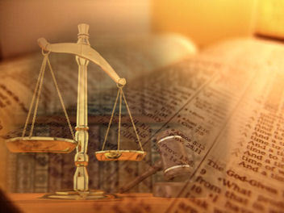
Seek the LORD while He may be found, Call upon Him while He is near. Let the wicked forsake his way, And the unrighteous man his thoughts; Let him return to the LORD, And He will have mercy on him; And to our God, For He will abundantly pardon. — Isaiah 55:6-7
LORD
LORD
LORD
return
LORD
He will have mercy
authority
abundantly pardon
pardon
Notes:
Lives are brought back into the balance when God is chosen as supreme. His ways are the ways of justice for the righteous as the upright await His appearance.

Slide 14
The eyes of the LORD are in every place, Keeping watch on the evil and the good. — Proverbs 15:3
LORD
eyes of the LORD
i
e
n
Keeping watch
h
hidden
hidden
hidden
hidden
hidden
hidden
d
d
For the ways of man are before the eyes of the LORD, And He ponders all his paths. — Proverbs 5:21
ENTER
ENTER
Notes:
Evil foolishly remains oblivious to His presence as it seeks its’ own. This is the reason for all nations and or peoples that collapse into discord, disregarding Him, as they lose respect for the Lord, and consequentially, each other. No blinking light district is hidden darkened from His view. It is the absolute truth that the Lord possesses, and with this authority of plain truth, we will all humbly come before Him. His crown is above all crowns. Knowing He sees opens a soul’s eyes to see.

Slide 15
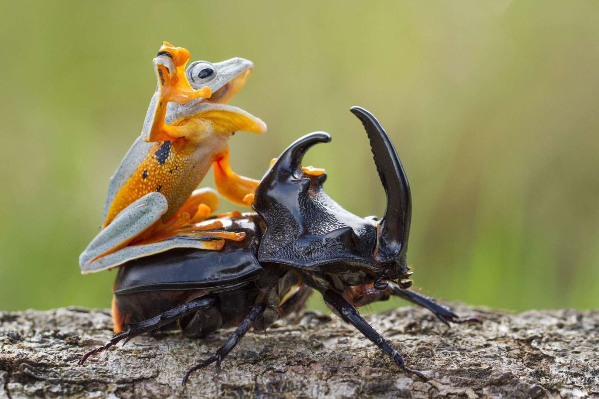
And there is no creature hidden from His sight, but all things are naked and open to the eyes of Him to whom we must give account. — Hebrews 4:13
d
r
c
hidden
e
direct
to whom we must give
i
must
t
authority
account
Notes:
However insignificant, the power of the LORD’s vision is there. We all start in a mindless state where as we grow to become conscious, and we need His direction to set our conscience if in fact eternal life is our goal and desire. Death is where laughter is heard no more. Laughter is where love resides and it is in His truth.

Slide 16
O LORD, I know the way of man is not in himself; It is not in man who walks to direct his own steps. — Jeremiah 10:23
not in man
not in man to direct his own steps
direct
to direct his own steps
Notes:
We miss the magnificence of God if we do not recognize His greatness. By recognizing the true nature of God and that we need to submit to Him, for who He is, allows for our nature to become more God like, in our feeble approach to His glory. We need His overall guidance to become the fullest illuminated life possible, all offered in Him. As the Creator of all, He is the beacon we all must reference to.

Slide 17
There is a way that seems right to a man, But its end is the way of death. — Proverbs 14:12
saved
v
a
death
There are many plans in a man's heart, Nevertheless the LORD'S counsel - that will stand. — Proverbs 19:21
not in man to direct his own steps
heart
the LORD'S
There is a way that seems right to a man, But its end is the way of death. — Proverbs 16:25
s
e
authority
counsel - that will stand
d
death
Notes:
It is when one assumes power over God as a self determining soul independent of His ordinances that the calamity of death attacks.

Slide 18
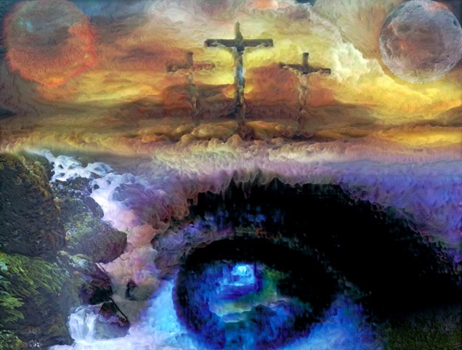
"Look to Me, and be saved, All you ends of the earth! For I am God, and there is no other. — Isaiah 45:22
saved
Look to Me
authority
I am God, and there is no other
I am God
Notes:
Looking up to God adds something greater than ourselves to our fundamental being. It is where glory rises and love flourishes. To miss the delicacies God offers, is truly, the sheer travesty of a soul; to miss such an expanse of eternal life’s wonderment itself.

Slide 19
→ All Scripture is given by inspiration of God
→ Fear God/keep His commandments/this is man's all
→ God will bring every work into judgment
→ There is no authority except from God
→ God reigns over the nations/sits on His holy throne
→ God lifts up reality as a simple thing
→ For the LORD is the great God and King above all
→ For of Him & through Him & to Him are all things
→ God is mighty in power/understanding is infinite
→ By the word/breath of God the heavens were made
→ Return to God & His mercy will abundantly pardon
→ God sees all - whom we must account; follow Him
→ Forsake evil; Look to God & be saved - no other way
His Authority is
in all of His Light
Notes:
His authority is in all of His light.

Slide 20
Notes:
Darkness is everywhere light is not.

Slide 21
Authority
Authority
Authority
2
Ron Bert
November 11, 2018
Notes:
The color of time cannot be expressed in human terms. God sees all in that timeless moment where He waits for souls committed in heart to His ways. To find our place in the authority chain is to realize we have little to none. God is the supreme authority and He has given us His word to understand this, instructing us in what He exactly expects, and who we must answer to.

Slide 22
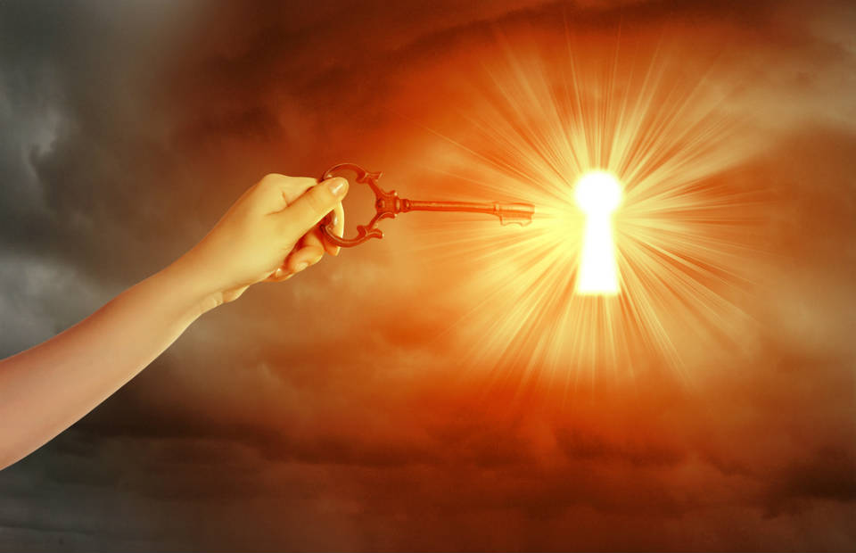
"Sanctify them by Your truth. Your word is truth." — John 17:17
LORD
truth
truth
LORD
Trust in the LORD with all your heart, And lean not on your own understanding; — Proverbs 3:5
Notes:
It is His word that sanctifies us. He is giving us the keys of His desires to be in His truth. Trusting in Him is a matter of spirit. The spirit is like a propeller, and we must pursue forward in our climb to reach the top where the truth strengthens the depth of our soul. There is no height below heaven that can cause a faithful soul to crash. Homeward bound to where our true citizenship remains.

Slide 23
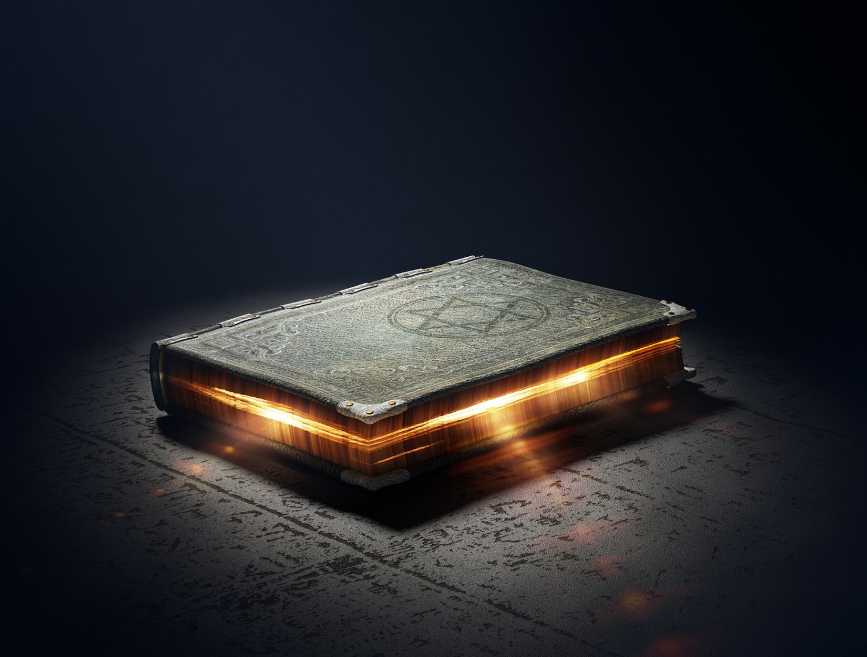
"The fear of the LORD is the beginning of wisdom, And the knowledge of the Holy One is understanding." — Proverbs 9:10
"The fear of the LORD is the beginning of wisdom, And the knowledge of the Holy One is understanding." — Proverbs 9:10
LORD
knowledge
… finding out what is acceptable to the Lord. — Ephesians 5:10
understanding
… finding out what is
. .
acceptable to the Lord.
— Ephesians 5:10
Therefore do not be unwise, but understand what the will of the LORD is. — Ephesians 5:17
Notes:
One has to dig to find the treasures within His word, and He instructs us to do just that. We are heartfelt miners filling our bags with jewels that cannot be taken away, unless we throw them away for the dark stones in and of an oblivious world. As mere pieces of His Spirit, no man is a planet unto himself.

Slide 24
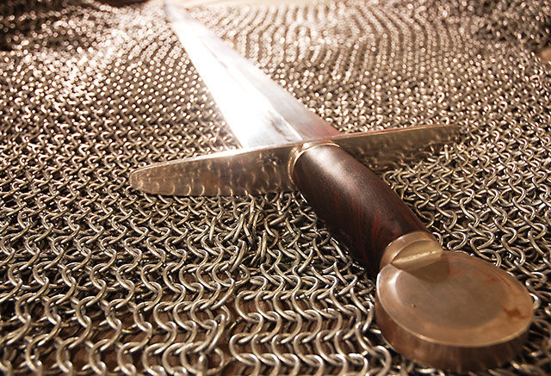
For the word of God is living and powerful, and sharper than any two-edged sword, piercing even to the division of soul and spirit, and of joints and marrow, and is a discerner of the thoughts and intents of the heart. — Hebrews 4:12
For the word of God is living and powerful, and sharper than any two-edged sword, piercing even to the division of soul and spirit, and of joints and marrow, and is a discerner of the thoughts and intents of the heart. — Hebrews 4:12
=
word of God
authority
powerful
thoughts
=
discerner of the thoughts
thoughts
thoughts
Notes:
God’s word is a gauge in relation to who we are and what we choose to think. God is asking if we consider His goodness which He has revealed to the world, and has written on the consciousness of all those who would want to be good. We take innate godly characteristics for granted as bestowed upon us in the gift of His image. Do we consider and or allow the word of God to have authority in our thoughts?

Slide 25
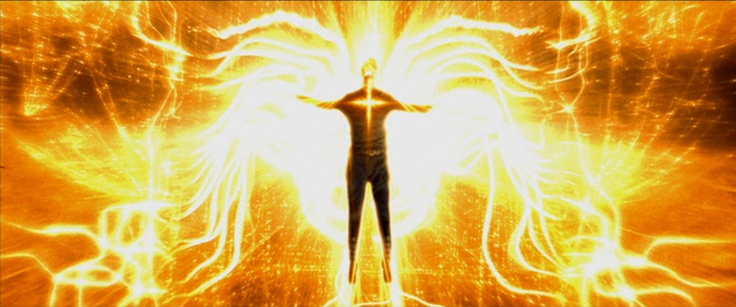
… that the God of our Lord Jesus Christ, the Father of glory, may give to you the spirit of wisdom and revelation in the knowledge of Him, the eyes of your understanding being enlightened; that you may know what is the hope of His calling, what are the riches of the glory of His inheritance in the saints, … — Ephesians 1:17
understand
knowledge
spirit of
wisdom
wisdom
thoughts
thoughts
revelation
knowledge
knowledge of Him
understanding
+
understanding
understand
enlightened
=
knowledge
Notes:
By incorporating knowledge of Christ within the wisdom that pours forth from His word, this is what develops keen understanding. What divides us as a people? Ignorance in confusion leading to outbursts of wrath is not what enlightens anyone. The peace of God can only be had by digesting His truths into the bosom of one’s heart.

Slide 26
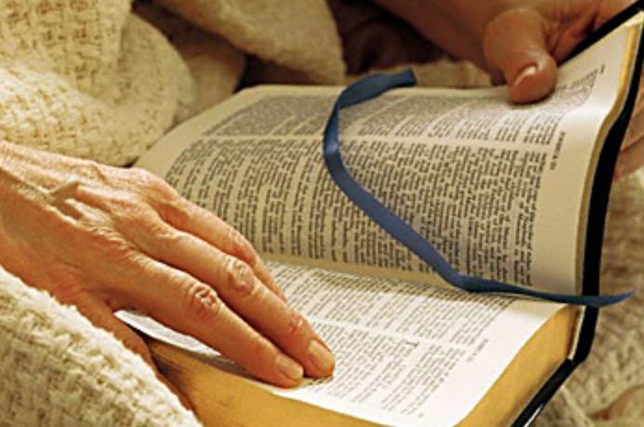
… by which, when you read, you may understand my knowledge in the mystery of Christ), which in other ages was not made known to the sons of men, as it has now been revealed by the Spirit to His holy apostles and prophets: — Ephesians 3:4-5
Spirit revealed to apostles and prophets
w
e
read
when you read
understand
knowledge
revealed
by the Spirit
Spirit
to
revealed
to
apostles and prophets
apostles and prophets
we read
Spirit
Notes:
God has told us that by reading His word we will find Him and His revelations to mankind. For our spirit to touch His, it comes by reading His word or at least by its’ audible ring. This Spirit that was revealed to the apostles and prophets comes by acquiring the knowledge delivered by the Bible and then allowing understanding to filter into our lives.

Slide 27
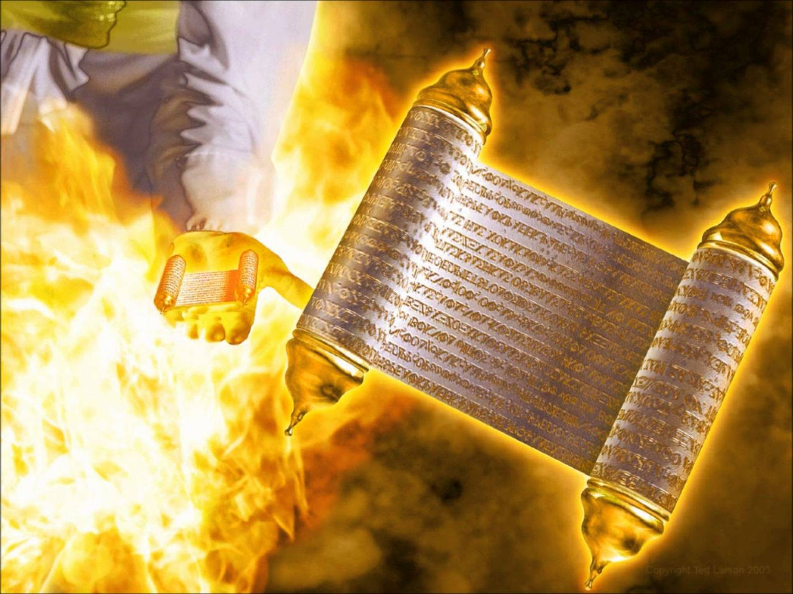
… knowing this first, that no prophecy of Scripture is of any private interpretation, for prophecy never came by the will of man, but holy men of God spoke as they were moved by the Holy Spirit. — 2nd Peter 1:20-21
insight
LORD
clarification
secretive
came by
God
holy men of God
Holy
Spirit
Spirit
Notes:
No insight of Scripture is in need of any secretive clarification. His word is, and it does not involve scheming's of man, but it is a revealing of God. Scripture is that it is, no more no less.

Slide 28
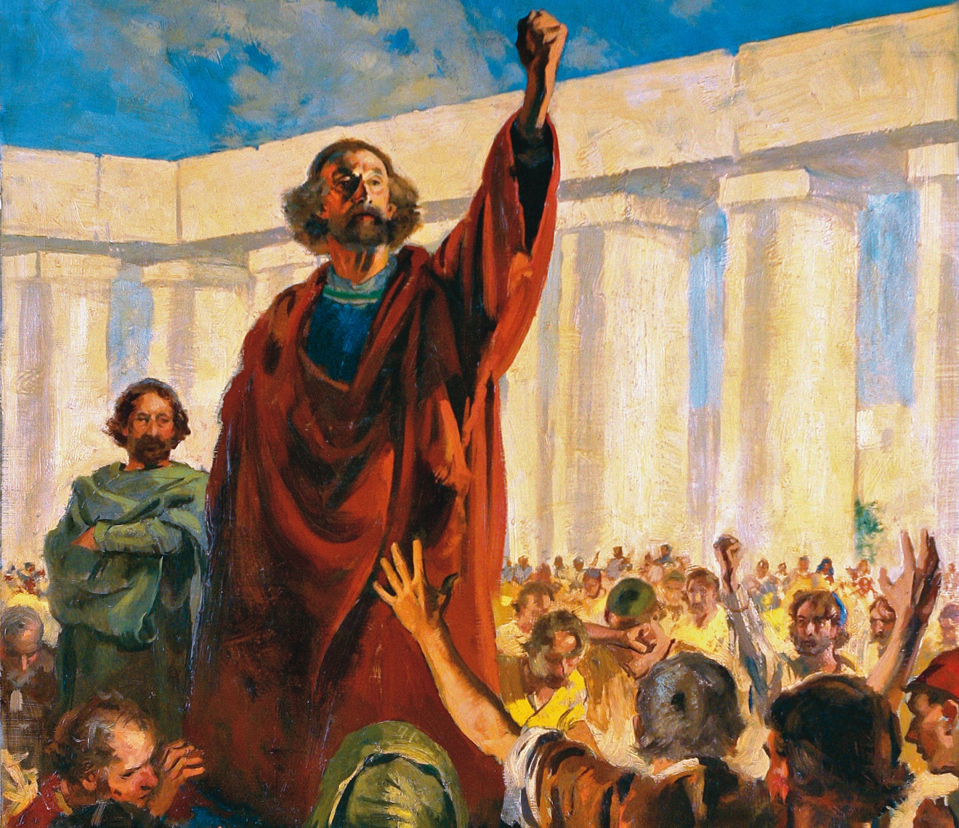
For I neither received it from man, nor was I taught it, but it came through the revelation of Jesus Christ. — Galatians 1:12
The Lord gave the word; Great was the company of those who proclaimed it: — Psalms 68:11
word
of
G
o
d
word of God
The LORD gave the word
LORD
The LORD gave the word; Great was the company of those who proclaimed it: — Psalms 68:11
The LORD gave the word; Great was the company of those who proclaimed it: — Psalms 68:11
through the revelation of Jesus
authority
Christ
Notes:
It is given to man to know God though His presence goes beyond understanding.

Slide 29
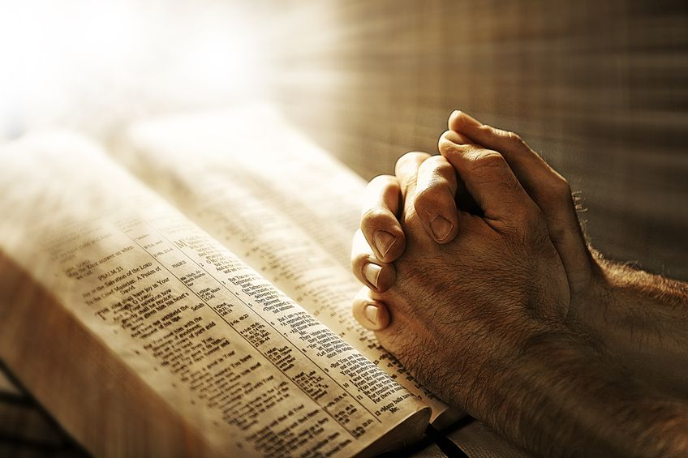
For this reason we also thank God without ceasing, because when you received the word of God which you heard from us, you welcomed it not as the word of men, but as it is in truth, the word of God, which also effectively works in you who believe. — 1st Thessalonians 2:13
receive
the word of God
word of God
you
in
truth, the word of God
in
you
Notes:
To reach a consensus concerning Biblical authority, it starts with acknowledging that the word is absolute in disclosing the truth of God and our relationship under His purposed design. Only a true believer can obtain the fruits of His blessings. One has to ask, what is in you? To acquire His word, and live by it, it has to be something pursued. Many miss His truth as fruitless desires blur the pure knowledge He wants all, in and of His creation, to have. So how about you, does the word charge the very essence of your life? How wondrous when it does when the hairs rise to Him.

Slide 30
If anyone thinks himself to be a prophet or spiritual, let him acknowledge that the things which I write to you are the commandments of the Lord. — 1st Corinthians 14:37
admit
you
I write to you
authority
commandments of the Lord
Notes:
To deny what the Bible teaches is to deny God.

Slide 31
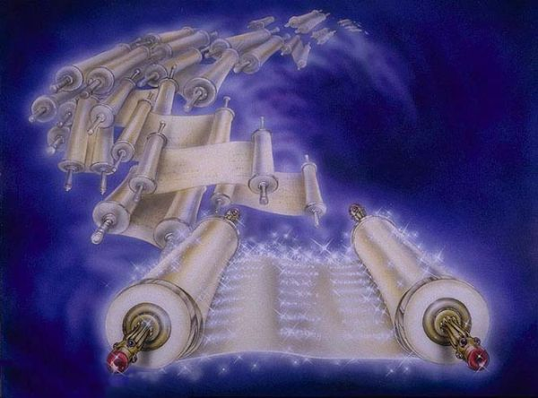
The entirety of Your word is truth, And every one of Your righteous judgments endures forever. — Psalms 119:160
The entirety of Your word is truth
The entirety of Your word is truth, And every one of Your righteous judgments endures forever. — Psalms 119:160
authority
not the author of
For God is not the author of confusion but of peace, as in all the churches of the saints. — 1st Corinthians 14:33
confusion
Notes:
Not only does the word proclaim authority, it claims credibility. Bitter hearts will always reject the message of peace through Him yet it remains for those that will have it.

Slide 32
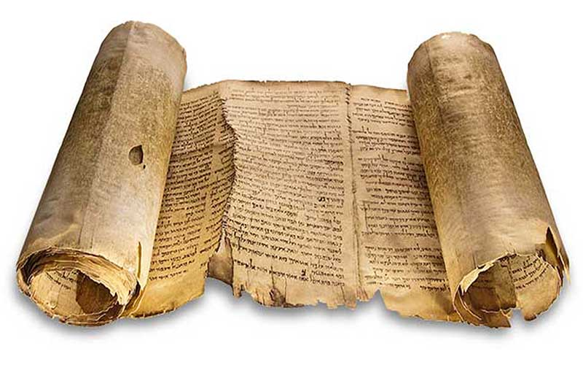
S
P
I
R
I
T
G
O
D
AU H RIT Y
AU H RI Y
AUTH RIT Y
POWER
IN WORD
AUTHOR
AUTHORIT Y
T
RU
T
H
Notes:
It is in realizing that God has given each of us life that the truth of His Spirit is revealed. Jesus has sealed the terms of our salvation for all those that would fully accept Him. Repent and be immersed in Him. Stand as a breathing living individual in God’s creation, knowing that His plan has eternal purpose. He is in fact the one that carries us all. We are of the rising dust of the earth; the mustard seed of life. We indubitably owe our lives to God; praise Him our Lord Jesus Christ and blessings untold will unfold. God’s plan is much larger than the dust that consumes us.

Slide 33
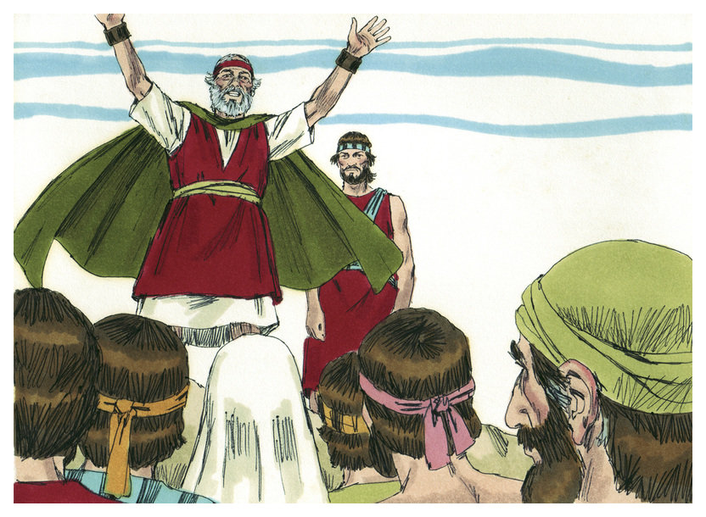
"You shall not add to the word which I command you, nor take from it, that you may keep the commandments of the LORD your God which I command you." — Deuteronomy 4:2
not
add
command
command
take
keep
commandments of the LORD
command
command
LORD
God
command
command
Notes:
Moses proclaims the excellence of God’s word in keeping to it exactly as it is. It is a warning, like a stop sign; do not add or take away from what has been given by God. It is the LORD God who has ordained this.

Slide 34
command
"Whatever I command you, be careful to observe it; you shall not add to it nor take away from it." — Deuteronomy 12:32
"Whatever I command you, be careful to observe it; you shall not add to it nor take away from it." — Deuteronomy 12:32
command
not add to it nor take away
Notes:
We are instructed to carefully observe those things delivered without deviating from His commands. It Words are given for our admonition and edification, and all meant to bring us closer to God in our understanding of Him. He does not want His given word to be shortened or added to as it is complete for His purposes. The Word is written with God’s own Life Force. He has sealed it with His own Blood and patient love.

Slide 35
For I testify to everyone who hears the words of the prophecy of this book: If anyone adds to these things, God will add to him the plagues that are written in this book; … — Revelation 22:18
For I testify to everyone who hears the words of the prophecy of this book: If anyone adds to these things, God will add to him the plagues that are written in this book; … — Revelation 22:18
if anyone takes away
… and if anyone takes away from the words of the book of this prophecy, God shall take away his part from the Book of Life, from the holy city, and from the things which are written in this book. — Revelation 22:19
word
If anyone adds to
God shall take away
authority
word
Book of Life
Notes:
He is plain in directing us to carefully observe all that has been delivered, and not to discard any of it, nor add supplements to blur its clarity. Man does not set the order, it is up to him to observe it. It is a sheer illusion when gray lines of tolerance become the molding light to His truth. Is the Bible the key to truth or is something more required; or something less, as claims are made it does not apply to modern culture? It has been repeatedly shown that to disregard or forget God’s word bring damnation upon the people. My people are destroyed for lack of knowledge.

Slide 36
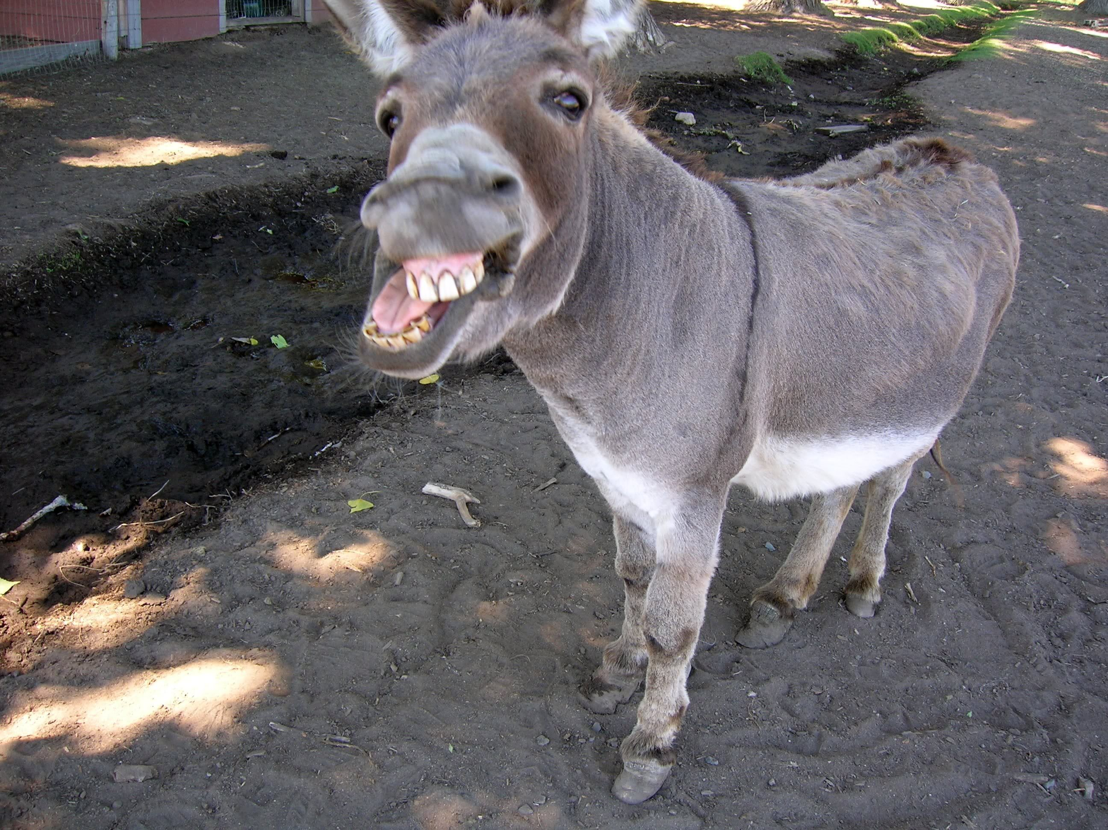
Then Balaam answered and said to the servants of Balak, "Though Balak were to give me his house full of silver and gold, I could not go beyond the word of the LORD my God, to do less or more." — Numbers 22:18
to do
not
word
go beyond the word of the LORD
to do
to do less or more
Notes:
True believers in God know that to go beyond what He has instructed invites fearful consequences. For both intentions of good and or bad, God does not want His word diluted by either of these types of additions. We see how the secular world has nonchalantly crept into the church, in both good and bad ways, i.e., ice cream parlors, sports centers, gift shops, all seem good and immoral behaviors deemed acceptable are counter to what God has announced. God wants us to worship Him from the inside where our thoughts focus on Him, and not on the outside where substitutions, good and bad, take place superseding His simple call to come clean, pure, and undefiled naked in spirit before Him. The times may have changed but His condemnation of human preference over His ways will end as it always has, in the death of those disobedient. The wise hear and obey.

Slide 37
"Only be strong and very courageous, that you may observe to do according to all the law which Moses My servant commanded you; do not turn from it to the right hand or to the left, that you may prosper wherever you go." — Joshua 1:7
observe to do
to do
do not turn
do not turn
right
left
Notes:
God does not want His people (children) to be weak but to draw strength from His presence (word). Instructions to observe what He has proclaimed is made clear numerously throughout His word.

Slide 38
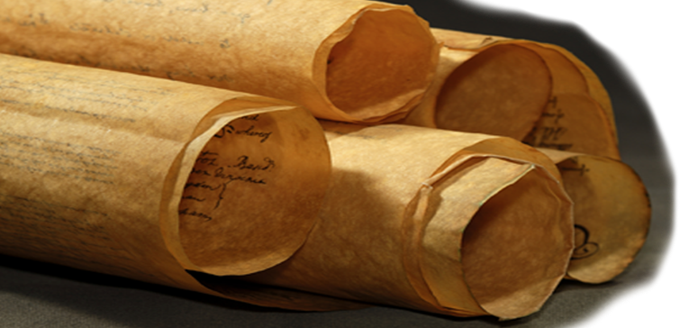
For whatever things were written before were written for our learning, that we through the patience and comfort of the Scriptures might have hope. — Romans 15:4
written for
our learning
Notes:
The entire Bible must be taken into consideration in order to understand the will of God. Many gruesome events are described in the wanderings of man, which expose the nature of man, and what God is trying to achieve in saving men (souls) from destruction through these various sinful pursuits. The whole gambit of emotions and situations spreads across these unfolding words revealing the highest of all truths. God is not hiding what He wants us to know, that is something man attempt to do in his scheming manipulations deceiving the innocent into questioning the validity of God. Some claim man as the apex of intelligence, which is by definition arrogance, and a foolhardy claim.

Slide 39
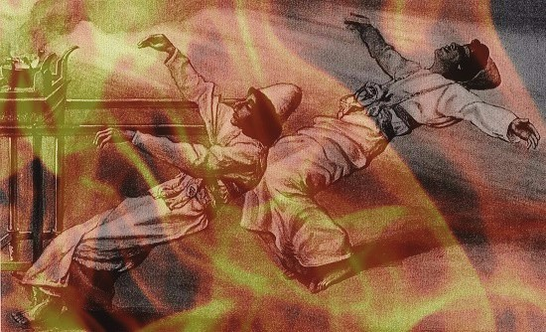
Then Nadab and Abihu, the sons of Aaron, each took his censer and put fire in it, put incense on it, and offered profane fire before the LORD, which He had not commanded them. So fire went out from the LORD and devoured them, and they died before the LORD. And Moses said to Aaron, "This is what the LORD spoke, saying: 'By those who come near Me I must be regarded as holy; And before all the people I must be glorified.'" So Aaron held his peace. — Leviticus 10:1-3
LORD
not commanded
LORD
they died
LORD
LORD
I must be regarded as holy
holy
Notes:
God does not want alterations in what He asks of us. To regard God as casual is to negate Him as Holy.

Slide 40
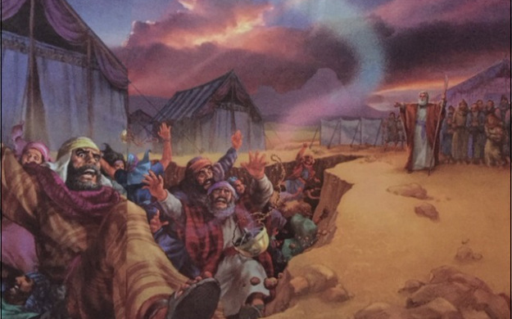
Now it came to pass, as he finished speaking all these words, that the ground split apart under them, and the earth opened its mouth and swallowed them up, with their households and all the men with Korah, with all their goods. So they and all those with them went down alive into the pit; the earth closed over them, and they perished from among the assembly. — Numbers 16:31-33
d
Korah
d
down alive into the pit
i
e
died
Notes:
He does not want man to overrule what He has established.

Slide 41
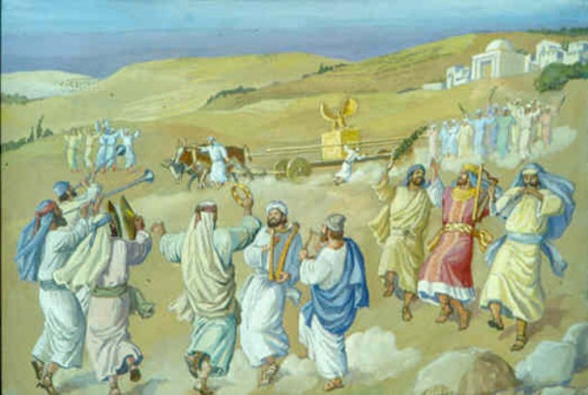
So they set the ark of God on a new cart, and brought it out of the house of Abinadab, which was on the hill; and Uzzah and Ahio, the sons of Abinadab, drove the new cart. And they brought it out of the house of Abinadab, which was on the hill, accompanying the ark of God; and Ahio went before the ark. Then David and all the house of Israel played music before the LORD on all kinds of instruments of fir wood, on harps, on stringed instruments, on tambourines, on sistrums, and on cymbals. And when they came to Nachon's threshing floor, Uzzah put out his hand to the ark of God and took hold of it, for the oxen stumbled. Then the anger of the LORD was aroused against Uzzah, and God struck him there for his error; and he died there by the ark of God. — 2nd Samuel 6:3-7
"For because you did not do it the first time, the LORD our God broke out against us, because we did not consult Him about the proper order." So the priests and the Levites sanctified themselves to bring up the ark of the LORD God of Israel. — 1st Chronicles 15:13-14
"For because you did not do it the first time, the LORD our God broke out against us, because we did not consult Him about the proper order." So the priests and the Levites sanctified themselves to bring up the ark of the LORD God of Israel. — 1st Chronicles 15:13-14
Uzzah
died there by the ark of God
died
Notes:
To forget or ignore His called out commands has dire consequences as shown to us through His word. God has made it abundantly clear He wants His instructions and or proclamations to be carefully considered and implemented without deviation.

Slide 42
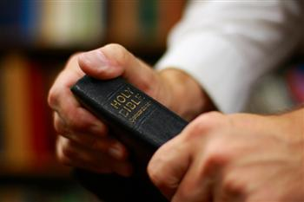
The things which you learned and received and heard and saw in me, these do, and the God of peace will be with you. —Philippians 4:9
The things which you learned and received and heard and saw in me, these do, and the God of peace will be with you. —Philippians 4:9
received and heard
heard
pattern
Hold fast the pattern of sound words which you have heard from me, in faith and love which are in Christ Jesus. — 2nd Timothy 1:13
Hold fast the pattern of sound words which you have heard from me, in faith and love which are in Christ Jesus. — 2nd Timothy 1:13
Hold fast the pattern of sound words which you have heard from me, in faith and love which are in Christ Jesus. — 2nd Timothy 1:13
in
Brethren, join in following my example, and note those who so walk, as you have us for a pattern. — Philippians 3:17
words which you have heard
in
in
Notes:
God wants us to follow the patterns He has set forth in word and doctrine. When one follows he is led, it is not that he leads.

Slide 43
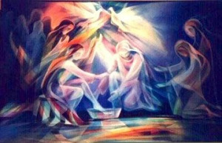
Now I praise you, brethren, that you remember me in all things and keep the traditions just as I delivered them to you. — 1st Corinthians 11:2
Now I praise you, brethren, that you remember me in all things and keep the traditions just as I delivered them to you. — 1st Corinthians 11:2
Now I praise you, brethren, that you remember me in all things and keep the traditions just as I delivered them to you. — 1st Corinthians 11:2
in
keep
Therefore, brethren, stand fast and hold the traditions which you were taught, whether by word or our epistle. — 2nd Thessalonians 2:15
just as
delivered
hold
taught
by word or
our epistle
Notes:
His word was delivered not to be altered but understood by those who received it.

Slide 44
→ Understand the will of, & what is acceptable to God
→ God’s word is living & powerful working in believers
→ No insight of Scripture is of any secretive awareness
→ His Holy Spirit gave the word to those who told it
→ Admit what is written to you is His commandments
→ Sum of God’s word is truth/not author of confusion
→ You shall not add to or take from the word of God
→ Do not turn from His word, to the right or to the left
→ Things written before were written for our learning
→ Nadab & Abihu died for not obeying God’s orders
→ Korah & houses all destroyed by turning in rebellion
→ Uzzah died as the Lord’s word (Ark) was disobeyed
→ Hold to traditions taught either by word or epistle
It is the Word of God that teaches us
Notes:
It is the Word of God that teaches us.

Slide 45
Notes:
Darkness is living on the edge of death.

Slide 46
Authority
Authority
Authority
3
Ron Bert
November 18, 2018
Notes:
Christ’s authority has no equal. Through Him He has delegated His church by His chosen Apostles. The ongoing appointment of Apostles by man is the greatest farce of our times. As man attempts to exalt himself, God remains impartial prior to judgment.

Slide 47
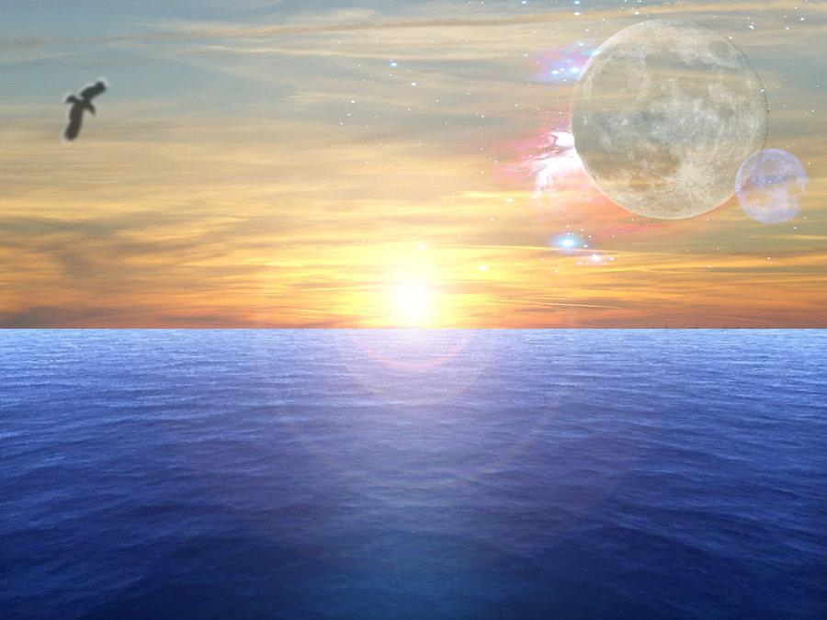
And Jesus came and spoke to them, saying, "All authority has been given to Me in heaven and on earth. — Matthew 28:18
authority
authority
All authority
Notes:
By His own words, Jesus has all authority. He watches and will judge over all the waves time and more has produced. Actions, be they righteous or despicable, will find there cost at His feet.

Slide 48
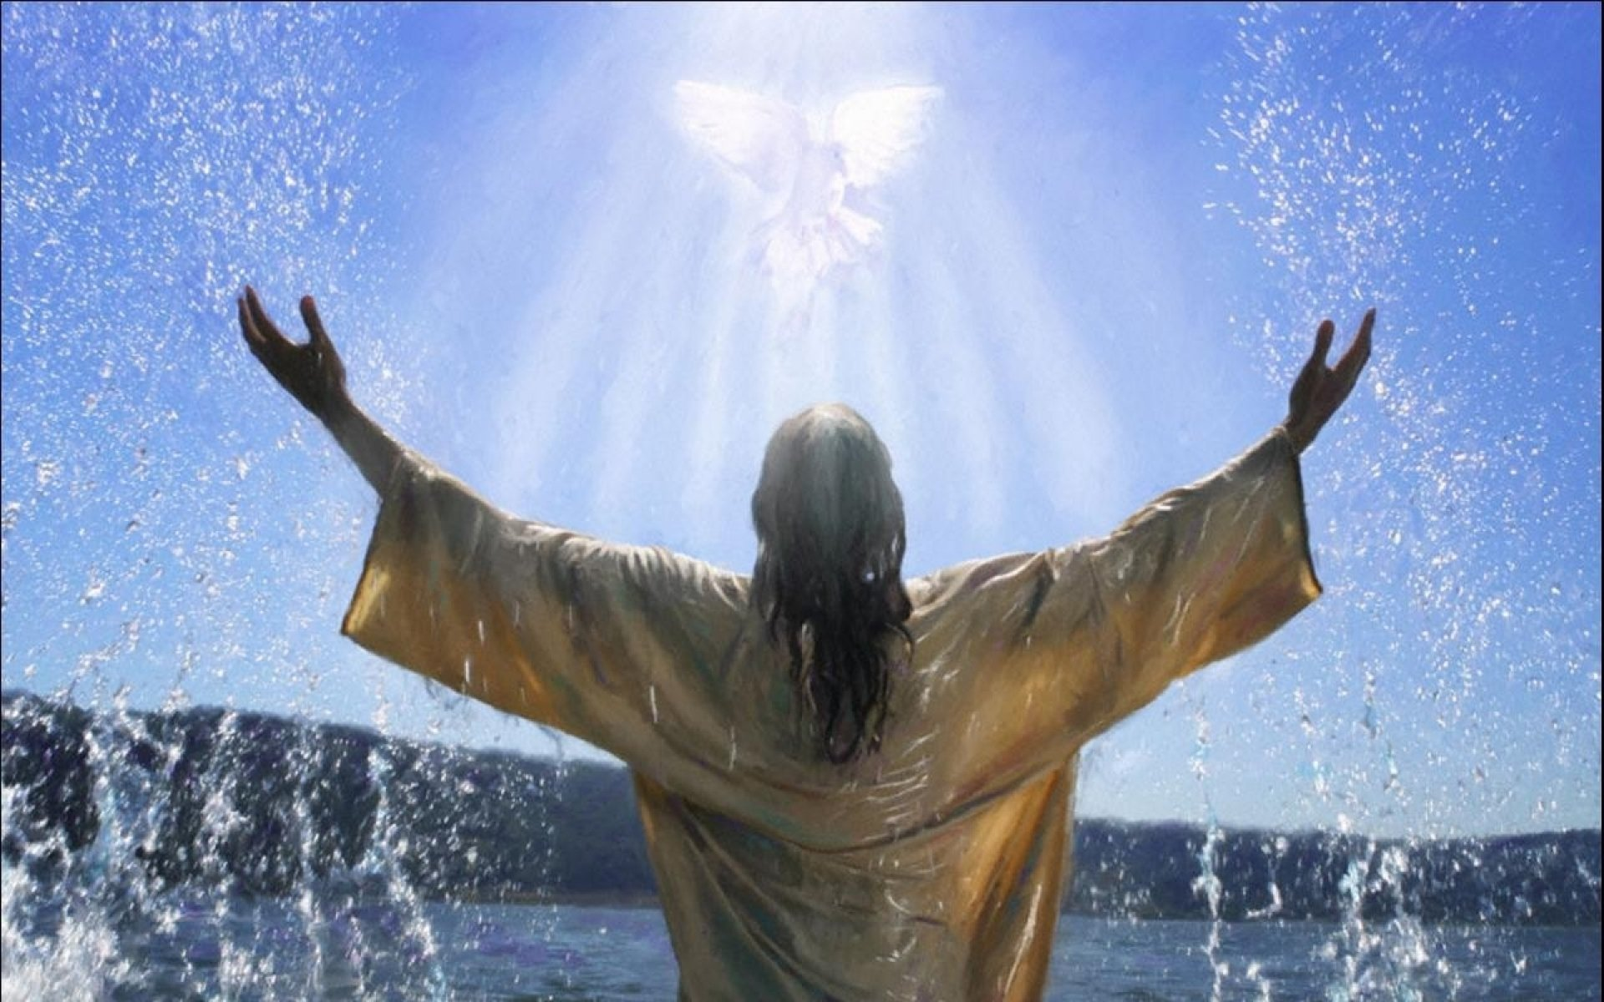
"For I have not spoke non My own authority; but the Father who sent Me gave Me a command, what I should say and what I should speak. And I know that His command is everlasting life. Therefore, whatever I speak, just as the Father has told Me, so I speak." — John 12:49-50
speak
authority
the Father
speak
speak
speak
Notes:
It is a humbling realization that God would come to speak with us in the flesh.

Slide 49
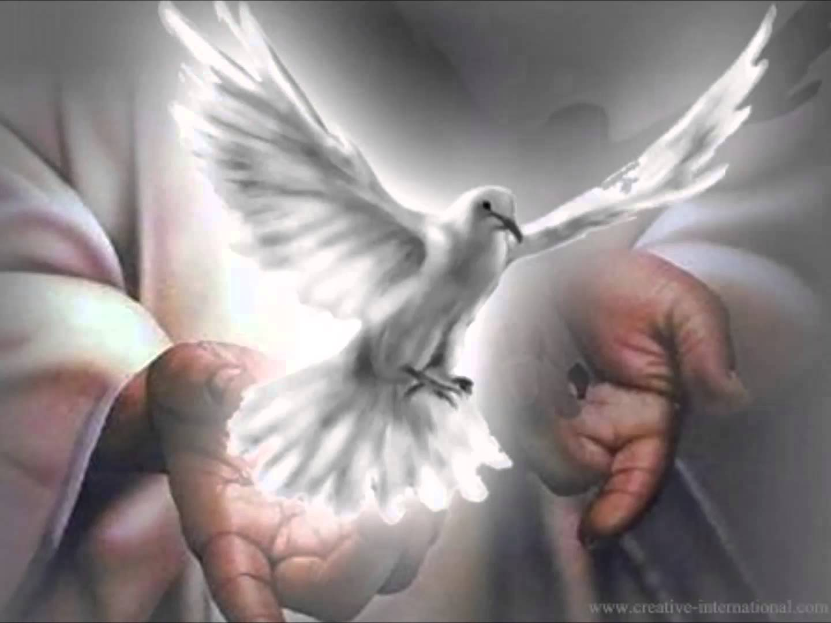
"For He whom God has sent speaks the words of God, for God does not give the Spirit by measure. The Father loves the Son, and has given all things into His hand. He who believes in the Son has everlasting life; and he who does not believe the Son shall not see life, but the wrath of God abides on him." — John 3:34-36
speak
the words of God
words
words
authority
all things into His hand
believes in the Son = everlasting life
not believe the Son = not see life
believes in the Son
everlasting
life
not believe the
Son
not see life
Notes:
His word is plain if taken as it is. God did not withhold what He wanted us, as individuals upon all lands and times, to know.

Slide 50
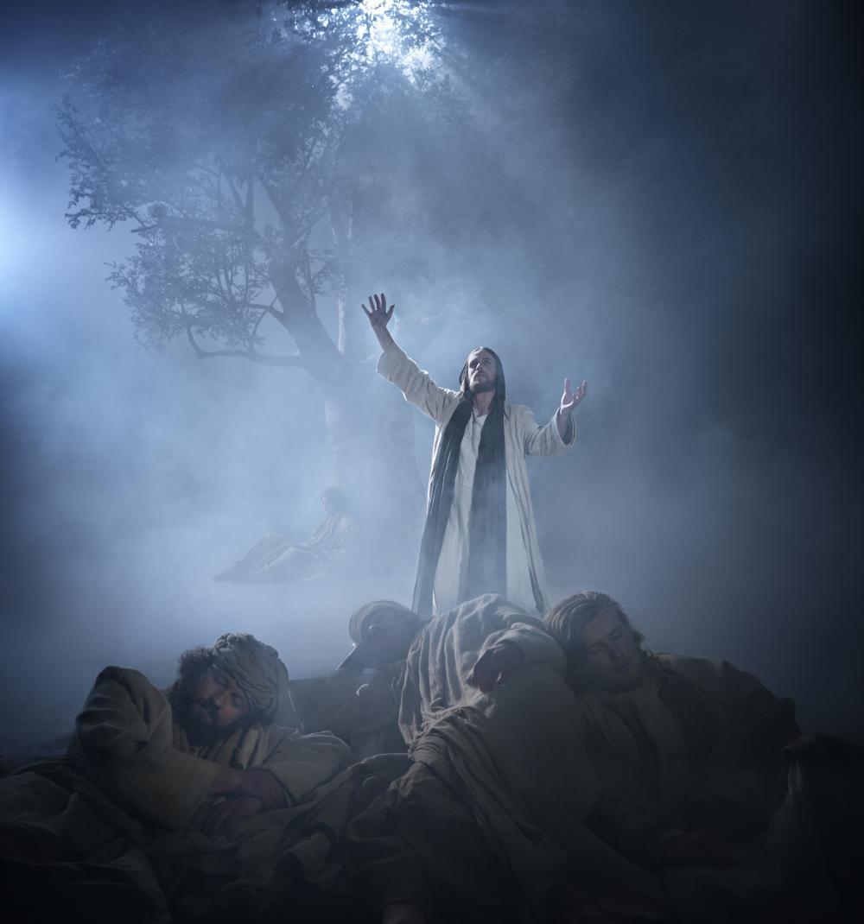
"For I have given to them the words which You have given Me; and they have received them, and have known surely that I came forth from You; and they have believed that You sent Me." — John 17:8
words
words
received
Notes:
Christ Himself announced the completion of what God wanted us to receive.

Slide 51
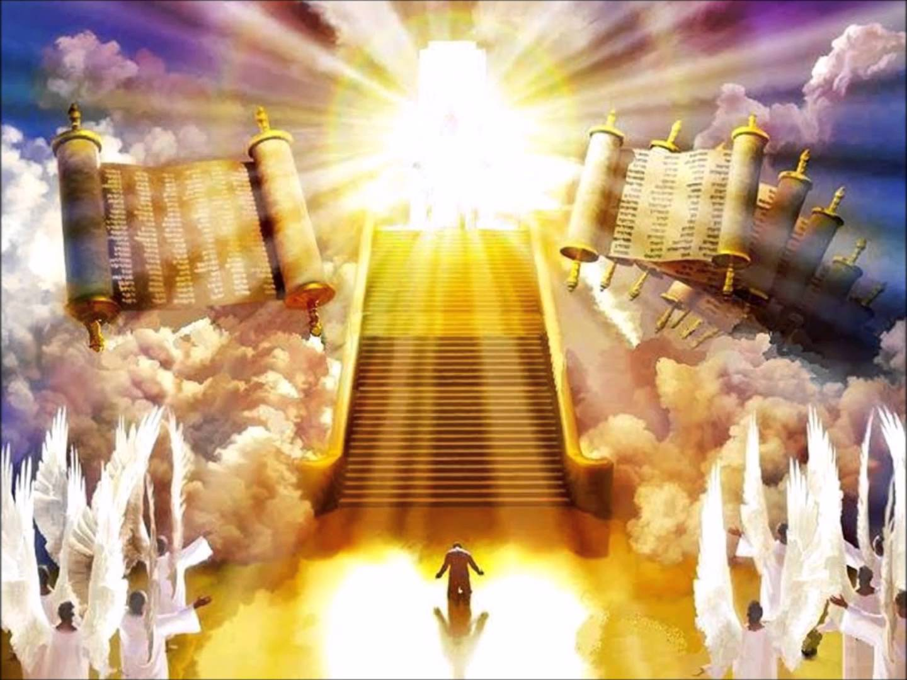
"He who rejects Me, and does not receive My words, has that which judges him -- the word that I have spoken will judge him in the last day." — John 12:48
words
the word
authority
will judge
Notes:
It is clear that observing what Scripture presents is an integral part towards our individual salvation.

Slide 52
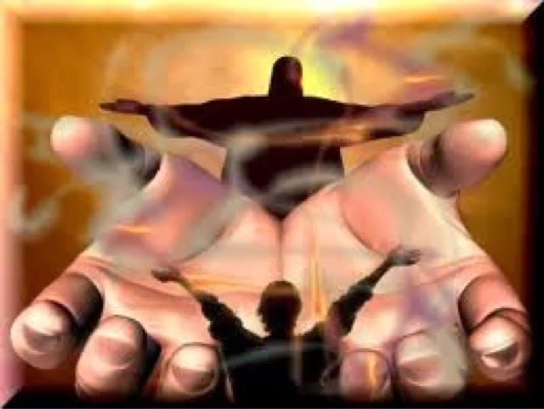
… as His divine power has given to us all things that pertain to life and godliness, through the knowledge of Him who called us by glory and virtue, … — 2nd Peter 1:3
His divine power
glory and virtue calls
through the knowledge of Him
life
godliness
divine power
His divine power
life
all things that pertain to life
godliness
through
through the knowledge
of Him
call
s
glory and
call
virtue
Notes:
We are told that His word is sufficient in order to come to the fullness that is in Him through His word. It is by knowledge in Christ that God calls to each heart and He calls us to life in godliness.

Slide 53
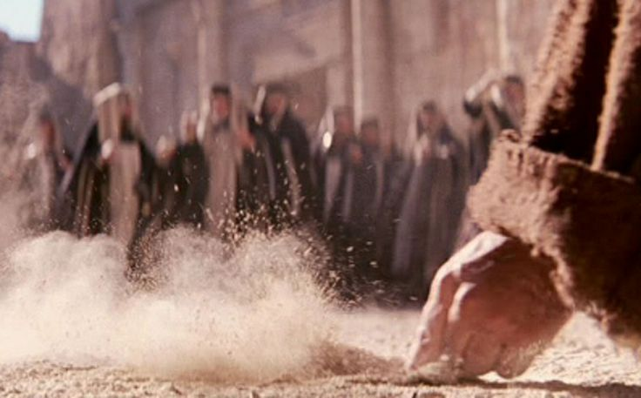
Then Jesus said to those Jews who believed Him, "If you abide in My word, you are My disciples indeed." — John 8:31
abide in
abide in My word
abide in
Notes:
Jesus boldly states that following and obeying His words is what makes one His disciple. Are we to be disciples of man or God?

Slide 54
Whoever transgresses and does not abide in the doctrine of Christ does not have God. He who abides in the doctrine of Christ has both the Father and the Son. — 2nd John 1:9
not abide in
doctrine of Christ
abide in
does not have God
authority
abides in
doctrine of Christ
has both the Father and the Son
Notes:
It is the doctrine of Christ that dictates both salvation and or damnation.

Slide 55
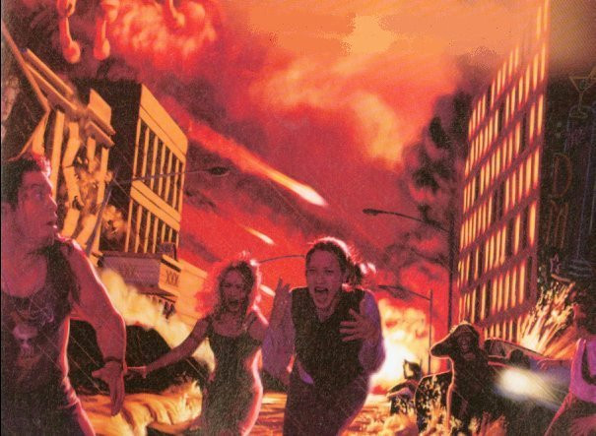
… and to give you who are troubled rest with us when the Lord Jesus is revealed from heaven with His mighty angels, in flaming fire taking vengeance on those who do not know God, and on those who do not obey the gospel of our Lord Jesus Christ. These shall be punished with everlasting destruction from the presence of the Lord and from the glory of His power, … — 2nd Thessalonians 1:7-9
… and to give you who are troubled rest with us when the Lord Jesus is revealed from heaven with His mighty angels, in flaming fire taking vengeance on those who do not know God, and on those who do not obey the gospel of our Lord Jesus Christ. These shall be punished with everlasting destruction from the presence of the Lord and from the glory of His power, … — 2nd Thessalonians 1:7-9
Lord
do not know God
do not obey the gospel
Lord
authority
Notes:
If everlasting destruction is for those that do not obey the gospel, should we not do our best to do what has been commanded by God, over excuses absolving one from observing His delivered truth?

Slide 56
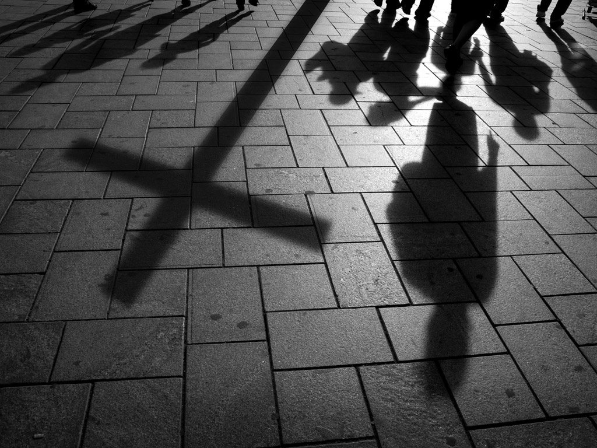
"But why do you call Me 'Lord, Lord,' and do not do the things which I say?" — Luke 6:46
Lord
Lord
Notes:
Jesus Himself wants to know why we acknowledge Him, and then do not adhere to the teachings He has brought to us. He wants us to do all the things He has brought to us in His word. Are you a servant of the Lord or is there a schism in your thinking. There is no doubt in service to Him.

Slide 57
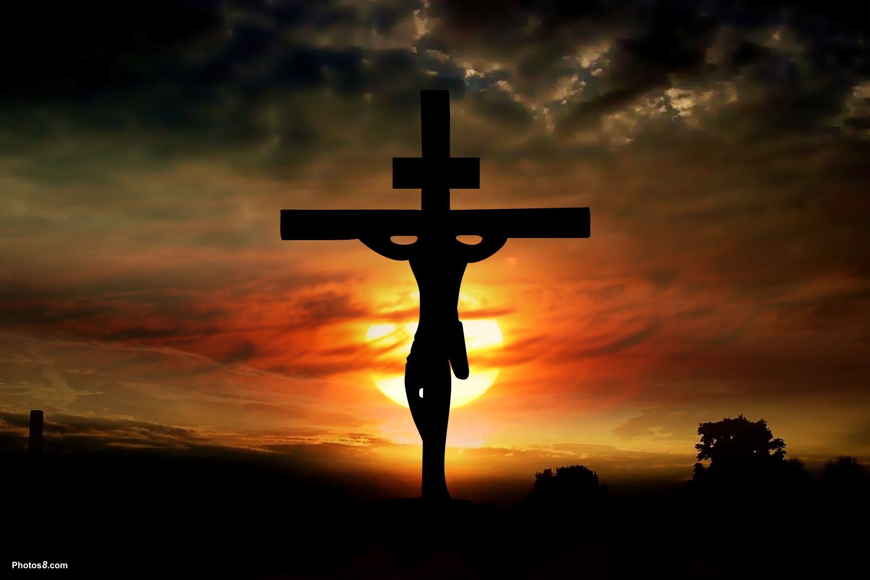
Then Jesus said to them, "When you lift up the Son of Man, then you will know that I am He, and that I do nothing of Myself; but as My Father taught Me, I speak these things." — John 8:28
authority
the Son of Man
I do nothing of Myself
Father
Notes:
Reiterated several times is the Father being through Jesus.

Slide 58
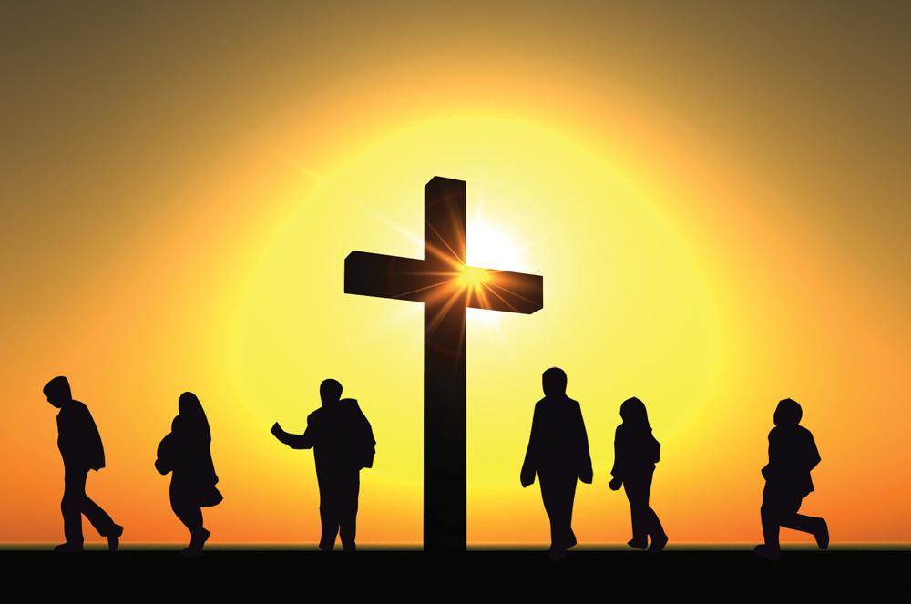
For the message of the cross is foolishness to those who are perishing, but to us who are being saved it is the power of God. — 1st Corinthians 1:18
power of God
God
God
Notes:
God sends His Son to die on the cross to save man and this just sounds foolish to the rational mind. However, through God’s own sacrifice, His divine call rings out most powerful. One either comes to God or leaves Him. His kingdom has no tolerance for the ambiguity of the insincere.

Slide 59
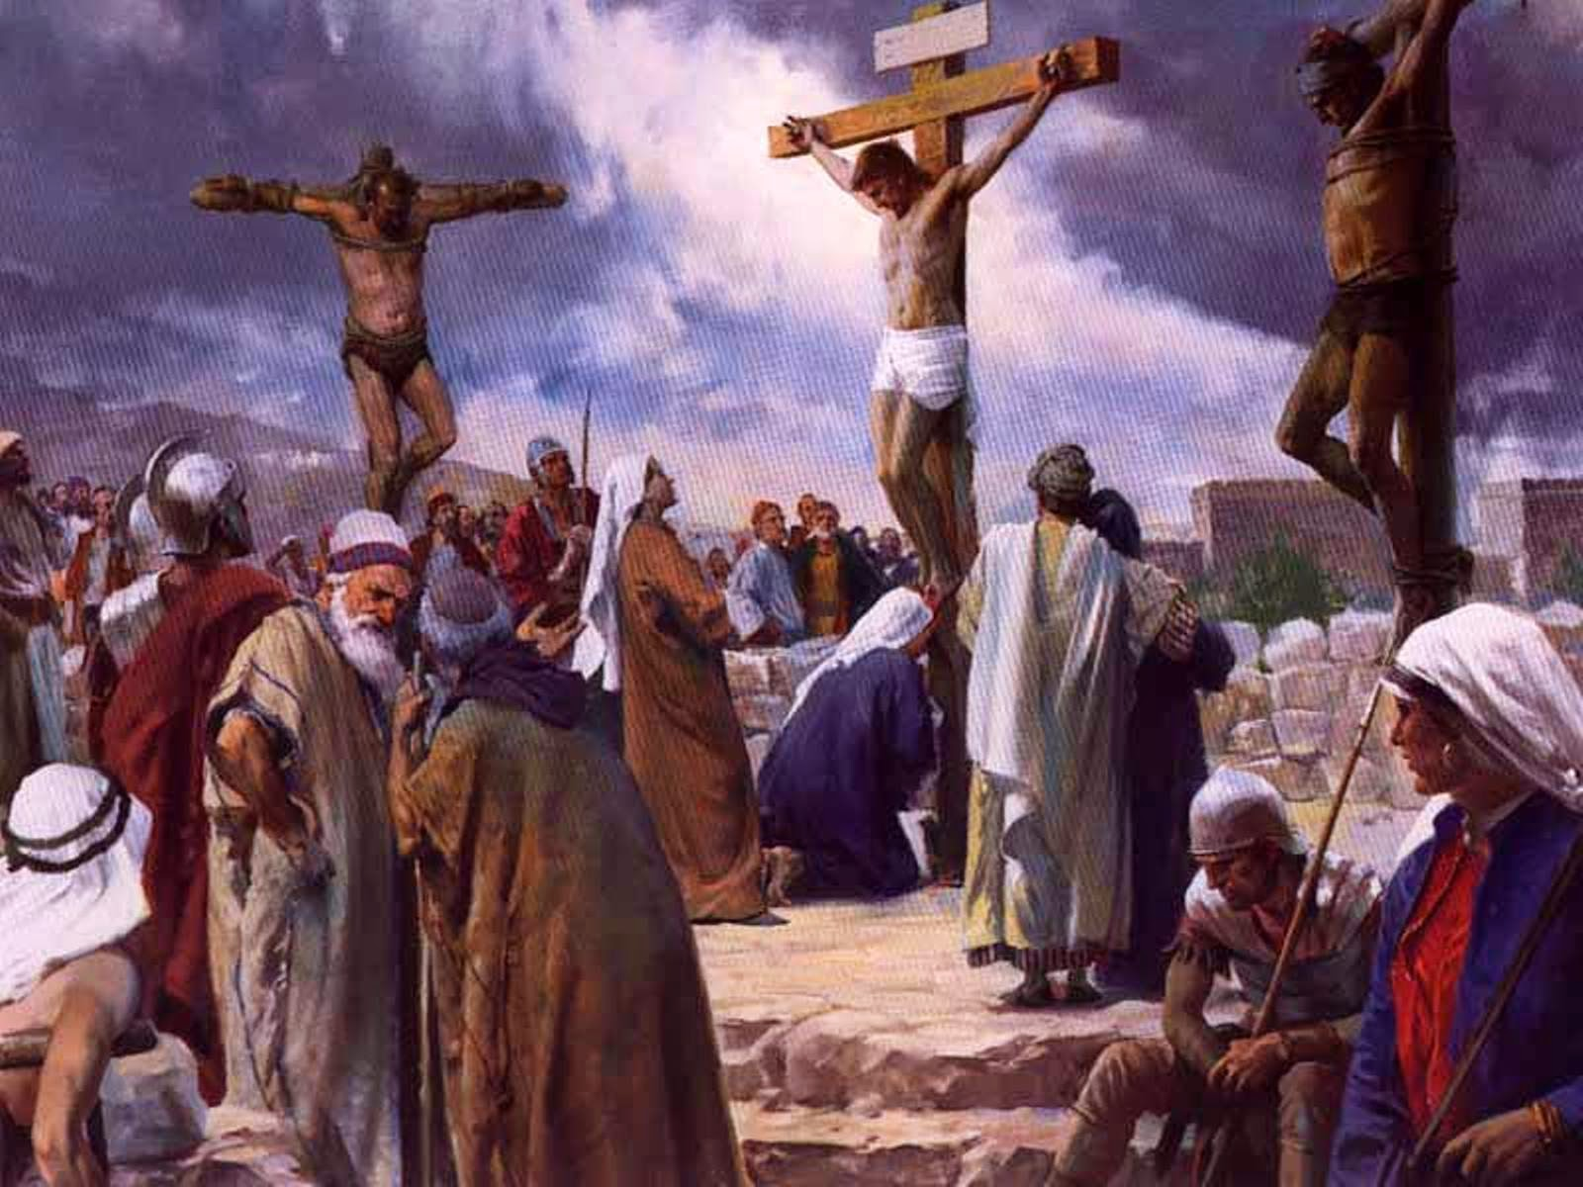
For it is written: "I will destroy the wisdom of the wise, And bring to nothing the understanding of the prudent." Where is the wise? Where is the scribe? Where is the disputer of this age? Has not God made foolish the wisdom of this world? — 1st Corinthians 1:19-20
God
God
Notes:
God brought His own truth by example in the flesh. Concern and love in the face of wickedness. To hold a forgiving heart over a condemning one.

Slide 60
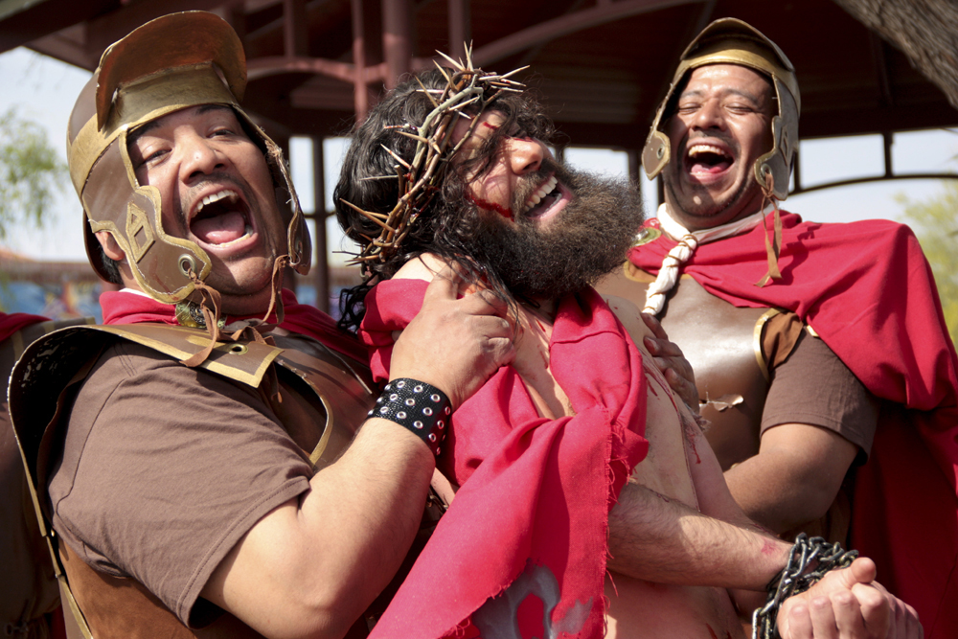
For since, in the wisdom of God, the world through wisdom did not know God, it pleased God through the foolishness of the message preached to save those who believe. For Jews request a sign, and Greeks seek after wisdom; — 1st Corinthians 1:21-22
God
God
God
God
Notes:
Inhumane is why Jesus came to earth to wake those sinning with no knowledge of eternal hope. He came in the stealthy shell of a man.

Slide 61
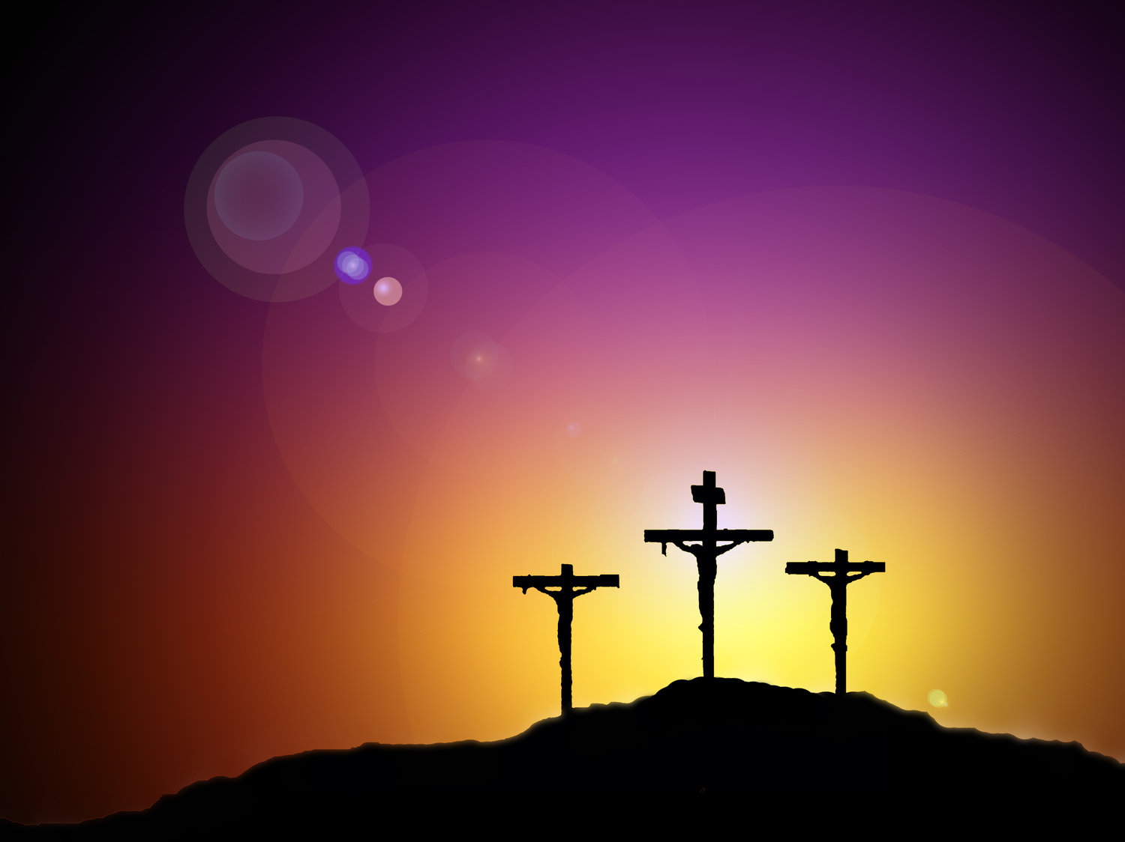
…. but we preach Christ crucified, to the Jews a stumbling block and to the Greeks foolishness, but to those who are called, both Jews and Greeks, Christ the power of God and the wisdom of God. Because the foolishness of God is wiser than men, and the weakness of God is stronger than men. — 1st Corinthians 1:23-25
Christ the power of God
authority
wisdom of God
God
God
God
God
Notes:
No greater act has had the redemptive power than the crucifixion of Jesus exposing the foolishness of man and the greatness of God.

Slide 62
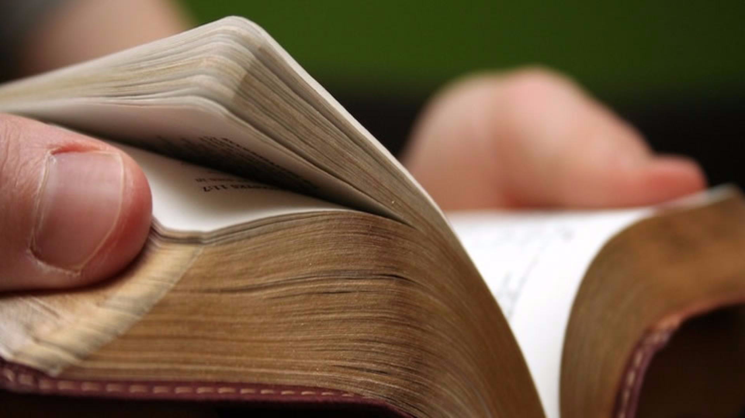
Now these things, brethren, I have figuratively transferred to myself and Apollos for your sakes, that you may learn in us not to think beyond what is written, that none of you may be puffed up on behalf of one against the other. — 1st Corinthians 4:6
not to think
beyond what is written
WARNING
one against the other
Notes:
The Bible tells us not to go beyond what is written. The worship of God is not a competition.

Slide 63
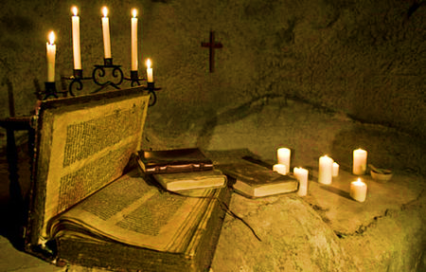
I marvel that you are turning away so soon from Him who called you in the grace of Christ, to a different gospel, which is not another; but there are some who trouble you and want to pervert the gospel of Christ. But even if we, or an angel from heaven, preach any other gospel to you than what we have preached to you, let him be accursed. — Galatians 1:6-8
I marvel that you are turning away so soon from Him who called you in the grace of Christ, to a different gospel, which is not another; but there are some who trouble you and want to pervert the gospel of Christ. But even if we, or an angel from heaven, preach any other gospel to you than what we have preached to you, let him be accursed. — Galatians 1:6-8
different
As we have said before, so now I say again, if anyone preaches any other gospel to you than what you have received, let him be accursed. — Galatians 1:9
different
any other gospel
any other gospel
Notes:
It is more than abundantly clear that God does not want us to add amendments to His delivered word.

Slide 64
But I fear, lest somehow, as the serpent deceived Eve by his craftiness, so your minds may be corrupted from the simplicity that is in Christ. For if he who comes preaches another Jesus whom we have not preached, or if you receive a different spirit which you have not received, or a different gospel which you have not accepted -- you may well put up with it! — 2nd Corinthians 11:3-4
corrupted
not
not
different spirit
different
not
different gospel
not
Notes:
Even in the first century the warning came forth not to tolerate different ways other than what Christ through His Apostles had delivered. Does one really want to follow that which is contrary to the word of God? In works and or beliefs, one can deny God if it goes against His doctrine preferring something else concocted of man.

Slide 65
If anyone teaches otherwise and does not consent to wholesome words, even the words of our Lord Jesus Christ, and to the doctrine which accords with godliness, he is proud, knowing nothing, but is obsessed with disputes and arguments over words, from which come envy, strife, reviling, evil suspicions, useless wranglings of men of corrupt minds and destitute of the truth, who suppose that godliness is a means of gain. From such withdraw yourself. — 1st Timothy 6:3-5
If anyone teaches otherwise
If anyone teaches otherwise and does not consent to wholesome words, even the words of our Lord Jesus Christ, and to the doctrine which accords with godliness, he is proud, knowing nothing, but is obsessed with disputes and arguments over words, from which come envy, strife, reviling, evil suspicions, useless wranglings of men of corrupt minds and destitute of the truth, who suppose that godliness is a means of gain. From such withdraw yourself. — 1st Timothy 6:3-5
As I urged you when I went into Macedonia -- remain in Ephesus that you may charge some that they teach no other doctrine, nor give heed to fables and endless genealogies, which cause disputes rather than godly edification which is in faith. — 1st Timothy 1:3-4
Christ
not
no
t
teach no other doctrine
no
t
Christ
From such withdraw yourself
Notes:
The warnings to stay with the delivered doctrine are to numerous to just ignore or flippantly reject. His word was created timeless upon its’ conception. To often men of selfish pursuits pollute the message God would have us to have. There is a trend that sexuality is the fulfillment of spirituality - that Christ loves you for who you choose to be no matter orientation, one way or another, even if preference is for both sexes in one’s call to satisfy innate desires. Are we to accept animal relations next, orgies at every corner? Blatant sexual freedoms abandon true spiritual wisdom. Devotion to self or God does draw a defining line. Tolerance taken to the extreme allows hypocrites, counter to God, to rule. They scream they're godly but deny Him in works of the flesh. Read the word. The flesh is a test exposing either weakness of character or not. It is not anything goes and God calls for responsibility to His word and repentance, not tolerance. This is why so many hate God, and not faithful Christian recipients who carry His truth – “They don’t hate you as they hated Me first.” People are drawn to the flash and what caters to their desires and so God’s ways are ignored.

Slide 66
Now I urge you, brethren, note those who cause divisions and offenses, contrary to the doctrine which you learned, and avoid them. For those who are such do not serve our Lord Jesus Christ, but their own belly, and by smooth words and flattering speech deceive the hearts of the simple. — Romans 16:17-18
deceive
the hearts
contrary to the doctrine
avoid
Jesus Christ
Christ
Jesus Christ
Jesus Christ
Jesus Christ
Jesus Christ
Jesus Christ
Jesus Christ
Jesus Christ
Jesus Christ
Jesus Christ
Jesus Christ
deceive
the
hearts
of the simple
Notes:
Plenty of churches do not follow the teachings of Jesus and the Apostles. Jim Jones claimed to be the incarnation of Christ as he sexually abused his flock and led them to suicide. These self seeking ravenous wolves stand for the lusts of man rather than the love of God. The young, and especially lonely, fall victim to false doctrines all to easy as it is the innate nature of the soul to desire others. Our social structure is wounded at its’ very core with parents that hate their children abandoning them to feasting predators. We are a nation, world, challenged in loving one another. It is how we desire that God watches closely. Desperation and fear can blur the better judgement of common sense when being lured into the snatch of man. It is Jesus Christ that has brought the light of truth into the world. We need to follow Christ and not the whims of selfish men enmeshed in earthly desires. In Him there is no deception.

Slide 67
If anyone speaks, let him speak as the oracles of God. If anyone ministers, let him do it as with the ability which God supplies, that in all things God may be glorified through Jesus Christ, to whom belong the glory and the dominion forever and ever. Amen. — 1st Peter 4:11
speak
speak
oracles of God
God
speak
God
God
Jesus Christ
Notes:
By meekly incorporating the word of God one grows. It is a personal relationship He wills for each of us.

Slide 68
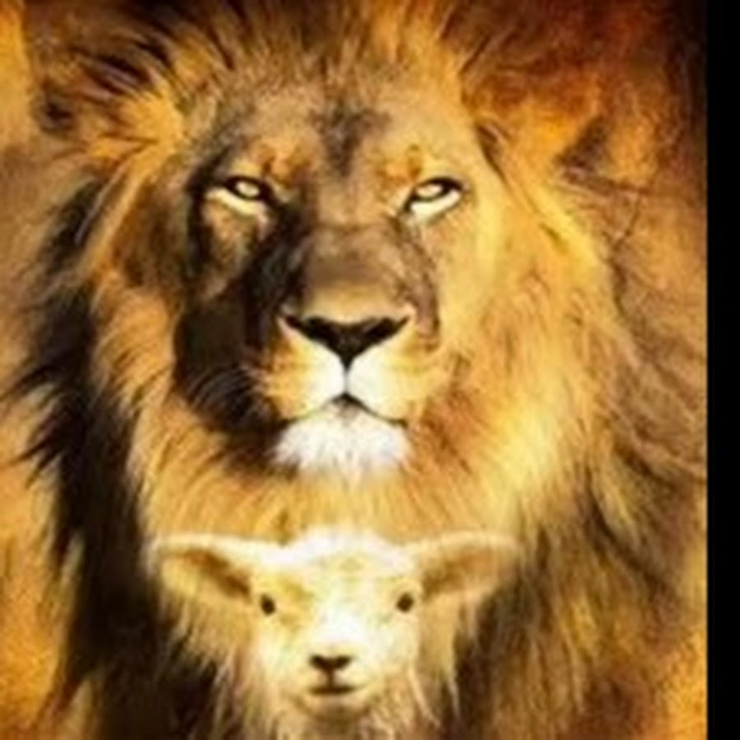
Speak these things, exhort, and rebuke with all authority. Let no one despise you. — Titus 2:15
● Speak these things
● exhort, rebuke with all authority
● Let no one despise you
Speak these things
exhort,
speak
rebuke with all authority
Let no
one despise you
Notes:
Through knowledge we are empowered with the calmness of real truth.

Slide 69
→ Jesus has all authority in heaven and on earth
→ Jesus spoke by the Father’s authority what to say
→ Jesus was sent to speak the words of God
→ Rejecting His words is that which judges one
→ Sinning & not abiding in Christ’s laws rejects God
→ Not knowing or obeying God in Christ condemns
→ Jesus asks why we do not do the things He says
→ Christ is the power of God and the wisdom of God
→ Hear by Apostles not to think beyond written word
→ Anyone talks another gospel let him be accursed
→ Be careful not to tolerate different gospels
→ Withdraw from those not following words of Christ
→ Speak as the oracles of God with the ability He gives
His Word has
Authority over all
Notes:
His Word has Authority over all.

Slide 70
Notes:
Darkness holds one word: Empty.

Slide 71
Authority
Authority
Authority
4
Ron Bert
November 25, 2018
Notes:
It is by the power of God that we are.

Slide 72
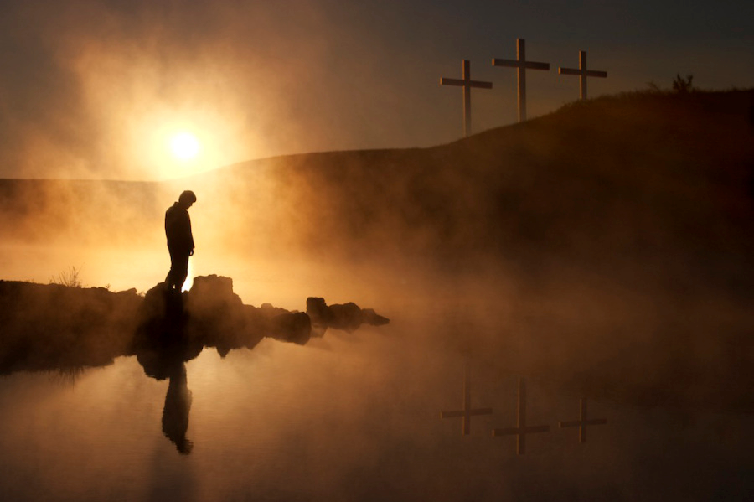
"God is Spirit, and those who worship Him must worship in spirit and truth." — John 4:24
Spirit
God is Spirit
Spirit
in
spirit
truth
Notes:
True to God’s own nature, we too must reflect truth from the core of our essence.

Slide 73
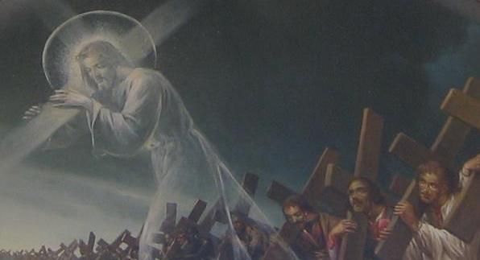
For the law of the Spirit of life in Christ Jesus has made me free from the law of sin and death. —Romans 8:2
authority
Spirit
law of the Spirit of life
Spirit
in
Notes:
Life is what God has given and He offers it eternally to those that overcome temptation; to those loyal carrying forth the burdens of living here on the earth. It is the Spirit of Christ that we follow. We are currently all under the authority of Christ and His Law for the Spirit of Life. He is what will decide our fate in eternity. He welcomes all who will come but will emphatically reject those that have rejected Him and His ways.

Slide 74
But God has revealed them to us through His Spirit. For the Spirit searches all things, yes, the deep things of God. For what man knows the things of a man except the spirit of the man which is in him? Even so no one knows the things of God except the Spirit of God. Now we have received, not the spirit of the world, but the Spirit who is from God, that we might know the things that have been freely given to us by God. These things we also speak, not in words which man's wisdom teaches but which the Holy Spirit teaches, comparing spiritual things with spiritual. — 1st Corinthians 2:10-13
God has revealed
r
h
s
Spirit
Spirit
Spirit
Spirit
Spirit
we have received
Christ
might know the things
t
given to us by God
i
C
Notes:
God has revealed what He wants us to know and it is up to us to receive it or not.

Slide 75
And He Himself gave some to be apostles, some prophets, some evangelists, and some pastors and teachers, for the equipping of the saints for the work of ministry, for the edifying of the body of Christ, till we all come to the unity of the faith and of the knowledge of the Son of God, to a perfect man, to the measure of the stature of the fullness of Christ; — Ephesians 4:11-13
He Himself gave
authority
Christ
body of Christ
unity of the faith
knowledge of the Son of God
measure
fullness of Christ
Notes:
Jesus Himself set up His church edifying various workers to bring us closer to His truth in the fullness of Himself. It is God that measures the hearts of man.

Slide 76
And when He had called His twelve disciples to Him, He gave them power over unclean spirits, to cast them out, and to heal all kinds of sickness and all kinds of disease. — Matthew 10:1
authority
He gave them power
Notes:
Jesus had the power to do as He willed on earth. He commissioned His apostles to have special and extraordinary authority over the material realm.

Slide 77
"Most assuredly, I say to you, he who receives whomever I send receives Me; and he who receives Me receives Him who sent Me." — John 13:20
whomever I send
APOSTLES
receives Me
JESUS
Him who sent Me
FATHER
Notes:
Jesus delegated authority to the Apostles to further His wishes and or objectives. This did not include the continuation of man appointing subsequent men to have the same authority as Christ’s original appointments.

Slide 78
"Nevertheless I tell you the truth. It is to your advantage that I go away; for if I do not go away, the Helper will not come to you; but if I depart, I will send Him to you." — John 16:7
Helper
go away
Helper
send Him to you
Notes:
Jesus proclaimed that the Helper would come after His physical departure.

Slide 79
"But when the Helper comes, whom I shall send to you from the Father, the Spirit of truth who proceeds from the Father, He will testify of Me." — John 15:26
Helper
Helper
Spirit of truth
proceeds from the Father
Notes:
This Helper would be a Spirit of truth sent forth from the Father as Christ’s advocational witness.

Slide 80
"But the Helper, the Holy Spirit, whom the Father will send in My name, He will teach you all things, and bring to your remembrance all things that I said to you." — John 14:26
Helper
Holy Spirit
teach you all things
bring to your remembrance
Notes:
The Holy Spirit came to Christ’s Apostles giving them special abilities to remember exactly what God wanted to convey to mankind.

Slide 81
"However, when He, the Spirit of truth, has come, He will guide you into all truth; for He will not speak on His own authority, but whatever He hears He will speak; and He will tell you things to come." — John 16:13
Spirit of truth
Spirit
guide you into all truth
not speak on His own authority
authority
Spirit
Notes:
The Holy Spirit speaks directly from the Father who has full authority.

Slide 82
For there are three that bear witness in heaven: the Father, the Word, and the Holy Spirit; and these three are one. — 1st John 5:7
Father
Holy Spirit
One
For there are three that bear witness in heaven: the Father, the Word, and the Holy Spirit; and these three are one. — 1st John 5:7
Christ
And the Word became flesh and dwelt among us, and we beheld His glory, the glory as of the only begotten of the Father, full of grace and truth. — John 1:14
authority
Holy Spirit = Father = Christ = One
Word
Spirit
these three are one
Notes:
The Word is synonymous with Jesus Christ Himself. In Him is the unity of the Father and eternal Spirit. Christ is not just a prophet as minimizers would have it, He is God manifested in the flesh as it is written.

Slide 83
And so it was, when Jesus had ended these sayings, that the people were astonished at His teaching, for He taught them as one having authority, and not as the scribes. — Matthew 7:28-29
And so it was, when Jesus had ended these sayings, that the people were astonished at His teaching, for He taught them as one having authority, and not as the scribes. — Matthew 7:28-29
Then they were all amazed and spoke among themselves, saying, "What a word this is! For with authority and power He commands the unclean spirits, and they come out." — Luke 4:36
word
And they were astonished at His teaching, for His word was with authority. — Luke 4:32
And they were astonished at His teaching, for His word was with authority. — Luke 4:32
He taught
word
His word
having authority
authority
authority
with authority and power
authority
Notes:
Jesus maintains a Spirit of truth in all that He is. If one dismisses statements and or instructions of Christ, it is a blatant case of denial which will be more than condemning upon judgment. His word is the final word.

Slide 84
For by Him all things were created that are in heaven and that are on earth, visible and invisible, whether thrones or dominions or principalities or powers. All things were created through Him and for Him. And He is before all things, and in Him all things consist. And He is the head of the body, the church, who is the beginning, the firstborn from the dead, that in all things He may have the preeminence. For it pleased the Father that in Him all the fullness should dwell, … — Colossians 1:16-19
word
authority
He is the head
Notes:
Since all is made through and by Him, our return is inevitable. For those fortunate enough to maintain loyal hearts, may He find us under the shield of His grace. With all that has been written, His authority is undeniable for all those studying His revelations.

Slide 85
"Truly, these times of ignorance God overlooked, but now commands all men everywhere to repent, …" — Acts 17:30
Repent
authority
now commands
repent
Notes:
Repentance and turning from unacceptable ways is key to anyone's salvation. Works will not save us, but by a lack of them or a blatant disregard to His call for good works will certainly be met with His wrath. It is a fearful moment to ignore what He has commanded.

Slide 86
Then Peter said to them, "Repent, and let every one of you be baptized in the name of Jesus Christ for the remission of sins; and you shall receive the gift of the Holy Spirit." — Acts 2:38
Atone
Apologize
Make up
For godly sorrow produces repentance leading to salvation, not to be regretted; but the sorrow of the world produces death. — 2nd Corinthians 7:10
repent
Be Sorry
Repent
repent
be baptized
in
Ask Forgiveness
for the remission of sins
Regret
Feel Sorrow
Be Remorseful
Notes:
Without the remission of sins the death of a soul is assured. For a spiritual rebirth into His kingdom, adherence to abiding in Him is plainly stated. Will you come to the call with a steadfast spirit?

Slide 87
"Remember therefore how you have received and heard; hold fast and repent. Therefore if you will not watch, I will come upon you as a thief, and you will not know what hour I will come upon you." — Revelation 3:3
Remember
received
hold fast
repent
repent
watch
authority
I will come upon you
Notes:
Our times are limited and to forget such grave Godly knowledge can only lead to a detrimental outcome.

Slide 88
For as in Adam all die, even so in Christ all shall be made alive. But each one in his own order: Christ the firstfruits, afterward those who are Christ's at His coming. Then comes the end, when He delivers the kingdom to God the Father, when He puts an end to all rule and all authority and power. For He must reign till He has put all enemies under His feet. —1st Corinthians 15:22-25
in
alive
Christ
Christ
Christ
must reign till
Notes:
To neglect the call to come will have dire consequences. For eternal life to be seized, life in Him must be pursued. Will you come to Christ? He will reign until time ends, and that is when the door will close with defiant souls left behind from His presence, without Him. We need to think and ask, why would authority be necessary where those alive worship God wholly in thankful praise?

Slide 89
"I am He who lives, and was dead, and behold, I am alive forevermore. Amen. And I have the keys of Hades and of Death." — Revelation 1:18
Christ
I have the keys
authority
Notes:
Having the keys to judge all and power over death is extreme definitive authority.

Slide 90
And God both raised up the Lord and will also raise us up by His power. — 1st Corinthians 6:14
authority
by His power
Notes:
By His authority we will live! If we turn from such a great salvation there will be no excuse.

Slide 91
"… as You have given Him authority over all flesh, that He should give eternal life to as many as You have given Him." — John 17:2
"For as the Father raises the dead and gives life to them, even so the Son gives life to whom He will." — John 5:21
authority over all flesh
life
life
authority
Son gives life to whom He will
Notes:
The master waits at the gates to eternity to welcome His children home. It is Jesus who will judge us as to the sincerity of our hearts and in His apparent absence from our immediate view. He will have mercy on whom He will. Welcome will trumpet sure for all those who rise in Him. A new life is coming for all and the question is, are you preparing for His final arrival? His arrival cannot be avoided though discarded.

Slide 92
→ The law of the Spirit of life in Christ makes one free
→ God has revealed truth to us through His Spirit
→ God calls for the unity of the faith measured in Him
→ His message is delivered to man to be received
→ The Spirit of truth proceeds from the Father
→ Holy Spirit taught & reminded the Apostles of Christ
→ The Spirit of truth is a guide into all truth
→ The Father, the Word, and the Holy Spirit are one
→ With authority & power Jesus commanded on earth
→ Christ is the head of the body, the church
→ God now commands all men everywhere to repent
→ Do not forget that received & heard else ruin come
→ He has authority over all flesh & to give eternal life
Salvation comes by God’s Authority over all
Notes:
Salvation comes by God’s Authority over all.

Slide 93
Notes:
Darkness has no breath to live.

Slide 94
Please visit http://www.LoveFromGod.com to explore further
Notes:
Eternity never ends.

